Slide 1
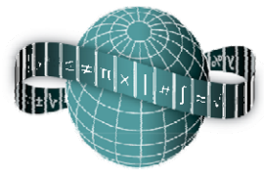
Reflections on Practice
Maths Counts 2016

Slide 2
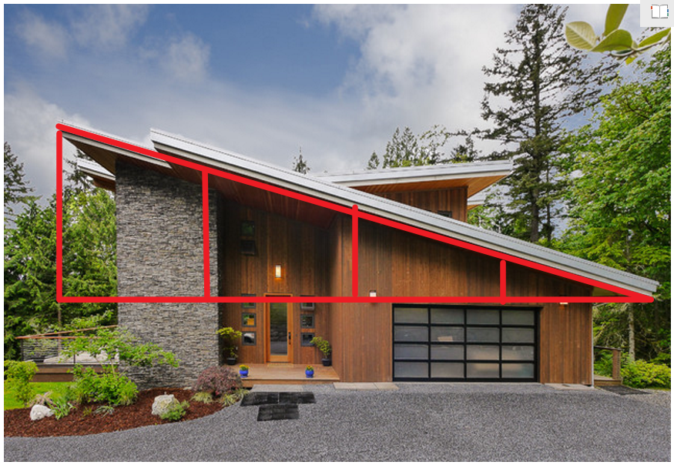
Teaching Theorem 13
using a contextualised problem.
Class: 2nd Year Maths
Level: Junior Cert. Higher Level
Duration: 70 minutes
Date: 16th March 2016
Topic: Geometry - Theorem 13

Slide 3
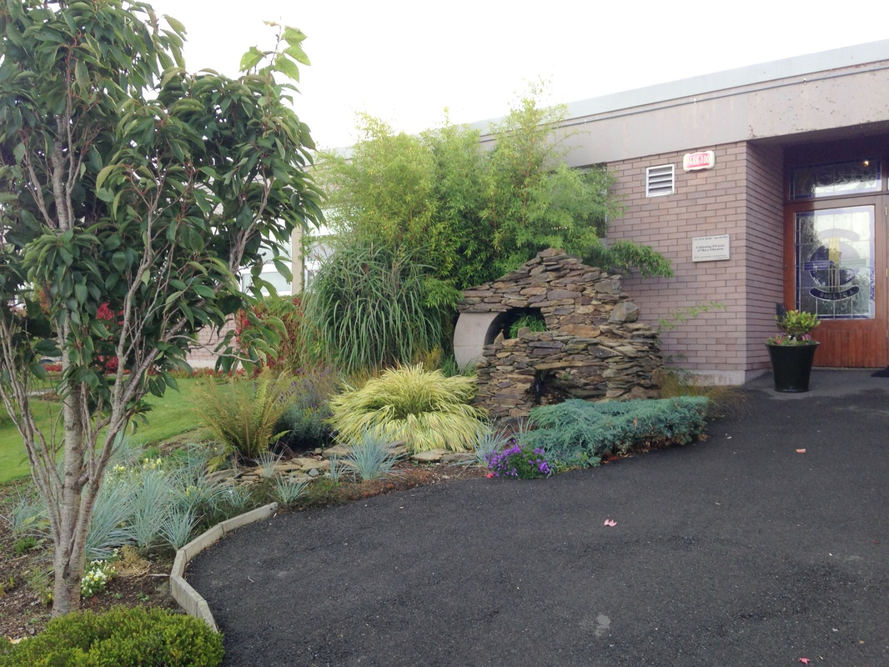
Designing the lesson
Three teachers met on seven occasions to research, design, teach and evaluate this lesson.
Class taught by:
Olive Mc Guinness
Lesson plan designed by:
Julie Duggan and
Olive McGuinness.
School: Coláiste Bríde, Enniscorthy, Co. Wexford.

Slide 4
Flow of the unit

Slide 5
Lesson Aims
For students to appreciate that:
Mathematics can be used to solve real world problems.
Mathematics can be used to communicate thinking effectively.
A problem can have several equally valid solutions.
I’d like to foster independent learning in my students.
I’d like my students to become more creative when devising approaches and methods to solve problems.
I’d like to build my students’ enthusiasm for the subject by engaging them with stimulating activities.

Slide 6
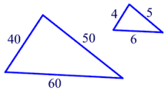
Learning Outcomes
Reinforce the prior learning of:
Disassembling geometric shapes and,
Identification of similarity between triangles.
Use the relationship between corresponding sides in similar triangles to find missing lengths.
Understand (Theorem 13) “If two triangles are similar then their corresponding sides are in proportion”.
Use the understanding of Theorem 13 to solve problems.

Slide 7
Skills
To encourage flexibility and ‘stick-ability’ with respect to geometry problems.
To encourage students to disassemble geometric figures as a part of the problem solving process.
To encourage discussion, debate and sharing of reasoning between students.
To make students aware that their first answer is not always correct but that there may be several equally valid approaches to the same problem.
Student work

Slide 8
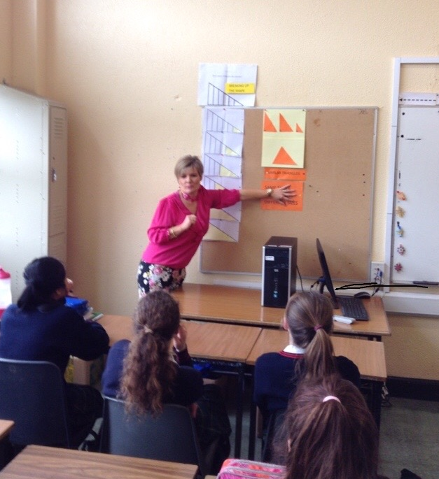
Prior Knowledge
Similar triangles
Disassembling shapes

Slide 9
Posing the task – Task 1
Stephen has recently purchased a new house and has decided to extend the front porch area. He wishes to calculate the amount of timber that he will need to buy so that he can factor this into his costings. He has a measuring tape but no ladder.
Using his measuring tape he has managed to take some measurements. They are recorded on the diagram. Can you help him calculate the lengths of the uprights that he cannot reach because he has no ladder?

Slide 10
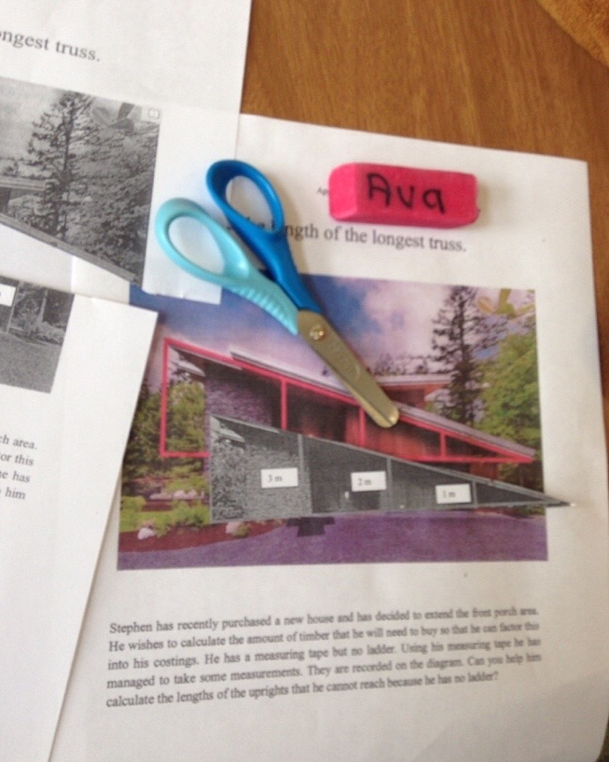
Materials distributed
Handouts with the problem
Rulers
Scissors

Slide 11
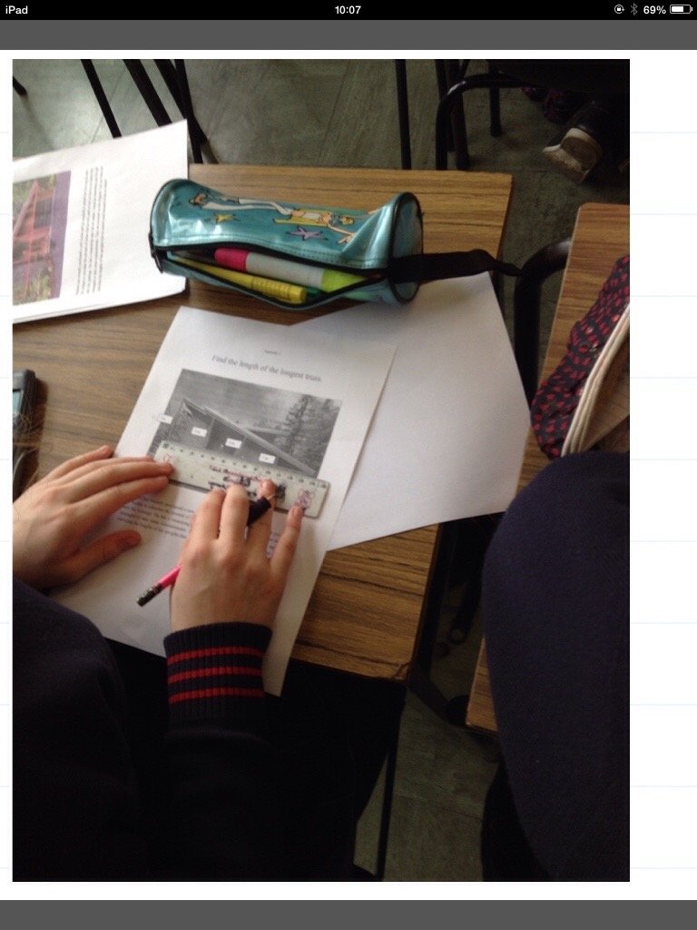
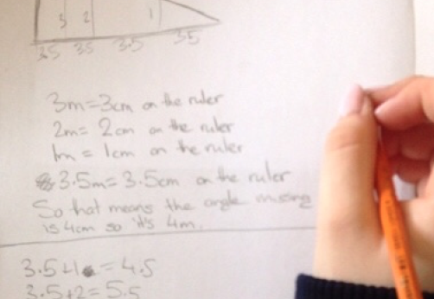
Student Response 1
“Measure” – students used measuring and scaling to find the length of the upright.
Board - work
Student work
Student work

Slide 12
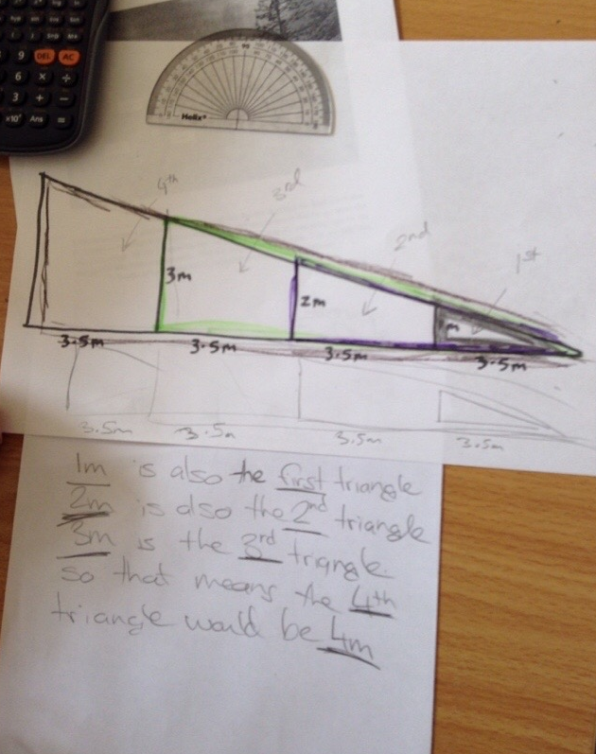
Student Response 2
Board - work
“Patterns” – students noticed that:
The 1st upright was 1m.
The 2nd was 2m.
The 3rd was 3m.
So the 4th must be 4m!?
Student work

Slide 13
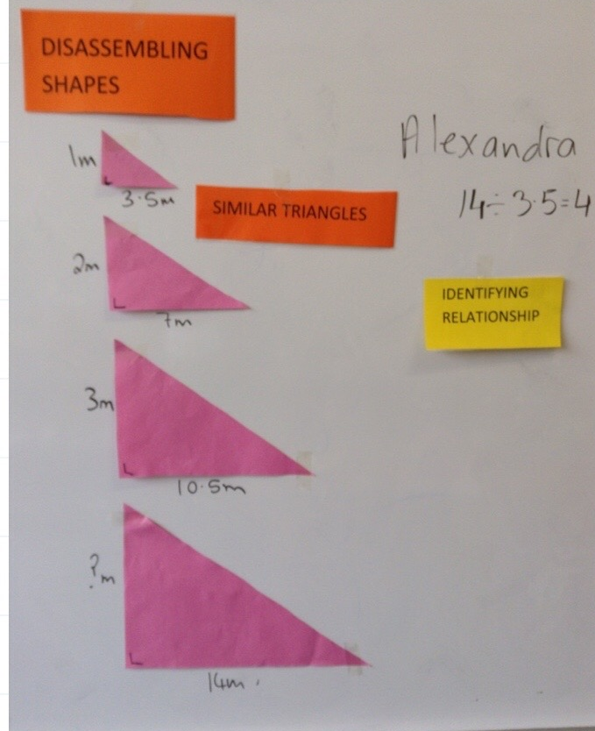
Student Response 3
“Disassembling shapes” to see “proportionality”. Students could see that sides of the 4th triangle were 4 times larger than the sides in the 1st triangle.
Board - work

Slide 14
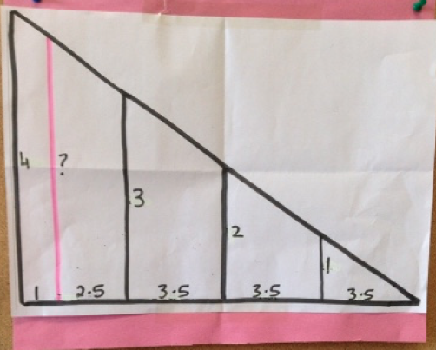
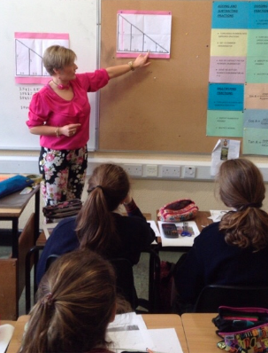
Posing the task – Task 2
Find the height of this upright?

Slide 15
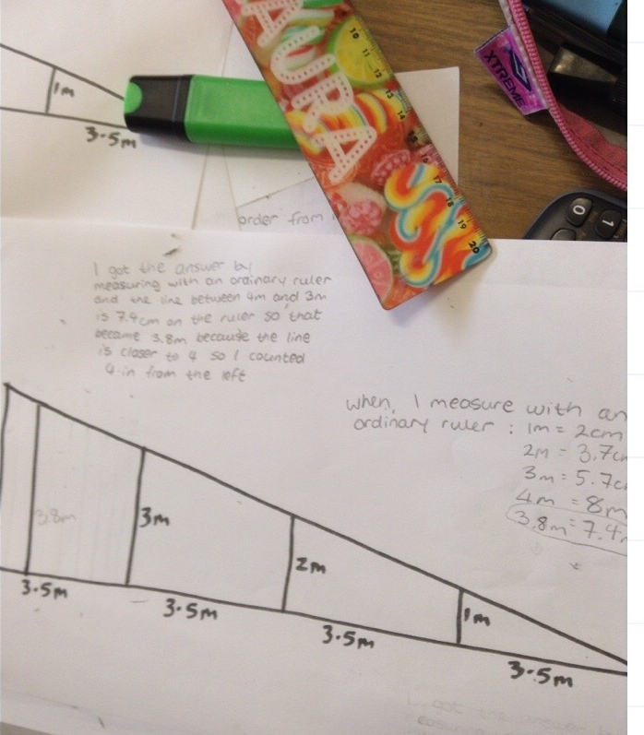
Student Response 1
Misconception – students measured but the drawing was not to scale!
Board - work
Student work

Slide 16
Student Response 2
Using the proportionality of corresponding sides a number of students correctly solved the problem.
Student work

Slide 17
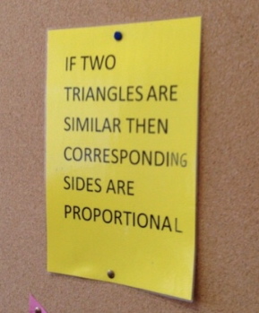
What did I learn?
In conclusion the teacher and students discussed their learning during the class.
Board-work

Slide 18
Board Plan – Task 1

Slide 19
Board Plan – Task 2

Slide 20
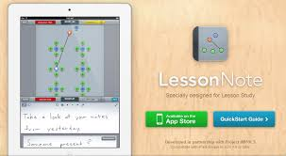
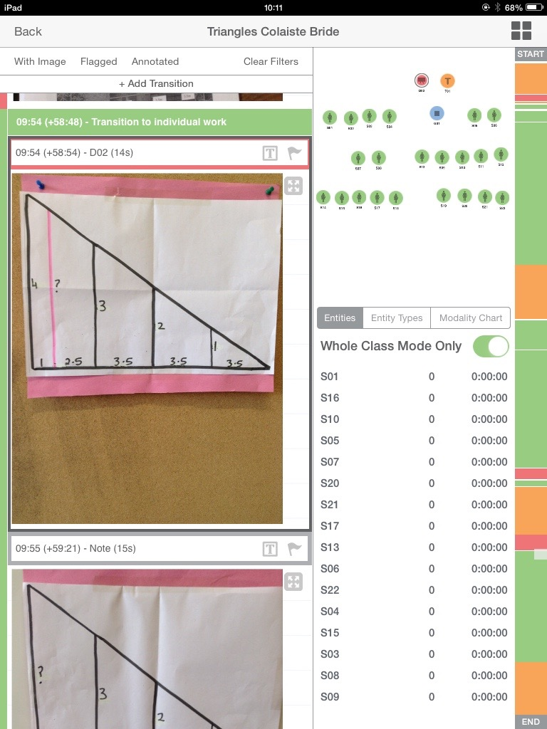
Plan for Peer Observation
The classroom was divided into sections and observing teachers were assigned a section each.
Two observing teachers used iPads to photograph samples of students work.
A third teacher recorded teacher-pupil interactions, students’ participation, presentations, questions and responses.
Lesson-Note App was used to record class modalities, student participation and the timing of events.
Lesson Note App
Lesson Note App

Slide 21
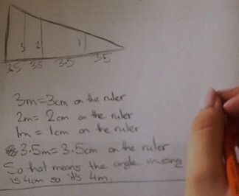
Findings
Students’ understanding of scaling was very good. Many students measured the trusses on the diagram in centimeters, identified the scaled relationship between their measurements and the information on the diagram and used it to calculate the length of the missing truss.
Student work

Slide 22
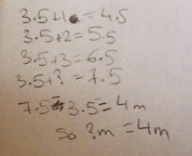
Findings
Students’ ability to manipulate ratios to calculate missing lengths is very good. A minority of students used the unitary method; the majority used their intuitive understanding of the relationship between the numbers (lengths).
Student work

Slide 23
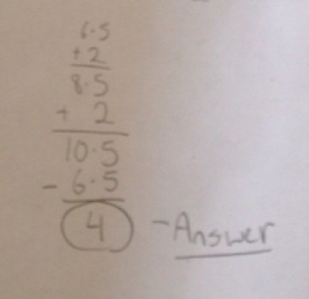
Findings
Central to the task is the identification of a multiplication pattern between triangles. There is evidence to suggest that students’ have a tendency to be limited to addition when trying to identify patterns.
The observers thought that the teacher was excellent in allowing the students thinking space. More than 45 minutes of the class was given to independent student work.
Student work
Student work

Slide 24
Findings
The accuracy of labeling of diagrams was very good.
Throughout the class student participation, engagement and effort was sustained.
Student work

Slide 25
Recommendations
The key recommendation is to give the students time to think! They will get there!
Student do require that time is spent considering prior knowledge re similar triangles and how to disassemble shapes.
Take time to clarify the problem for the students.
It might be useful to ask the students to write out a reflection on what they learned during the class.

Slide 26
Sources Used
Publications:
DES, (2002). Junior Certificate Guidelines for Teachers.
PMDT, (2011) First Year Handbook.
PMDT (2012) Second Year Handbook.
PMDT (2013) Third Year Handbook.
DES, (2016). Junior Certificate Mathematics Syllabus
Chief Examiners Report on Junior Certificate Mathematics 2006 (SEC 2006).
DES, (2011). Literacy and Numeracy for Learning and Life
Websites:
www.projectmaths.ie
www.nrich.maths.org

