Slide 1
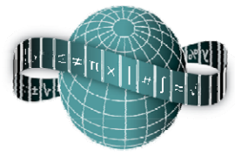
Reflections on Practice
Maths Counts 2016

Slide 2
GEOMETRY and Types of Triangles

Slide 3
Jimmy Meaney, Ramsgrange Community School, Wexford Mary Lenane, CBS Carrick on Suir, Tipperary Sean Ryan, Rockwell, Tipperary Mary Hally, Ard Scoil na Mara, Tramore, Waterford

Slide 4
Details
This lesson is for a 1st year group who have prior knowledge of geometry from previous lessons
length of lesson, 35 mins
Date of the lesson, 29/1/2016
This is lesson designed to slot in after 6/8 lessons an geometry with up to 4 lessons required to complete section.

Slide 5
Student Learning Goals
Aims of the Lesson:
Long term goals;
Students appreciate that mathematics can be used to communicate thinking effectively, through reflection and expansion of mathematical relationships.
Students will become independent learners.
Students become more creative when devising approaches and methods to solving problems.
Students discover that any problem can have several equally valid solutions.
Build upon my students’ enthusiasm for the subject by engaging them with stimulating activities.
Notes:
Refer to note 3 of lesson plan

Slide 6
Student Learning Goals
Short term goals;
Students will be able name the triangles and identify different characteristics of each type.
Students will use appropriate language when describing triangles, i.e. right angle, isosceles and scalene.
Notes:
Refer to note 3 of lesson plan

Slide 7
Student Learning Goals
Learning Outcomes:
Students will name and describe the fundamental characteristics of the 3 of the main types the triangles in geometry.
Notes:
Refer to note 3 of lesson plan

Slide 8
Design of Lesson
We first researched the maths inspectorate reports where inspectors are looking for more differentiation built into lessons, catering directly for the learner diversity within each classroom.
The theme of the research is learning through problem solving with the distinct aim of students expressing thoughts in logical steps using words, numbers and diagrams.
Students also listen others thoughts and deepen their understanding by noticing similarities and differences.
Notes:
Refer to notes 5-9 of lesson plan during presentation

Slide 9
Materials
Cut outs of different triangle types
Predesigned worksheets, see appendix 1.
Pencils and rulers each.
Flip chart and blue tack for students presentation sheets to be displayed
Observation records for teachers.

Slide 10
Plan for Peer Observation
An observation record is used during the lesson to assess students thinking and expansion of mathematical relationships.
refer to appendix 3 of lesson plan.

Slide 11
Findings
The general consensus was that individual work allowed students to engage and allow for further clarification of outcomes among the group.
Confidence levels increased across the group and weaker students

Slide 12
Findings contd.
Observers agreed thelesson was successful and more time for student feedback was desirable.
The success of this teaching technique is dependent on a good teacher pupil relationship, clearly evident in this lesson.

Slide 13
Findings/Student Learning
Lesson criteria was understood by the majority of students
Little time was given to student instruction
Students ran out of strategies and included incorrect answers as they felt the need to insert answers.

Slide 14
Findings contd.
Students thinking it was a minimum of 2 construction lines to be used.
Student were unaware that triangles were the only shape permitted, accidental quadrilaterals produced.
A lack of focus as time progressed
Two students came up with solutions not anticipated

Slide 15
Findings contd.
Positive feedback was experienced by all students
Preparation of visual displays was time consuming, however, very effective.
Students were more attentive to peers and learned from them.

Slide 16
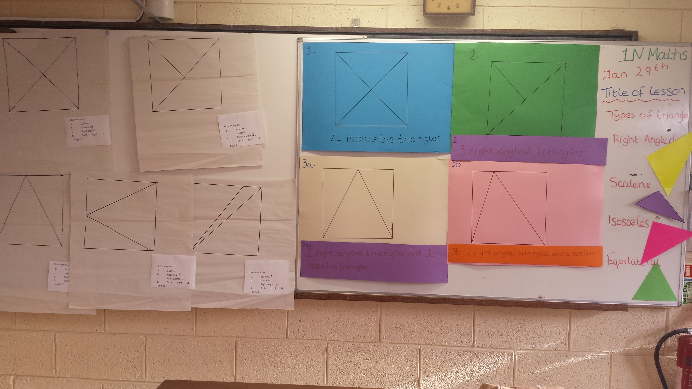
Board Plan

Slide 17
Recommendations
Students should read instructions and teacher questions for understanding prior to activity.
Lesson should be carried out in a standard class room, (this lesson was conducted in a science laboratory)

Slide 18
Questions anyone??

Slide 19
Sources Used
Junior certificate mathematics syllabus
Various JC maths textbooks
Instructional video from Drumcondra reflections on practice pilot lesson.

Slide 20
Thank you for your attention after such a long day of presentations. Jimmy Meaney meano@me.com
Maths Counts 2016

