Slide 1
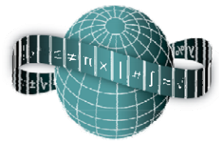
Reflections on Practice
Maths Counts 2016

Slide 2
Many paths from word problems to linear equations

Slide 3
Philip Brady – John Scottus Secondary School, Dublin Mieke Sanders – Killinarden Community School, Dublin Eilish O’Leary – Holy Family Secondary School, Newbridge

Slide 4
Details
Level: 1st Year Mixed Ability class
Duration:70 minutes
Date: Friday 22nd January 2016
Number of students: 20

Slide 5
Design of Lesson
Using the syllabus as a guide:
Strand 3, ‘Number’ ‘builds on the ideas about number that learners developed in primary school and facilities the transition between arithmetic and algebra’ and
in Strand 4, ‘Algebra’, two aspects of algebra are said to be: ‘a systematic way of expressing generality and abstraction.’

Slide 6
Where lesson fits into the course
 | Strand 4 (Algebra)
Topics in Introducing algebra | Main Approaches | Duration (in 35 min lessons)
Patterns | Generalise to rule; graphs | 6
Simplifying expressions | Like terms ; Rectangular arrays | 6
Linear equations | Balance; circle diagrams; back tracking, Think of a number. | 6

Slide 7
Student Learning Goals
The students will
Recognize that algebra is being used in everyday life and can simplify a problem into an equation that requires finding an unknown quantity.
See a need for a formal approach, involving variables/unknowns, to solving problems, while acknowledging that a problem can have several valid representations.
Develop confidence in using variables along with numbers in problems requiring solving algebraic equations.

Slide 8
Objectives
Recognize and use inverse operations in order to work back to an unknown.
Connect and use letters as ‘unknowns’ as a facility for more efficient and effective means to finding numerical solutions to word problems.

Slide 9
Question
When a certain number is multiplied by 5 and the answer is added to 45 the total is 110. What is the number?

Slide 10
Expected methods
Trial and error
Backtracking
Numerical
Circle diagram
Table
Solving equation
Changing signs
Balancing

Slide 11
Materials
Balance
To stretch the students we distributed worksheets with the problem and included space for 6 expected methods.
We had cards for different anticipated methods which could be ‘blu-tacked’ onto the board beside selected answers.

Slide 12
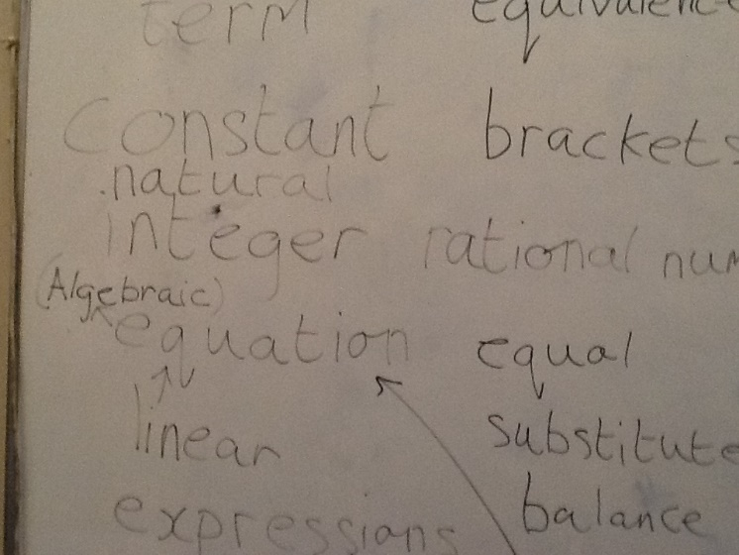
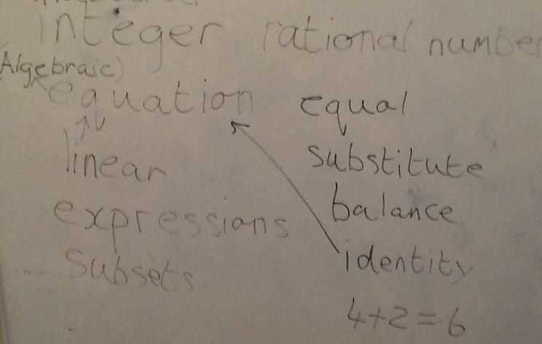
Design of Lesson
Recap of vocabulary previously introduced.
‘Give me some words related to algebra, we have been doing.’
Introduce and distribute worksheet
‘I have a worksheet for you with a problem. The problem might be easy for you but the aim is to find as many ways as possible to solve the problem.’
Notes:
Slide 4: ‘Number’ ‘builds on the ideas about number that learners developed in primary school and facilities the transition between arithmetic and algebra’
‘Algebra’, two aspects of algebra are said to be: ‘a systematic way of expressing generality and abstraction.’

Slide 13
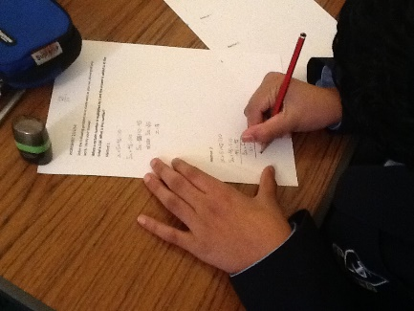
Design of Lesson
As students work, the teacher walks around observing them. Teacher notes the different methods being used and selects students who will demonstrate, on the board, one method each, in the order laid out as follows.
Notes:
Slide 4: ‘Number’ ‘builds on the ideas about number that learners developed in primary school and facilities the transition between arithmetic and algebra’
‘Algebra’, two aspects of algebra are said to be: ‘a systematic way of expressing generality and abstraction.’

Slide 14
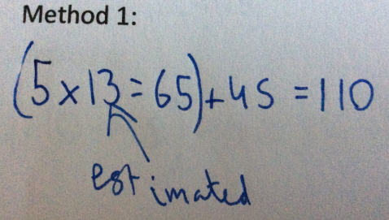
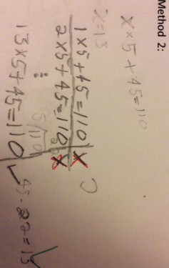
Trial and Error
Student insists on including 65 in the equation.
Systematic trial and error
answers
Misconception:
Having 2 equal signs in an equation.

Slide 15
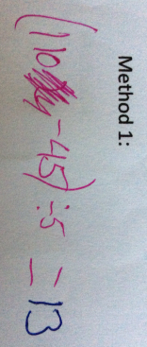
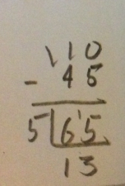
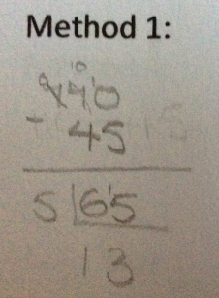
Backtracking - numerical
Student works from left to right; does not have the right concept of equal sign.

Slide 16
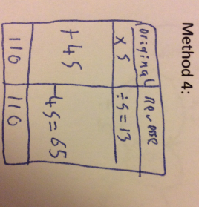
Backtracking – table format

Slide 17
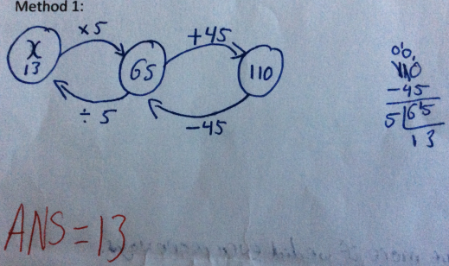
Backtracking – circle diagram

Slide 18
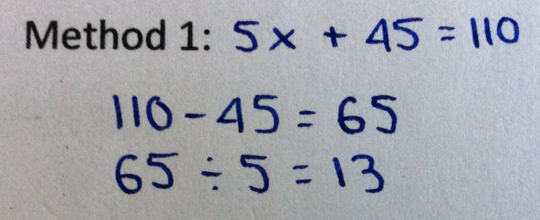
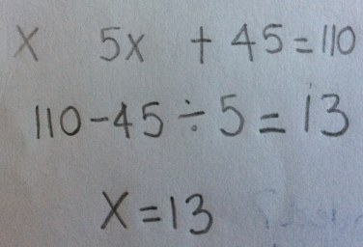
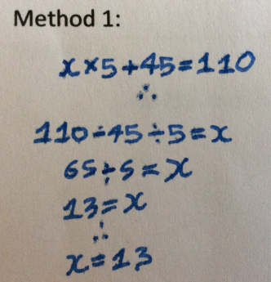
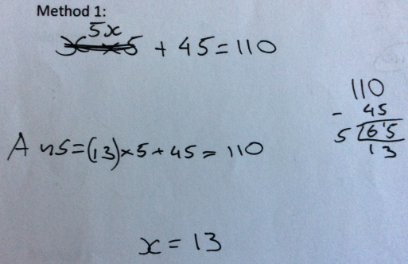
Further along the path to a formal approach…
Misconception: Students work from left to right, omitting brackets.
Student using an equation but x gets lost.
Student verifies answer.

Slide 19
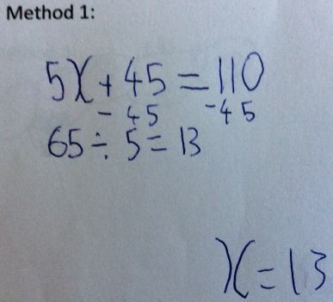
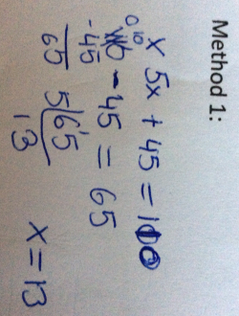
… and even further

Slide 20
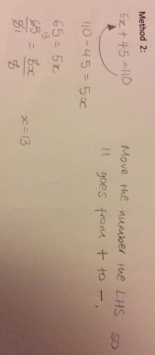
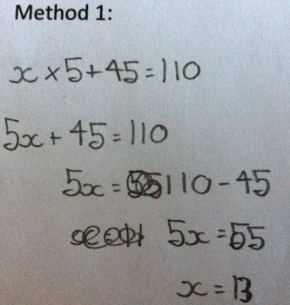
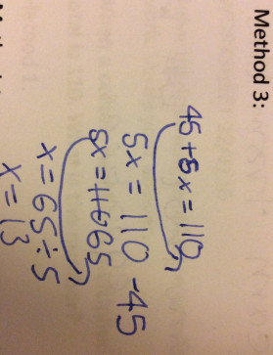
Solving equation using ‘changing signs’

Slide 21
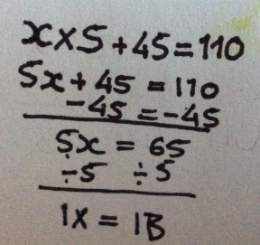
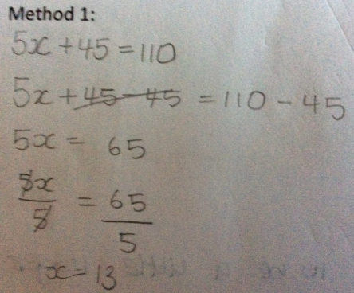
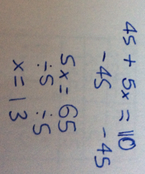
Solving equation using balancing method

Slide 22
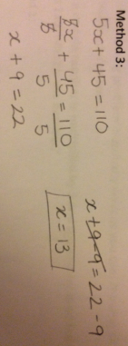
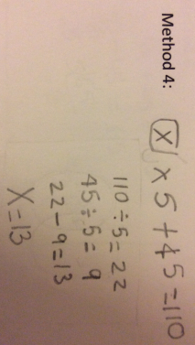
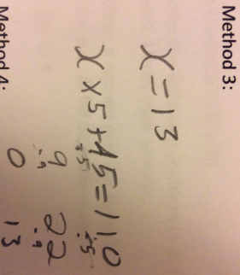
Surprise method
Students do multiplication first.

Slide 23
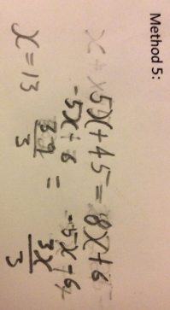
Being creative
A challenge to the teacher.

Slide 24
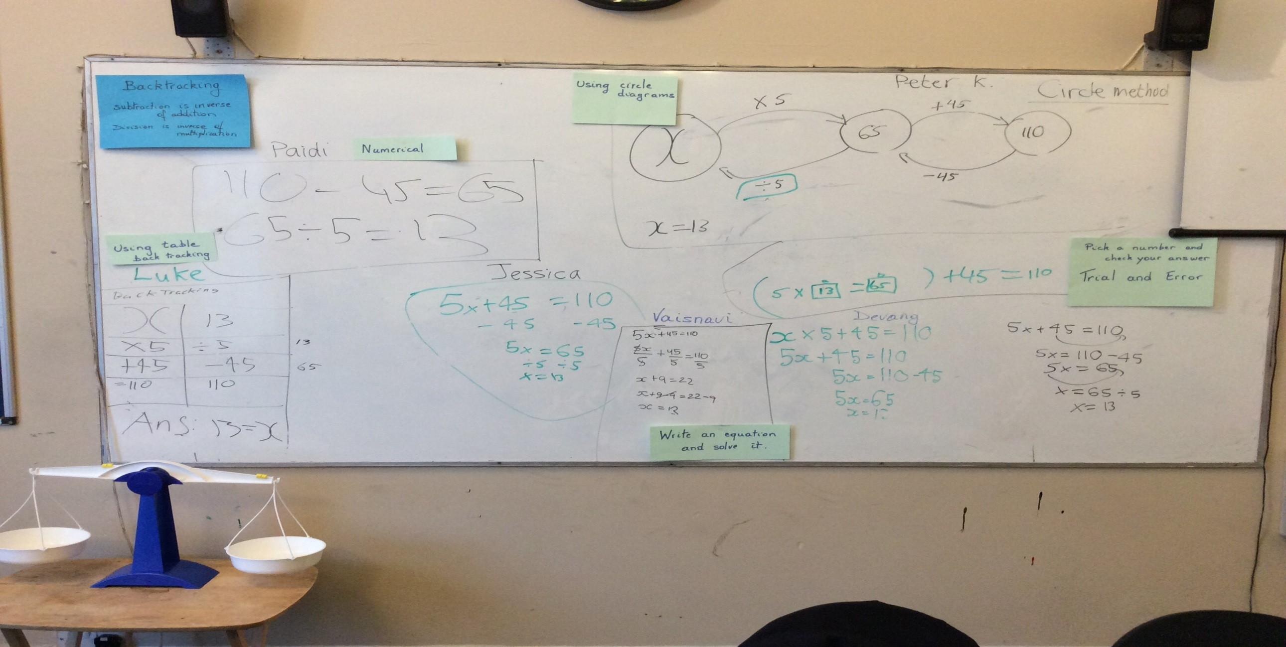
Boardplan
Students present their work at the board and explain their answer to the class.
Notes:
Slide 4: ‘Number’ ‘builds on the ideas about number that learners developed in primary school and facilities the transition between arithmetic and algebra’
‘Algebra’, two aspects of algebra are said to be: ‘a systematic way of expressing generality and abstraction.’

Slide 25
Presentation of work
Teacher calls particular students to the board to present their solution
Teacher highlights connections between methods. “Can you show me where that step is done in another method?”
“Did anyone come up with another method?”

Slide 26
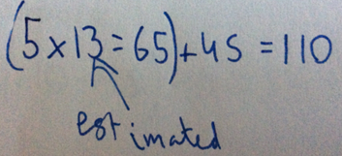
Presentation of work: Trial and error
Student comment: “That will take ages to get to the answer.”
Teacher’s reply:
Not a great approach. But if all else fails, it is something.
This goes some way to addressing our objective of seeing the efficiency of a formal approach to problem solving.

Slide 27
Student evaluation
Students were asked 2 questions:
What did you learn from this lesson?
What could be improved?
Notes:
Slide 4: ‘Number’ ‘builds on the ideas about number that learners developed in primary school and facilities the transition between arithmetic and algebra’
‘Algebra’, two aspects of algebra are said to be: ‘a systematic way of expressing generality and abstraction.’

Slide 28
What did you learn from this lesson?
I learned multiple ways of solving an equation.
There are more than 2 or 3 ways of doing an equation.
I learned that there are many ways to approach one question.
I learned that there are more ways than I thought to solve this type of problem. Some of these suit certain problems and less so others. I learnt some of the new ways that were shown.
I learned another way to solve equations
I learned different ways of figuring out sums
I learned two new ways of solving algebraic equations: table and backtracking and Varisnavi’s way.
I learned a lot and that it is easier to do the problem many ways.
Not much, just one more way
I learned many other ways to solve algebraic equations
I learned there are many ways to do maths and to always try them all.
Different people have different ways of solving problems
I learnt that there are a lot of different methods to use for just one question and that the easier methods will be easier for easier question but a heard method might be better for a harder question.

Slide 29
What did you learn from this lesson?
I learned another way to solve equations.
I learned different ways of figuring out sums.
I learned two new ways of solving algebraic equations: table and backtracking and Vaishnavi’s way.
I learned many other ways to solve algebraic equations.
I learned there are many ways to do maths and to always try them all.

Slide 30
What did you learn from this lesson?
Nothing really ?? Not much, just one more way
Different people have different ways of solving problems.
I learned a lot and that it is easier to do the problem many ways.
I learnt that there are a lot of different methods to use for just one question and that the easier methods will be easier for easier question but a hard method might be better for a harder question.

Slide 31
What could be improved?
Maybe group activities.
I could not give up after finding most of the answers.
Working in pairs, more chance to speak.
I don’t think anything could be improved.
I don’t know.
I want to know how to do each method exactly.

Slide 32
What could be improved?
Maybe spend less time using the textbook and whiteboard and more group work.
It could help me more if we did even more ways.
I would have liked it to be a little longer so I got to see everyone’s way of doing something.
When we do problems let people do it their own way.

Slide 33
What could be improved?
Maybe spend less time using the textbook and whiteboard and more group work.
It could help me more if we did even more ways.
I would have liked it to be a little longer so I got to see everyone’s way of doing something.
When we do problems let people do it their own way.

Slide 34
What can you improve on?
To try out different ways, not to stick with one way.

Slide 35
Our Observation and evaluation
Though there was some doubt that one problem would keep the class going for the full two lessons, it was clear that depth rather than breadth in this case sufficed. Some students even wished for more time, as their evaluations indicated.

Slide 36
We would agree with Paul Black, Emeritus professor, King’s College, London, who says that:
It's about the way a teacher gives feedback to pupils and is quite delicate. Perhaps the best example we've had, just as an anecdote, is a pupil who said to one of our researchers, "Now I know she's interested in what I think, not in whether I've got the right answer." And for a pupil to make that change is to establish a climate of trust so that thinking, speculation, and misconceptions can be brought out.

Slide 37
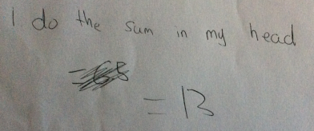
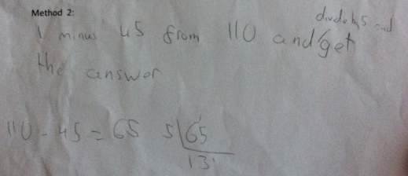
Student’s path through the problem
Method 1:

Slide 38
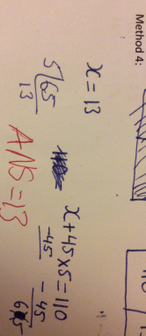
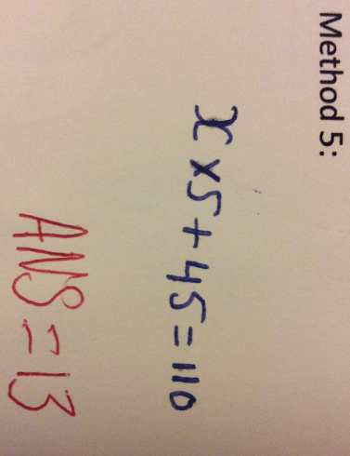
Student correcting his error in the next method.

Slide 39
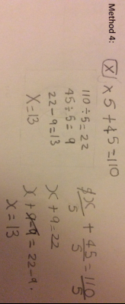
Learning from others
Students work
Method presented on the board

Slide 40
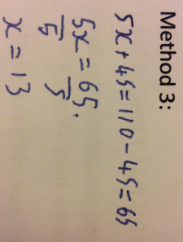
Misconception from one student
Student works from left to right. Does not have the right concept of equal sign.
Two equal signs in the same line.

Slide 41
Misconceptions by same student
Students work from left to right, omitting brackets.

Slide 42
Misconceptions
Student insists on including 65 in the equation.

Slide 43
Misconceptions in solving equations
Two equal signs in the same line.
Two errors compensate each other.

Slide 44
Observation
Students know how to write the equation but revert back to backtracking to solve it.

Slide 45
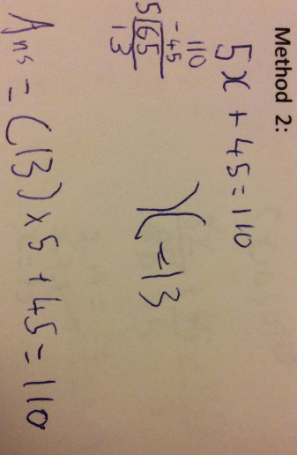
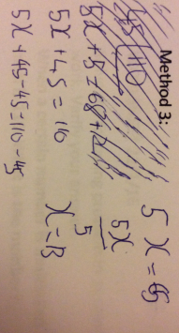
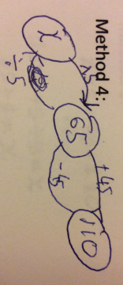
Student progressing

Slide 46
Some statistics

Slide 47
First method used by students
Number of students

Slide 48
Second method
Number of students

Slide 49
Frequency of use of different methods
Number of students

Slide 50
Number of methods used
Number of students
Number of methods

Slide 51
Recommendations
You can underestimate the time the lesson takes
Have a template that you can use to select students for presented their work
Co-teaching may be beneficial (fresh eyes)

Slide 52
Sources Used
Project Maths Development Team Teaching & Learning Plans-Introduction to equations, Junior Cert Syllabus. Available at www.projectmaths.ie/documents/T&L/IntroductionToEquations.pdf
(accessed 9/2/2016)
Hoffmanm, M. and Powell, A. (1992) ‘Circle expressions and equations: multivalent pedagogical tools’, in: Pimm, D. and Love, E. eds.Teaching and Learning School Mathematics. London:.The Open University.

Slide 53
Sources (continued)
Referred to the following 6th Class Primary books:
Maths Matters 6 – Edco publication
Maths Together 6 – Florence Gavin
Mulberry Publication
and
Mathematics Today – Extension
Prim-Ed Publication

Slide 54
Any Questions?

Slide 55
Thank You!
Maths Counts 2016

