Slide 2
Index
Section A: Investigating Compound Interest
Section B: Discovering the Formula
Section C: Investigating the Compounding Period
Section D: Depreciation
Section E: Reducing Balance
Appendix: Revision of Prior Knowledge Required

Slide 3
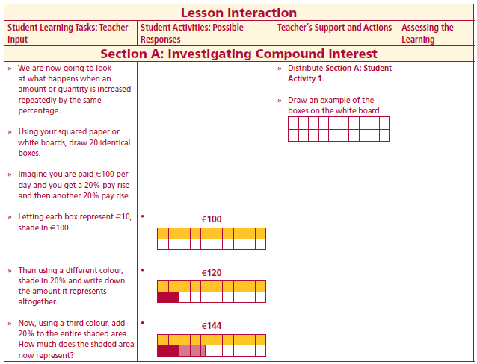
Section A: Student Activity 1
Investigating Compound Interest
We are now going to look at what happens when an amount or quantity is increased repeatedly by the same percentage.
Using your squared paper or white boards, draw 20 identical boxes.
Imagine you are paid €100 per day and you get a 20% pay rise and then another 20% pay rise
Lesson interaction

Slide 4
Section A: Student Activity 1
Investigating Compound Interest
1. If each block represents €10, shade in €100.
2. Then, using another colour, add 20% to the original shaded area.
3. Finally, using a third colour, add 20% of the entire shaded area.
4. What is the value of the second shaded area?_____________________________
5. What is the value of the third shaded area?_______________________________
6. Why do they not have the same amount?_______________________________
Lesson interaction
2

Slide 5
Section A: Student Activity 1
Investigating Compound Interest
1. If each block represents €10, shade in €100.
2. Then, using another colour, add 20% to the original shaded area.
3. Finally, using a third colour, add 20% of the entire shaded area.
4. What is the value of the second shaded area?_____________________________
5. What is the value of the third shaded area?_______________________________
6. Why do they not have the same amount?_______________________________
Lesson interaction
2

Slide 6
Section A: Student Activity 1
Investigating Compound Interest
1. If each block represents €10, shade in €100.
2. Then, using another colour, add 20% to the original shaded area.
3. Finally, using a third colour, add 20% of the entire shaded area.
4. What is the value of the second shaded area?_____________________________
5. What is the value of the third shaded area?_______________________________
6. Why do they not have the same amount?_______________________________
Lesson interaction
2

Slide 7
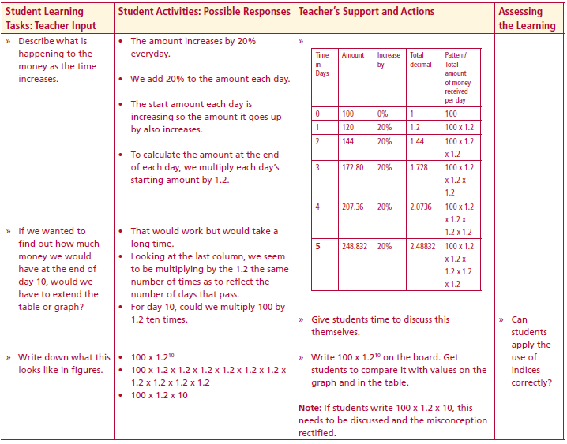
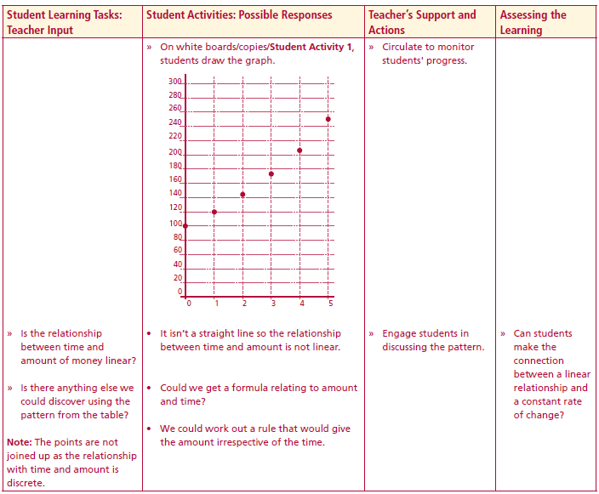
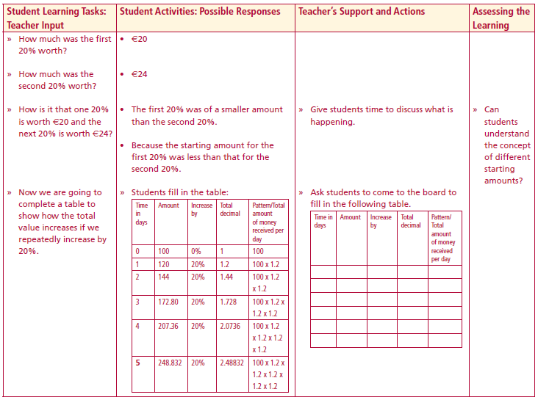
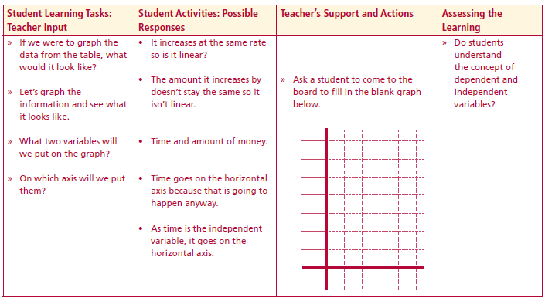
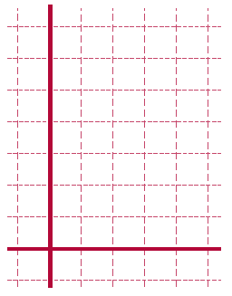
7. Complete the following table and investigate the patterns which appear.
Lesson interaction
Lesson interaction
8. Can you find a way of getting the value for day 10 without having to do the table to day 10? ___________________________________________________________________ ________________________________________________________________________________________________________________________________________
9. Use the diagram on the right to graph time against amount. Is the relationship linear?
Lesson interaction
Lesson interaction

Slide 8
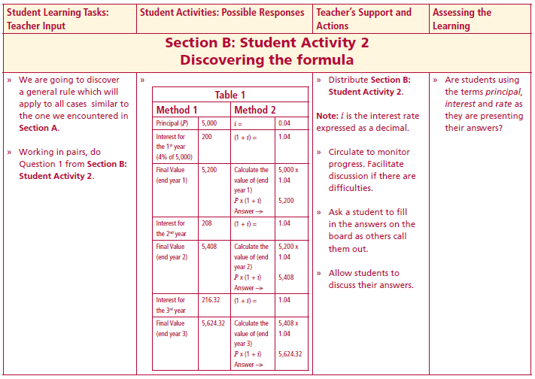
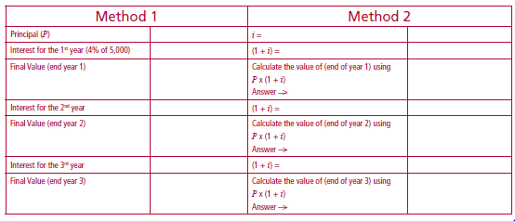
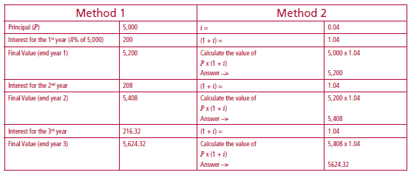
Section B: Student Activity 2
Discovering the Formula
Mary received a gift of €5,000. She is hoping to buy a car costing €6,000 with her
savings in 3 years time. She intends to invest the €5,000 until then. The bank is
offering her interest of 4% p.a. She leaves it in for the 3 years. Will she be able to
afford to buy the car?
Looking at the table, which of the methods is closest to what we used in Section A?
Lesson interaction

Slide 9
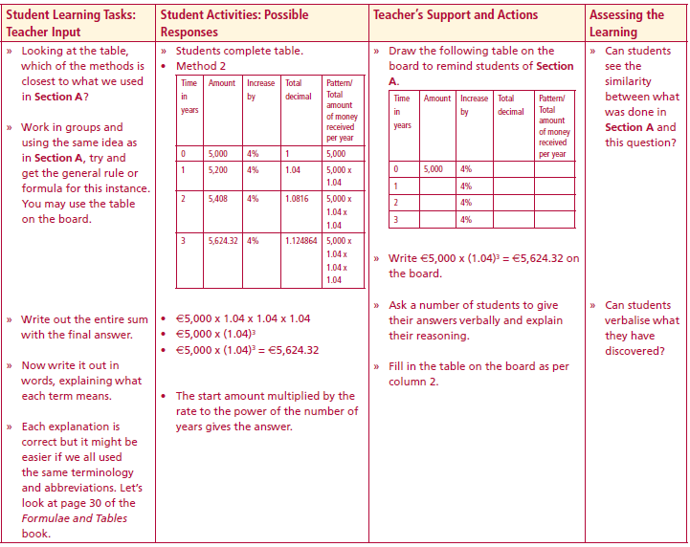
Work in groups and using the same idea as in Section A, try and get the general rule or formula for this instance.
You may use the following table.
Write out the entire sum with the final answer.
Now write it out in words, explaining what each term means.
Each explanation is correct but it might be easier if we all used the same terminology and abbreviations. Let’s look at page 30 of the Formulae and Tables book.
Lesson interaction
Time in years | Amount | Increase by | Total decimal | Pattern/ Total amount of money received per year
0 | 5,000 | 4%
1 |  | 4%
2 |  | 4%
3 |  | 4%

Slide 10
Now write out the general rule for Section A in the same order as the formula in the Formulae and Tables book.
Using €5,000 x (1.04)³ = €5,624.32 and the formula in the tables, rewrite the equation to look like the original formula.
Lesson interaction

Slide 11
1. Does this amount to the proof of the formula? Discuss. __________________ ____________________________________________________________________________________________________________________________________
2. Write a sentence explaining whether or not Mary can afford the car from her bank savings.______________________________________________________ ____________________________________________________________________________________________________________________________________
3. Write the value of the interest for the 1st, 2nd and 3rd years in the boxes below.
4. Fill in the appropriate values:
a. Principal = ________________________________
b. Total interest = ____________________________
c. Final value = ______________________________
5. Using the formula from the tables, write out the entire equation in the same order. _____________________________________________________________
__________________________________________________________________
Lesson interaction

Slide 12
4. Fill in the appropriate values:
a. Principal = _____________________________________
b. Total interest = _________________________________
c. Final value = ___________________________________
5. Using the formula from the tables, write out the entire equation in the same order. ________________________________________________________________________ ________________________________________________________________________________________________________________________________________________
Lesson interaction

Slide 13
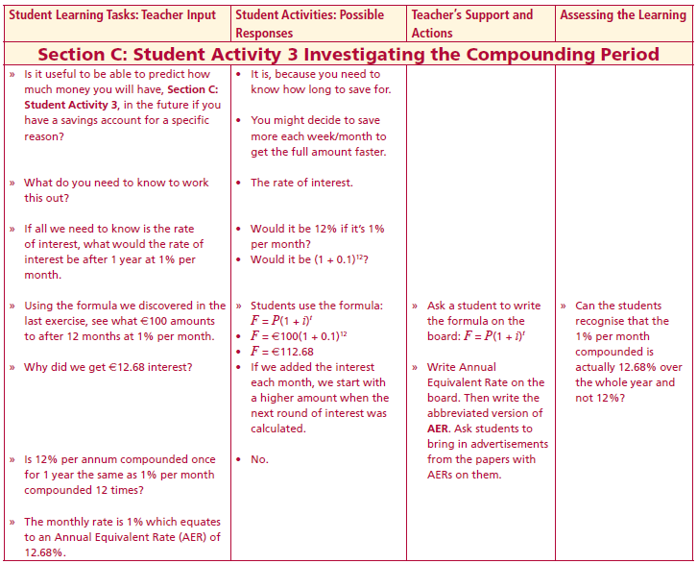
Section C
Investigating the Compounding Period
Is it useful to be able to predict how much money you will have, in the future if you have a savings account for a specific reason?
What do you need to know to work this out?
If all we need to know is the rate of interest, what would the rate of interest be after 1 year at 1% per month.
Using the formula we discovered in the last exercise, see what €100 amounts to after 12 months at 1% per month.
Why did we get €12.68 interest?
Is 12% per annum compounded once for 1 year the same as 1% per month compounded 12 times?
Lesson interaction

Slide 14
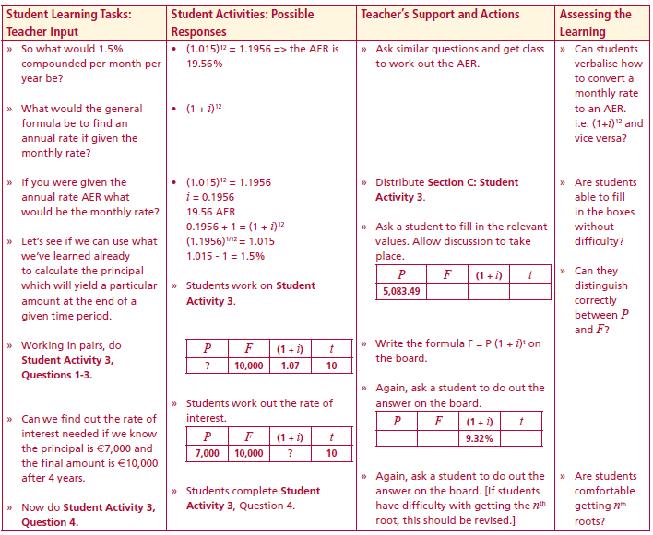
The monthly rate is 1% which equates to an Annual Equivalent Rate (AER) of 12.68%
So what would 1.5% compounded per month per year be?
What would the general formula be to find an annual rate if given the monthly rate?
If you were given the annual rate AER what would be the monthly rate?
Let’s see if we can use what we’ve learned already to calculate the principal which will yield a particular amount at the end of a given time period.
Working in pairs, do Student Activity 3, Questions 1-3.
Lesson interaction

Slide 15
Section C: Student Activity 3
Investigating the Compounding Period
John wants to have €10,000 saved in 10 years time to pay for his child’s education. The bank is offering him an annual interest rate of 7%. How much money would he need to put in now in order to have €10,000 in 10 years time? Round off to the nearest €100.
1. Fill as many variables as you can into the table below
2. Use the boxes below to find the value of P
Lesson interaction

Slide 16
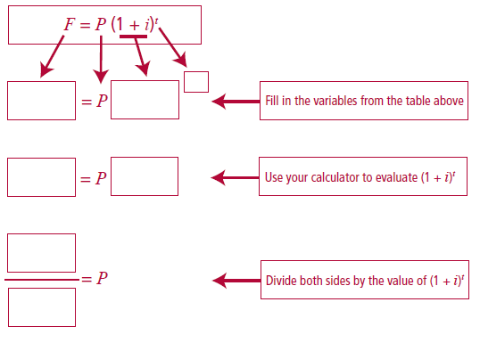
2. Use the boxes below to find the value of P
Lesson interaction
3. How much, to the nearest euro, should John deposit in the bank?________

Slide 17
4. The formula for compound interest is F = P (1 + i)t
Using the relevant nth root, find the rate of interest applied to get the final
sum from the principal sum. Remember that you are working with money so rounding to the nearest cent has occurred. The rates should be written to one decimal place (AER) for this exercise.
Example:
Complete the following:
Lesson interaction

Slide 18
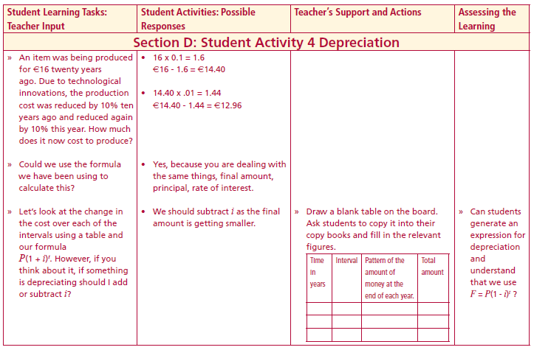
Section D:
Depreciation
An item was being produced for €16 twenty years ago. Due to technological innovations, the production cost was reduced by 50% ten years ago and reduced again by 50% this year. How much does it now cost to produce?
Could we use the formula we have been using to calculate this?
Let’s look at the change in the cost over each of the intervals using a table and our formula P(1 + i)t.
If something is depreciating should I add or subtract i?
Lesson interaction
Time in years | Interval | Pattern of the amount of money at the end of each year | Total amount

Slide 19
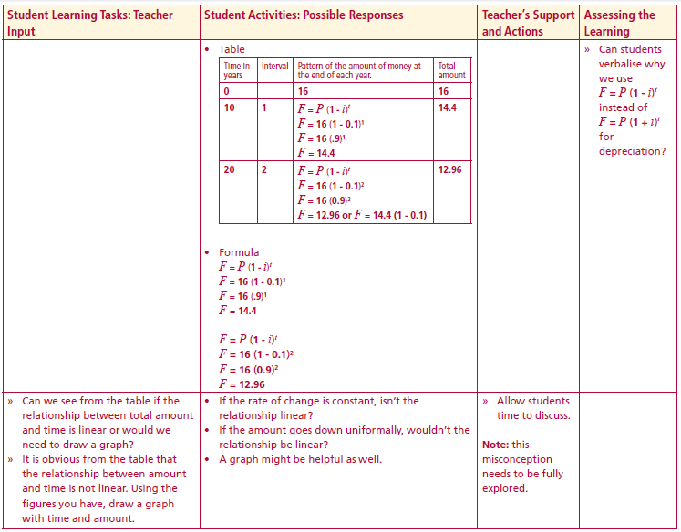
Section D:
Investigating Reducing Balance
An item was being produced for €16 twenty years ago. Due to technological innovations, the production cost was reduced by 50% ten years ago and reduced again by 50% this year. How much does it now cost to produce?
Lesson interaction
Time in years | Interval | Pattern of the amount of money at the end of each year | Total amount
Lesson interaction

Slide 20
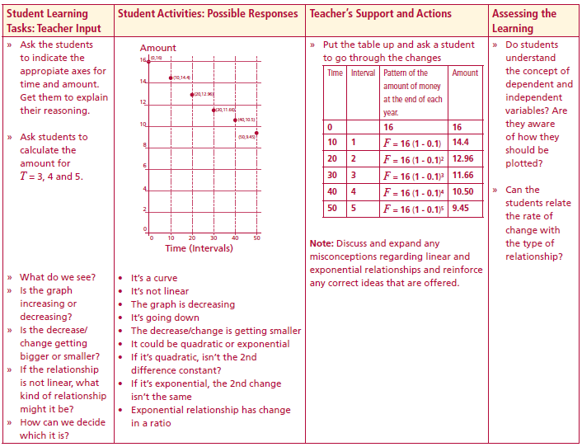
Can we see from the table if the relationship between total amount and time is linear or would we need to draw a graph?
Using the figures you have, draw a graph with time and amount.
Indicate the appropriate axes for time and amount, explaining your reasoning.
calculate the amount for T = 3, 4 and 5.
Lesson interaction
Lesson interaction

Slide 21
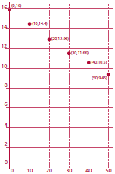
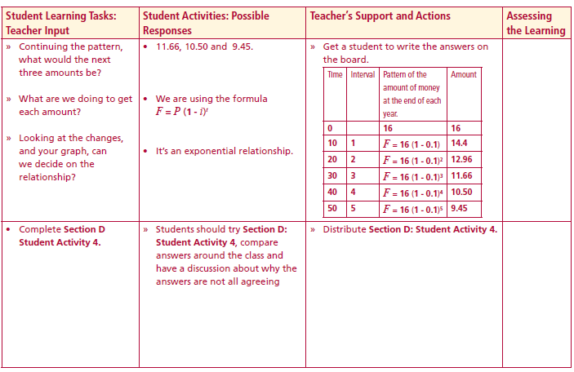
What do we see?
Is the graph increasing or decreasing?
Is the decrease/ change getting bigger or smaller?
If the relationship is not linear, what kind of
relationship might it be?
How can we decide which it is?
Continuing the pattern, what would the next three amounts be?
What are we doing to get each amount?
Looking at the changes, and your graph, can we decide on the relationship?
Lesson interaction
Lesson interaction

Slide 22
Section D: Student Activity 4
The selling price €S of a car after t years can be expressed as follows:
S = 25000 (o.9)t
a. What is the current selling price of the car?
b. What will be the selling price of the car after 3 years?
2. Mary has gone on a diet. Her weight w kg after t weeks is given by
w = 50(2)-0.01t
a. Find her current weight.
b. Find her weight after 10 weeks.
The current value of a vehicle is €18,000 and it depreciates by 25%
every year.
a. Express the value of the vehicle after t years in terms of t.
b. What kind of a function is obtained in part (a)?
c. What is the percentage change in the value of the vehicle after 2 years

Slide 23
Conor makes a New Year’s resolution and plans to keep fit for the
coming year. His target is to decrease his current weight of 80 kg by
1% each week in the coming months. If Conor reaches his target each
week,
a. Express his weight after t weeks in terms of t.
b. Find his weight after 4 weeks.
c. Find the percentage change in his weight after 4 weeks

Slide 24
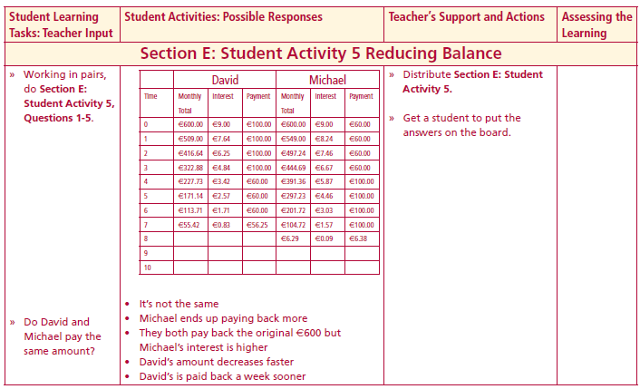
Section E: Student Activity 5
Reducing Balance
David and Michael are going on the school tour this year. They are each taking out a loan of €600, which they hope to pay off over the next year. Their bank is charging a monthly interest rate of 1.5% on loans.
David says that with his part time work at present he will be able to pay €100 for the first 4 months but will only be able to pay off €60 a month after that. Michael says that he can only afford to pay €60 for the first 4 months and then €100 after that. Michael reckons that they are both paying the same amount for the loan. Why? ____________________________________________________________________________________________________________________________________________________________________________________
Note: This problem is posed based on the following criteria:
(a) A loan is taken out
(b) After 1 month interest is added on
(c) The person then makes his/her monthly repayment. This process is then repeated until the loan is fully paid off.
Lesson interaction

Slide 25
 | David |  |  |  |  | Michael
Time | Monthly Total | Interest | Payments |  | Time | Monthly Total | Interest | Payments
0 | €600.00 |  |  |  | 0
1 |  |  |  |  | 1
2 |  |  |  |  | 2
3 |  |  |  |  | 3
4 |  |  |  |  | 4
5 |  |  |  |  | 5
6 |  |  |  |  | 6
7 |  |  |  |  | 7
8 |  |  |  |  | 8
9 |  |  |  |  | 9
10 |  |  |  |  | 10
 | David |  |  |  |  | Michael
Time | Monthly Total | Interest | Payments |  | Time | Monthly Total | Interest | Payments
0 | €600.00 | €9.00 |  |  | 0
1 |  |  |  |  | 1
2 |  |  |  |  | 2
3 |  |  |  |  | 3
4 |  |  |  |  | 4
5 |  |  |  |  | 5
6 |  |  |  |  | 6
7 |  |  |  |  | 7
8 |  |  |  |  | 8
9 |  |  |  |  | 9
10 |  |  |  |  | 10
 | David |  |  |  |  | Michael
Time | Monthly Total | Interest | Payments |  | Time | Monthly Total | Interest | Payments
0 | €600.00 | €9.00 | €100.00 |  | 0
1 |  |  |  |  | 1
2 |  |  |  |  | 2
3 |  |  |  |  | 3
4 |  |  |  |  | 4
5 |  |  |  |  | 5
6 |  |  |  |  | 6
7 |  |  |  |  | 7
8 |  |  |  |  | 8
9 |  |  |  |  | 9
10 |  |  |  |  | 10
 | David |  |  |  |  | Michael
Time | Monthly Total | Interest | Payments |  | Time | Monthly Total | Interest | Payments
0 | €600.00 | €9.00 | €100.00 |  | 0
1 | €509.00 |  |  |  | 1
2 |  |  |  |  | 2
3 |  |  |  |  | 3
4 |  |  |  |  | 4
5 |  |  |  |  | 5
6 |  |  |  |  | 6
7 |  |  |  |  | 7
8 |  |  |  |  | 8
9 |  |  |  |  | 9
10 |  |  |  |  | 10
 | David |  |  |  |  | Michael
Time | Monthly Total | Interest | Payments |  | Time | Monthly Total | Interest | Payments
0 |  |  |  |  | 0
1 |  |  |  |  | 1
2 |  |  |  |  | 2
3 |  |  |  |  | 3
4 |  |  |  |  | 4
5 |  |  |  |  | 5
6 |  |  |  |  | 6
7 |  |  |  |  | 7
8 |  |  |  |  | 8
9 |  |  |  |  | 9
10 |  |  |  |  | 10
 | David |  |  |  |  | Michael
Time | Monthly Total | Interest | Payments |  | Time | Monthly Total | Interest | Payments
0 | €600.00 | €9.00 | €100.00 |  | 0 | €600.00 | €9.00 | €60.00
1 | €509.00 | €7.64 | €100.00 |  | 1 | €549.00 | €8.24 | €60.00
2 | €416.64 | €6.25 | €100.00 |  | 2 | €497.24 | €7.46 | €60.00
3 | €322.88 | €4.84 | €100.00 |  | 3 | €444.69 | €6.67 | €60.00
4 | €227.73 | €3.42 | €60.00 |  | 4 | €391.36 | €5.87 | €100.00
5 | €171.14 | €2.57 | €60.00 |  | 5 | €297.23 | €4.46 | €100.00
6 | €113.71 | €1.71 | €60.00 |  | 6 | €201.72 | €3.03 | €100.00
7 | €55.42 | €0.83 | €56.25 |  | 7 | €104.72 | €1.57 | €100.00
8 |  |  |  |  | 8 | €6.29 | €0.09 | €6.38
9 |  |  |  |  | 9
10 |  |  |  |  | 10
Lesson interaction
1. What do David and Michael have in common at the beginning of the loan period?________________________________________________________

Slide 26
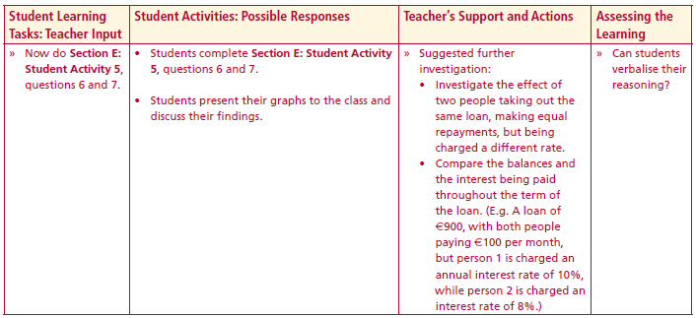
What do David and Michael have in common at the beginning of the
loan period?__________________________________________________
2. Calculate the first 3 months transactions for each. (How much, in total, had they each paid back after 3 months?)
David ___________ Michael __________
3. What is the total interest paid by each?
David _________ Michael __________
4. Based on your answers to the first 3 questions, when would you recommend making the higher payments and why?____________________ ______________________________________________________________
5. Is Michael’s assumption that they will eventually pay back the same amount valid? __________________________________________________
______________________________________________________________
Lesson interaction
Lesson interaction

Slide 27
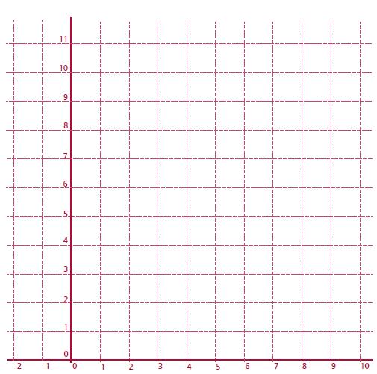
Lesson interaction
Using the graph below, plot the amount of interest added each month to both David‘s and Michael’s account.
Looking at the graph, who will pay the most interest overall? _________
____________________________________________________________________________________________________________________________

Slide 28
Appendix
Revision of Prior Knowledge Required
The teacher may use some or all of the following activities in preparing this topic.
This document covers the following:
1. The terms used
2. Interest rate as r/100
3. Adding (or subtracting) the decimal rate to from the unit
4. Multiplying indices
5. Calculating simple interest and checking it
6. Basic calculator skills

Slide 29
1. John put €200 into the bank for 1 year and got 10% interest during that year.
At the end of the year he had €220. This means that he had gained €20 on his
investment. Match John’s figures to each of the words in the table below.
2. Mary put €600 into the bank for 2 years at 9% per annum and at the end of
the 2 years she had €712.86 in total. Complete the table below to illustrate
this.
3. The following figures represent a certain amount of money put into a bank
for a certain number of years at a certain interest rate. Using all of the words
in the table above, write out a few sentences which would explain all of these
figures. Figures: €472.05, 4 yrs, €300, 12%, €172.05 ________________________________________________________________________________________________________________________________________________________________________________________________________________________________________________________________________________________________________________________________________________________________________________________________

Slide 30
4. Complete the table below. Note: p.a. means per annum (per year)

Slide 31
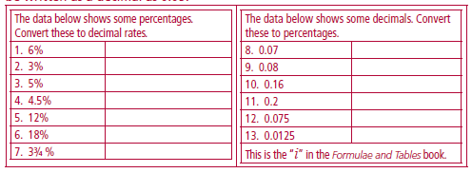
Interest rate as r/100
A percentage is a fraction having a denominator of 100. Therefore 9% means 9/100 which is 0.09 as a decimal. Therefore an annual interest rate of 9% could be written as a decimal as 0.09.

Slide 32
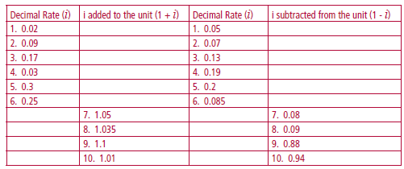
Adding or subtracting the decimal rate to/from the unit
For the work which follows the decimal rate is added (or subtracted) to the
unit. The unit is 100% i.e. 100/100 = 1). For example if the annual rate is 7%
then the decimal rate is 0.07 and the unit added to this is 1.07. In the table
below some of the figures are missing. Complete the table.

Slide 33
Multiplying indices
On page 21 “Formulae and Tables” book it says a^{p}a^{q} = a ^{p + q} at the top of the page
An example of this would be k⁵ x k⁴ = k⁹ (since 5 + 4 is 9)
Complete the following table, without the use of a calculator.
Leave your answer in index form:

Slide 34
Calculating simple interest and checking it
1 Patrick puts €400 into the bank for 1 year and gets an annual interest rate of 4%. At the end of the year he asks the bank how much money he has in total and how much interest he made. Fill out the table below to see what figures the bank might give him.
Did both methods give the same final value? ____________
Patrick had a final value of € ___________ and made €___________ in interest.

Slide 35
2. Kathleen puts €200 into the bank for 1 year and gets an interest rate of 8% during that year. Use method 1 and method 2 to work out how much she had in the bank and how much interest she made during the year.
Did the both methods give the same final value? ____________
Kathleen had a final value of € ___________ and made €___________ in interest.

Slide 36
3. Raul puts €900 into the bank for 1 year and gets an interest rate of 7% during that year. Use method 2 to work out how much he had in the bank at the end of the year. Then find out how much interest he made during the year.

Slide 37
Checking Understanding
Write out, in your own words, the meaning of each word and term in the table below.

Slide 38
Basic Calculator Skills
Evaluate the following using your calculator:

Slide 39
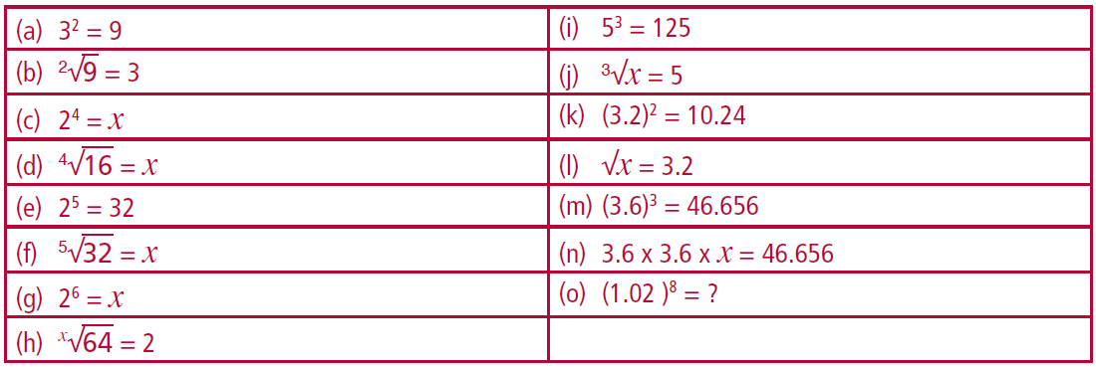
In the following table, fill in the correct figures:

