Slide 1
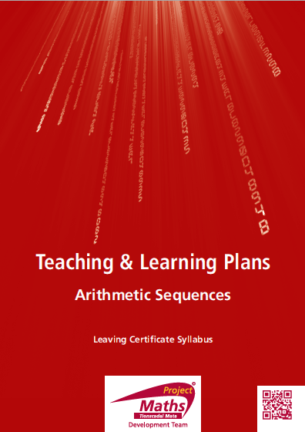

Slide 2
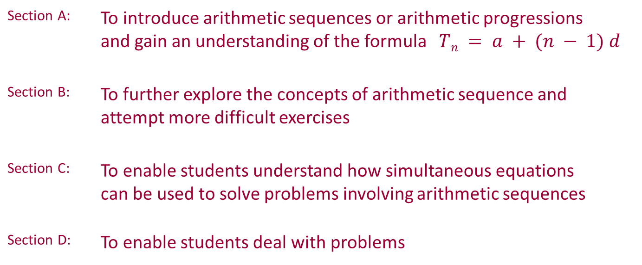
Index
Section A: | To introduce arithmetic sequences or arithmetic progressions and gain an understanding of the formula $Tn = a + (n − 1) d$
Section B: | To further explore the concepts of arithmetic sequence and attempt more difficult exercises
Section C: | To enable students understand how simultaneous equations can be used to solve problems involving arithmetic sequences
Section D: | To enable students deal with problems

Slide 3
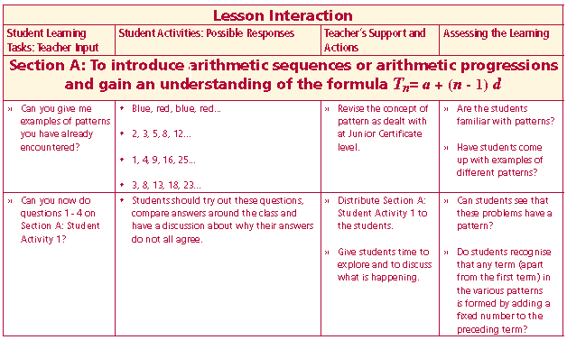
Student Activity 1
Can you give me examples of patterns you have already encountered?
Now do questions 1 - 4 on Section A: Student Activity 1?
Lesson interaction

Slide 4
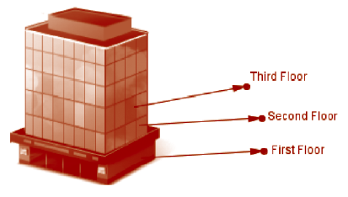
Student Activity 1
1. A gardener buys a plant that is 12cm in height. Each week after that the plant grows 10cm. Note: The plant is 12cm high at the beginning of the first week.
a. What will be the height of the plant at the beginning of the 1st, 2nd, 3rd, 4th and 5th weeks, if it follows the same pattern?
b. Use graph paper to represent the pattern from part a.
c. Explain your reasoning.
d. What two pieces of information were you given initially?
2. The ground floor of a building is 6 metres in height and each floor above it is 4 metres in height.
a. Taking the ground floor as floor one. List the height of the building at each of the first five floors.
b. Use graph paper to represent the pattern
from part a.
c. Explain your reasoning.
d. What two pieces of information were you
initially given?

Slide 5
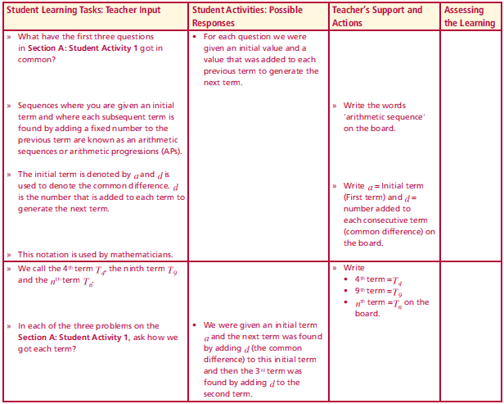
3. John has €500, and wants to go on a holiday, but does not have sufficient money. He decides to save €40 per week for a number of weeks to make up the deficit.
a. Given that he has €500 at the beginning of the first week, how much will he have saved at the end of the, 2nd, 3rd, 4th and 5th weeks?
b. Use graph paper to represent the pattern from part a.
c. Explain your reasoning.
d. What two pieces of information were you given initially?
4. What have the previous three questions got in common?
Lesson interaction

Slide 6
Sequences where you are given an initial term and where each subsequent term is found by adding a fixed number to the previous term are known as an arithmetic sequences or arithmetic progressions (APs).
The initial term is denoted by a and d is used to denote the common difference. d is the number that is added to each term to generate the next term.
This notation is used by mathematicians. We call the 4th term T₄, the ninth term T₉ and the nth term T_{n}.
In each of the three problems on the Section A: Student Activity 1, how do we get each term?

Slide 7
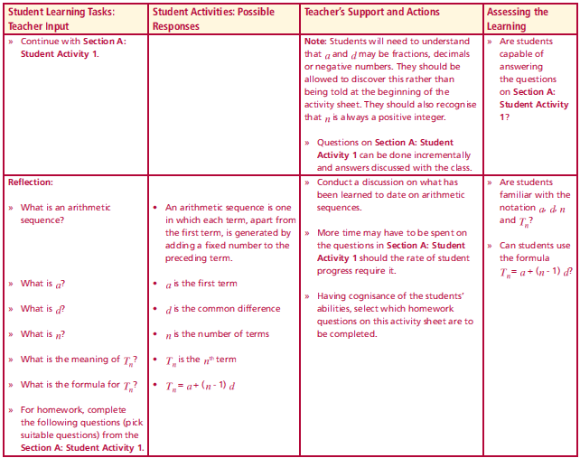
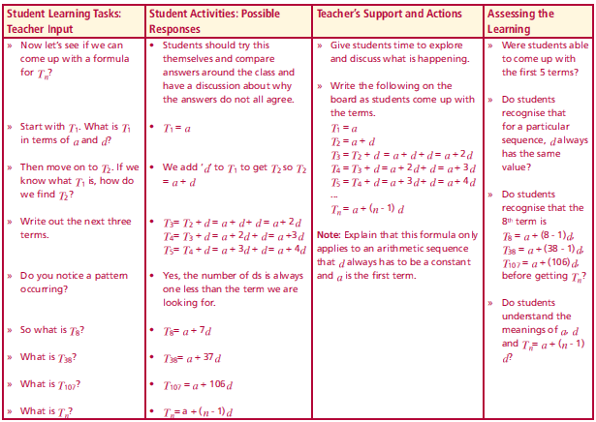
Now let’s see if we can come up with a formula for T n?
Start with T₁ . What is T₁ in terms of a and d?
Then move on to T₂. If we know what T₁ is, how do we find T₂?
Write out the next three terms.
Do you notice a pattern occurring?
So what is T₈?
What is T₃₈?
What is T₁₀₇?
What is T_{n}?
Lesson interaction
Lesson interaction

Slide 8
Reflection:
What is an arithmetic sequence?
What is a?
What is d?
What is n?
What is the meaning of T_{n}?
What is the formula for T_{n}?
Complete Section A: Student Activity 1.
Lesson interaction

Slide 9
5. Find T₁₀ and T₁₂ for questions 1, 2 and 3 above.
 | Formula for T₁₀ | Value for T₁₀ | Formula for T₁₂ | Value for T₁₂
Question 1
Question 2
Question 3

Slide 10
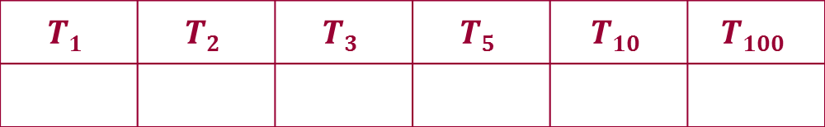
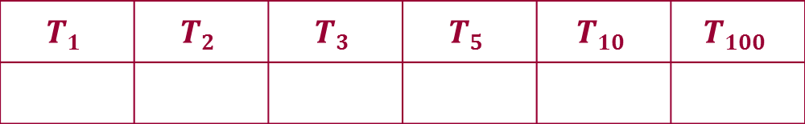

6. Find T₁, T₂, T₃, T₅, T₁₀, and T₁₀₀ of an arithmetic sequence where
a = 4 and d = 6
7. Find T₁, T₂, T₃, T₅, T₁₀, and T₁₀₀ of an arithmetic sequence where
a = 3 and d = -2.
8. Find T₁, T₂, T₃, T₅, T₁₀, and T₁₀₀ of an arithmetic progression where
a = 3 and d = ½.
$$T1$$ | $$T2$$ | $$T3$$ | $$T5$$ | $$T10$$ | $$T100$$
$$T1$$ | $$T2$$ | $$T3$$ | $$T5$$ | $$T10$$ | $$T100$$
$$T1$$ | $$T2$$ | $$T3$$ | $$T5$$ | $$T10$$ | $$T100$$

Slide 11
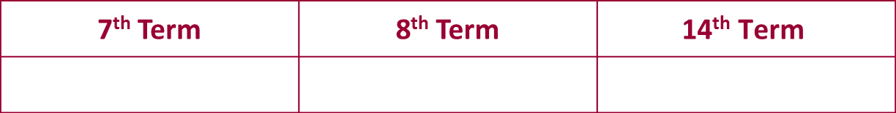
9. Find the 7th, 8th and 14th term in the arithmetic sequence 2, 6, 10, 14, ...
10. A baker has 400kg of flour on the first day of the month and uses no flour that day. How much will he have at closing time on the 17th day of the month, if he uses 24kg each day? Show your calculations using the formula for T_{n} of an arithmetic sequence.
11. Marjorie is trying to increase her fitness through exercise. The first day she walks 1500 metres and every day after that she increases this distance by 110 metres. How far will she be walking on the 12th day? Show your calculations using the formula for T_{n} of an arithmetic sequence.
7th Term | 8th Term | $$\text{14}\text{th} \text{Term}$$

Slide 12
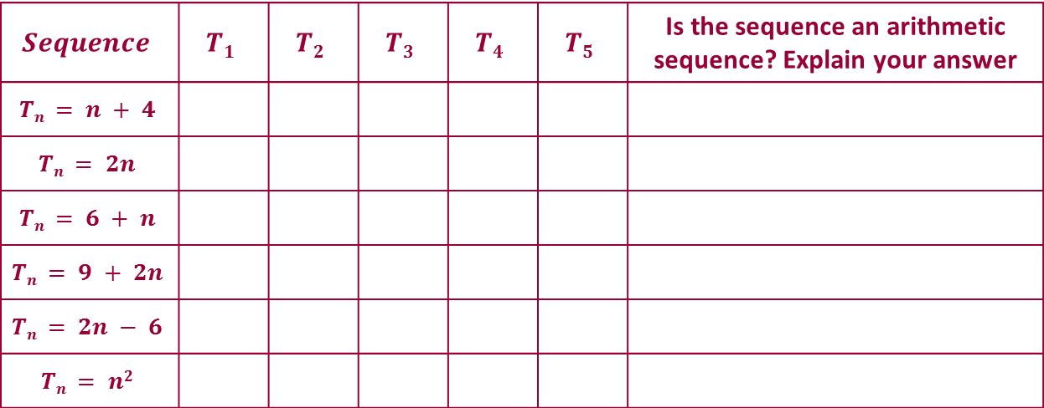
12. Find the first 5 terms in each of the following sequences and determine which of the sequences are arithmetic assuming they follow the same pattern.
$$Sequence$$ | $$T1$$ | $$T2$$ | $$T3$$ | $$T4$$ | $$T5$$ | Is the sequence an arithmetic sequence? Explain your answer
$$Tn = n + 4$$
$$Tn = 2n$$
$$Tn = 6 + n$$
$$Tn = 9 + 2n$$
$$Tn = 2n − 6$$
$$Tn = n2$$

Slide 13
13. On 1st November Joan has 200 sweets in a box. She eats no sweets the first day and she eats 8 sweets per day from the box thereafter. On what day of the month will she have 40 sweets left? Show your calculations using the formula for T_{n} of an arithmetic sequence.
14. Joan joins a video club. It costs €12 to join the club and any video she rents will cost €2. Jonathan’ joins a different video club where there is no initial charge, but it costs €4 to rent a video. Represent these two situations graphically and in algebraic form. Do either or both plans follow the pattern of an arithmetic sequence? Explain your reasoning.

Slide 14
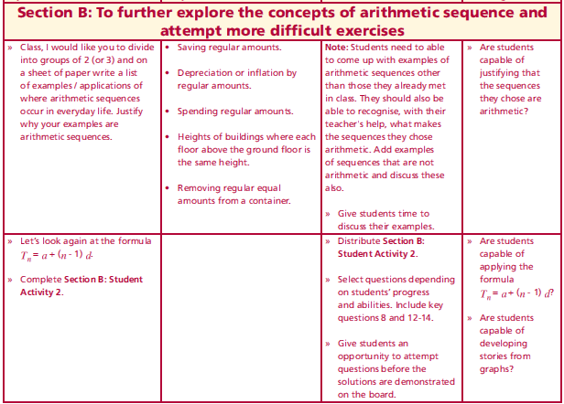
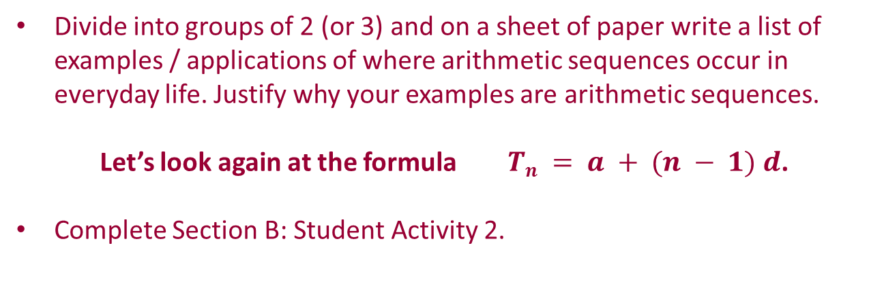
Section B: Student Activity 2
Divide into groups of 2 (or 3) and on a sheet of paper write a list of examples / applications of where arithmetic sequences occur in everyday life. Justify why your examples are arithmetic sequences.
Let’s look again at the formula $Tn = a + (n − 1) d$.
Complete Section B: Student Activity 2.
Lesson interaction

Slide 15
Section B: Student Activity 2
1. An art collection is valued at €50,000 in 2001 and its value increases by
€4,000 annually.
a. Show that, as time passes, the value of the collection follows an
arithmetic sequence? List the first ten terms of the sequence and give
the first term and common difference.
b. How much will the collection be worth in 2051?
2. A new car was valued at €21,000 on 1st January 2001, and depreciated
in value by a regular amount each year. On 1st January 2008, it had a
value of zero. Show that the value of the car could follow an arithmetic
sequence. How many terms are there in this sequence? By how much
did it depreciate each year? Show your calculations.
3. The sum of the interior angles of a triangle is 180°, of a quadrilateral is
360° and of a pentagon is 540°. Assuming this pattern continues, find
the sum of the interior angles of a dodecagon (12 sides). Show your
calculations.
http://www.regentsprep.org/Regents/math/algtrig/ATP2/SequenceWordpractice.htmrow seat?

Slide 16

4. A restaurant uses square tables and if one person sits on each side how many people can sit at each table?
a. If two tables are pushed together, how many people can be seated? Draw a diagram.
b. If three tables are placed together in a straight line,
how many people can be seated? Draw a diagram.
c. If 4 tables are placed together in a straight line how many people can
be seated?
d. Is the pattern in this question an arithmetic sequence? Explain your
answer.
5. The seats in a theatre are arranged so that each row accommodates
four people less than the previous row. If the first row seats 50 people,
how many will the 9th row seat?
6. The seats in a theatre are arranged so that each row accommodates
four people more than the previous row. If the first row seats 50
people, how many will the 9th

Slide 17
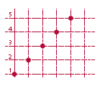
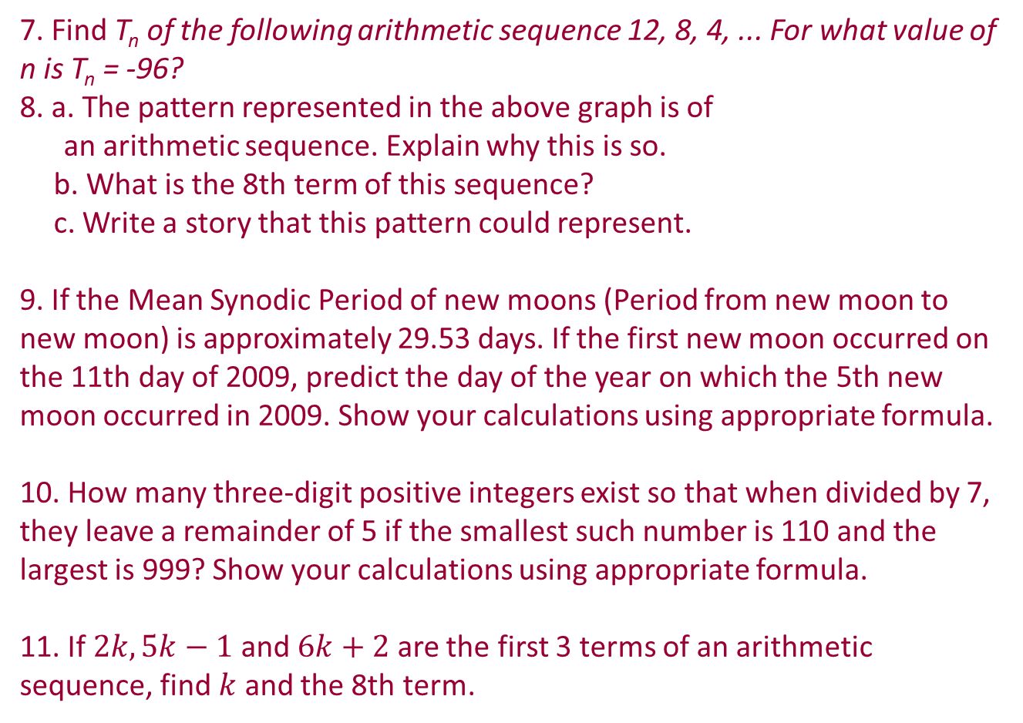
7. Find T_{n} of the following arithmetic sequence 12, 8, 4, ... For what value of n is T_{n} = -96?
8. a. The pattern represented in the above graph is of
an arithmetic sequence. Explain why this is so.
b. What is the 8th term of this sequence?
c. Write a story that this pattern could represent.
9. If the Mean Synodic Period of new moons (Period from new moon to new moon) is approximately 29.53 days. If the first new moon occurred on the 11th day of 2009, predict the day of the year on which the 5th new moon occurred in 2009. Show your calculations using appropriate formula.
10. How many three-digit positive integers exist so that when divided by 7, they leave a remainder of 5 if the smallest such number is 110 and the largest is 999? Show your calculations using appropriate formula.
11. If $2k, 5k−1$and $6k+2$ are the first 3 terms of an arithmetic sequence, find $k$ and the 8th term.

Slide 18
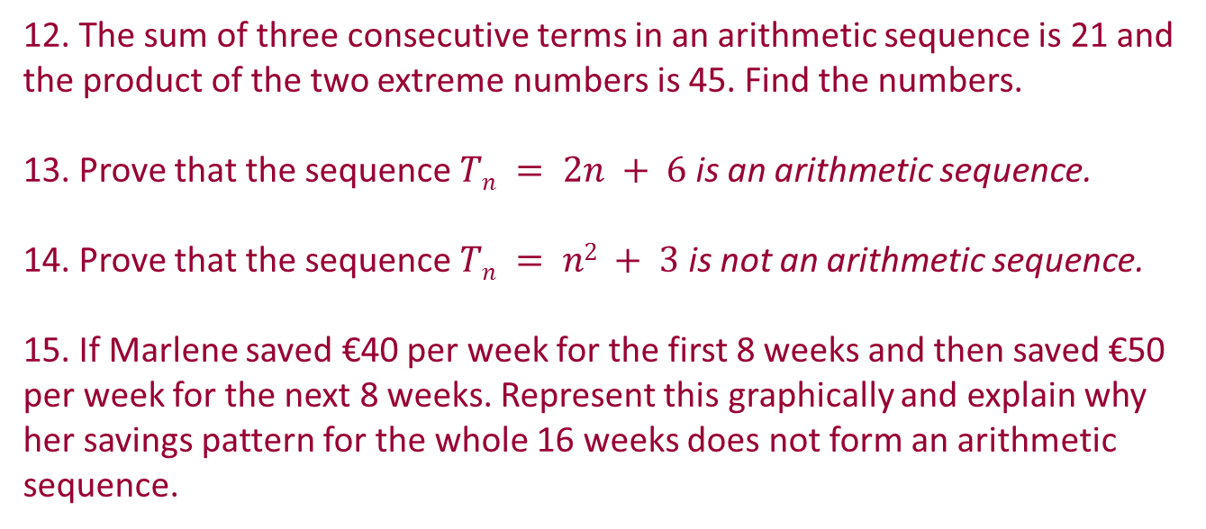
12. The sum of three consecutive terms in an arithmetic sequence is 21 and the product of the two extreme numbers is 45. Find the numbers.
13. Prove that the sequence $Tn = 2n + 6$is an arithmetic sequence.
14. Prove that the sequence $Tn = n2 + 3$is not an arithmetic sequence.
15. If Marlene saved €40 per week for the first 8 weeks and then saved €50 per week for the next 8 weeks. Represent this graphically and explain why her savings pattern for the whole 16 weeks does not form an arithmetic sequence.

Slide 19
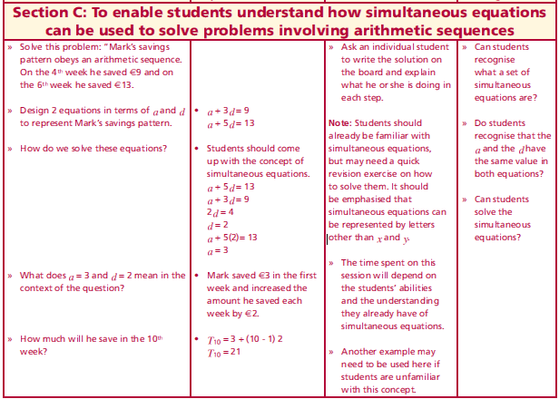
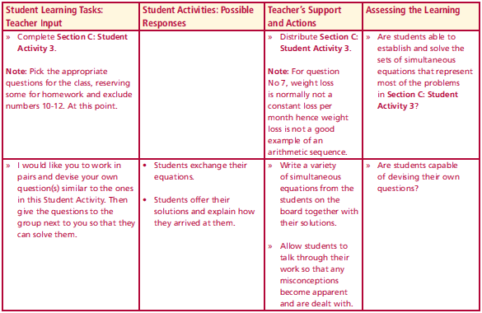
Section C: Student Activity 3
Problem:
“Mark’s savings pattern obeys an arithmetic sequence. On the 4th week he saved €9 and on the 6th week he saved €13.
Design 2 equations in terms of a and d to represent Mark’s savings pattern.
How do we solve these equations?
What does a = 3 and d = 2 mean in the context of the question?
How much will he save in the 10th week?
Complete Section C: Student Activity 3, Questions 1 to 9.
Lesson interaction
Lesson interaction

Slide 20
Section C: Student Activity 3
(Calculations must be shown in all cases.)
The tenth term of an arithmetic sequence is 40 and the twentieth term is 30. Find the common difference and the first term.
2. A doctor asked a patient to reduce his medication by a regular number of tablets per week. The reduction plan begins one week after the visit to the doctor. If 10 weeks after the visit to the doctor the person is taking 40 tablets and 20 weeks after the visit the person is taking 30. Find the weekly reduction in his consumption of tablets.
3. Patricia is climbing up a large number of steps and to encourage her on her way, her friend started counting the number of steps she completes every minute. From then on she keeps a regular pace. After 2 minutes she has climbed 56 steps in total and after 8 minutes she has climbed 158 steps in total.
a. Find the number of steps she climbs every minute once her friend started counting.
b. Find the number of steps she had climbed before her friend started counting.
If she had not maintained a regular pace, would you still have been able to use this method?

Slide 21
4. If the 9th floor of a building is 40 metres above the ground and the ground floor is 4 metres in height and each floor apart from the ground floor has equal height. Find the height of each floor. (Note the 1st floor is the one above the ground floor etc.)
5. On the first day of a month a baker receives a delivery of flour and starts using this flour at the beginning of the following day. He uses a regular amount of flour each day thereafter. At the end of the 4th day of the month he has 1,000kg of flour remaining and at the end of the 12th of the month 640kg remain. How much flour does he use per day and how much flour did he have delivered? Use equations to represent this information and then solve the equations.
6. A woman has a starting salary of €20,000 and after the first year she gets an annual increase of €2,000 per year. Find her annual salary when she reaches retirement age, 40 years from when she started the job?

Slide 22
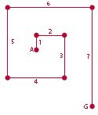
7. One week after joining a gym a man starts losing a constant amount of weight. Eight weeks after joining the gym he weighs 98kg and 15 weeks after joining the gym the weighs 91kgs, find his weight before joining the gym and the amount of weight he lost each week.
Is a weight loss programme a good application for an arithmetic sequence? Explain your answer.
8. a. Why is the pattern in the following drawing an
arithmetic sequence and what will the length of the 88th
side be?
b. List an arithmetic sequence of your choice and draw a geometric representation of it.
9. A new company made a profit of €2,000 in the 8th week of business and in the 12th week of business they made €3,000. If their accountant informed you that the increases in their profit followed an arithmetic sequence pattern, how much profit did they make in the first 4 weeks of business?

Slide 23
Work in pairs and devise your own question(s) similar to the ones in this Student Activity. Then give the questions to the group next to you so that they can solve them.

Slide 24
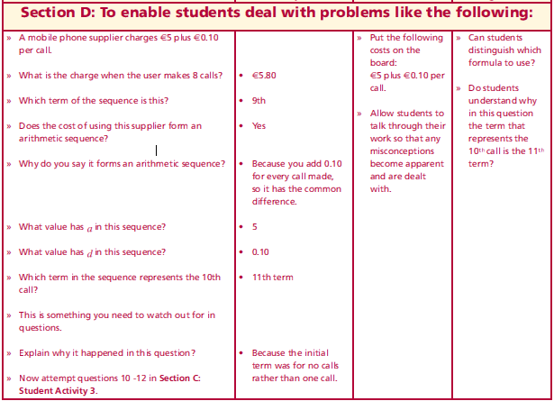
Solving Problems
A mobile phone supplier charges €5 plus €0.10 per call.
What is the charge when the user makes 8 calls?
Which term of the sequence is this?
Does the cost of using this supplier form an arithmetic sequence?
Why do you say it forms an arithmetic sequence?
What value has a in this sequence?
What value has d in this sequence?
Which term in the sequence represents the 10th call?
This is something you need to watch out for in questions.
Explain why it happened in this question?
Now attempt questions 10 -12 in Section C:Student Activity 3.
Lesson interaction

Slide 25
10. The membership fee for a gym is €100 and for each visit after that the charge is €10.
a. How much will ten visits cost? Show your calculations.
b. What will be the cost of joining the gym and visiting it on n occasions?
11. A walker is already walking 5km per day and decides to increase this amount by 0.1km per day starting on 1st August.
a. What distance will he be walking on 3rd August?
b. Is this an arithmetic sequence? Explain your reasoning.
c. What is the formula for the n^{th} term?
d. If this question had stated that the walker walked 5km on 1st August and that he had increased this by 0.1km, each day thereafter. What would the formula have been for:
i. The 16th August?
ii. The n^{th} day of the month
12. On 1st June, Joseph has 200 sweets in a box. He eats 8 sweets per day from the box starting on the 1st June. On what day of the month will he have 40 sweets left? Show your calculations using algebra. How does this differ from question 13 in Section A: Student Activity 1?
Lesson interaction

Slide 26
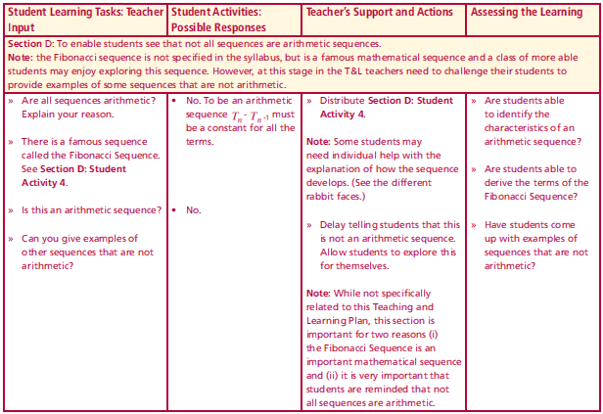
Section D: Student Activity 4
Are all sequences arithmetic?
Explain your reason.
There is a famous sequence called the Fibonacci Sequence.
See Section D: Student Activity 4.
Lesson interaction

Slide 27
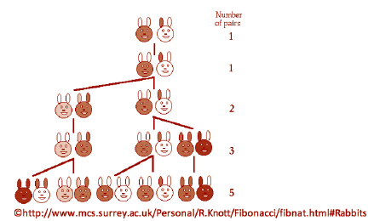

Section D: Student Activity 4
Fibonacci was an Italian mathematician, who worked on this problem in the 13th century. He studied how fast rabbits breed in ideal circumstances. He imagined a newly born pair of rabbits, one male and one female were placed in a field and made the following assumptions about the mating habits of rabbits:
• Rabbits mate at exactly one month old and mate every month after that.
• Rabbits always have litters of exactly one male and one female.
• The gestation period for rabbits is exactly one month. (Not true)
• Rabbits never die. (Not true)
Lesson interaction

Slide 28
Section D: Student Activity 4
Are all sequences arithmetic?
Explain your reason.
There is a famous sequence called the Fibonacci Sequence.
See Section D: Student Activity 4.
Is this an arithmetic sequence?
Can you give examples of other sequences that are not arithmetic?
Lesson interaction

Slide 29
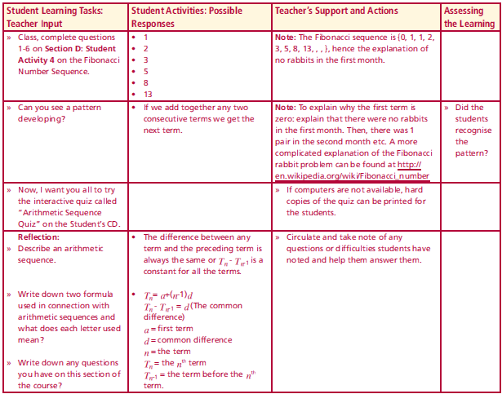
Lesson interaction
1 How many pairs will there be after 1 month? Explain.
2 How many pairs will there be after 2 months? Explain.
3 How many pairs will there be after 3 months? Explain.
4 How many pairs will there be after 4 months? Explain.
5 How many pairs will there be after 5 months? Explain.
6 How many pairs will there be after 6 months? Explain.
7 Can you see a pattern developing?

Slide 30
Now, I want you all to try the interactive quiz called “Arithmetic Sequence Quiz” on the Student’s CD.
Lesson interaction

Slide 31
Reflection:
Describe an arithmetic sequence.
Write down two formula used in connection with arithmetic sequences and what does each letter used mean?
Write down any questions you have on this section of the course?
Lesson interaction

