Slide 1
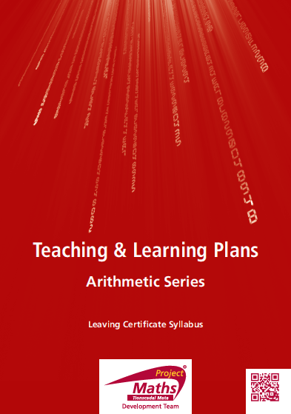

Slide 2
Index
Section A: | To find the sum of first n terms of an arithmetic series
Section B: | To further develop the concept of S_{n} of an arithmetic series
Reflection
Appendix | Proof of Formula for arithmetic series

Slide 3
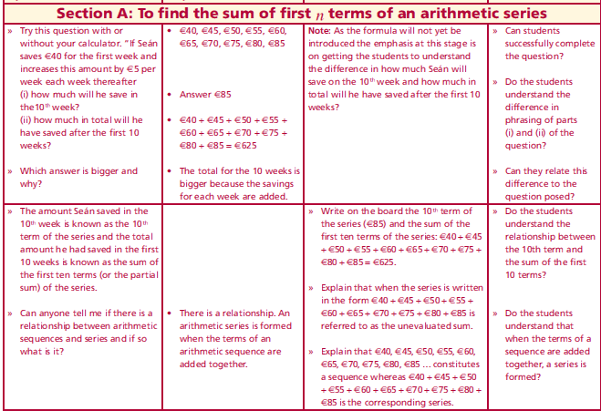
Section A: Introduction
Try this question with or without your calculator.
If Seán saves €40 for the first week and increases this amount by €5 per
week each week thereafter
(i) how much will he save in the10th week?
(ii) how much in total will he have saved after the first 10 weeks?
Which answer is bigger and why?
The amount Seán saved in the 10th week is known as the 10th term of the series and the total amount he had saved in the first 10 weeks is known as the sum of the first ten terms (or the partial sum) of the series.
Is there a relationship between arithmetic sequences and series and if so what is it?
Lesson interaction

Slide 4
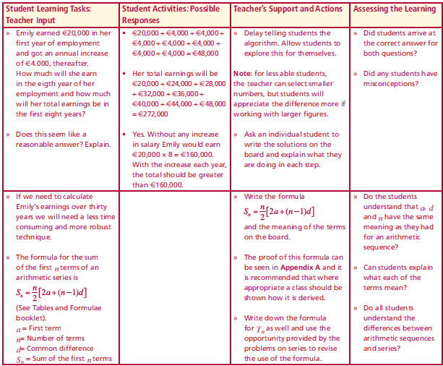
Section A: Introduction
Emily earned €20,000 in her first year of employment and got an annual increase of €4.000, thereafter. How much will she earn in the eighth year of her employment and how much will her total earnings be in the first eight years?
Does this seem like a reasonable answer? Explain.
If we need to calculate Emily’s earnings over thirty years we will need a less time consuming and more robust technique.
The formula for the sum of the first n terms of an arithmetic series is
$$S_{n}=\frac{n}{2}\left[2a+\left(n−1\right)d\right]$$
(See Tables and Formulae booklet page 22).
a = First term
n= Number of terms
d= Common difference
S_{n}= Sum of the first n terms
Lesson interaction
Page 22
Page 23

Slide 5
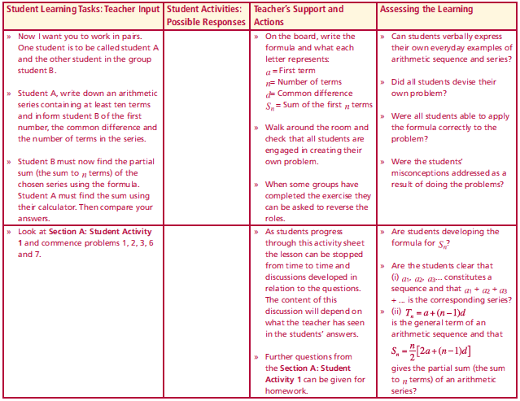
Section A: Introduction
Work in pairs. One student is to be called student A and the other student in the group student B.
Student A, write down an arithmetic series containing at least ten terms
and inform student B of the first number, the common difference and
the number of terms in the series.
Student B must now find the partial sum (the sum to n terms) of the chosen series using the formula. Student A must find the sum using their calculator. Then compare your answers.
$$S_{n}=\frac{n}{2}\left[2a+\left(n−1\right)d\right]$$
Complete Section A: Student Activity 1
Lesson interaction

Slide 6
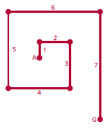
Section A: Student Activity 1
(Calculations must be shown in all cases.)
1. A craftsman uses 100 beads on the first day of the month and this
amount increases by 15 beads each day thereafter. If he works 24 days
in the month, how many beads will he need to order in advance to have a month’s supply?
2. Find the total amount of metal required to continue
this shape with 20 sides. The lengths of the sides are in metres.
3. A factory produced 10, 13, 16 and 19 items per week in the first four
weeks of the year. If this pattern continues how many items will this
factory produce in the last week of the year and how many items will
the factory produce in total in a complete year of business (52 weeks in
the year)?
4. If James saves €40 during the first week of January and increases this
amount by €5 per week every week for the following ten weeks, how
much will he save in total?

Slide 7
Section A: Student Activity 1
5. A woman has a starting salary of €20,000 and gets an annual increase
Of €2,000 per year thereafter. How much will she earn in total during
her working life, if she retires after working for 40 years?
6. Your new employer offers you a choice of 2 salary packages. Package
A has a starting salary of €12,000 per year with an annual increase
of €2,000. Package B has a starting salary of €20,000 and an annual
increase of €1,500. Assuming you plan to remain in the firm for ten
years which is the best package and by how much? Illustrate your
reasoning with the help of calculations.
7. In a cinema, there are 140 seats in the front row, 135 in the second and
130 in the third row. This pattern continues until the last row. If the last
row has 45 seats, how many rows are there in the cinema? Calculate
the total number of seats in the cinema.

Slide 8
Section A: Student Activity 1
8. Find an expression for S_{n} for the arithmetic Series 2 + 4 + 6 + 8 +….
9. How many terms of the arithmetic series 1 + 3 + 5 +.... are required to
give a sum in excess of 600?
10. Kayla got her new mobile phone on the first of April. She sent 1 text
that day, 3 texts the next day and 5 texts the next day. If this pattern
continues how many texts will she send on 30th April and how many
texts in total will she send in the month of April that year? (April has
30 days.) If each text message costs 13 cent how much will she spend
sending texts in April?
11. Is it possible for an arithmetic series to have a first term and a common
difference that are both non-zero and have a partial sum of zero? If so,
give an example and explain the circumstance that causes this to happen.

Slide 9
Section A: Student Activity 1
12. A water tank containing 377 litres of water develops a leak. On the first
day the tank leaks 5 litres of water and this increases by 4 litres each day
thereafter. Show that the amount of water that leaks each day follows
an arithmetic progression and apply the S_{n} formula to determine how
long it takes for the tank to empty. Show your calculations.
13. A bricklayer has 400 bricks and wants to build a wall following the
pattern below. How many layers high will the wall be if he plans to use
all his bricks?

Slide 10
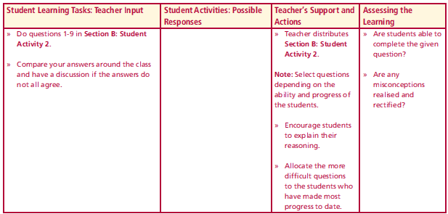
Section B: Student Activity 2
Complete the interactive quiz called “Arithmetic Series” on the Students' CD.
We know that the sum of the first eight terms of an arithmetic series is 80 and that the sum of the first sixteen terms is 288. How can we represent this information using algebra?
Now, what types of equations do we have and what can we do with them?
What information does this give us?
Complete questions 1 to 9 in Section B: Student Activity 2.
Lesson interaction
Lesson interaction

Slide 11
Section B: Student Activity 2
(Calculations must be shown in all cases.)
1. For a given arithmetic series, S₄= 26 and S₆= 57, find T_{n}.
2. The terms of an arithmetic sequence are given by the formula
$Tn = 25−4n$.
a. Find the first three terms of the sequence. What is the value of d, the
common difference?
b. Find the first negative term of the sequence.
c. For what value of n is the sum of the first n terms of the series equal to 30?
3. Given that S₁ of an arithmetic series is -3 and S₂ of the same series is 3.
a. Find the common difference.
b. Find the 20th term of the equivalent sequence.
c. When S_{n} of this series is equal to 75, what value has n?
Lesson interaction

Slide 12
Section B: Student Activity 2
4. Jonathan saved a certain amount for one year and increased this amount
by a regular amount each year thereafter. If the total amount he saved in
the first 8 years of this savings plan is €1,690 and he saved €220 in the 5th year. Find how much he saved in the first year and by how much did he
increase his savings each year.
5. The sum of the first n terms of an arithmetic series is given by
$Sn = n2− 15n$.
a. Find the first term and the common difference.
b. Find T_{n} the nth term of the equivalent sequence.
c. When is the series equal to -50?
6. The first 4 terms of arithmetic series is -3 + 4 + 11 + 18 +...
a. Find d, the common difference.
b. Find T₂₀ , the 20th term of the equivalent sequence.
c. Find S₂₀ , the sum of the first twenty terms of the series.

Slide 13
Section B: Student Activity 2
7. Three consecutive terms of an arithmetic sequence are
$x + 3$, $4x+ 1$and $6x+ 1$. Find the value of $x$.
Find an expression for S_{n} the equivalent series.
8. If a household uses 1kg of sugar each week and decides to reduce
this amount by 10g per week. How much sugar per week would the
household be using at the end of the year (52 weeks in the year)? What
is the total amount of sugar this household would use that year?
9. Prove that the formula for the sum of the first n Natural Numbers (N) is
$S_{n}=\frac{n(n+1)}{2}$ $N = \{1, 2, 3, 4, …\}$

Slide 14
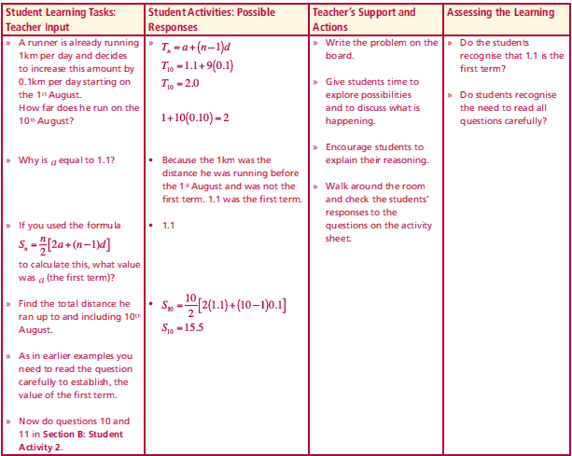
Section B: Student Activity 2
A runner is already running 1km per day and decides to increase this amount by 0.1km per day starting on the 1st August.
How far does he run on the 10th August?
Why is $a$ equal to 1.1?
If you used the formula $S_{n}=\frac{n}{2}\left[2a+\left(n−1\right)d\right]$to calculate this, what value was a (the first term)?
Find the total distance he ran up to and including 10th August.
As in earlier examples you need to read the question carefully to establish, the value of the first term.
Now do questions 10 and 11 in Section B: Student Activity 2.
Lesson interaction

Slide 15
Section B: Student Activity 2
10. Emer purchases a new car every year on 1st January. She purchased her
first car in 2001 and it cost €20,000. Each year after that the cost of her
new car increases by €3,000.
a. How much did she spend on her 10th car?
b. How much did she spend on the car she purchased in 2011?
c. Why were the previous two answers not the same?
d. How much did she spend, in total, on her first ten cars?
e. By 1st February 2011, how much would she have spent on cars,
assuming that she bought no cars other than those in the pattern
mentioned in this question?
11. Emer purchases a new car every second year on 1st January. If the first
car she purchases costs €20,000 and each time she changes the cost
increases by €6,000
a. how much will she have spent in total in buying the cars on 1st February, ten years after she bought the first car?
b. how much will she spend in total on her first ten cars?

Slide 16
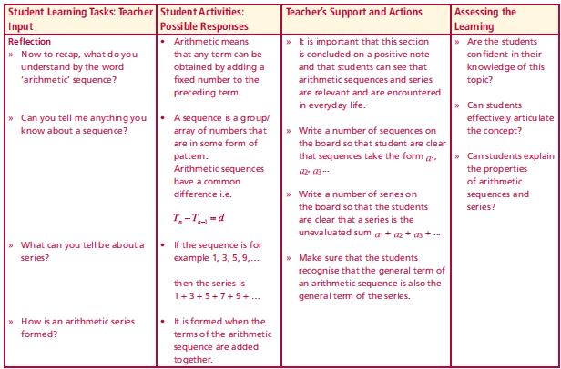
Reflection
What do you understand by the word ‘arithmetic’ sequence?
What can you tell about a sequence?
What can you tell be about a series?
How is an arithmetic series formed?
Lesson interaction

Slide 17
Appendix A
Proof of Formula for arithmetic series
(Students will not be required to prove this formula.)
$$Sn = T1 + T2 + T3 + T4 + ⋯+ Tn−1 + Tn$$
$S_{n}=a+a+d+a+2d+a+3d+⋯+a+\left(n−2\right)d+a+\left(n−1\right)d$ $(1)$
Note S_{n} can also be written as T_{n} + T_{n-1} ...............+ T₄ + T₃ + T₂ +T₁
Writing S_{n} in reverse:
$$S_{n}=a+\left(n−1\right)d+a+\left(n−2\right)d+⋯+a+3d+a+2d+a+d+a (2)$$

Slide 18
Appendix A
$$S_{n}=a+a+d+a+2d+a+3d+⋯+a+\left(n−2\right)d+a+\left(n−1\right)d (1)$$
$$S_{n}=a+\left(n−1\right)d+a+\left(n−2\right)d+⋯+a+3d+a+2d+a+d+a (2)$$
$$Adding (1) and (2)$$
$$2S_{n}=$$
$$2Sn = n\{2a + (n−1)d\}$$
$$Sn = \frac{n}{2}\{2a + (n−1)d\} Formula as per tables but note$$
$$Sn =\frac{n}{2}\{a + a + (n−1)d\} =\frac{n}{2}\{first term + nth term\}$$
$\left\{2a+\left(n−1\right)d\right\}$ +
$\left\{2a+\left(n−1\right)d\right\}$+
$⋯+\left\{2a+\left(n−1\right)d\right\}$+
$$\left\{2a+\left(n−1\right)d\right\}$$
Page 22

