Slide 1
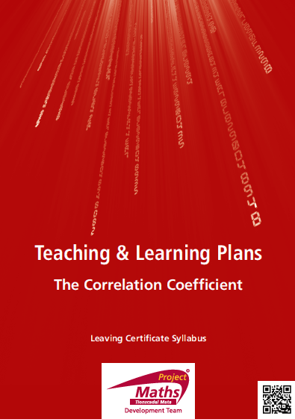

Slide 2
INDEX
Student Activity 1: Drawing a Scatter Plot
Student Activity 2: Correlation coefficient
Student Activity 3: Interpreting the data and
the Correlation Coefficient
Student Activity 4: Calculating the Correlation Coefficient (HL)
and Causation (OL)
Student Activity 5: Line of Best Fit (HL only)
Student Activity 6: Outliers (HL Only)

Slide 3
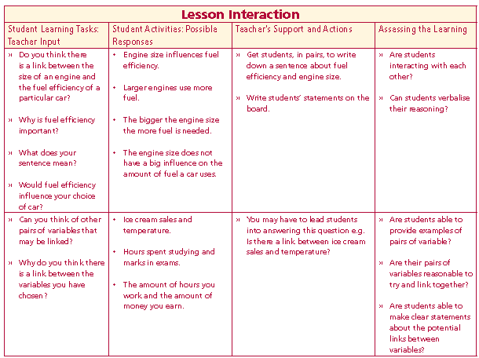
Student Activity 1: Introduction
Do you think there is a link between the size of an engine and the fuel efficiency of a particular car?
Why is fuel efficiency important?
What does your sentence mean?
Would fuel efficiency influence your choice of car?
Can you think of other pairs of variables that may be linked?
Why do you think there is a link between the variables you have chosen?
Lesson interaction

Slide 4
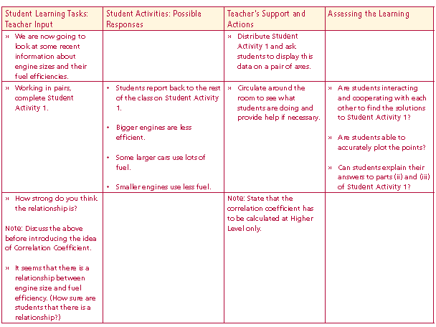

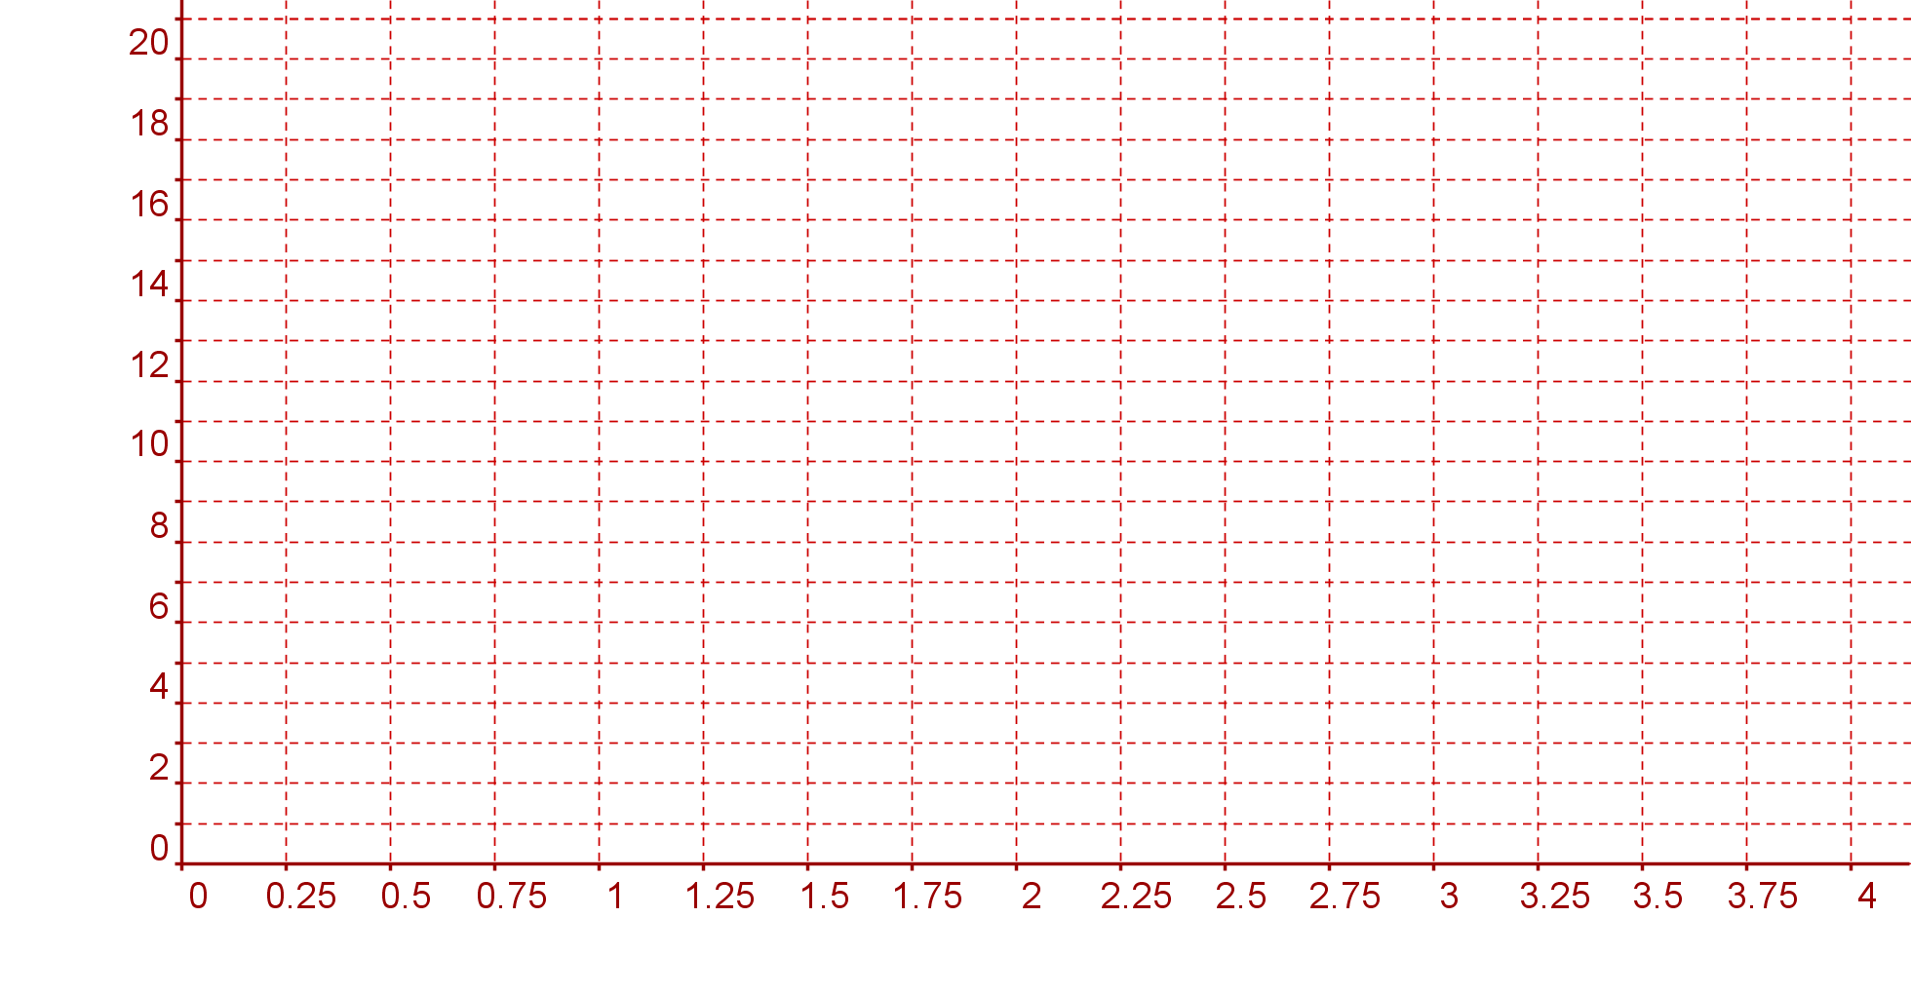
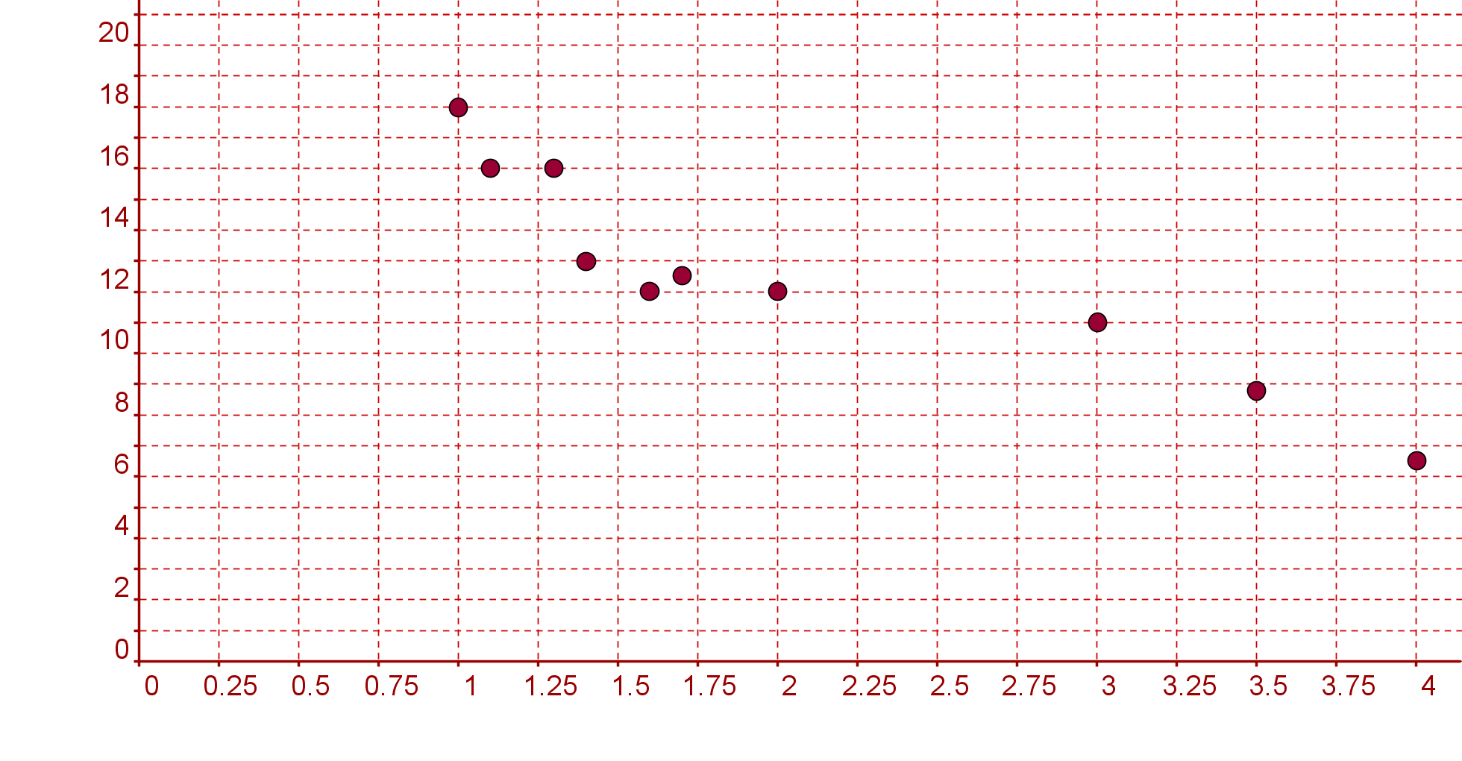
Student Activity 1
Drawing a scatter plot
Below is some recent research about engine sizes. This data shows the
engine size and the fuel economy of a range of petrol car.
Show this information on a scatter diagram
Lesson interaction
Kpl
Engine sice (cc)
How strong do you think
the relationship is?

Slide 5
Describe, in your own words the relationship between the engine size and fuel economy of these cars. ______________________________________________________________________________________________________________________________________________________________________________
iii A car manufacturer produces a new car with a 1.8 litre engine and a
fuel efficiency of 17 kilometres per litre. Plot this car’s performance on
your scatter plot. If you were interested in buying a new car that was
fuel efficient with this size engine would you buy this car? Write a short
comment.
___________________________________________________________________________________________________________________________________________________________________________

Slide 6
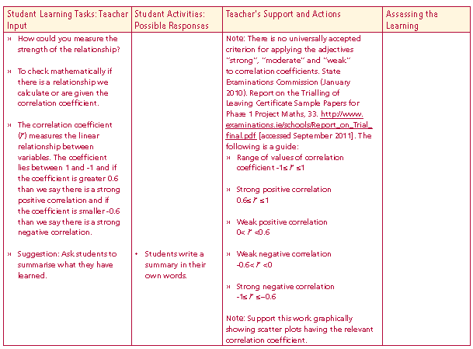
Student Activity 2A: Introduction
How could you measure the strength of the relationship?
To check mathematically if there is a relationship we calculate or are given the correlation coefficient.
The correlation coefficient (r) measures the linear relationship between variables. The coefficient lies between 1 and -1 and if the coefficient is greater 0.6 than we say there is a strong positive correlation and if the coefficient is smaller -0.6 than we say there is a strong negative correlation.
Lesson interaction

Slide 7
Note: There is no universally accepted criterion for applying the adjectives
“strong”, “moderate” and “weak” to correlation coefficients. State Examinations Commission (January 2010). Report on the Trialling of Leaving Certificate Sample Papers for Phase 1 Project Maths, . http://www.examinations.ie/schools/Report_on_Trial_final.pdf [accessed September 2011].
The following is a guide:
Range of values of correlation coefficient -1≤ r ≤1
Strong positive correlation 0.6 ≤ r ≤ 1
Weak positive correlation 0 < r < 0.6
Weak negative correlation - 0.6 < r < 0
Strong negative correlation - 1 ≤ r ≤ −0.6
Lesson interaction

Slide 8
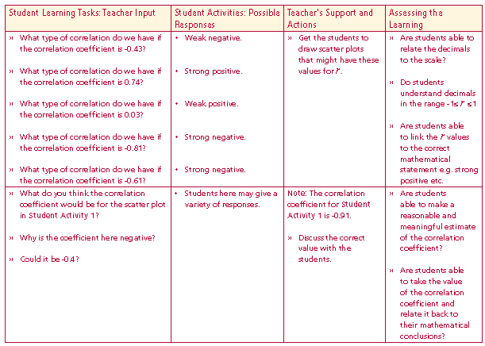
What type of correlation do we have if the correlation coefficient is -0.43?
What type of correlation do we have if the correlation coefficient is 0.74?
What type of correlation do we have if the correlation coefficient is 0.03?
What type of correlation do we have if the correlation coefficient is -0.81?
What type of correlation do we have if the correlation coefficient is -0.61?
What do you think the correlation coefficient would be for the scatter plot in
Student Activity 1?
Why is the coefficient here negative?
Could it be -0.4?
Lesson interaction

Slide 9
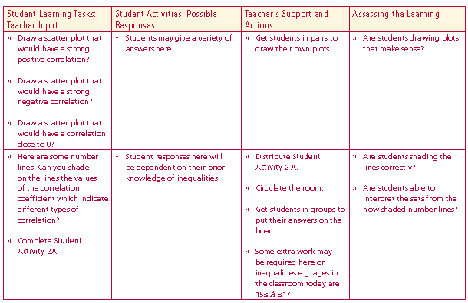
Draw a scatter plot that would have a strong positive correlation?
Draw a scatter plot that would have a strong negative correlation?
Draw a scatter plot that would have a correlation close to 0?
Lesson interaction

Slide 10
Student Activity 2A
Correlation Coefficient: The scale
(i) On the number line below shade in the possible values of the correlation coefficient.
Lesson interaction
(ii) On the number line below shade in the possible values of the correlation coefficient that indicate a strong positive correlation.
(iii) On the number line below shade in the possible values of the correlation coefficient that indicate a weak positive correlation.
(iv) On the number line below shade in the possible values of the correlation coefficient that indicate a strong negative correlation
(v) On the number line below shade in the possible values of the correlation coefficient that indicate a weak negative correlation

Slide 11
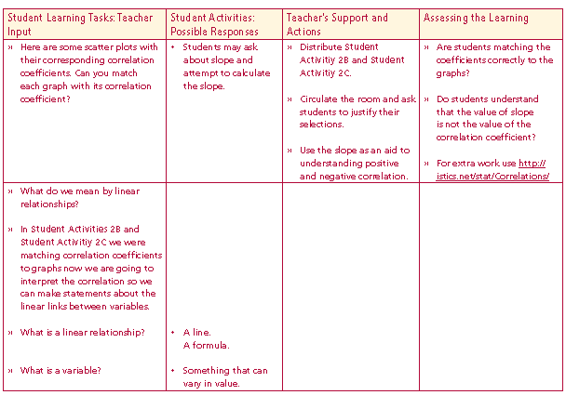

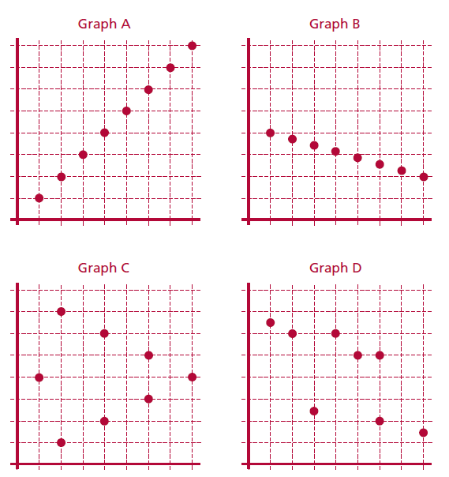
Student Activity 2B
Matching Correlations Coefficients to scatter plots
The table shows the correlations for the four graphs below. Match each graph to the correlation coefficient.
Lesson interaction
D
A
B
C

Slide 12

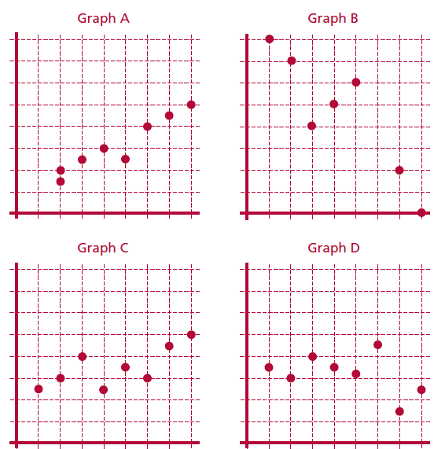
Matching Correlations Coefficients to scatter plots
The table shows the correlations for the four graphs below. Match each graph to the correlation coefficient.
Lesson interaction
C
B
A
D

Slide 13
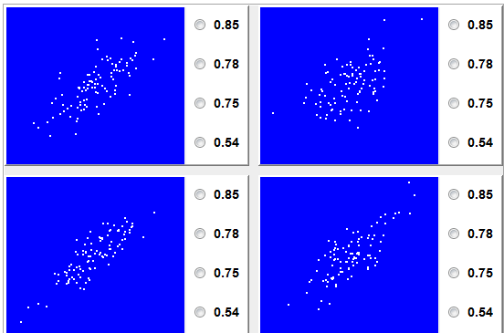
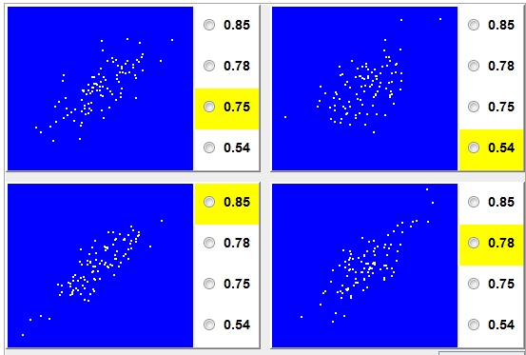

Slide 14
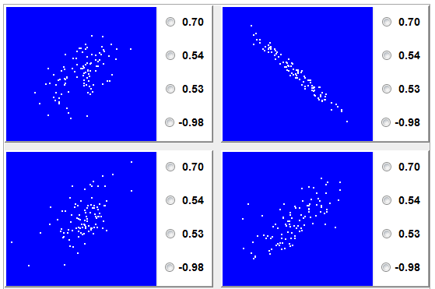
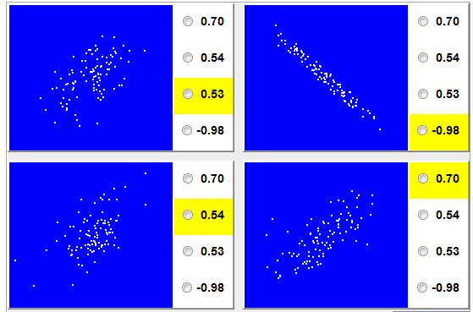

Slide 15
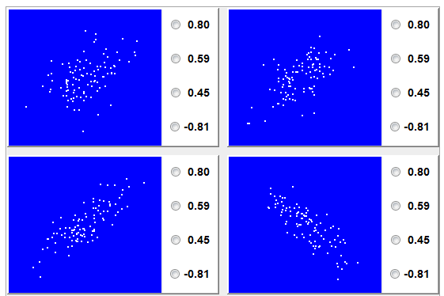
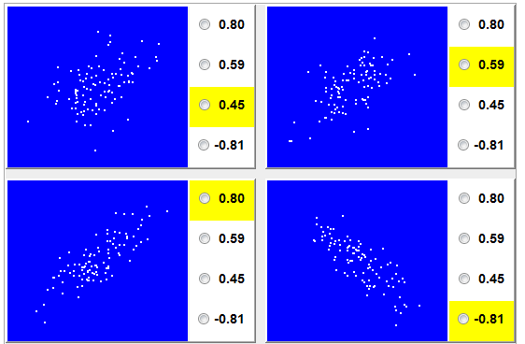

Slide 16
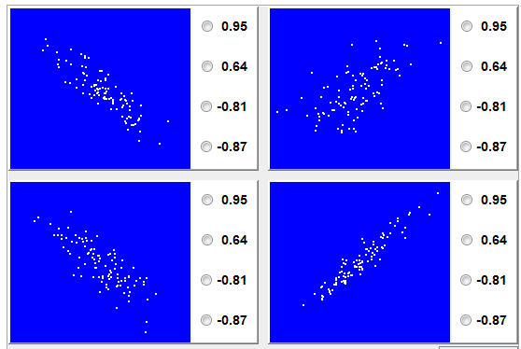
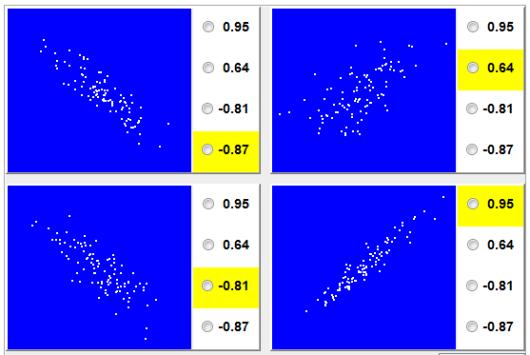

Slide 17
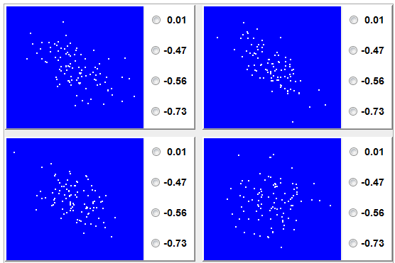
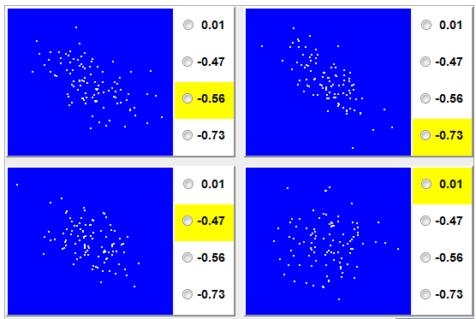

Slide 18
Student Activity 3A: Introduction
In Student Activities 2B and 2C we were matching Correlation coefficients to graphs now we are going to interpret the correlation so we can make statements about the linear links between variables.
Lesson interaction
What is a linear relationship?
What is a variable?

Slide 19
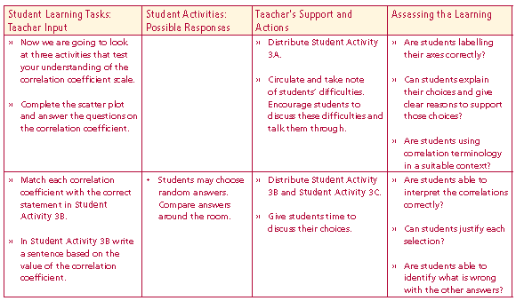

Student Activity 3A
Interpreting the data and the Correlation Coefficient
An ice cream seller records the maximum daily temperature and the number of ice creams she sells each day. Her results for a period of ten days are shown in the table.
Lesson interaction
Display the data in a way that allows you to examine the relationship
between the two variables.

Slide 20
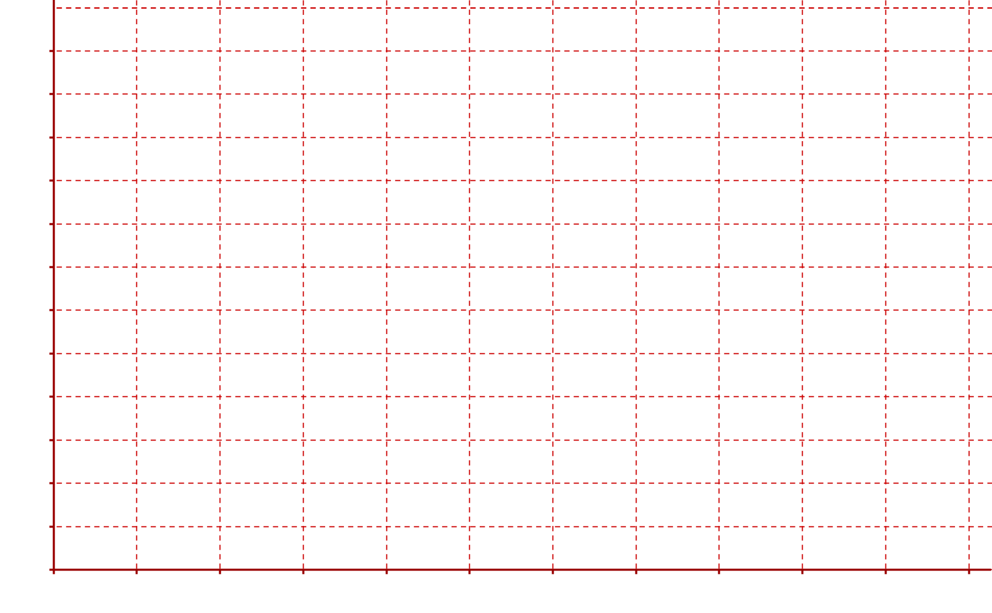
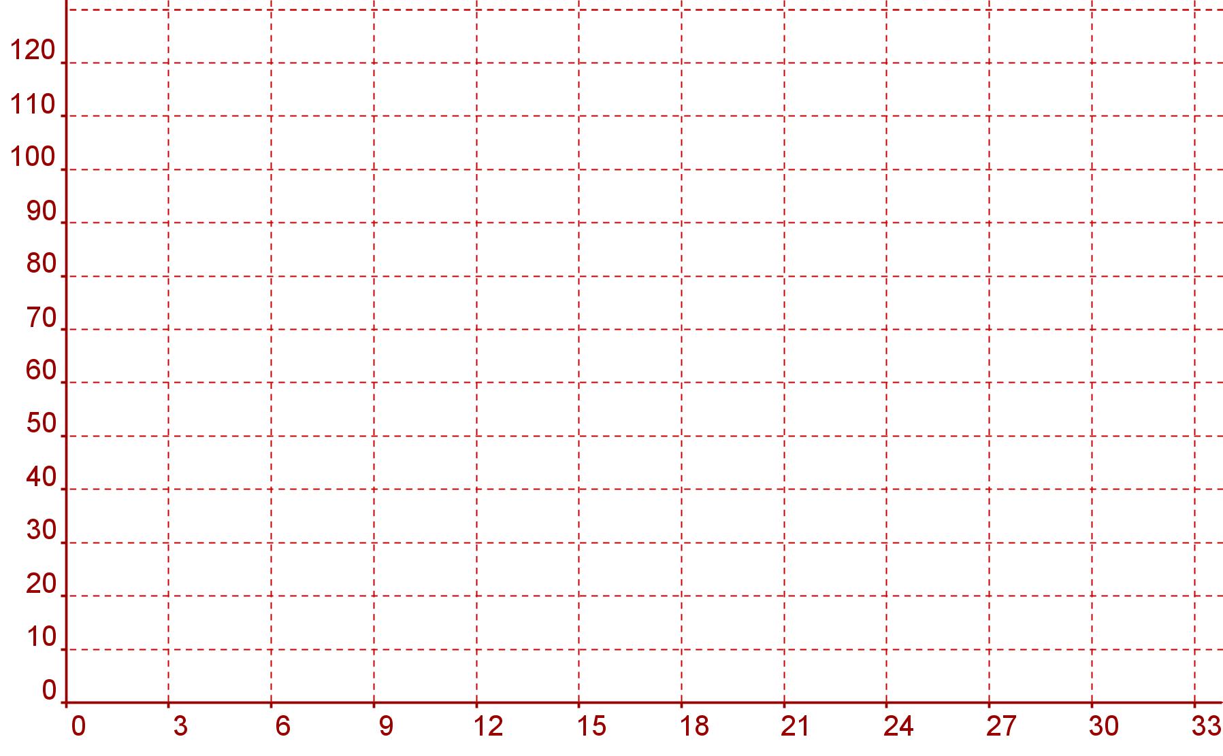
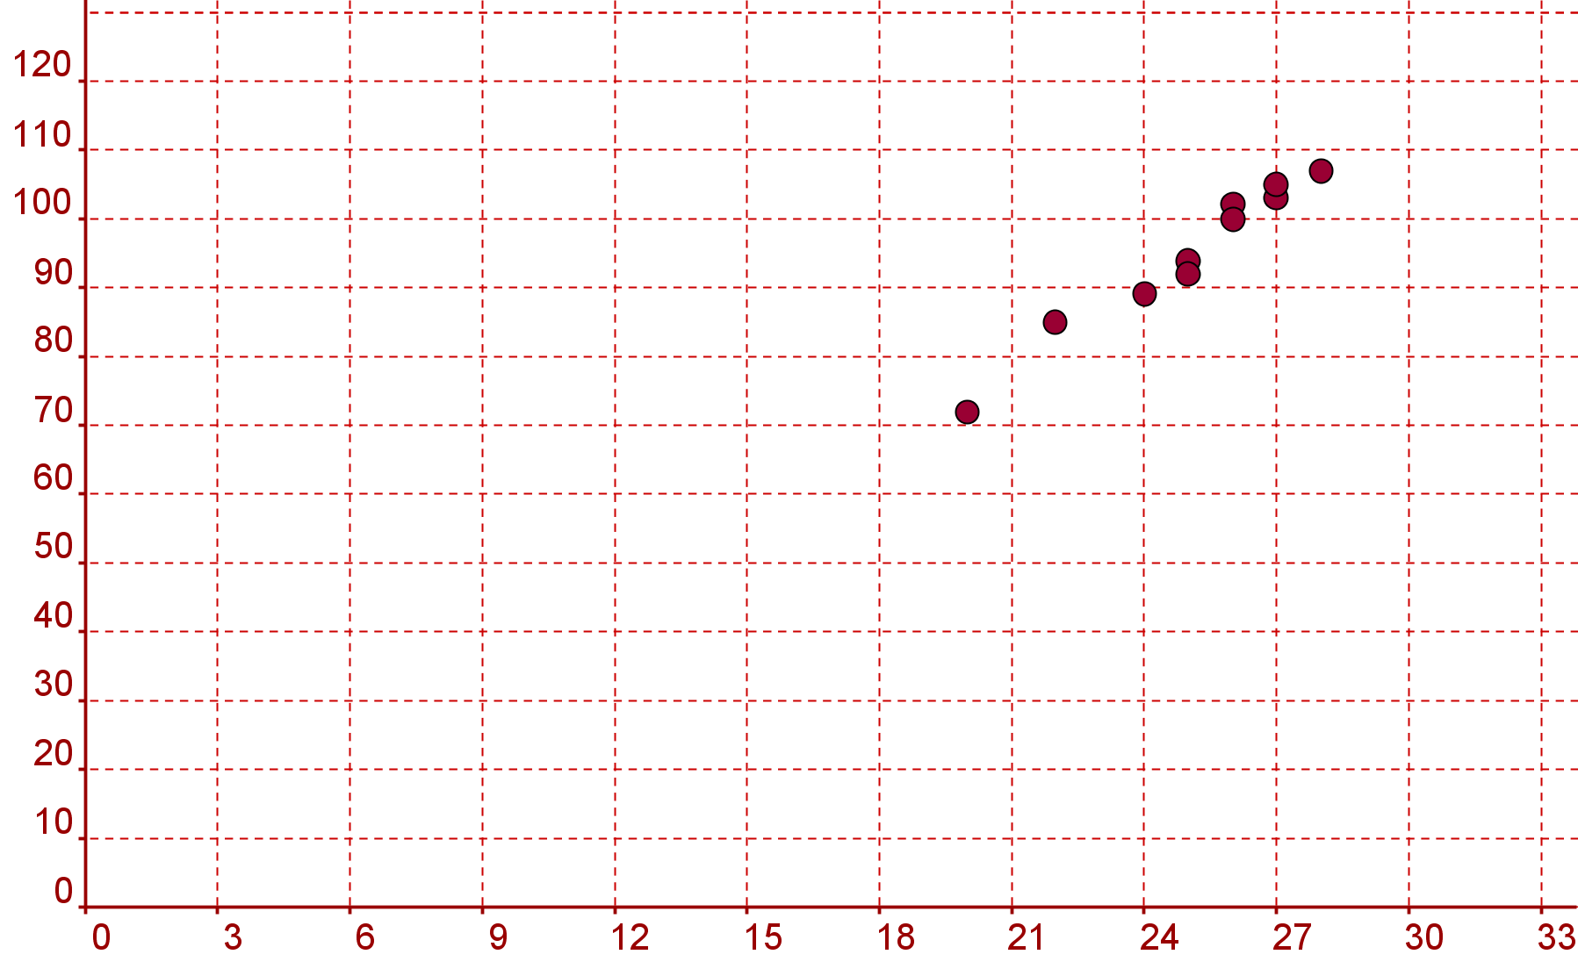
Student Activity 3A
Interpreting the data and the Correlation Coefficient
An ice cream seller records the maximum daily temperature and the number of ice creams she sells each day. Her results for a period of ten days are shown in the table.
Lesson interaction
Display the data in a way that allows you to examine the relationship
between the two variables.

Slide 21
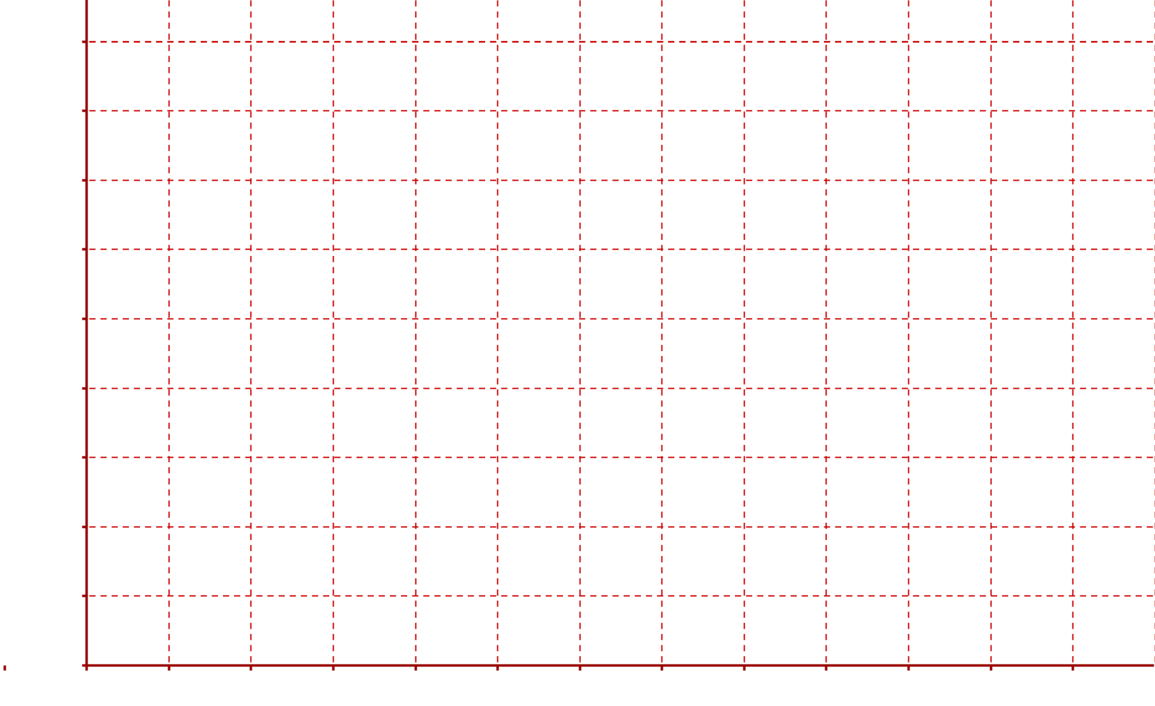
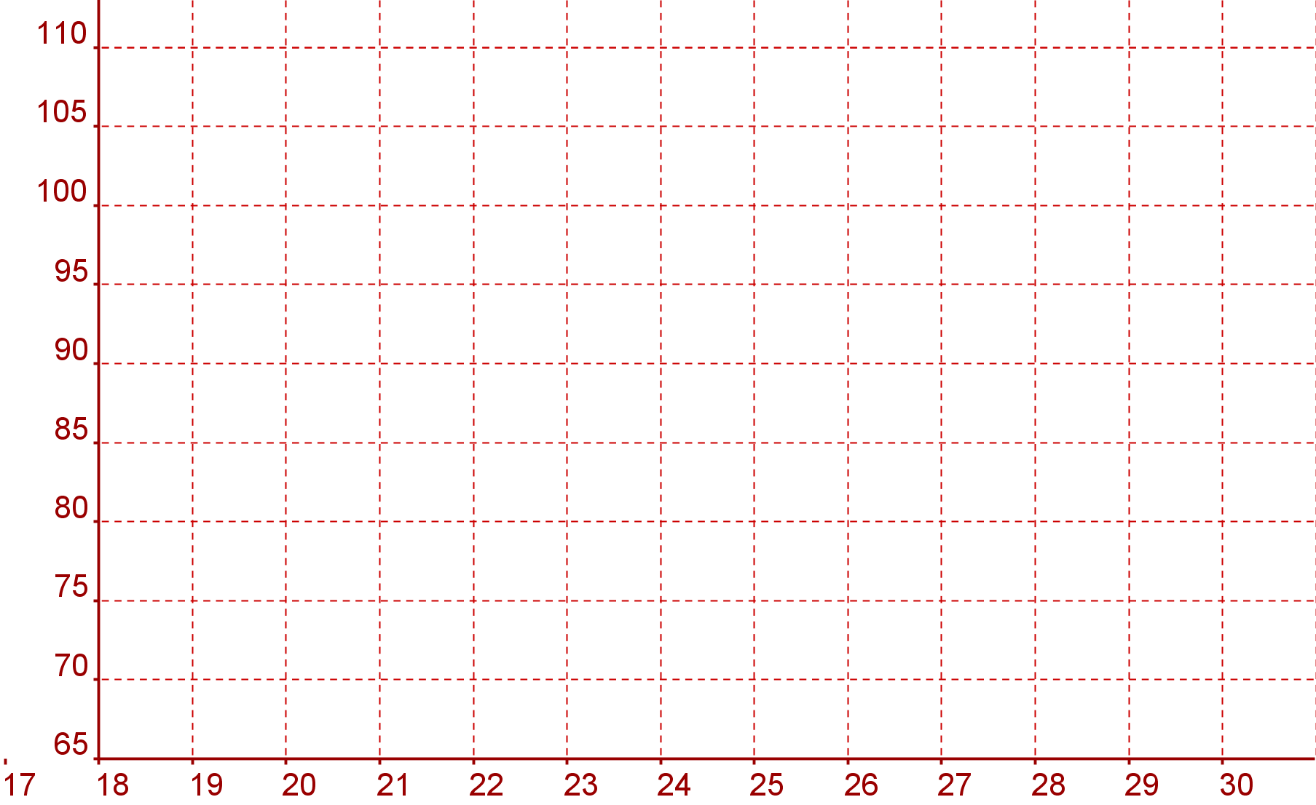
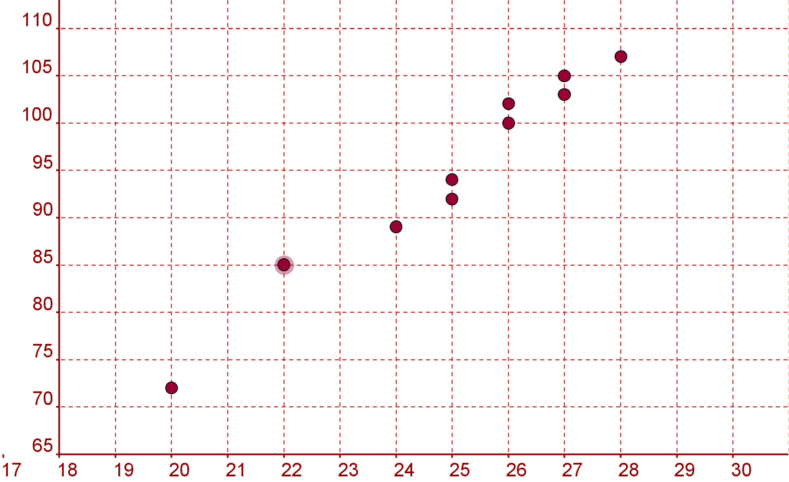
Student Activity 3A
Interpreting the data and the Correlation Coefficient
An ice cream seller records the maximum daily temperature and the number of ice creams she sells each day. Her results for a period of ten days are shown in the table.
Lesson interaction
Display the data in a way that allows you to examine the relationship
between the two variables.

Slide 22
The correlation coefficient here is 0.98. With this in mind and looking at the
Scatter plot which of the following statements is correct. Give a reason for
your answer.
A. As the temperature increases ice cream sales increase.
B. As the temperature increases ice cream sales tend to increase.
C. There is no evidence of a linear relationship between temperature and ice
cream sales.
D. As the temperature increases ice cream sales decrease.
E. As the temperature increases ice cream sales tend to decrease.
Choice:____________________________________________________________
Reason for your answer: _____________________________________________
__________________________________________________________________
If the correlation coefficient had been 0.4 which of the above statements would be correct.
Choice:____________________________________________________________
Lesson interaction

Slide 23
A. As the temperature increases ice cream sales increase.
B. As the temperature increases ice cream sales tend to increase.
C. There is no evidence of a linear relationship between temperature and ice cream sales.
D. As the temperature increases ice cream sales decrease.
E. As the temperature increases ice cream sales tend to decrease.
Lesson interaction
(iii) If the correlation coefficient had been 0.4 which of the above statements would be correct.
Choice:________________________________________________________
(iv) If the correlation coefficient had been -0.7 which of the above statements would be correct?
Choice: ________________________________________________________
(v) Identify two statements that are always incorrect no matter what the value of the correlation coefficient is. Give a reason for your answer.
Choices:_________________________________________________________
Reason for you’re answer: __________________________________________
_______________________________________________________________

Slide 24
Student Activity 3B
Interpreting the data and the Correlation Coefficient
Here are the results of some other research with their correlation coefficients:
Pick the appropriate statement for each survey and give a reason for your answer.
1. In a survey the correlation coefficient between engine size and fuel economy was found to be -0.9.
A. As the engine size increases fuel efficiency increases.
B. As the engine size increases fuel efficiency tends to increase.
C. There is no evidence of a linear relationship between engine size and fuel efficiency.
D. As the engine size increases fuel efficiency decreases.
E. As the engine size increases fuel efficiency tends to decrease.
Choices: _______________________________________________________
Reason for your answer: ___________________________________________
_______________________________________________________________
2. In a survey the correlation between the numbers of hours per week students spent studying and their performance in an exam was 0.7.
Lesson interaction

Slide 25
2. In a survey the correlation between the numbers of hours per week students spent studying and their performance in an exam was 0.7.
A. As the number of hours spent studying increases student exam performance increases.
B. As the number of hours spent studying increases student exam performance tends to increase.
C. There is no evidence of a linear relationship between the number of hours spent studying and student exam performance.
D. As the number of hours spent studying increases student exam performance decreases.
E. As the number of hours spent studying increases student exam performance tends to decrease.
Choices: ______________________________________________________
Reason for your answer: _________________________________________
_____________________________________________________________
Lesson interaction

Slide 26
Student Activity 3C
Interpreting the data and
the Correlation Coefficient
Here are the results of some other research with their correlation coefficients:
In a survey the correlation between the heights of male students and their shoe sizes was -0.01.
(ii) In the 1960’s the U.S. army undertook research into the relationship
between a man’s height and the chances of him receiving a promotion. The results showed that the correlation between a man’s height and his chance of promotion was 0.8. Pretend you are a journalist, write a sentence based on the value of the correlation coefficients in (i) and (ii) above.
________________________________________________________________________________________________________________________________________________________________________________________________________________________________________________________________

Slide 27
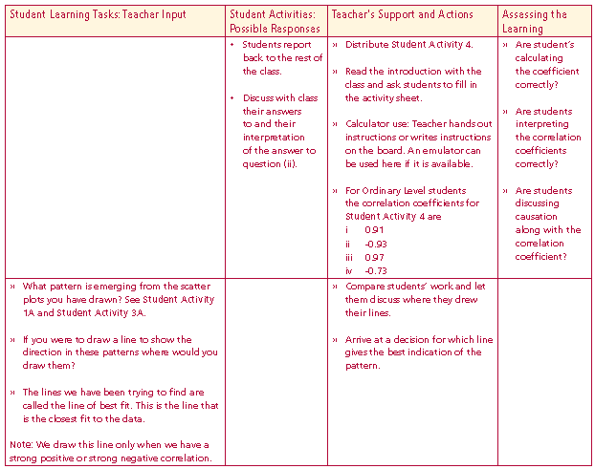
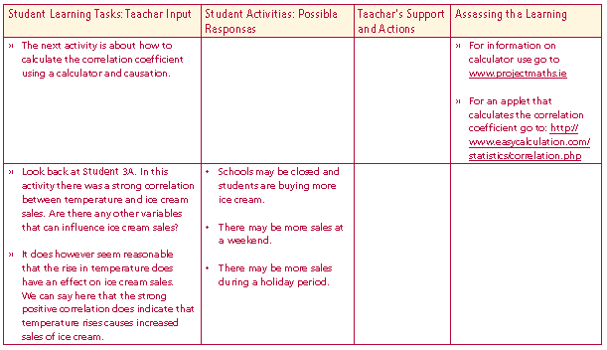
Student Activity 4
Calculating the Correlation Coefficient (HL)
and Causation (OL)
For each of the following sets of data calculate the correlation coefficient and write a conclusion.
Note: In some of the surveys below there are strong correlations but this does not always imply causation. In some cases there may be a lurking variable that can explain the strong correlation. For example in the last 10 years there is a strong positive correlation between the sales of cars and the sales of electrical items. Can we say a rise in the sale of cars tends to lead to a rise in the sale of electrical items? No we cannot. The lurking variable here is the performance of the economy as a whole. Correlation does not always imply causation.
Lesson interaction
Lesson interaction

Slide 28
Look back at Student 3A. In this activity there was a strong correlation between temperature and ice cream sales. Are there any other variables that can influence ice cream sales?
It does however seem reasonable that the rise in temperature does have an effect on ice cream sales. We can say here that the strong positive correlation does indicate that temperature rises causes increased sales of ice cream.

Slide 29


Using your calculator calculate the correlation coefficient and write a conclusion.
(i) Roller coasters get their speed as a result of dropping down a steep incline. The table below gives height of a drop and the speed achieved for different roller coasters around the world.
Correlation coefficient: ____________________________________________
Conclusion:____________________________________________________________________________________________________________________
(ii) The table shows the number of units of electricity used in heating a house on ten different days and the average temperature for each day.
Correlation Coefficient: ___________________________________________
Conclusion:____________________________________________________________________________________________________________________

Slide 30


(iii) The table shows the number washing machines sold on 8 different months in an electrical supply shop and the number of dishwashers sold for each of those months.
Correlation Coefficient: ___________________________________________
Conclusion:___________________________________________________________________________________________________________________
(iv) The table shows the average number of hours spent daily by students watching television and the average mark they achieved in their summer exams.
Correlation Coefficient: ___________________________________________
Conclusion:___________________________________________________________________________________________________________________

Slide 31
Student Activity 5: Introduction
If you were to draw a line to show the direction in these patterns where would you draw them?
The lines we have been trying to find are called the line of best fit. This is the line that is the closest fit to the data.
Note: We draw this line only when we have a strong positive or strong negative correlation.

Slide 32
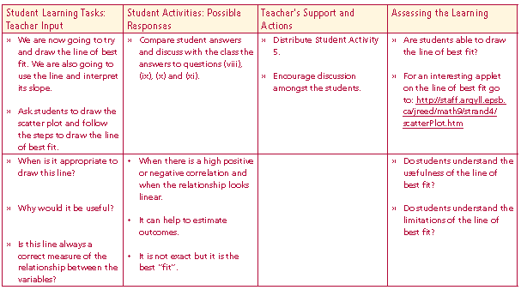

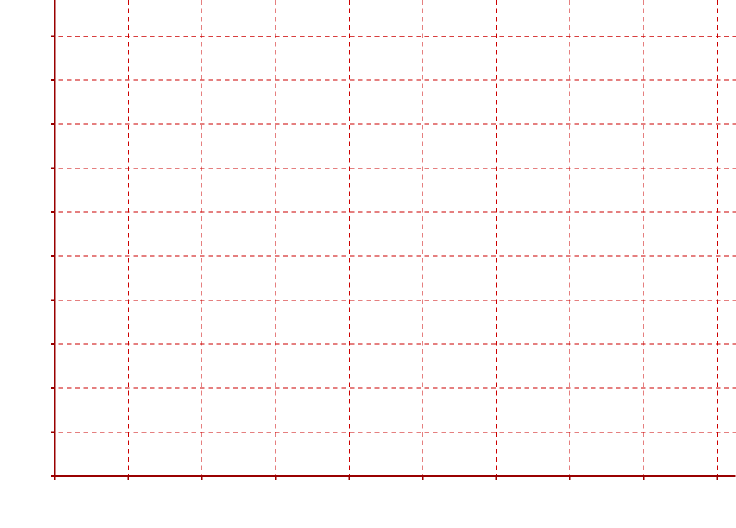
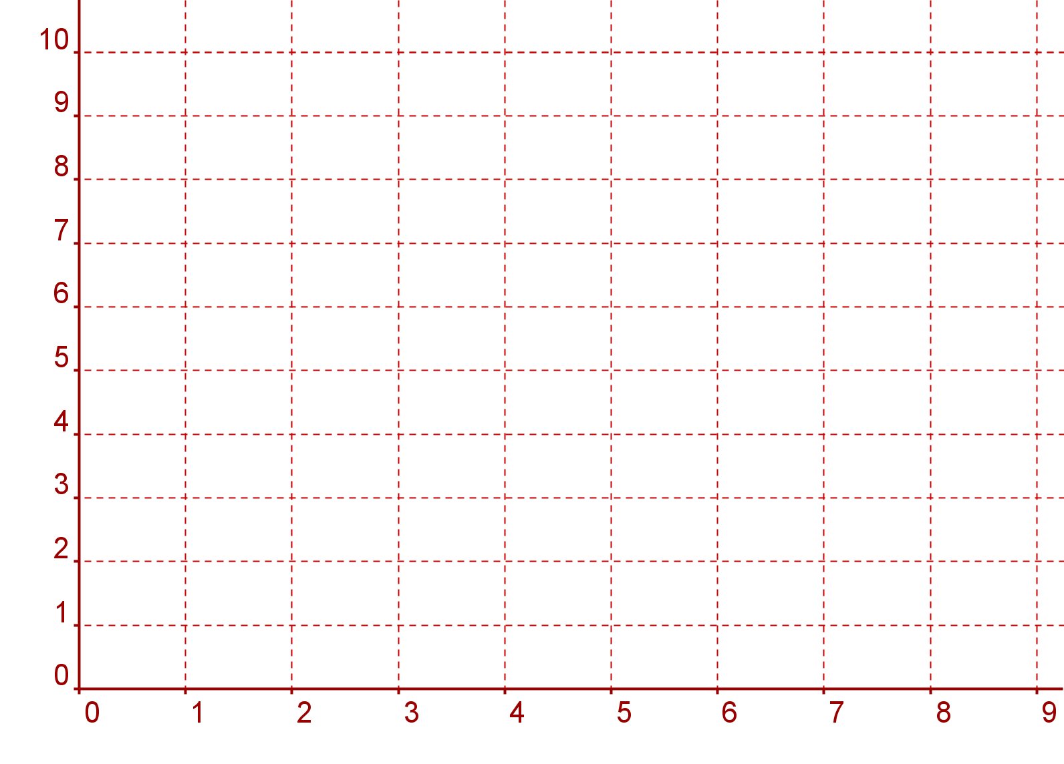
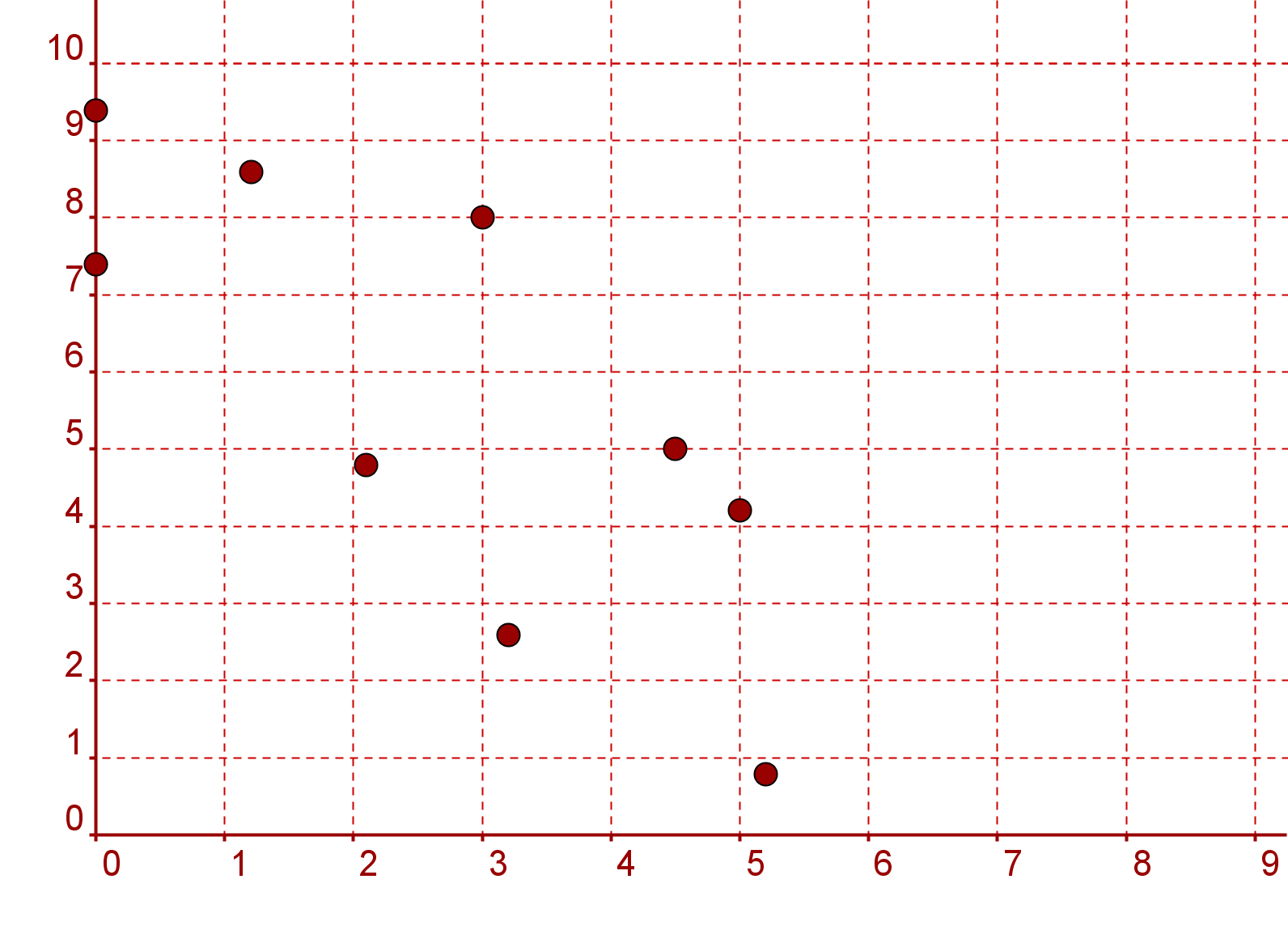
Student Activity 5
Line of Best Fit (HL only)
The following table shows the weekly rainfall (x cm) and the number of tourists
(y thousand) visiting a certain beauty spot, for 9 successive weeks.
Lesson interaction
(i) Draw a scatter plot for this data.

Slide 33
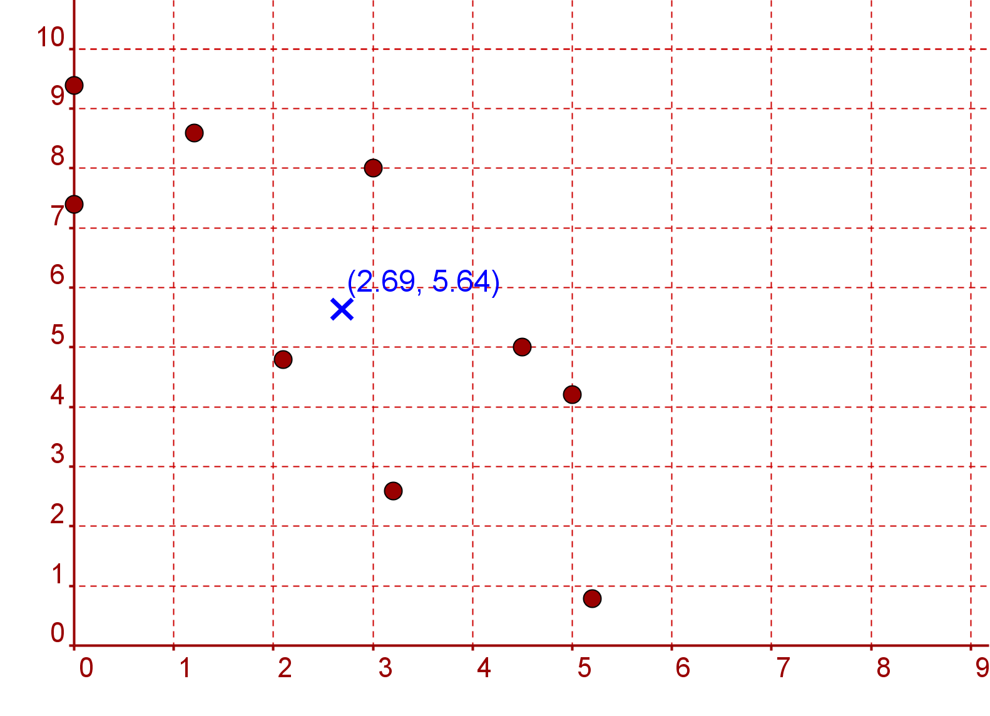
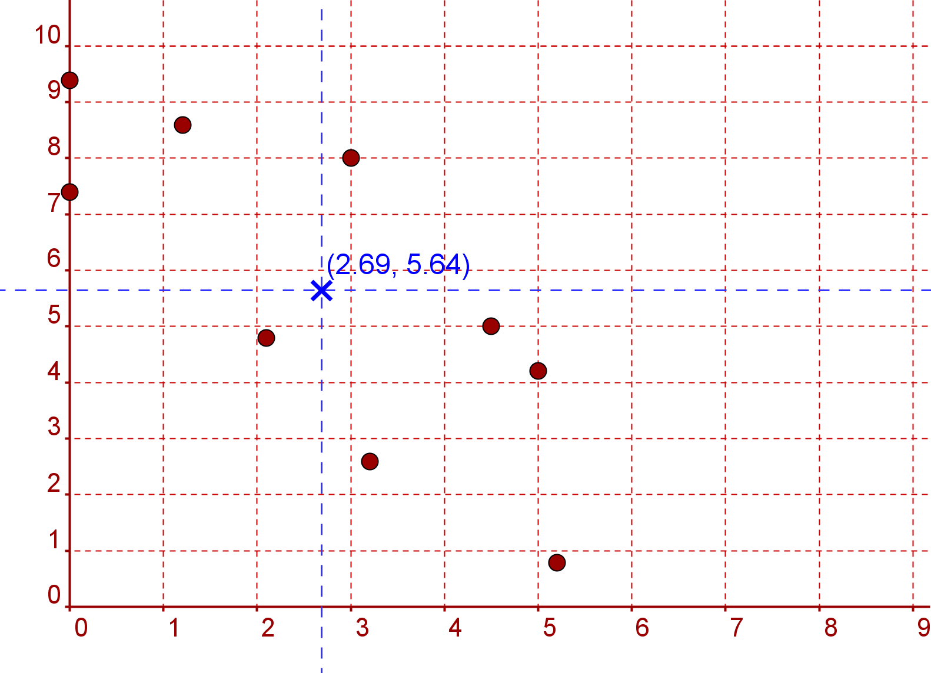

(ii) Find the mean rainfall $\overline{x }$._________________________________________
(iii) Find the mean number of tourists $\overline{y}$. ________________________________
(iv) Plot the point $\left(\overline{x},\overline{y}\right)$. Draw lines parallel to the x-axis and y-axis through this point.
(v) This splits the scatter plot into 4 quadrants. In which quadrants do you find the most points?________________________________________________
__________________________________________________________________
__________________________________________________________________

Slide 34
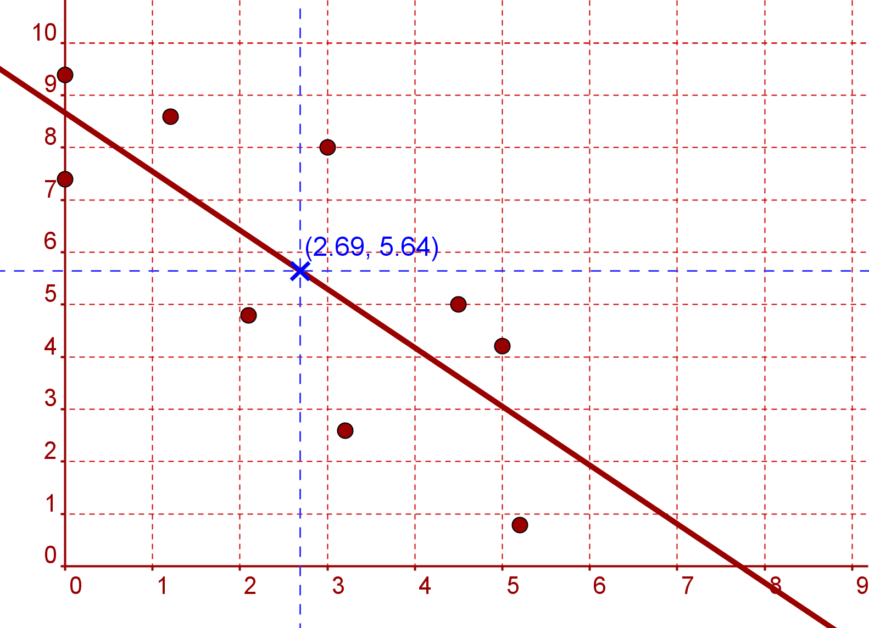
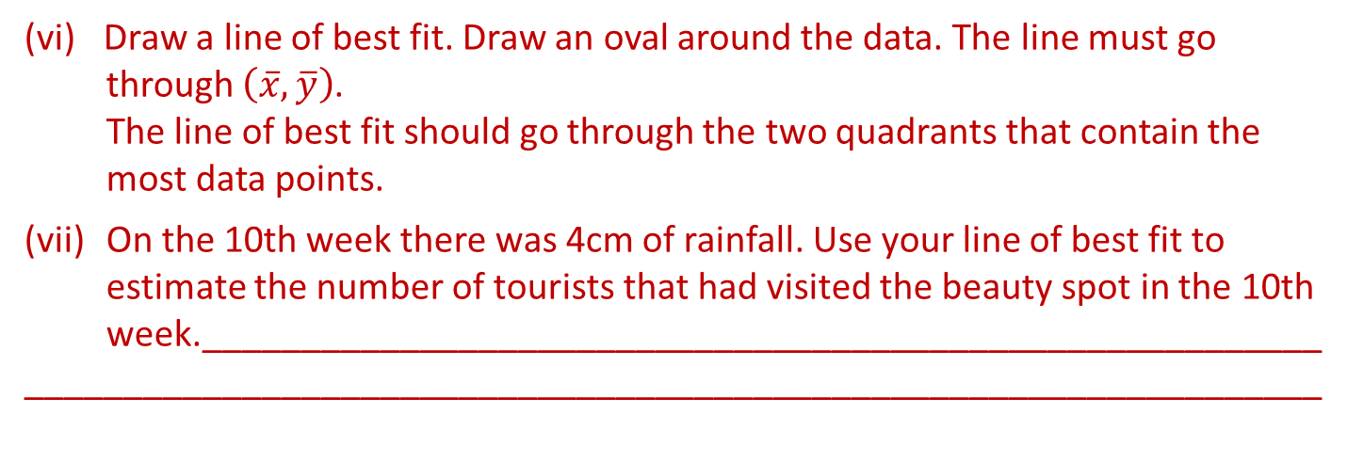
Draw a line of best fit. Draw an oval around the data. The line must go through $\left(\overline{x},\overline{y}\right)$.
The line of best fit should go through the two quadrants that contain the most data points.
(vii) On the 10th week there was 4cm of rainfall. Use your line of best fit to estimate the number of tourists that had visited the beauty spot in the 10th week._________________________________________________________
__________________________________________________________________

Slide 35
On the 10th week there was 4cm of rainfall. Use your line of best fit to estimate the number of tourists that had visited the beauty spot in the 10th week. ________________________________________________________
(viii) By picking appropriate points find the slope of the line of best fit.________
(ix) Interpret the slope in the context of rainfall and number of tourists._____
__________________________________________________________________________________________________________________________________

Slide 36
(x) Find the equation of the line of best fit and use it to check your answer to part vii. __________________________________________________________
(xi) The manager of the café at this beauty spot has to plan staffing levels. A mix of full time and part time staff are employed. In the light of the information above and the fact that the correlation coefficient is -0.77 what advice would you give the manager? ______________________________________________
__________________________________________________________________________________________________________________________________

Slide 37
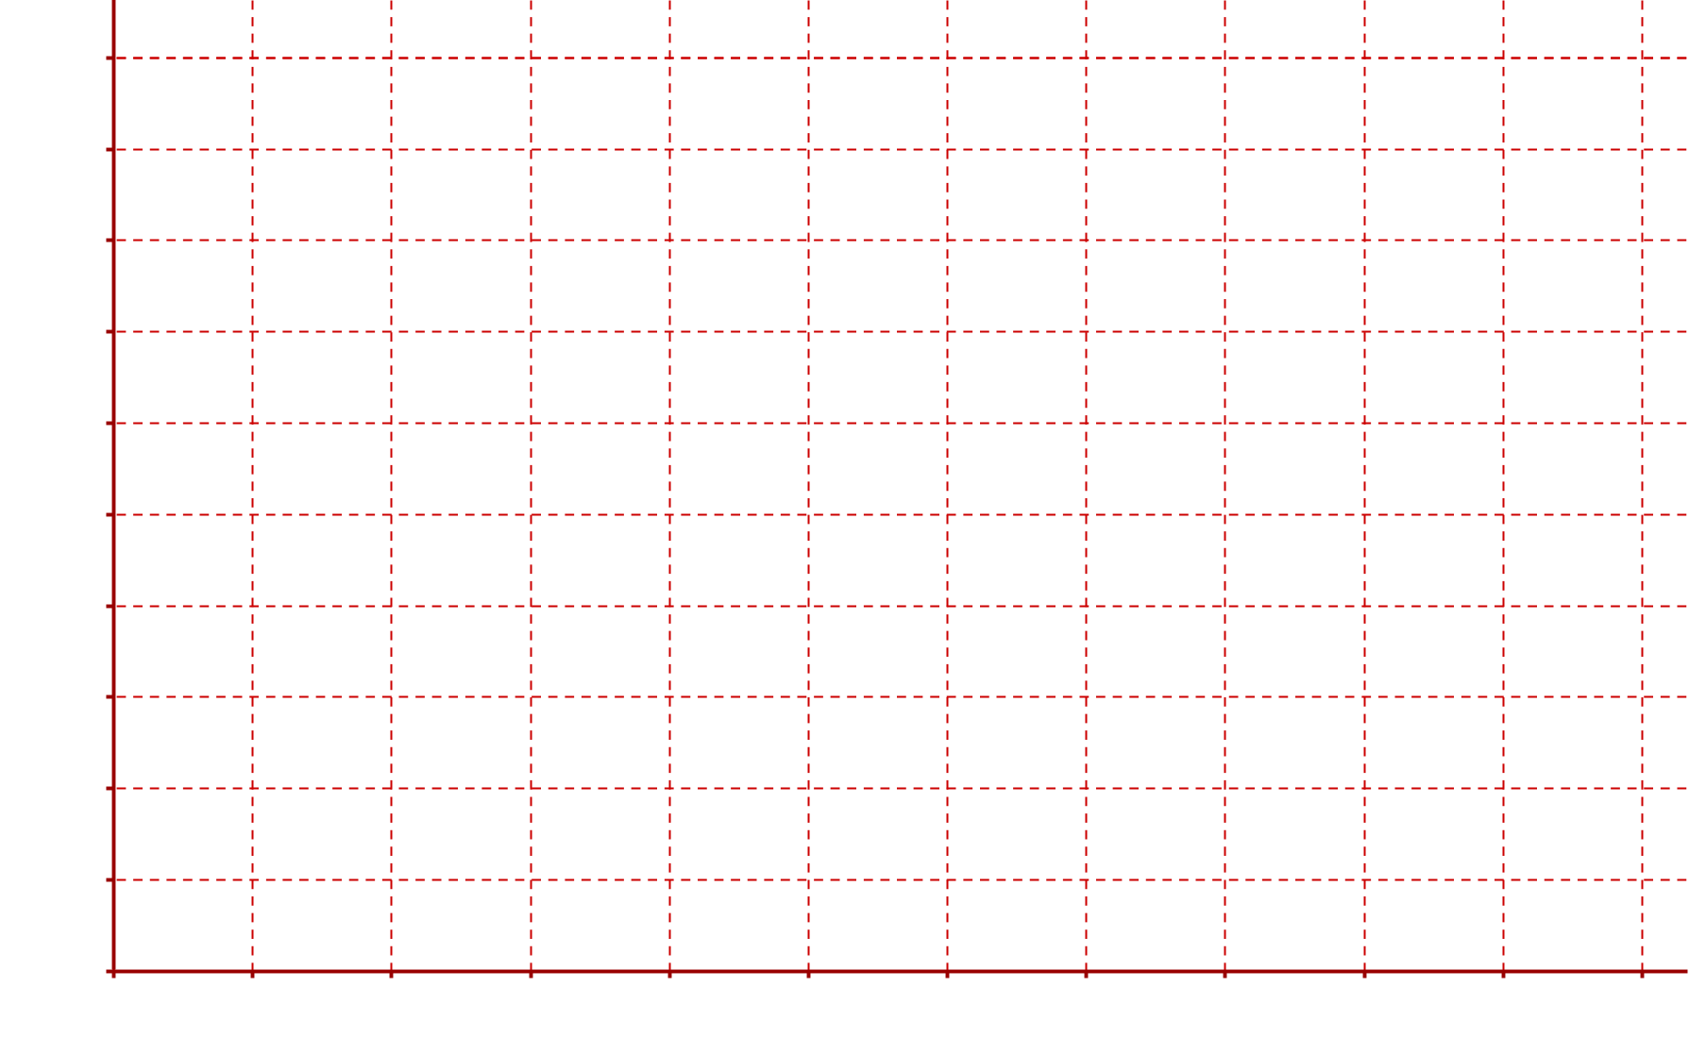
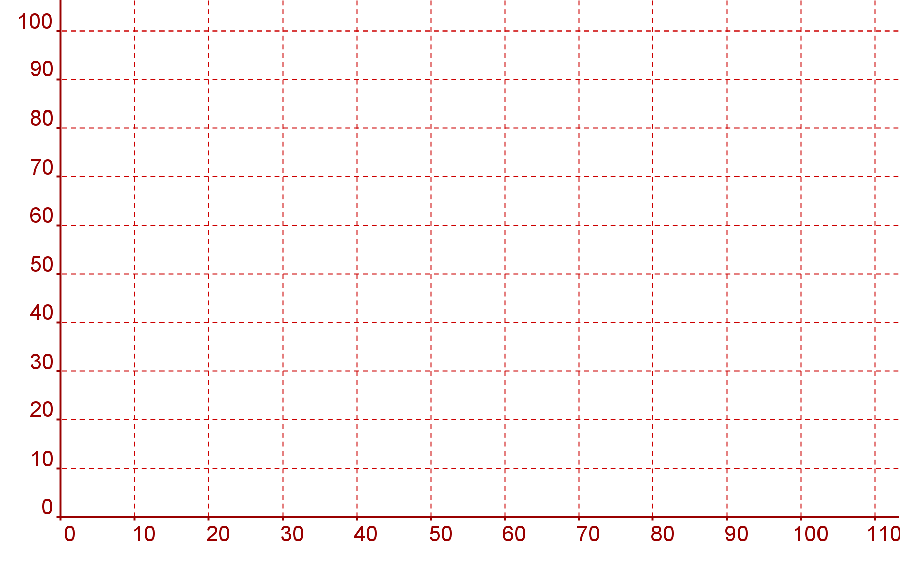
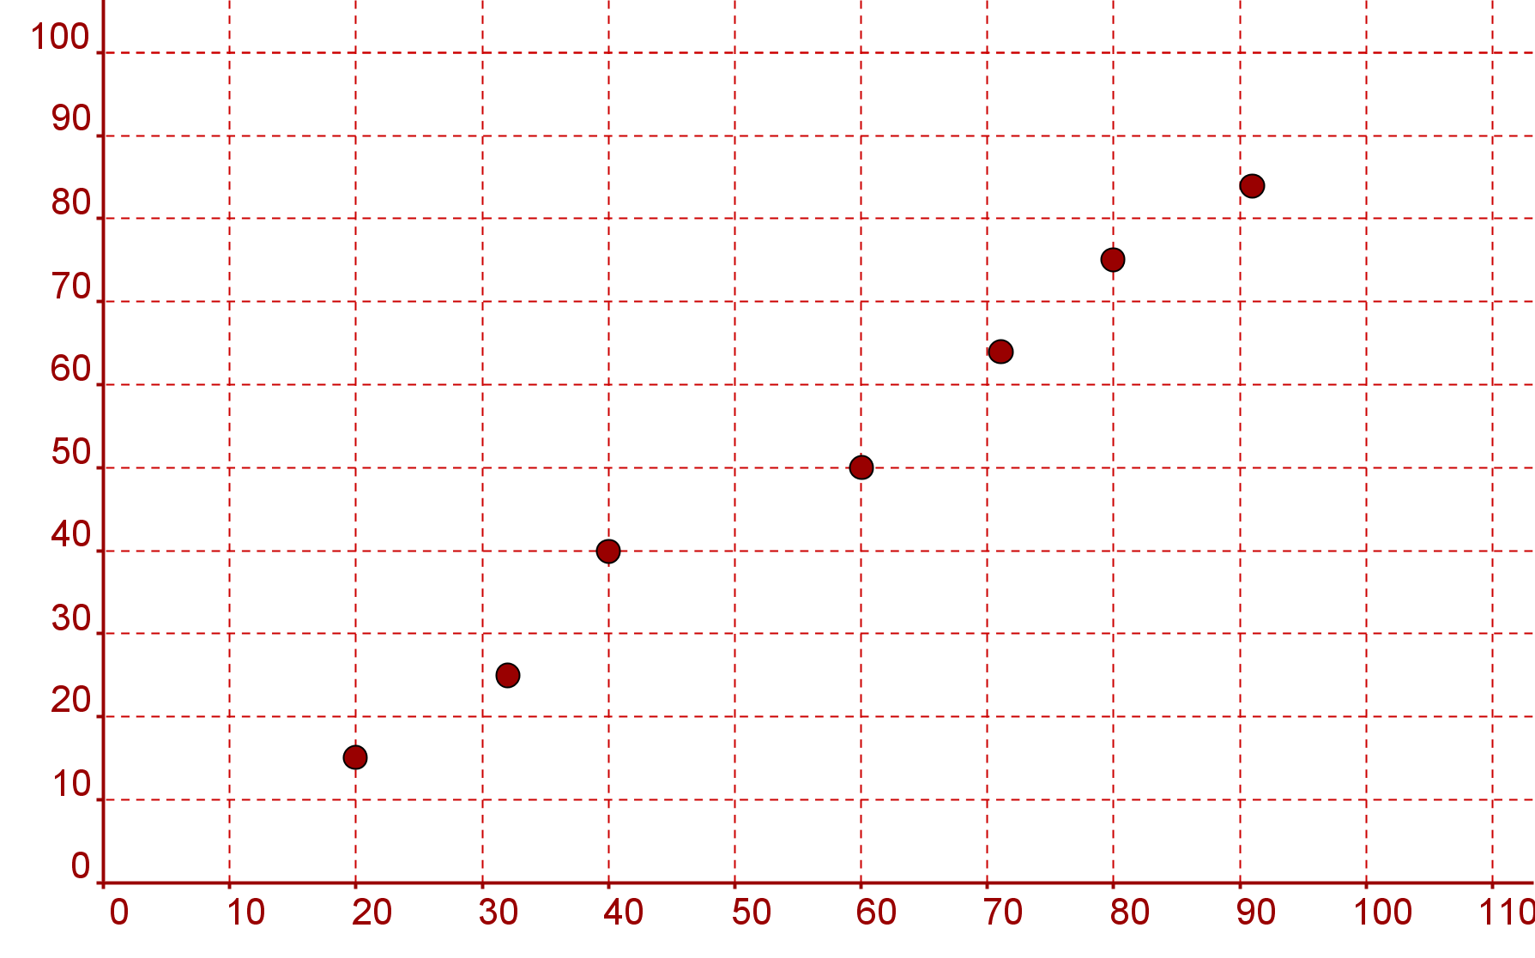
Extra Questions
1. The marks of 7 pupils in two Maths papers are as follows :
a) Plot the marks on a scatter graph.
(Paper 1 marks on the horizontal axis and Paper 2 marks on the vertical axis)
b) Is there any correlation between the marks on Paper 1
and Paper 2 ?

Slide 38
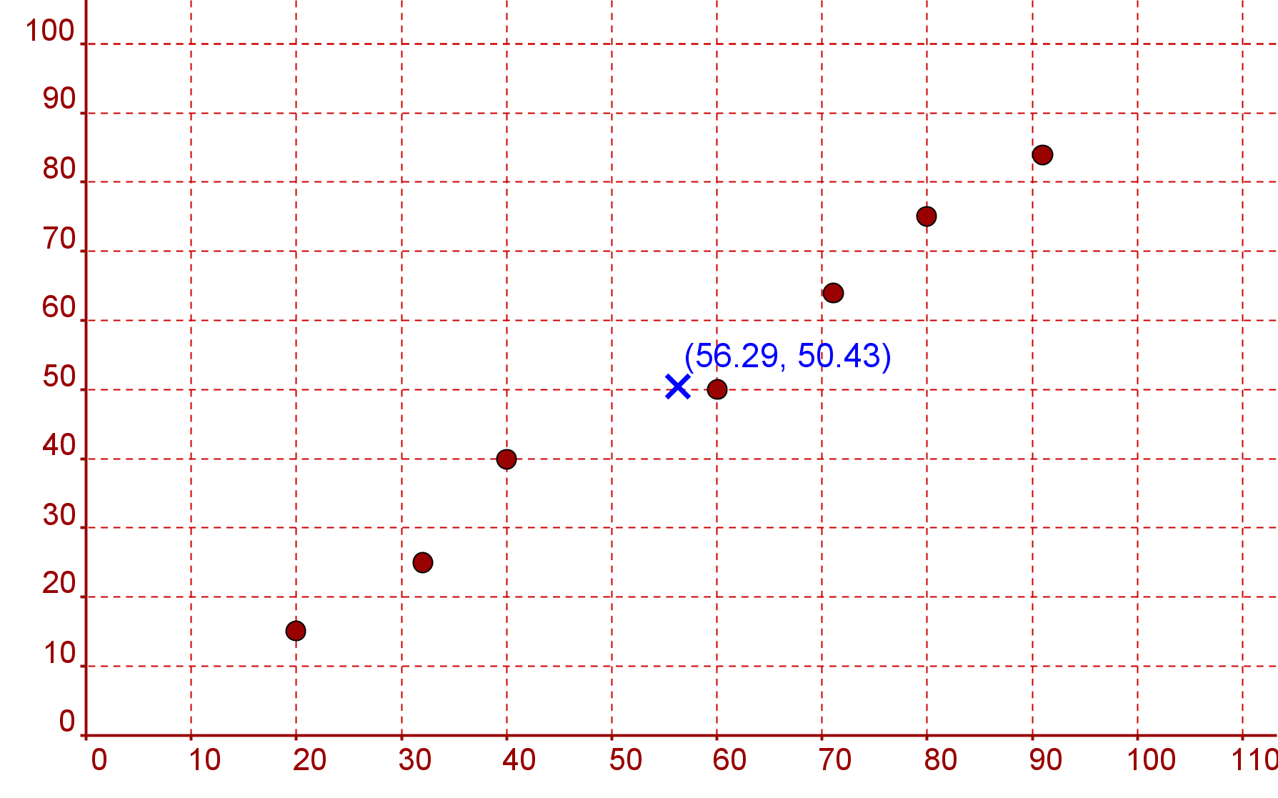
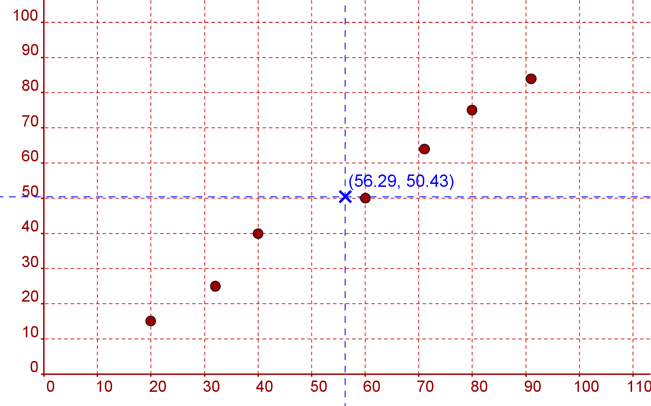
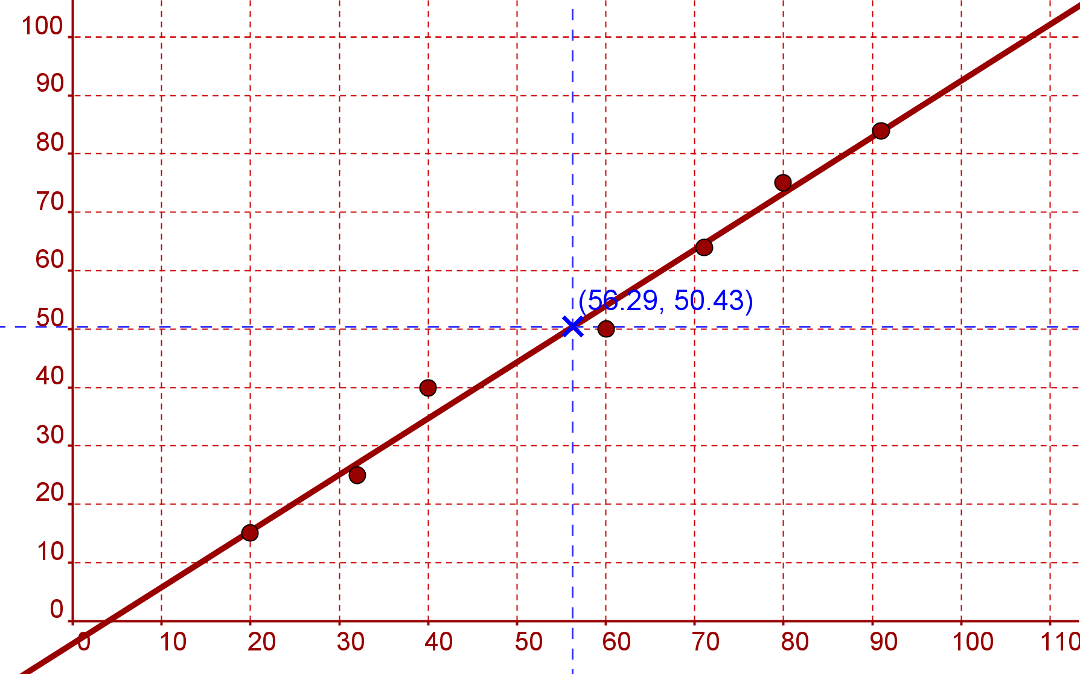
Extra Questions
Questions
  Use your calculator to find the Correlation coefficient
d) Find the equation of the Line of Best Fit for the data
e) Eve achieves a score of 6 on Test A. Use the line of best fit
to give an estimate of her score on Test B

Slide 39
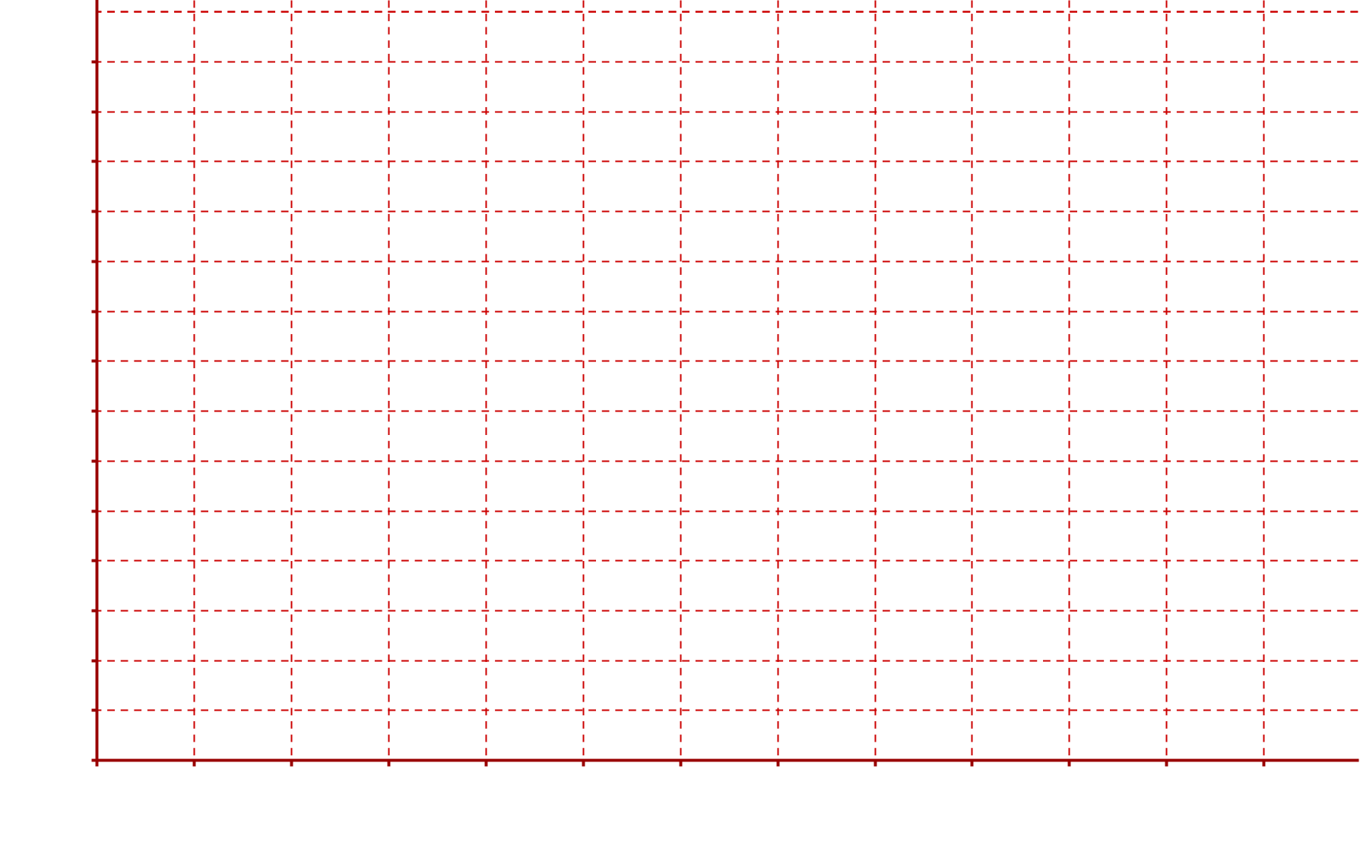
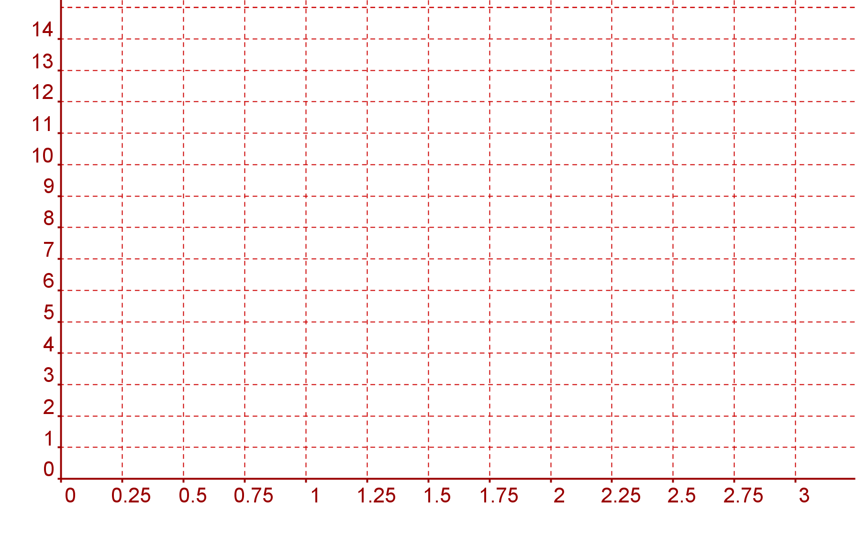
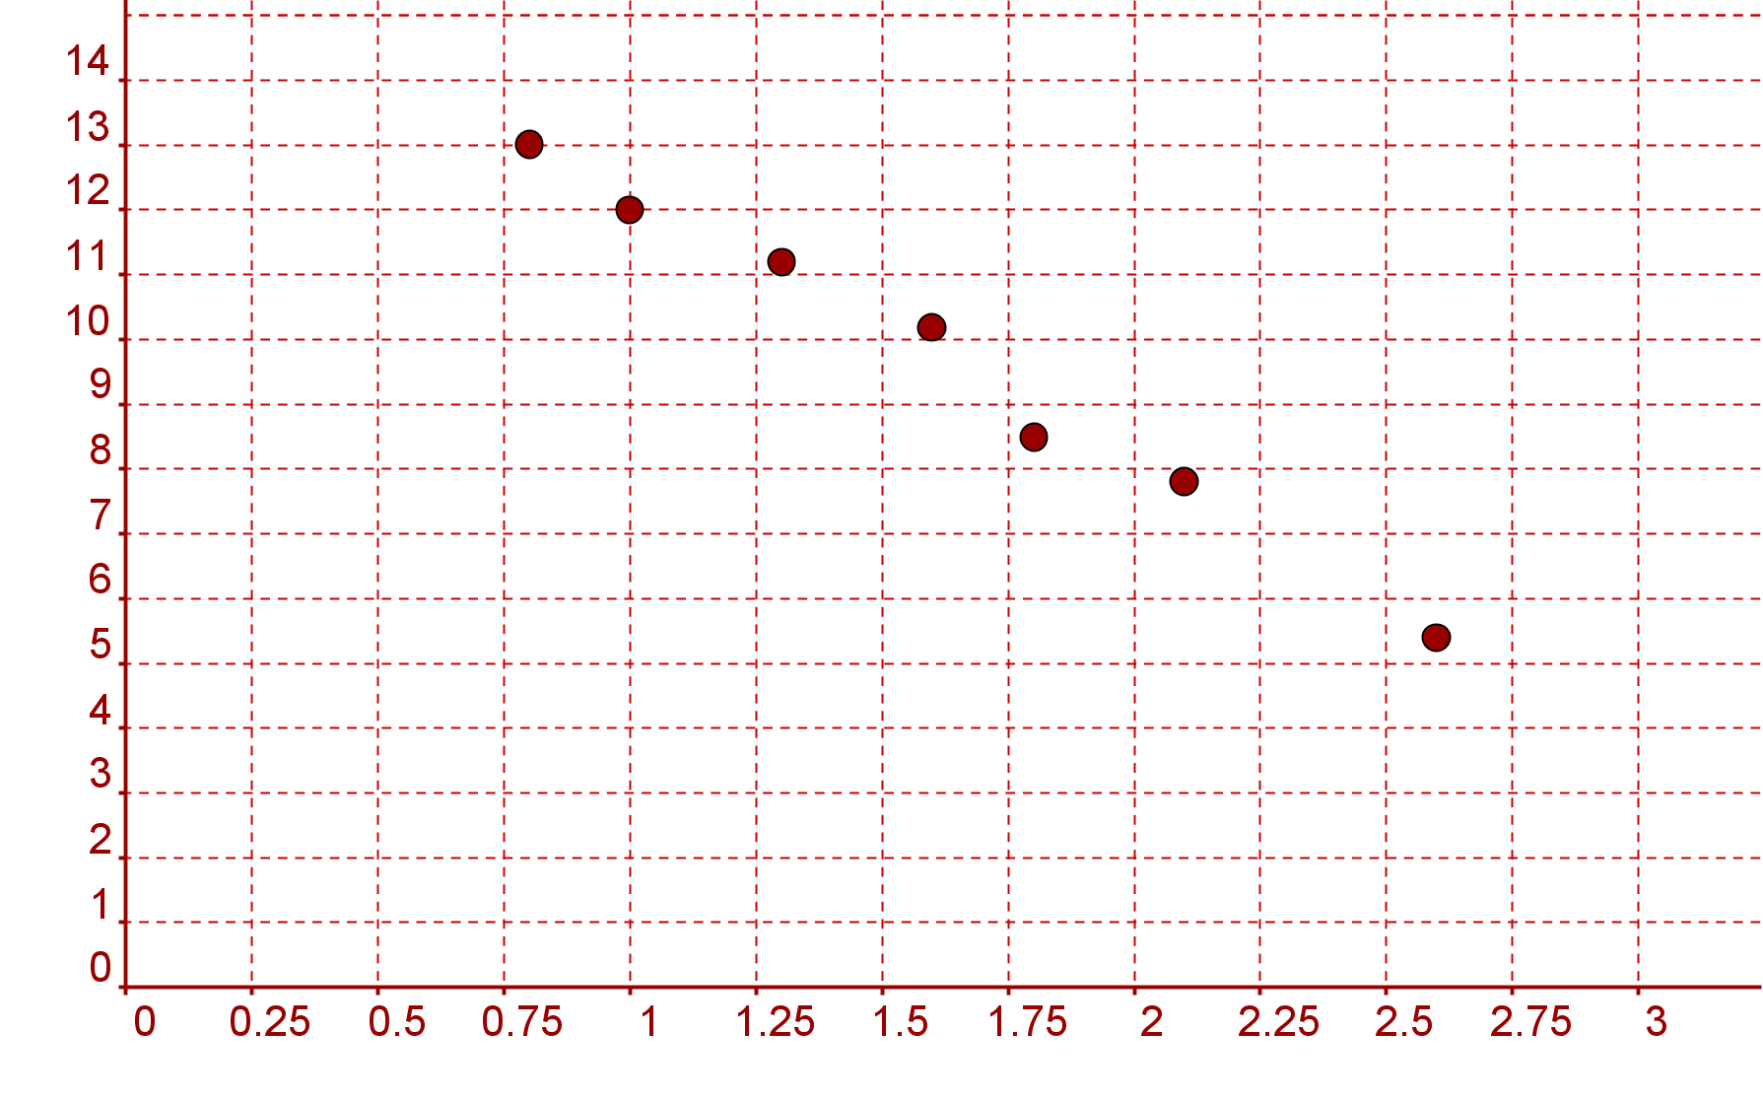
Extra Questions
Top Gear are doing a review of cars. The table below shows the engine size of a car in litres and the distance it travelled in km on one litre of petrol.
Top Gear want to know if there is any correlation between engine size
and distance travelled.
Plot the marks on a scatter graph.
Is there any correlation between the Engine Size and Distance

Slide 40
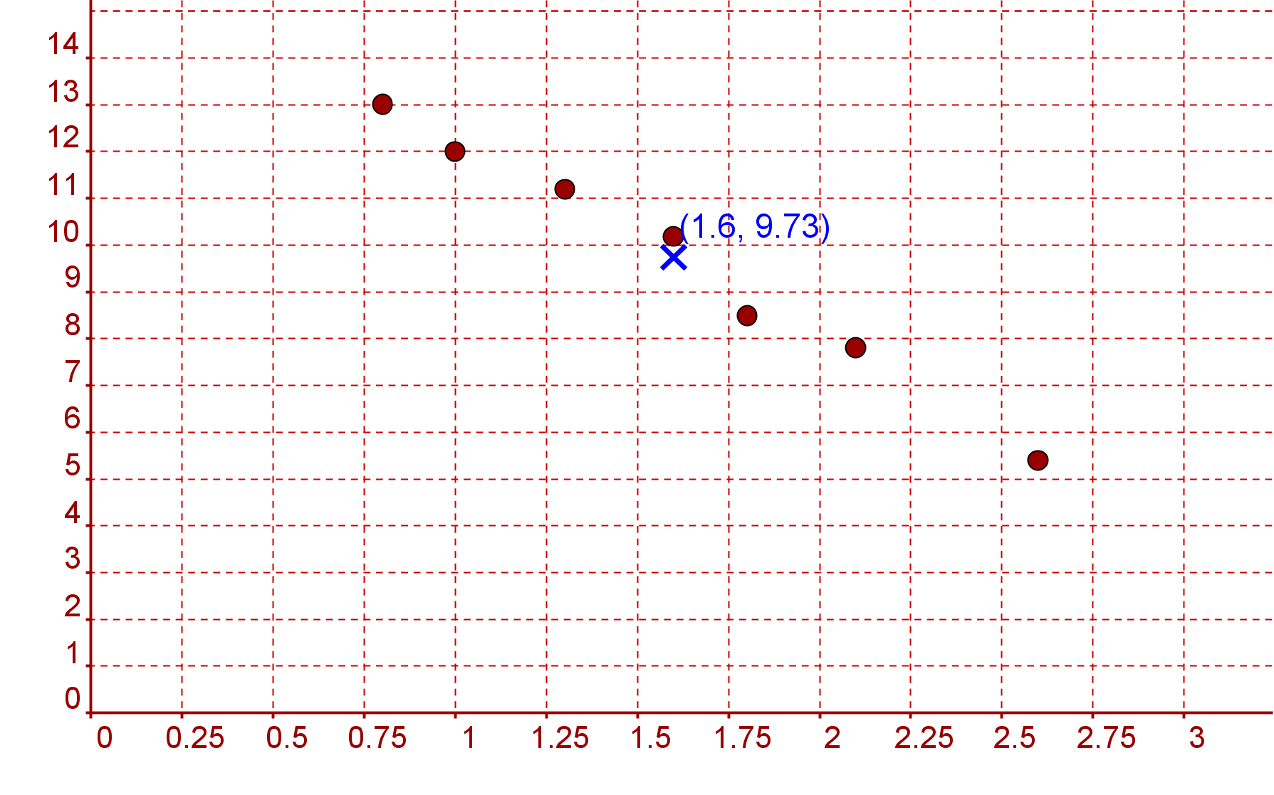
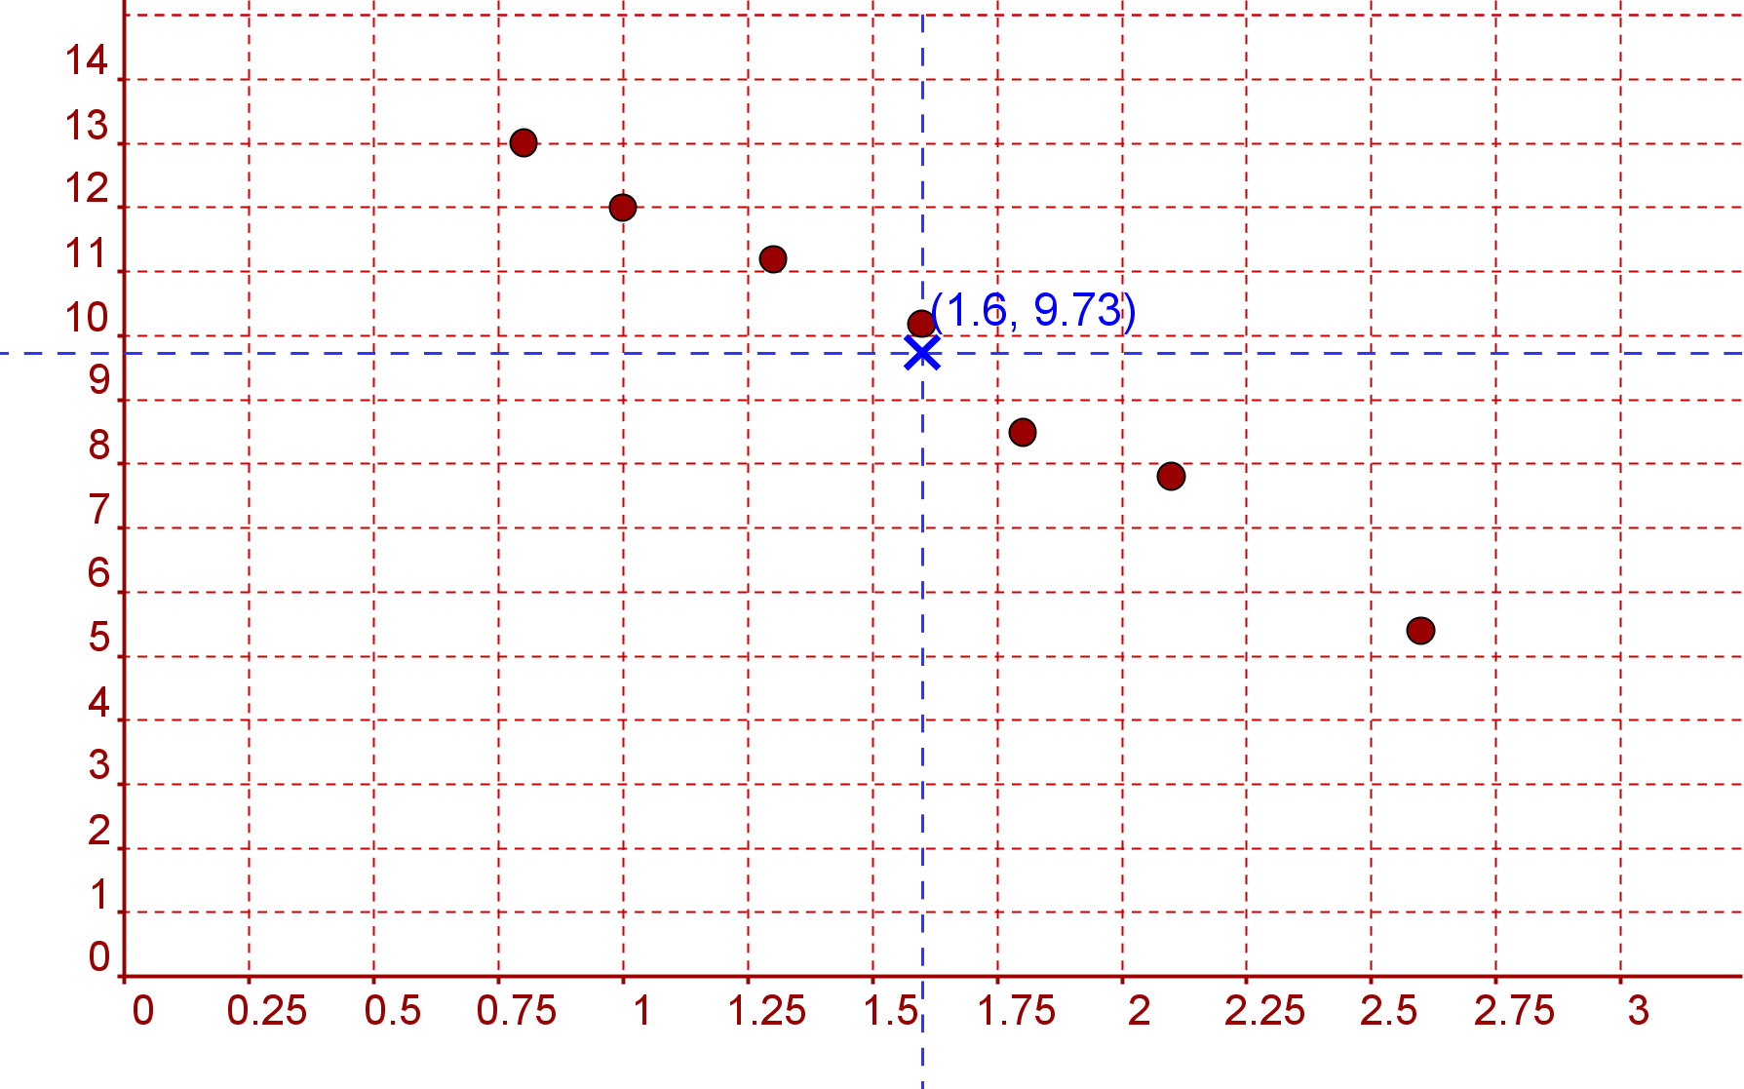

Extra Questions
2.
  Use your calculator to find the Correlation coefficient
Find the equation of the Line of Best Fit for the data
A car has a 2.3 litre engine. How far would you expect
it to go on one litre of petrol ?

Slide 41

Student Activity 6: Introduction
Sometimes when we do a scatter plot we can come across a result that is out of step with the rest of the data. Just because the piece of data does not “fit” this does not mean it is wrong. Data like this are called outliers and can have a major effect on the correlation coefficient and the line of best fit.
Lesson interaction

Slide 42


Student Activity 6
Outliers (HL Only)
A Company surveyed 12 of its employees. Below is a table of their year’s experience with the company and their income
Lesson interaction
(i) Draw a scatter plot of the data.

Slide 43
Lesson interaction
(ii) Circle one or more outliers.
(iii) Calculate the correlation coefficient for all the data.________________
(iv) Remove the outlier and calculate the correlation coefficient. _________
What do you notice? _________________________________________
______________________________________________________________
Draw your line of best fit for all the data and draw the line of best fit
when the outlier is removed.
What effect, if any, does removing the outlier have on the line of best
fit?_______________________________________________________
______________________________________________________________
______________________________________________________________

Slide 44
Finding Correlation Coefficient
&
Line of Best Fit using Casio

Slide 45


We first need to make sure the calculator is CLeaR
of all previous content

Slide 46






We first need to make sure the calculator is CLeaR
of all previous content
3: All
Yes
Reset All

Slide 47


Statistical and Regression Calculations
Put the calculator into STAT mode

Slide 48









We have 2 variables so Select
Enter the Rainfall row first pressing
after each one.
Go to the top of the next column
Enter each frequency pressing
After each one
Once they have all been entered press

Slide 49


We now need to analyse the statistics we have input

Slide 50





1: Type 2: Data
change the type of data Edit the data
3: Sum 4: Var
1: How many terms
5: Regression 2(5): Mean of data
3(6): Population Standard
Deviation
For the Line of Best fit 4(7): Sample Standard
1: y intercept Deviation
2: Slope
3: Correlation Coefficient 6: Max Min
4: Estimated value of x for
a given value of y
5: Estimated value of y for
a given value of x Find Max/Min for each column
Once you have chosen your required output you need to press

Slide 51




We want to find the correlation coefficient
Which is part of regression
5
And we use the letter r

Slide 52




To find the Equation for the line of Best Fit
Y = A + B x
A
A= 8.66
B
B = -1.12
Line of Best Fit
y = 8.66 – 1.12x

Slide 53






Using the Equation of
the line of Best Fit
e.g. To find the value of y
when x is 9
Press 9
Then in regression
choose $\tilde{x}$ (4)
e.g. To find the value of x
when y is 3.2
Press 3.2
Then in regression
choose $\tilde{y}$ (4)

Slide 54
Finding Correlation Coefficient
&
Line of Best Fit using Sharp

Slide 55



Finding Correlation Coefficient
Find the Correlation Coefficient for the following data
We want to
M CLR
the calculator to
Clear its Memory
Rainfall (x cm) | 4.5 | 3.0 | 5.2 | 5.0 | 2.1 | 0 | 0 | 1.2 | 3.2
No. of tourists (1000’s | 5.0 | 8.0 | 0.8 | 4.2 | 4.8 | 7.4 | 9.4 | 8.6 | 2.6
Finding Correlation Coefficient

Slide 56



Rainfall (x cm) | 4.5 | 3.0 | 5.2 | 5.0 | 2.1 | 0 | 0 | 1.2 | 3.2
No. of tourists (1000’s | 5.0 | 8.0 | 0.8 | 4.2 | 4.8 | 7.4 | 9.4 | 8.6 | 2.6
We want to
M CLR
the calculator to
Clear its Memory
Finding Correlation Coefficient

Slide 57

Rainfall (x cm) | 4.5 | 3.0 | 5.2 | 5.0 | 2.1 | 0 | 0 | 1.2 | 3.2
No. of tourists (1000’s | 5.0 | 8.0 | 0.8 | 4.2 | 4.8 | 7.4 | 9.4 | 8.6 | 2.6
We want the calculator
in STATS mode
Finding Correlation Coefficient

Slide 58


Rainfall (x cm) | 4.5 | 3.0 | 5.2 | 5.0 | 2.1 | 0 | 0 | 1.2 | 3.2
No. of tourists (1000’s | 5.0 | 8.0 | 0.8 | 4.2 | 4.8 | 7.4 | 9.4 | 8.6 | 2.6
We want to find a LINE linking the points
Finding Correlation Coefficient

Slide 59
















Rainfall (x cm) | 4.5 | 3.0 | 5.2 | 5.0 | 2.1 | 0 | 0 | 1.2 | 3.2
No. of tourists (1000’s | 5.0 | 8.0 | 0.8 | 4.2 | 4.8 | 7.4 | 9.4 | 8.6 | 2.6
Repeat the process entering all the Data in the table
Enter each pair of points separated by a comma
Pressing
DATA
afterwards
Finding Correlation Coefficient

Slide 60



Rainfall (x cm) | 4.5 | 3.0 | 5.2 | 5.0 | 2.1 | 0 | 0 | 1.2 | 3.2
No. of tourists (1000’s | 5.0 | 8.0 | 0.8 | 4.2 | 4.8 | 7.4 | 9.4 | 8.6 | 2.6
We want the
Correlation
Coefficient
r
Its in Green so press ALPHA first
The
Correlation
Coefficient
= -0.775947983
Finding Correlation Coefficient

Slide 61


Rainfall (x cm) | 4.5 | 3.0 | 5.2 | 5.0 | 2.1 | 0 | 0 | 1.2 | 3.2
No. of tourists (1000’s | 5.0 | 8.0 | 0.8 | 4.2 | 4.8 | 7.4 | 9.4 | 8.6 | 2.6
Line of Best Fit
Y = a + bx
a
= 8.66
b
b = -1.12
Y = 8.66 – 1.12x
Finding Correlation Coefficient

