Slide 1
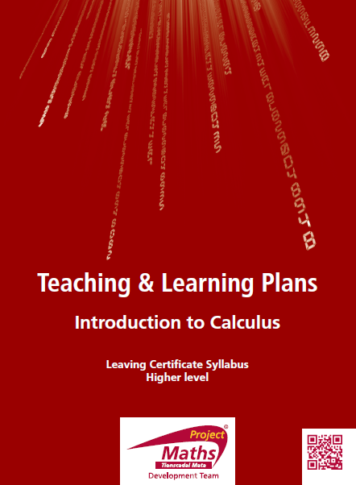

Slide 2
Index
Section A | Rates of Change
Student Activity 1: | Independent & Dependent variables
Student Activity 2: | Vocabulary to describe rates of change
Student Activity 3: | Graphing rates of change
Student Activity 4: | Train experiment on constant speed
Student Activity 5: | Usain Bolt
Student Activity 6: | Victoria Pendleton
Section B | Rules of Differentiation
Student Activity 1: | Linear Functions and their Slope Functions
Student Activity 2: | Linear Functions and their Slope Functions
Student Activity 3: | Quadratic Functions and their associated Slope Functions
Student Activity 4: | Cubic Functions and their associated Slope Functions
Student Activity 5: | Finding the slope function of a polynomial
Student Activity 6: | Co-polynomial functions and their associated Slope Functions
Student Activity 7: | Summary of how to find slope functions Tarsia

Slide 3
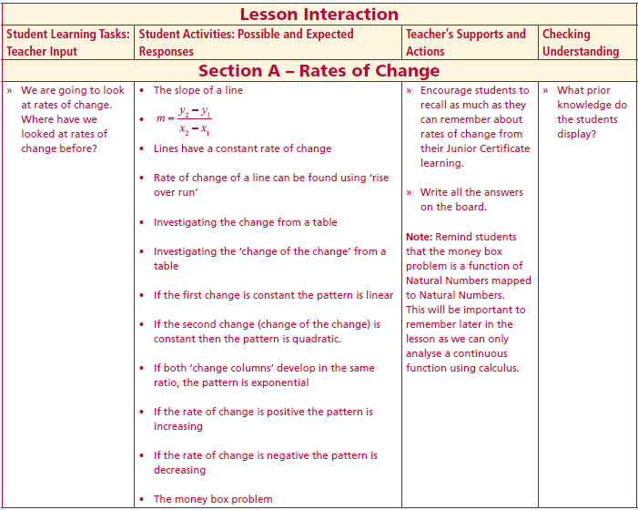
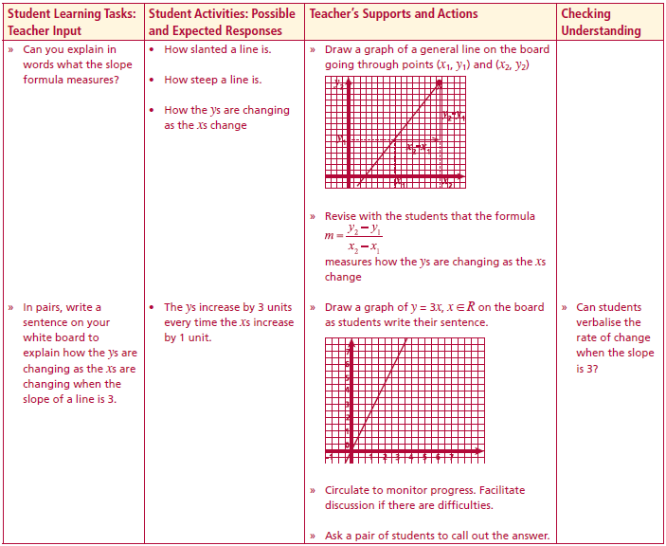
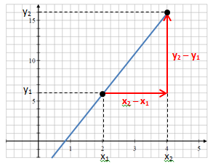
Section A – Rates of Change
We are going to look at rates of change. Where have we looked at rates of change before?
Can you explain in words what the slope formula measures?
In pairs, write a sentence on your white board to explain how the y’s are changing as the x’s are changing when the slope of a line is 3.
Lesson interaction
Lesson interaction

Slide 4
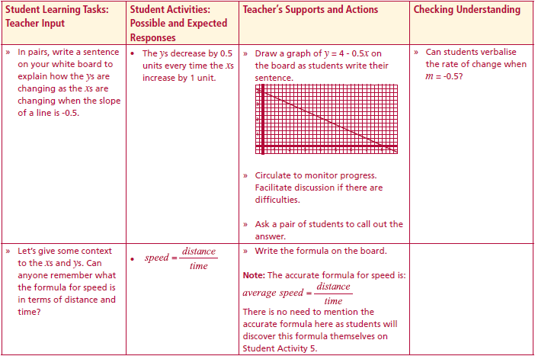
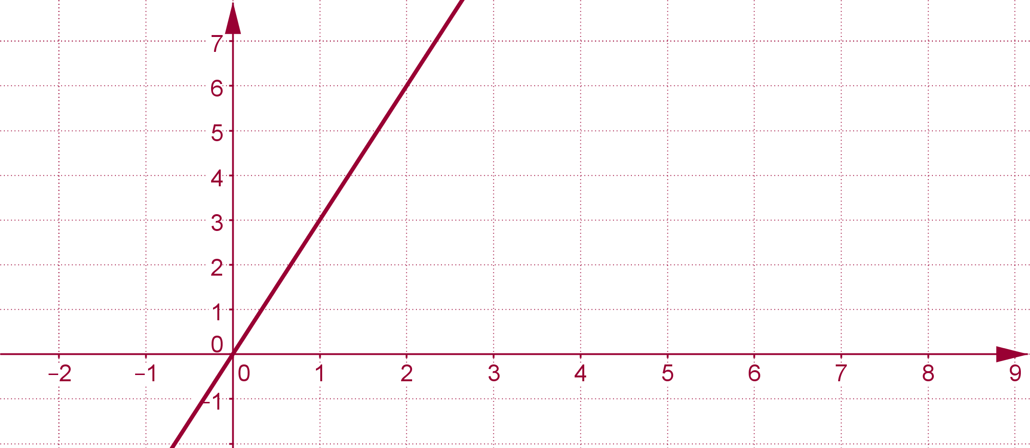
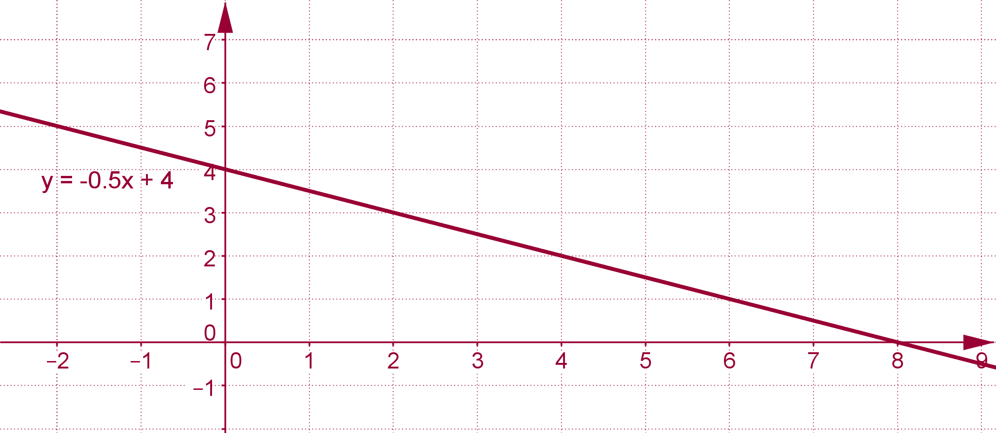
Section A – Rates of Change
In pairs, write a sentence on your white board to explain how the ys are changing as the xs are changing when the slope of a line is 3.
Lesson interaction
y=3x
Lesson interaction
In pairs, write a sentence on your white board to explain how the ys are changing as the xs are changing when the slope of a line is -0.5.

Slide 5
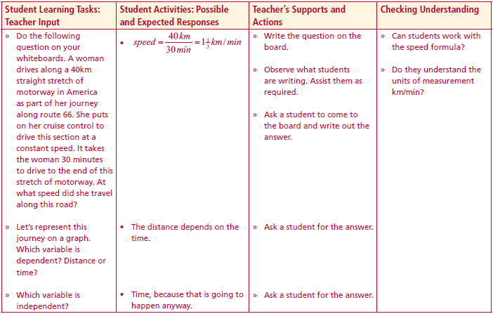
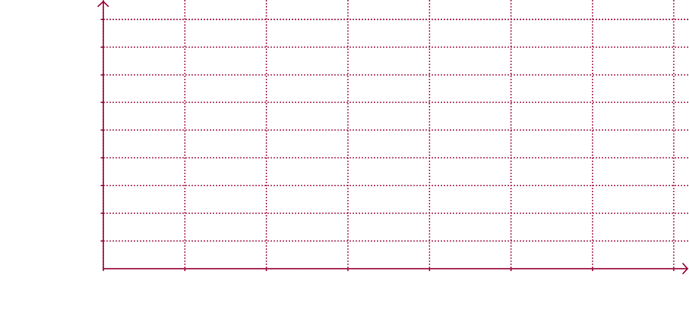
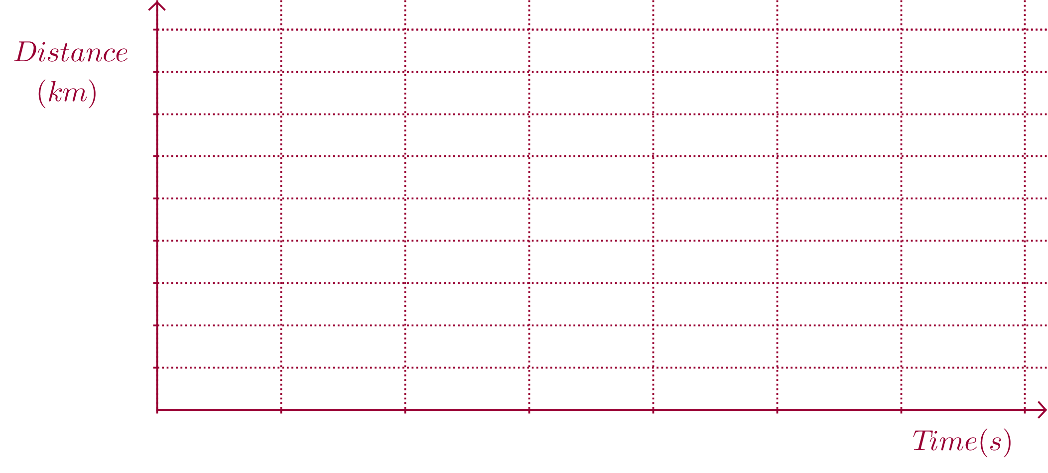
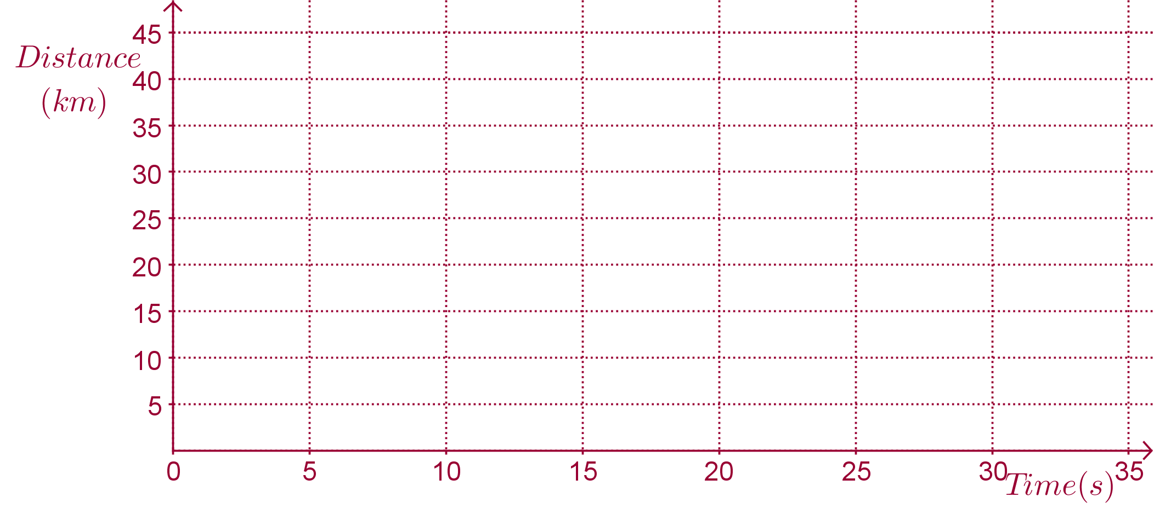
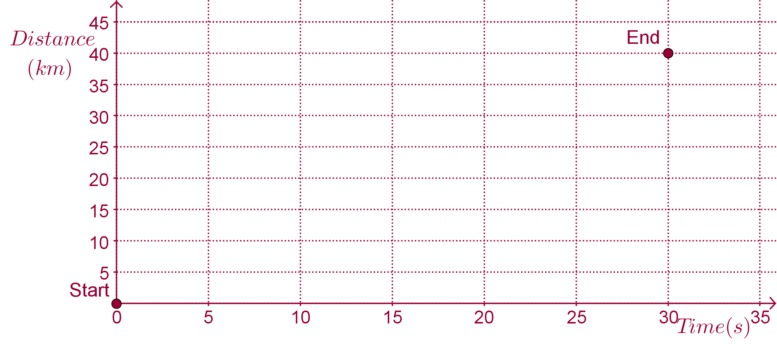
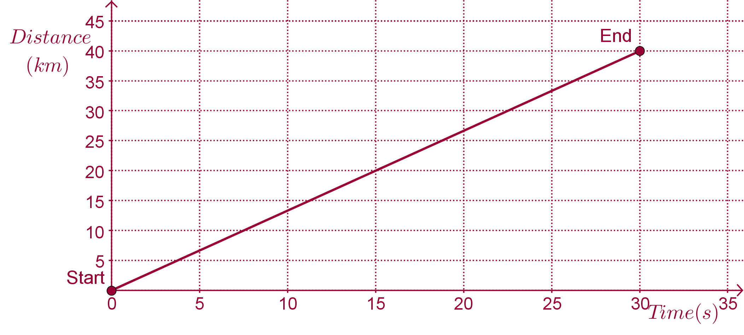

Section A – Rates of Change
Let’s give some context to the xs and ys. Can anyone remember what the formula for speed is in terms of distance and time?
$$speed=\frac{distance}{time}$$
Lesson interaction
A woman drives along a 40km straight stretch of motorway in America as part of her journey along route 66. She puts on her cruise control to drive this section at a constant speed. It takes the woman 30 minutes to drive to the end of this stretch of motorway. At what speed did she travel along this road?
Lesson interaction
Let’s represent this journey on a graph. Which variable is dependent? Distance or time?
Which variable is independent?
Which variable do we traditionally put on the x axis?

Slide 6
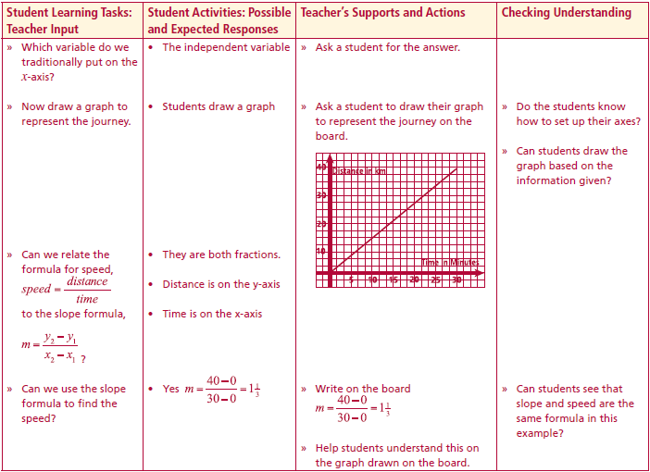
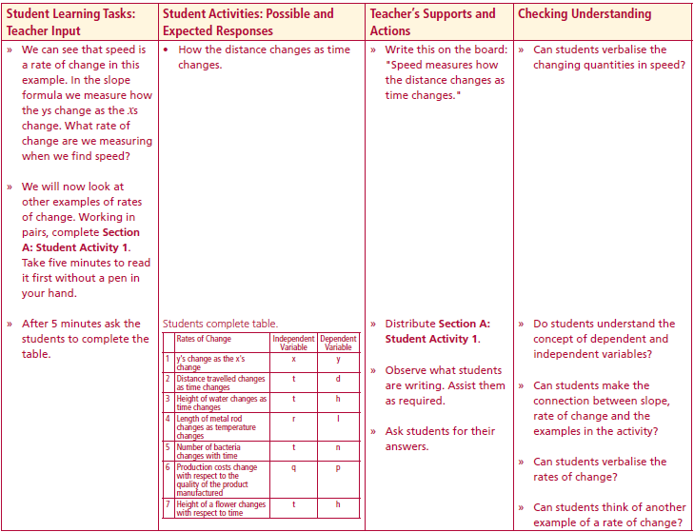

Section A – Rates of Change
Can we relate the formula for speed to the slope formula?
Can we use the slope formula to find the speed?
We can see that speed is a rate of change in this example. In the slope formula we measure how the ys change as the xs change. What rate of change are we measuring when we find speed?
$$speed=\frac{distance}{time}$$
Lesson interaction
Lesson interaction
We will now look at other examples of rates of change. Working in pairs, complete Section A: Student Activity 1.
Take five minutes to read it first without a pen in your hand

Slide 7
Section A: Student Activity 1
Read the following examples of rates of change.
The slope of a line measures the rate at which the ys change as the xs change.
The speed of a vehicle measures the rate at which the distance travelled changes as time changes.
We might be interested in the rate at which the height of water in a container (h) changes as time (t) changes.
An engineer might be interested in the rate at which the length of a metal rod (l) changes as temperature (r) changes.
A microbiologist might be interested in the rate at which the number of bacteria (n) on a piece of cheese changes with time (t).
An economist could be interested in the rate at which production costs (p) change with respect to the quantity of the product manufactured (q).
A gardener could be interested in the rate at which the height of a flower changes with respect to time.
Lesson interaction

Slide 8
Section A: Student Activity 1
The slope of a line measures the rate at which the ys change as the xs change.
The speed of a vehicle measures the rate at which the distance travelled changes as time changes.
We might be interested in the rate at which the height of water in a container (h) changes as time (t) changes.
An engineer might be interested in the rate at which the length of a metal rod (l) changes as temperature (r) changes.
Lesson interaction
From the above examples, fill in the following table.
 | Rates of change | Independent Variable | Dependent Variable
1 | ys change as the xs change | x | y
2 | distance travelled changes as time changes | t | d
3
4

Slide 9
Section A: Student Activity 1
A microbiologist might be interested in the rate at which the number of bacteria (n) on a piece of cheese changes with time (t).
An economist could be interested in the rate at which production costs (p) change with respect to the quantity of the product manufactured (q).
A gardener could be interested in the rate at which the height of a flower changes with respect to time.
Lesson interaction
From the above examples, fill in the following table.
 | Rates of change | Independent Variable | Dependent Variable
5
6
7
Can you think of another rate of change that we might be interested in?
8

Slide 10
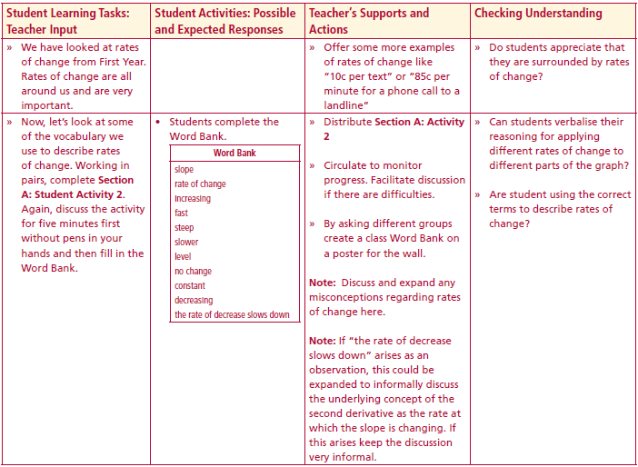
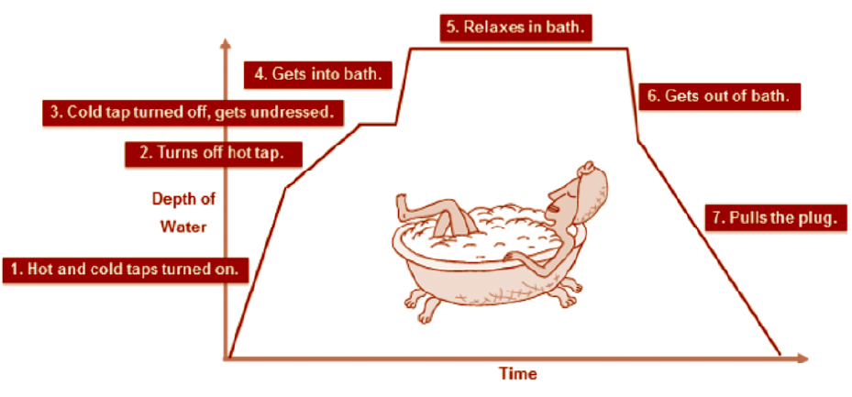
Section A: Student Activity 2
Now, let’s look at some of the vocabulary we use to describe rates of change.
Looking at the graph above, discuss in groups how the depth of water changes with time as Isabelle takes her bath.
Create a word bank of terms that were used during your discussion.
Lesson interaction

Slide 11
Section A: Student Activity 2
Lesson interaction
Word Bank

Slide 12
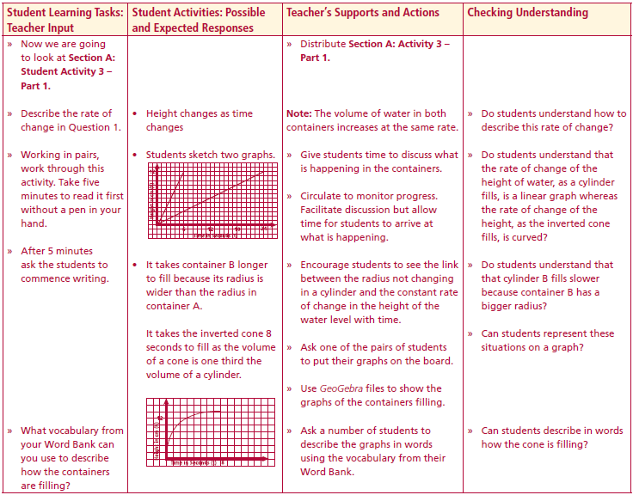
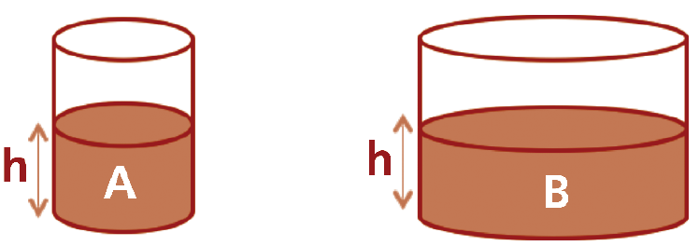
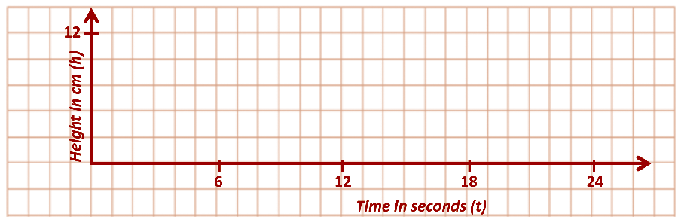
Section A: Student Activity 3– part 1
(i) Two cylindrical containers A and B are filled with water. The volume of water increases at the same rate in both and the height of both containers is 12cm. Sketch a graph to show the rate at which the height of the water level changes with time for both containers. Put both containers on one graph. Container A is full after 6 seconds and container B is full after 24 seconds.
ii) Why does it take container B longer to fill?
Lesson interaction
A
B

Slide 13
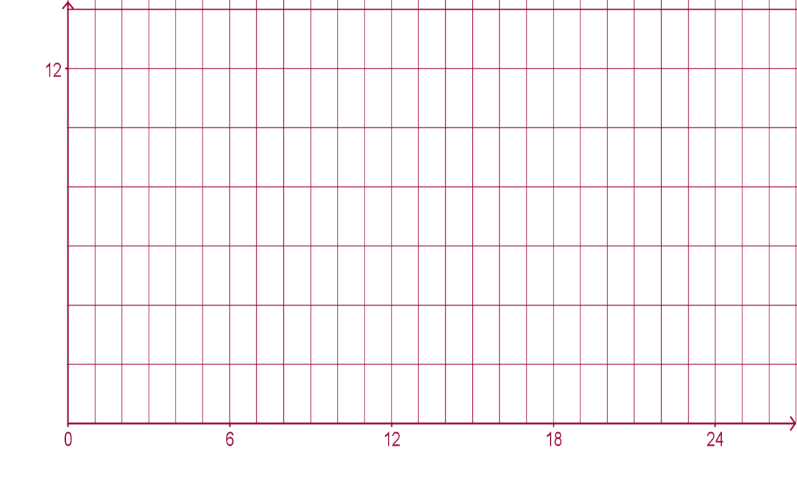
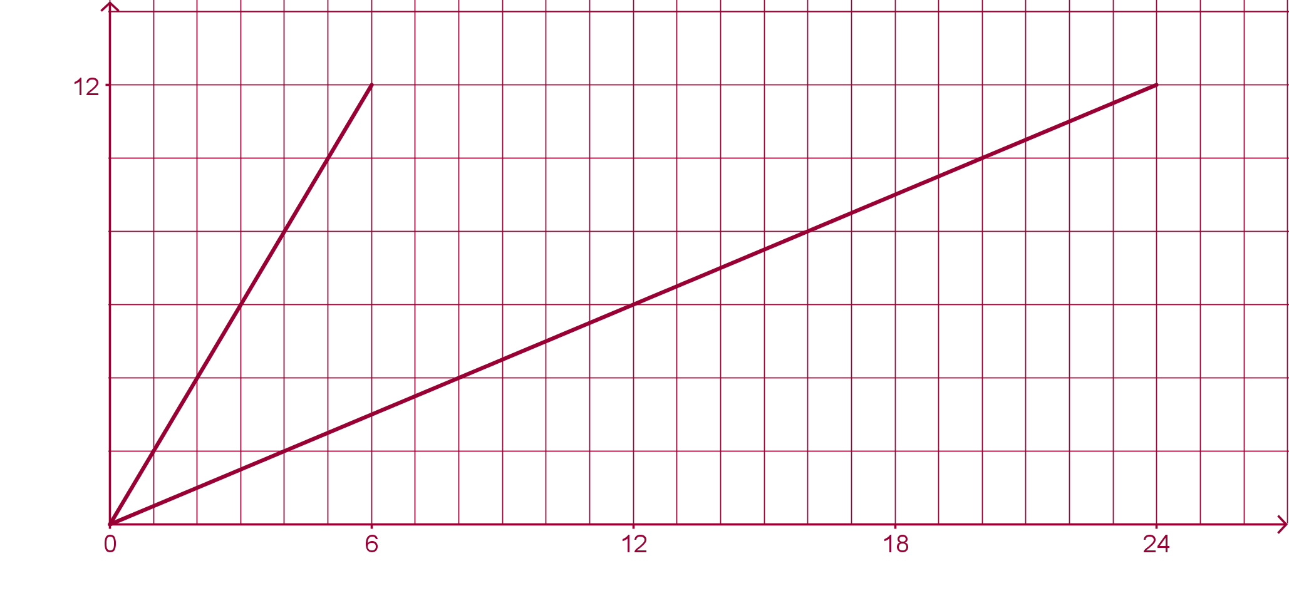
Section A: Student Activity 3– part 1
(i) Two cylindrical containers A and B are filled with water. The volume of water increases at the same rate in both and the height of both containers is 12cm. Sketch a graph to show the rate at which the height of the water level changes with time for both containers. Put both containers on one graph. Container A is full after 6 seconds and container B is full after 24 seconds.
ii) Why does it take container B longer to fill?
Lesson interaction
A
B
Height in cm (h)
A
B
h
h
Time in seconds (t)

Slide 14
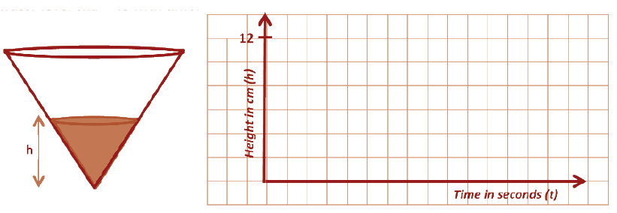
Section A: Student Activity 3– part 1
(i) Water flows into a vessel in the shape of an inverted cone as shown below. The volume of water increases at the same rate as for the two cylinders above. The vessel has the same height and radius as container B. How long will it take to fill the vessel?
(ii) As water is poured into the vessel, sketch a rough graph to show how the height of the water level changes with time.

Slide 15
Section A: Student Activity 3– part 1
(i) Water flows into a vessel in the shape of an inverted cone as shown below. The volume of water increases at the same rate as for the two cylinders above. The vessel has the same height and radius as container B. How long will it take to fill the vessel?
(ii) As water is poured into the vessel, sketch a rough graph to show how the height of the water level changes with time.
Height in cm (h)
h
Time in seconds (t)

Slide 16
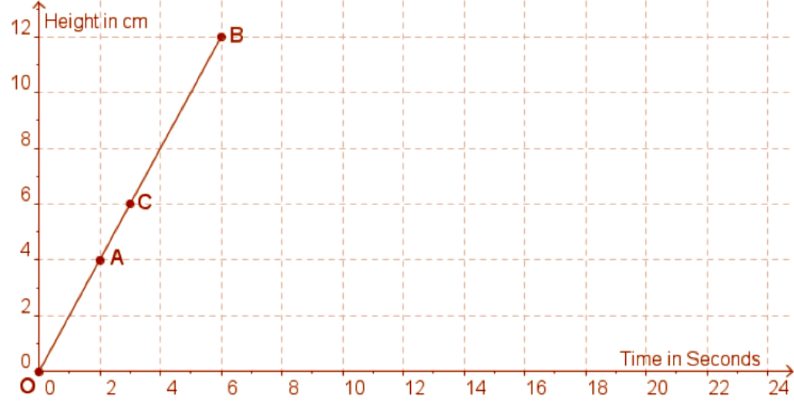
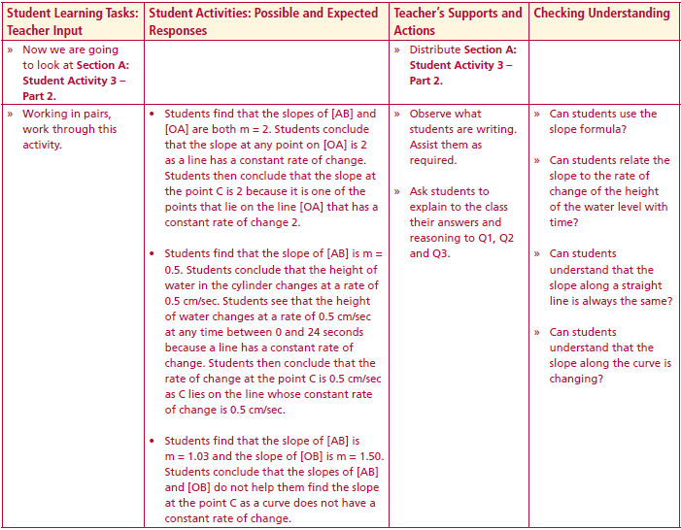
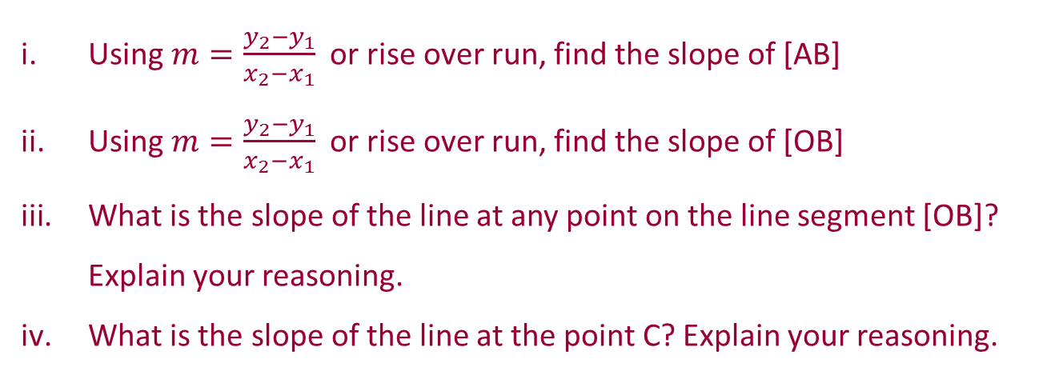
Section A: Student Activity 3 – part 2
3. Graph of cylinder A being filled
Lesson interaction
Using $m=\frac{y_{2}−y_{1}}{x_{2}−x_{1}}$ or rise over run, find the slope of [AB]
Using $m=\frac{y_{2}−y_{1}}{x_{2}−x_{1}}$ or rise over run, find the slope of [OB]
What is the slope of the line at any point on the line segment [OB]? Explain your reasoning.
What is the slope of the line at the point C? Explain your reasoning.

Slide 17
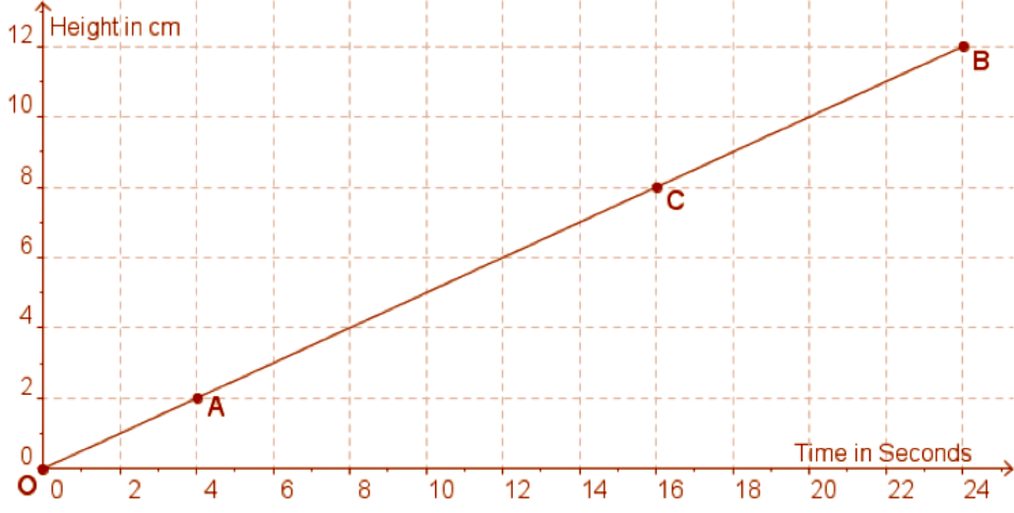
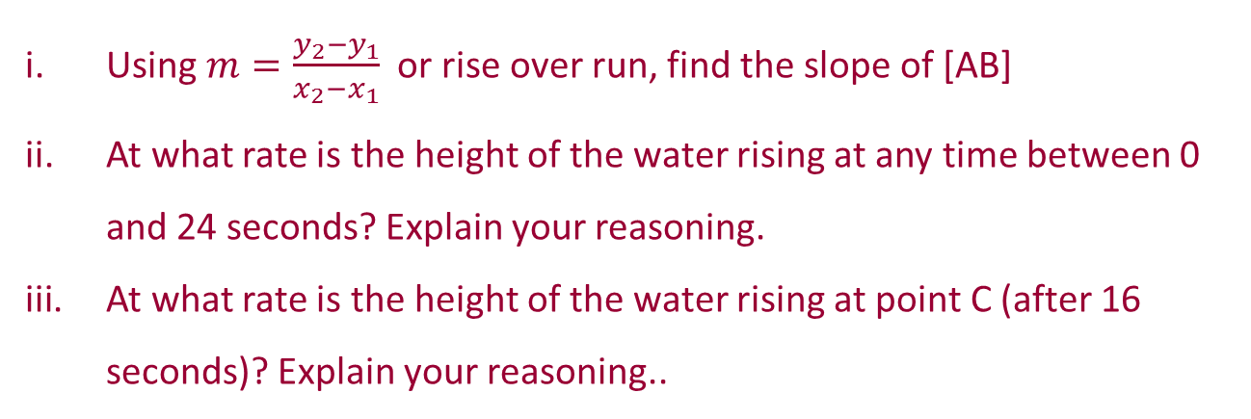
Section A: Student Activity 3 – part 2
4. Graph of cylinder A being filled
Lesson interaction
Using $m=\frac{y_{2}−y_{1}}{x_{2}−x_{1}}$ or rise over run, find the slope of [AB]
At what rate is the height of the water rising at any time between 0 and 24 seconds? Explain your reasoning.
At what rate is the height of the water rising at point C (after 16 seconds)? Explain your reasoning..

Slide 18
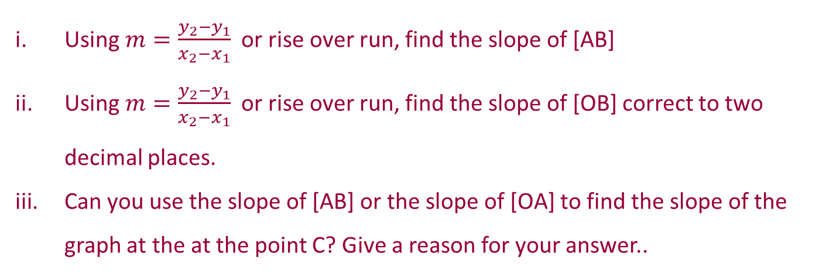
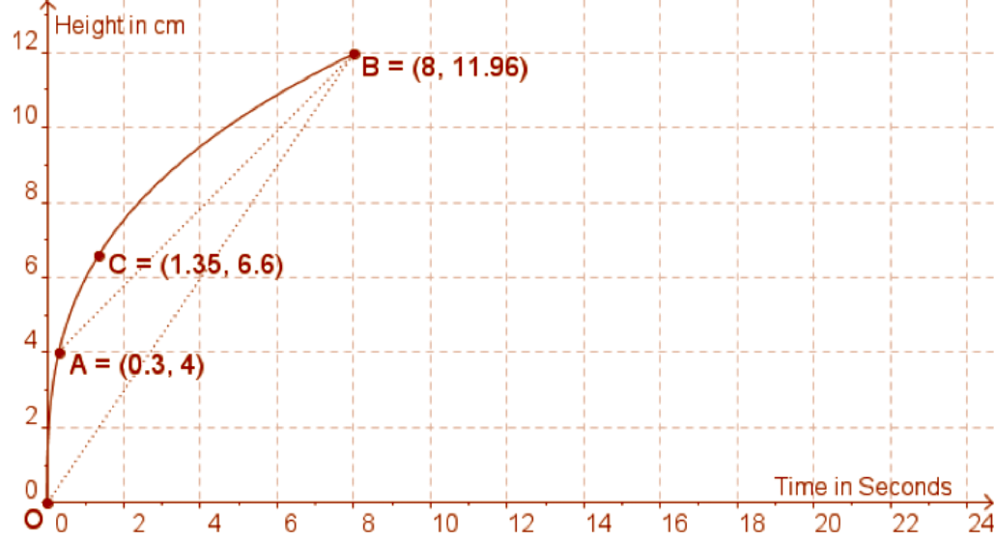
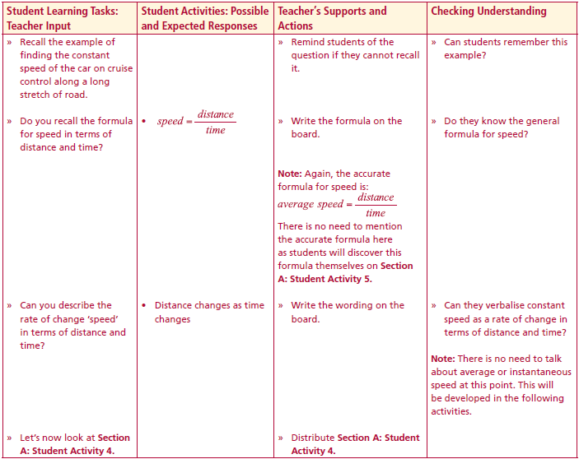
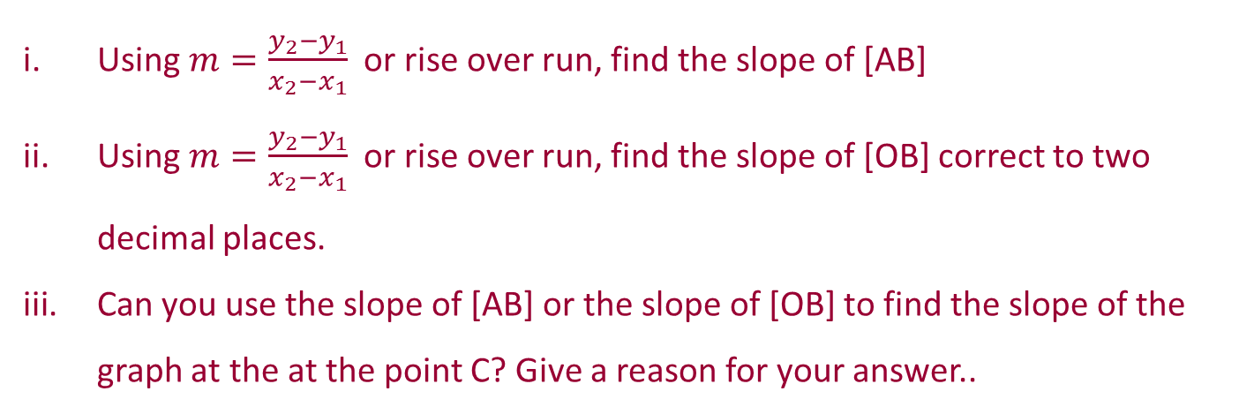
Section A: Student Activity 3 – part 2
5. Graph of Vessel being filled
Lesson interaction
Lesson interaction
Using $m=\frac{y_{2}−y_{1}}{x_{2}−x_{1}}$ or rise over run, find the slope of [AB]
Using $m=\frac{y_{2}−y_{1}}{x_{2}−x_{1}}$ or rise over run, find the slope of [OB] correct to two decimal places.
Can you use the slope of [AB] or the slope of [OB] to find the slope of the graph at the at the point C? Give a reason for your answer..

Slide 19

What’s the difference?
Height in cm (h)
Height in cm (h)
Time in seconds (t)
Time in seconds (t)
Cylinders
Cone
Notes:
Constant versus non Constant (variable change)
Rate of change is the same everywhere for the cylinders whereas the cone is a different story.
T&L has another real world activity where students could see these ideas: Train

Slide 20
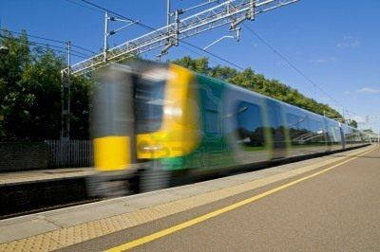

Section A: Student Activity 4
Recall the example of finding the constant speed of the car on cruise control along a long stretch of road.
Do you recall the formula for speed in terms of distance and time?
Can you describe the rate of change ‘speed’ in terms of distance and time?
Lesson interaction
$$speed=\frac{distance}{time}$$

Slide 21

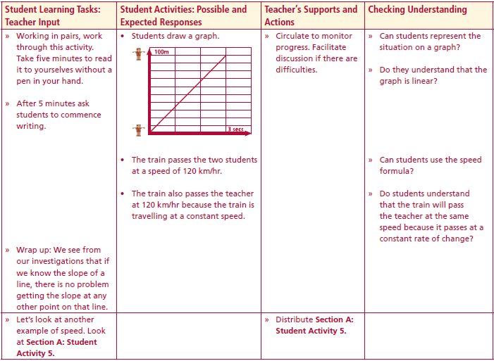
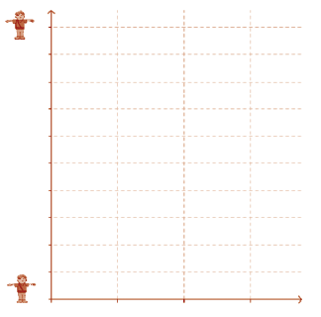
Section A: Student Activity 4
Lesson interaction
1. The two students stand 100 metres apart and discover that it takes 3 seconds for the front of the train to travel between the two positions. Draw a graph to represent how the distance changes with time during these 3 seconds. Let the position of the first student be at the origin of the graph and put the independent variable on the horizontal axis.
2. At what speed does the train pass the two students in km/hour?
3. The teacher was standing half way between the students during the experiment to supervise. At what speed did the train pass the teacher? Give a reason for your answer.
Distance (m)
Time in seconds (t)

Slide 22
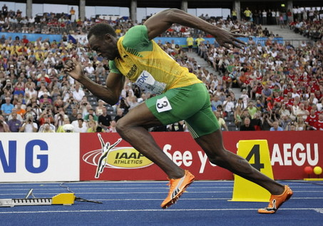
Section A: Student Activity 5

Slide 23
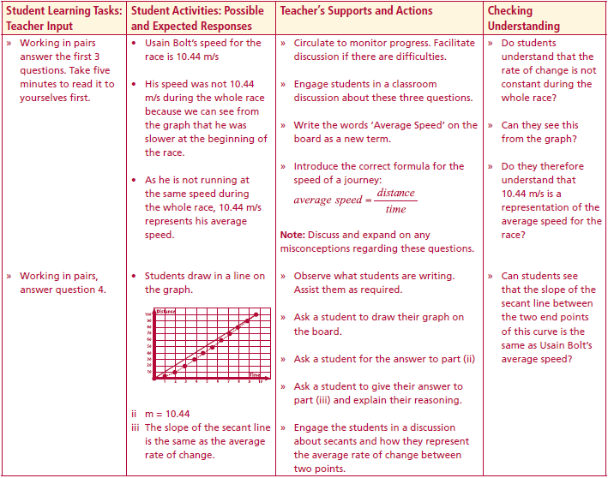
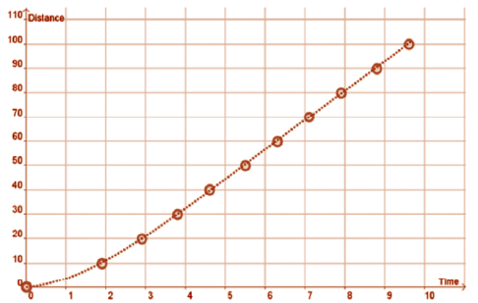
Section A: Student Activity 5
In the 2009 World Championships in Berlin, Usain Bolt set the World Record for the Men’s 100m sprint, running it in 9.58 seconds. Below is a table of Usain Bolt’s split times every 10 metres during the race
Lesson interaction
Distance (m) | 0 | 10 | 20 | 30 | 40 | 50 | 60 | 70 | 80 | 90 | 100
Time (s) | 0 | 1.89 | 2.88 | 3.78 | 4.64 | 5.47 | 6.29 | 7.10 | 7.92 | 8.75 | 9.58
1. How fast do you think Usain Bolt ran during the race? Give your answer correct to 2 decimal places in m/sec.
2. Do you think he ran at this speed throughout the whole race? Give two reasons for your answer.
3. What do you think your answer for Question 1 represents?

Slide 24
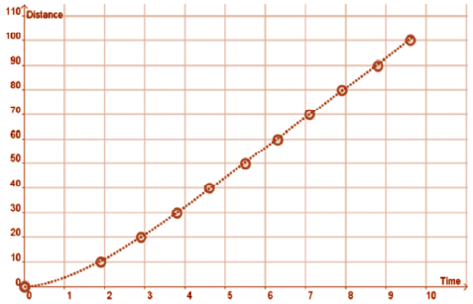
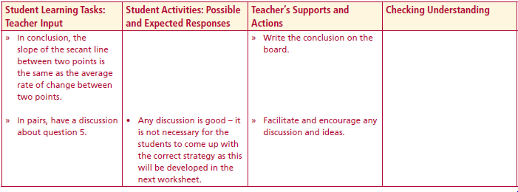
Section A: Student Activity 5
4. (i) Using a ruler, join the points (0,0) and (9.58,100) on the graph below.
(ii) Find the slope of this line.
(iii) The line that joins (0,0) to (9.58,100) has a special name. It is called a secant line to the above curve. What observation can you make about the slope of this secant line?
5. How do you think we could calculate Usain’s speed at precisely 1 second into the race?
Lesson interaction
Lesson interaction

Slide 25
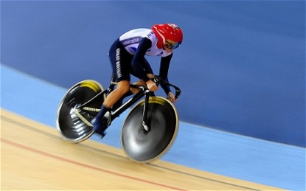
Section A: Student Activity 6, part 1

Slide 26
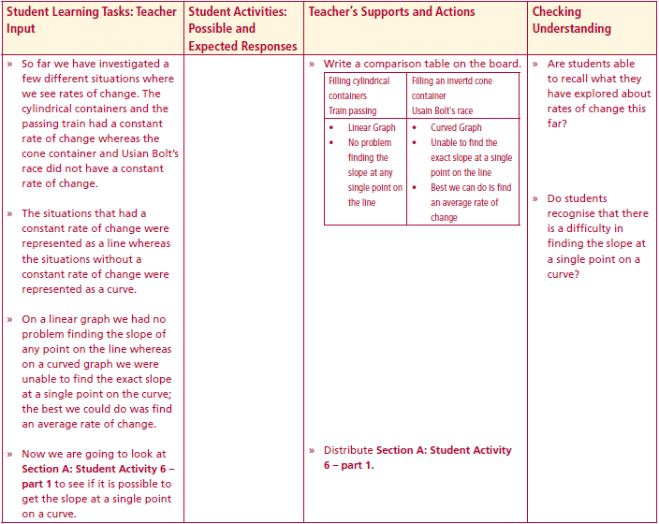
Section A: Student Activity 6, part 1
So far we have investigated a few different situations where we see rates of change. The cylindrical containers and the passing train had a constant rate of change whereas the cone container and Usian Bolt’s race did not have a constant rate of change. Compare the two different situations
The situations that had a constant rate of change were represented as a line whereas the situations without a constant rate of change were represented as a curve.
On a linear graph we had no problem finding the slope of any point on the line whereas on a curved graph we were unable to find the exact slope at a single point on the curve; the best we could do was find an average rate of change.
Now we are going to look at Section A: Student Activity 6 – part 1 to see if it is possible to get the slope at a single point on a curve.
Lesson interaction
Filling cylindrical containers Train passing | Filling an inverted cone container Usain Bolt's race

Slide 27
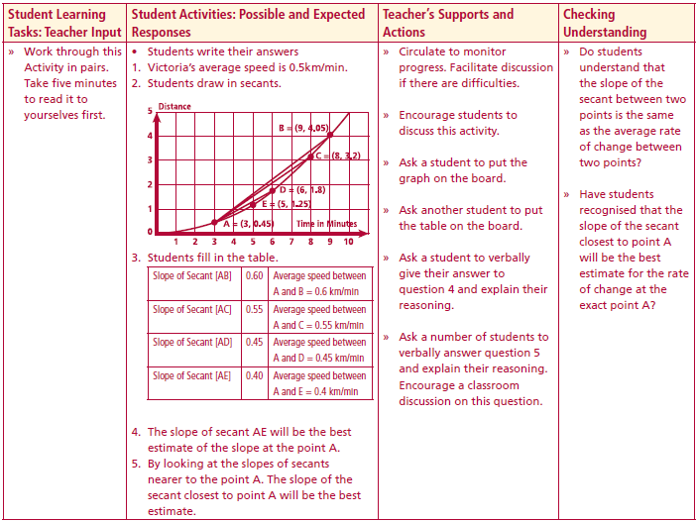
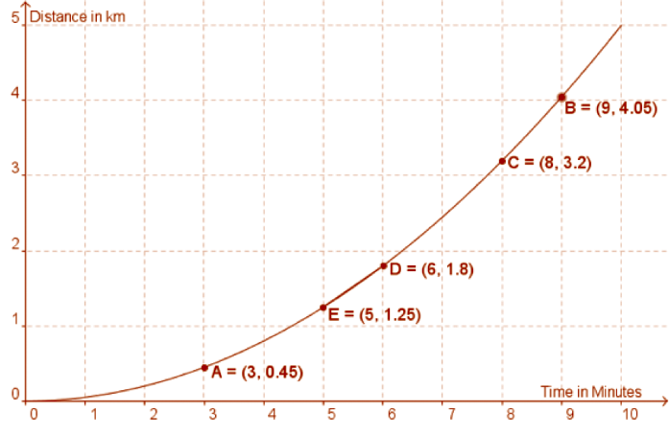
Section A: Student Activity 6, part 1
Below is a distance-time graph of the first ten minutes of a warm-up cycle by Olympic Gold medallist Victoria Pendleton.
1. Over these 10 minutes, what is Victoria Pendleton’s average speed in km/min?
2. The coach wants to know what her speed is at exactly 3 minutes during this
Warm-up. To help answer this question do the following:
Lesson interaction
(i) Using your ruler, draw in the secants [AB], [AC], [AD], [AE].
(ii) Fill in the following table. Answers correct to 2 decimal places.
Slope of Secant [AB] = | Average speed between A and B =
Slope of Secant [AC] = | Average speed between A and C =
Slope of Secant [AD] = | Average speed between A and D =
Slope of Secant [AE] = | Average speed between A and E =

Slide 28
Section A: Student Activity 6, part 1
3. The slope of which secant is the nearest estimate to Victoria’s speed after exactly 3 minutes?
4. How might you find a better estimate for Victoria’s speed after 3 minutes?
Lesson interaction
Slope of Secant [AB] = 0.60 | Average speed between A and B = 0.6 km/min
Slope of Secant [AC] = 0.55 | Average speed between A and C = 0.55 km/min
Slope of Secant [AD] = 0.45 | Average speed between A and D = 0.45 km/min
Slope of Secant [AE] = 0.40 | Average speed between A and E = 0.4 km/min
Slope of Secant [AB] = | Average speed between A and B =
Slope of Secant [AC] = | Average speed between A and C =
Slope of Secant [AD] = | Average speed between A and D =
Slope of Secant [AE] = | Average speed between A and E =

Slide 29
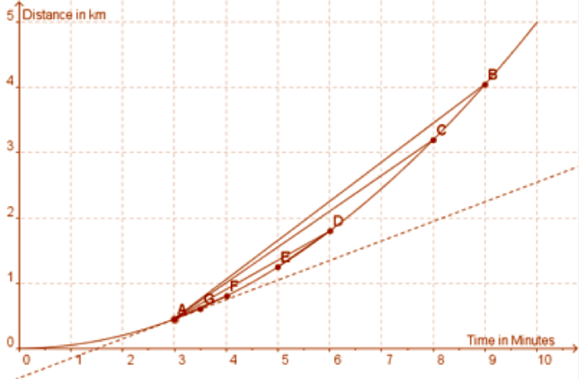
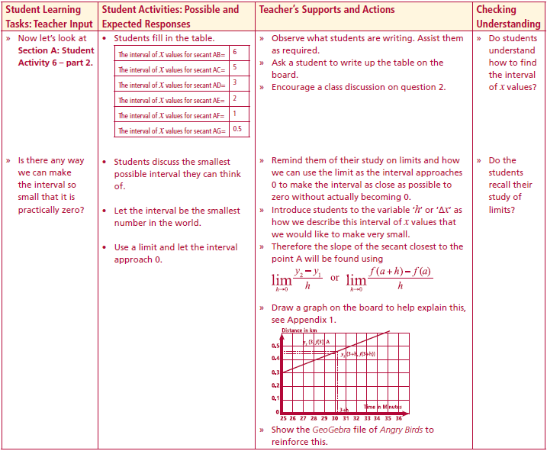
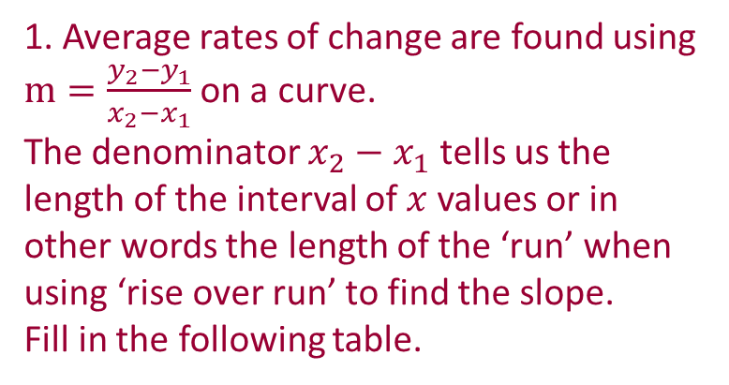
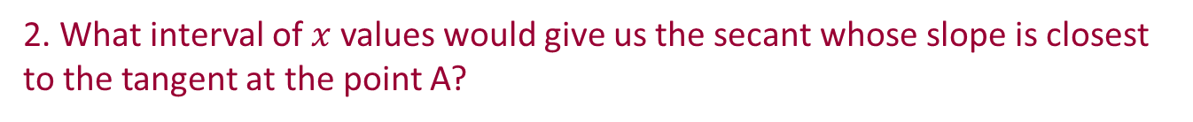
Section A: Student Activity 6, part 2
Here is a distance-time graph of the first ten minutes of a warm up cycle by Olympic Gold medallist Victoria Pendleton.
Lesson interaction
1. Average rates of change are found using $m=\frac{y_{2}−y_{1}}{x_{2}−x_{1}}$ on a curve.
The denominator $x_{2}−x_{1}$ tells us the length of the interval of $x$ values or in
other words the length of the ‘run’ when using ‘rise over run’ to find the slope.
Fill in the following table.
The interval of x values for secant AB = | 6
The interval of x values for secant AC =
The interval of x values for secant AD =
The interval of x values for secant AE =
The interval of x values for secant AF =
The interval of x values for secant AG =
5
3
2
1
0.5
2. What interval of $x$values would give us the secant whose slope is closest to the tangent at the point A?

Slide 30
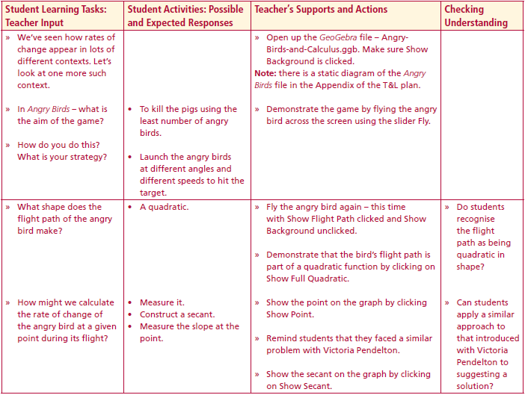
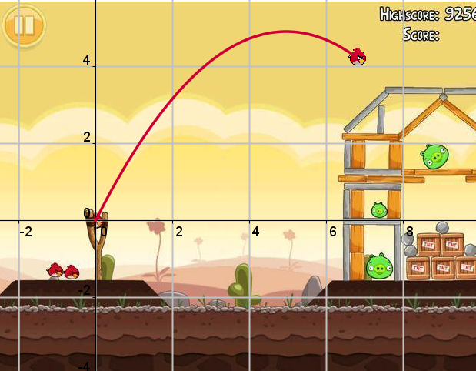
Angry birds
Is there any way we can make the interval so small that it is practically zero?
We’ve seen how rates of change appear in lots of different contexts. Let’s look at one more such context.
In Angry Birds – what is the aim of the game?
Lesson interaction

Slide 31
Angry birds
Lesson interaction
How do you do this? What is your strategy?
What shape does the flight path of the angry bird make?
How might we calculate the rate of change of the angry bird at a given point during its flight?

Slide 32

Angry birds
Lesson interaction
How might we modify our secant so that it would provide a better estimate of the rate of change of the angry bird at the point? How might we get the actual rate of change at the point of interest – as opposed to an estimate?
Does this approach work for getting the instantaneous rate of change? Why doesn’t it work? We would like to know what happens when the purple point approaches the blue point so that the two points are ever closer but never directly on top of each other. Is there a tool in Mathematics which allows us to investigate such an occurrence?

Slide 33












Angry birds
$$y_{2}$$
$$y_{2}−y_{1}$$
Lesson interaction
$$y_{1}$$
$$x_{2}−x_{1}$$
$$h$$
$$x_{1}$$
$$x_{2}$$
What limit do we want to find?
Could we use some variables to write it in a more mathematical form?
The choice of the second point depends on the location of the first point. For this reason, could we re-write the denominator in terms of the location of the point of interest?
$lim$ (slope)
$$lim\frac{y_{2}−y_{1}}{x_{2}−x_{1}}$$
$$lim\frac{y_{2}−y_{1}}{h}$$

Slide 34





Angry birds
$$f(a+h)$$
$$f(a+h)−f(a)$$
Lesson interaction
$$f(a)$$
$$h$$
$$a$$
$$a+h$$
We can write this using function notation letting the first point we choose on the x axis being the point a

Slide 35
Angry birds
$$f(a+h)$$
$$f(a+h)−f(a)$$
Lesson interaction
$$f(a)$$
$$h$$
$$a$$
$$a+h$$
We can write this using function notation letting the first point we choose on the x axis being the point a

Slide 36





Angry birds
$$f(a+h)$$
Lesson interaction
$$f(a+h)−f(a)$$
$$f(a)$$
$$h$$
$$a$$
$$a+h$$
We can write this using function notation letting the first point we choose on the x axis being the point a
We then make as h a small as possible so that the secant becomes closer to the tangent at the required point
$$lim\frac{f(a+h) −f(a) }{h}$$

Slide 37


Angry birds
$$f(a+h)$$
Lesson interaction
$$f(a+h)−f(a)$$
$$f(a)$$
$$h$$
$$a$$
$$a+h$$
We can write this using function notation letting the first point we choose on the x axis being the point a
We then make as h a small as possible so that the secant becomes closer to the tangent at the required point
$$lim\frac{f(a+h) −f(a) }{h}$$

Slide 38



Angry birds
$$f(a+h)$$
Lesson interaction
$$f(a)$$
$$f(a+h)−f(a)$$
$$h$$
$$a$$
$$a+h$$
We can write this using function notation letting the first point we choose on the x axis being the point a
We then make as h a small as possible so that the secant becomes closer to the tangent at the required point
$$lim\frac{f(a+h) −f(a) }{h}$$

Slide 39





Angry birds
Lesson interaction
$$f(a+h)$$
$$f(a)$$
$$f(a+h)−f(a)$$
$$h$$
$$a$$
$$a+h$$
We can write this using function notation letting the first point we choose on the x axis being the point a
We then make as h a small as possible so that the secant becomes closer to the tangent at the required point
$$\lim_{h→0}{\frac{f(a+h) −f(a) }{h}}$$

Slide 40


This is Calculus.
$$\lim_{h→0}{\frac{f(a+h) −f(a) }{h}}$$
Lesson interaction
Calculus is the branch of mathematics that allows us to calculate
instantaneous rates of change.

Slide 41



Section B: Student Activity 1
Linear Functions and their Slope Functions
We now see the need for being able to calculate the instantaneous rate of change. We also see that we can calculate instantaneous rate of change at a given point using
This approach may be extended to calculate a general expression which tells us the instantaneous rate of change at any point (x) along the function.
Proceed to apply the limit to calculate derivative functions of linear functions and quadratic functions (Differentiation by First Principles - H.L. only )
Lesson interaction
$$\lim_{h→0}\frac{\left.f(a+h)−f(a\right)}{h}$$
$$\lim_{h→0}\frac{f\left(x+h\right)−f(x)}{h}$$

Slide 42

Section B: Student Activity 1
Linear Functions and their Slope Functions
We will now investigate how to work out the instantaneous rate of change practically – such that we can perform these calculations efficiently. This will allow us to use calculus to solve real-world problems.
We will do this by looking at how the slope of various functions changes from one location to the next on a function and see if there is a pattern to this change. Identifying a pattern in the slopes would allow us to predict slope (and instantaneous rate of change) at any point.
We will start by examining linear functions.
For each graph A-D in Section B: Student Activity 1, can you write down their slopes at each point given in the table?
Lesson interaction

Slide 43




Section B: Student Activity 1
Linear Functions and their Slope Functions
A | B
C | D

Slide 44

Section B: Student Activity 1
Linear Functions and their Slope Functions
A | B | C | D

Slide 45


Section B: Student Activity 1
Linear Functions and their Slope Functions
If I came up with a new function e.g. $q(x)=95$, could you tell me about the slope of that function just by looking at the form of the function?
If you were given any horizontal line could you explain how to find the slope at any point
Can you explain why the rate of change of a function $f (x) = c$should be zero?
Lesson interaction

Slide 46







Section B: Student Activity 2
Linear Functions and their Slope Functions
A | B | C
D | E | F
Lesson interaction

Slide 47

Section B: Student Activity 2
Linear Functions and their Slope Functions
A | B | C
Function | Slope (Rate of change) when $x$ is |  |  |  |  |  |  | Slope Function
 | -3 | -2 | -1 | 0 | 1 | 2 | 3
$$f\left(x\right)=x$$ |  |  |  |  |  |  |  | $$f^{′}\left(x\right)=$$
$$w\left(x\right)=x+2$$ |  |  |  |  |  |  |  | $$w’(x)=$$
$$r\left(x\right)=3/2x$$ |  |  |  |  |  |  |  | $$r’(x)=$$

Slide 48

Section B: Student Activity 2
Linear Functions and their Slope Functions
D | E | F
Function | Slope (Rate of change) when $x$ is |  |  |  |  |  |  | Slope Function
 | -3 | -2 | -1 | 0 | 1 | 2 | 3
$$a\left(x\right)=3/2x+3$$ |  |  |  |  |  |  |  | $$a^{′}\left(x\right)=$$
$$g\left(x\right)=−x$$ |  |  |  |  |  |  |  | $$g’(x)=$$
$$p\left(x\right)=−x+3$$ |  |  |  |  |  |  |  | $$p’(x)=$$
$$n\left(x\right)=$$ |  |  |  |  |  |  |  | $$n’(x)=$$

Slide 49


Section B: Student Activity 2
Linear Functions and their Slope Functions
Function | Slope (Rate of change) when $x$ is |  |  |  |  |  |  | Slope Function
 | -3 | -2 | -1 | 0 | 1 | 2 | 3
$$f\left(x\right)=x$$ |  |  |  |  |  |  |  | $$f^{′}\left(x\right)=$$
$$w\left(x\right)=x+2$$ |  |  |  |  |  |  |  | $$w’(x)=$$
$$r\left(x\right)=3/2x$$ |  |  |  |  |  |  |  | $$r’(x)=$$
$$a\left(x\right)=3/2x+3$$ |  |  |  |  |  |  |  | $$a^{′}\left(x\right)=$$
$$g\left(x\right)=−x$$ |  |  |  |  |  |  |  | $$g’(x)=$$
$$p\left(x\right)=−x+3$$ |  |  |  |  |  |  |  | $$p’(x)=$$
$$n\left(x\right)=$$ |  |  |  |  |  |  |  | $$n’(x)=$$
$$f(x)=nx$$ |  |  |  |  |  |  |  | $$f^{′}\left(x\right)=$$
$$f(x)=nx+c$$ |  |  |  |  |  |  |  | $$f^{′}\left(x\right)=$$
Complete the following:
The rate of change of a function $f (x) = nx$is ___________________________
The rate of change of a function $f (x) = nx + c$is _______________________

Slide 50


Section B: Student Activity 2
Linear Functions and their Slope Functions
If you were presented with a straight-line graph in the domain $−4 < x < 4$and you were asked to determine the slope of the line when $x = 15$how would you do it?
If you were presented with a new linear function $f\left(x\right)=13.5x+5$ could you describe what its slope is for all values of x?
Can you generalise the pattern you have just discovered? Suppose you were given a function $a(x) = 7x$or $b(x) = −8x$or $g(x) = nx$, how would you calculate its slope?
Suppose we modified the previous three functions so that they now read $a(x) = 7x + 2$or $b(x) = −8x + 5$or $f(x) = nx + c$, how would you calculate their slopes?
Lesson interaction
Lesson interaction

Slide 51



Section B: Student Activity 3, A
Quadratic Functions and their associated Slope Functions $f(x) = x2$
We have now identified a problem with rates of change for quadratic functions – they are not the same so knowing the rate of change at one point does not mean we know the rate of change at any point. Do you think it’s the same for other functions that are non-linear?
Can we predict what the rate of change (slope) of a quadratic function will be at any point?
Lesson interaction
Lesson interaction

Slide 52

Section B: Student Activity 3, A
Quadratic Functions and their associated Slope Functions $f(x) = x2$
Many real-life situations are modelled by quadratic functions e.g. a projectile falling through the air. One way of determining how quickly a projectile falls is to calculate its rate of change as it falls.
Lesson interaction
Given the quadratic function $f(x) = x2$, if you were told that the slope of the function at the point $x=−3 is−6$, could you say what the slopes of the function are at all other points?
Given that we are dealing with a curve what do we mean by the slope at a point?

Slide 53

Section B: Student Activity 3, A
Quadratic Functions and their associated Slope Functions $f(x) = x2$
1 Using the appropriate GeoGebra file or the graph below – complete the table by filling in the slopes of the tangents to the function at points A – G.
Point | $$x$$ | Slope of tangent $f’(x)$ | Change of $f’(x)$
A | -3
B | -2
C | -1
D | 0
E | 1
F | 2
G | 3
2 Investigate the pattern of the slopes by completing the Change column in the table.

Slide 54


Point | $$x$$ | Slope of tangent $f’(x)$
A | -3
B | -2
C | -1
D | 0
E | 1
F | 2
G | 3
1
-6
1
-4
1
0
-2

Slide 55

Point | $$x$$ | Slope of tangent $f’(x)$
A | -3 | -6
B | -2 | -4
C | -1 | -2
D | 0 | 0
E | 1
F | 2
G | 3
4
6
1
1
2
1

Slide 56





Section B: Student Activity 3, A
Quadratic Functions and their associated Slope Functions $f(x) = x2$
3 Graph the slopes of the tangent (as a function of x) in the space provided.
4 Using your pattern-analysis skills, write down the slope function ( f '(x))
Slope of f ’(x):
y-intercept of f ’(x):
Equation of f ’(x):
Point | $$x$$ | Slope of tangent $f’(x)$ | Change of $f’(x)$
A | -3 | -6
B | -2 | -4
C | -1 | -2
D | 0 | 0
E | 1 | 2
F | 2 | 4
G | 3 | 6
Point | $$x$$ | Slope of tangent $f’(x)$ | Change of $f’(x)$
A | -3 | -6
 |  |  | 2
B | -2 | -4
 |  |  | 2
C | -1 | -2
 |  |  | 2
D | 0 | 0
 |  |  | 2
E | 1 | 2
 |  |  | 2
F | 2 | 4
 |  |  | 2
G | 3 | 6

Slide 57



Section B: Student Activity 3, A
Quadratic Functions and their associated Slope Functions $f(x) = x2$
Are the slope values you measured predictable in any way?
For the function $f(x)=x2$, could you tell me what the slope of that function is when $x=8$? How about when $x=57$? How might you do it?
The slopes of the function $f(x)=x2$themselves form a pattern. The slopes form a linear pattern and can be represented by a linear function. We call this function the slope function, the differential function or simply the derivative. There are various different notations used to denote the slope function, including $f ′(x)$and $\frac{dy}{dx}$ .
This slope function allows us to calculate the slope of our original function at a given point.
If you were given a different quadratic function – e.g$. f\left(x\right)= 2x2,$
$f(x)=3x2 or f(x) =4x2$, could you predict what their slopes would be when $x=−20$? What would you need? How might you find this out?
Lesson interaction
Lesson interaction

Slide 58

Section B: Student Activity 3, B
Quadratic Functions and their associated Slope Functions $f(x) =2x2$
1 Using the appropriate GeoGebra file or the graph below – complete the table by filling in the slopes of the tangents to the function at points A – G.
Point | $$x$$ | Slope of tangent $f’(x)$ | Change of $f’(x)$
A | -3
B | -2
C | -1
D | 0
E | 1
F | 2
G | 3
2 Investigate the pattern of the slopes by completing the Change column in the table.

Slide 59





Section B: Student Activity 3, B
Quadratic Functions and their associated Slope Functions $f(x) =2x2$
3 Graph the slopes of the tangent (as a function of x) in the space provided.
4 Using your pattern-analysis skills, write down the slope function ( f '(x))
Slope of f ’(x):
y-intercept of f ’(x):
Equation of f ’(x):
Point | $$x$$ | Slope of tangent $f’(x)$ | Change of $f’(x)$
A | -3 | -12
B | -2 | -8
C | -1 | -4
D | 0 | 0
E | 1 | 4
F | 2 | 8
G | 3 | 12
Point | $$x$$ | Slope of tangent $f’(x)$ | Change of $f’(x)$
A | -3 | -12
 |  |  | 4
B | -2 | -8
 |  |  | 4
C | -1 | -4
 |  |  | 4
D | 0 | 0
 |  |  | 4
E | 1 | 4
 |  |  | 4
F | 2 | 8
 |  |  | 4
G | 3 | 12

Slide 60

Section B: Student Activity 3, C
Quadratic Functions and their associated Slope Functions $f(x) =3x2$
1 Using the appropriate GeoGebra file or the graph below – complete the table by filling in the slopes of the tangents to the function at points A – G.
Point | $$x$$ | Slope of tangent $f’(x)$ | Change of $f’(x)$
A | -3
B | -2
C | -1
D | 0
E | 1
F | 2
G | 3
2 Investigate the pattern of the slopes by completing the Change column in the table.

Slide 61





Section B: Student Activity 3, C
Quadratic Functions and their associated Slope Functions $f(x) =3x2$
3 Graph the slopes of the tangent (as a function of x) in the space provided.
4 Using your pattern-analysis skills, write down the slope function ( f '(x))
Slope of f ’(x):
y-intercept of f ’(x):
Equation of f ’(x):
Point | $$x$$ | Slope of tangent $f’(x)$ | Change of $f’(x)$
A | -3 | -18
B | -2 | -12
C | -1 | -6
D | 0 | 0
E | 1 | 6
F | 2 | 12
G | 3 | 18
Point | $$x$$ | Slope of tangent $f’(x)$ | Change of $f’(x)$
A | -3 | -18
 |  |  | 6
B | -2 | -12
 |  |  | 6
C | -1 | -6
 |  |  | 6
D | 0 | 0
 |  |  | 6
E | 1 | 6
 |  |  | 6
F | 2 | 12
 |  |  | 6
G | 3 | 18

Slide 62

Section B: Student Activity 3, D
Quadratic Functions and their associated Slope Functions $f(x) =4x2$
1 Using the appropriate GeoGebra file or the graph below – complete the table by filling in the slopes of the tangents to the function at points A – G.
Point | $$x$$ | Slope of tangent $f’(x)$ | Change of $f’(x)$
A | -3
B | -2
C | -1
D | 0
E | 1
F | 2
G | 3
2 Investigate the pattern of the slopes by completing the Change column in the table.

Slide 63





Section B: Student Activity 3, D
Quadratic Functions and their associated Slope Functions $f(x) =4x2$
3 Graph the slopes of the tangent (as a function of x) in the space provided.
4 Using your pattern-analysis skills, write down the slope function ( f '(x))
Slope of f ’(x):
y-intercept of f ’(x):
Equation of f ’(x):
Point | $$x$$ | Slope of tangent $f’(x)$ | Change of $f’(x)$
A | -3 | -24
B | -2 | -16
C | -1 | -8
D | 0 | 0
E | 1 | 8
F | 2 | 16
G | 3 | 24
Point | $$x$$ | Slope of tangent $f’(x)$ | Change of $f’(x)$
A | -3 | -24
 |  |  | 8
B | -2 | -16
 |  |  | 8
C | -1 | -8
 |  |  | 8
D | 0 | 0
 |  |  | 8
E | 1 | 8
 |  |  | 8
F | 2 | 16
 |  |  | 8
G | 3 | 24

Slide 64



Section B: Student Activity 4, A
Cubic Functions and their associated Slope Functions $f(x) =x3$
Several real-world situations, including the volume of three-dimensional objects like cuboids, spheres and cones, are modelled by cubic functions. Accordingly we would also like to be able to calculate the rate of change at any point on a cubic function.
Given a cubic function can you determine how to calculate its slope at any point? How might you go about this?
Could you calculate what the slope of the function $f(x) = x3$ is at the point on the function when x = 16? How would you do it?
Lesson interaction

Slide 65

Section B: Student Activity 4, A
Cubic Functions and their associated Slope Functions $f(x) =x3$
1 Using the appropriate GeoGebra file or the graph below – complete the table by filling in the slopes of the tangents to the function at points A – G.
Point | $$x$$ | Slope of tangent $f’(x)$ | Change of $f’(x)$ | Change of the Change of $f’(x)$
A | -3
B | -2
C | -1
D | 0
E | 1
F | 2
G | 3
2 Investigate the pattern of the slopes by completing the Change column in the table.

Slide 66






Section B: Student Activity 4, A
Cubic Functions and their associated Slope Functions $f(x) =x3$
3 Graph the slopes of the tangent (as a function of x) in the space provided.
4 Using your pattern-analysis skills, write down the slope function ( f '(x))
Slope of f ’(x):
y-intercept of f ’(x):
Equation of f ’(x):
Point | $$x$$ | Slope of tangent $f’(x)$ | Change of $f’(x)$ | Change of the Change of $f’(x)$
A | -3 | 27
B | -2 | 12
C | -1 | 3
D | 0 | 0
E | 1 | 3
F | 2 | 12
G | 3 | 27
Point | $$x$$ | Slope of tangent $f’(x)$ | Change of $f’(x)$ | Change of the Change of $f’(x)$
A | -3 | 27
 |  |  | -15
B | -2 | 12
 |  |  | -9
C | -1 | 3
 |  |  | -3
D | 0 | 0
 |  |  | 3
E | 1 | 3
 |  |  | 9
F | 2 | 12
 |  |  | 12
G | 3 | 27
Point | $$x$$ | Slope of tangent $f’(x)$ | Change of $f’(x)$ | Change of the Change of $f’(x)$
A | -3 | 27
 |  |  | -15
B | -2 | 12 |  | 6
 |  |  | -9
C | -1 | 3 |  | 6
 |  |  | -3
D | 0 | 0 |  | 6
 |  |  | 3
E | 1 | 3 |  | 6
 |  |  | 9
F | 2 | 12 |  | 6
 |  |  | 12
G | 3 | 27

Slide 67
Section B: Student Activity 4, B
Cubic Functions and their associated Slope Functions $f(x) =2x3$
1 Using the appropriate GeoGebra file or the graph below – complete the table by filling in the slopes of the tangents to the function at points A – G.
Point | $$x$$ | Slope of tangent $f’(x)$ | Change of $f’(x)$ | Change of the Change of $f’(x)$
A | -3
B | -2
C | -1
D | 0
E | 1
F | 2
G | 3
2 Investigate the pattern of the slopes by completing the Change column in the table.

Slide 68






Section B: Student Activity 4, B
Cubic Functions and their associated Slope Functions $f(x) =2x3$
3 Graph the slopes of the tangent (as a function of x) in the space provided.
4 Using your pattern-analysis skills, write down the slope function ( f '(x))
Slope of f ’(x):
y-intercept of f ’(x):
Equation of f ’(x):
Point | $$x$$ | Slope of tangent $f’(x)$ | Change of $f’(x)$ | Change of the Change of $f’(x)$
A | -3 | 54
B | -2 | 24
C | -1 | 6
D | 0 | 0
E | 1 | 6
F | 2 | 24
G | 3 | 54
Point | $$x$$ | Slope of tangent $f’(x)$ | Change of $f’(x)$ | Change of the Change of $f’(x)$
A | -3 | 54
 |  |  | 30
B | -2 | 24
 |  |  | 18
C | -1 | 6
 |  |  | 6
D | 0 | 0
 |  |  | 6
E | 1 | 6
 |  |  | 18
F | 2 | 24
 |  |  | 30
G | 3 | 54
Point | $$x$$ | Slope of tangent $f’(x)$ | Change of $f’(x)$ | Change of the Change of $f’(x)$
A | -3 | 54
 |  |  | 30
B | -2 | 24 |  | 12
 |  |  | 18
C | -1 | 6 |  | 12
 |  |  | 6
D | 0 | 0 |  | 12
 |  |  | 6
E | 1 | 6 |  | 12
 |  |  | 18
F | 2 | 24 |  | 12
 |  |  | 30
G | 3 | 54

Slide 69



Section B: Student Activity 4, C
Cubic Functions and their associated Slope Functions $f(x) =ax3$
1 Complete the table below and explain your findings
Explanation (in words).
To find the derivative (slope function) of a cubic function…
Have you seen this approach to finding the slope function before? Explain
Lesson interaction
Function $f(x)$ | Slope Function $f’(x)$
$$f(x) =x3$$
$$f(x) =2x3$$
$$f(x) =ax3$$
Lesson interaction

Slide 70

Section B: Student Activity 5
Finding the slope function of a polynomial
Quadratic and cubic functions are all part of the same family of functions – known as polynomials. Let’s look at a higher order polynomial - $k(x) = 5x4$. Based on your investigation of quadratics and cubics so far, could you suggest what its slope function is? How did you do it?
Linear functions are also members of the polynomial family. Can we find the slope of a linear function using the same rule we used for quadratics and cubics?
Lesson interaction

Slide 71


Section B: Student Activity 5
Finding the slope function of a polynomial
1 Based on the results of activities Section B : Student Activities 1-4, complete
the following table:
Lesson interaction
 | Function | Slope Function |  |  | Function | Slope Function
1 | $$f(x)=3$$ | $$f’(x)=$$ |  | 9 | $$a(x)=2x^{2}$$ | $$a’(x)=$$
2 | $k(x)=$1 | $$k’(x)=$$ |  | 10 | $$f(x)={3x}^{2}$$ | $$f’(x)=$$
3 | $$p\left(x\right)=−1$$ | $$p’(x)=$$ |  | 11 | $$g(x) =4x^{2}$$ | $$g’(x)=$$
4 | $d\left(x\right)=−$3 | $$d’(x)=$$ |  | 12 | $$k(x)=x^{3}$$ | $$k’(x)=$$
5 | $$f\left(x\right)=x$$ | $$f’(x)=$$ |  | 13 | $$p\left(x\right)=2x^{3}$$ | $$p’(x)=$$
6 | $$g(x)=2/3x$$ | $$g’(x)=$$ |  | 14
7 | $$h\left(x\right)=−x$$ | $$h’(x)=$$ |  | 15
8 | $$f(x) = x^{2}$$ | $$f’(x)=$$ |  | 16
2. Can you summarise how you might find the slope function of any given polynomial function?

Slide 72

Section B: Student Activity 5
Finding the slope function of a polynomial
3. Using this approach – write down the slope functions of the following functions
 | Function | Slope Function |  |  | Function | Slope Function
1 | $$f\left(x\right)=5x$$ | $$f’(x)=$$ |  | 9 | $$k(x) =x^{−1}$$ | $$k’(x)=$$
2 | $$g(x) =4x^{3}$$ | $$g’(x)=$$ |  | 10 | $$f(x) = {2x}^{0}$$ | $$f’(x)=$$
3 | $$h\left(x\right)=−9x$$ | $$h’(x)=$$ |  | 11 | $$z(x) =1/x$$ | $$z’(x)=$$
4 | $$k\left(x\right)={−6x}^{2}$$ | $$k’(x)=$$ |  | 12 | $$a(x) =\sqrt{x}$$ | $$a’(x)=$$
5 | $$f(x) ={0.5x}^{2}$$ | $$f’(x)=$$ |  | 13 | $$g(x) =2/{x^{3}}$$ | $$g’(x)=$$
6 | $$w(x) ={5x}^{4}$$ | $$w’(x)=$$ |  | 14
7 | $$g\left(x\right)=−{3x}^{2}$$ | $$g’(x)=$$ |  | 15
8 | $$r(x) = x^{−2}$$ | $$r’(x)=$$ |  | 16 | $$f(x) = {ax}^{n}$$ | $$f’(x)=$$

Slide 73


Section B: Student Activity 6, A
Co-polynomial functions and their associated Slope Functions $f\left(x\right)= x2−x−6$
We have investigated various functions of the form $f\left(x\right)= axn$ and have discovered a reliable and quick approach to determining their slope functions.
We now want to do the same for polynomials which are a combination of a quadratic, a linear and a horizontal line.
Given a function $f(x) = x2 − x − 6$how could we determine how to find its slope function?
Lesson interaction
Lesson interaction

Slide 74


Section B: Student Activity 6, A
Co-polynomial functions and their associated Slope Functions $f\left(x\right)= x2−x−6$
1 Using the appropriate GeoGebra file or the graph below – complete the table by filling in the slopes of the tangents to the function at points A – G.
Point | $$x$$ | Slope of tangent $f’(x)$ | Change of $f’(x)$
A | -2.5
B | -1.5
C | -0.5
D | 0.5
E | 1.5
F | 2.5
G | 3.5
2 Investigate the pattern of the slopes by completing the Change column in the table.

Slide 75





Section B: Student Activity 6, A
Co-polynomial functions and their associated Slope Functions $f\left(x\right)= x2−x−6$
3 Graph the slopes of the tangent (as a function of x) in the space provided.
Point | $$x$$ | Slope of tangent $f’(x)$ | Change of $f’(x)$
A | -2.5 | -6
B | -1.5 | -4
C | -0.5 | -2
D | 0.5 | 0
E | 1.5 | 2
F | 2.5 | 4
G | 3.5 | 6
Point | $$x$$ | Slope of tangent $f’(x)$ | Change of $f’(x)$
A | -2.5 | -6
 |  |  | 2
B | -1.5 | -4
 |  |  | 2
C | -0.5 | -2
 |  |  | 2
D | 0.5 | 0
 |  |  | 2
E | 1.5 | 2
 |  |  | 2
F | 2.5 | 4
 |  |  | 2
G | 3.5 | 6
4 Using your pattern-analysis skills, write down the slope function ( f '(x))
Slope of f ’(x):
y-intercept of f ’(x):
Equation of f ’(x):

Slide 76


Section B: Student Activity 6, B
Co-polynomial functions and their associated Slope Functions $f(x)=x2+3x+4$
1 Using the appropriate GeoGebra file or the graph below – complete the table by filling in the slopes of the tangents to the function at points A – G.
Point | $$x$$ | Slope of tangent $f’(x)$ | Change of $f’(x)$
A | -4.5
B | -3.5
C | -2.5
D | -1.5
E | -0.5
F | 0.5
G | 1.5
2 Investigate the pattern of the slopes by completing the Change column in the table.

Slide 77





Section B: Student Activity 6, B
Co-polynomial functions and their associated Slope Functions $f\left(x\right)= x2+ 3x+4$
3 Graph the slopes of the tangent (as a function of x) in the space provided.
Point | $$x$$ | Slope of tangent $f’(x)$ | Change of $f’(x)$
A | -4.5 | -6
B | -3.5 | -4
C | -2.5 | -2
D | -1.5 | 0
E | -0.5 | 2
F | 0.5 | 4
G | 1.5 | 6
Point | $$x$$ | Slope of tangent $f’(x)$ | Change of $f’(x)$
A | -4.5 | -6
 |  |  | 2
B | -3.5 | -4
 |  |  | 2
C | -2.5 | -2
 |  |  | 2
D | -1.5 | 0
 |  |  | 2
E | -0.5 | 2
 |  |  | 2
F | 0.5 | 4
 |  |  | 2
G | 1.5 | 6
4 Using your pattern-analysis skills, write down the slope function ( f '(x))
Slope of f ’(x):
y-intercept of f ’(x):
Equation of f ’(x):

Slide 78


Section B: Student Activity 6, C
Cubic Functions and their associated Slope Functions$f\left(x\right)=ax2+bx+c$
1 Complete the table below and explain your findings
Explanation (in words).
To find the derivative (slope function) of any function of the form
$$f(x) = g(x) + h(x) + k(x)…$$
Lesson interaction
Function $f(x)$ | Slope Function $f’(x)$
$$f\left(x\right)= x2−x−6$$
$$f\left(x\right)= x2+ 3x+4$$
$$f\left(x\right)= x2−4x−5$$
$$f\left(x\right)=3x2−5x$$
$$f\left(x\right)=2x2+3x−2$$
$$f\left(x\right)=ax2+bx+c$$

Slide 79



Section B: Student Activity 7
Summary of how to find slope functions Tarsia
Lesson interaction

Slide 80

Reflection
Can you write down a list of the major learning outcomes of this lesson?
Lesson interaction

Slide 81

Appendix 1
Introducing h as the interval of x values that approach 0

Slide 82
Appendix 1
Introducing h as the interval of x values that approach 0

Slide 83

Appendix 1
Introducing h as the interval of x values that approach 0

Slide 84

Appendix 1
Introducing h as the interval of x values that approach 0

