Slide 2
INDEX
Student Activity 1: Fair trials with two dice
Student Activity 2: Two way table
Student Activity 3: Probability

Slide 3
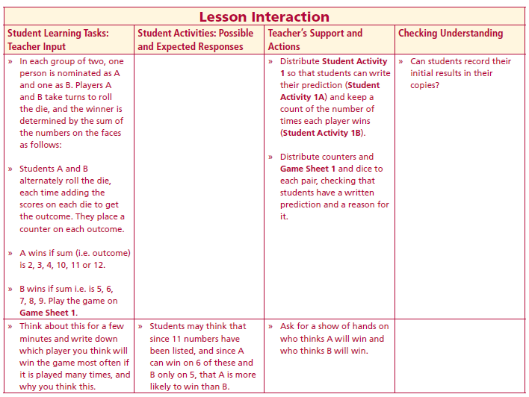
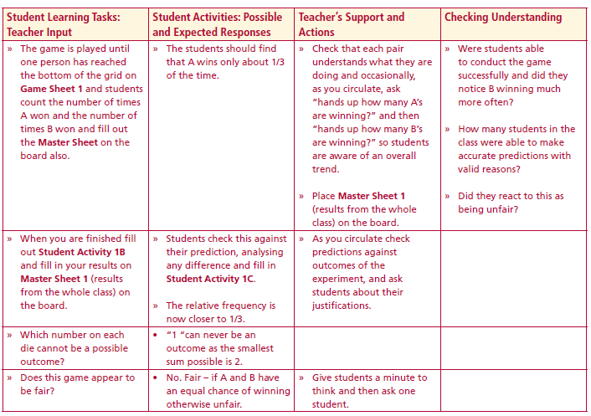
Section A: Fair trials with two dice
In each group of two, one person is nominated as A and one as B. Players A and B take turns to roll the die, and the winner is determined by the sum of the numbers on the faces as follows:
Students A and B alternately roll the die, each time adding the scores on each die to get the outcome. They place a counter on each outcome.
A wins if sum (i.e. outcome) is 2, 3, 4, 10, 11 or 12.
B wins if sum i.e. is 5, 6,7, 8, 9. Play the game on
Lesson interaction
Lesson interaction
Student Activity 1A
Prediction
Player _____ will win most often because:
________________________________________________________________________________________________________________________________________________________________________________________________________________________________________________________________________________________

Slide 4
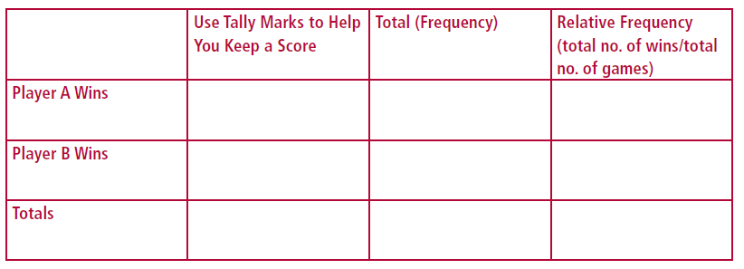
Student Activity 1B
Play the game and record the results below for the whole class:
Lesson interaction
Did your predicted results agree with your actual results?______________
____________________________________________________________________________________________________________________________________________________________________________________

Slide 5
Lesson interaction

Slide 6
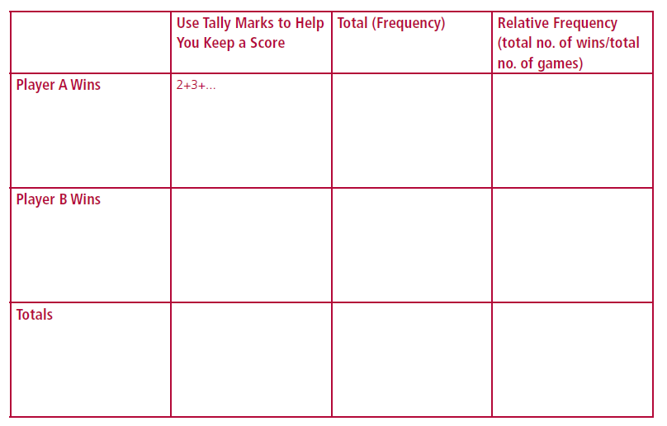
Master Sheet 1
(Results from the Whole Class)
Play the game and record the results below:

Slide 7
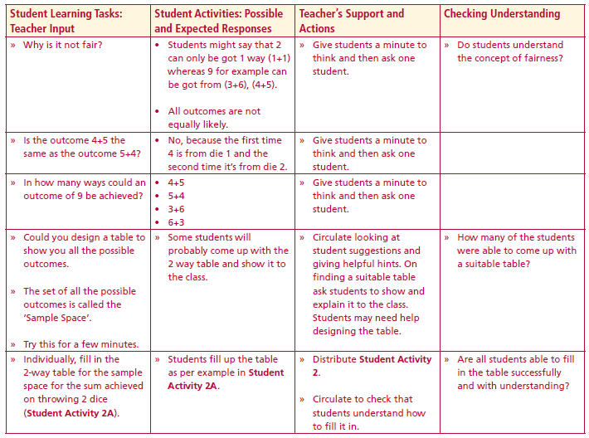
Which number on each die cannot be a possible outcome?
Does this game appear to be fair?
Why is it not fair?
Is the outcome 4+5 the same as the outcome 5+4?
In how many ways could an outcome of 9 be achieved?
Could you design a table to show you all the possible outcomes.
The set of all the possible outcomes is called the ‘Sample Space’.
Lesson interaction

Slide 8
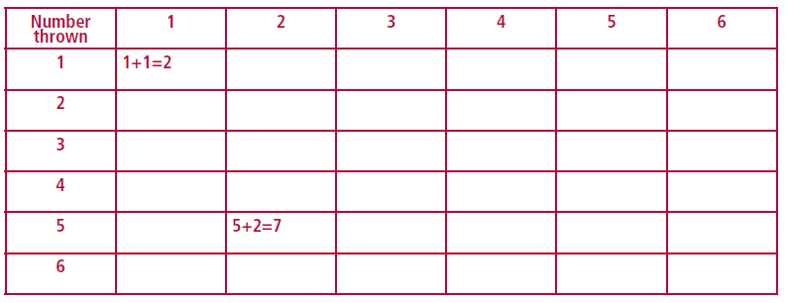
Student Activity 2
Individually, fill in the 2-way table for the sample space for the sum achieved on throwing 2 dice.
Two way table showing the sample space.
Lesson interaction

Slide 9
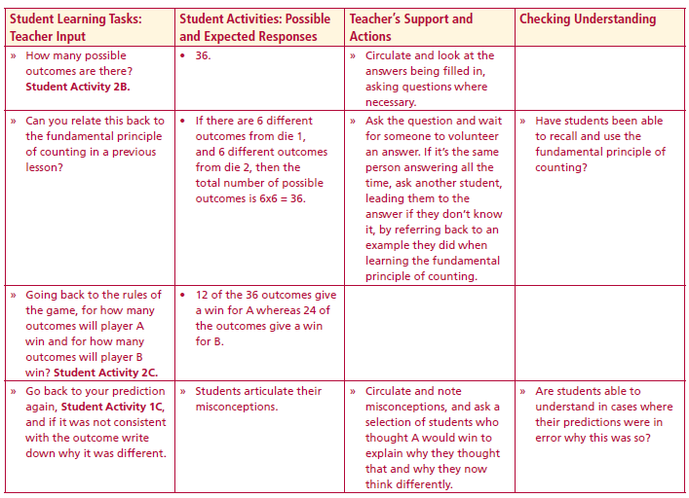
Student Activity 2B
How many possible outcomes are there?__________________
Lesson interaction
Can you relate this back to the fundamental principle of counting in a previous lesson?
Student Activity 2C
Original Rules: Player A wins when the sum is 2, 3, 4, 10, 11 or 12.
Player B wins when the sum is 5, 6, 7, 8 or 9.
For how many outcomes will player A win?__________________
For how many outcomes will player B win?__________________

Slide 10
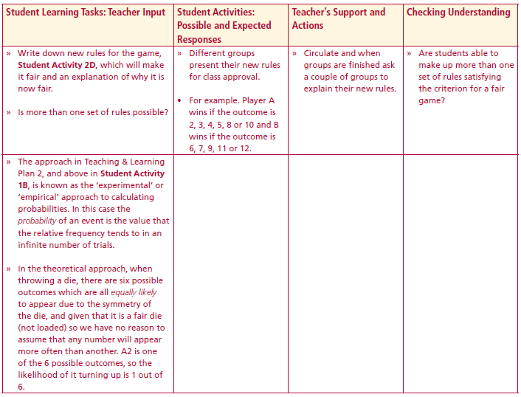
Student Activity 2D
New Rules: Player A wins when the sum is __________________________________
Player B wins when the sum is ___________________________________________
Why I chose these new rules: ___________________________________________
____________________________________________________________________
Lesson interaction
Is more than one set of rules possible?
The approach in Student Activity 1B, is known as the ‘experimental’ or ‘empirical’ approach to calculating probabilities. In this case the probability of an event is the value that the relative frequency tends to in an infinite number of trials.
In the theoretical approach, when throwing a die, there are six possible outcomes which are all equally likely to appear due to the symmetry of the die, and given that it is a fair die (not loaded) so we have no reason to assume that any number will appear more often than another. A2 is one of the 6 possible outcomes, so the likelihood of it turning up is 1 out of 6.

Slide 11
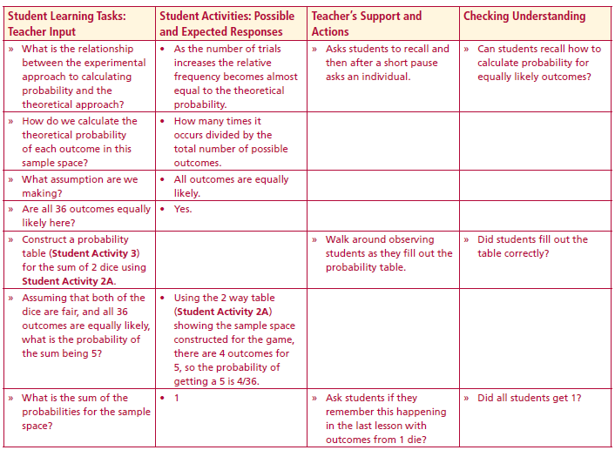
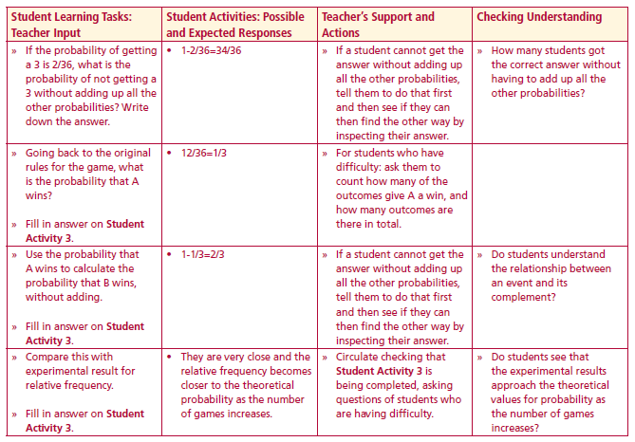
What is the relationship between the experimental approach to calculating probability and the theoretical approach
How do we calculate the theoretical probability of each outcome in this sample space
What assumption are we making
Are all 36 outcomes equally likely here?
Construct a probability table (Student Activity 3) for the sum of 2 dice using Student Activity 2A
Assuming that both of the dice are fair, and all 36 outcomes are equally likely, what is the probability of the sum being 5?
What is the sum of the probabilities for the sample space?
Lesson interaction
Lesson interaction

Slide 12
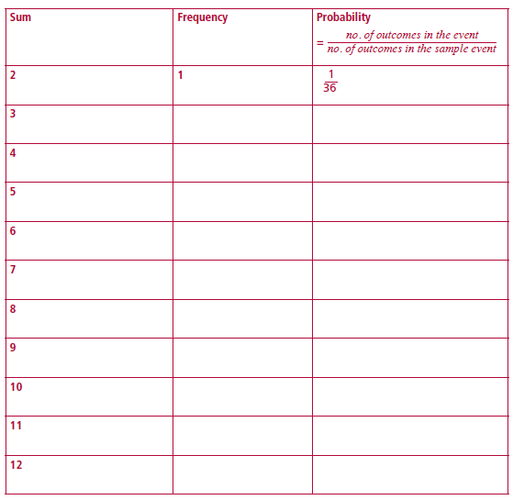
Student Activity 3

Slide 13
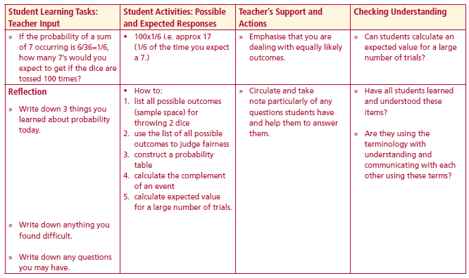
If the probability of getting a 3 is 2/36, what is the probability of not getting a 3 without adding up all the other probabilities? Write down the answer
Going back to the original rules for the game, what is the probability that A wins?
Fill in answer on Student Activity 3.
Use the probability that A wins to calculate the probability that B wins, without adding.
Fill in answer on Student Activity 3.
Compare this with experimental result for relative frequency.
Fill in answer on Student Activity 3.
If the probability of a sum of 7 occurring is 6/36=1/6, how many 7’s would you expect to get if the dice are tossed 100 times?
Lesson interaction

Slide 14
Reflection
Write down 3 things you learned about probability today.
Write down anything you found difficult.
Write down any questions you may have.
Lesson interaction

