Slide 2
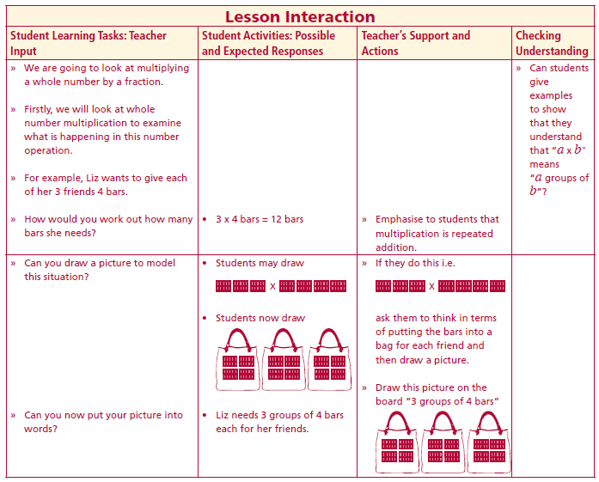
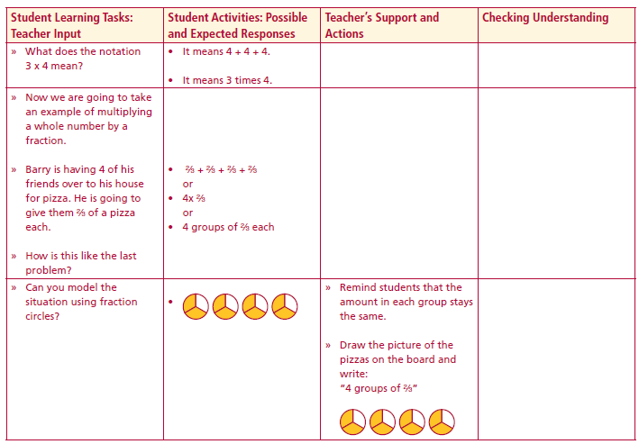
Introduction
We are going to look at multiplying a whole number by a fraction.
Firstly, we will look at whole number multiplication to examine what is happening in this number operation.
For example, Liz wants to give each of her 3 friends 4 bars.
How would you work out how many bars she needs?
Can you draw a picture to model this situation?
Can you now put your picture into words?
What does the notation 3 x 4 mean?
• It means 4 + 4 + 4.
• It means 3 times 4.
Lesson interaction
Lesson interaction

Slide 3
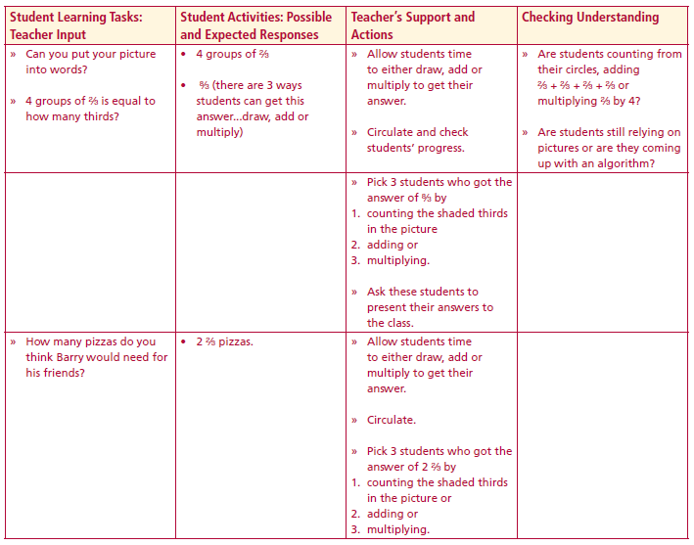
Now we are going to take an example of multiplying a whole number by a
fraction.
Barry is having 4 of his friends over to his house for pizza. He is going to
give them ⅔ of a pizza each.
How is this like the last problem?
Can you model the situation using fraction circles?
Can you put your picture into words?
4 groups of ⅔ is equal to how many thirds?
How many pizzas do you think Barry would need for his friends?
Lesson interaction
Lesson interaction

Slide 4
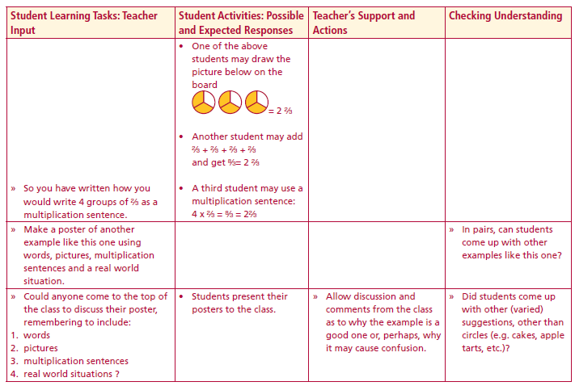
So you have written how you would write 4 groups of ⅔ as a multiplication sentence.
Make a poster of another example like this one using words, pictures, multiplication sentences and a real world situation.
Could anyone come to the top of the class to discuss their poster,
remembering to include:
1. words
2. pictures
3. multiplication sentences
4. real world situations ?
If I ask you to multiply ⅔ by 4, what incorrect answer do you think I could get?
Lesson interaction

Slide 5
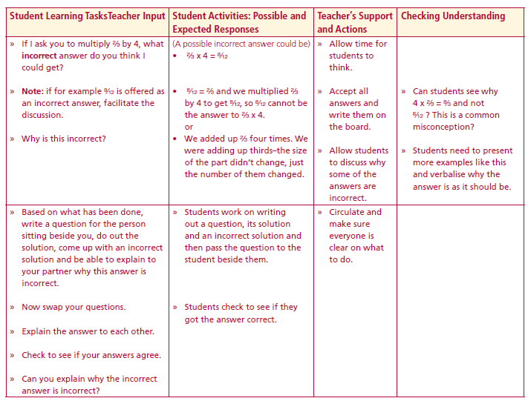
If I ask you to multiply ⅔ by 4, what incorrect answer do you think I
could get?
Why is this incorrect?
Based on what has been done, write a question for the person sitting beside you, do out the solution, come up with an incorrect solution and be able to explain to your partner why this answer is incorrect.
Now swap your questions.
Explain the answer to each other.
Check to see if your answers agree.
Can you explain why the incorrect answer is incorrect?
Lesson interaction

Slide 6
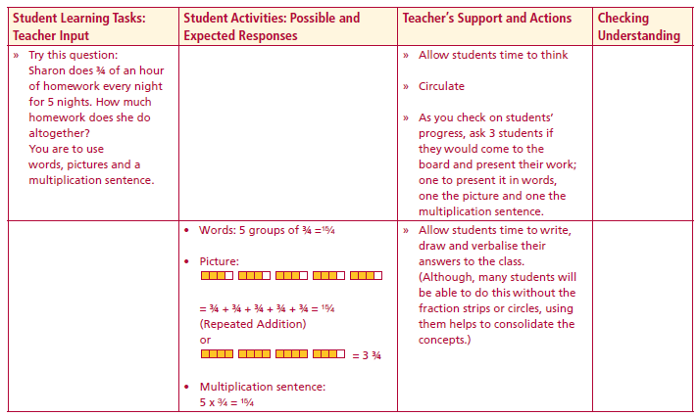
Try this question:
Sharon does ¾ of an hour of homework every night for 5 nights. How much homework does she do altogether?
You are to use words, pictures and a multiplication sentence.
Lesson interaction

Slide 7
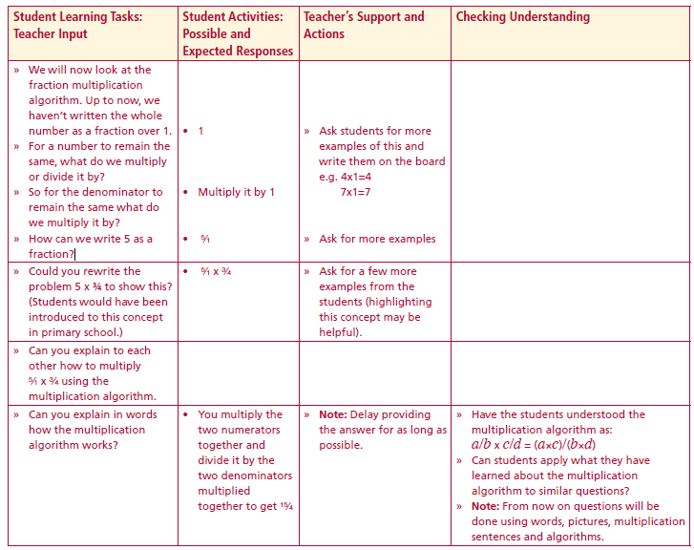
We will now look at the fraction multiplication algorithm. Up to now, we haven’t written the whole number as a fraction over 1.
For a number to remain the same, what do we multiply or divide it by?
So for the denominator to remain the same what do we multiply it by?
How can we write 5 as a fraction?
Could you rewrite the problem 5 x ¾ to show this?
Can you explain to each other how to multiply 5/1 x ¾ using the
multiplication algorithm.
Can you explain in words how the multiplication algorithm works?
Lesson interaction

Slide 8
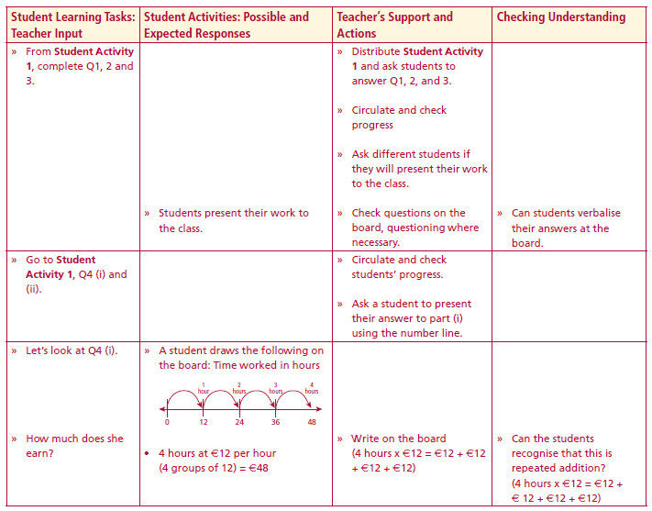
Student Activity 1
The unit:
Picture:
Words: The above diagrams show ________groups of ________
Multiplication sentence: ____ x ____ = ________
Algorithm:
Lesson interaction

Slide 9
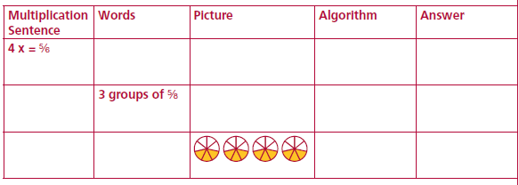
Student Activity 1
Fill in the blank spaces below. When the answers are improper fractions, change them into proper fractions.
3. Mentally picture the following problems before calculating the answers:
(i) 8 x 2/3 = (ii) 5 x 3/11 = (iii) 6 x 5/8 =

Slide 10
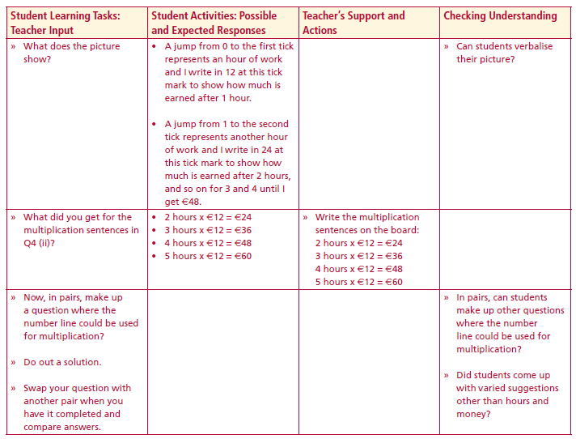
Student Activity 1
4. Aoife works during her Summer holidays for 4 hours on Saturdays and earns €12 per hour.
(i) How much does she earn each Saturday ?
Hint: If €12, the amount earned in 1 hour, is represented by the first tick mark after 0 on the number line below, mark in the amount earned after 2, 3, and 4 hours.
Model the situation on the number line
Lesson interaction
Lesson interaction
(ii) Write the multiplication sentence for the amount earned in
2 hours ________ 3 hours _________ 4 hours _________ 5 hours __________

Slide 11
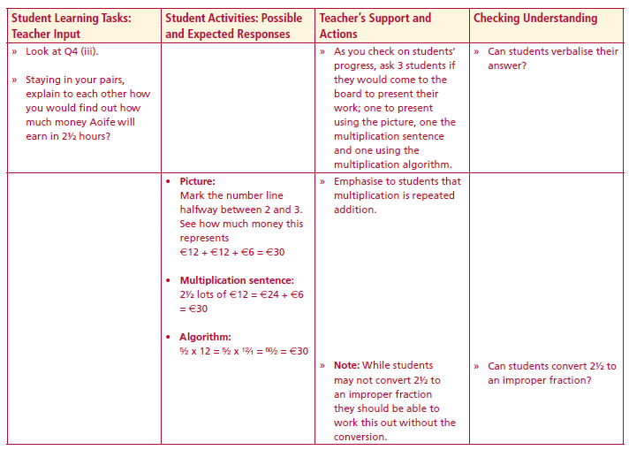
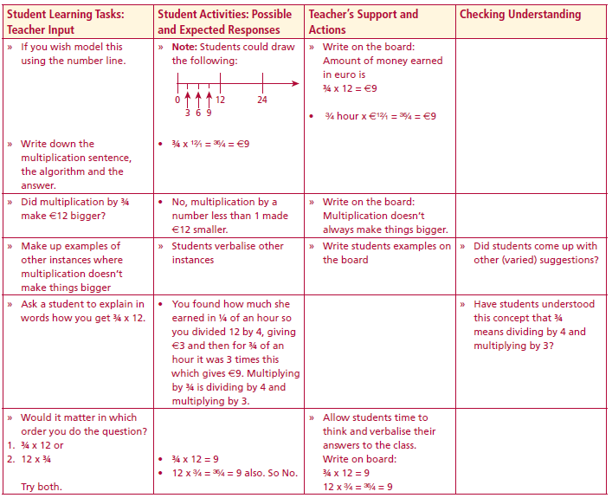
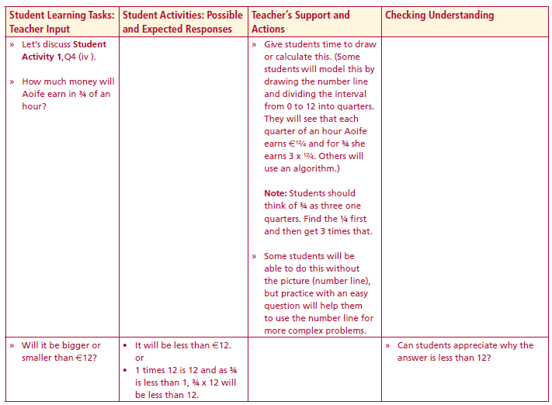
Student Activity 1
(iii) How much money will Aoife earn in 2½ hours?
Model the situation on the number line
Multiplication Sentence ____________________________________________
Algorithm _______________________________________________________
Lesson interaction
Lesson interaction
(iv) Use the number line to model the amount Aoife earns in ¾ hr?
Model the situation on the number line
Multiplication sentence for the amount earned in ¾ of an hour _____________
Algorithm________________________________________________________
Lesson interaction

Slide 12
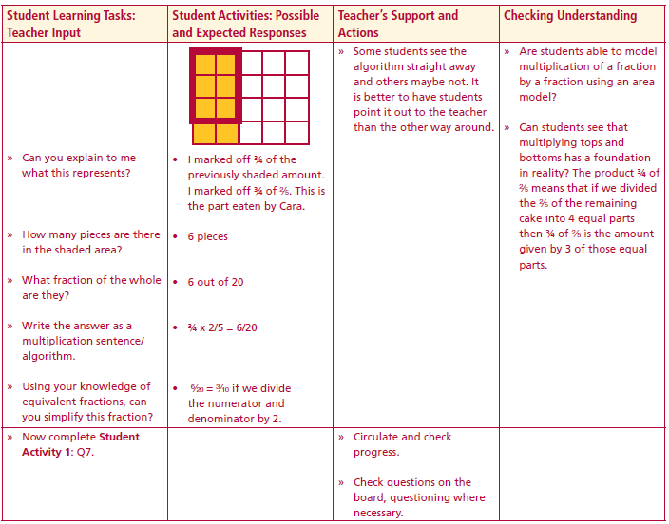
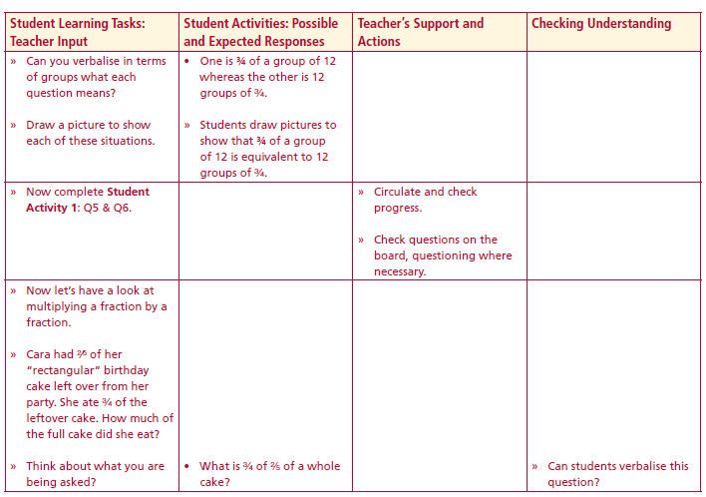
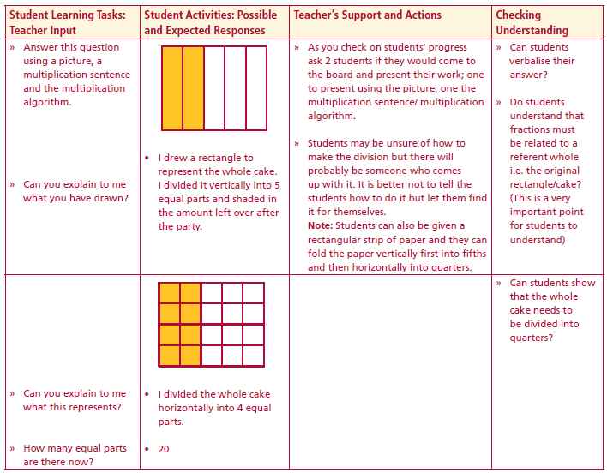
Student Activity 1
5. There are 24 students in Mary’s class. 5/6 of the class went on the school trip. How many students from Mary’s class went on the school trip?
Model the situation on the number line
Multiplication sentence ___________________________________________
Algorithm_______________________________________________________
Lesson interaction
Lesson interaction
6. David picks strawberries during the summer holidays. He earns €8 for each basket of strawberries he picks. How much does he earn if he picks 2¼ baskets of strawberries? Model the situation on the number line
Multiplication sentence ___________________________________________
Algorithm_______________________________________________________
Lesson interaction

Slide 13
Student Activity 1
7. Tony tiled 4/5 of a bathroom wall. Next day he grouted 7/8 of the tiled section. What fraction of the bathroom wall had the tiles grouted?
Model this using an area model Multiplication sentence ____________________________________________________________
Algorithm ___________________________________________________

Slide 14
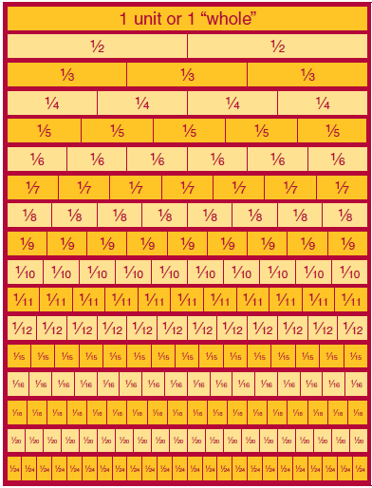
Fraction Wall

