Slide 1


Slide 2
INDEX
Section A: | An Introduction to Geometric Series.
Section B: | To write a series using sigma notations
Appendix | To prove by induction the formula for the sum of the first n terms of a geometric series.

Slide 3
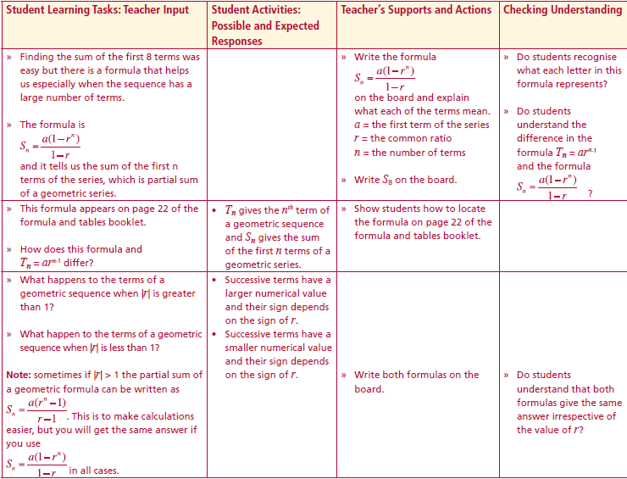
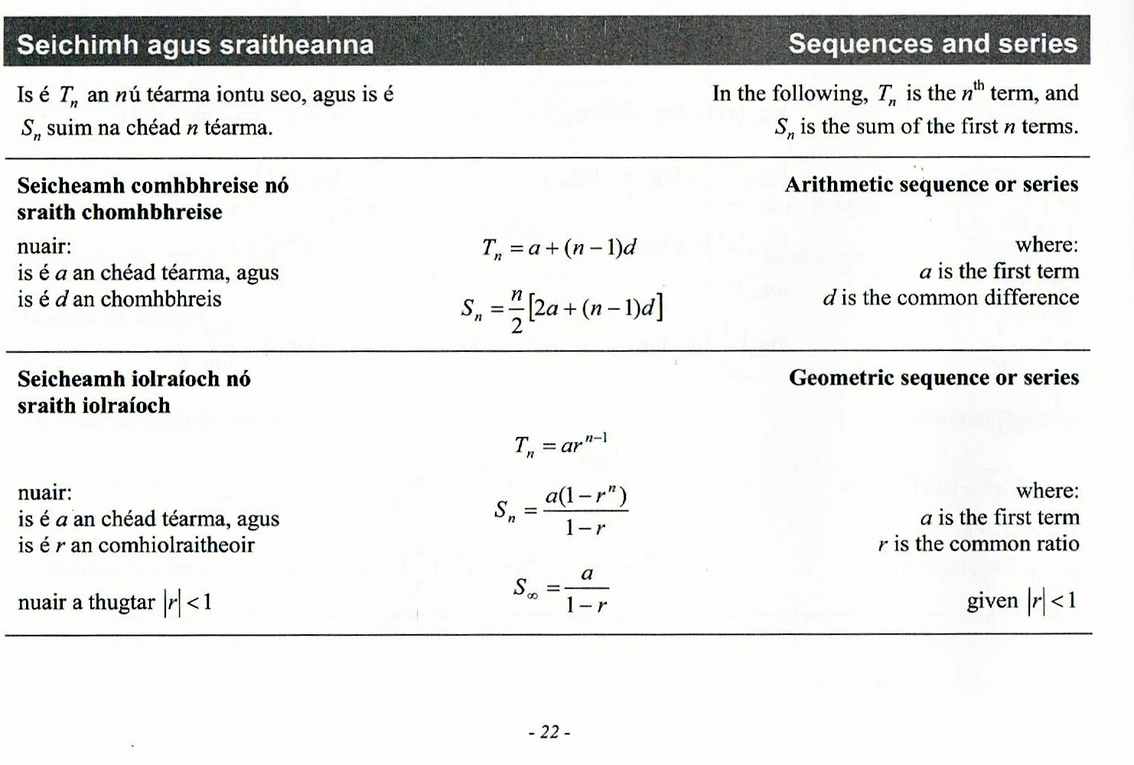
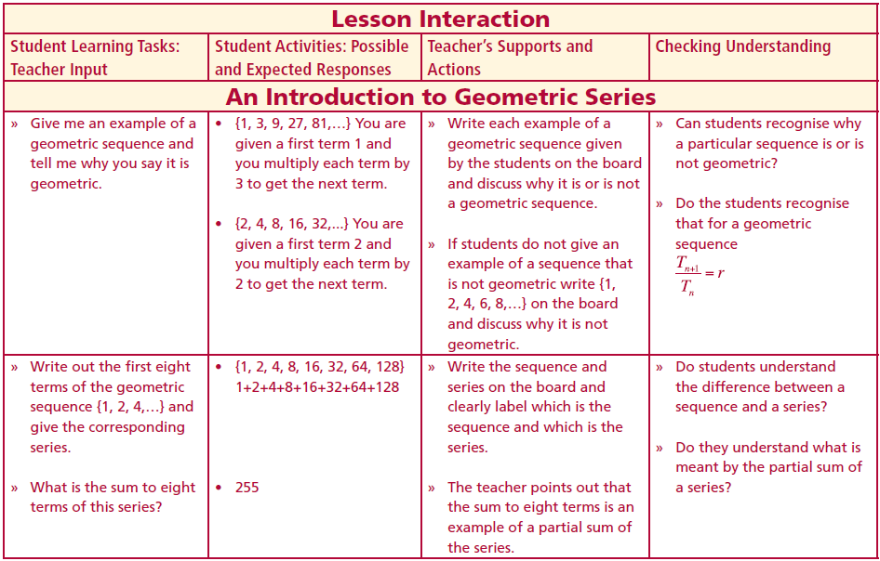
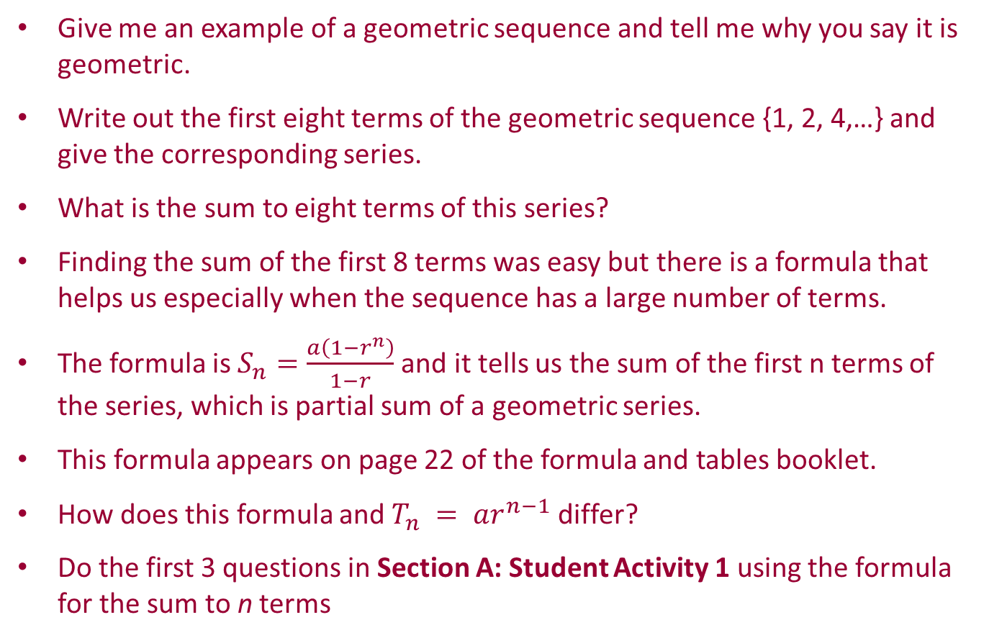
Section A: Student Activity 1
An Introduction to Geometric Series
Give me an example of a geometric sequence and tell me why you say it is geometric.
Write out the first eight terms of the geometric sequence {1, 2, 4,…} and give the corresponding series.
What is the sum to eight terms of this series?
Finding the sum of the first 8 terms was easy but there is a formula that helps us especially when the sequence has a large number of terms.
The formula is $S_{n}=\frac{a\left(1−r^{n}\right)}{1−r}$and it tells us the sum of the first n terms of the series, which is partial sum of a geometric series.
This formula appears on page 22 of the formula and tables booklet.
How does this formula and $T_{n} = ar^{n−1}$differ?
Do the first 3 questions in Section A: Student Activity 1 using the formula for the sum to n terms
Lesson interaction
Lesson interaction
Page 22

Slide 4
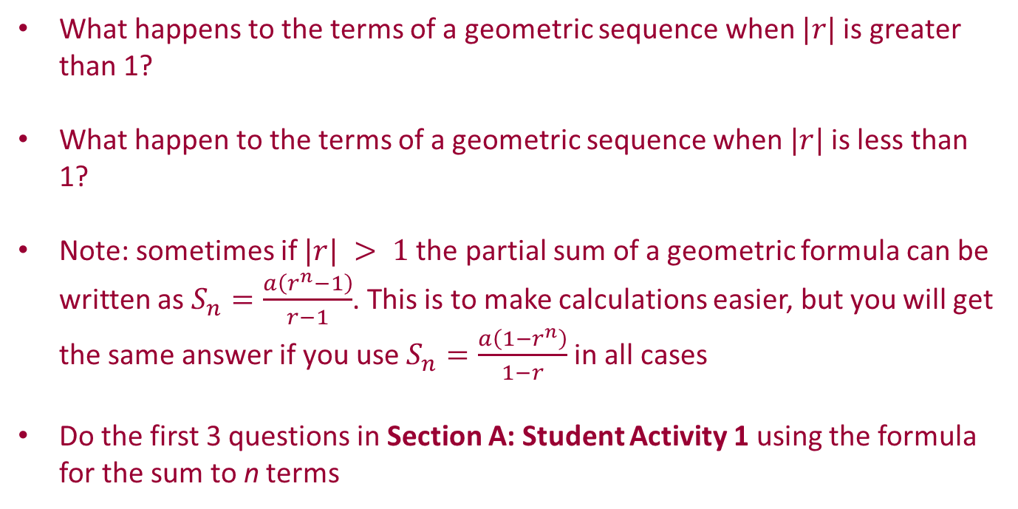
Section A: Student Activity 1
An Introduction to Geometric Series
What happens to the terms of a geometric sequence when $|r|$is greater than 1?
What happen to the terms of a geometric sequence when $|r|$is less than 1?
Note: sometimes if $|r| > 1$the partial sum of a geometric formula can be written as $S_{n}=\frac{a\left(r^{n}−1\right)}{r−1}$. This is to make calculations easier, but you will get the same answer if you use $S_{n}=\frac{a\left(1−r^{n}\right)}{1−r}$in all cases
Do the first 3 questions in Section A: Student Activity 1 using the formula for the sum to n terms
Lesson interaction
Lesson interaction
Page 22

Slide 5
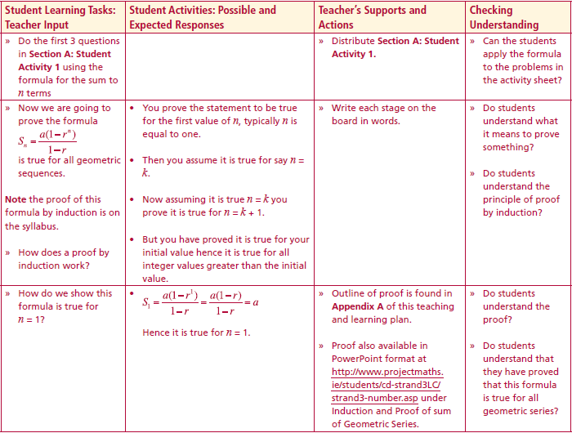
Section A: Student Activity 1
An Introduction to Geometric Series
(Calculations must be shown in all cases.)
1. A person saves €1 in the first month and decides to double the amount he saves the next month. He continues this pattern of saving twice the amount he saved the previous month for 12 months how much will he save on the 12th month and how much will he have saved in total for the year ignoring any interest he received?
2. A culture of bacteria doubles every hour. If there are 100 bacteria at the beginning, how many bacteria will there be at the same time tomorrow, assuming none of these bacteria die in the meantime?
3. a. Find the sum of the first 5 powers of 3.
b. Find the sum of the first 10 powers of 3.
c. Find the sum of the second 5 powers of 3.
Lesson interaction

Slide 6


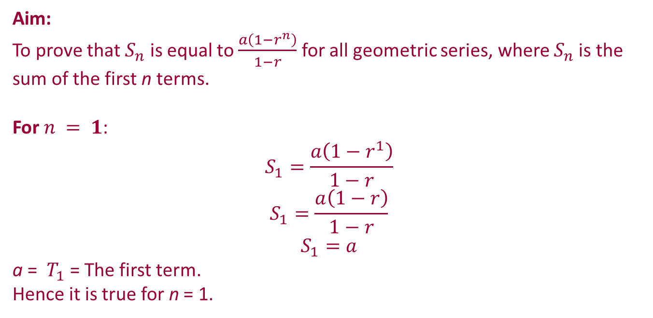
To prove by induction the formula for the sum of the first n terms of a geometric series.
Now we are going to prove the formula $S_{n}=\frac{a\left(1−r^{n}\right)}{1−r}$ is true for all geometric series.
Lesson interaction
Aim:
To prove that $S_{n}$ is equal to $\frac{a\left(1−r^{n}\right)}{1−r}$ for all geometric series, where $S_{n}$is the sum of the first n terms.
For $n = 1$:
$$S_{1}=\frac{a\left(1−r^{1}\right)}{1−r}$$
$$S_{1}=\frac{a\left(1−r\right)}{1−r}$$
$$S_{1}=a$$
a = $T_{1}$= The first term.
Hence it is true for n = 1.

Slide 7
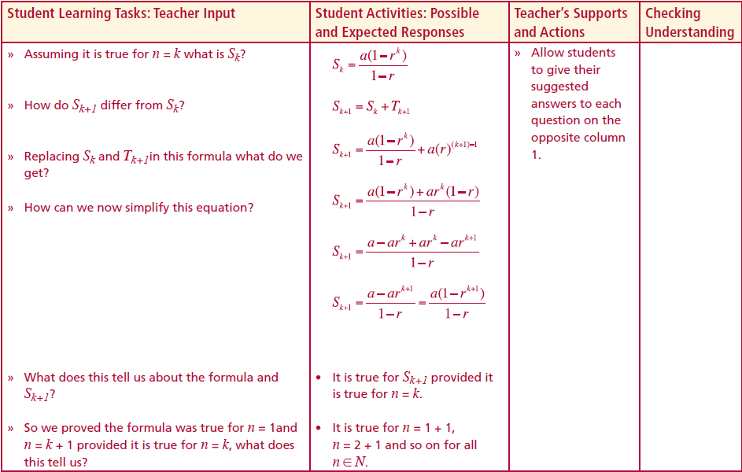



For all n:
Assume true for n = k.
Hence the formula is true for $n = k + 1$provided it is true for $n = k$, but it is true for $n = 1$, hence it is true for all $n$.
Note: $n$ is always a natural number.
Hence $S_{k}=\frac{a\left(1−r^{k}\right)}{1−r}$
But $S_{k+1}=S_{k}+T_{k+1}$
Hence $S_{k+1}=\frac{a\left(1−r^{k}\right)}{1−r}+a{\left(r\right)}^{k+1−1}$
$S_{k+1}=\frac{a\left(1−r^{k}\right) + ar^{k}\left(1−r\right)}{1−r}$
$S_{k+1}=\frac{ a − ar^{k} + ar^{k}−ar^{k+1}}{1−r}$
$S_{k+1}=\frac{ a − ar^{k+1}}{1−r}$ = $\frac{ a\left(1−r^{k+1}\right) }{1−r}$
This proves that $S_{k+1}$ = $\frac{ a\left(1−r^{k+1}\right) }{1−r}$
what is $S_{k}$?
How does $S_{k+1}$ differ from $S_{k}$?
Replacing $S_{k}$ and $T_{k+1}$in this formula what do we get?
How can we now simplify this equation?
What does this tell us about the formula and $S_{k+1}$?
So we proved the formula was true for $n = 1$and $n = k + 1$provided it is true for $n = k$, what does this tell us?
Lesson interaction

Slide 8
Section A: Student Activity 1
4. If the sum of the first 12 terms of a geometric series is 8190 and the common ratio is 2. Find the first term and the 20th term.
5. A person invests €100 and leaves it there for 5 years at 4% compound interest. Assume the interest is paid at the end of each year.
a. What percentage of the original €100 will he have at the end of the first year?
b. How much will he have at the end of the 1 year? Show your calculations.
c. If you know what he had at the end of the first year, how will you work out what he had at the end of the second year?
d. Is this a geometric sequence? If so what are “a” and “r”?
e. How much money will this person have at the end of the 5 years?
f. If the person in this question decided to invest €100 at the beginning of each year for 5 years. Find the total accumulated at the end of the 5 years.
6. Claire has a starting salary of €20,000 and gets a 5% increase per year. How much will she be earning in her 10th year in the job? How much in total will she earn in the first 10 years she works for this firm?

Slide 9
Section A: Student Activity 1
7. Find the sum of the 15th to the 32th terms (inclusive) of the series formed by the following geometric sequence 1, 3, 9, 27,...
8. Find the sum of the following geometric series
9. The birth rate in an area is increasing by 6% per annum. If there are 20,000 children born in this area in 2009.
a. How many children will be born in 2018 in this area?
b. How many children in total will be born in this area between the years 2009 to 2018 inclusive?
10. Alice saves €450 at the beginning of each year for 10 years at 5% compound interest added at the end of each year. How much will they have on the 10th anniversary of her first payment?

Slide 10

Section A: Student Activity 1
11. Alan aged 25 starts paying €2000 per annum into a pension fund and they are guaranteed a 4% interest rate throughout the savings period. How much will they have in the pension fund at the end of 30 years? Note for this particular pension the payments are made at the beginning of each year and the interest is paid at the end of each year.
12. A ball is bounced from a height of 2 metres and bounces back to ¾ of the height from which it fell. Find the total distance the ball travels, when it hits the ground for the 6th time
13. A carpenter is drilling a hole in a wall, which is a metre wide. In the first second he drills 30 centimetres and every second after that he drills ¾ the distance he drilled the previous second. How long will it be until he has completely drilled through the wall?
$$\frac{200 \left(1−{\left(\frac{3}{4}\right)}^{6}\right)}{1−\frac{3}{4}}$$

Slide 11
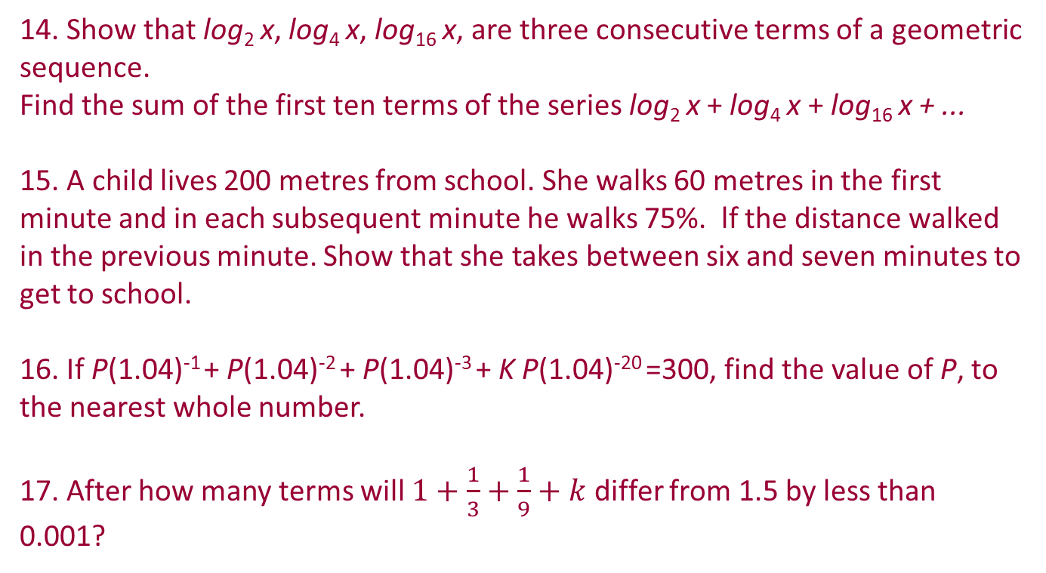
Section A: Student Activity 1
14. Show that log₂ x, log₄ x, log₁₆ x, are three consecutive terms of a geometric sequence.
Find the sum of the first ten terms of the series log₂ x + log₄ x + log₁₆ x + ...
15. A child lives 200 metres from school. She walks 60 metres in the first minute and in each subsequent minute he walks 75%. lf the distance walked in the previous minute. Show that she takes between six and seven minutes to get to school.
16. If P(1.04)⁻¹ + P(1.04)⁻² + P(1.04)⁻³ + K P(1.04)⁻²⁰ =300, find the value of P, to the nearest whole number.
17. After how many terms will $1+\frac{1}{3}+\frac{1}{9}+k$ differ from 1.5 by less than 0.001?

Slide 12
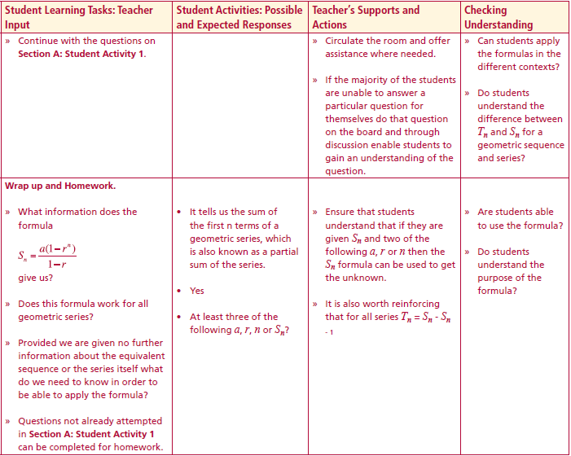
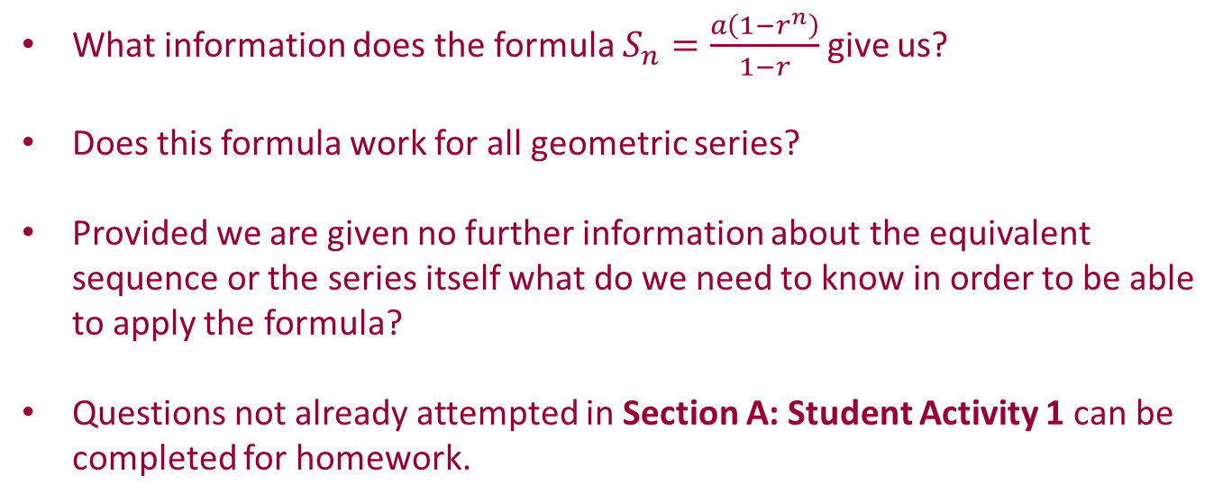
Section A: Student Activity 1
Summary
Lesson interaction
What information does the formula $S_{n}=\frac{a\left(1−r^{n}\right)}{1−r}$give us?
Does this formula work for all geometric series?
Provided we are given no further information about the equivalent sequence or the series itself what do we need to know in order to be able to apply the formula?
Questions not already attempted in Section A: Student Activity 1 can be completed for homework.

Slide 13
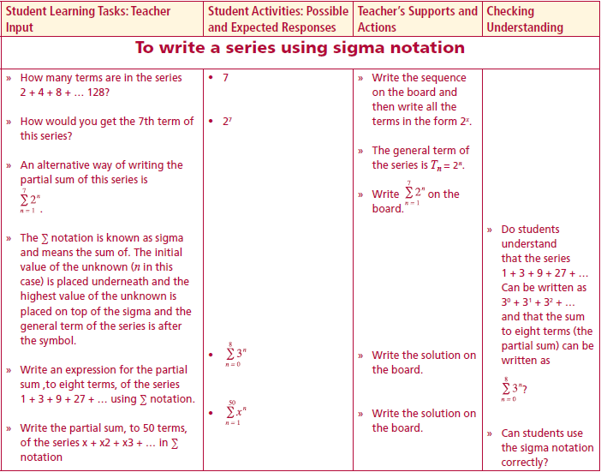
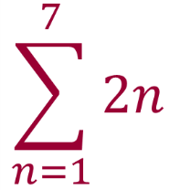
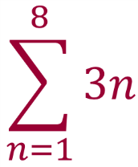
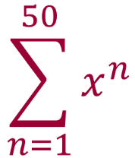
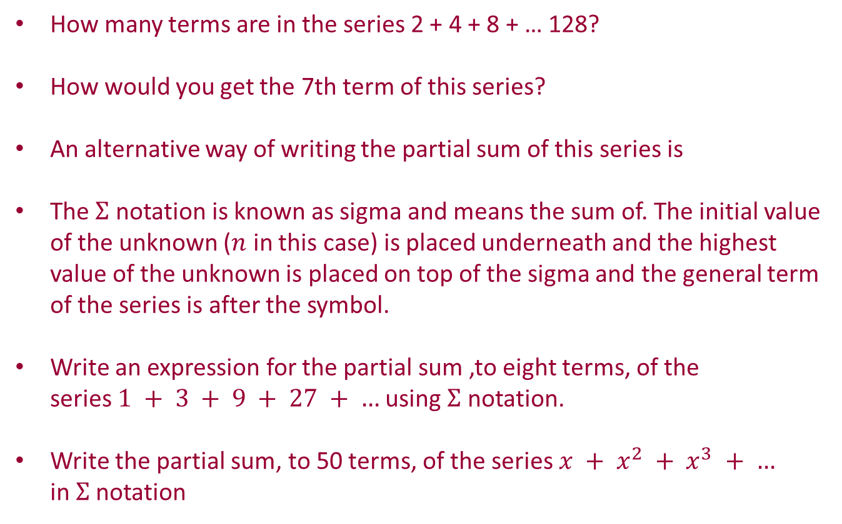
Section B: Student Activity 1
To write a series using sigma notation
How many terms are in the series 2 + 4 + 8 + … 128?
How would you get the 7th term of this series?
An alternative way of writing the partial sum of this series is
The $Σ$ notation is known as sigma and means the sum of. The initial value of the unknown ($n$ in this case) is placed underneath and the highest value of the unknown is placed on top of the sigma and the general term of the series is after the symbol.
Write an expression for the partial sum ,to eight terms, of the series $1 + 3 + 9 + 27 + …$using $Σ$ notation.
Write the partial sum, to 50 terms, of the series $x + x^{2} + x^{3} + …$ in $Σ$notation
Lesson interaction

Slide 14
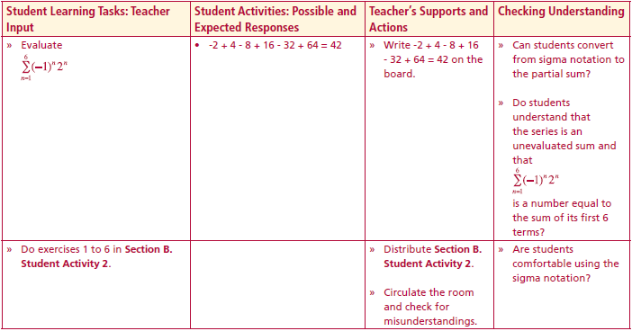
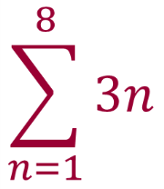
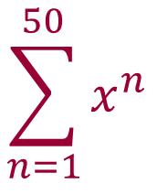
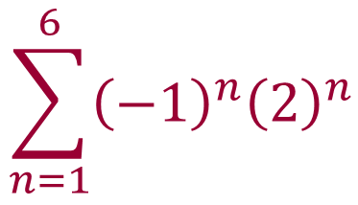
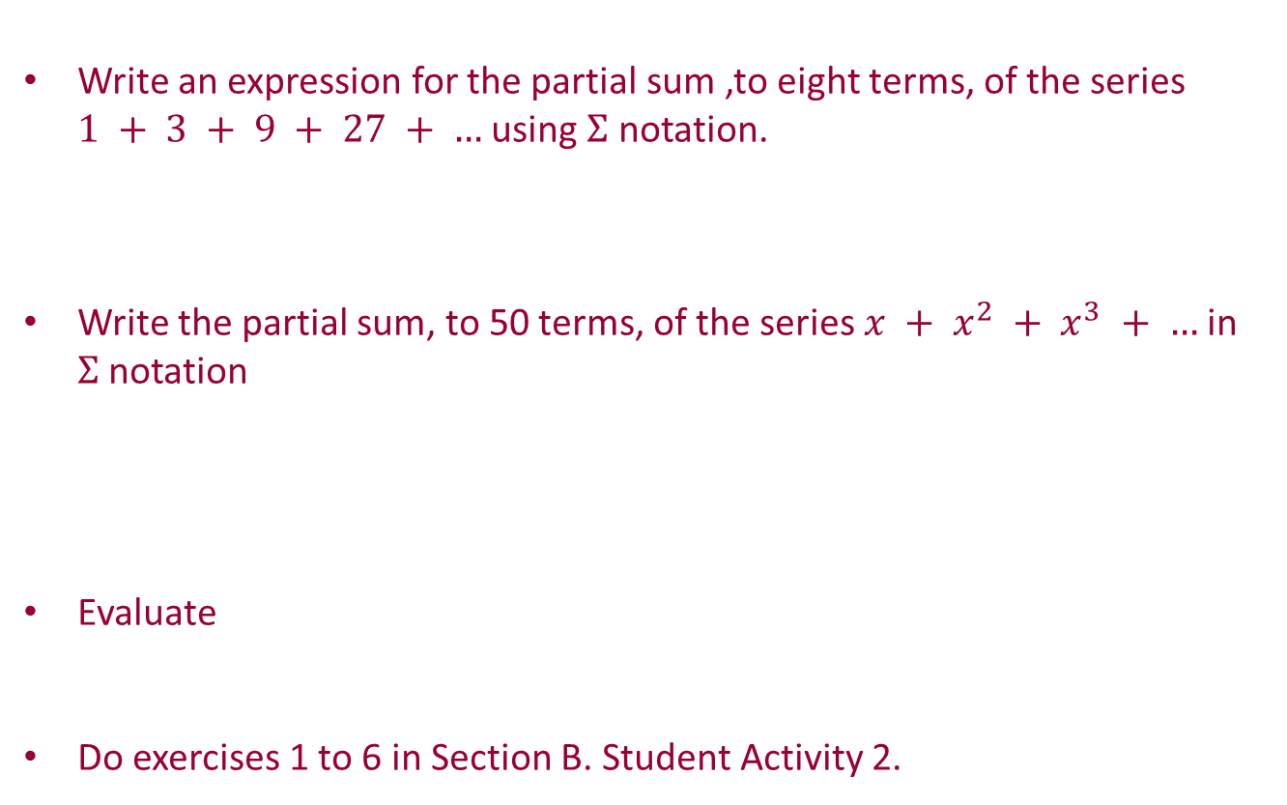
Section B: Student Activity 1
To write a series using sigma notation
Write an expression for the partial sum ,to eight terms, of the series $1 + 3 + 9 + 27 + …$using $Σ$ notation.
Write the partial sum, to 50 terms, of the series $x + x^{2} + x^{3} + …$in $Σ$notation
Evaluate
Do exercises 1 to 6 in Section B. Student Activity 2.
Lesson interaction
Lesson interaction
= - 2 + 4 – 8 + 16 - 32 + 64
= 42

Slide 15
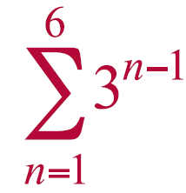
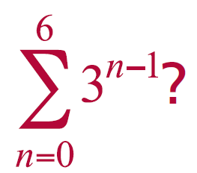
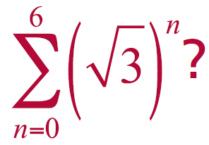
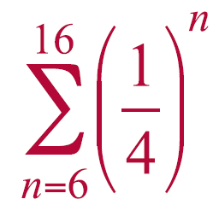
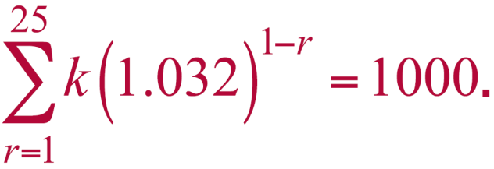
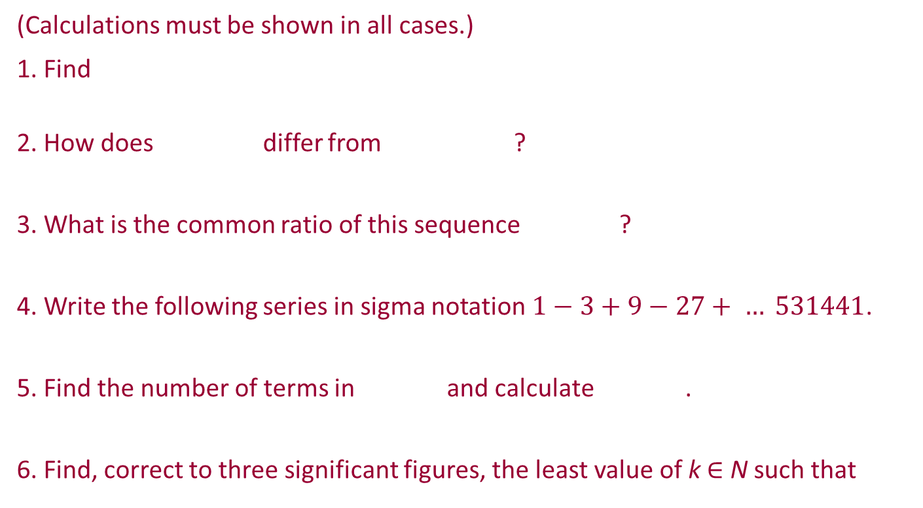
Section B: Student Activity 2
(Calculations must be shown in all cases.)
1. Find
2. How does differ from ?
3. What is the common ratio of this sequence ?
4. Write the following series in sigma notation $1−3+9−27+ … 531441$.
5. Find the number of terms in and calculate .
6. Find, correct to three significant figures, the least value of k ∈ N such that

Slide 16
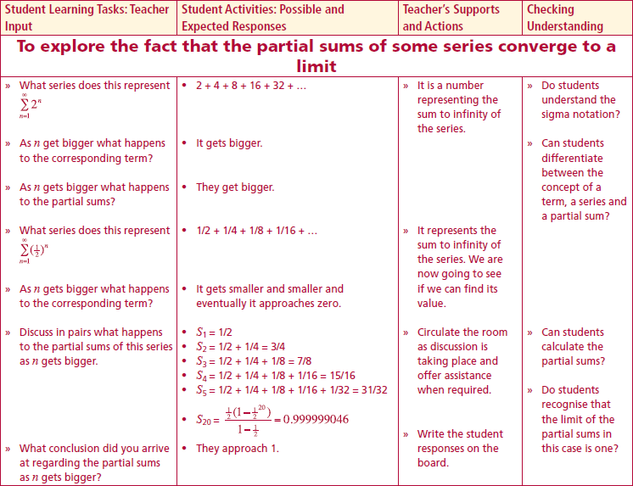
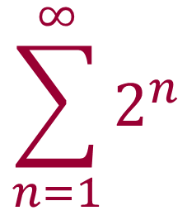
Section B: Student Activity 2
To explore the fact that the partial sums of some series converge to a limit
What series does this represent
2 + 4 + 8 + 16 + 32 + …
As n get bigger what happens to the corresponding term?
It gets bigger.
As n gets bigger what happens to the partial sums?
They get bigger.
Lesson interaction

Slide 17
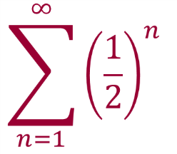

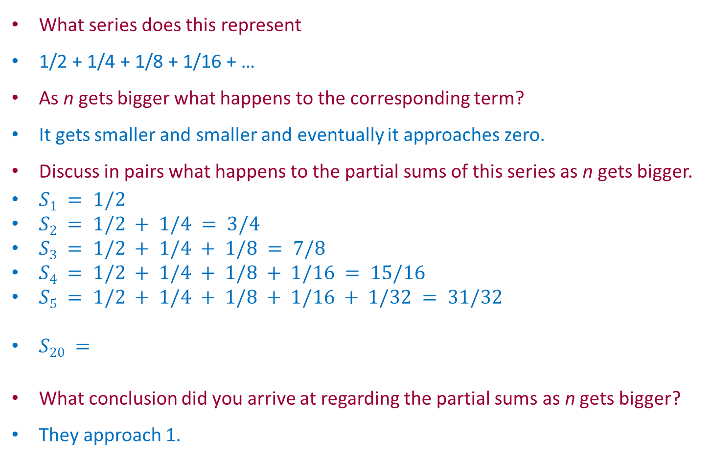
Section B: Student Activity 2
To explore the fact that the partial sums of some series converge to a limit
What series does this represent
1/2 + 1/4 + 1/8 + 1/16 + …
As n gets bigger what happens to the corresponding term?
It gets smaller and smaller and eventually it approaches zero.
Discuss in pairs what happens to the partial sums of this series as n gets bigger.
$S1 = 1/2$
$S2 = 1/2 + 1/4 = 3/4$
$S3 = 1/2 + 1/4 + 1/8 = 7/8$
$S4 = 1/2 + 1/4 + 1/8 + 1/16 = 15/16$
$S5 = 1/2 + 1/4 + 1/8 + 1/16 + 1/32 = 31/32$
$S20 =$
What conclusion did you arrive at regarding the partial sums as n gets bigger?
They approach 1.
Lesson interaction
$$\frac{\frac{1}{2}\left(1−{\left(\frac{1}{2}\right)}^{20}\right)}{1−\frac{1}{2}}=0.999999046$$

Slide 18
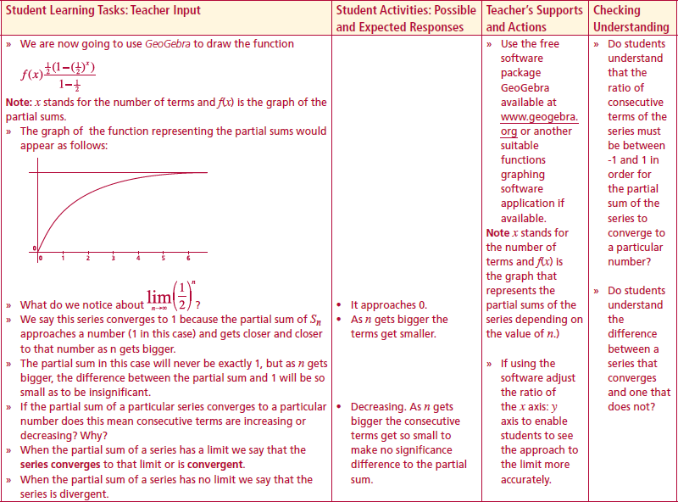
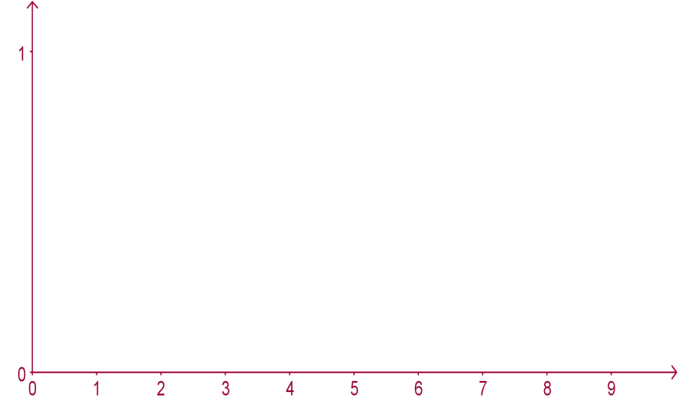
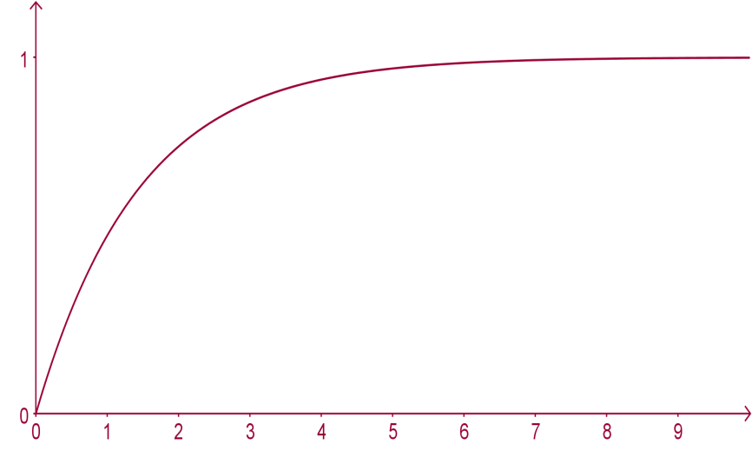
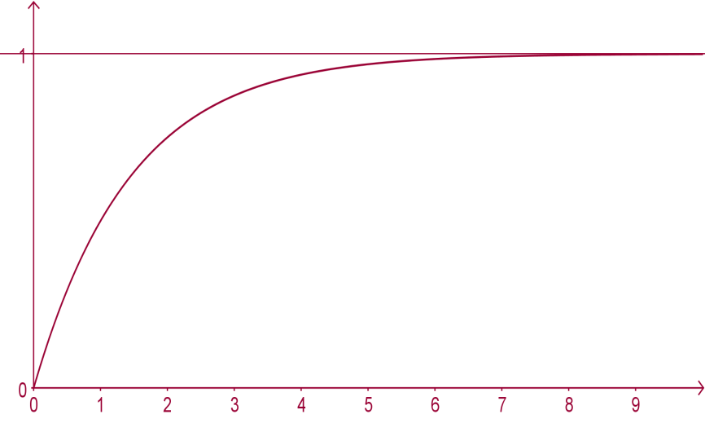
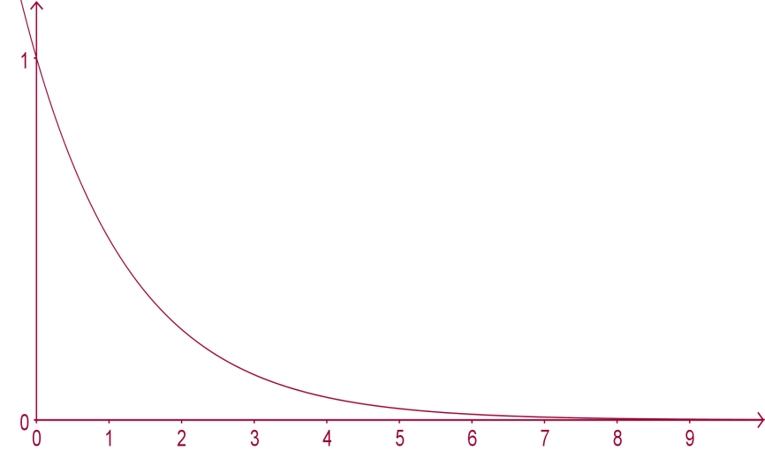




Section B: Student Activity 2
To explore the fact that the partial sums of some series converge to a limit
We can use GeoGebra to draw the function
Note: x stands for the number of terms and f(x) is the graph of the partial sums.
The graph of the function representing the partial sums would appear as follows:
What do we notice about $lim{\left(\frac{1}{2}\right)}^{n}$?
We say this series converges to 1 because the partial sum of $S_{n}$ approaches a number (1 in this case) and gets closer and closer to that number as n gets bigger.
Lesson interaction
$$f\left(x\right)=\frac{\frac{1}{2}\left(1−{\left(\frac{1}{2}\right)}^{x}\right)}{1−\frac{1}{2}}$$
$$f\left(x\right)={\left(\frac{1}{2}\right)}^{x}$$
$$n→∞$$

Slide 19
Section B: Student Activity 2
To explore the fact that the partial sums of some series converge to a limit
The partial sum in this case will never be exactly 1, but as n gets bigger, the difference between the partial sum and 1 will be so small as to be insignificant.
If the partial sum of a particular series converges to a particular number does this mean consecutive terms are increasing or decreasing? Why?
When the partial sum of a series has a limit we say that the series converges to that limit or is convergent.
When the partial sum of a series has no limit we say that the series is divergent.
Lesson interaction

Slide 20
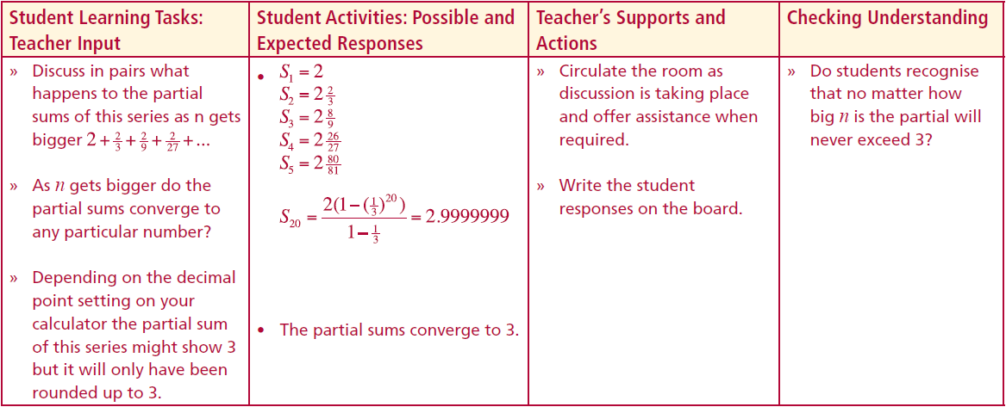
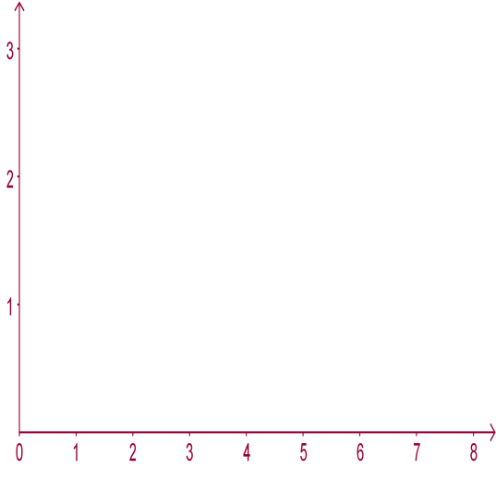
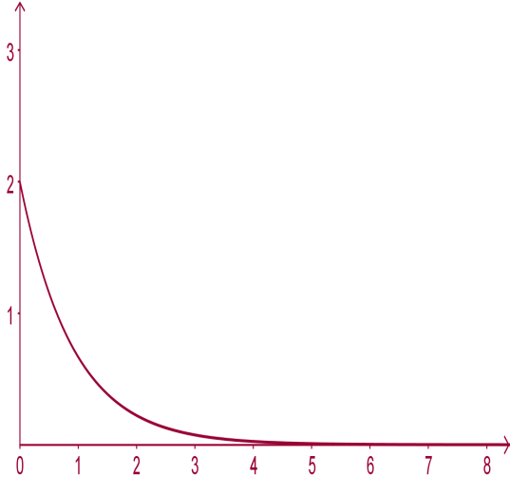
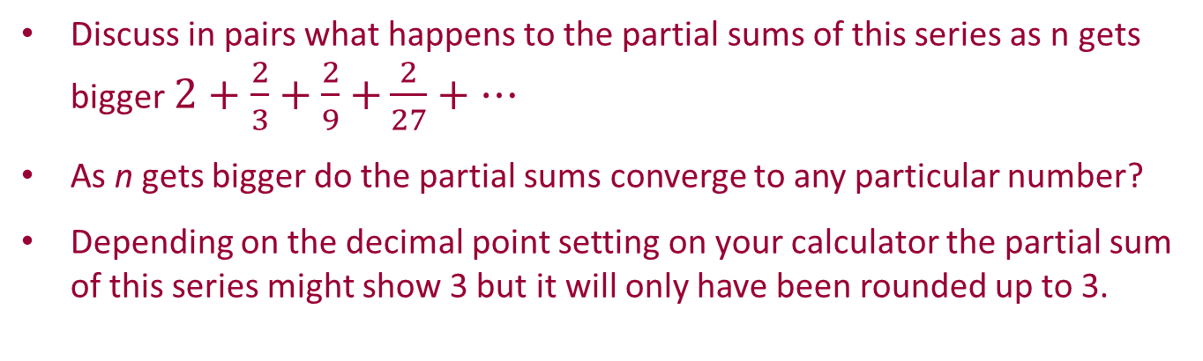
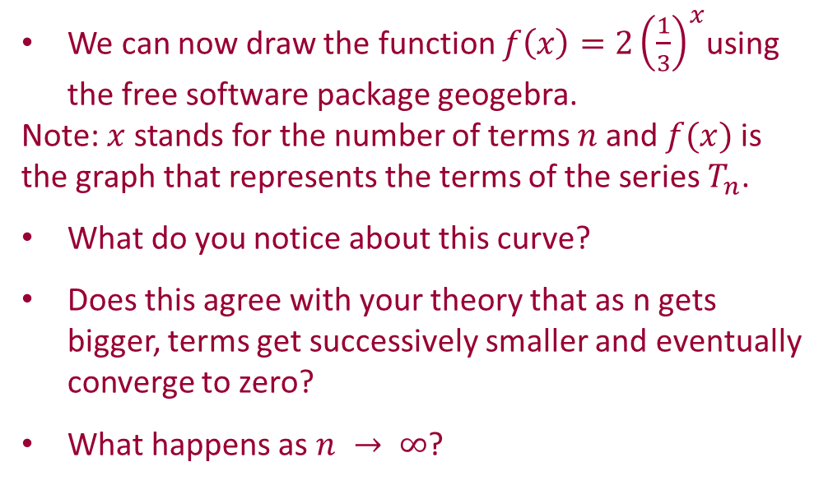
Section B: Student Activity 2
To explore the fact that the partial sums of some series converge to a limit
Discuss in pairs what happens to the partial sums of this series as n gets bigger $2+\frac{2}{3}+\frac{2}{9}$ $+\frac{2}{27}+…$
As n gets bigger do the partial sums converge to any particular number?
Depending on the decimal point setting on your calculator the partial sum of this series might show 3 but it will only have been rounded up to 3.
Lesson interaction
We can now draw the function $f\left(x\right)=2{\left(\frac{1}{3}\right)}^{x}$using the free software package geogebra.
Note: $x$stands for the number of terms $n$and $f(x)$is the graph that represents the terms of the series $T_{n}$.
What do you notice about this curve?
Does this agree with your theory that as n gets bigger, terms get successively smaller and eventually converge to zero?
What happens as $n → ∞$?

Slide 21
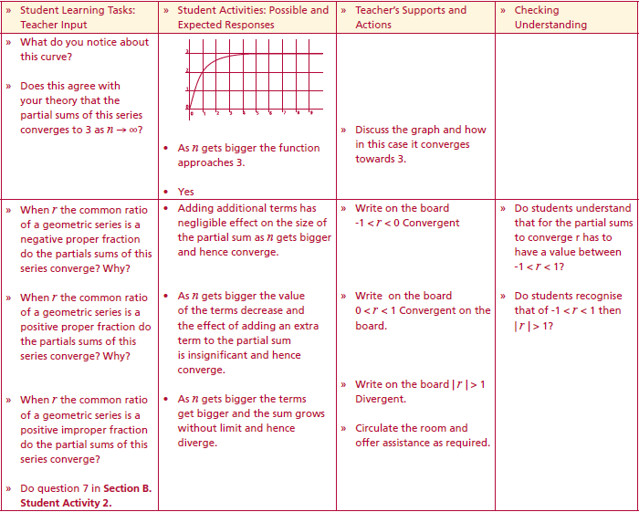






Section B: Student Activity 2
To explore the fact that the partial sums of some series converge to a limit
We can now use GeoGebra to draw the function $f\left(x\right)=\frac{2\left(1−{\left(\frac{1}{3}\right)}^{x}\right)}{1−\frac{1}{3}}$
Note: $x$ stands for the number of terms and $f(x)$is the graph of the partial sums.
Lesson interaction
What do you notice about this curve?
Does this agree with your theory that the partial sums of this series converges to 3 as $n → ∞$?
Lesson interaction
$$f\left(x\right)=\frac{2\left(1−{\left(\frac{1}{3}\right)}^{x}\right)}{1−\frac{1}{3}}$$

Slide 22
Section B: Student Activity 2
To explore the fact that the partial sums of some series converge to a limit
When r the common ratio of a geometric series is a negative proper fraction do the partials sums of this series converge? Why?
When r the common ratio of a geometric series is a positive proper fraction do the partials sums of this series converge? Why?
When r the common ratio of a geometric series is a positive improper fraction do the partial sums of this series converge?
Do question 7 in Section B. Student Activity 2.
Lesson interaction

Slide 23

Section B: Student Activity 2
(Calculations must be shown in all cases.)
7. Examine the partial sums of the series shown below and determine if they converge to a particular value. Explain your reasoning.
a. $\frac{1}{3}+\frac{1}{9}$ $+\frac{1}{27}+…$
b. $1 + 3 + 9 + …$

Slide 24






Section B: Student Activity 1
To develop the concept of the sum to infinity of a geometric series when $−1< r <1$
Now we are going to develop a formula for the sum to infinity of a geometric series when $−1 < r < 1.$That is when r is either a positive or negative proper fraction.
What is the formula for $S_{n}$?
Now we take the limit of this as $n$ goes to infinity:
$limS_{n}=lim\left(\frac{a\left(1−r^{n}\right)}{1−r} \right)$
$limS_{n}=lim\left(\frac{a}{1−r}\right)−lim\left(\frac{ar^{n}}{1−r}\right)$
What value does r have in this special case?
So as $n → ∞$what value has $r^{n}$?
Hence $limS_{n}=lim\left(\frac{a\left(1−r^{n}\right)}{1−r} \right)=\left(\frac{a}{1−r}\right)$
Lesson interaction
$$S_{n}=\frac{a\left(1−r^{n}\right)}{1−r}$$
$$n→∞$$
$$n→∞$$
$$n→∞$$
$$n→∞$$
$$n→∞$$
$$n→∞$$
$$n→∞$$

Slide 25




Section B: Student Activity 1
To develop the concept of the sum to infinity of a geometric series when $−1< r <1$
Lesson interaction
$$S_{∞}=\frac{a}{1−r}$$
This is the formula for the sum to infinity of a geometric series when $−1 < r < 1.$
Why does the sum to infinity formula for a geometric series only work when $−1 <r < 1$?
Now do question 8 onwards in Section B. Student Activity 2.
Lesson interaction

Slide 26

Section B: Student Activity 1
8. Find the sum to infinity of the geometric series $3+\frac{3}{4}+\frac{3}{16}$ $+\frac{3}{64}+…$and explain what information this number provides.
9. Find the sum to infinity of the geometric series $1+\frac{1}{2}+\frac{1}{4}$ $+\frac{1}{8}+…$and explain what information this number provides.
10. The cost of laying a cable comprises a fixed amount of €3,000 for every 50m and a variable cost of €3,000 for the first 50m, €2,400 for the next 50m, and €1,920 for the next 50m and this geometric decrease continues.
a. Calculate the total cost of laying a 300m long cable.
b. Show that theoretically the total variable cost cannot exceed €15000.
11. The first term of a geometric series is 2 and the sum to infinity of this geometric sequence is 3 find the common ratio.
12. Find the sum to infinity of the geometric series 49 + 14 + 2 + ...
Lesson interaction

Slide 27



Section B: Student Activity 1
13. Evaluate
14. Evaluate
15. Why can you not find the sum to infinity of the series 1 - 1 + 1 - 1 + 1 + … using the formula $S_{∞}=\frac{a}{1−r}=\frac{1}{1−(−1)}=\frac{1}{2}$
16. Why is it not possible to find the sum to infinity of the geometric sequence 1 + 2 + 4 + 8 + 16 + ... ?
17. a. Do you agree that .$\dot{3}=.33333=\frac{3}{10}+\frac{3}{100}+\frac{3}{1000}+\frac{3}{10000}+ …?$
b. Find the sum to infinity of the geometric series shown in part a.
c. If the above sum to infinity is equal to .$\dot{3}$ , what does it tell us about .$\dot{3}$ in fraction format?
18. Using the sum to infinity formula for a geometric series write each of the following recurring decimals as a fraction.

Slide 28


Section B: Student Activity 1
18. Using the sum to infinity formula for a geometric series write each of the following recurring decimals as a fraction.
.$\dot{7}$ b. .$\dot{4}$ c. 1.$\dot{6}$ d. 2$\text{.}\dot{4}\dot{2}$
$2.4\dot{2}$ f. $0.4\dot{2}\dot{1}$ g. 3$\text{.}\dot{0}\dot{2}$
19. Find the first 4 terms of the geometric series if the first term is 6 and the sum to infinity is 12.
20. The sum to infinity of a geometric series is $5\frac{1}{3}$ and the common ratio is $−\frac{1}{2}$. Determine the first term.
21. The sum to infinity of a geometric sequence is 8 and the first term is 2, find the common ratio and the 5th term.
22. The 2nd term of a geometric sequence is 9 and the 4th term is 1. Find the sum to infinity.

Slide 29

Section B: Student Activity 1
(Calculations must be shown in all cases.)
23. An art student starts with a white triangle that has a base of 16cm and a height of80 cm. Using different colours of construction paper the student places smaller triangles on top of the initial triangle. The side lengths of each triangle are exactly half the lengths of the previous triangle.
© http://www.bmlc.ca/Math40S/Pre-Calculus%20Math%20 40s%20Standards%20Test%20-%20Geometric%20Series%20 QUESTIONS.pdf
If in theory the student can continue this process an infinite number of times, determine the total area of all the triangles..

Slide 30


Section B: Student Activity 1
(Calculations must be shown in all cases.)
24. A square is drawn with a side length of 16cm. A second square is drawn using the midpoints of the first square, and has a side length of $8\sqrt{2}$cm. The process continues infinitely.
a. If the side lengths form a geometric sequence, determine the length of S4.
b. The perimeter of the squares forms a geometric sequence. Find the perimeter of S6 to the nearest tenth.
c. The areas of consecutive squares form a geometric sequence. Determine the common ratio of this sequence.
© http://www.bmlc.ca/Math40S/Pre-Calculus%20Math%2040s%20 Standards%20Test%20-%20Geometric%20Series%20QUESTIONS.pdf

Slide 31
Section B: Student Activity 1
(Calculations must be shown in all cases.)
25. The area of square 1 is ¼ of the area of the square ABCD and the area of Square 2 is a ¼ of the area of square 1. Assuming this pattern continues for an infinite number of times, what fraction of the square ABCD will be covered by the coloured squares.
4
Sq 3
Square 2
Square 1

Slide 32

Appendix A
To prove by induction the formula for the sum of the first n terms of a geometric series.
Aim:
To prove that $S_{n}$ is equal to $\frac{a\left(1−r^{n}\right)}{1−r}$ for all geometric series, where $S_{n}$is the sum of the first n terms.
For $n = 1$:
$$S_{1}=\frac{a\left(1−r^{1}\right)}{1−r}$$
$$S_{1}=\frac{a\left(1−r\right)}{1−r}$$
$$S_{1}=a$$
a = $T_{1}$= The first term.
Hence it is true for n = 1.

Slide 33

Appendix A
For all n:
Assume true for n = k.
Hence the formula is true for $n = k + 1$provided it is true for $n = k$, but it is true for $n = 1$, hence it is true for all $n$.
Note: $n$ is always a natural number.
Hence $S_{k}=\frac{a\left(1−r^{k}\right)}{1−r}$
But $S_{k+1}=S_{k}+T_{k+1}$
Hence $S_{k+1}=\frac{a\left(1−r^{k}\right)}{1−r}+a{\left(r\right)}^{k+1−1}$
$S_{k+1}=\frac{a\left(1−r^{k}\right) + ar^{k}\left(1−r\right)}{1−r}$
$S_{k+1}=\frac{ a − ar^{k} + ar^{k}−ar^{k+1}}{1−r}$
$S_{k+1}=\frac{ a − ar^{k+1}}{1−r}$ = $\frac{ a\left(1−r^{k+1}\right) }{1−r}$
This proves that $S_{k+1}$ = $\frac{ a\left(1−r^{k+1}\right) }{1−r}$

