Slide 1
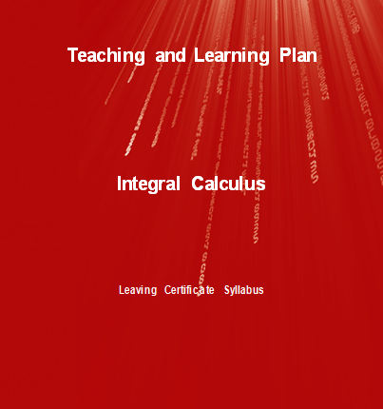

Slide 2
INDEX
Section A : | The Anti-Derivative
Section B: | Integration
Section C: | The Area Function
Section D: | Area as sum

Slide 3
Section A Index
Student Activity 1: | Match each function to its correct derivative.
Student Activity 2: | Find the anti-derivative of…
Student Activity 3: | Using Formulae and Tables
Student Activity 4: | Indefinite form of the anti-derivative
Student Activity 5: | Real life situations

Slide 4
Section A: Student Activity 1
Lesson interaction
We will now revise the process of differentiation. In
Section A: Student Activity 1 there are 10 functions
together with their derivatives. Working in pairs,
I want you to match the correct derivative to each
function.
When you complete the task I want you to examine the function-derivative pairs. Is there anything interesting/noteworthy about your results?

Slide 5
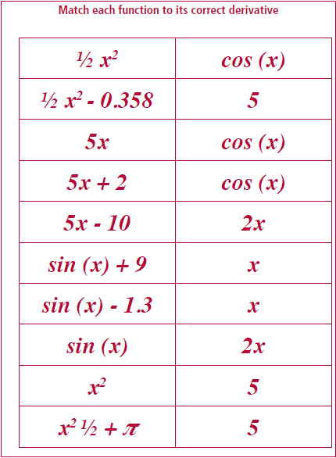
Section A: Student Activity 1
Lesson interaction

Slide 6
Section A: Student Activity 1
Lesson interaction

Slide 7
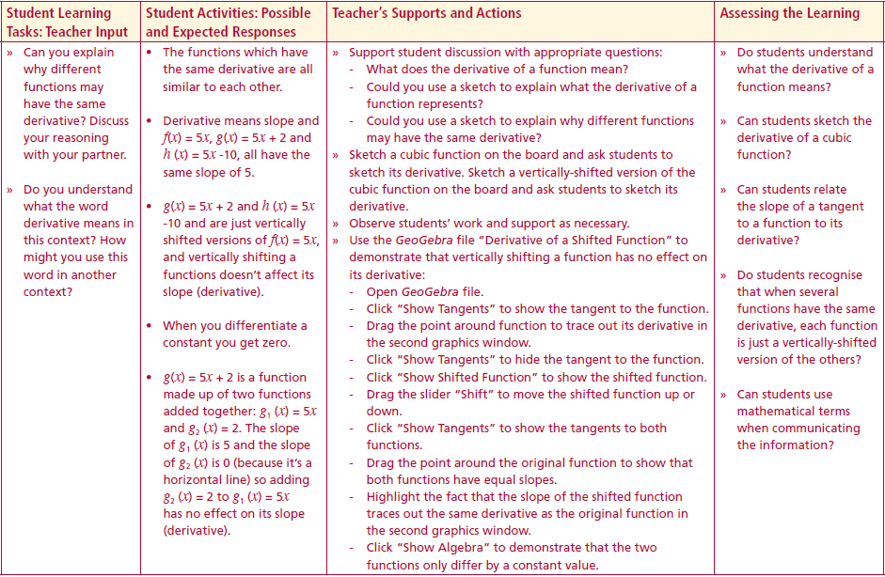
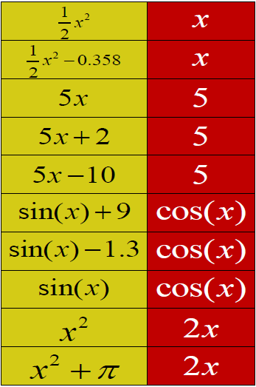
Section A: Student Activity 1
Lesson interaction
Lesson interaction

Slide 8
Section A: Student Activity 1
Function f(x)
Derivative f’(x)
Can you explain why this is so?

Slide 9
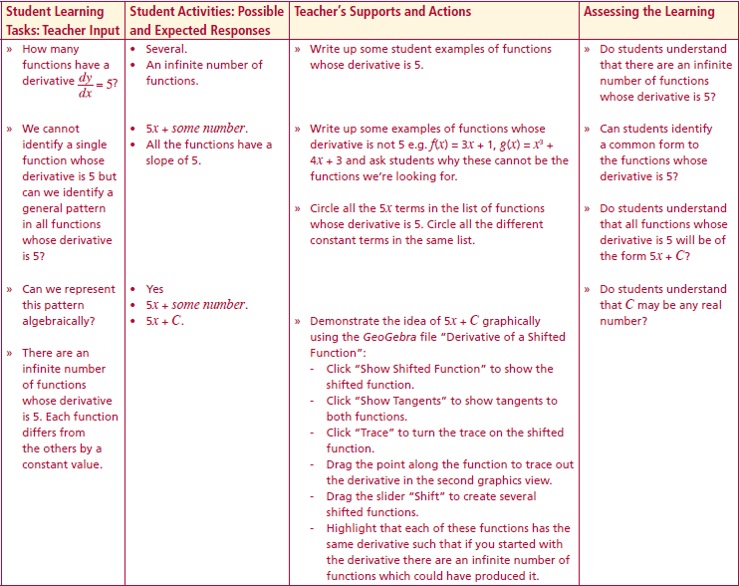
Section A: Student Activity 1
How many functions have a derivative $\frac{dy}{dx}=5$ ?
We cannot identify a single function whose derivative is 5 but can we identify a general pattern in all functions whose derivative is 5?
Can we represent this pattern algebraically?
There are an infinite number of functions whose derivative is 5. Each function differs from the others by a constant value.
Lesson interaction

Slide 10
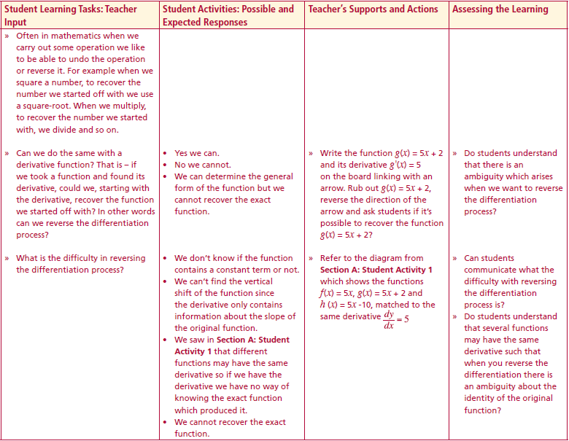
Section A: Student Activity 1
We now see that different functions may have the same derivative.
Can you explain why different functions may have the same derivative? Discuss your reasoning with your partner.
Do you understand what the word derivative means in this context ? How might you use this word in another context?
Often in mathematics when we carry out some operation we like to be able to undo the operation or reverse it. For example when we square a number, to recover the number we started off with we use a square-root. When we multiply, to recover the number we started with, we divide and so on.
Can we do the same with a derivative function? That is – if we took a function and found its derivative, could we, starting with the derivative, recover the function we started off with? In other words can we reverse the differentiation process?
What is the difficulty in reversing the differentiation process?
Lesson interaction
Lesson interaction

Slide 11
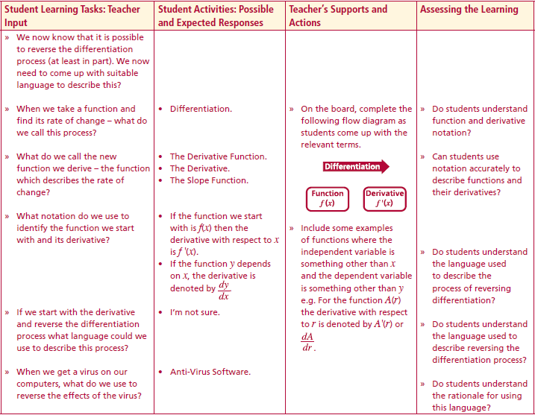
Section A: Student Activity 1
We now know that it is possible to reverse the differentiation process (at least in part). Can we come up with suitable language to describe this?
When we take a function and find its rate of change – what do we call this process?
What do we call the new function we derive – the function which describes the rate of change?
What notation do we use to identify the function we start with and its derivative?
If we start with the derivative and reverse the differentiation process what language could we use to describe this process?
When we get a virus on our computers, what do we use to reverse the effects of the virus?
Lesson interaction
Differentiation
Function
Function$f(x)$
Derivative
Derivative
$$f′(x)$$

Slide 12
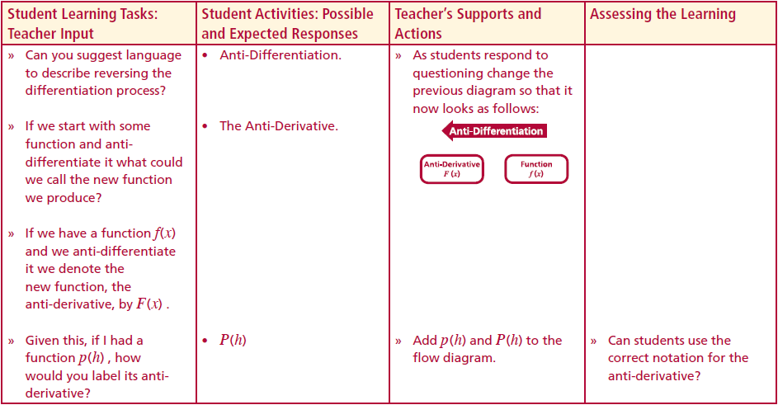
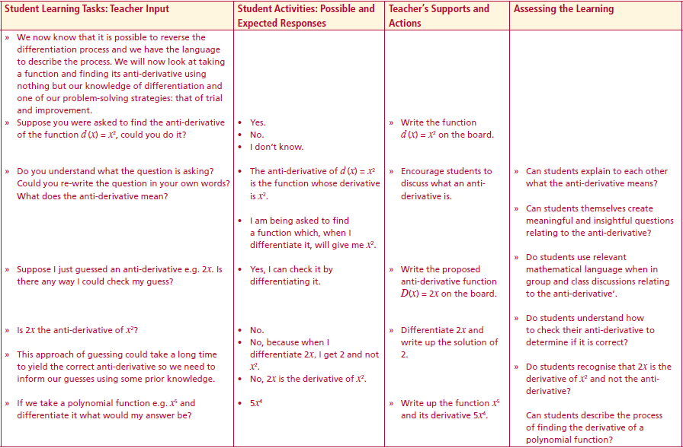
Section A: Student Activity 1
Can you suggest language to describe reversing the differentiation process?
If we start with some function and anti-differentiate it what could we call the new function we produce?
If we have a function f(x) and we anti-differentiate it we denote the new function– the anti-derivative – by F(x).
Given this, if I had a function p(h) , how would you label its anti-derivative?
We now know that it is possible to reverse the differentiation process and we have the language to describe the process. We will now look at taking a function and finding its anti-derivative using nothing but our knowledge of differentiation and one of our problem solving strategies - that of trial and improvement.
Lesson interaction
Lesson interaction
Anti - Differentiation
Anti-Derivative
Anti-Derivative
$$F(x)$$
Function
Function$f(x)$

Slide 13
Section A: Student Activity 1
Suppose you were asked to find the anti-derivative of the function $d(x)=x^{2}$ - could you do it?
Do you understand what the question is asking? Could you re-write the question in your own words? What does the anti-derivative mean?
Suppose I just guessed an anti-derivative e.g. $2x$ . Is there any way I could check my guess?
Is$2x$the anti-derivative of $x^{2}$?
This approach of guessing could take a long time to yield the correct anti-derivative so we need to inform our guesses using some prior knowledge.
If we take a polynomial function e.g. $x^{5}$and differentiate it what would my answer be?
Lesson interaction

Slide 14
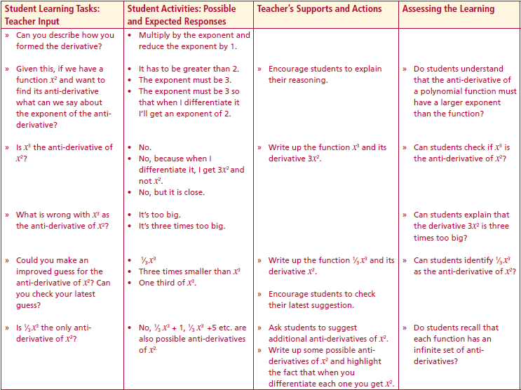
Section A: Student Activity 1
If we take a polynomial function e.g. $x^{5}$and differentiate it what would my answer be?
Can you describe how you formed the derivative?
Given this, if we have a function $x^{2}$and want to find its anti-derivative what can we say about the exponent of the anti-derivative?
Is $x^{3}$the anti-derivative of $x^{2}$?
What is wrong with $x^{3}$as the anti-derivative of $x^{2}$?
Could you make an improved guess for the anti-derivative of $x^{2}$? Can you check your latest guess?
Is ${\frac{1}{3}x}^{3}$ the only anti-derivative of $x^{2}$?
Lesson interaction

Slide 15
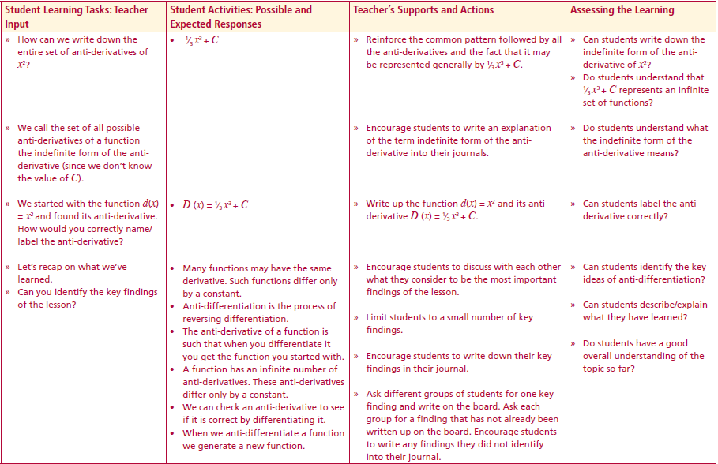
Section A: Student Activity 1
How can we write down the entire set of anti-derivatives of $x^{2}$?
We call the set of all possible anti-derivatives of a function the indefinite form of the anti-derivative (since we don’t know the value of C ).
We started with the function $d\left(x\right)=x^{2}$and found its anti-derivative.
How would you correctly name/label the anti-derivative?
Let’s recap on what we’ve learned.
Can you identify the key findings of the lesson?
Lesson interaction

Slide 16
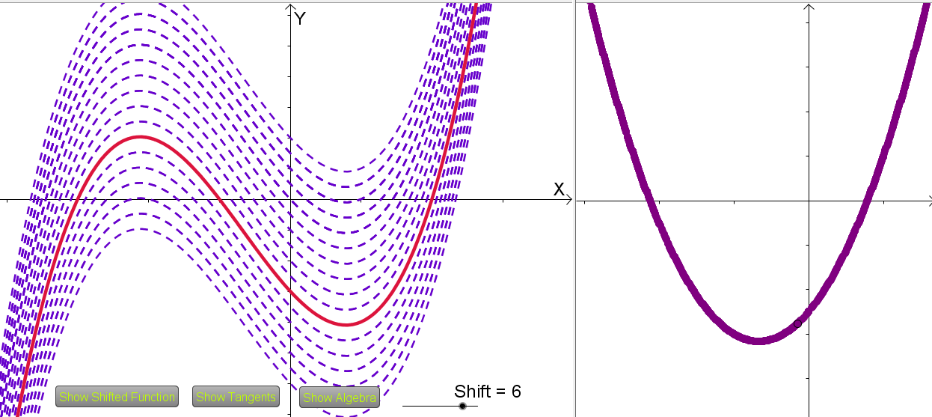
Student Activity
Function f(x)
Derivative f’(x)

Slide 17
Section A: Student Thinking Find the anti-derivative of ... $x^{2}$
What about $x^{3}?$
$$\frac{d}{dx}x^{3}=\left(3\right)x^{2}=3x^{2}$$
It’s closer but still 3 times too big!
I’ll try:
$$\frac{d}{dx}{(\frac{1}{3}x}^{3})=\left(3\right)\frac{1}{3}x^{2}=x^{2}$$
The $3$ and $\frac{1}{3}$ multiply to give 1!
Perfect!…….or is it?
Ok - can I check?
$$\frac{d}{dx}{2x}^{1}=\left(1\right)2x^{0}=2$$
$2x$ is the derivative of $x^{2}$….not
the anti-derivative
Need to think this through…
When I differentiate I get a function which has a smaller exponent ….
So I need a larger exponent
Now this is perfect!
$$\frac{1}{3}x^{3}+C$$
How about $2x?$
Find the function which, when I differentiate it,
gives me $x^{2}$
So – how do I anti-differentiate?
Can I check my result?

Slide 18
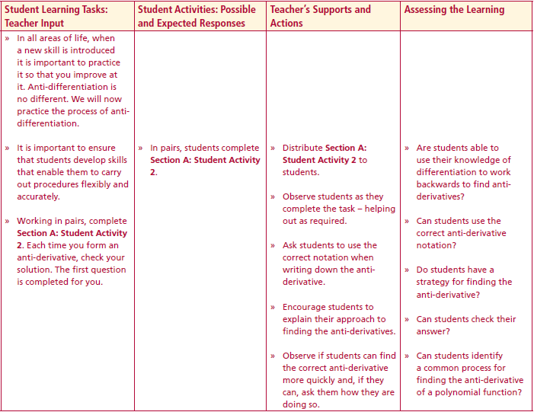
Section A: Student Activity 2
In all areas of life, when a new skill is introduced it is important to practice it so that you improve at it. Anti-differentiation is no different. We will now practice the process of anti-differentiation.
Working in pairs, complete Section A: Student Activity 2. Each time you form an anti-derivative, check your solution. The first question is completed for you.
Lesson interaction

Slide 19
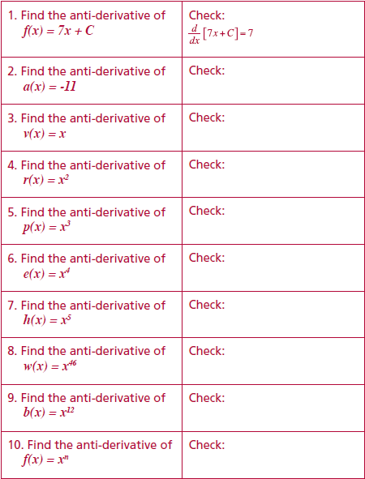
Section A: Student Activity 2

Slide 20
Section A: Student Activity 2
Describe a general rule for taking a polynomial function
and finding its anti-derivative

Slide 21
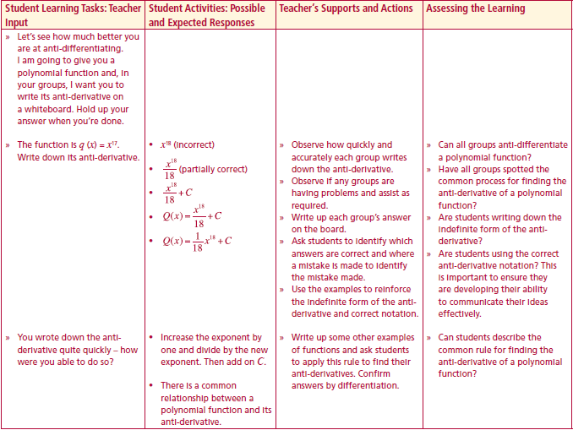
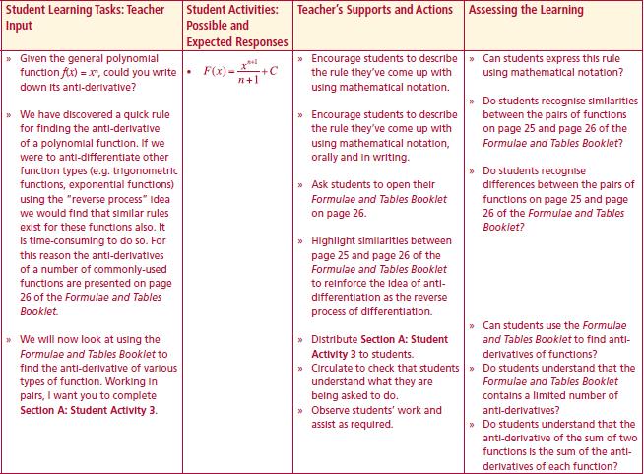
Section A: Student Activity 3
Let’s see how much better you are at anti-differentiating. I am going to give you a polynomial function and, in your groups, I want you to write its anti-derivative on a whiteboard. Hold up your answer when you’re done.
The function is $q(x){=x}^{17}$. Write down its anti-derivative.
You wrote down the anti-derivative quite quickly – how were you able to do so?
Given the general polynomial function $f(x)=x^{n}$ , could you write down its anti-derivative?
We have discovered a quick rule for finding the anti-derivative of a polynomial function. If we were to anti-differentiate other function types (e.g. trigonometric functions, exponential functions) using the “reverse process” idea we would find that similar rules exist for these functions also. It is time-consuming to do so. For this reason the anti-derivatives of a number of commonly-used functions are presented on Pg. 26 of the Formulae and Tables Booklet.
Lesson interaction
Lesson interaction

Slide 22
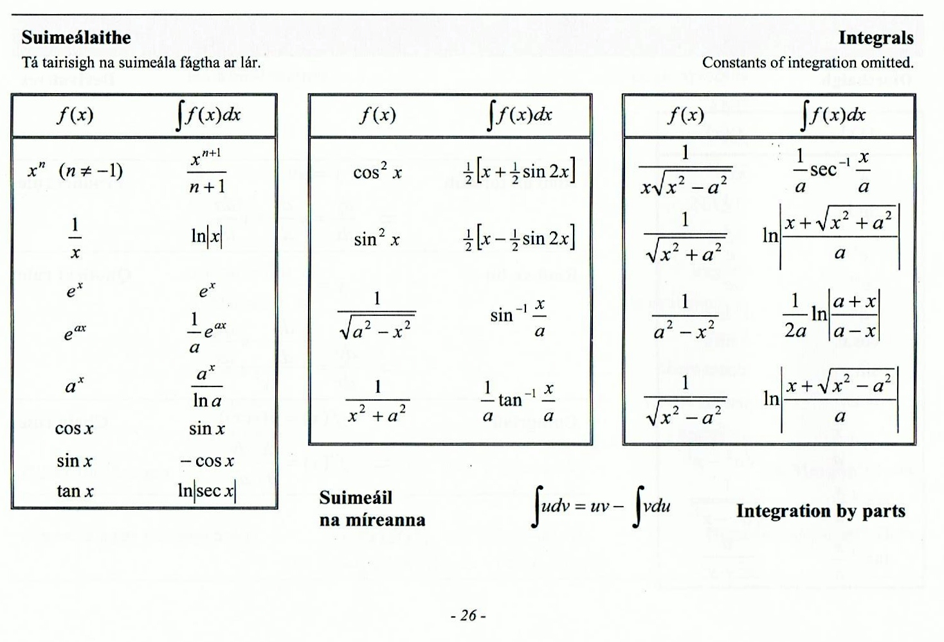
Section A: Student Activity 3
Page 26
By referring to Pg. 25 and Pg. 26 of the Formulae and Tables Booklet or otherwise, answer the following questions.
Q1. Write down the anti-derivative of h(x) =16 $x^{3}$ .
Q2. Write down the anti-derivative of $c\left(x\right)=e^{5x}$.
Q3. Write down the anti-derivative of $r\left(a\right)=9a^{−19}$ .
Q4. Write down the anti-derivative of $w\left(x\right)=x^{−1}$.
Q5. Write down the anti-derivative of $p\left(t\right)=\frac{3}{t^{4}}$
Q6. (a) Find the derivative of $f\left(x\right)=cos⁡(5x).$
(b) Hence find the anti-derivative of $g\left(x\right)=sin⁡(5x)$.
Q7. Find the anti-derivative of $t\left(x\right)={4x}^{3}−3x$.
Page 25

Slide 23
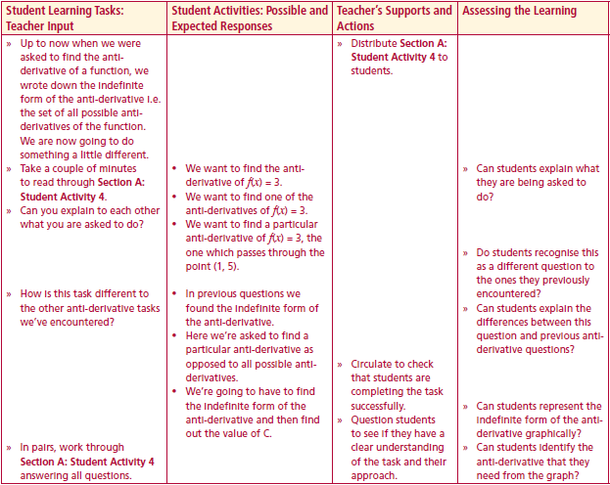
Section A: Student Activity 4
Up to now when we were asked to find the anti-derivative of a function, we wrote down the indefinite form of the anti-derivative i.e. the set of all possible anti-derivatives of the function. We are now going to do something a little different.
Take a couple of minutes to read through Section A: Student Activity 4.
Can you explain to each other what you are asked to do?
How is this task different to the other anti-derivative tasks we’ve encountered?
In pairs, work through Section A: Student Activity 4 answering all questions.
Lesson interaction

Slide 24
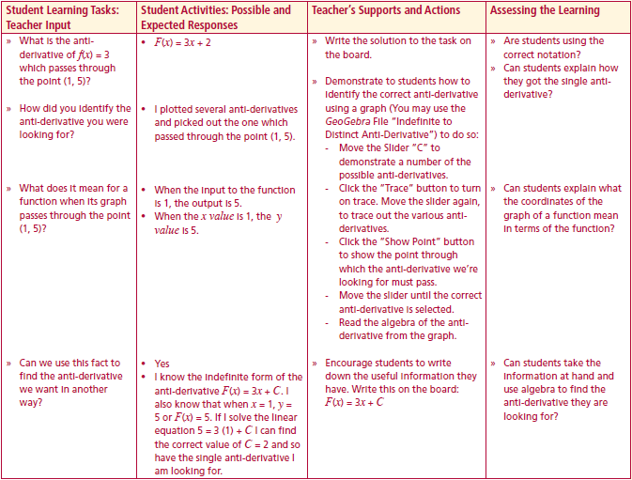
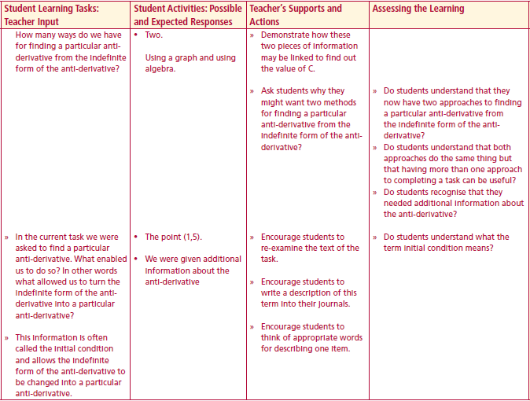
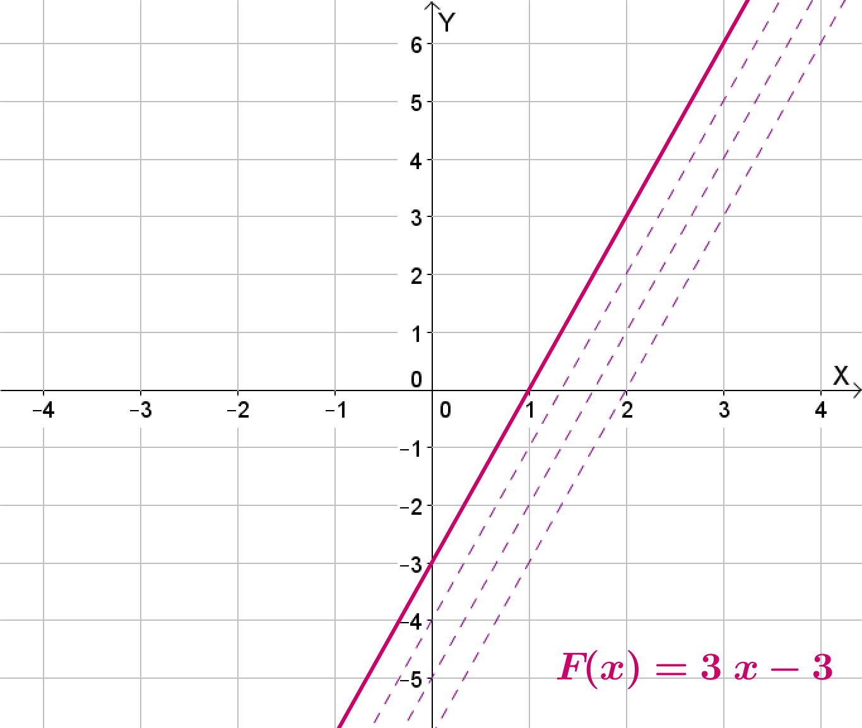
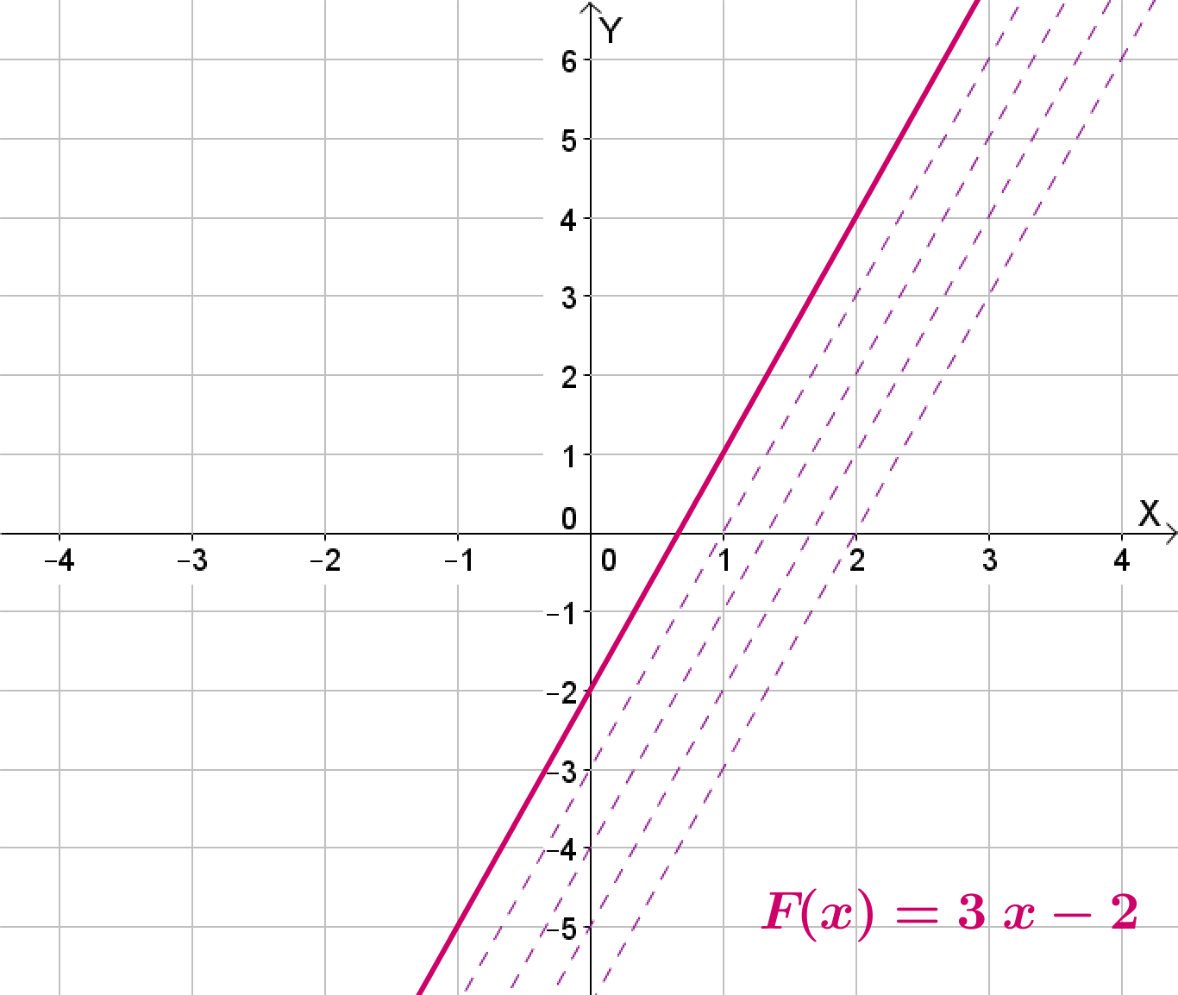
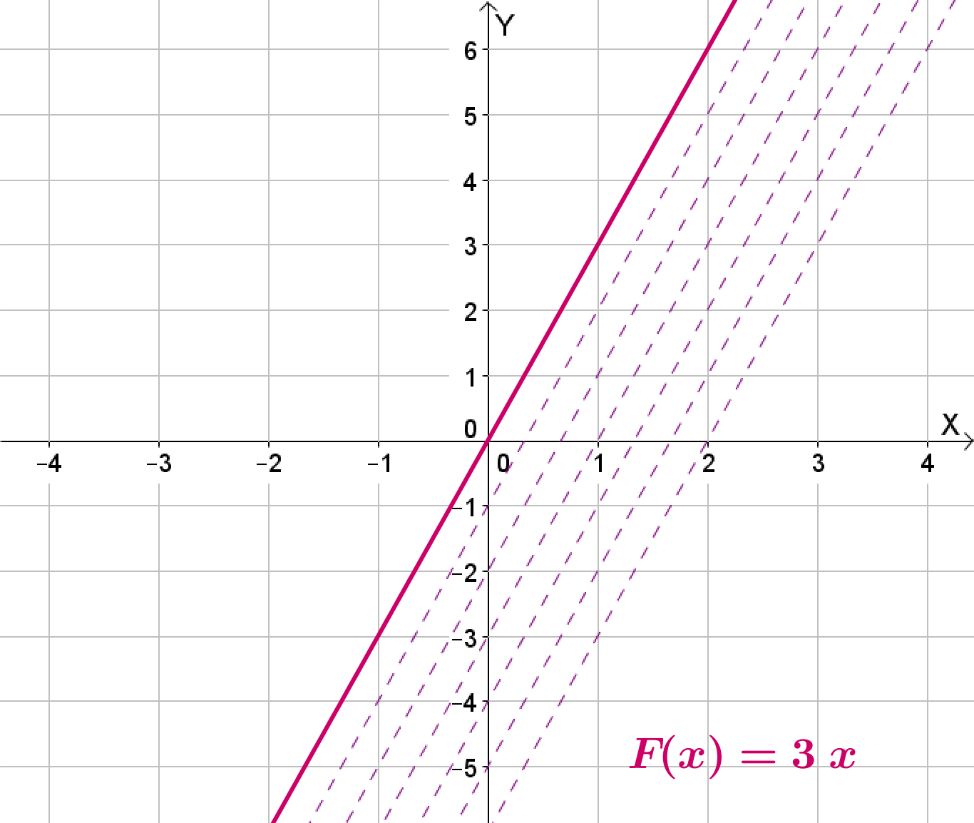
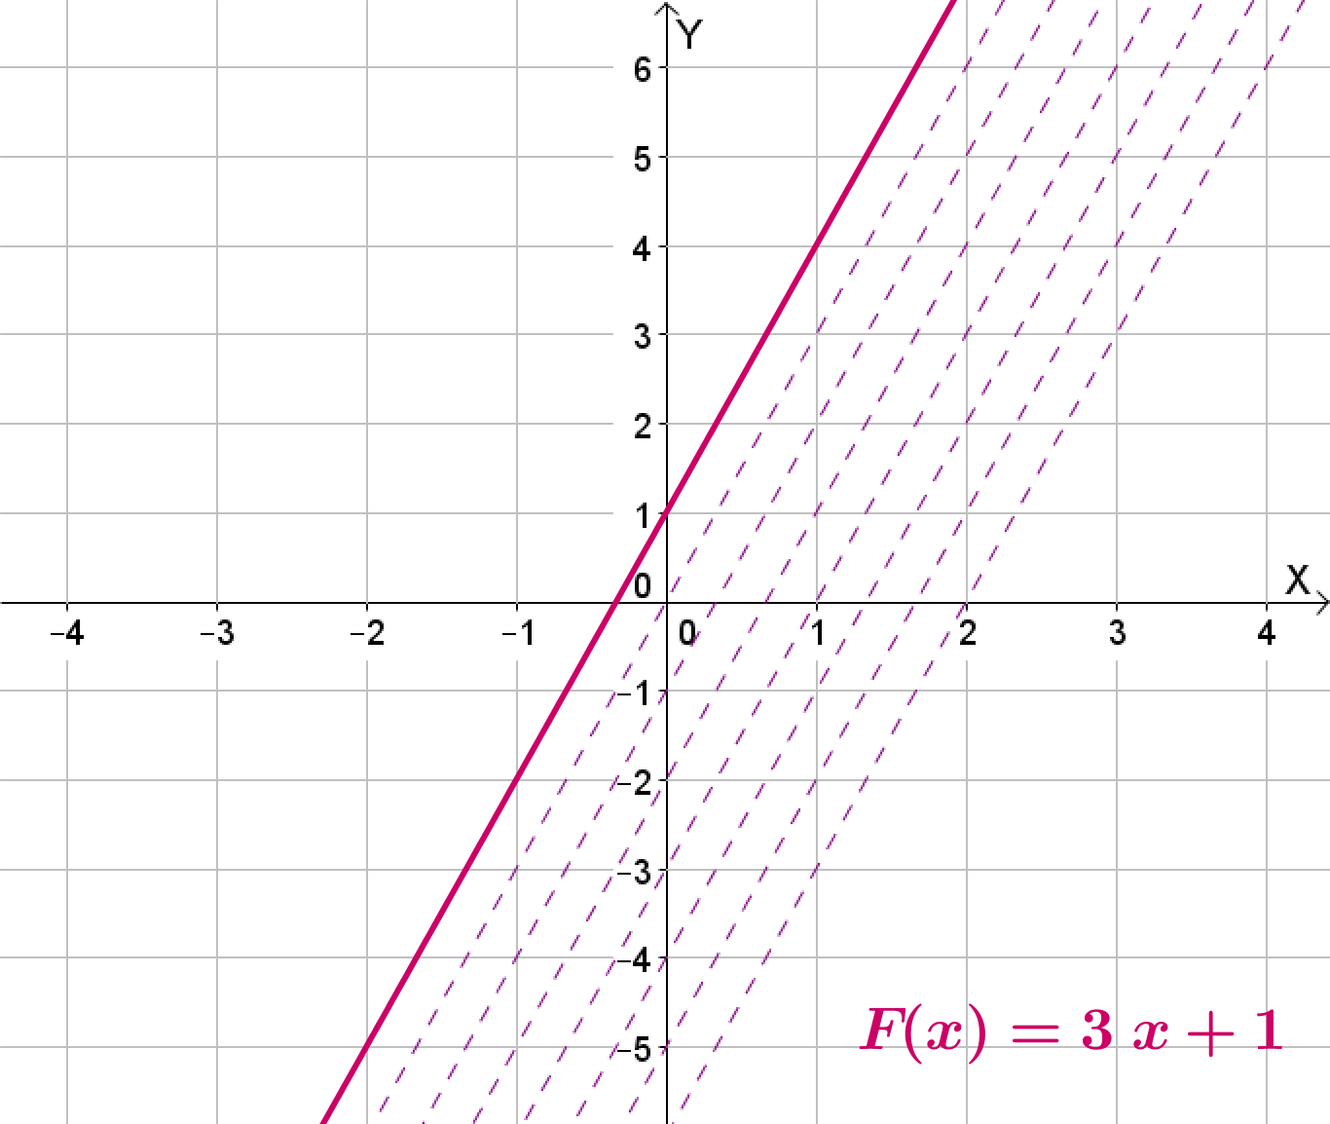
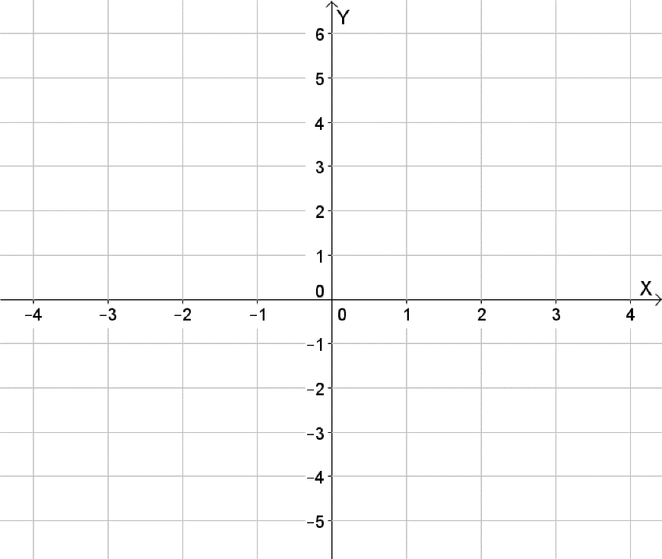
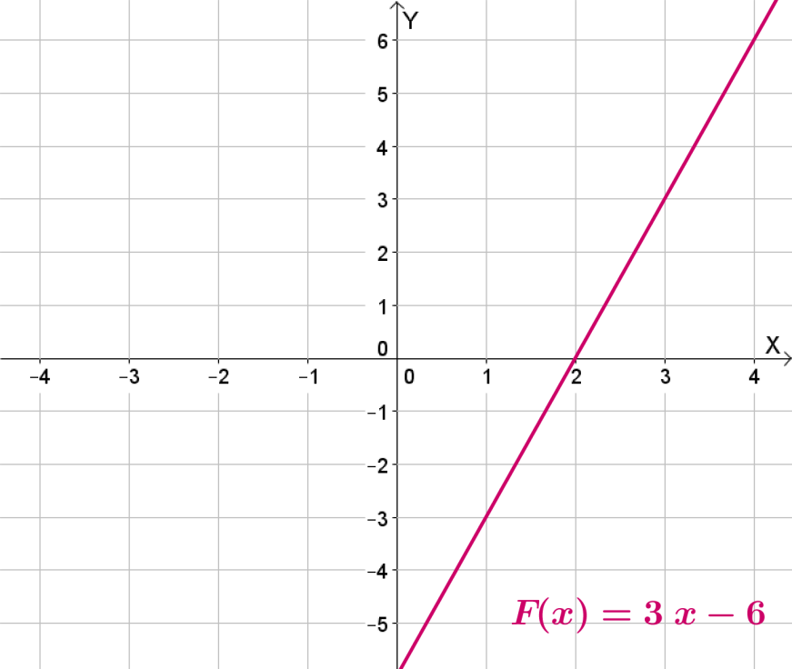
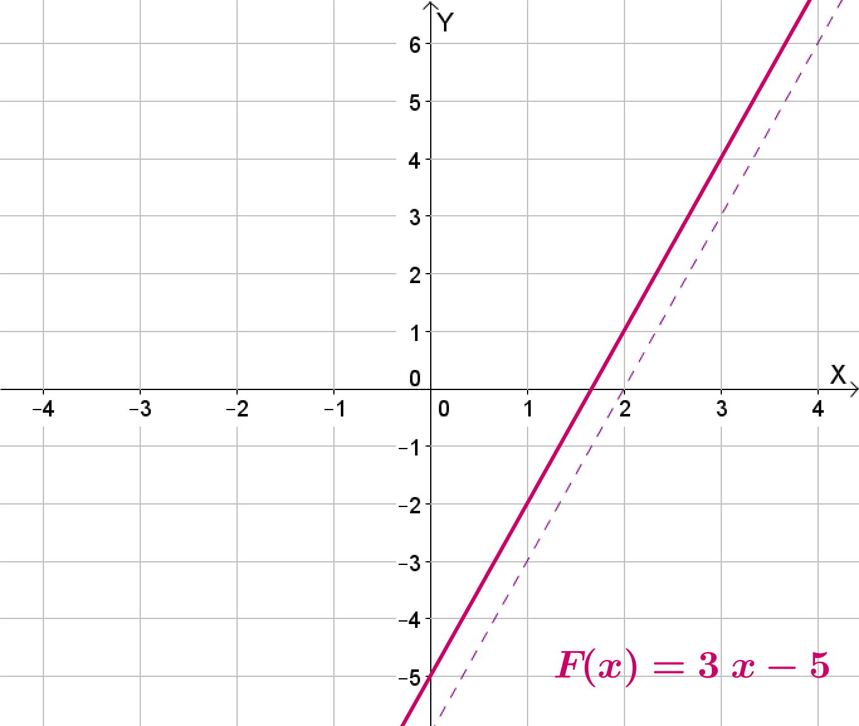
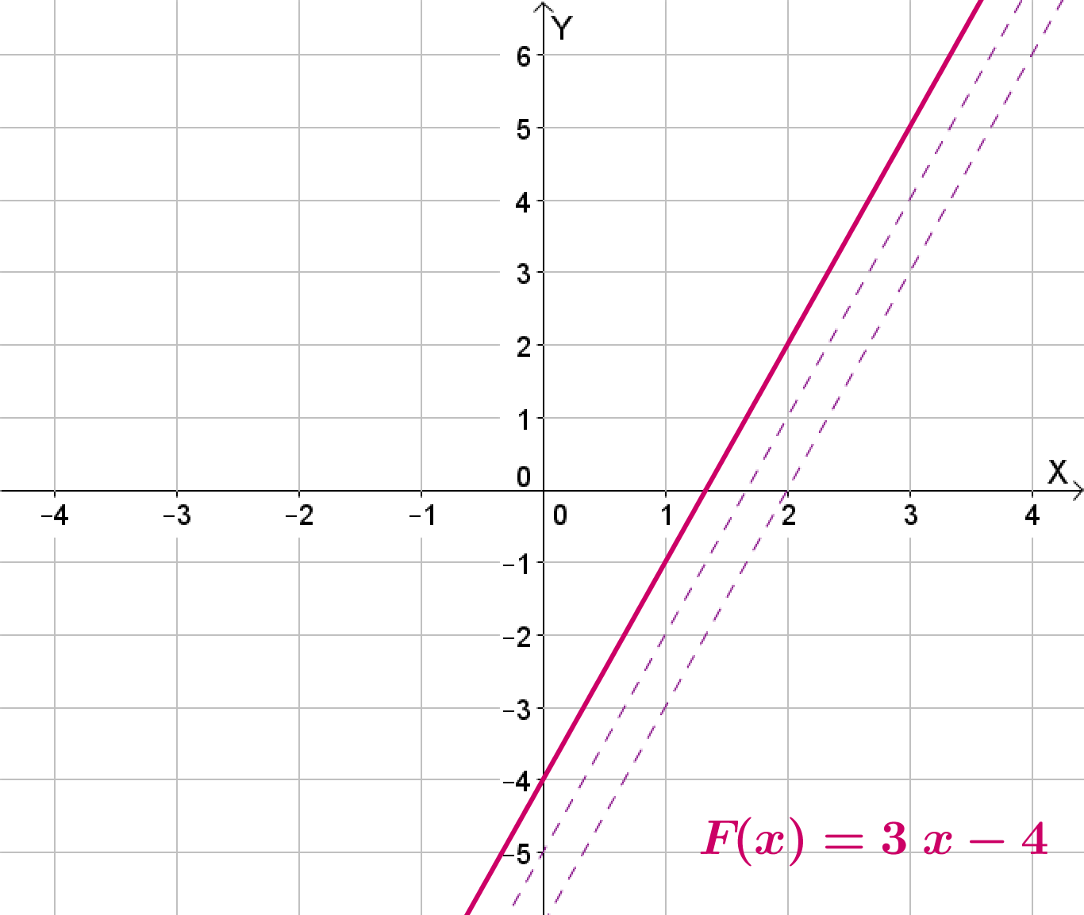
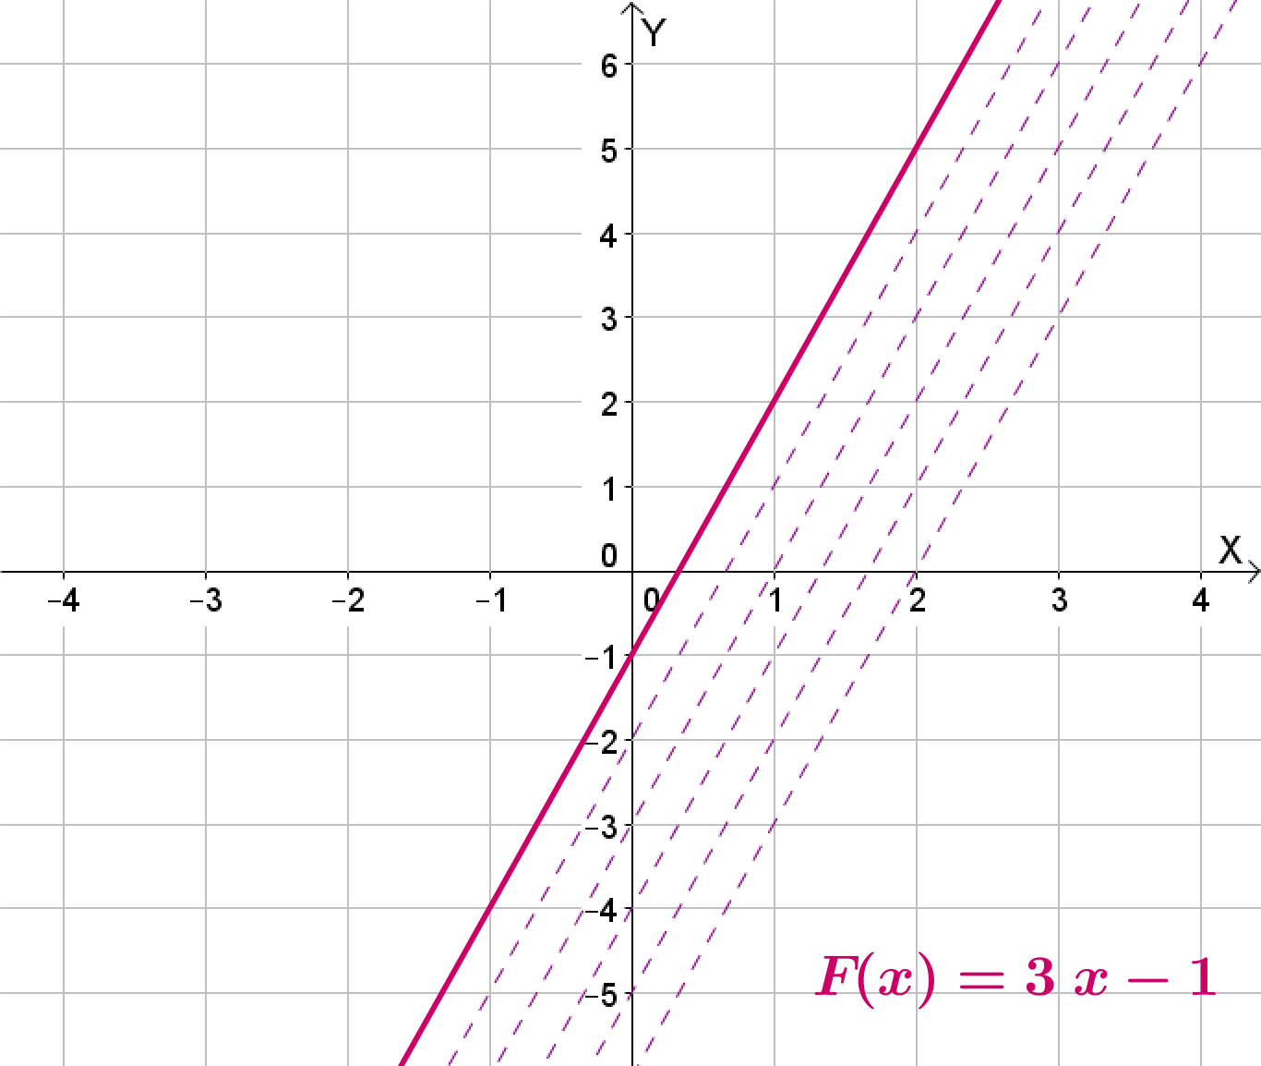
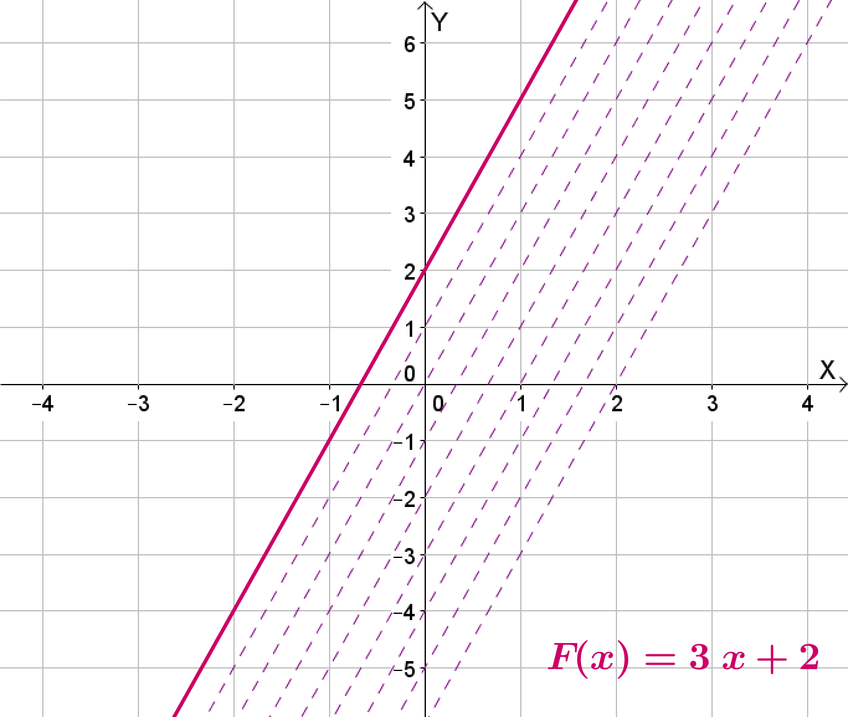
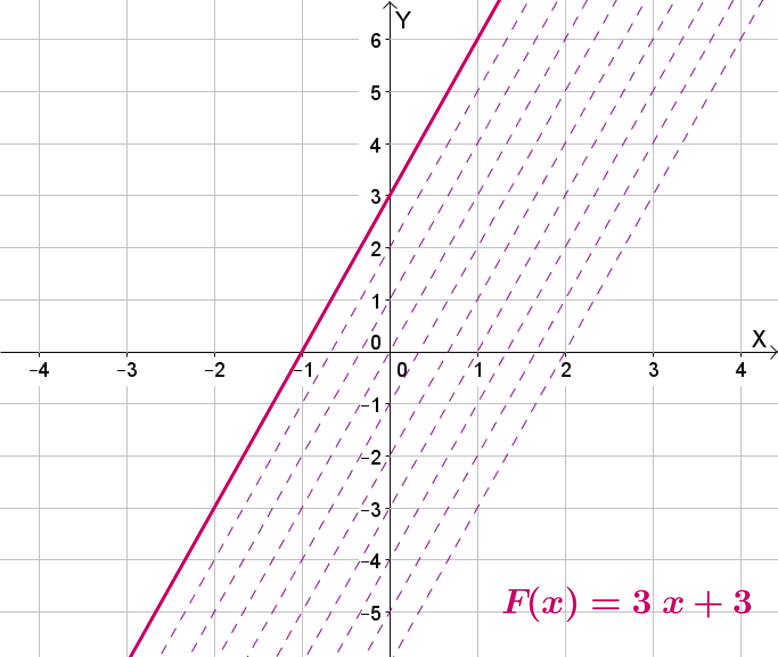
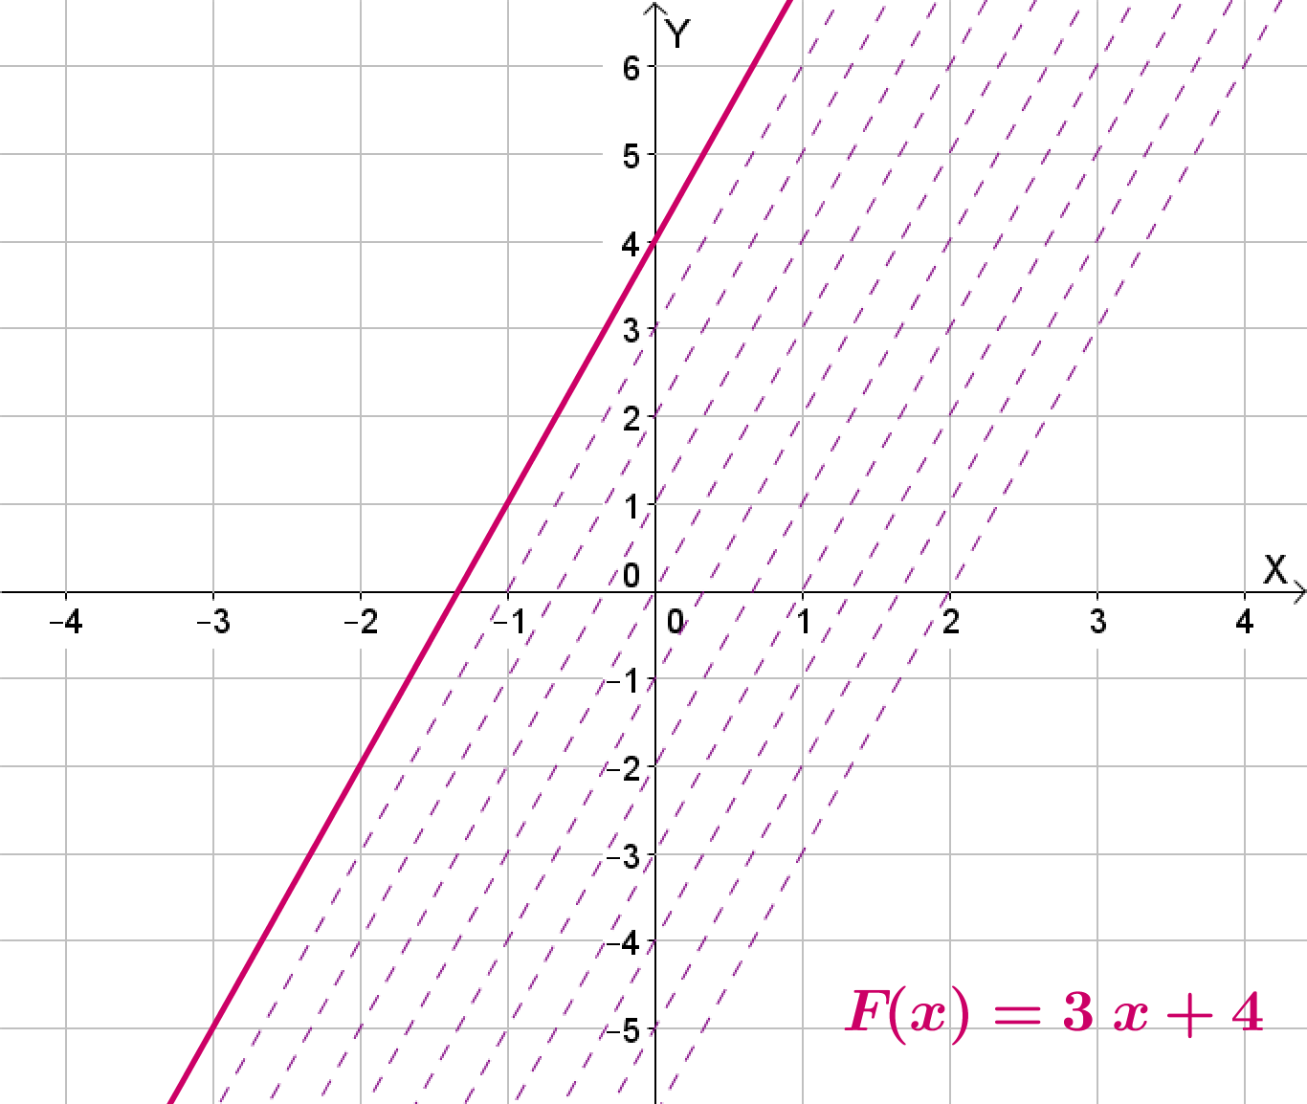
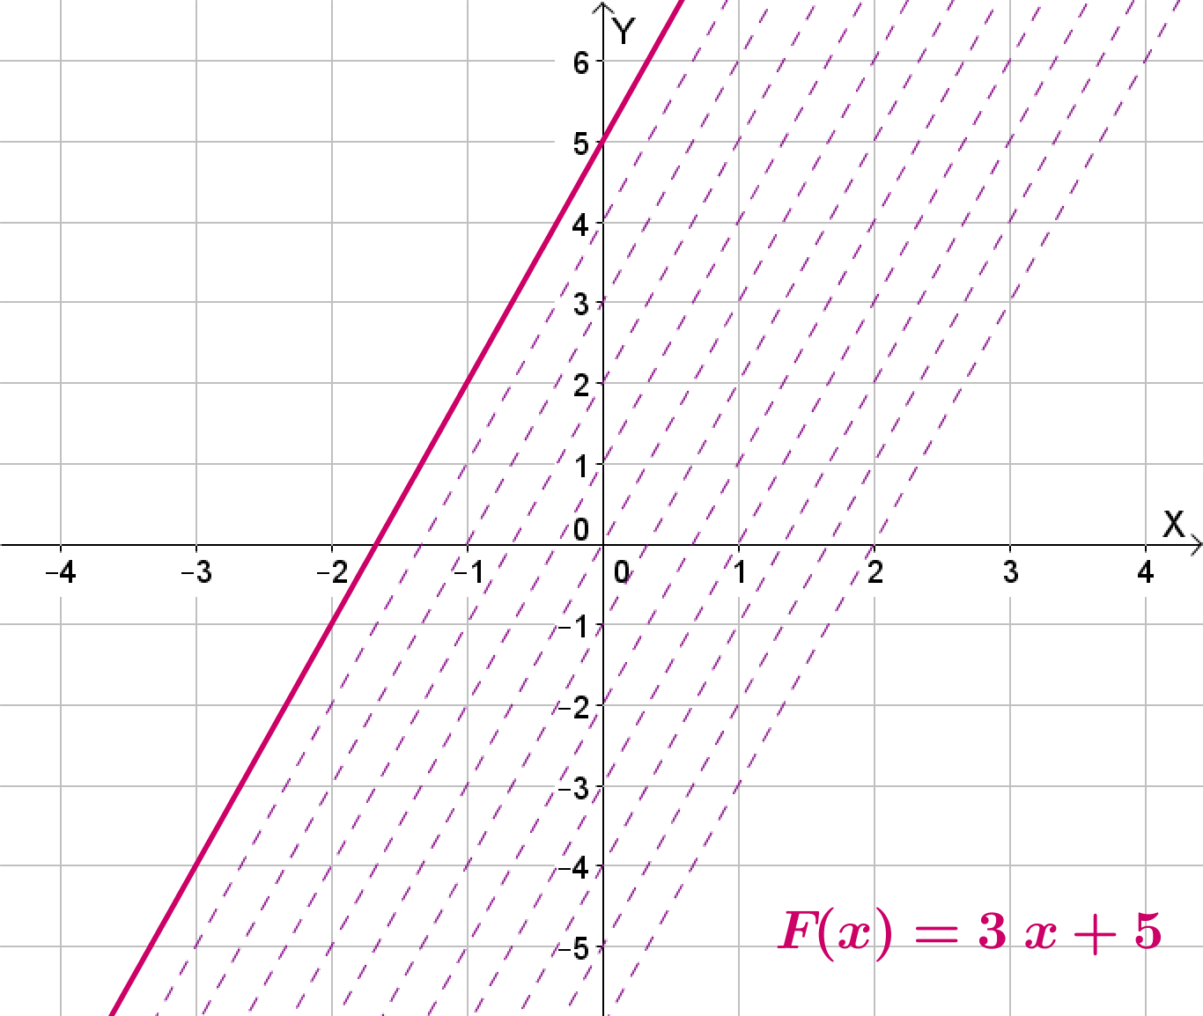
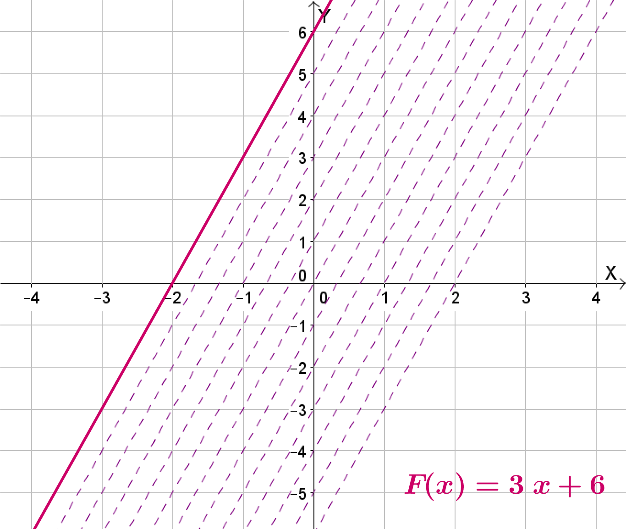
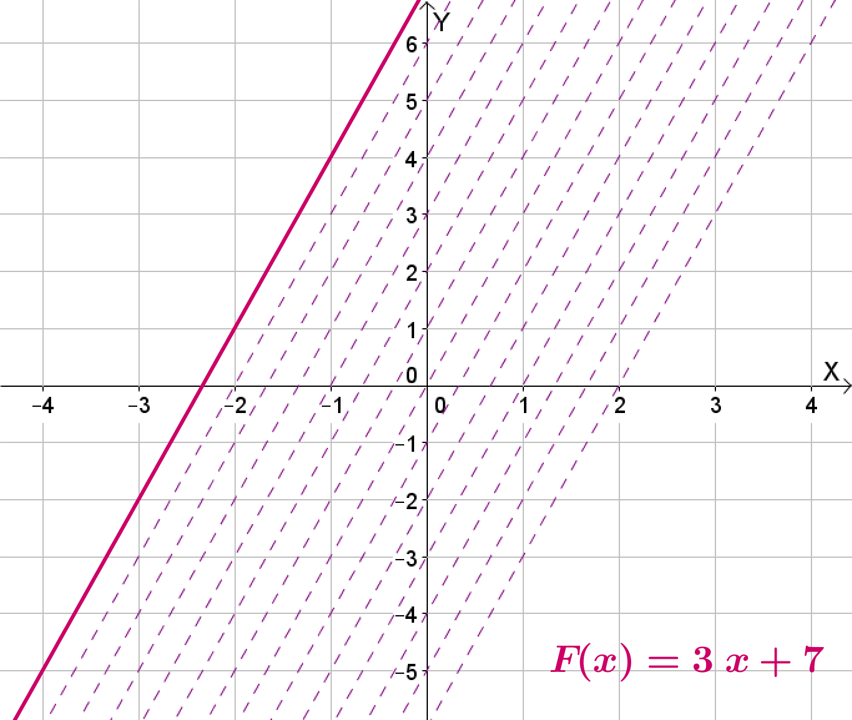
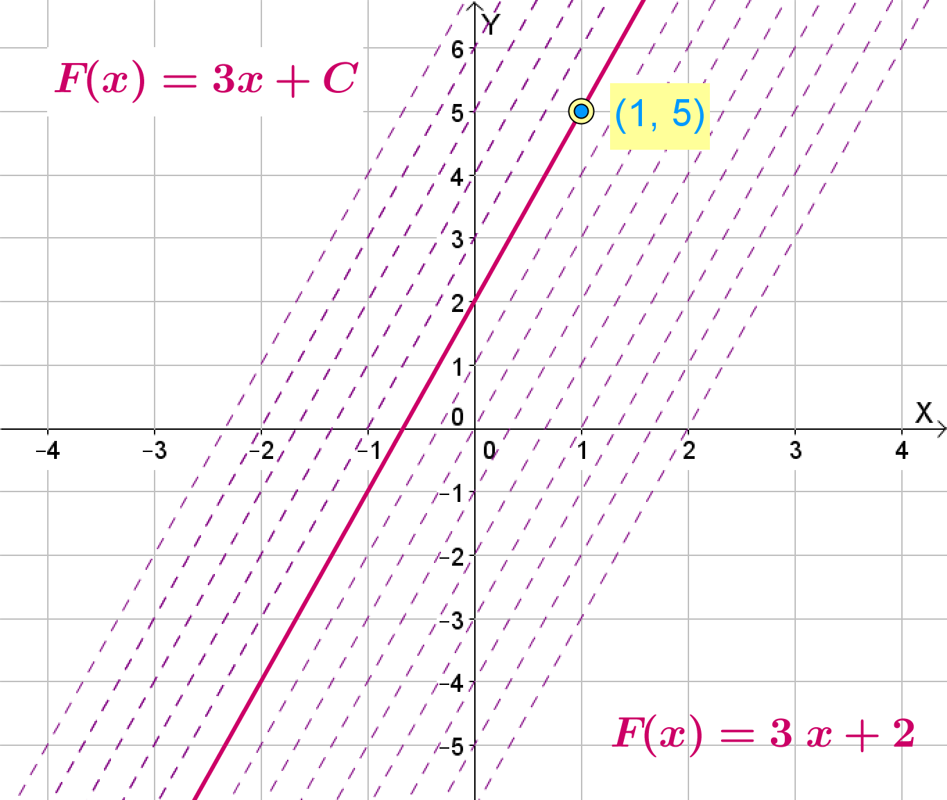
Section A: Student Activity 4
You are asked to find the anti-derivative of the function $f\left(x\right)=3$which passes through the point (1, 5).
How is this question different to all the previous anti-derivative questions you have encountered?
Find the indefinite form of the anti-derivative of $f\left(x\right)=5$.
Represent the indefinite form of the anti-derivative graphically below by sketching the anti-derivatives for each of the following values of C = {-3, -2, -1, 0, 1, 2, 3}.
Identify the distinct anti-derivative you were asked to find.
Lesson interaction
Lesson interaction

Slide 25
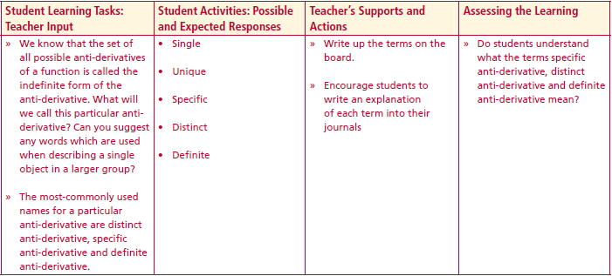
Section A: Student Activity 4
In the current task we were asked to find a particular anti-derivative. What enabled us to do so? In other words what allowed us to turn the indefinite form of the anti-derivative into a particular anti-derivative?
This information is often called the initial condition and allows the indefinite form of the anti-derivative to be changed into a particular anti-derivative.
We know that the set of all possible anti-derivatives of a function is called the indefinite form of the anti-derivative. What will we call this particular anti-derivative?
Can you suggest any words which are used when describing a single object in a larger group?
The most-commonly used names for a particular anti-derivative are distinct anti-derivative, specific anti-derivative and definite anti-derivative.
Lesson interaction
Lesson interaction

Slide 26
Section A: Student Activity 4
What is the anti-derivative of $f(x) = 3$which passes through the point $(1, 5)$?
How did you identify the anti-derivative you were looking for?
What does it mean for a function when its graph passes through the point $(1, 5)?$
Can we use this fact to find the anti-derivative we want in another way?
How many ways do we have for finding a particular anti-derivative from the indefinite form of the anti-derivative?
Lesson interaction
Lesson interaction

Slide 27
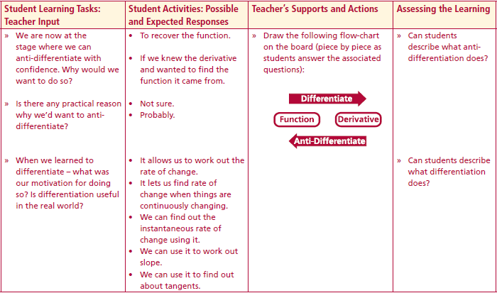
Section A: Student Activity 4
We are now at the stage where we can anti-differentiate with confidence. Why would we want to do so?
Is there any practical reason why we’d want to anti-differentiate?
When we learned to differentiate – what was our motivation for doing so? Is differentiation useful in the real world?
Lesson interaction
Differentiate
Function
Derivative
Anti - differentiate

Slide 28
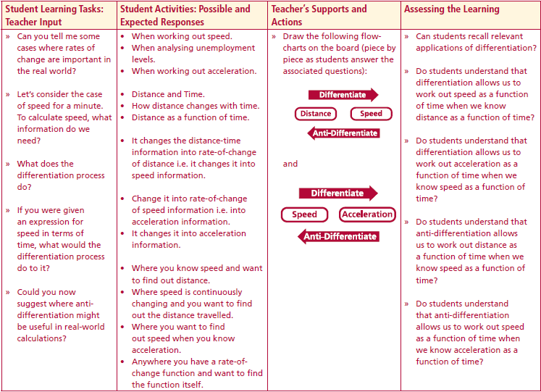
Section A: Student Activity 4
Can you tell me some cases where rates of change are important in the real world?
Let’s consider the case of speed for a minute. To calculate speed – what information do we need?
What does the differentiation process do?
If you were given an expression for speed in terms of time, what would the differentiation process do to it?
Could you now suggest where anti-differentiation might be useful in real-world calculations?
Are there any real-world situations where you might know rate-of-change information and would like to recover the information from which it came?
Lesson interaction
Differentiate
Distance
Speed
Anti - Differentiate
Lesson interaction
Differentiate
Speed
Acceleration
Anti - Differentiate

Slide 29
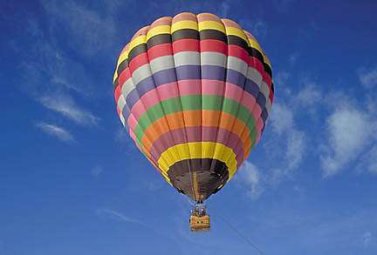
Section A: Student Activity 5
A hot air balloon is ascending through the atmosphere. When the balloon reaches a height above ground of 80 m, a snooker ball is dropped from the basket. The ball’s velocity when it is released is 3.6 m/s. The acceleration of a falling object due to gravity is a constant value of -9.8 m/s².
Write down an expression describing the acceleration of the snooker ball as a function of time?
Will the velocity of the ball remain at 3.6 m/s throughout the fall? Explain.
Write down an expression describing the ball’s velocity as a function of time.
Write down an expression describing the ball’s height as a function of time.
What will the height of the snooker ball be when it hits the ground?
How long does it take the snooker ball to hit the ground?

Slide 30
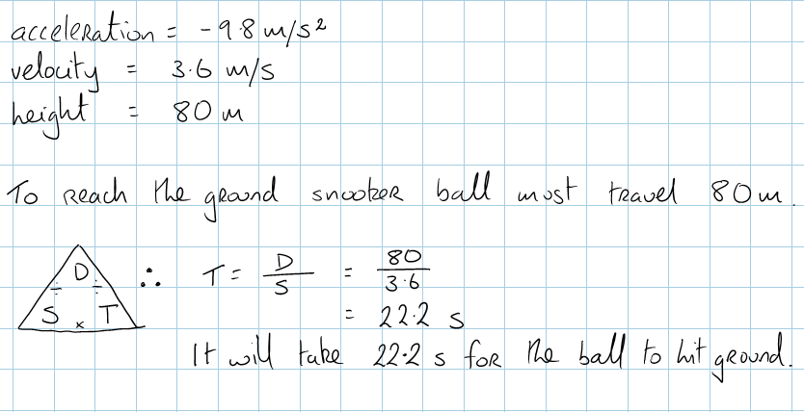
Section A: Student Activity 5
7. The following image shows an example of a student’s efforts to calculate how long it took the ball to hit the ground.
Explain why this calculation is incorrect.

Slide 31
Key Ideas
Anti-differentiation is the reverse process of differentiation.
The General Anti-derivative is the set of all possible anti-derivatives of a function.
A distinct anti-derivative is one element of this set which satisfies some initial condition.

Slide 32
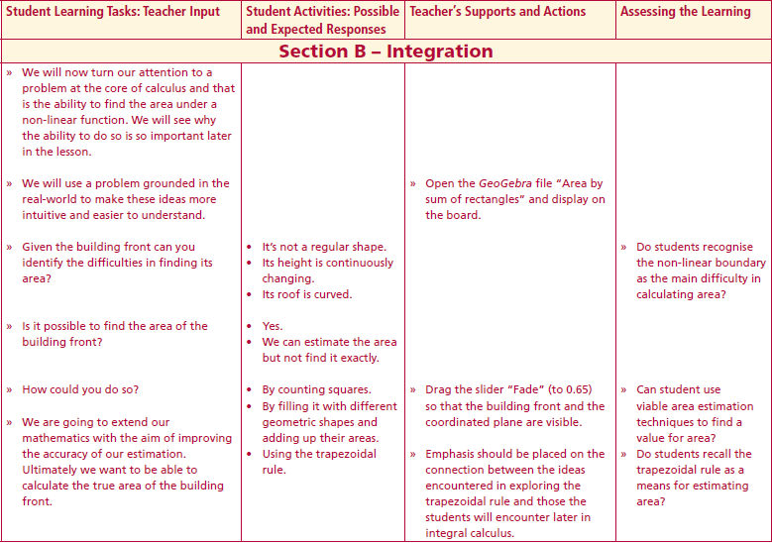
Section B
We will now turn our attention to a problem at the core of calculus and that is the ability to find the area under a non-linear function. We will see why the ability to do so is so important later in the lesson.
We will use a problem grounded in the real-world to make these ideas more intuitive and easier to understand.
Lesson interaction

Slide 33
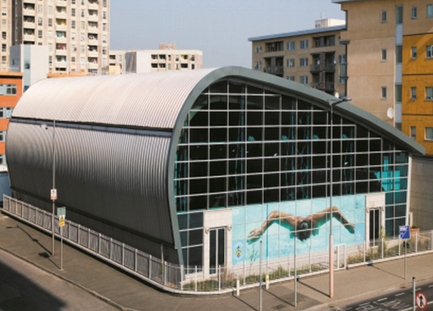
Section B

Slide 34
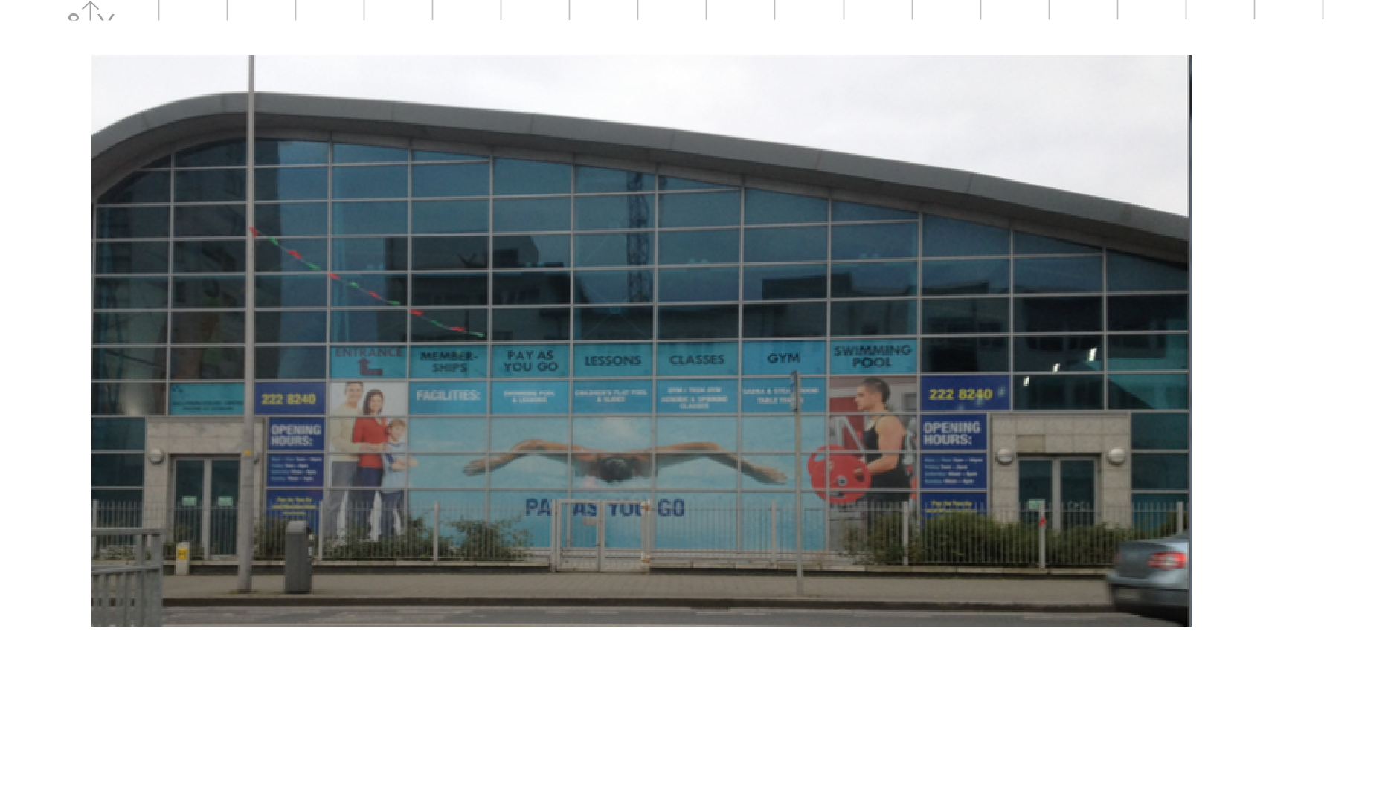
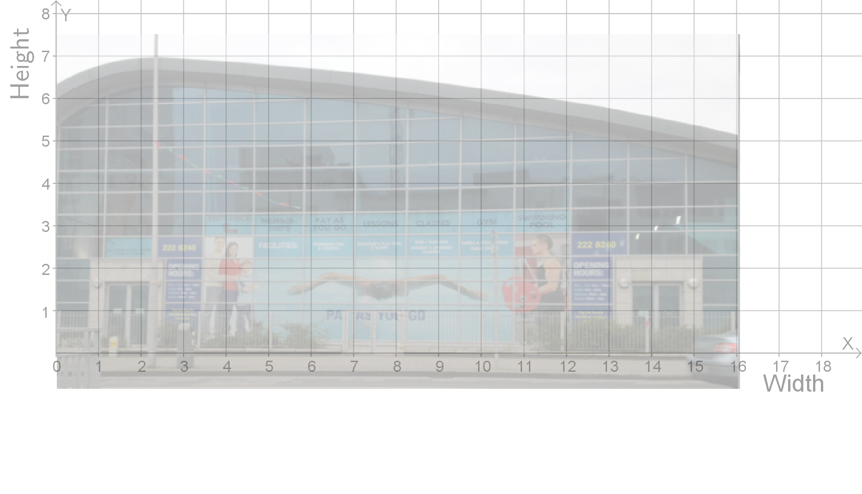
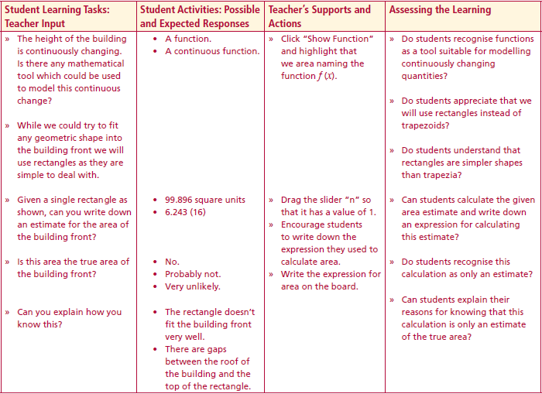
Section B
Lesson interaction
Lesson interaction
Given the building front can you identify the difficulties in finding its area?
Is it possible to find the area of the building front?
How could you do so?
We are going to extend our mathematics with the aim of improving the accuracy of our estimation. Ultimately we want to be able to calculate the true area of the building front.
The height of the building is continuously changing – is there any mathematical tool which could be used to model this continuous change?

Slide 35
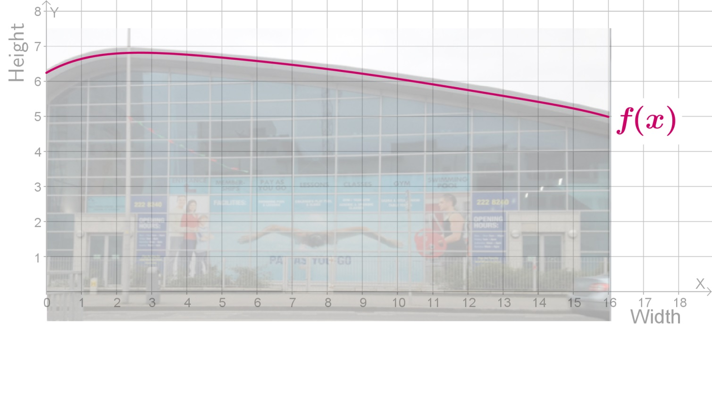
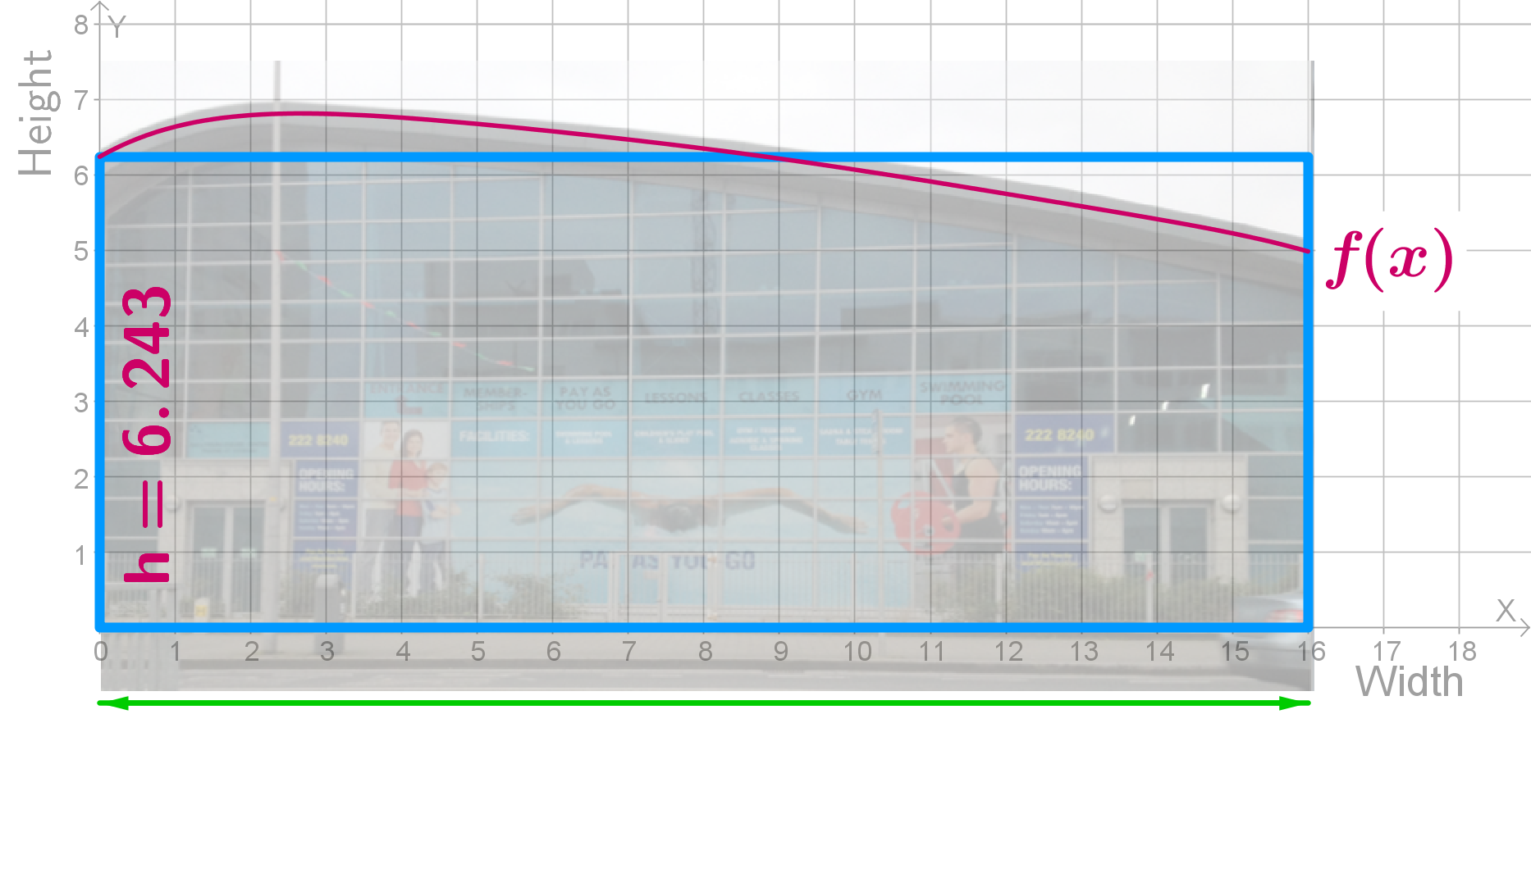
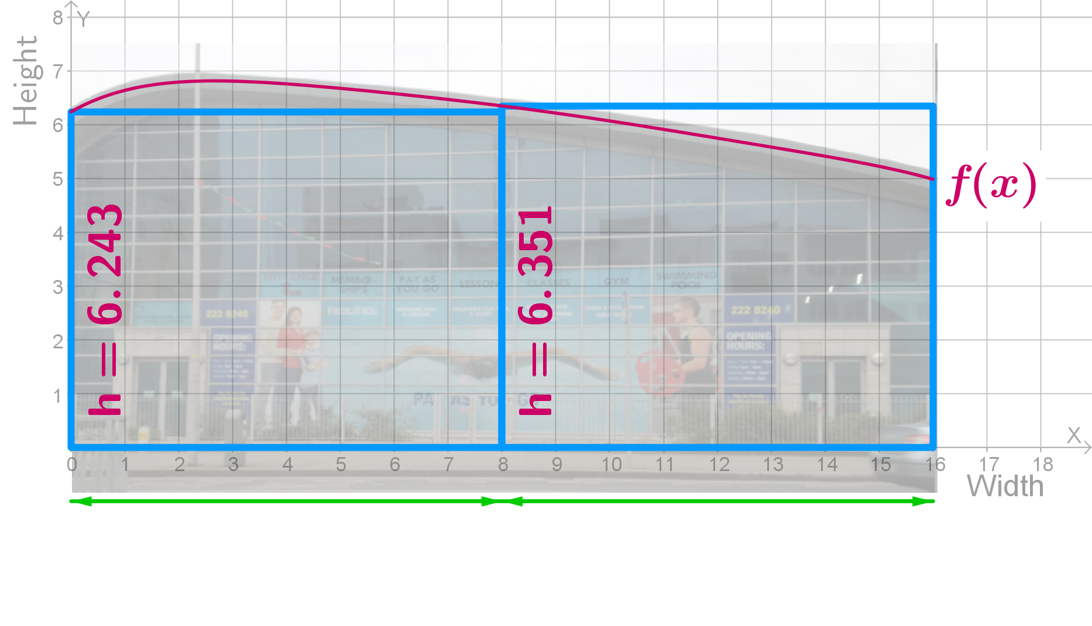
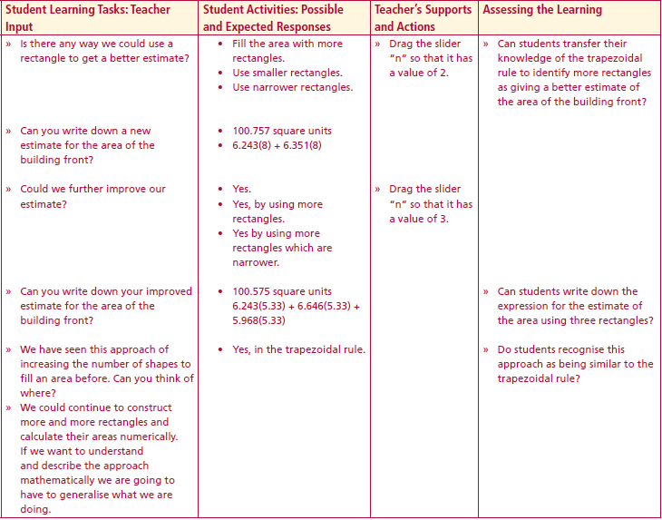
Section B
Lesson interaction
Lesson interaction
While we could try to fit any geometric shape into the building front we will use rectangles as they are simple to deal with.
Given a single rectangle as shown– can you write down an estimate for the area of the building front?
Is this area the true area of the building front?
Can you explain how you know this?
Is there any way we could use a rectangle to get a better estimate?
Can you write down a new estimate for the area of the building front?

Slide 36
Section B
Lesson interaction
Could we further improve our estimate?
Can you write down your improved estimate for the area of the building front?
We have seen this approach of increasing the number of shapes to fill an area before. Can you think of where?
While we could continue to construct more and more rectangles and calculate their areas numerically – if we want to understand and describe the approach mathematically we are going to have to generalise what we are doing.

Slide 37
Section B
$$f(x_{1})$$
$$f(0)$$
Lesson interaction
$$x_{1}$$
($x_{2}−x_{1})$
$$x_{2}$$
$$∆x$$
Revisiting the case of a single rectangle – can you explain to me where the two terms in the area expression came from?
Can you explain how you calculated the width of the rectangle?
Could you describe the width in more general terms – using coordinate geometry?
Can you explain how you calculated the height of the rectangle?

Slide 38
Section B
$$f(x_{1})$$
$$f(x_{2})$$
Lesson interaction
$$x_{1}$$
$$∆x$$
$$∆x$$
$$x_{1}$$
$$x_{2}$$
$$x_{2}$$
$$x_{3}$$
Could you describe the width in more general terms – using coordinate geometry?
Can you explain how you calculated the height of the rectangle?
Can we now write down a more generalised form for the area of the building based on one rectangle?
Could you use two rectangles to get a fresh estimate of the area?
($x_{2}−x_{1})$ $→$
$$∆x$$
$$f(0)→$$
$$f(x_{1})$$
$$Area = f(x1)∆x$$
$$Area = f\left(x1\right)∆x+f(x2)∆x$$

Slide 39
Section B
In pairs, I want you to complete Section B: Student Activity 1 by writing down a
numerical expression for each estimate and then writing down a generalised expression. We have already completed the first two area
estimates.

Slide 40
Section B
Section B | Area workings | General Area expression
 | Area workings | General Area expression
 | $$Area = 6.243(16)$$
 | Area workings | General Area expression
 | $$Area = 6.243(16)$$ | $$Area = f(x1)∆x$$

Slide 41
Section B
Section B | Area workings | General Area expression
 | Area workings | General Area expression
 | $$Area = 6.243\left(8\right)+6.351(8)$$ | $$Area = f\left(x1\right)∆x+f(x2)∆x$$

Slide 42
Section B | Area workings | General Area expression
Lesson interaction
$$Area= 6.243\left(5.33\right)+6.646\left(5.33\right)+5.968(5.33)$$
$$Area = f\left(x1\right)∆x+f(x2)∆x+f(x3)∆x$$
$$Area = 6.243\left(4\right)+6.761\left(4\right)+6.351\left(4\right)+5.752(4)$$
$$Area = f\left(x1\right)∆x+f(x2)∆x+f(x3)∆x+f(x4)∆x$$
$$Area = 6.243\left(3.2\right)+6.806\left(3.2\right)+6.538\left(3.2\right)+6.132\left(3.2\right)+5.619(3.2)$$
$$Area = f\left(x1\right)∆x+f(x2)∆x+f(x3)∆x+f(x4)∆x+f(x5)∆x$$

Slide 43
Section B | Area workings | General Area expression
 | Area workings | General Area expression
 | $$Area = 6.243(16)$$ | $$Area = f(x1)∆x$$
 | Area workings | General Area expression
 | $$Area = 6.243(16)$$ | $$Area = f(x1)∆x$$
 | $$Area = 6.243\left(8\right)+6.351(8)$$ | $$Area = f\left(x1\right)∆x+f(x2)∆x$$
 | Area workings | General Area expression
 | $$Area = 6.243(16)$$ | $$Area = f(x1)∆x$$
 | $$Area = 6.243\left(8\right)+6.351(8)$$ | $$Area = f\left(x1\right)∆x+f(x2)∆x$$
 | $$Area = 6.243\left(5.33\right)+6.646\left(5.33\right)+5.968(5.33)$$ | $$Area = f\left(x1\right)∆x+f(x2)∆x+f(x3)∆x$$
 | Area workings | General Area expression
 | $$Area = 6.243(16)$$ | $$Area = f(x1)∆x$$
 | $$Area = 6.243\left(8\right)+6.351(8)$$ | $$Area = f\left(x1\right)∆x+f(x2)∆x$$
 | $$Area = 6.243\left(5.33\right)+6.646\left(5.33\right)+5.968(5.33)$$ | $$Area = f\left(x1\right)∆x+f(x2)∆x+f(x3)∆x$$
 | $$Area = 6.243\left(4\right)+6.761\left(4\right)+6.351\left(4\right)+5.752(4)$$ | $$Area = f\left(x1\right)∆x+f(x2)∆x+f(x3)∆x+f(x4)∆x$$
 | Area workings | General Area expression
 | $$Area = 6.243(16)$$ | $$Area = f(x1)∆x$$
 | $$Area = 6.243\left(8\right)+6.351(8)$$ | $$Area = f\left(x1\right)∆x+f(x2)∆x$$
 | $$Area = 6.243\left(5.33\right)+6.646\left(5.33\right)+5.968(5.33)$$ | $$Area = f\left(x1\right)∆x+f(x2)∆x+f(x3)∆x$$
 | $$Area = 6.243\left(4\right)+6.761\left(4\right)+6.351\left(4\right)+5.752(4)$$ | $$Area = f\left(x1\right)∆x+f(x2)∆x+f(x3)∆x+f(x4)∆x$$
 | $$Area = 6.243\left(3.2\right)+6.806\left(3.2\right)+6.538\left(3.2\right)+6.132\left(3.2\right)+5.619(3.2)$$ | $$Area = f\left(x1\right)∆x+f(x2)∆x+f(x3)∆x+f(x4)∆x+f(x5)∆x$$
Lesson interaction

Slide 44
Section B
The expressions are getting a bit unwieldy to write out. Is there a more efficient way to write out sum of the five terms in the last area expression?
How do we know that doing so improves our estimate?
We can confirm this by comparing our estimate to the true area of the building front.
Why does increasing the number of rectangles improve our estimate?
Could we improve our estimate even further?
Lesson interaction
$$Area≈\sum_{i=1}^{5}{f(x_{i})∆x}$$
Why did we change our area estimate from a single rectangle to two, three, four and five rectangles?

Slide 45
Section B
Could we improve our estimate even further?
Can you write down a general expression to describe our latest estimate?
$$Area≈\sum_{i=1}^{10}{f(x_{i})∆x}$$
Lesson interaction
Could we improve our estimate even further?
Can you write down a general expression to describe our latest area estimate?
How many rectangles do you think we’d need to reduce the percentage error to zero i.e. to calculate the true area of the building front?
$$Area≈\sum_{i=1}^{100}{f(x_{i})∆x}$$

Slide 46
Section B
How many rectangles do you think we’d need to calculate the true area?
Can you write down an expression to represent this area estimate?
What happens when you use an infinite number of rectangles to estimate the area?
Lesson interaction
$$Area≈\sum_{i=1}^{∞}{f(x_{i})∆x}$$
Lesson interaction
In pairs I want you do discuss and explain why this happens Why doesn’t our infinite sum give the correct area?
Why doesn’t our infinite sum give the correct area?
So we have a problem. If we want to calculate the true area, we need an infinite number of rectangles but when we use an infinite number of rectangles our sum returns an area of zero.
Somehow we need to let our number of rectangles get closer and closer to infinity without ever being equal to infinity. Do we have any mathematical tools which allow us to do so?

Slide 47
Section B
Could you now write down an expression for the true area of the building front?
This is an amazing discovery. Using a limit together with rectangles it is possible to calculate the area under any boundary.
This process of finding area is known as Integration or Integral Calculus.
The notation for describing the process is itself a bit unwieldy. Gotfreid Wilhelm Liebniz developed a shorthand version of the notation. Here is what Leibniz’s notation looks like.
I would like you to discuss what each part of the notation mean. To help you out I will write up the notation for the building example we’ve just looked at.
$$Area=\lim_{n→∞}{\sum_{i=1}^{n}{f(x_{i})∆x}}$$
Lesson interaction
Lesson interaction
$$\int_{a}^{b}{f\left(x\right)dx}$$

Slide 48
Student Thinking
Lesson interaction
Lesson interaction
Area of any shape – by adding up lots of really narrow rectangles
Height of a rectangle
Width of a rectangle (tiny)
Horizontal distance
Add them up
Area of a very thin rectangle
What does this mean?
……a.k.a. Integration

Slide 49
Section B Student Activity 2
$$\int_{2}^{5}{\left(2x+1\right)dx}$$
Q1 What is ?
Lesson interaction
Lesson interaction
What does the question mean?
How did you do it?
Did you need to split the area up into lots of different rectangles?
We’ve discovered a lot of new mathematics throughout the last two activities. Let’s recap on what we’ve learned.
If you’re presented with a non-linear function and asked to find the area under a part of it, how would you do it?
Do you understand what the following notation means?

Slide 50
Section B Student Activity 2
If you’re presented with a non-linear function and asked to find the area under a part of it, how would you do it?
Do you understand what the following notation means?
Lesson interaction
$$\int_{a}^{b}{f\left(x\right)dx}$$

Slide 51
Section C Index
Student Activity 1: | Introduction
Group A | The UCD Student Computer Centre
Group B | The Vu Bar in Dubai.
Group C | A modern timber dwelling.
Group D | Office block in Aomori, Japan
Group E | House in New England.
Student Activity 2: | Area of the glass façade

Slide 52
Section C
In groups I would like you to complete Section C: Student Activity 1. For our initial investigation we will start with simple linear functions – since we already know how to calculate areas under such functions using geometry
Does the area under your function follow a predictable pattern?
Can you describe the pattern algebraically?
Lesson interaction
Lesson interaction

Slide 53
Section C
We now have a method for calculating the area under a continuous function. While this method works, it is not without its limitations. Using $\lim_{n→∞}\sum_{i=1}^{n}{f(x_{i})Δx}$ to calculate area is time consuming. The limit has to be re-calculated every time one wishes to calculate the area under the function between two different extremes.
We encountered a somewhat similar problem when we started our investigations in differential calculus.
What problem were we trying to solve when we introduced differential calculus?
How did we solve the problem?
Were there any issues with this approach?
How did we overcome these issues?
Perhaps a similar approach will work for calculating area. Is it possible to find a function which describes the area at all points under another function?
Lesson interaction
Lesson interaction
Lesson interaction

Slide 54
Section C - Student Activity 1
Notes:
Let’s investigate if there is any identifiable pattern that the area beneath a function follows.
Leaning on our problem-solving strategies we will start with some simple examples which we already know quite a lot about.
We’re going to investigate the area beneath three different functions.
Different groups will look at different functions and then we will share our results and see what learning there is in them.

Slide 55
Section C - Student Activity 1 Group A
1. Write down the function which describes the height of the building as we move from left $(x = 0)$to $right (x = 6).$
$$h(x) =$$
Figure 1 shows the UCD Student Computer Centre.
The area of the building changes as we move from left to right. We will now investigate the relationship between the area of the building and its width.
2. Complete the statement below by calculating the area of the rectangular piece of building shown.
When the width of the rectangular piece is 1 unit, the
area of the rectangle is
$$A =$$
Notes:
Let’s investigate if there is any identifiable pattern that the area beneath a function follows.
Leaning on our problem-solving strategies we will start with some simple examples which we already know quite a lot about.
We’re going to investigate the area beneath three different functions.
Different groups will look at different functions and then we will share our results and see what learning there is in them.

Slide 56
Section C - Student Activity 1 Group A
3. Complete the statement below by calculating the area of the rectangular piece of building shown.
When the width of the rectangular piece is 2 units, the area of the rectangle is A =
Notes:
Let’s investigate if there is any identifiable pattern that the area beneath a function follows.
Leaning on our problem-solving strategies we will start with some simple examples which we already know quite a lot about.
We’re going to investigate the area beneath three different functions.
Different groups will look at different functions and then we will share our results and see what learning there is in them.

Slide 57
Section C - Student Activity 1 Group A
Width | Height | Area | Pattern
$$w=0$$ |  |  | $$A=$$
$$w=1$$ |  |  | $$A=$$
$$w=2$$ |  |  | $$A=$$
$$w=3$$ |  |  | $$A=$$
$$w=4$$ |  |  | $$A=$$
$$w=5$$ |  |  | $$A=$$
$$w=6$$ |  |  | $$A=$$
$$w=7$$ |  |  | $$A=$$
$$⋮$$ | $$⋮$$ | $$⋮$$ | $$⋮$$
$$w=x$$ |  | $$A(x)=$$
Notes:
Let’s investigate if there is any identifiable pattern that the area beneath a function follows.
Leaning on our problem-solving strategies we will start with some simple examples which we already know quite a lot about.
We’re going to investigate the area beneath three different functions.
Different groups will look at different functions and then we will share our results and see what learning there is in them.

Slide 58
Section C - Student Activity 1 Group A
Q4. Sketch the graph of the area function on the empty axes.
Area
$$x$$
Notes:
Let’s investigate if there is any identifiable pattern that the area beneath a function follows.
Leaning on our problem-solving strategies we will start with some simple examples which we already know quite a lot about.
We’re going to investigate the area beneath three different functions.
Different groups will look at different functions and then we will share our results and see what learning there is in them.

Slide 59
Section C - Student Activity 1 Group A
Q5. For each of the areas in the table below:
(a) Shade in the given area on the diagram.
(b) Use the area function to calculate the given area.
(c) Explain how the area function is used to calculate area.
Section of Building | Diagram | Area Calculation | Explanation
From $x=0$ up to $x=2$
From $x=0$ up to $x=5$
From $x=2$ up to $x=5$
Notes:
Let’s investigate if there is any identifiable pattern that the area beneath a function follows.
Leaning on our problem-solving strategies we will start with some simple examples which we already know quite a lot about.
We’re going to investigate the area beneath three different functions.
Different groups will look at different functions and then we will share our results and see what learning there is in them.

Slide 60
Section C - Student Activity 1 Group A
Q6.
(a) In the space below write in the bounding function (from Q1 above) and the area function (from Q3 above).
Bounding Function | Area Function
$$h\left(x\right)=$$ | $$A\left(x\right)=$$
(b) If you were presented only with the bounding function, is there a way in which you could determine the area function? Explain
Notes:
Let’s investigate if there is any identifiable pattern that the area beneath a function follows.
Leaning on our problem-solving strategies we will start with some simple examples which we already know quite a lot about.
We’re going to investigate the area beneath three different functions.
Different groups will look at different functions and then we will share our results and see what learning there is in them.

Slide 61
Section C - Student Activity 1 Group B
1. The height of the building changes as we move from left $(x = 0)$to right $(x = 8)$. Write down the function
which describes the changing height of the building.
$$h(x) =$$
Figure shows The Vu Bar in Dubai.
The area of the building changes as we move from left to right. We will now investigate the relationship between the area of the building and its width.
2. Complete the statement below by calculating the area of the rectangular piece of building shown.
When the width of the rectangular piece is 1 unit, the
area of the rectangle is
$$A =$$
Notes:
Let’s investigate if there is any identifiable pattern that the area beneath a function follows.
Leaning on our problem-solving strategies we will start with some simple examples which we already know quite a lot about.
We’re going to investigate the area beneath three different functions.
Different groups will look at different functions and then we will share our results and see what learning there is in them.

Slide 62
Section C - Student Activity 1 Group B
3. Complete the statement below by calculating the area of the rectangular piece of building shown.
When the width of the rectangular piece is 2 units, the area of the rectangle is $A =$
Notes:
Let’s investigate if there is any identifiable pattern that the area beneath a function follows.
Leaning on our problem-solving strategies we will start with some simple examples which we already know quite a lot about.
We’re going to investigate the area beneath three different functions.
Different groups will look at different functions and then we will share our results and see what learning there is in them.

Slide 63
Section C - Student Activity 1 Group B
Width | Height | Area | Pattern
$$w=0$$ |  |  | $$A=$$
$$w=1$$ |  |  | $$A=$$
$$w=2$$ |  |  | $$A=$$
$$w=3$$ |  |  | $$A=$$
$$w=4$$ |  |  | $$A=$$
$$w=5$$ |  |  | $$A=$$
$$w=6$$ |  |  | $$A=$$
$$w=7$$ |  |  | $$A=$$
$$⋮$$ | $$⋮$$ | $$⋮$$ | $$⋮$$
$$w=x$$ |  | $$A(x)=$$
Notes:
Let’s investigate if there is any identifiable pattern that the area beneath a function follows.
Leaning on our problem-solving strategies we will start with some simple examples which we already know quite a lot about.
We’re going to investigate the area beneath three different functions.
Different groups will look at different functions and then we will share our results and see what learning there is in them.

Slide 64
Section C - Student Activity 1 Group B
Q4. Sketch the graph of the area function on the empty axes.
Area
$$x$$
Notes:
Let’s investigate if there is any identifiable pattern that the area beneath a function follows.
Leaning on our problem-solving strategies we will start with some simple examples which we already know quite a lot about.
We’re going to investigate the area beneath three different functions.
Different groups will look at different functions and then we will share our results and see what learning there is in them.

Slide 65
Section C - Student Activity 1 Group B
Q5. For each of the areas in the table below:
(a) Shade in the given area on the diagram.
(b) Use the area function to calculate the given area.
(c) Explain how the area function is used to calculate area.
Section of Building | Diagram | Area Calculation | Explanation
From $x=0$ up to $x=3$
From $x=0$ up to $x=5$.5
From $x=$3 up to $x=5.5$
Notes:
Let’s investigate if there is any identifiable pattern that the area beneath a function follows.
Leaning on our problem-solving strategies we will start with some simple examples which we already know quite a lot about.
We’re going to investigate the area beneath three different functions.
Different groups will look at different functions and then we will share our results and see what learning there is in them.

Slide 66
Section C - Student Activity 1 Group B
Q6.
(a) In the space below write in the bounding function (from Q1 above) and the area function (from Q3 above).
Bounding Function | Area Function
$$h\left(x\right)=$$ | $$A\left(x\right)=$$
(b) If you were presented only with the bounding function, is there a way in which you could determine the area function? Explain
Notes:
Let’s investigate if there is any identifiable pattern that the area beneath a function follows.
Leaning on our problem-solving strategies we will start with some simple examples which we already know quite a lot about.
We’re going to investigate the area beneath three different functions.
Different groups will look at different functions and then we will share our results and see what learning there is in them.

Slide 67
Section C - Student Activity 1 Group C
1. The height of the building changes as we move from 1. Write down the function which describes the height of
the building as we move from left $(x =3)$to right $(x =12)$.
$$h(x) =$$
Figure 1 shows a modern timber dwelling.
The area of the building changes as we move from left to right. We will now investigate the relationship between the area of the building and its width.
2. Complete the statement below by calculating the area of the rectangular piece of building shown.
When the width of the rectangular piece is 1 unit, the
area of the rectangle is
$$A =$$
Notes:
Let’s investigate if there is any identifiable pattern that the area beneath a function follows.
Leaning on our problem-solving strategies we will start with some simple examples which we already know quite a lot about.
We’re going to investigate the area beneath three different functions.
Different groups will look at different functions and then we will share our results and see what learning there is in them.

Slide 68
Section C - Student Activity 1 Group C
3. Complete the statement below by calculating the area of the rectangular piece of building shown.
When the width of the rectangular piece is 2 units, the area of the rectangle is $A =$
Notes:
Let’s investigate if there is any identifiable pattern that the area beneath a function follows.
Leaning on our problem-solving strategies we will start with some simple examples which we already know quite a lot about.
We’re going to investigate the area beneath three different functions.
Different groups will look at different functions and then we will share our results and see what learning there is in them.

Slide 69
Section C - Student Activity 1 Group C
$$x$$ | Width | Height | Area | Pattern
$$3$$ | $$w=0$$ |  |  | $$A=$$
$$4$$ | $$w=1$$ |  |  | $$A=$$
$$5$$ | $$w=2$$ |  |  | $$A=$$
$$6$$ | $$w=3$$ |  |  | $$A=$$
$$7$$ | $$w=4$$ |  |  | $$A=$$
$$8$$ | $$w=5$$ |  |  | $$A=$$
$$9$$ | $$w=6$$ |  |  | $$A=$$
$$10$$ | $$w=7$$ |  |  | $$A=$$
$$⋮$$ | $$⋮$$ | $$⋮$$ | $$⋮$$ | $$⋮$$
$$x$$ | $$w=$$ |  | $$A(x)=$$
Notes:
Let’s investigate if there is any identifiable pattern that the area beneath a function follows.
Leaning on our problem-solving strategies we will start with some simple examples which we already know quite a lot about.
We’re going to investigate the area beneath three different functions.
Different groups will look at different functions and then we will share our results and see what learning there is in them.

Slide 70
Section C - Student Activity 1 Group C
Q4. Sketch the graph of the area function on the empty axes.
Area
$$x$$
Notes:
Let’s investigate if there is any identifiable pattern that the area beneath a function follows.
Leaning on our problem-solving strategies we will start with some simple examples which we already know quite a lot about.
We’re going to investigate the area beneath three different functions.
Different groups will look at different functions and then we will share our results and see what learning there is in them.

Slide 71
Section C - Student Activity 1 Group C
Q5. For each of the areas in the table below:
(a) Shade in the given area on the diagram.
(b) Use the area function to calculate the given area.
(c) Explain how the area function is used to calculate area.
Section of Building | Diagram | Area Calculation | Explanation
From $x=3$ up to $x=11$
From $x=0$ up to $x=6$
From $x=6$ up to $x=11$
Notes:
Let’s investigate if there is any identifiable pattern that the area beneath a function follows.
Leaning on our problem-solving strategies we will start with some simple examples which we already know quite a lot about.
We’re going to investigate the area beneath three different functions.
Different groups will look at different functions and then we will share our results and see what learning there is in them.

Slide 72
Section C - Student Activity 1 Group C
Q6.
(a) In the space below write in the bounding function (from Q1 above) and the area function (from Q3 above).
Bounding Function | Area Function
$$h\left(x\right)=$$ | $$A\left(x\right)=$$
(b) If you were presented only with the bounding function, is there a way in which you could determine the area function? Explain
Notes:
Let’s investigate if there is any identifiable pattern that the area beneath a function follows.
Leaning on our problem-solving strategies we will start with some simple examples which we already know quite a lot about.
We’re going to investigate the area beneath three different functions.
Different groups will look at different functions and then we will share our results and see what learning there is in them.

Slide 73
Section C - Student Activity 1 Group D
1. The height of the building changes as we move from left $(x = 0)$to right $(x =3.7)$ . Write down the function
which describes the changing height of the building..
$$h(x) =$$
Figure 1 shows an office block in Aomori, Japan.
The area of the building changes as we move from left to right. We will now investigate the relationship between the area of the building and its width.
2. Complete the statement below by calculating the area of the rectangular piece of building shown.
When the width of the rectangular piece is 1 unit, the
area of the rectangle is
$$A =$$
Notes:
Let’s investigate if there is any identifiable pattern that the area beneath a function follows.
Leaning on our problem-solving strategies we will start with some simple examples which we already know quite a lot about.
We’re going to investigate the area beneath three different functions.
Different groups will look at different functions and then we will share our results and see what learning there is in them.

Slide 74
Section C - Student Activity 1 Group D
3. Complete the statement below by calculating the area of the rectangular piece of building shown.
When the width of the rectangular piece is 2 units, the area of the rectangle is $A =$
Notes:
Let’s investigate if there is any identifiable pattern that the area beneath a function follows.
Leaning on our problem-solving strategies we will start with some simple examples which we already know quite a lot about.
We’re going to investigate the area beneath three different functions.
Different groups will look at different functions and then we will share our results and see what learning there is in them.

Slide 75
Section C - Student Activity 1 Group D
Width | Height | Area | Pattern
$$w=0$$ |  |  | $$A=$$
$$w=1$$ |  |  | $$A=$$
$$w=2$$ |  |  | $$A=$$
$$w=3$$ |  |  | $$A=$$
$$w=4$$ |  |  | $$A=$$
$$w=5$$ |  |  | $$A=$$
$$w=6$$ |  |  | $$A=$$
$$w=7$$ |  |  | $$A=$$
$$⋮$$ | $$⋮$$ | $$⋮$$ | $$⋮$$
$$w=x$$ |  | $$A(x)=$$
Notes:
Let’s investigate if there is any identifiable pattern that the area beneath a function follows.
Leaning on our problem-solving strategies we will start with some simple examples which we already know quite a lot about.
We’re going to investigate the area beneath three different functions.
Different groups will look at different functions and then we will share our results and see what learning there is in them.

Slide 76
Section C - Student Activity 1 Group D
Q4. Sketch the graph of the area function on the empty axes.
The Area Function
Area
$$x$$
Notes:
Let’s investigate if there is any identifiable pattern that the area beneath a function follows.
Leaning on our problem-solving strategies we will start with some simple examples which we already know quite a lot about.
We’re going to investigate the area beneath three different functions.
Different groups will look at different functions and then we will share our results and see what learning there is in them.

Slide 77
Section C - Student Activity 1 Group D
Q5. For each of the areas in the table below:
(a) Shade in the given area on the diagram.
(b) Use the area function to calculate the given area.
(c) Explain how the area function is used to calculate area.
Section of Building | Diagram | Area Calculation | Explanation
From $x=0$ up to $x=1.5$
From $x=0$ up to $x=3.7$
From $x=1.5$ up to $x=3.7$
Notes:
Let’s investigate if there is any identifiable pattern that the area beneath a function follows.
Leaning on our problem-solving strategies we will start with some simple examples which we already know quite a lot about.
We’re going to investigate the area beneath three different functions.
Different groups will look at different functions and then we will share our results and see what learning there is in them.

Slide 78
Section C - Student Activity 1 Group D
Q6.
(a) In the space below write in the bounding function (from Q1 above) and the area function (from Q3 above).
Bounding Function | Area Function
$$h\left(x\right)=$$ | $$A\left(x\right)=$$
(b) If you were presented only with the bounding function, is there a way in which you could determine the area function? Explain
Notes:
Let’s investigate if there is any identifiable pattern that the area beneath a function follows.
Leaning on our problem-solving strategies we will start with some simple examples which we already know quite a lot about.
We’re going to investigate the area beneath three different functions.
Different groups will look at different functions and then we will share our results and see what learning there is in them.

Slide 79
Section C - Student Activity 1 Group E
1. The height of the building changes as we move from left $(x =2)$to right $(x =7.4)$ . Write down the function
which describes the changing height of the building..
$$h(x) =$$
Figure 1 shows a house in New England.
The area of the building changes as we move from left to right. We will now investigate the relationship between the area of the building and its width.
2. Complete the statement below by calculating the area of the rectangular piece of building shown.
When the width of the rectangular piece is 1 unit, the
area of the rectangle is
$$A =$$
Notes:
Let’s investigate if there is any identifiable pattern that the area beneath a function follows.
Leaning on our problem-solving strategies we will start with some simple examples which we already know quite a lot about.
We’re going to investigate the area beneath three different functions.
Different groups will look at different functions and then we will share our results and see what learning there is in them.

Slide 80
Section C - Student Activity 1 Group E
3. Complete the statement below by calculating the area of the rectangular piece of building shown.
When the width of the rectangular piece is 2 units, the area of the rectangle is $A =$
Notes:
Let’s investigate if there is any identifiable pattern that the area beneath a function follows.
Leaning on our problem-solving strategies we will start with some simple examples which we already know quite a lot about.
We’re going to investigate the area beneath three different functions.
Different groups will look at different functions and then we will share our results and see what learning there is in them.

Slide 81
Section C - Student Activity 1 Group E
$$x$$ | Width | Height | Area | Pattern
$$2$$ | $$w=0$$ |  |  | $$A=$$
$$3$$ | $$w=1$$ |  |  | $$A=$$
$$4$$ | $$w=2$$ |  |  | $$A=$$
$$5$$ | $$w=3$$ |  |  | $$A=$$
$$6$$ | $$w=4$$ |  |  | $$A=$$
$$7$$ | $$w=5$$ |  |  | $$A=$$
$$⋮$$ | $$⋮$$ | $$⋮$$ | $$⋮$$ | $$⋮$$
$$x$$ | $$w=$$ |  | $$A(x)=$$
Notes:
Let’s investigate if there is any identifiable pattern that the area beneath a function follows.
Leaning on our problem-solving strategies we will start with some simple examples which we already know quite a lot about.
We’re going to investigate the area beneath three different functions.
Different groups will look at different functions and then we will share our results and see what learning there is in them.

Slide 82
Section C - Student Activity 1 Group E
Q4. Sketch the graph of the area function on the empty axes.
Area
$$x$$
Notes:
Let’s investigate if there is any identifiable pattern that the area beneath a function follows.
Leaning on our problem-solving strategies we will start with some simple examples which we already know quite a lot about.
We’re going to investigate the area beneath three different functions.
Different groups will look at different functions and then we will share our results and see what learning there is in them.

Slide 83
Section C - Student Activity 1 Group E
Q5. For each of the areas in the table below:
(a) Shade in the given area on the diagram.
(b) Use the area function to calculate the given area.
(c) Explain how the area function is used to calculate area.
Section of Building | Diagram | Area Calculation | Explanation
From $x=2$ up to $x=3.2$
From $x=2$ up to $x=7$
From $x=3.2$ up to $x=7$
Notes:
Let’s investigate if there is any identifiable pattern that the area beneath a function follows.
Leaning on our problem-solving strategies we will start with some simple examples which we already know quite a lot about.
We’re going to investigate the area beneath three different functions.
Different groups will look at different functions and then we will share our results and see what learning there is in them.

Slide 84
Section C - Student Activity 1 Group E
Q6.
(a) In the space below write in the bounding function (from Q1 above) and the area function (from Q3 above).
Bounding Function | Area Function
$$h\left(x\right)=$$ | $$A\left(x\right)=$$
(b) If you were presented only with the bounding function, is there a way in which you could determine the area function? Explain
Notes:
Let’s investigate if there is any identifiable pattern that the area beneath a function follows.
Leaning on our problem-solving strategies we will start with some simple examples which we already know quite a lot about.
We’re going to investigate the area beneath three different functions.
Different groups will look at different functions and then we will share our results and see what learning there is in them.

Slide 85
Section C - Student Activity 1
Group | Function | Area Function
A | $$h\left(x\right)=5$$ | $$A\left(x\right)=5x$$
B | $$h\left(x\right)=x$$ | $$A\left(x\right)=\frac{1}{2}x^{2}$$
C | $$h\left(x\right)=9$$ | $$A\left(x\right)=9x−27$$
D | $$h\left(x\right)=2x$$ | $$A\left(x\right)=x^{2}$$
E | $$h\left(x\right)=2x−4$$ | $$A\left(x\right)=x^{2}−4x+4$$
Lesson interaction
Notes:
Here’s all your answers.

Slide 86
Section C – Group B
Width | Height | Area | Pattern
$$w=0$$ | $$h=0$$ | $$A=0$$ | $$A=\frac{1}{2}(0)(0)$$
$$w=1$$ | $$h=1$$ | $$A=0.5$$ | $$A=\frac{1}{2}(1)(1)$$
$$w=2$$ | $$h=2$$ | $$A=2$$ | $$A=\frac{1}{2}(2)(2)$$
$$w=3$$ | $$h=3$$ | $$A=4.5$$ | $$A=\frac{1}{2}(3)(3)$$
$$w=4$$ | $$h=4$$ | $$A=8$$ | $$A=\frac{1}{2}(4)(4)$$
$$w=5$$ | $$h=5$$ | $$A=12.5$$ | $$A=\frac{1}{2}(5)(5)$$
$$w=6$$ | $$h=6$$ | $$A=18$$ | $$A=\frac{1}{2}(6)(6)$$
$$w=7$$ | $$h=7$$ | $$A=24.5$$ | $$A=\frac{1}{2}(7)(7)$$
$$⋮$$ | $$⋮$$ | $$⋮$$ | $$⋮$$
$$w=x$$ | $$h=x$$ | $A(x)=\frac{1}{2}(x)(x)$=$\frac{1}{2}x^{2}$
Notes:
Let’s look at one case in more detail: Group B

Slide 87
Group B
Given the function $h(x) = x$and its area function, can you tell me what the area function $A(x)=\frac{1}{2}x^{2}$ means?
Given the function $h(x) = x$and its area function, $A(x)=\frac{1}{2}x^{2}$ can you tell me what the area under $h(x)$is between $x= 0$and $x=4.5$?
Lesson interaction
Lesson interaction
Notes:
We can also graph the area function.
The area function is a description of how the area changes as we move out from the point x=0 on the face of the building.

Slide 88
Using the Area Function
Given the function $h(x) = x$and its area function, $A(x)=\frac{1}{2}x^{2}$ can you tell me what the area under $h(x)$is between $x= 0$and $x=4.5$?
Can you explain how you arrived at your answer?
Is there any way you could check your answer?
Lesson interaction
Lesson interaction
$$\int_{0}^{4.5}{h\left(x\right)dx=}$$
$$\frac{1}{2}{\left(4.5\right)}^{2}=$$
$$A\left(4.5\right)=$$
$$10.125$$
Notes:
We can use the area function to quickly calculate any given area.
The area from 0 up to 4.5 units along the face is simply given by A(4.5) since this is what the area function does.

Slide 89
Using the Area Function
Can you re-write the question using integral notation?
Can you extend the notation to describe how you answered the question?
Given the function $h(x) = x$and its area function, $A(x)=\frac{1}{2}x^{2}$ can you tell me what the area under $h(x)$is between $x=4.5$and $x=7$?
Lesson interaction
Lesson interaction
$$\int_{4.5}^{7 }{h\left(x\right)dx=}$$
$$\frac{1}{2}{\left(7\right)}^{2}−\frac{1}{2}{\left(4.5\right)}^{2}=$$
$$A\left(7\right)−A(4.5)=$$
$$14.375$$
Notes:
What about the area between 4.5 and 7.
The area function describes the area between 0 and some other value of x so we cannot use it – or can we?
Well if we realise that the area between 4.5 and 7 is the difference in the areas between 0 and 7 and 0 and 4.5 then we can.
Subtraction of area extends the usefulness of the area function and allows us to use it to calculate pretty-much any area.

Slide 90
Prior Knowledge
Lesson interaction
Lesson interaction
Notes:
This idea of subtraction to find unknown area is not new.
Students meet it early in JC with compounded shapes.

Slide 91
Recap
Can you explain what the area function represents?
Suppose you were asked to find the area under $h(x)$between any two vertical lines $x=a$& $x=b$. How would you do so?
Could you describe your approach using integral notation?
Lesson interaction

Slide 92
Links

Slide 93
Section C: Student Activity 2
We now know that it is possible to describe the area under a function using a new function.
We also know how to use this area function to find areas under a function.
Let’s look at calculating the area under another function.
I want you to read through Section C: Student Activity 2 and discuss how you plan to complete it.
Lesson interaction

Slide 94
Section C: Student Activity 2
1. The glass façade of the building shown is parabolic in shape. The upper boundary of the glass front is described by the function
$$c\left(x\right)=−0.53x^{2}+4.4x −3.73.$$
Calculate the area of the glass front from $x = 2$to $x = 6.5$.
$$\left.\int_{2}^{6.5}{c\left(x\right)dx=}A\left(6.5\right)−A\left(2\right) \right)$$

Slide 95
Section C: Student Activity 2
Can you identify any differences between this activity and the previous activities?
Are there any difficulties with completing this task?
How did we find the area function in the previous examples?
Can we use the same approach here to find the area function?
We have a problem. We cannot easily find the area function for the given function as we did in the Section C: Student Activity. We need a quick and efficient way to find the area bounded by any function but how can we do so?
Let’s re-examine the results from Section C: Student Activity 1.
Lesson interaction
Lesson interaction

Slide 96
Recall Section C - Student Activity 1
Given this – can you suggest a relationship between the boundary function and the area function?
This is amazing. It seems that a particular anti-derivative of a function gives us that function’s area function.
In differential calculus we expended a lot of energy finding the slope function of various functions but then we discovered that we could derive the slope function of many functions simply by inspecting the function we started with.
Is it possible to do the same here – to derive the area function simply by inspecting the bounding function?
Is there any obvious relationship between the function and its corresponding area function?
If you were presented with the area function can you see a way to find the boundary function?
Lesson interaction
Lesson interaction
Group | Function | Area Function
A | $$h\left(x\right)=5$$ | $$A\left(x\right)=5x$$
B | $$h\left(x\right)=x$$ | $$A\left(x\right)=\frac{1}{2}x^{2}$$
C | $$h\left(x\right)=9$$ | $$A\left(x\right)=9x−27$$
D | $$h\left(x\right)=2x$$ | $$A\left(x\right)=x^{2}$$
E | $$h\left(x\right)=2x−4$$ | $$A\left(x\right)=x^{2}−4x+4$$
Anti-differentiate
Notes:
Let’s look at the table summarising the area functions for each of our bounding functions and see if there is another way to figure out the area function.
When we were interested in finding slope functions we started off with some pattern analysis of slopes but this proved too time-consuming and eventually after seeing enough examples of functions and their slope functions we discovered an approach to finding a slope function simply by inspecting a function.
Can we do the same here?
Is there a way to take a function and simply change it into its area function?
Suppose we knew the area function – could we do something to find the first function? – Differentiate it.
This must mean that to change a function into its area function (i.e. reverse the process) we must anti-differentiate!

Slide 97
Section C: Student Activity 2
$$c\left(x\right)=−0.53x^{2}+4.4x−3.73$$
Are there any remaining difficulties with solving this problem?
Can we find the area function of a function by anti-differentiation alone?
What would we need to find the area function?
$$C\left(x\right)=\frac{−0.53x^{3}}{3}+\frac{4.4x^{2}}{2}−3.3x+c$$
For the moment let’s just guess a value for C. Each person guess a different value of C.
Using your value for C, I want you to calculate the area of the building front as originally requested.
Lesson interaction
$$\int_{2}^{6.5}{c\left(x\right)dx=C\left(6.5\right)−C\text{(2)}}$$
Notes:
Write out using integral notation
What do we need to do this in a similar way to the previous exercise?
- it’s area function
Can we find the area function as we did for the pervious examples?
- No
Why not?
- Because we cannot investigate the pattern of areas easily since the areas are not made of rectilinear geometric shapes
We’re stuck!

Slide 98
Section C: Student Activity 2
What value did you get for the area of the building front?
$$20.26$$
Do you notice anything unusual about the results of each group?
What is the area of the building front?
What is the value of C?
This is amazing it seems that the value of C doesn’t affect our area calculation
Can you explain why this is i.e. why did everybody get the same (correct) answer for the area?
Lesson interaction
$$\int_{2}^{6.5}{c\left(x\right)dx=\left[\frac{−0.53{(6.5)}^{3}}{3}+\frac{4.4{(6.5)}^{2}}{2}−3.3(6.5)+c \right]−}$$
$$\left[\frac{−0.53{(2)}^{3}}{3}+\frac{4.4{(2)}^{2}}{2}−3.3(2)+c\right]$$
Notes:
Write out using integral notation
What do we need to do this in a similar way to the previous exercise?
- it’s area function
Can we find the area function as we did for the pervious examples?
- No
Why not?
- Because we cannot investigate the pattern of areas easily since the areas are not made of rectilinear geometric shapes
We’re stuck!

Slide 99
Using the Anti-Derivative to calculate areas
Lesson interaction
If we were given some function $f (x)$and asked to find the area under the function between the vertical lines $x = a$ and $x = b$, how would you do it?
Can you write down your approach using integral notation?

Slide 100
Key Ideas
The area beneath a function may be calculated using the limit of an infinite sum of infinitesimally-wide rectangles.
A distinct anti-derivative describes the area beneath a function from some starting point up to any specified point.
The area beneath a function $f(x)$ from a to b is given by $F\left(b\right)−F(a)$

Slide 101
Section C: Student Activity 3
Up to now we’ve focused on linear and quadratic boundary functions when calculating areas.
Let us now look at a different function$k(x) = sin⁡x$.
Working in pairs I would like you to answer Question 1 in Section C: Student Activity 3.
Lesson interaction
Notes:
Write out using integral notation
What do we need to do this in a similar way to the previous exercise?
- it’s area function
Can we find the area function as we did for the pervious examples?
- No
Why not?
- Because we cannot investigate the pattern of areas easily since the areas are not made of rectilinear geometric shapes
We’re stuck!

Slide 102
Section C: Student Activity 3
Using anti-differentiation, calculate the area between the function and $x−$ axis from $x= 0$ to $x=π$.
Using anti-differentiation, calculate the area between the function $x−$axis from $x=π$ to $x=2π$.
Can you now explain why your answer in Question 1 is not the area between the function and the $x −$axis ?
Lesson interaction
Notes:
Write out using integral notation
What do we need to do this in a similar way to the previous exercise?
- it’s area function
Can we find the area function as we did for the pervious examples?
- No
Why not?
- Because we cannot investigate the pattern of areas easily since the areas are not made of rectilinear geometric shapes
We’re stuck!

Slide 103
Section C: Student Activity 3
Using anti-differentiation, calculate the area between the function $k\left(x\right)= sin⁡(x)$and the $x$ axis , from $x= 0$to $x= 2π$?
The graph of $k\left(x\right)= sin⁡(x)$is shown. The shaded portion of the graph is the area which you were asked to calculate in Question 1 From the graph, estimate what the shaded area is? Is your answer for Question 1 consistent with your estimate? Explain.
Lesson interaction
We seem to have a problem. Anti-differentiation is not giving us the correct value for the area between the function and the $x−axis$ . Can you suggest why this is so?
Notes:
Write out using integral notation
What do we need to do this in a similar way to the previous exercise?
- it’s area function
Can we find the area function as we did for the pervious examples?
- No
Why not?
- Because we cannot investigate the pattern of areas easily since the areas are not made of rectilinear geometric shapes
We’re stuck!

Slide 104
Section C: Student Activity 3
Given this, can you now explain why anti-differentiation produces an area of zero for $\int_{0}^{2π}{sin x dx}$?
What is the true size of the area $\int_{0}^{2π}{sin x dx}$
How did you arrive at this value?
If you were now asked to calculate the area between the graph of $k\left(x\right)=sin⁡(x)$ from $x=0$to $x=2π$, could you describe how you would do so?
Why did you decide to split the area up in this way?
Lesson interaction
Lesson interaction
How did you know which portion of the area was above the $x−axis$ and which was below the $x−axis$?
Let’s have a look at calculating a different area. In pairs I would like you to answer Question 6 from Section C: Student Activity 3.
Lesson interaction
Notes:
Write out using integral notation
What do we need to do this in a similar way to the previous exercise?
- it’s area function
Can we find the area function as we did for the pervious examples?
- No
Why not?
- Because we cannot investigate the pattern of areas easily since the areas are not made of rectilinear geometric shapes
We’re stuck!

Slide 105
Section C: Student Activity 4
A graph of the function $q\left(x\right)=x^{3}$ is shown. Calculate the shaded area, that is, the area between $q\left(x\right)=x^{3}$and the $y −$axis from $y= 0$to $y = 8 .$
Lesson interaction
Notes:
Write out using integral notation
What do we need to do this in a similar way to the previous exercise?
- it’s area function
Can we find the area function as we did for the pervious examples?
- No
Why not?
- Because we cannot investigate the pattern of areas easily since the areas are not made of rectilinear geometric shapes
We’re stuck!

Slide 106
Section C: Student Activity 3
Determine the area of the region between the function and the $x−$ axis , from $x=0$to $x =5$.
Lesson interaction
Lesson interaction
Can you describe your approach to calculating the given area?
Can you check your answer?
Can you summarise what you’ve just learned about using anti-differentiation to calculate area?
Notes:
Write out using integral notation
What do we need to do this in a similar way to the previous exercise?
- it’s area function
Can we find the area function as we did for the pervious examples?
- No
Why not?
- Because we cannot investigate the pattern of areas easily since the areas are not made of rectilinear geometric shapes
We’re stuck!

Slide 107
Section D: Student Activity 1
We have spent a lot of time investigating ways to calculate the area inside a curved boundary. Why is this important?
Lesson interaction
There is another reason. Aside from calculating the area inside a curved boundary, what we’ve also done is to figure out a way to calculate the area under a function. Why would we want to do this?
When we introduced differential calculus– what problem were we trying to solve?
Why is slope so important?
Lesson interaction
In a similar way to slope meaning rate of change, area can also mean something more than the physical space inside a boundary. What else do you think area means?
Let’s investigate what else area may be used for.
Notes:
Write out using integral notation
What do we need to do this in a similar way to the previous exercise?
- it’s area function
Can we find the area function as we did for the pervious examples?
- No
Why not?
- Because we cannot investigate the pattern of areas easily since the areas are not made of rectilinear geometric shapes
We’re stuck!

Slide 108
Section D: Student Activity 1
Time | Savings(€)
April | 8000
May | 18000
June | 16000
July | 16000
August | 16000
September | 12000
October | 12000
Bernie has a savings account which he can add to or withdraw from. The table below shows the activity in the account over a 7 month period:
Calculate the average amount of money in Bernie’s account.
Notes:
Write out using integral notation
What do we need to do this in a similar way to the previous exercise?
- it’s area function
Can we find the area function as we did for the pervious examples?
- No
Why not?
- Because we cannot investigate the pattern of areas easily since the areas are not made of rectilinear geometric shapes
We’re stuck!

Slide 109
Section D: Student Activity 1
2. On a certain day in Cork, air temperature was described by the following
function: $T(t) = − 0.2t2 + 6.4t − 35.2 ; 9 ≤ t ≤16$
where T is temperature in o^{C} and t is time since midnight in hours.
Calculate the average air temperature between 9 am and 4 pm
$$T(t) = − 0.2t2 + 6.4t − 35.2$$
Integral | 89.1333
Area | 89.1333
Notes:
Write out using integral notation
What do we need to do this in a similar way to the previous exercise?
- it’s area function
Can we find the area function as we did for the pervious examples?
- No
Why not?
- Because we cannot investigate the pattern of areas easily since the areas are not made of rectilinear geometric shapes
We’re stuck!

Slide 110
Why area?
We will now discuss the two questions.
What is the average amount of money in Bernie’s bank account?
How did you calculate the average amount of money in Bernie’s bank account?
Can you write down your approach using mathematical notation?
What is the average air temperature in Cork on the given day?
How did you do it?
Lesson interaction
$$\sum_{i=1}^{7}{Money}$$
$$Average=\frac{Sum}{No. of months}$$
$$Average=\frac{}{ 7 }$$

Slide 111
Why area?
How was this question different to Bernie’s bank account?
Could I find some temperature values?
Lesson interaction
Could I then use these values to calculate the average temperature?
Can anybody identify limitations to this approach?
We have a problem – when dealing with a continuously changing quantity we have no accurate method for calculating average. Why is this?
We need an alternative approach to finding a sum.
Let’s re-examine Bernie’s savings account from a different point of view. This time we will use a graphical representation of his savings.
Lesson interaction
Lesson interaction

Slide 112
Why area?
$$Area =98000$$
Could you now use the graph to add up all the monies from the start of April to the end of October?
Lesson interaction
Can you now describe a graphical approach to finding the average savings in Bernie’s account?
Let’s now return to the average temperature problem and look at it from a graphical point of view also.
When we first attempted this question, what was our issue with finding the average temperature?
On the graph of the temperature function can you identify where the sum of all the values is represented?
On the graph of the temperature function can you identify where the number of hours is represented?
Were you able to calculate the average temperature?
How did you find the area under the function? What value did you get?
Lesson interaction
Lesson interaction
Lesson interaction

Slide 113
Why area?
$$Area =98000$$
Let’s re-examine Bernie’s savings account from a different point of view. This time we will use a graphical representation of his savings.
Lesson interaction
Examine the graph of Bernie’s savings in Section D: Student Activity 1. To calculate the average savings in Bernie’s account we need two things:
- The sum of all the monies & - The number of months.
Is the number of months identifiable from the graph? Is the sum of all monies identifiable from the graph?
If I asked you to add up the monies for June, July and August using the graph, how would you do it?
Can you identify where this sum is represented on the graph?
Why does the area represent the sum?
Using the graph could you add up the monies for September and October?
Lesson interaction

Slide 114
Why area?
$$Area =98000$$
Could you now use the graph to add up all the monies from the start of April to the end of October?
Lesson interaction
Can you now describe a graphical approach to finding the average savings in Bernie’s account?
Let’s now return to the average temperature problem and look at it from a graphical point of view also.
When we first attempted this question, what was our issue with finding the average temperature?
On the graph of the temperature function can you identify where the sum of all the values is represented?
On the graph of the temperature function can you identify where the number of hours is represented?
Were you able to calculate the average temperature?
How did you find the area under the function? What value did you get?
Lesson interaction
Lesson interaction
Lesson interaction

Slide 115
Why area?
We’ve discovered a lot of useful mathematics from this activity. Let’s summarise what we’ve learned.
Lesson interaction
If you were given any continuous function and asked to find its average value – could you do it?
Can you describe your approach using mathematical notation?
Lesson interaction
$$\int_{a}^{b}{f\left(x\right)dx}$$
$$Average Value=\frac{}{ b−a }$$

Slide 116
Key Points
The sum of a function may be determined by calculating the area beneath the function
The average value of a function may be calculated by dividing the area beneath a function by the width of the function

