Slide 1


Slide 2
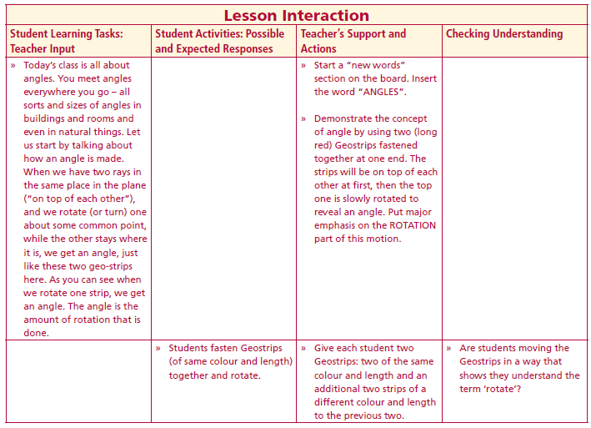
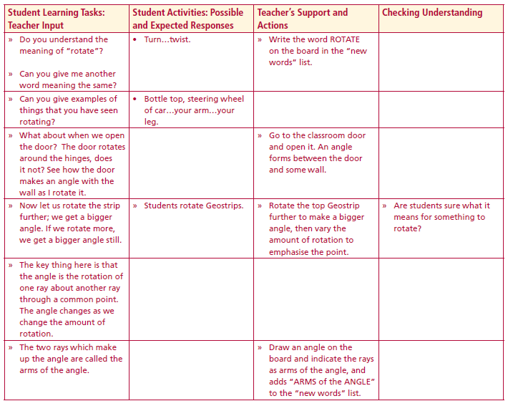
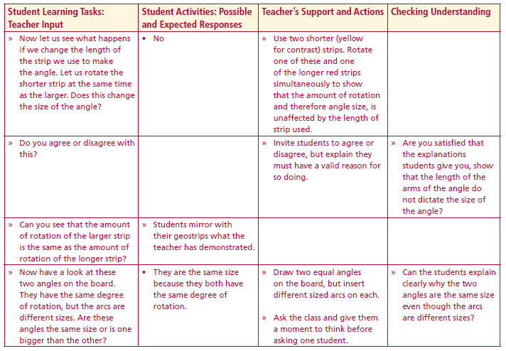
Angles
New words
Angles
Rotate
Arms of the Angle
Each student has two Geostrips: two of the same colour and length and an additional two strips of a different colour and length to the previous two
Students fasten Geostrips (of same colour and length) together and rotate.
The two rays which make up the angle are called the arms of the angle.
Now let us see what happens if we change the length of the strip we use to make the angle. Let us rotate the shorter strip at the same time as the larger. Does this change the size of the angle?
Lesson interaction
Lesson interaction
Lesson interaction

Slide 3
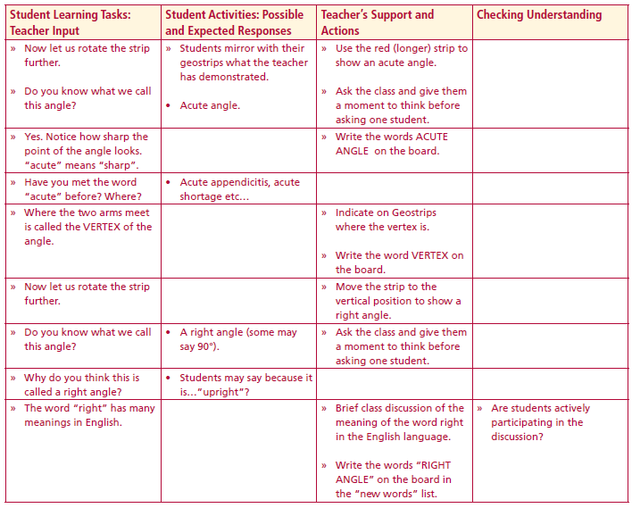
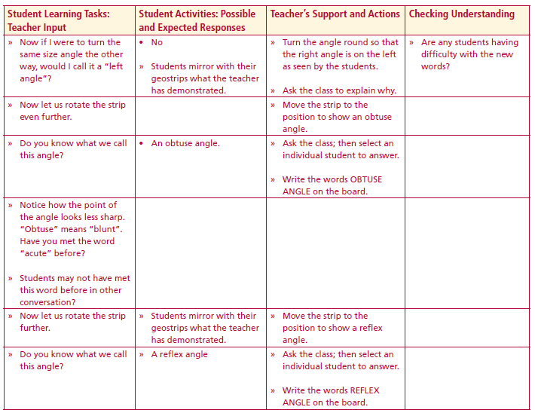
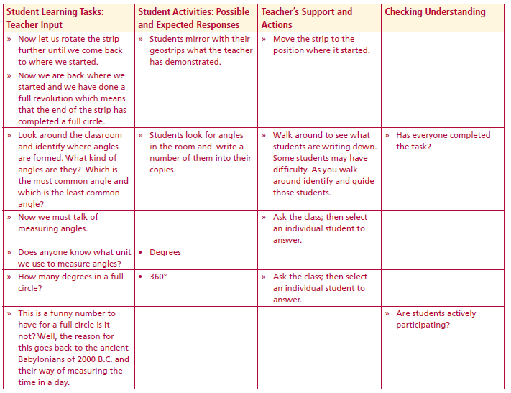
New words
Angles
Rotate
Arms of the Angle
Acute Angle
Vertex
Right Angles
Obtuse Angle
Reflex Angle
Lesson interaction
Lesson interaction
Lesson interaction

Slide 4
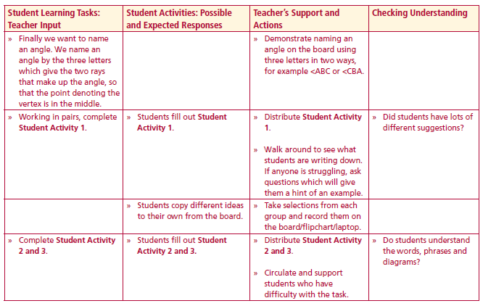
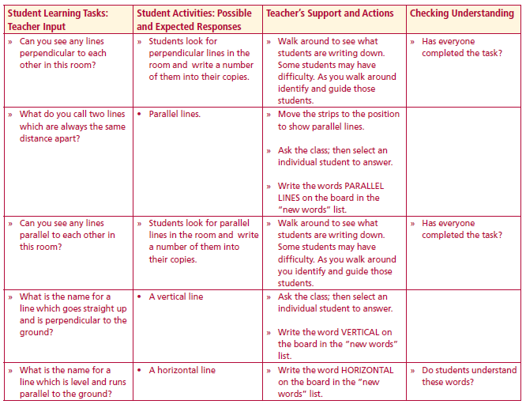
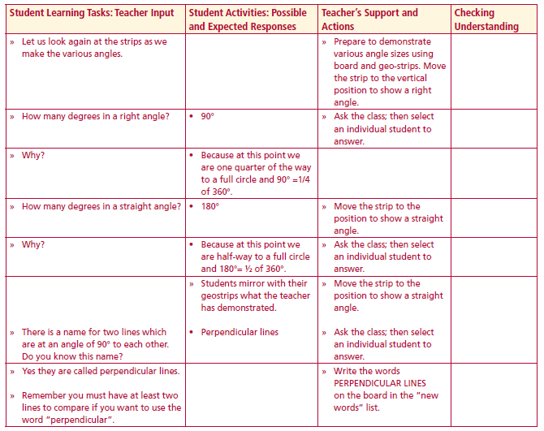
New words
Angles
Rotate
Arms of the Angle
Acute Angle
Vertex
Right Angles
Obtuse Angle
Reflex Angle
Perpendicular line
Parallel lines
Vertical
Horizontal
Lesson interaction
Lesson interaction
Lesson interaction

Slide 5
Student Activity 1
Students work in pairs.
1. Find and list 5 surfaces in the classroom which are horizontal and 5 which are
vertical.___________________________________________________________________
_________________________________________________________________________
_________________________________________________________________________
_________________________________________________________________________
_________________________________________________________________________
2. See if you can find lines or surfaces which are parallel.___________________________
_________________________________________________________________________
_________________________________________________________________________
_________________________________________________________________________
3. See if you can find lines or surfaces which are perpendicular to each other.
_________________________________________________________________________
_________________________________________________________________________
_________________________________________________________________________
4. Can you find perpendicular lines in the classroom where the lines are not vertical or
horizontal?________________________________________________________________
_________________________________________________________________________
_________________________________________________________________________
5. What type of lines are used in the pages of your copy?__________________________
_________________________________________________________________________
_________________________________________________________________________
6. Why is it important to have walls vertical?______________________________________
_________________________________________________________________________
_________________________________________________________________________

Slide 6
4. Can you find perpendicular lines in the classroom where the lines are not vertical or horizontal? _________________________________________________________
_____________________________________________________________________
_____________________________________________________________________
5. What type of lines are used in the pages of your copy?_____________________________________________________________________________________________________________________________________
6. Why is it important to have walls vertical? ________________________________
_____________________________________________________________________
_____________________________________________________________________
7. Is it important to have floors horizontal? Why? _____________________________
_____________________________________________________________________
8. Do you know what a builder uses to ensure that he builds a wall vertically?
_____________________________________________________________________
_____________________________________________________________________
9. What building in Italy is famous for not being vertical? _______________________
__________________________________________________________________________________________________________________________________________

Slide 7
Student Activity 2
Look at the mathematical words/phrases in the middle column below and rewrite each into the correct description box on the left and diagram box on the right.

Slide 8
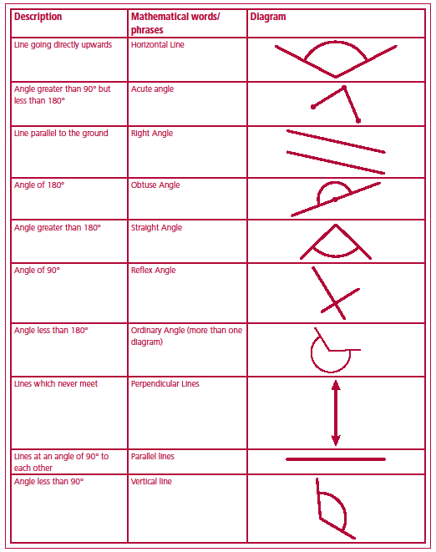

Slide 9
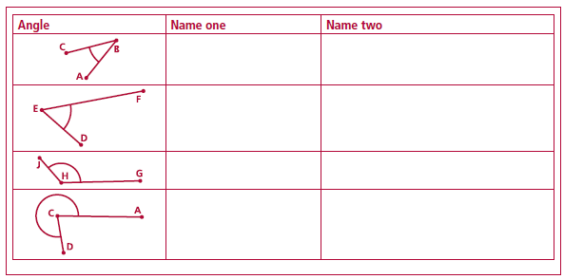
Student Activity 3
1. Name each of these angles using three letters in two ways:
2. What is a wide-angle lens in a camera? What does it do? What type of picture does it take?_______________________________________________________
____________________________________________________________________________________________________________________________________
3. What does it mean when we say that in football that “the goalkeeper narrowed the angle”? What angle did the goalkeeper narrow?_____________

Slide 10
3. What does it mean when we say that in football that “the goalkeeper narrowed the angle”? What angle did the goalkeeper narrow?_________________________
_________________________________________________________________________________________________________________________________________________________________________________________________________
4. Draw out the last five letters of the alphabet in capitals. What kinds of angles are formed in them? _________________________________________________
______________________________________________________________________________________________________________________________________
5. What kinds of angle are formed by the hands of a clock?
(a) At 9.00p.m?_____________________________________________________
(b) At 6.00 a.m.?____________________________________________________
(c) At 3.00 a.m.?____________________________________________________
6. Through how many degrees will the minute hand of a clock rotate in:
(a) 30 minutes?______________________________________________________
(b) 20 minutes?______________________________________________________
(c) 40 minutes?______________________________________________________
(d) 45 minutes?______________________________________________________

Slide 11
Reflection
Write down 3 items you learned about angles and lines today.
Write down anything you found difficult.
Write down any question you may have.

