Slide 2
Index
Section A: | An introduction to equations and how to solve equations using the concept of balance
Section B: | Backtracking and writing a simple algebraic equation to represent situations and how to solve these equations
Section C: | Dealing with variations in layout of equations of the form ax + b = c. Dealing with equations of the form ax + b = cx + d and variations of this layout
Section D: | Forming an equation given a problem and relating a problem to a given equation
Section E: | To show that equations can also be solved graphically
Section F: | To solve equation involving brackets
Section G: | To solve equations involving fractions
Section H: | For students taking higher level in the Junior Certificate the variables and solutions can be elements of Q.

Slide 3
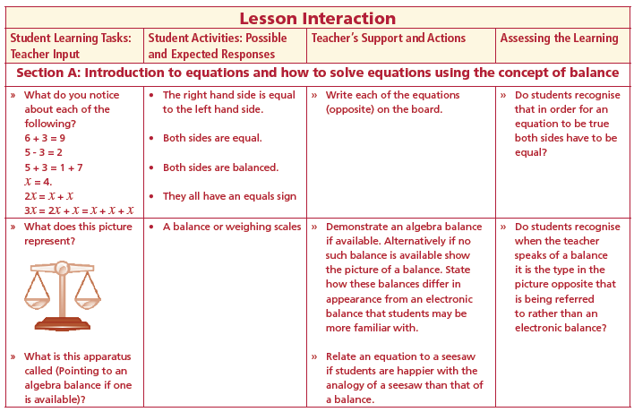
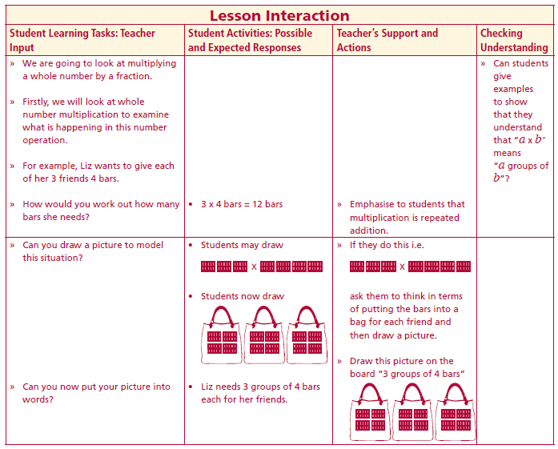
Section A: Student Activity 1
What do you notice about each of the following?
6 + 3 = 9
5 - 3 = 2
5 + 3 = 1 + 7
x = 4.
2x = x + x
3x = 2x + x = x + x + x
What does this picture represent?
What is this apparatus called?
Lesson interaction
Lesson interaction

Slide 4
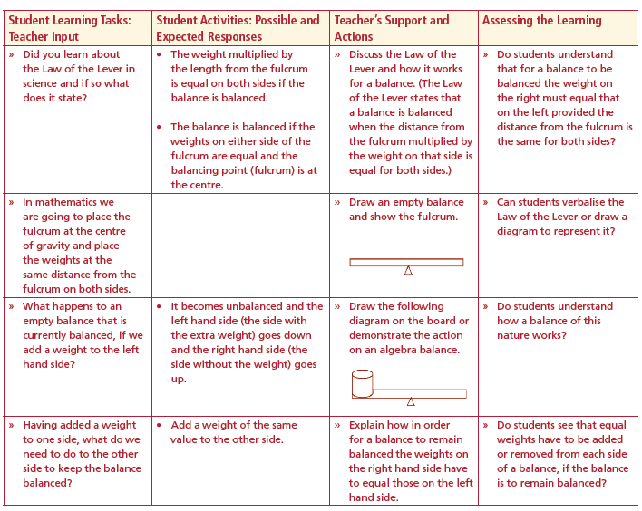
Did you learn about the Law of the Lever in science and if so what does it state?
The weight multiplied by the length from the fulcrum is equal on both sides if the balance is balanced.
The balance is balanced if the weights on either side of the fulcrum are equal and the balancing point (fulcrum) is at the centre.
In mathematics we are going to place the fulcrum at the centre of gravity and place the weights at the same distance from the fulcrum on both sides.
What happens to an empty balance that is currently balanced, if we add a weight to the left hand side?
Having added a weight to one side, what do we need to do to the other side to keep the balance balanced?
Lesson interaction

Slide 5
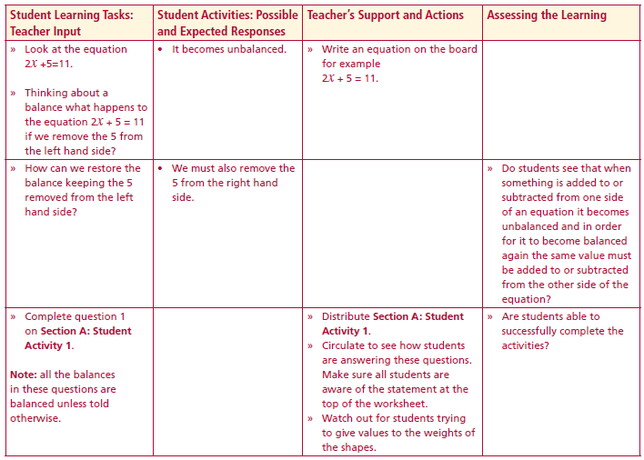
Look at the equation 2x +5=11.
Thinking about a balance what happens to the equation 2x + 5 = 11 if we remove the 5 from the left hand side?
How can we restore the balance keeping the 5 removed from the left hand side?
Complete question 1 on Section A: Student Activity 1.
Note: all the balances in these questions are balanced unless told otherwise.
Lesson interaction

Slide 6
Section A: Student Activity 1
1. Describe the balances labelled a, b, c and d below in two ways:
(i) using words and
(ii) using mathematical symbols.
(i) Words:
the weight of three spheres is balanced by the weight of one cylinder
(ii) Symbols:
3s =c
(Assume all balances in these questions are balanced unless told otherwise)

Slide 8
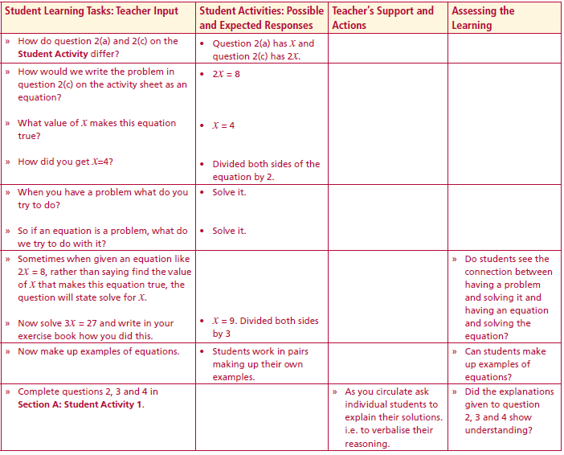
How do question 2(a) and 2(c) on the Student Activity differ?
When you have a problem what do you try to do?
So if an equation is a problem, what do we try to do with it?
Sometimes when given an equation like 2x = 8, rather than saying find the value of x that makes this equation true, the question will state solve for x.
Now solve 3x = 27 and write in your exercise book how you did this
Now make up examples of equations
Complete questions 2, 3 and 4 in Section A: Student Activity 1.
Lesson interaction

Slide 9
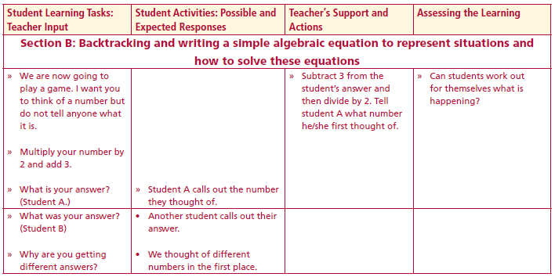
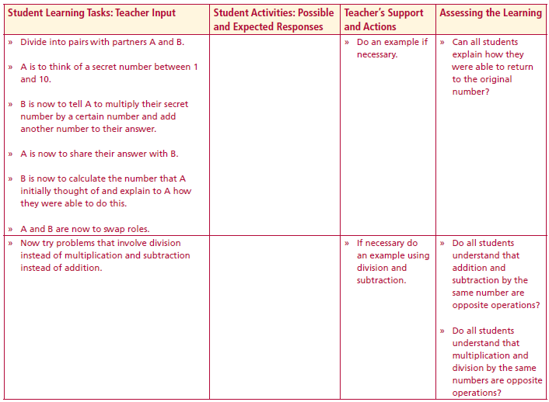
Section B: Student Activity 2
We are now going to play a game.
I want you to think of a number but do not tell anyone what it is.
Multiply your number by 2 and add 3.
What is your answer?
Why are we all getting different answers?
Divide into pairs with partners A and B.
A is to think of a secret number between 1 and 10.
B is now to tell A to multiply their secret number by a certain number and add another number to their answer.
A is now to share their answer with B.
B is now to calculate the number that A initially thought of and explain to A how they were able to do this.
A and B are now to swap roles.
Lesson interaction
Lesson interaction

Slide 10
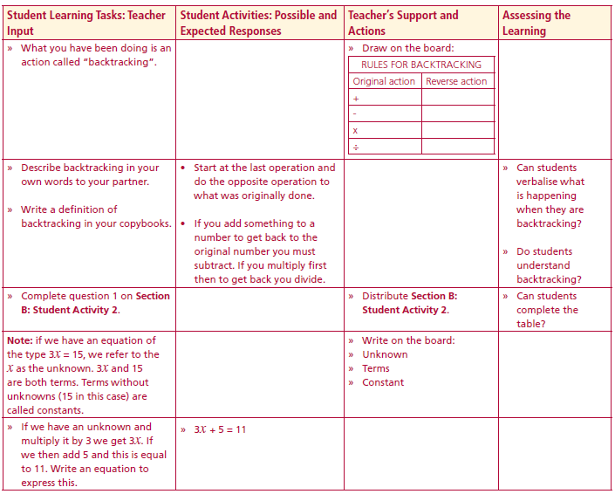
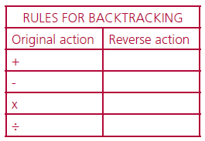
What you have been doing is an action called “backtracking”
Describe backtracking in your own words to your partner.
Write a definition of backtracking in your copybooks
Complete question 1 on Section B: Student Activity 2.
Lesson interaction

Slide 11
Section B: Student Activity 2
Complete the table of rules for backtracking.
Lesson interaction
If you add something to a Number, to get back to the original number you must subtract.
If you multiply first then to get back you divide.
Start at the last operation and
do the opposite operation to
what was originally done

Slide 12
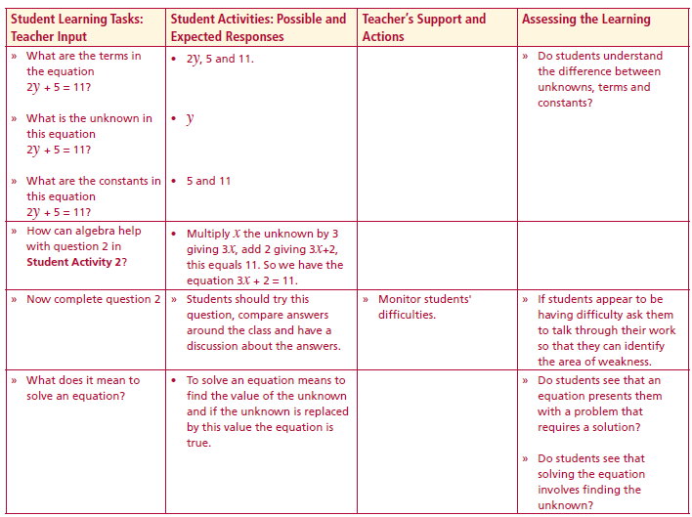
Note: if we have an equation of the type 3x = 15, we refer to the x as the unknown. 3x and 15 are both terms.
Terms without unknowns (15 in this case) are called constants.
If we have an unknown and multiply it by 3 we get 3x. If we then add 5 and this is equal to 11.
Write an equation to express this.
What are the terms in the equation 2y + 5 = 11?
What is the unknown in this equation 2y + 5 = 11?
What are the constants in this equation 2y + 5 = 11?
How can algebra help with question 2 in Student Activity 2?
Now complete question 2
What does it mean to solve an equation?
Lesson interaction
Lesson interaction

Slide 13
Section B: Student Activity 2
Complete the table of rules for backtracking.
2. John thinks of a number, multiplies it by 3 and adds 2 to his
answer. The result is 11.
a. Using backtracking, what number did he think of?
b. Write an equation to represent this problem.
c. Solve the equation.
d. How are your answers for parts a and c related?

Slide 14
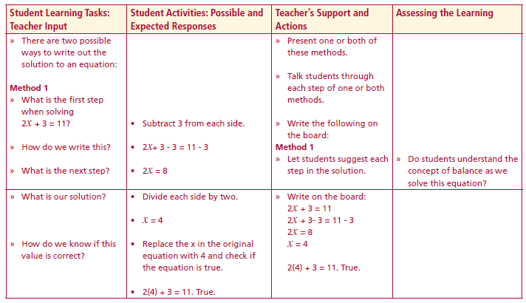
There are two possible ways to write out the solution to an equation:
Method 1
What is the first step when solving 2x + 3 = 11?
How do we write this?
2x + 3 - 3 = 11 - 3
What is the next step?
2x = 8
What is our solution?
2x = 8
2 2
x = 4
How do we know if this value is correct?
Lesson interaction

Slide 15
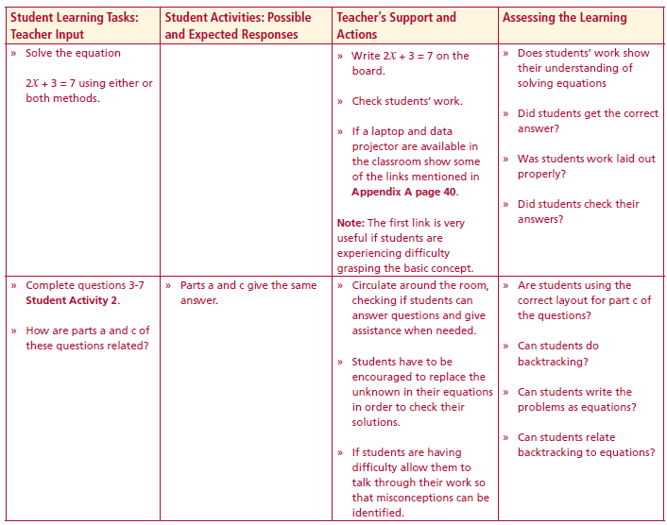
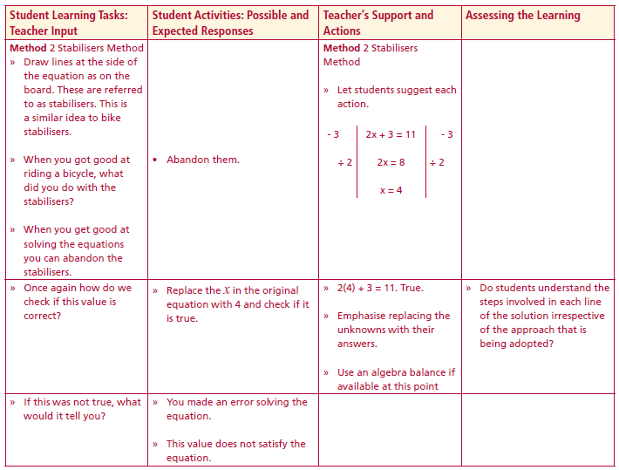
Method 2 Stabilisers Method
Draw lines at the side of the equation as on the board. These are referred to as stabilisers. This is a similar idea to bike stabilisers.
When you got good at riding a bicycle, what did you do with the stabilisers?
When you get good at solving the equations you can abandon the stabilisers.
Once again how do we check if this value is correct?
If this was not true, what would it tell you?
Solve the equation 2x + 3 = 7 using either or both methods
Complete questions 3-7 Student Activity 2.
How are parts a and c of these questions related
Lesson interaction
- 3
2x + 3 = 11
- 3
÷ 2
2x = 8
÷ 2
x = 4
Lesson interaction

Slide 16
3. Sarah thinks of a number, multiplies it by 4 and adds 5 to her
answer. The result is 25.
a. Using backtracking, what number did she think of?
b. Write an equation to represent this problem.
c. Solve the equation.
d. How are your answers for part a and c related?
4. Dillon thinks of a number, multiplies it by 3 and subtracts 5 from
his answer. The result is 7.
a. Using backtracking, what number did he think of?
b. Write an equation to represent this problem.
c. Solve the equation.
d. How are your answers for part a and c related?

Slide 17
5. Saoirse thinks of a number and divides it by 2 and adds 5 to her
answer. The result is 9.
a. Using backtracking, what number did she think of?
b. Write an equation to represent this.
c. Solve the equation.
d. How are your answers for part a and c related?
6. Susan thinks of a number and divides it by 3 and subtracts 5 from
her answer. The result is 14.
a. Using backtracking, what number did she think of?
b. Write an equation to represent this.
c. Solve the equation.
d. How are your answers for part a and c related?
7. Solve the following equations and check solutions (Answers):
a. 2x = 4 b. 3x + 1 = 13
c. 5x - 4 = 21 d. 4x - 4 = 44
e. 11x - 5 = 3 f. 3x - 4 = 11

Slide 18
Reflection:
Write down what you learned about equations today.
Write down anything you found difficult today.
Lesson interaction

Slide 19
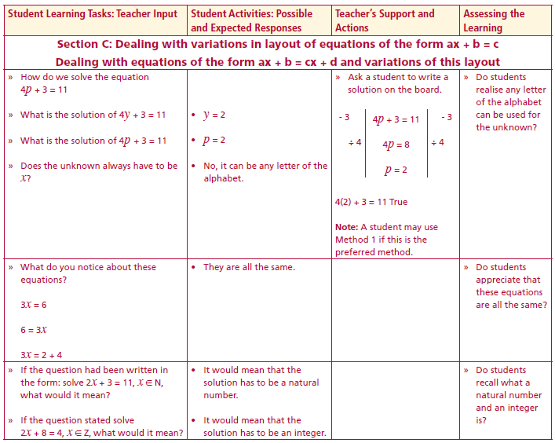
Section C: Student Activity 3
How do we solve the equation 4p + 3 = 11
What is the solution of 4y + 3 = 11
What is the solution of 4p + 3 = 11
Does the unknown always have to be x?
What do you notice about these equations?
3x = 6
6 = 3x
3x = 2 + 4
If the question had been written in the form: solve 2x + 3 = 11, x ∈ N, what would it mean?
If the question stated solve 2x + 8 = 4, x ∈ Z, what would it mean?
Lesson interaction

Slide 20
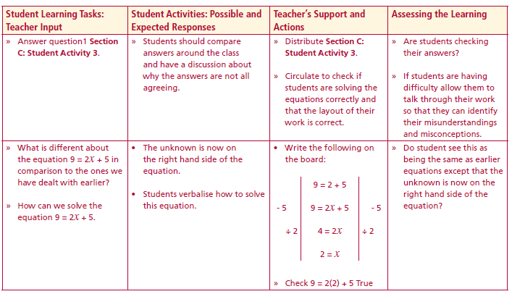
Section C: Student Activity 3
1. Solve the following equations and check solution which will be a
natural number in each case:
N.B. When asked to solve equations, always check answers.
a. 2x = 8 b. 40y = 160 c. 40z = 360
d. 2s + 1 = 9 e. 2t - 1 = 7 f. 5r - 8 = 17
g. 2x - 9 = -1 h. 2y - 15 = 31 i. 1 - 2c = -5
j. 8d -168 = -16
2. Solve the following equation 4s + 7 = 19, x ∈ N.
3. Does the equation 6x + 12 = 8, x ∈ N have a solution? Explain.
4. Does the equation 6x + 12 = 8, x ∈ Z have a solution? Explain.
5. Is x = -1 a solution to the equation 2x + 10= 8? Explain your answer.
Lesson interaction

Slide 21
6. Is x = 4 a solution to the equation 2x + 5 = 10? Explain your answer.
7. Is x = 2 a solution to the equation –x + 3 = 1? Explain your answer.
8. Examine this student’s work. What do you notice?
3x + 6 = 21
3x + 6 – 6 = 21
3x = 21
x = 7

Slide 22
What is different about the equation 9 = 2x + 5 in comparison to the ones we have dealt with earlier?
How can we solve the equation 9 = 2x + 5.
9. Solve the following equations and check your solutions which will
be an integer in each case:
a. 3x - 7 = 2x b. 4t + 6 = 2t c. 1 + 2c = 7
d. 42 = 7 – 5c e. -42 = 5m – 7 f. –p = 72 + 2p
g. 6 -3k= 0 h. -9y = -y - 48
i. x = 5 j. x = -5
3 3
Lesson interaction
- 5
9 = 2x + 5
- 5
÷ 2
4 = 2x
÷ 2
2 = x

Slide 23
10. Is x = 9 a solution to the equation 5 - 2x = -13?
Explain your answer.
11. Is r = 2 a solution to the equation –6r + 3 = r?
Explain your answer.
12. Examine this student’s work. What do you notice?
5 – x = 21
5 – 5 – x = 21 - 5
-x=16

Slide 24
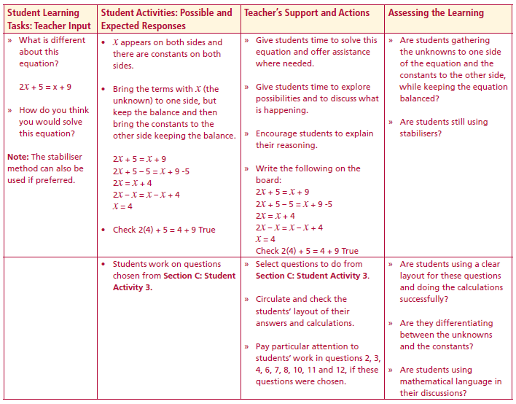
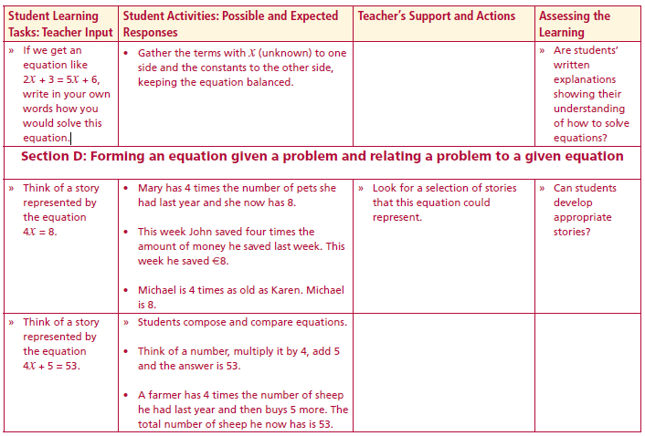
What is different about this equation? 2x + 5 = x + 9
How do you think you would solve this equation?
If we get an equation like 2x + 3 = 5x + 6, write in your own words how you would solve this equation.
13. Is t = 4 a solution to the equation 5t - 2 = 3t - 3? Explain your answer.
14. Is x = -2 a solution to the equation –6x + 3 = -x + 13? Explain your answer.
Lesson interaction
- 5
2x + 5 = x + 9
- 5
- x
2x = x + 4
- x
x = 4
Lesson interaction

Slide 25
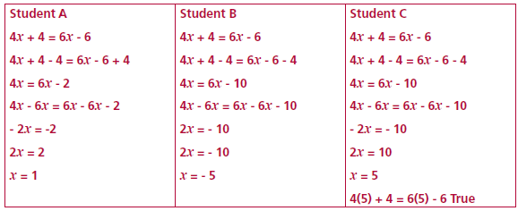
15. Examine this student’s work. Spot the errors, if any, in each case.

Slide 26
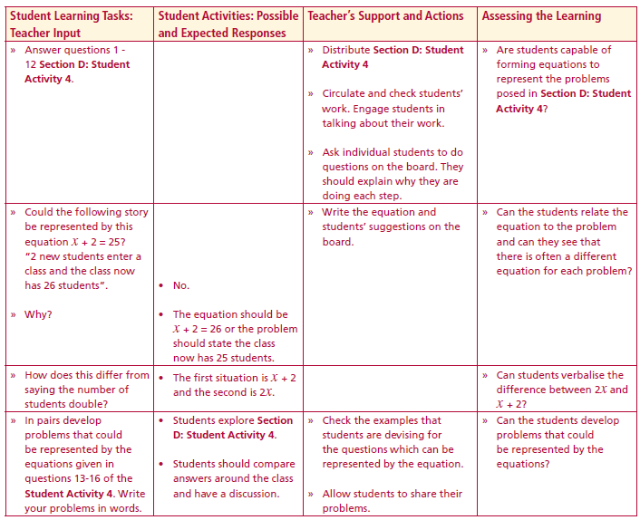
Section D: Student Activity 4
Think of a story represented by the equation 4x = 8
Think of a story represented by the equation 4x + 5 = 53.
Lesson interaction
Lesson interaction

Slide 27
Section D: Student Activity 4
Brendan thinks of a number, adds 3 and the answer is 15. Represent this statement as an equation. Solve the equation and check your answer.
2. Joanne thinks of a number then subtracts 5 and the answer is 10. Represent this statement as an equation. Solve the equation and check your answer.
3. A farmer has a number of cows and he plans to double that number next year, when he will have 24. Represent this statement as an equation. Solve the equation and check your answer.
4. A new student enters a class and the class now has 25 students. Represent this statement as an equation. Solve the equation and check your answer.
5. The temperature increases by 18 degrees and the temperature is now 15. Represent this statement as an equation. Solve the equation and check your answer.

Slide 28
6. A farmer doubles the amount of cows he has and then buys a further three cows. He now has 29. Represent this as an equation. How many did he originally have?
7. Emma and her twin brother will have a total age of 42 in 5 year’s time. Represent this as an equation. How old are they at the moment?
8. A table’s length is 6 metres longer than its width and the perimeter of the table is 24 metres. Allow x to represent the width of the table write an equation to represent this information and solve the equation to find the width of the table.
x

Slide 29
9. Mark had some cookies He gave half of them to his friend John. He then divided his remaining cookies evenly between his other three friends each of whom got four cookies. How many cookies did Mark have?
10. Chris has €400 in his bank account and he deposits €5 per week thereafter into his account. His brother Ben has €582 in his account and withdraws €8 per week from his account. If this pattern continues, how many weeks will it be before they have the same amounts in their bank accounts?
11. The sum of three consecutive natural numbers is 51. What are the numbers?
12. A ribbon is 30cm long and it is cut into three pieces such that each piece is 2cm longer than the next. Represent this as an equation? Solve the equation to discover how long each piece of ribbon is.

Slide 30
Could the following story be represented by this equation x + 2 = 25?
“2 new students enter a class and the class now has 26 students”.
Why?
How does this differ from saying the number of students double?
In pairs develop problems that could be represented by the equations given in question 13 of the Student Activity 4.
13. Write a story that each of the following equations could represent:
i. 2x = 10 ii. 2x + 5 = 11 iii. 3x – 5 = 13 iv. 3x – 5 = 2x + 13
Lesson interaction

Slide 31
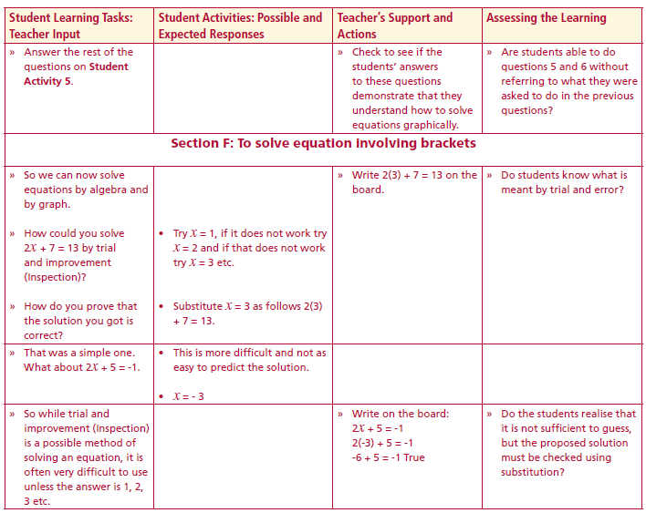
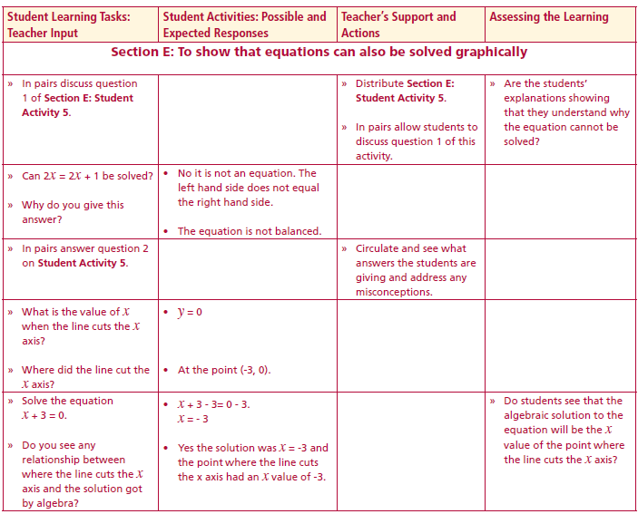
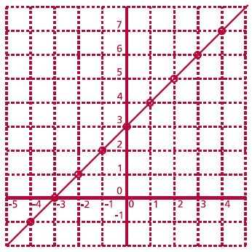
Section E: Student Activity 5
Can you solve the equation 2x=2x+1? Why or why not?
2.
a. Make a list of 4 points on this line.
b. What is added to each x to give the
y value?
c. So is it true to say the line has equation
y = x + 3?
d. Solve the equation x + 3 = 0 by algebra.
e. Can we read from the graph the point
where y = 0 (or x + 3 = 0)?
f. Do you get the same answer when you
graph the line y = x + 3 and find where it
cuts the x axis as you get when you solve
the equation x + 3 = 0 by algebra?
3. Complete the following table and draw the resulting line on graph
paper.
Lesson interaction
Lesson interaction

Slide 32
3. Complete the following table and draw the resulting line on graph
paper.
a. Where does the line y = 2x + 2 cut the x axis?
b. What is the x value of the point where this line cuts the x axis?
c. Solve the equation 2x + 2 = 0 using algebra.
d. Do you get the same answer for the x value of the point where the line
y = 2x + 2 cuts the x axis and from solving the equation 2x + 2 = 0 using
algebra?

Slide 33
4. Complete the following table and draw the resulting line on graph
paper.
a. Where does the line y = 2x -1 cut the x axis?
b. What is the x value of the point where this line cuts the x axis?
c. Solve the equation 2x – 1 = 0 using algebra.
d. Do you get the same answer for the x value of the point where the line
y =2x -1 cuts the x axis and from solving the equation 2x -1 = 0 using #
algebra?

Slide 34
5. Given the table below find the solution to the equation 2x – 3 = 0.
6. Solve the equation 2x - 6 = 0 graphically.
7. Solve the equation x + 5 = 0 graphically.
8. Describe in your own words how to solve an equation graphically.

Slide 35
Section F: Student Activity 6
So we can now solve equations by algebra and by graph.
How could you solve 2x + 7 = 13 by trial and improvement (Inspection)?
How do you prove that the solution you got is correct?
That was a simple one.
What about 2x + 5 = -1.
So while trial and improvement (Inspection) is a possible method of solving an equation, it is often very difficult to use unless the answer is 1, 2, 3 etc.
Lesson interaction

Slide 36
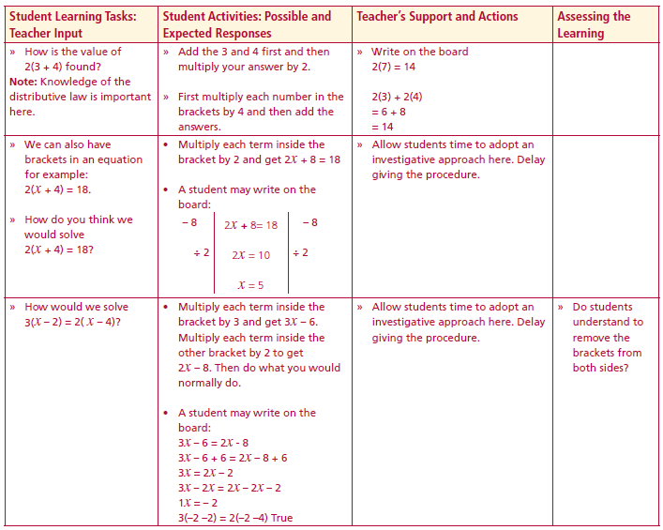
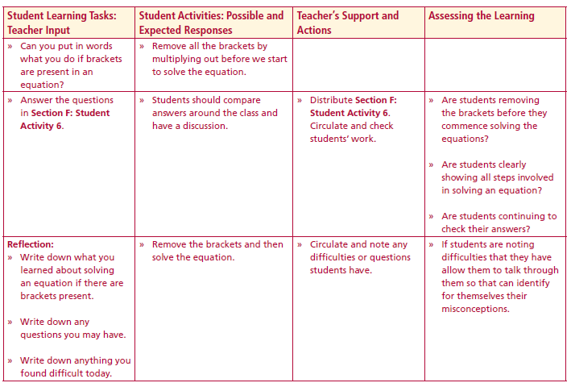
How is the value of 2(3 + 4) found?
We can also have brackets in an equation for example: 2(x + 4) = 18.
How do you think we would solve 2(x + 4) = 18?
How would we solve 3(x – 2) = 2( x – 4)?
Can you put in words what you do if brackets are present in an equation?
Answer the questions in Section F: Student Activity 6.
Lesson interaction
2(x + 4) = 18
- 8
2x + 8 = 18
- 8
Lesson interaction
÷2
2x = 10
÷2
x = 5

Slide 37
Section F: Student Activity 6
1. Solve the following equations and check your solutions:
a. 3(y – 2) = 3 b. 4(x - 2) = 8
c. 2(4 - x) = 6x d. 5(t - 2) + 6(t - 3) = 5
e. 4(x - 1) + 3(x - 2) = 4 f. 4(p + 7) + 5 = 5p + 36
g. 5(q - 4) + 12 = 3(q - 3) h. 2(x + 3) - 3(x + 2) = - 2
i. 2(s - 1) + 3(s - 3) + s = 1 j. 3(x + 1) - (x + 5) = 0
k. 2(d + 3) + 3(d + 4) = 38 l. (x + 1) + 5(x + 1) = 0
2. Is y=5 a solution to the equation 2(y - 4) + 5 = 3(y + 2)? Explain your
answer.
Is y=2 a solution to the equation (y - 4) + 6 = 3(y + 2) - 7? Explain your
answer.

Slide 38
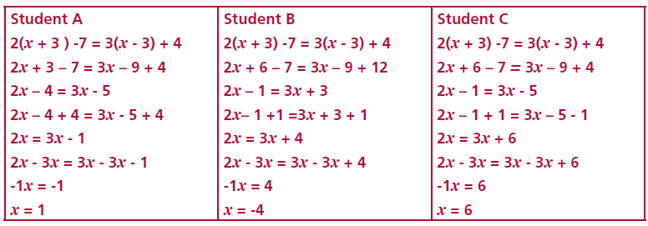
4. a. These students each made one error, explain the error in each case.
b. Solve the equation correctly showing all the steps clearly.
Mary is 5 years older than Jack. Twice Mary’s age plus 3 times Jack’s age is 125. Write an equation to represent this information and solve the equation to find Mary’s age.
The current price of an apple is x cents. The price of an apple increases by 4 cents and Alan goes to the shop and buys 4 apples plus a magazine costing €2. His total bill came to €4.44.

Slide 39
7. Half of a number added to a quarter of the same number is 61. Write an equation to represent this information. Solve the equation to find the number?
8. Erica went shopping. She spent a quarter of her money on books, half of her money on shoes and €5 on food. She had €12 left. Write an equation to represent this situation. Solve the equation to find how much money she had at the beginning of the day?
a. Write an equation in terms of x to represent her total bill in cents?
b. Solve the equation. What does the answer tell you?

Slide 40
Reflection:
Write down what you learned about solving an equation if there are brackets present.
Write down any questions you may have.
Write down anything you found difficult today.
Lesson interaction

Slide 41
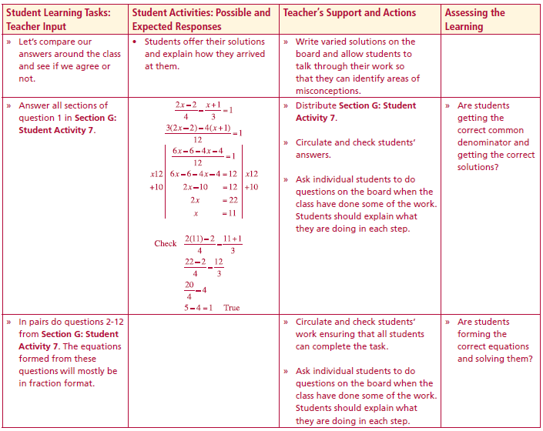
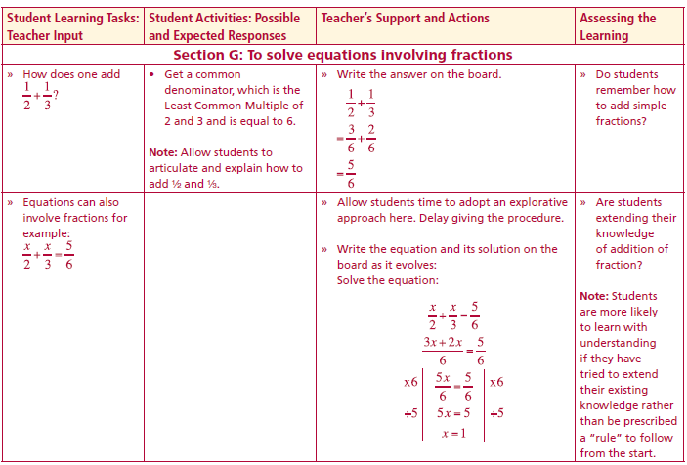
Section G: Student Activity 7
How does one add 1 1
2 3
Equations can also involve fractions for example:
x x 5
2 3 6
+
Lesson interaction
Lesson interaction
+ =

Slide 42
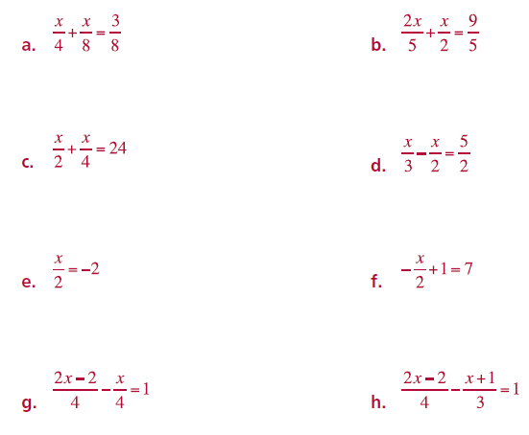
Section G: Student Activity 7
1. Solve the following equations and check your solutions:

Slide 43
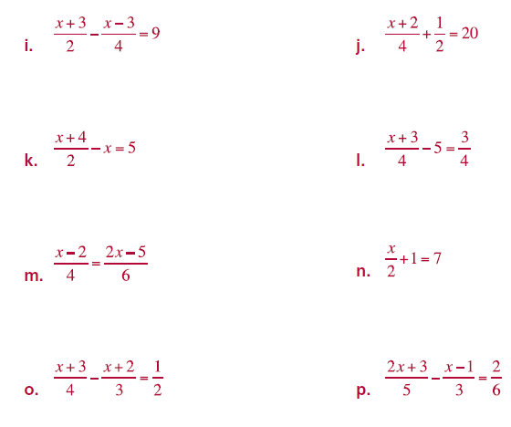
1. Solve the following equations and check your solutions:

Slide 44
Martha has a certain number of sweets in a bag and she gives half to Mary and Mary gets 20. How can this be represented as an equation? Solve the equation and check your answer.
A father is x years of age and is twice the age of his daughter, who is now 23. Find an equation in terms of x to represent this situation and solve the equation.
There are three generations in a family: daughter, mother and Grandmother. The daughter is half the age of the mother and the grandmother is twice the age of the mother. The sum of their ages is 140. Write an equation to represent this situation and solve the equation to find the ages of each member of the family.

Slide 45
A carpenter wished to measure the length and width of a rectangular room, but forgot his measuring tape. He gets a piece of wood and discovers the length of the room is twice as long as the piece of wood and the width of the room is half that of the wood. The owner says that the only information he can remember about the room is that its perimeter is 50 metres. Write an equation to represent this information, letting x equal the length of the piece of wood. Solve the equation and explain your answer.
Jonathan is half Jean’s age and Paul is 3 years older than Jean. Given that the sum of their ages is 43, write an equation to represent this situation and solve the equation. What age is each person?

Slide 46
A student took part in a triathlon which involved swimming, running and cycling. He spent ½ the time swimming that he spent running and 3 times the time cycling as he spent running. His total time was 45 minutes. Write an equation to represent this situation. Solve the equation and state how long he spends at each sport.
Kirsty has just bought a new outfit consisting of a skirt, a shirt and shoes. She will not tell her mother the cost of the shoes, but her mother knows she spent all her pocket money of €220 on the outfit. Through a series of questions her mother discovers that she spent 4 times the amount she spent on the skirt on the shoes and she spent half the amount she spent on the skirt on the shirt. Write an equation to represent this information and find the cost of the shoes using this equation.
There are x chocolate buttons in a bag. Dan ate 6 chocolate buttons. Eamon then ate a quarter of the remaining chocolate buttons in the bag. There were now 90 chocolate buttons left in the bag. Write an equation to represent this information and solve the equation to find the number of chocolate buttons originally in the bag?

Slide 47
10 Simplify and hence solve for x.
11 Simplify
and hence solve for x.

Slide 48
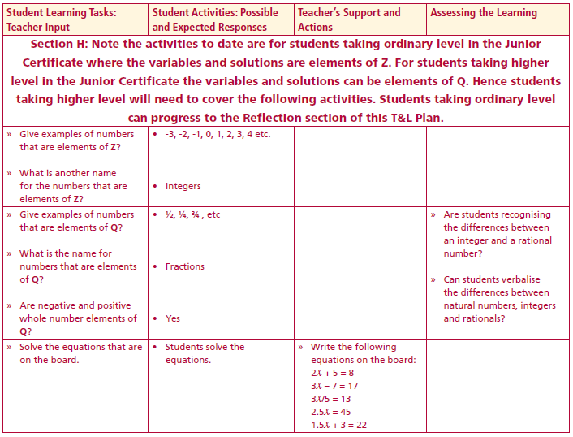
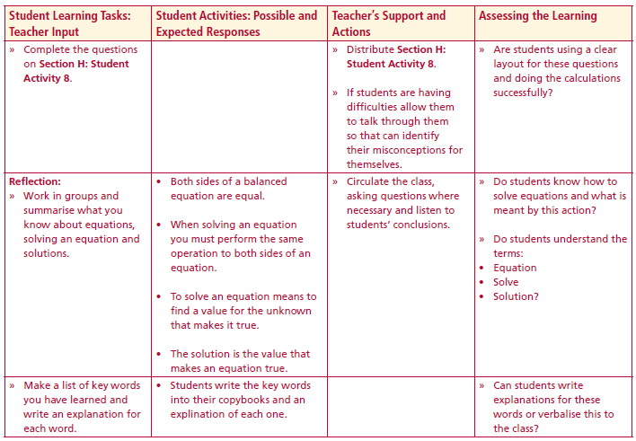
Section H: Student Activity 8
Elements of Z: -3, -2, -1, 0, 1, 2, 3, 4 etc
What is another name for the numbers that are elements of Z?
Elements of Q? ½, ¼, ¾ , etc
What is the name for numbers that are elements of Q
Are negative and positive whole number elements of Q?
Solve the equations the following equations
2x + 5 = 8
3x – 7 = 17
3x/5 = 13
2.5x = 45
1.5x + 3 = 22
Lesson interaction
Lesson interaction

Slide 49
Section H: Student Activity 8
Higher level only Solution may be elements of Q.
1 Solve the equation 2x = 9.
2 Solve the equation 2x – 5 = -3x – 7.
3 Solve
4 Solve the equation 2(x - 3) - 3(x - 2) = 15.
5 Solve the equation 5(x - 5) - 3(x - 2) + 4 = 0.
6 Solve the equation
7 An electric supplier has a fixed charge of €48 for every two months and also charges 9 cent per unit of electricity used.
(a). Write an equation to represent this information.
(b). The Gallagher family got a bill for €77.97 for the last 2 months. Use your equation to find how many units of electricity they used during this period.

Slide 50
3 is taken from a number and the result divided by 4. This is then added to
half of the original number giving an answer of 47. Find the original number?
9 Julie went shopping. She spent one sixth of her money on books, an eight of
her money on shoes and €5 on food. She had €13.50 left. Write an equation
to represent this information. Solve the equation to find how much money
she had at the beginning of the day?
The difference between a half of a number and a third of the same number is 34.5.
What is the number?
11 The difference between one third of a number and 2 sevenths of the same
number is 2½
Find the number.

Slide 51
Reflection:
Work in groups and summarise what you know about equations, solving an equation and solutions.
key words
Make a list of key words you have learned and write an explanation for each word.

Slide 52
Appendix A
Internet sites that will aid the teaching of this topic:
http://nlvm.usu.edu/en/nav/frames_asid_201_g_4_t_2.html?open=instructions&from=category_g_4_t_2.html
http://www.mathsisfun.com/algebra/add-subtractbalance.html

