Slide 2
INDEX
Student Activity 1: Patterns
Student Activity 2: Money Box Problem
Student Activity 3: Using Graphs to represent
information
Student Activity 4: Finding Formulae (HL)
Student Activity 5: Graphing Functions (HL)

Slide 3
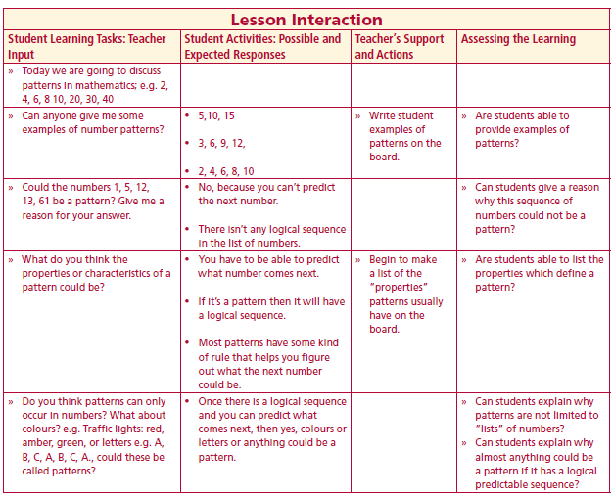
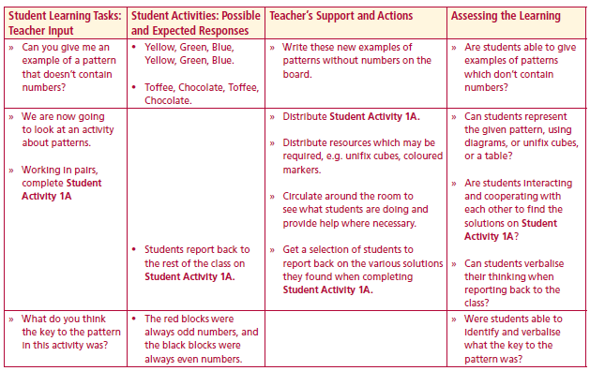
Today we are going to discuss patterns in mathematics; e.g. 2, 4, 6, 8 10,20, 30, 40
Can anyone give me some examples of number patterns?
Could the numbers 1, 5, 12, 13, 61 be a pattern? Give me a reason for your answer
What do you think the properties or characteristics of a pattern could be?
Do you think patterns can only occur in numbers? What about colours? e.g. Traffic lights: red, amber, green, or letters e.g. A, B, C, A, B, C, A., could these be called patterns?
Can you give me an example of a pattern that doesn’t contain numbers?
We are now going to look at an activity about patterns.
Lesson interaction
Lesson interaction

Slide 4
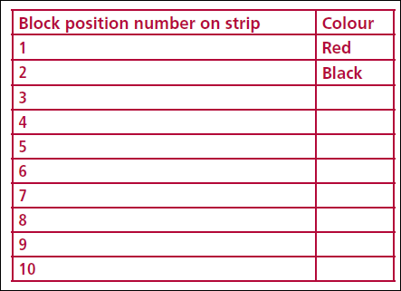
Student Activity 1A
Represent this repeating pattern - red, black, red, black, red, black, – by
building it with blocks or colouring it in on the number strip below:
Lesson interaction
1
2
3
4
5
6
7
8
9
10
2. Complete the following table based on your diagram above:

Slide 5
3. Answer the following questions:
1. List the position numbers of the first 5 red blocks:____________________
2. What do you notice about these numbers?__________________________
3. List the position numbers of the first 5 black blocks:___________________
4. What do you notice about these numbers?__________________________
5. What colour is the 100th block?___________________________________
6. What colour is the 101st block?___________________________________
7. What position number on the strip has the 100th black block?__________
8. What position number on the strip has the 100th red block?____________
9. What colour will the 1000th block be?______________________________
Explain how you found your answer for question 8:_____________________
______________________________________________________________
Lesson interaction

Slide 6
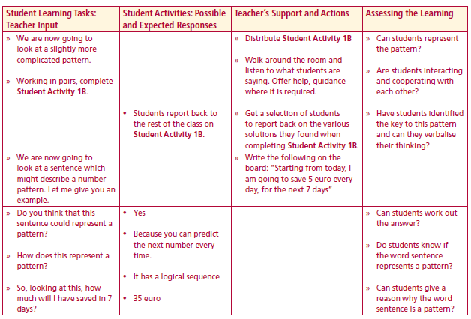
Student Activity 1B
1. Represent this repeating pattern – yellow, black, green, yellow, black, green – by building it with blocks or colouring it in on a number strip or drawing a table or
in any other suitable way.
1. List the numbers of the first 3 yellow blocks. Is there a pattern in these numbers?
_____________________________________________________________________
2. List the numbers of the first 3 black blocks. Is there a pattern in these numbers?
_____________________________________________________________________
3. List the numbers of the first 3 green blocks. Is there a pattern in these numbers?
_____________________________________________________________________
4. What colour is the 6th block?____________________________________________
5. What colour is the 18th block?__________________________________________
6. What colour is the 25th block?__________________________________________
7. What colour is the 13th block?__________________________________________
8. What colour will the 100th block be in the sequence?________________________
Lesson interaction
1
2
3
4
5
6
7
8
9
10

Slide 7
7. What colour is the 13th block?_ ____________________________________
8. What colour will the 100th block be in the sequence?________________________
9. What colour will the 500th block be in this sequence?________________________
10. Explain how you found your answers to questions 8 and 9,
______________________________________________________________________
______________________________________________________________________
______________________________________________________________________
______________________________________________________________________
11. What rule could you use to work out the position number of any of the (i) yellow
blocks, (ii) black blocks, (iii) green blocks?
______________________________________________________________________
______________________________________________________________________
______________________________________________________________________
______________________________________________________________________
______________________________________________________________________
How does this represent a pattern?

Slide 8
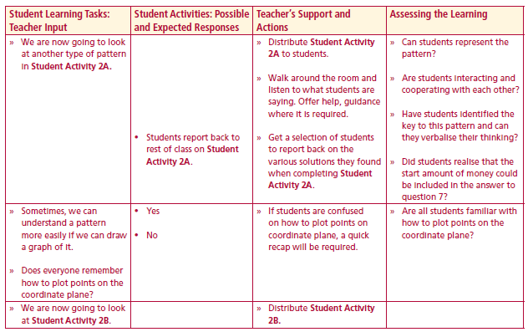
Student Activity 2A
Money box problem
John receives a gift of a money box with €4 in it for his birthday. This is his starting amount. John decides he will save €2 a day. Represent this pattern by drawing a table,
or a diagram, or by building it with blocks.
Lesson interaction
1. How much money will John have in his money box on the following days?
Day 5: _______ Day: 10: _________ Day 14: ________ Day 25: ___________
2. By looking at the pattern in this question, can you explain why the amount of
money John has on day 10 is not twice the amount he has on day 5? __________________________________________________________________
__________________________________________________________________
__________________________________________________________________
3. How much money does John have in his money box on day 100? ___________
4. Explain how you found your answer for the amount for day 100: ____________________________________________________________________________________________________________________________________
__________________________________________________________________________________________________________________________________________________

Slide 9
4. Explain how you found your answer for the amount for day 100: ______________________________________________________________________________________________________________________________________________________________________________________________________
5. How much money has John actually put in his money box after 10 days? Explain how you arrived at this amount. __________________________________________________________________________________________________________________________________________________________________________________________________________________________________________________________________________________________________________________________________________
6. John wants to buy a new computer game. The game costs €39.99. What is the
minimum number of days John will have to save so that he has enough money to
buy the computer game?_ ___________________________________________________________________________________________________________________________________________________________________________________________________________________________________________________________________________________________________b
Lesson interaction

Slide 10
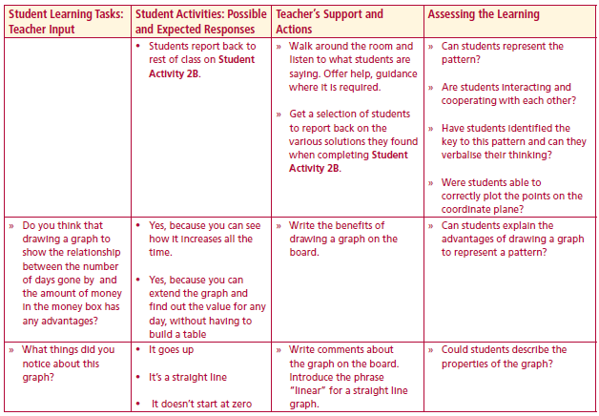
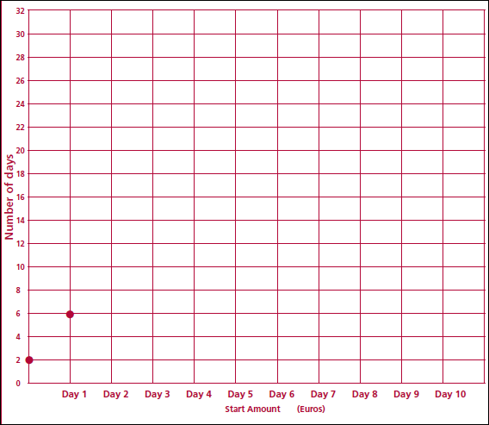
Student Activity 2B
Annie has a money box; she starts with €2 and adds €4 each day. Create a table showing the amount of money Annie has each day over a period of 10 days.
1. Using the axes below, draw a graph to show how much
money Annie has saved over 6 days
Lesson interaction

Slide 11
2. List two things that you notice about this graph
a._______________________________________________________________
b._______________________________________________________________
3. Could you extend the line on this graph to find out how much money Annie has inher money box on day 10?
a. Amount on day 10 = ______________________________________________

Slide 12
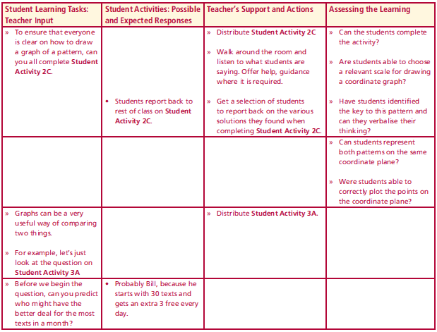
Student Activity 2C
Owen has a money box; he starts with €1 and adds €3 each day.
Lesson interaction
Draw a table showing the amount of money Owen has each day.
2. Draw a graph to show the amount of money Owen has saved over 10
days.
Hint: Think carefully about the following before you draw your graph:
Where will you put “Number of days” and “Amount of money” on your
graph?
What scale will you use for the amount of money? (Will you use 1, 2,
3,... or will you decide to use 5, 10, 15, 20..... or perhaps a different
scale?)

Slide 13
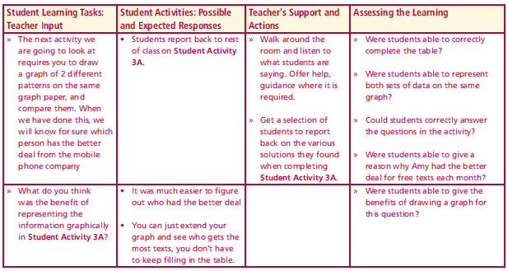
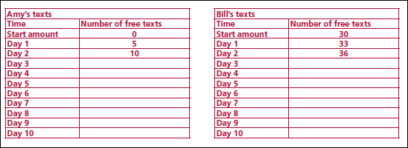
Student Activity 3A
Using Graphs to represent information
Amy and Bill are discussing phone network offers. Bill says that on his network he begins each month with 30 free texts and receives 3 additional free texts each night. Amy says that she gets no free texts at the beginning of the month but that she receives 5 free texts each night. To see how many texts each person has over a period of time, complete the tables below.
Lesson interaction
Lesson interaction
Who has the most free texts after 10 days?_________________________
2. Using the graph paper provided, draw a graph showing the number of texts
Amy has, and using the same axes draw a graph of the texts Bill has, for 10 days.

Slide 14
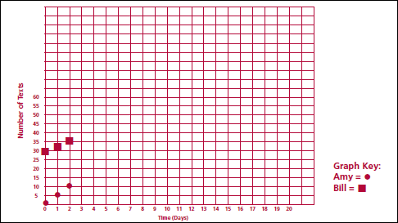
3. What do you notice about each graph? ________________________________
_________________________________
4. Extend the lines of each graph to “Day 20”. In your opinion, who do you think has the better deal on free texts Bill or Amy? Why? _________________________________________________________________
5. Will Amy and Bill ever have the same number of texts on a particular day? If so, which day? If not, why? ___________________________________________________________________________________________________

Slide 15
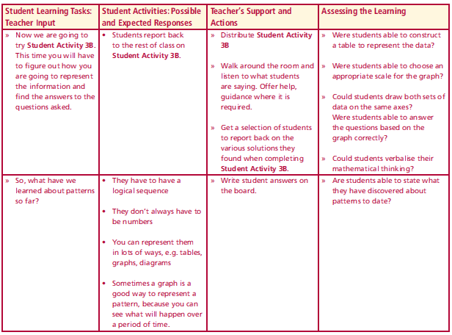
Student Activity 3B
Examine the situation below
Liam begins the month with 20 free texts and receives 2 additional free texts each night. Jessie does not have any free texts at the beginning of the month but receives 3 free texts each night.
1. Draw a table showing the following information.
a. The number of free texts Liam has after 10 days
b. The number of free texts Jessie has after 10 days
2. Represent this information on a graph, (note: show Liam’s and Jessie’s number of free texts on the same graph)
3. Will Liam and Jessie ever have the same number of free texts on a certain day? If so, which day? If not, why not? _______________________________
4. Who in your opinion has the better deal for free texts each month? Give a reason for your answer. ____________________________________________
_______________________________________________________________
Lesson interaction

Slide 16
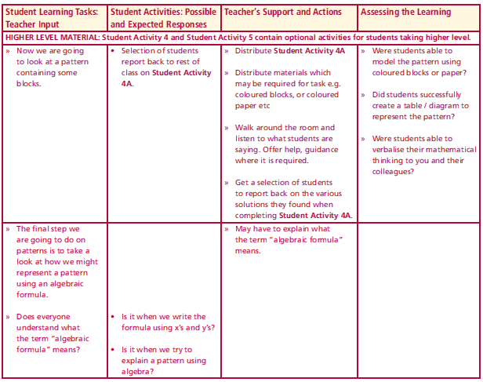
Student Activity 4A (Higher Level Material)
Finding Formulae
The figures below are made up of white and red square tiles. The white squares are in the middle row and have a border of red tiles around them. For 1 white tile, 8 red tiles are needed; for 2 white tiles, 10 red tiles are needed, and so on.
Using the information above, create a table or diagram which will show how the number of red tiles increases as the number of white tiles increases.
(Hint: Look at the way the number of red tiles change each time a white tile is added, can you see a pattern?)
Lesson interaction

Slide 17
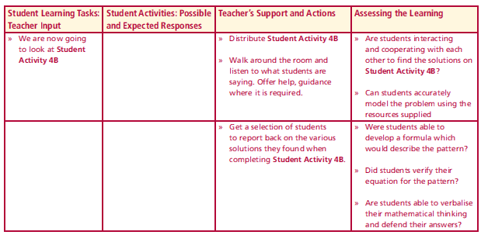
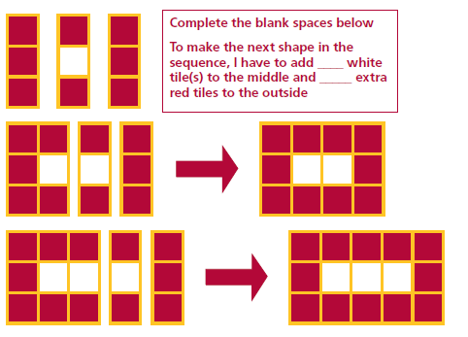
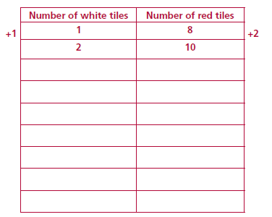
Student Activity 4B
Breaking down the pattern and developing your own formula
Let’s look at how each shape is built.
Lesson interaction
So each time I make a new figure the number of white tiles increases by ______ and the number of red tiles increases by _______; complete the pattern in the table below.

Slide 18
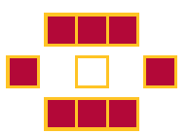
Let the number of white tiles = n. We know from our first shape that the white tile is surrounded by 8 red tiles, and each time we add a white tile we must add two red tiles.
If n is the number of white tiles and there are the same number of red tiles above and below it (i.e. a total of 2n) and two lots of 3 at either side (i.e. +6). Then the general formula (or expression) for the number of red tiles must be 2n + 6.
(Remember we are calculating the total number of RED tiles, not the total number of tiles in the shape)
Using the logic above, can you develop another formula or expression based on the information below; (let the number of white tiles = n)

Slide 19
Using the logic above, can you develop another formula or expression based on the information below; (let the number of white tiles = n)
Hint: The number of red tiles above and below is 2 more than the number of white tiles and 2 extra at the sides. How many red tiles will there be if there are 100 white tiles? (Check your answer using both equations, i.e. 2n + 6 AND the one you have found above.)
_______________________________________________________________________________________________________________________________________________________________________________________

Slide 20
Student Activity 5 (Higher Level Material)
Set 1. Group Work: Graphing Functions
1. I have €36 to buy a gift. The amount of money I have left depends on the price of the purchase. (x-axis, price of purchase; y-axis, amount of money I have left).
2. A straight line, 36cm long, is divided into 2 parts A and B. The length of part B depends on the length of part A. (x-axis, length in cm of part A; y-axis, length in cm of part B ). For each of the sets assigned to your “expert” group:
• Find some data points that fit the given problem, e.g. (1, 35) or (10, 26) etc
• Organise the data into a table. Use the quantity identified as the x-axis for the left column and the quantity identified as the y-axis for the right column.
• Organise the data into a graph. Use the quantity identified as the x-axis for the horizontal axis and the quantity identified as the y-axis for the vertical axis.
IMPORTANT: Each member of the group will need a copy of each graph to share with the next group.
• Share and compare your graphs with other groups
• Identify similarities (things that are the same) and differences among the various graphs.

Slide 21
Set 2.
3. The amount of money collected for a particular show is dependent on the number of tickets sold. Tickets cost €8 each. (x-axis, number of tickets sold; y-axis, amount of money collected).
4. The number of empty seats in a cinema that seats 350 people depends on the number of seats that are sold (x-axis, number of seats that are sold; y-axis, number of seats that are empty).
For each of the sets assigned to your “expert” group:
• Find some data points that fit the given ticket problem, e.g. (1,8) or (2,16) etc
• Find some data points that fit the cinema problem, e.g. (0,350) or (20,330) etc
• Organise the data into a table. Use the quantity identified as the x-axis for the left column and the quantity identified as the y-axis for the right column.
• Organise the data into a graph. Use the quantity identified as the x-axis for the horizontal axis and the quantity identified as the y-axis for the vertical axis.
IMPORTANT: Each member of the group will need a copy of each graph to share with the next group.
• Share and compare your graphs with other groups
• Identify similarities (things that are the same) and differences among the various graphs.

Slide 22
Set 3
5. The perimeter of a square depends on the length of a side (x-axis, length of side; y-axis, perimeter.)
6. If I fold a paper in half once I have 2 sections. If I fold it in half again I have 4 sections. What happens if I continue to fold the paper? (x-axis, number of folds; y-axis, number of sections )
7. The area of a square depends on the length of a side. (x-axis, length of side; y-axis, area of the square).
For each of the sets assigned to your “expert” group:
• Find some data points that fit the given problem.
• Organise the data into a table. Use the quantity identified as the x-axis for the left
column and the quantity identified as the y-axis for the right column.
• Organise the data into a graph. Use the quantity identified as the x-axis for the
horizontal axis and the quantity identified as the y-axis for the vertical axis.
IMPORTANT: Each member of the group will need a copy of each graph to share with the
next group.
• Share and compare your graphs with other groups
• Identify similarities (things that are the same) and differences among the various graphs.

