Slide 2
Index
Student Activity 1: Questions to familiarise students with the
deck/pack of cards
Student Activity 2: Probability questions for a fair Deck of Cards

Slide 3
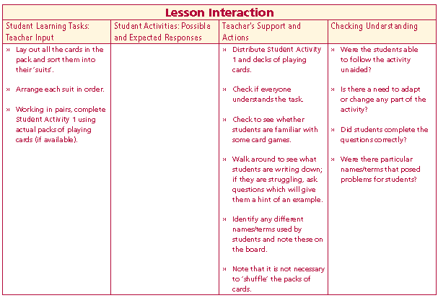
Lay out all the cards in the pack and sort them into their ‘suits’.
Arrange each suit in order.
Working in pairs, complete Student Activity 1 using actual packs of playing cards
Lesson interaction

Slide 4
Student Activity 1
Questions to familiarise students with the deck/pack of cards
1. How many cards are in the deck/pack?___________________________
2. How many different types of cards, i.e. suits, are there?______________
3. Name the ‘suits’._____________________________________________
4. How many black suits are there?________________________________
5. How many red suits are there?__________________________________
6. How many cards in each suit?__________________________________
7. List the cards in any one suit.___________________________________
8. What is the name given to the card with an A written on it? __________
9. What is a ‘face’ (picture) card?__________________________________
10. How many ‘face’ cards are there in each suit?_____________________
11. Name the ‘face’ cards. (Aces are not considered to be ‘face’ cards.) ___
12. How many numbered cards does each suit have?__________________
13. How many even numbered cards does each suit have?_____________

Slide 5
14. How many odd numbered cards does each suit have?______________
15. How many non-numbered (lettered) cards are in each suit?__________
16. Which card is non-numbered and is not a face (picture) card?________
17. How many black cards are there in a fair deck?____________________
18. How many red cards are there in a fair deck?_____________________
19. In the whole deck:
a. How many even numbered cards are there? ____________________
b. How many odd numbered cards are there? ____________________
c. How many lettered cards are there?___________________________
d. How many picture (face) cards are there?______________________
e. How many of each kind of card are there in the full pack?
(i.e. how many 1’s, 2’s, …Aces, Kings, etc)?________________________
f. What is the lowest numbered card you can pick in any suit?________

Slide 6
Student Activity 2
Probability questions for a fair Deck of Cards
1. What is the probability that the card is red?________________________
2. What is the probability that the card is a from the heart suit?__________
3. What is the probability that the card is a Queen?____________________
4. What is the probability that the card is the Queen of Spades?__________
5. What is the probability that the card is a picture card?________________
6. What is the probability that the card is a two-eyed Jack?______________
7. What is the probability that the card is a one-eyed King?______________
8. What is the probability that the card is even numbered?______________
9. What is the probability that the card has a number on it?_____________
10. Not all the cards look the same when you turn them around. What is the probability that the card does not look exactly the same when it is turned around?_____________________________________________________________________________________________________________________
Lesson interaction

