Slide 1


Slide 2
Index
Section 1: Uncertainty
Section 2: Introduction to Scale
Section 3: Probability Scale

Slide 3
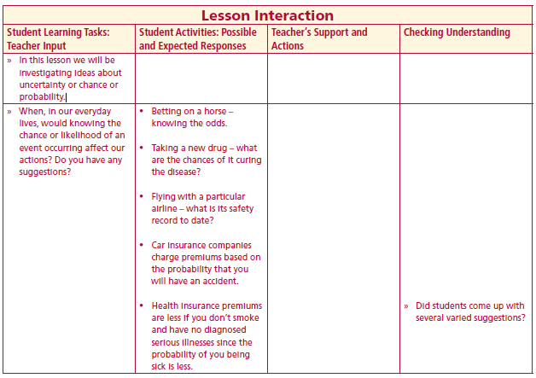
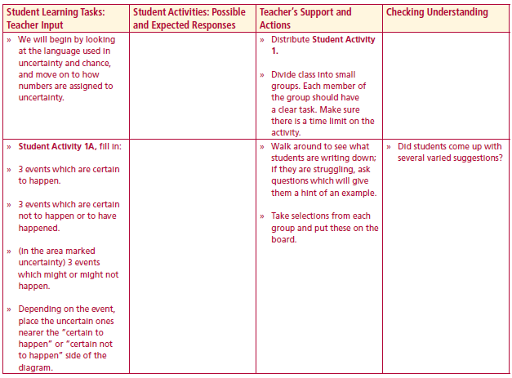
In this lesson we will be investigating ideas about uncertainty or chance or probability.
When, in our everyday lives, would knowing the chance or likelihood of an event occurring affect our actions?
Lesson interaction
Lesson interaction

Slide 4
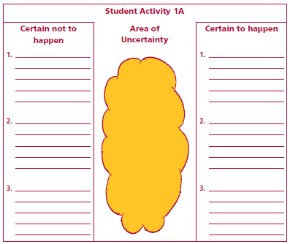
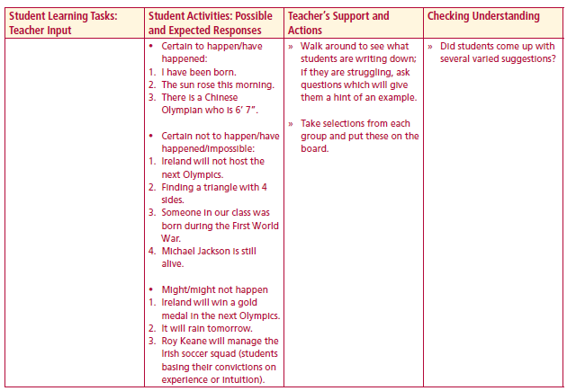
Student Activity 1
Lesson interaction
Lesson interaction

Slide 5
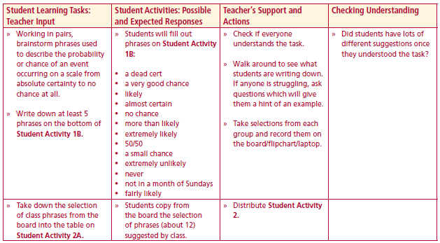
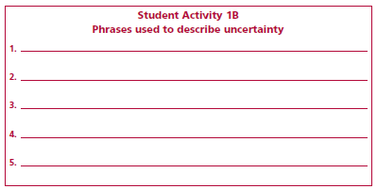
Working in pairs, brainstorm phrases used to describe the probability or chance of an event occurring on a scale from absolute certainty to no chance at all.
Write down at least 5
Lesson interaction

Slide 6
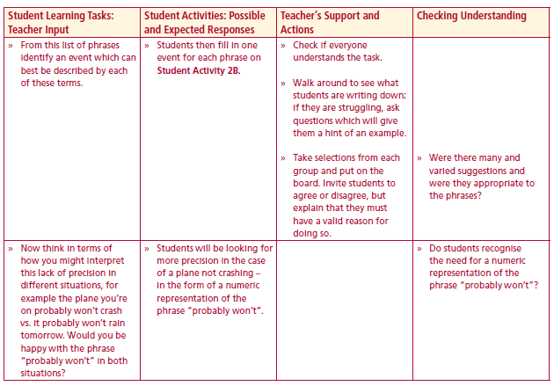
Student Activity 2A
Phrases used to describe uncertainty
(examples from the class)
1. _______________________
2. _______________________
3. _______________________
4. _______________________
5. _______________________
6. _______________________
7. _______________________
8. _______________________
9. _______________________
10. ______________________
11. ______________________
12. ______________________
Student Activity 2B
An event associated with each phrase
(examples from the class)
1. _______________________
2. _______________________
3. _______________________
4. _______________________
5. _______________________
6. _______________________
7. _______________________
8. _______________________
9. _______________________
10. ______________________
11. ______________________
12. ______________________
Lesson interaction
Lesson interaction

Slide 7
Student Activity 2C
Order the previous phrases on the scaled line segment below – from least likely to most likely.

Slide 8
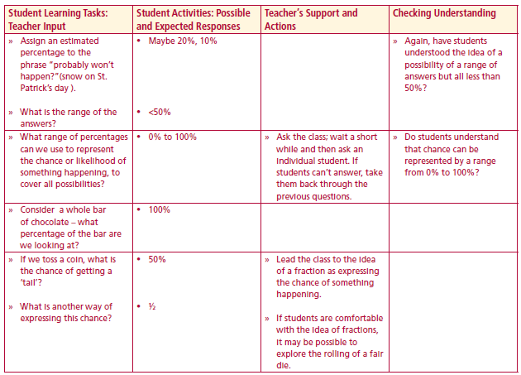
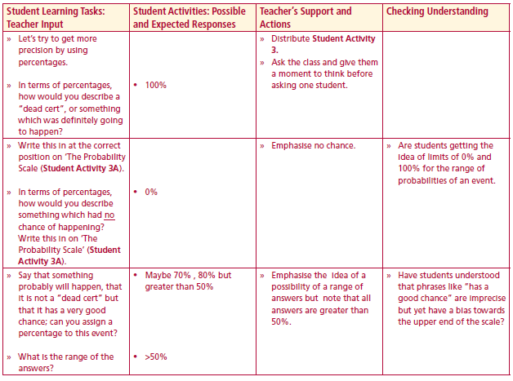
Student Activity 3A
Let’s try to get more precision by using percentages.
Assign an estimated percentage to the phrase
a “dead cert”, or something which was definitely going to
happen?
no chance of happening?
“probably won’t happen?”(snow on St. Patrick’s day ).
What range of percentages can we use to represent the chance
or likelihood of something happening, to cover all possibilities
Consider a whole bar of chocolate – what percentage of the bar
are we looking at?
If we toss a coin, what is the chance of getting a ‘tail’?
What is another way of expressing this chance?
Lesson interaction
Lesson interaction

Slide 9
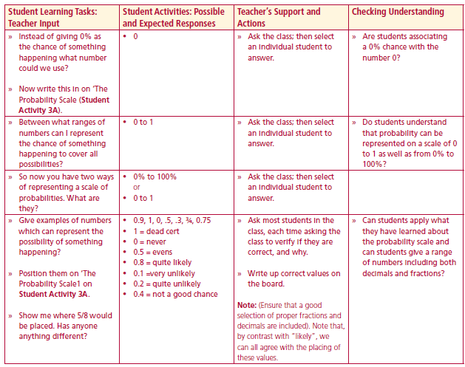
Student Activity 3A
The Probability Scale
Lesson interaction
Instead of giving 0% as the chance of something happening what number could we use?
Between what ranges of numbers can I represent the chance of something
happening to cover all possibilities?
So now you have two ways of representing a scale of probabilities. What are
they?
Give examples of numbers which can represent the possibility of something
happening?
Position them on ‘The Probability Scale’ above.
Show me where 5/8 would be placed. Has anyone anything different?

Slide 10
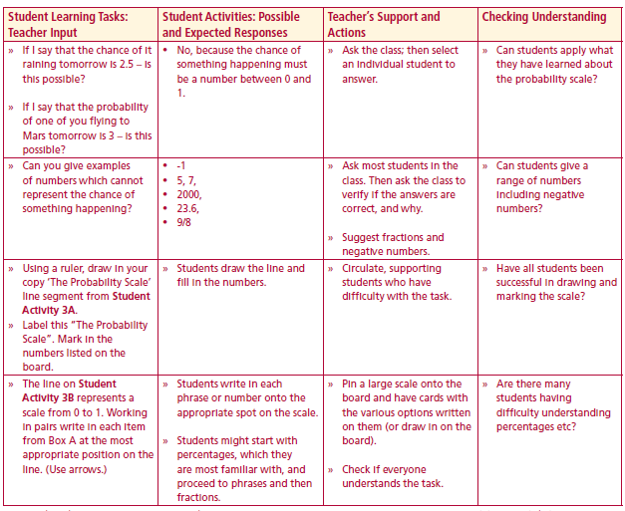
The Probability Scale
Lesson interaction
If I say that the chance of it raining tomorrow is 2.5 – is this possible?
If I say that the probability of one of you flying to Mars tomorrow is 3 –
is this possible?
Can you give examples of numbers which cannot represent the chance of
something happening?

Slide 11
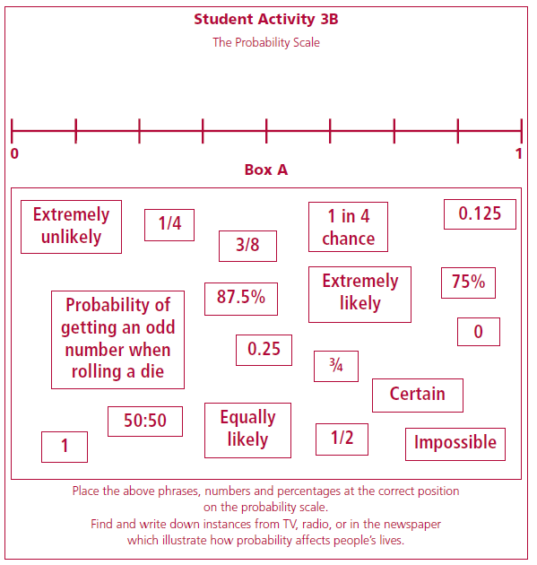
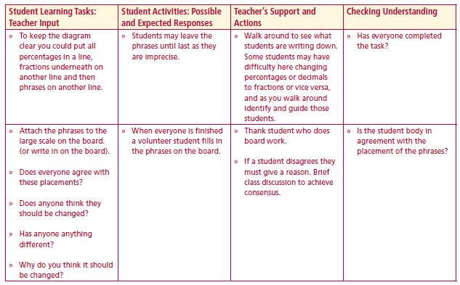
Student Activity 3B
The Probability Scale
Lesson interaction
To keep the diagram
clear you could put all
percentages in a line,
fractions underneath on another line
and then
phrases on another line.

Slide 12
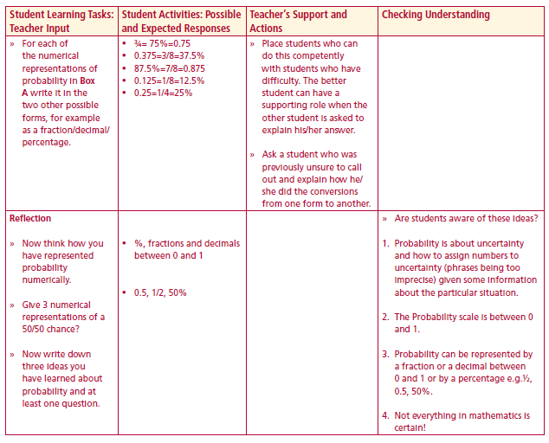
For each of the numerical representations of probability in Box A write it in the
two other possible forms, for example as a fraction/decimal/ percentage.
Now think how you have represented probability numerically.
Give 3 numerical representations of a 50/50 chance?
Now write down three ideas you have learned about probability and at least one question.
Lesson interaction

Slide 13
Probability is about uncertainty and how to assign numbers to uncertainty (phrases being too imprecise) given some information about the particular situation.
The Probability scale is between 0 and 1.
Probability can be represented by a fraction or a decimal between 0 and 1 or by a percentage
  e.g.½, 0.5, 50%.
Not everything in mathematics is certain!

