Slide 1
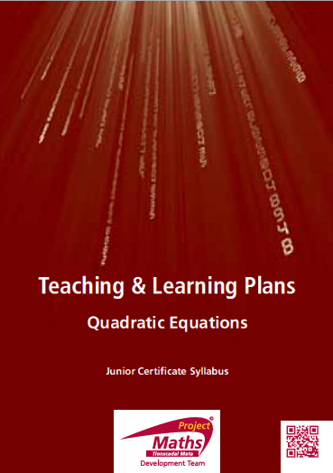

Slide 2
Index
Section A: | To solve quadratic equations of the form $\left(x−a\right)\left(x−b\right)=0$ algebraically
Section B: | To solve quadratic equations of the form$(x − a) (x − b) = 0$ making use of tables and graphs
Section C: | To solve quadratic equations of the form $x^{2}+ bx + c = 0$ that are factorable
Section D: | To solve quadratic equations of the form${ ax}^{2}+ bx + c = 0$ that are factorable (Higher Level only)
Section E: | To solve quadratic equations of the form $x^{2}−a^{2}=0$
Section F: | To solve quadratic equations using the formula (Higher Level only)
Section G: | To solve quadratic equations given in rational form

Slide 3
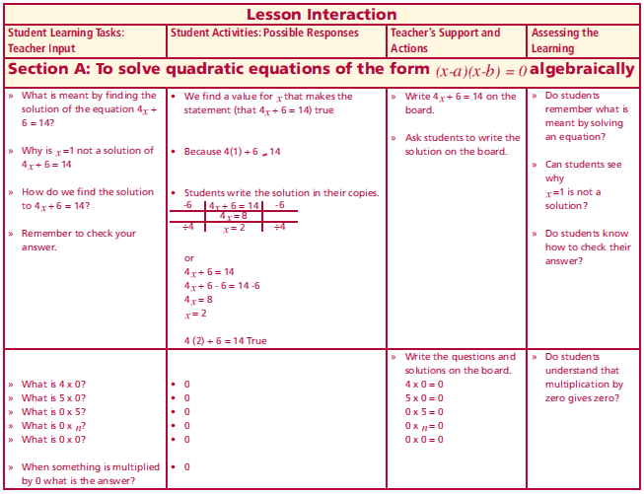
Section A: Introduction
What is meant by finding the solution of the equation 4x +6=14?
Why is x =1 not a solution of 4x+6=14
How do we find the solution to 4x + 6 = 14?
Remember to check your answer.
What is 4 x 0?
What is 5 x 0?
What is 0 x 5?
What is 0 x n?
What is 0 x 0?
When something is multiplied by 0 what is the answer?
Lesson interaction

Slide 4
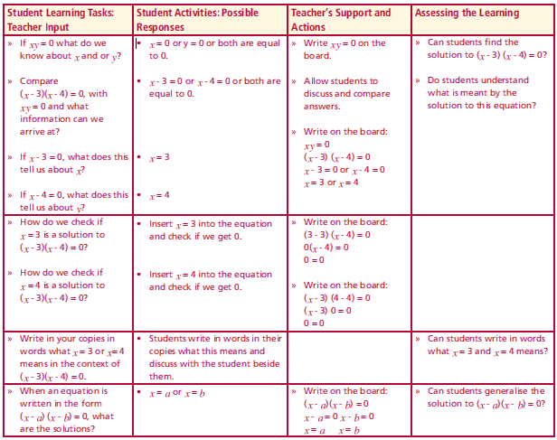
Section A: Introduction
If xy = 0 what do we know about x and or y?
Compare (x - 3)(x - 4) = 0, with xy = 0 and what information can we arrive at?
If x - 3 = 0, what does this tell us about x?
If x - 4 = 0, what does this tell us about y?
How do we check if x = 3 is a solution to (x - 3)(x - 4) = 0?
How do we check if x = 4 is a solution to (x - 3)(x - 4) =0?
Write in your copies in words what x = 3 or x= 4 means in the context of (x - 3)(x - 4) = 0.
When an equation is written in the form (x - a)(x - b)=0, what are the solutions?
Lesson interaction

Slide 5
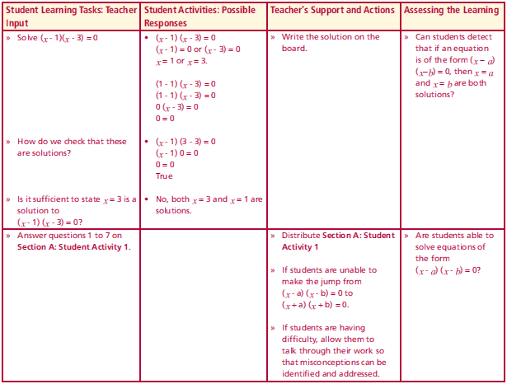
Section A: Introduction
Solve (x - 1)(x - 3) = 0
x – 1= 0 or x - 3 = 0
x =1 x = 3
How do we check that these are solutions?
Let x = 1
(1 - 1)(1 - 3) = 0
(0)(-2) = 0
0 = 0
Is it sufficient to state x = 3 is a solution to (x - 1) (x - 3) = 0?
No both x = 3 and x = 1 are solutions
Answer questions 1 to 7 on Section A: Student Activity 1.
Lesson interaction
Let x = 3
(3 - 1)(3 - 3) = 0
(2)(0) = 0
0 = 0
TRUE

Slide 6
Section A: Student Activity 1
Note: It is always good practice to check solutions. The roots of a quadratic equation are the elements of its solution set. For example if x = 1,x = 2 are the root ⇒{1, 2} = solution set. The roots of a quadratic equation are another name for its solution set.
1. If xy = 0, what value must either x or y or both have?
2. Write in your own words what solving an equation means.
3. Solve the following equations:
a. (x - 1) (x - 2) = 0 b. (x - 4) (x - 5) = 0
c. (x - 3) (x - 5) = 0 d. (x - 2) (x - 5) = 0
4. What values of x make the following statements true:
a. (x - 2) (x - 5) = 0 b. (x - 4) (x + 5) = 0 c. (x - 2) (x + 4) = 0
5. Find the roots of (x - 4) (x + 5) = 0.

Slide 7
Section A: Student Activity 1
5. Find the roots of (x - 4) (x + 5) = 0.
6. Solve the equation (x - 3) (x + 2) = 0.
Hence state what the roots of (x - 3) (x + 2) = 0 are.
7. Find a positive value for x that makes the statement (x - 4) (x + 2) = 0
true.
8. Solve the following equations:
a. x (x - 1) = 0 b. x (x - 2) = 0 c. x (x + 4) = 0
9. a. These students each made at least one error, explain the error(s) in
each case:

Slide 8
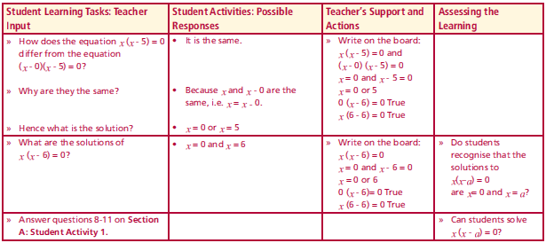
Section A: Student Activity 1
How does the equation x (x - 5) = 0 differ from the equation
(x - 0)(x - 5) = 0?
Why are they the same?
Hence what is the solution?
What are the solutions of x (x - 6) = 0?
Answer questions 8-11 on Section A: Student Activity 1.
Lesson interaction

Slide 9
Section A: Student Activity 1
8. Solve the following equations:
a. x (x - 1) = 0 b. x (x - 2) = 0 c. x (x + 4) = 0
9. a. These students each made at least one error, explain the error(s) in
each case:

Slide 10
Section A: Student Activity 1
9. a. These students each made at least one error, explain the error(s) in each case:
b. Solve each equation correctly showing all the steps clearly
10. If x = 5 is a solution to the equation (x - 4) (x – b) =0what is the value of b?
11. Is x = 3 a solution to the equation (x - 3) (x - 2) Explain your reasoning. Solve this equation.

Slide 11
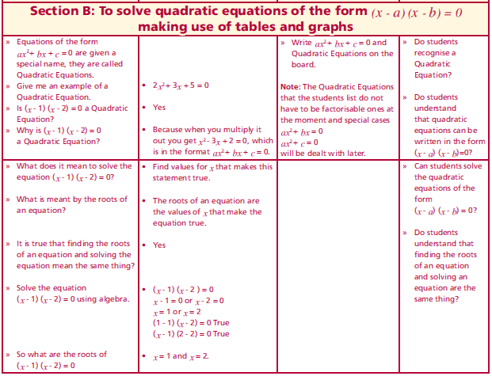
Section B: Introduction
Equations of the form ${ax}^{2}+bx+c=0$are given a special name, they are called quadratic Equations.
Give me an example of a quadratic Equation.
Is (x - 1) (x - 2) = 0 a quadratic Equation?
Why is (x - 1) (x - 2) = 0 a quadratic Equation?
What does it mean to solve the equation (x - 1) (x - 2) = 0?
What is meant by the roots of an equation?
It is true that finding the roots of an equation and solving the equation mean the same thing?
Solve the equation (x - 1) (x - 2) = 0 using algebra.
So what are the roots of (x - 1) (x - 2) = 0
Lesson interaction

Slide 12
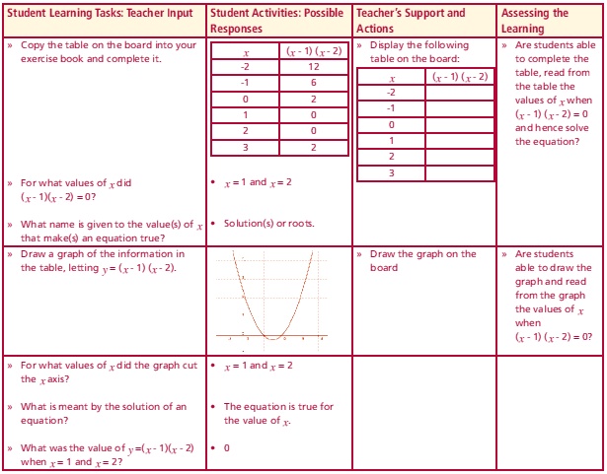
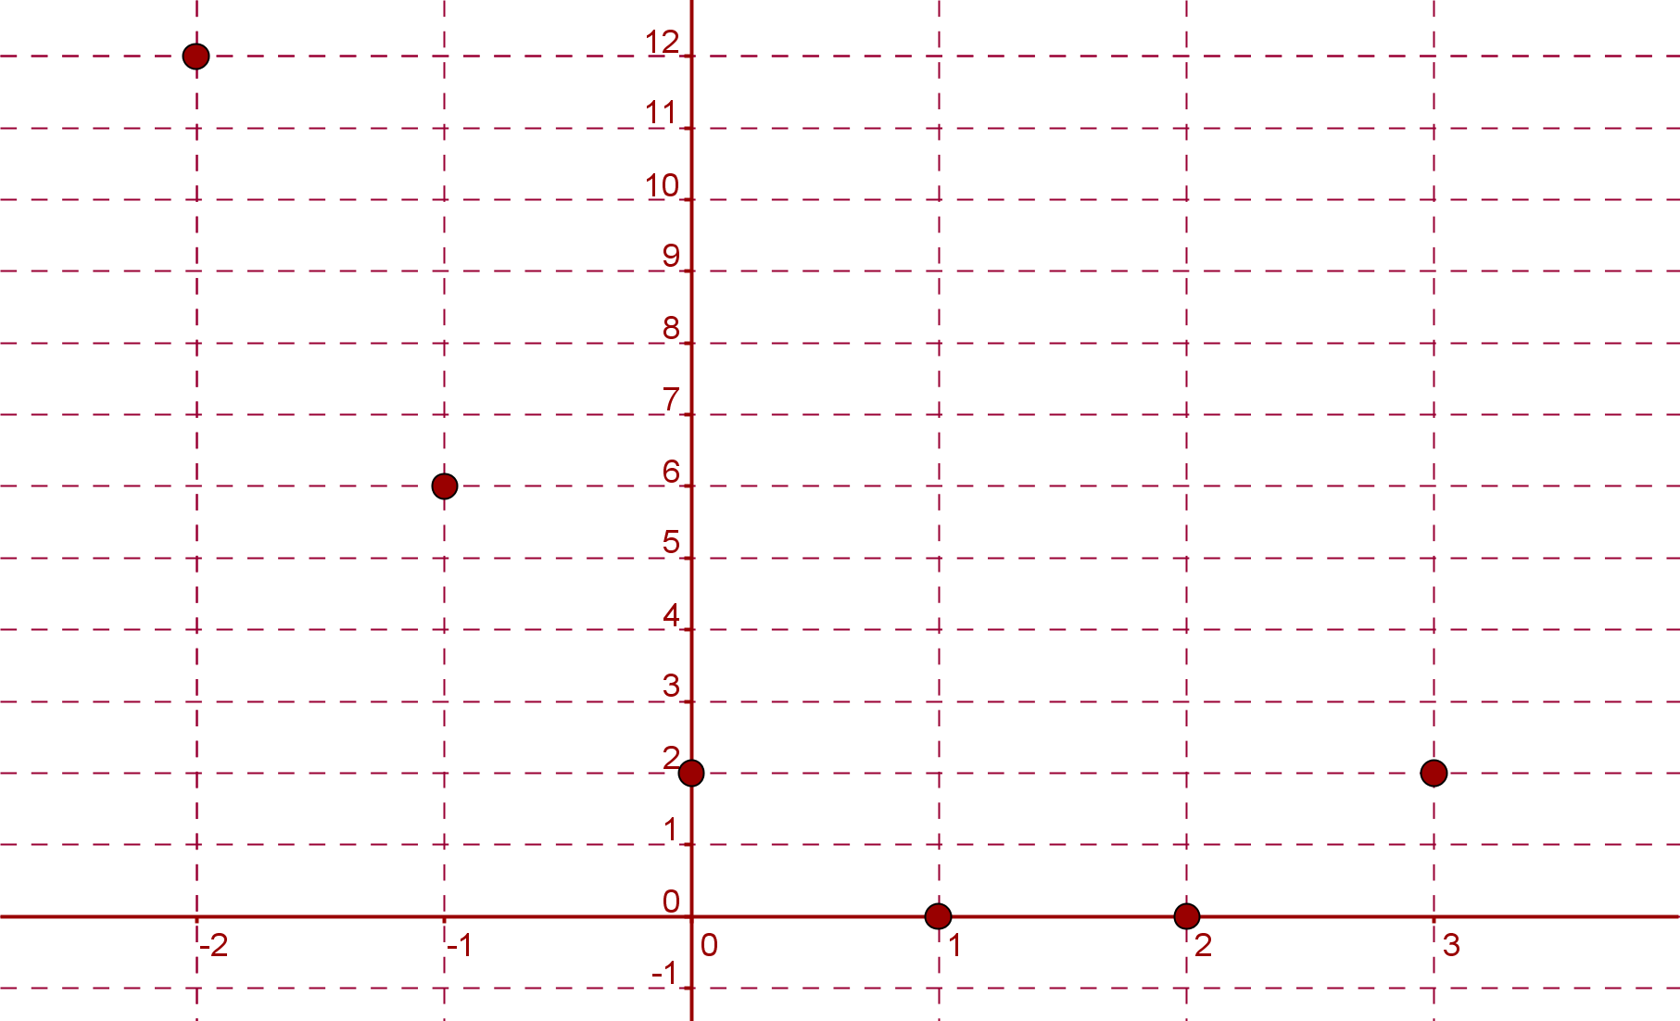
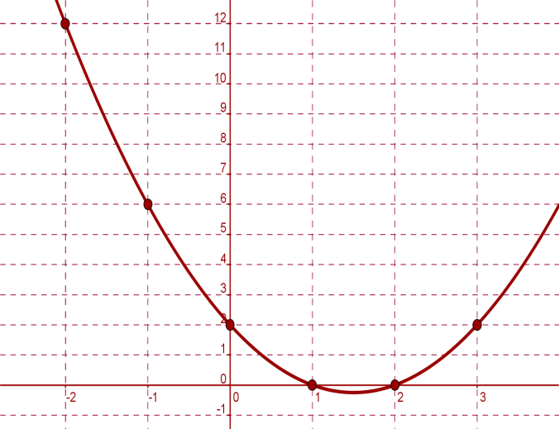
Section B: Introduction
Copy the table on the board into
your exercise book and complete it.
For what values of x did (x - 1)(x - 2) = 0?
What name is given to the value(s) of x that make(s) an equation true?
Draw a graph of the information in
the table, letting y = (x - 1) (x - 2).
$$x$$ | $$(x−1)(x−2)$$
-2
-1
0
1
2
3
$$x$$ | $$(x−1)(x−2)$$
-2 | 12
-1 | 6
0 | 2
1 | 0
2 | 0
3 | 2
Lesson interaction

Slide 13
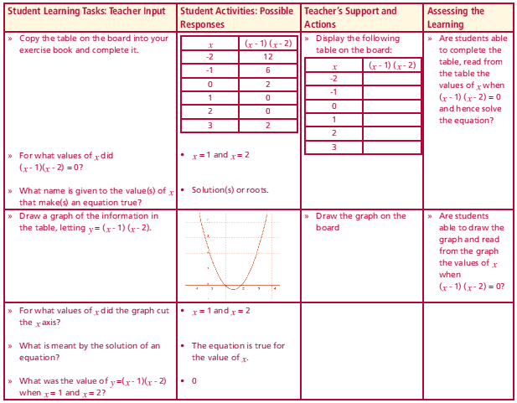
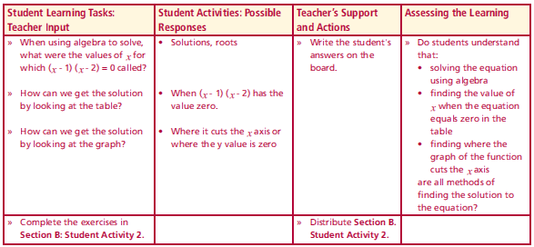
Section B: Introduction
For what values of x did the graph cut
the x axis?
What is meant by the solution of an
equation?
What was the value of y =(x - 1)(x - 2)
when x = 1 and x = 2?
When using algebra to solve, what were the
values of x for which (x - 1) (x - 2) = 0 called?
How can we get the solution by looking at the table?
How can we get the solution by looking at the graph?
Complete the exercises in
Section B: Student Activity 2.
Lesson interaction
Lesson interaction
$$x$$ | $$(x−1)(x−2)$$
-2 | 12
-1 | 6
0 | 2
1 | 0
2 | 0
3 | 2

Slide 14
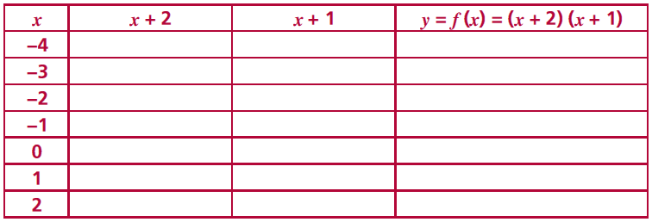
Section B: Student Activity 2
a. Complete the following table:
From the table above determine the values of x for which the
equation is equal to 0.
c. Solve the equation (x + 2) (x + 1) = 0 by algebra.
What do you notice about the answer you got to parts b. and c. in
this question?
e. Draw a graph of the data represented in the above table.
f. Where does the graph cut the x axis? What is the value of
f (x) = (x + 2)(x + 1) at the points where the graph cuts the x axis?
g. Can you describe three methods of finding the solution to
(x + 2) (x + 1) = 0.

Slide 15
Section B: Student Activity 2
2. Solve the equation (x - 1) (x - 4) = 0
a) by table, b) by graph and c) algebraically.
3. Write the equation represented in this table in the form (x−a)(x−b)=0.

Slide 16
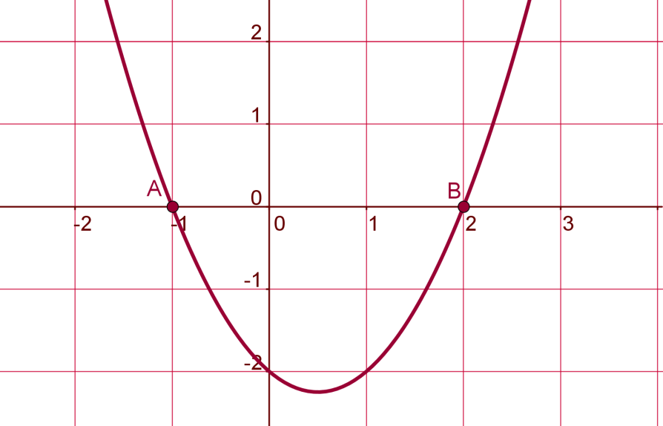
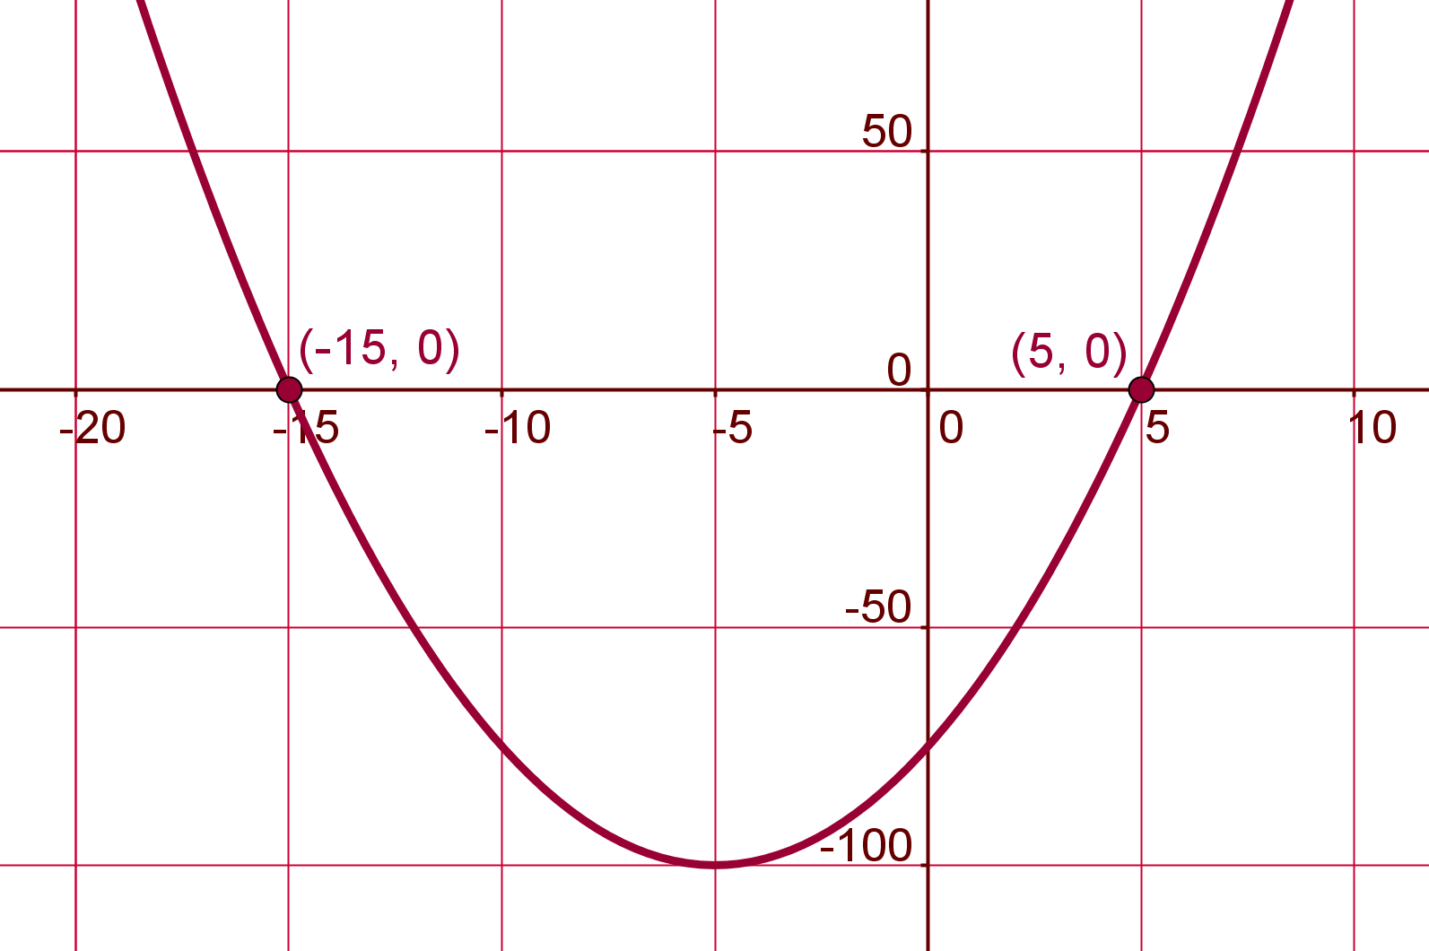
Section B: Student Activity 2
4. The graph of a quadratic function
f(x) = ax² + bx +c is represented by the
curve in the diagram.
Find the roots of the equation f(x) = 0
and so identify the function.
5. The graph of a quadratic function
f(x) = ax² + bx +c is represented by the
curve in the diagram.
Find the roots of the equation f(x) = 0
and so identify the function.

Slide 17
Section B: Student Activity 2
6. Where will the graphs of the following functions cut the x axis?
a. f (x) = (x - 7) (x - 8)
b. f (x) = (x + 7) (x + 8)
c. f (x) = (x - 7) (x + 8)
d. f (x) = (x + 7) (x - 8)
7. For what values of x does (x - 7) (x - 8) = 0?

Slide 18
Section C: Introduction
What does it mean to find the factors of a number?
What does it mean to find the factors of $x^{2}+3x+2?$
What is the guide number of this equation?
How did you get this guide number?
What are the factors of 2?
Which pair shall we use?
Why would I not use the pair -1 and -2?
Ask students if this looks familiar to any other type of factorising they have done before?
Could I have written $1x$ plus $2x$ instead of $2x$ and $1x$?
Lesson interaction

Slide 19
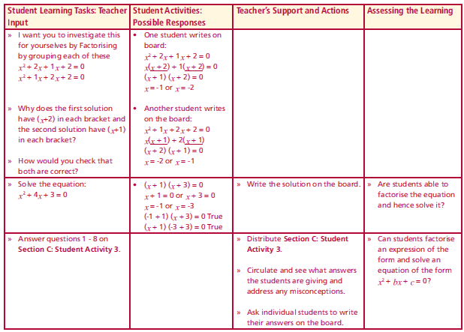
Section C: Introduction
I want you to investigate this for yourselves by factorising by grouping each of these $x^{2}+2x+1x+2=0$
$x^{2}+1x+2x+2=0$
Why does the first solution have (x+2) in each bracket and the second solution have (x+1) in each bracket?
How would you check that both are correct?
Solve the equation: $x^{2}+4x+3=0$
Answer questions 1 - 8 on Section C: Student Activity 3.
Lesson interaction

Slide 20
Solving quadratic equations x squared, x’s, number equals zero
-
Can we FACTORISE ?
Guide number
14
1x14
2x7
Subtract to 13
No Good
Subtract to 5
Yes! Perfect
Factorised
Solved
Notes:
Ask if they have heard of the guide number method
Certainly would not go through all this powerpoint just at the flip chart doing it this way and then move on to ilusstare guide method
Reports from exams all point out it is the most effective method especially when the coeffivient of x squared is not 1. In addition you are builing on he grouping methood

Slide 21
Choose an appropriate method for factorising from the two below, you can hide the slide you do not want. Create more examples by duplicating the slide you wish and editing the numbers.

Slide 22
Factoring ${ x}^{2}+ bx + c$
Multiply coefficient of $x2$ and the constant to get the guide number
Find the factor pairs of this number
We want the factor pair that sums to give the middle term
Split the middle term up using these two terms
Factorise the four terms by grouping
$$x2 – 5x + 6$$
$$1 x 6 −1 x −6$$
$$2 x 3 −2 x −3$$
$$x2 – 5x + 6$$
$$x^{2}−3x−2x+6$$
$$x2 – 5x + 6$$
$$x^{2}−3x−2x+6$$
$$x(x−3)−2(x−3)$$
$$x2 – 5x + 6$$
$$x^{2}−3x−2x+6$$
$$x(x−3)−2(x−3)$$
$$(x−3)(x−2)$$
+6
Notes:
Explain how +6 came from multiplying the coefficient of x squared and the constant
Mention that it is advisable (and maths inspectors advise as well) that a common method be adopted within school departments. If a student moved from one class to another and was taught a different method then at the very least teachers should be aware of diferent methods for the student’s sake.

Slide 23
Factoring ${ x}^{2}+ bx + c$
$$x2 – 5x + 6$$
$$1 x 6 −1 x −6$$
$$2 x 3 −2 x −3$$
$$x2 – 5x + 6$$
$$x^{2}−3x−2x+6$$
$$x2 – 5x + 6$$
$$x^{2}−3x−2x+6$$
$$(x−3)(x−2)$$
+6
x
− 3
Multiply coefficient of $x2$ and the constant to get the guide number
Find the factor pairs of this number
We want the factor pair that sums to give the middle term
Split the middle term up using these two terms
Factorise the four terms by grouping
x
x²
− 3x
− 2
− 2x
+6
Notes:
Explain how +6 came from multiplying the coefficient of x squared and the constant
Mention that it is advisable (and maths inspectors advise as well) that a common method be adopted within school departments. If a student moved from one class to another and was taught a different method then at the very least teachers should be aware of diferent methods for the student’s sake.

Slide 24
Section C: Student Activity 3
Note: It is always good practice to check solutions.
It is recommended you use the guide number method to find the factors.
1. Solve the following equations:
a. $x^{2}+6x+8=0$ b. $x^{2}+5x+4=0$
c. $x^{2}−9x+8=0$ d. $x^{2}−6x+8=0$
2. Solve the equations:
a. $x^{2}+2x=3$ b. $x(x−1)=0$ c. $x(x−1)=6$
3. Are the following two equations different
$x(x−1)=0$ $and$ $x\left(x−1\right)=6?$ Explain.
4. When a particular natural number is added to its square the result is 12. Write an equation to represent this and solve the equation. Are both solutions realistic? Explain.

Slide 25
Section C: Student Activity 3
5. A number is 3 greater than another number. The product of the numbers is 28. Write an equation to represent this and hence find two sets of numbers that satisfy this problem.
6. The area of a garden is 50cm². The width of the garden is 5cm less than the breadth. Represent this as an equation. Solve the equation. Use this information to find the dimensions of the garden.
7. A garden with an area of 99m² has length x m. Its width is 2m longer than its length. Write its area in term of x. Solve the equation to find the length and width of the garden.
8. The product of two consecutive positive numbers is 110. Represent this as an algebraic equation and solve the equation to find the numbers.

Slide 26
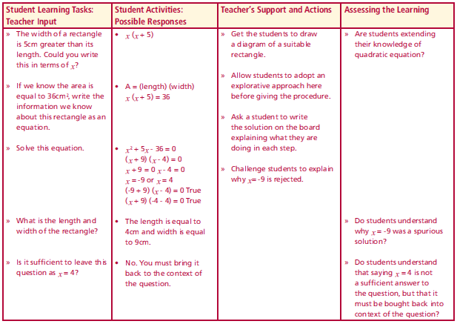
Section C: Introduction (II)
The width of a rectangle is 5cm greater
than its length.
Could you write this in terms of x?
If we know the area is equal to 36cm², write the information we know about this rectangle as an equation.
Solve this equation.
What is the length and width of the rectangle?
Is it sufficient to leave this question as x = 4?
$$x$$
Lesson interaction
$$x+5$$
$$Area=(length)(width)$$
$$Area=x(x+5)$$
Lesson interaction
$$36=x(x+5)$$
$$x\left(x+5\right)=36$$
Check
$$\left(−9+9\right)\left(−9−4\right)=0$$
$$\left(4−9\right)\left(4−4\right)=0$$
$$x^{2}+5x=36$$
$$✓$$
$$x^{2}+5x−36=0$$
$$✓$$
$$(x+9)(x−4)=0$$
Are both solutions acceptable?
$$\left(x+9\right)=0 or (x−4)=0$$
$$x=−9 or x=4$$
$$length=4cm and width=9cm$$

Slide 27
Section C: Student Activity 3
9. Use Pythagoras theorem to generate an
equation to represent the information in the
diagram. Solve this equation to find x.
10. One number is 2 greater than another number. When these two
numbers are multiplied together the result is 99. Represent this problem as an equation and solve the equation.
11. Examine these students’ work and spot the error(s) in each case and solve the equation fully:

Slide 28
Section C: Student Activity 3
12.
Complete a table for $x^{2}−2x+1=0$for integer values between
-2 and 2.
b. Draw the graph of $x^{2}−2x+1$ for values of x between -2 and 2.
Where does this graph cut the x axis?
c. Factorise $x^{2}−2x+1$ and solve $x^{2}−2x+1=0$
d. What do you notice about the values you got for parts
a), b) and c)?

Slide 29
Section C: Student Activity 3
13.
Complete a table for $x^{2}+3x+2=0$for integer values between
-3 and 3.
b. Draw the graph of $x^{2}+3x+2$for values of x between -3 and 3.
Where does this graph cut the x axis?
c. Factorise $x^{2}+3x+2$ and solve${ x}^{2}+3x+2=0$
d. What do you notice about the values you got for parts
a), b) and c)?

Slide 30
Section D: Introduction
Solve the equation ${2x}^{2}+5x+2=0$
Lesson interaction

Slide 31
Choose an appropriate method for factorising from the two below, you can hide the slide you do not want. Create more examples by duplicating the slide you wish and editing the numbers.

Slide 32
Factoring ${ ax}^{2}+ bx + c$
Multiply coefficient of $x2$ and the constant to get the guide number
Find the factor pairs of this number
We want the factor pair that sums to give the middle term
Split the middle term up using these two terms
Factorise the four terms by grouping
4$x2 –4x −15$
$$4x2 –4x −15$$
4$x^{2}+6x−10x−15$
$$4x2 –4x −15$$
4$x^{2}+6x−10x−15$
$$2x(2x+3)−5(2x+3)$$
$$4x2 –4x −15$$
4$x^{2}+6x−10x−15$
$$2x(2x+3)−5(2x+3)$$
$$(2x+3)(2x−5)$$
$$− 60$$
$$− 2 x 30 2 x − 30$$
$$− 3 x 20 3 x −20$$
$$− 4 x 15 4 x − 15$$
$$− 5 x 12 5 x −12$$
$$− 6 x 10 6 x − 10$$
Notes:
Explain how +6 came from multiplying the coefficient of x squared and the constant
Mention that it is advisable (and maths inspectors advise as well) that a common method be adopted within school departments. If a student moved from one class to another and was taught a different method then at the very least teachers should be aware of diferent methods for the student’s sake.

Slide 33
Factoring ${ ax}^{2}+ bx + c$
$$4x2 –4x −15$$
$$4x2 –4x −15$$
$$\text{4}x^{2}+6x−10x−15$$
$$4x2 –4x −15$$
$$\text{4}x^{2}+6x−10x−15$$
$$(2x+3)(2x−5)$$
$$− 60$$
$$− 2 x 30 2 x − 30$$
$$− 3 x 20 3 x −20$$
$$− 4 x 15 4 x − 15$$
$$− 5 x 12 5 x −12$$
$$− 6 x 10 6 x − 10$$
Multiply coefficient of $x2$ and the constant to get the guide number
Find the factor pairs of this number
We want the factor pair that sums to give the middle term
Split the middle term up using these two terms
Factorise the four terms by grouping
2x
+ 3
2x
4x²
+ 6x
− 5
− 10x
- 15
Notes:
Explain how +6 came from multiplying the coefficient of x squared and the constant
Mention that it is advisable (and maths inspectors advise as well) that a common method be adopted within school departments. If a student moved from one class to another and was taught a different method then at the very least teachers should be aware of diferent methods for the student’s sake.

Slide 34
Section D: Introduction
Solve the equation ${2x}^{2}+5x+2=0$
Find the factors of ${3x}^{2}+4x+1=0$and hence solve ${3x}^{2}+4x+1=0$
Answer questions contained in Section D: Student Activity 4.
Lesson interaction

Slide 35
Section D: Student Activity 4
Note: It is always good practice to check solutions.
It is recommended you use the guide number method to find the factors.
Find the factors of ${2x}^{2}+7x+3.$Hence solve ${2x}^{2}+7x+3=0$
Find the factors of ${3x}^{2}+4x+1.$Hence solve ${3x}^{2}+4x+1=0$
Find the factors of ${4x}^{2}+4x+1.$Hence solve ${4x}^{2}+4x+1=0$
Find the factors of ${3x}^{2}−4x+1.$Hence solve ${3x}^{2}−4x+1=0$
Find the factors of ${2x}^{2}+x−3.$Hence solve ${2x}^{2}+x−3=0$
a. Is ${2x}^{2}+x=0$ a quadratic equation? Explain your reasoning.
b. Find the factors of ${2x}^{2}+x$. Hence solve ${2x}^{2}+x=0$
7. Factorise ${4x}^{2}−1x−9.$ Hence solve ${4x}^{2}−1x−$ 9 = 0

Slide 36
Section D: Student Activity 4
8. Twice a certain number plus four times the same number less one is 0. Find the numbers.
9. a. Complete the following table and using your results, suggest
solutions to ${2x}^{2}+3x+1=0$
b. Using the information in the table above, draw a graph of
${f\left(x\right)=2x}^{2}+3x+1$hence solve the equation.
c. Did your results for a. agree with your results in b?

Slide 37
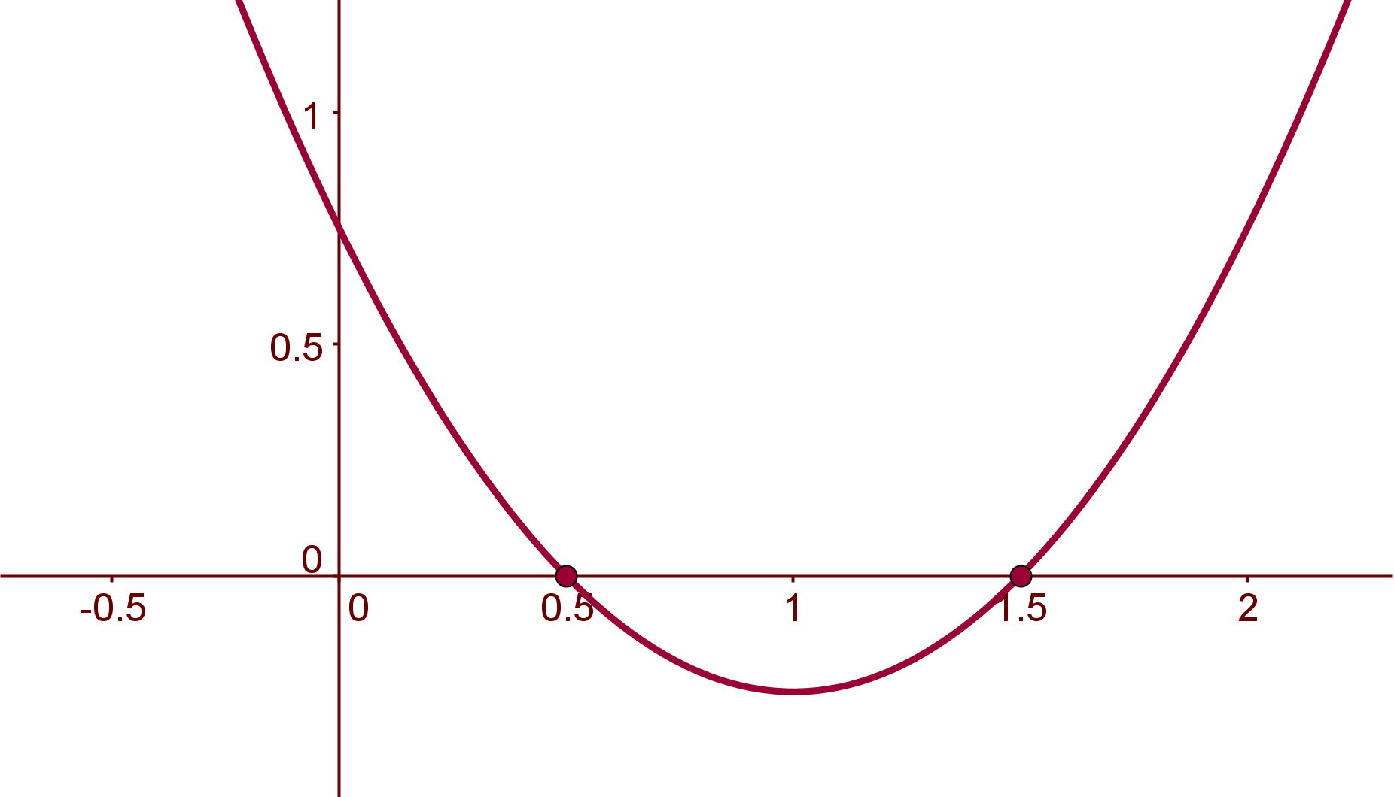
Section D: Student Activity 4
10. Find the function represented by the curve in the
diagram opposite in the form ${f\left(x\right)=ax}^{2}+bx+c=0.$
Then solve the equation

Slide 38
Section E: Introduction
Are $x^{2}+6x+5=0 and{ x}^{2}+6x=0$ quadratic equations? Explain why.
Give a general definition of a quadratic equation?
Are ${ax}^{2}+c=0$
$ax^{2}+bx=0$
${ax}^{2}=0$ quadratic equations?
Do you have a quadratic equation if a = 0?
If not what is it called?
What would the general form of the equation look like if
(i) b = 0,
(ii) c = 0,
(iii) a = 0,
(iv) b = 0 and c = 0?
Lesson interaction

Slide 39
Section E: Introduction
So is $x^{2}−16$ a quadratic expression?
What are the factors of $x^{2}−16$?
What was this called?
What is the solution of $x^{2}−16$ = 0?
How can we prove these values are the factors of $x^{2}−16$?
Lesson interaction

Slide 40
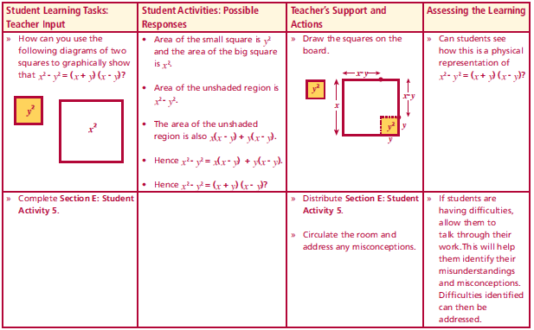
Section E: Introduction
How can you use the following diagrams of two squares to graphically show that $x^{2}−y^{2}=(x+y)(x−y)$?
Lesson interaction
x - y
x - y
A
y²
A
y
y
x
x²
x
x
B
B
y
x -y
x -y
x
x
(x)
(x - y)
(y)
Area A =
Area B =
(x - y)
(x - y)
(y)
(x)
(x - y)
Area A + Area B =
+
x² – y² =
(x - y)
(x + y)
Complete Section E: Student Activity 5.

Slide 41
Section E: Student Activity 5
Factorise
a. $x^{2} −25$ b. $x^{2} −49$
2. Solve:
a. $x^{2} −36=0$ b. ${36 −x}^{2}=0$ c. $n^{2} −625=0$a. d. $x^{2} −x=0$ e. ${3x}^{2}−4x=0$ f. ${3x}^{2}=11x$
g. ${(a+3)}^{2} −25=0$
3. Think of a number, square it, and subtract 64. If the answer is 0, find the number(s).
4. Given an equation of the form $x^{2} −b=0$, write the solutions to this equation in terms of b.
5. Solve the equation $x^{2} −16=0$ graphically. Did you get the results you expected? Explain your answer.
6. Calculate: a. ${99}^{2} −{101}^{2}$ b. ${103}^{2}−{97}^{2}$
Higher Level Only
7. Solve the following equations:
a.
4x
2
- 36 = 0
b.
4x
2
- 9 = 0
c.
4x
2
- 25 = 0
d.
16x
2
- 9 = 0
8. A man has a square garden of side 20m. He builds a pen for his dog in
one corner. If the area of the remaining part of his garden is 144m
2
, find
the dimensions of the dog’s pen.

Slide 42
Section E: Student Activity 5
Higher Level Only
7. Solve the following equations:
$4x^{2} −36=0$ b. ${4x}^{2}−9=0$
c. ${4x}^{2} −25=0$ d. ${16x}^{2}−9=0$
8. A man has a square garden of side 20m. He builds a pen for his dog in one corner. If the area of the remaining part of his garden is 144m², find the dimensions of the dog’s pen.

Slide 43
Section F: Introduction
e.g. 1 $x^{2}+3x+2=0$
$$x=\frac{−b±\sqrt{b^{2}−4ac}}{2a}$$
$$a=$$
$$b=$$
$$c=$$
$$1$$
$$3$$
$$2$$
Lesson interaction
$$x=\frac{−(3)±\sqrt{{(3)}^{2}−4(1)(2)}}{2(1)}$$
$$x=\frac{−3±\sqrt{1}}{2}$$
$$x=\frac{−3±1}{2}$$
$$x=−1 0r −2$$

Slide 44
Section F: Introduction
Is $x^{2}+3x+1=0$ a quadratic equation?
Can you find the factors of $x^{2}+3x+1?$
It is not always possible to solve quadratic equations through the use of factors, but there are alternative methods to solve them.
Comparing $x^{2}+3x+1=0$ to a$x^{2}+bx+c=0$ , the general form of a quadratic equation
What are the values of a, b and c?
Mathematicians use the formula to find the solutions to quadratic equations when they are unable to find factors. It is worth noting however that the formula can be used with all quadratic equation. We will now try it for $x^{2}+3x+2=0$, which we already know has x = - 2 and x= - 1 as its solutions.
Lesson interaction
$$x=\frac{−b±\sqrt{b^{2}−4ac}}{2a}$$

Slide 45
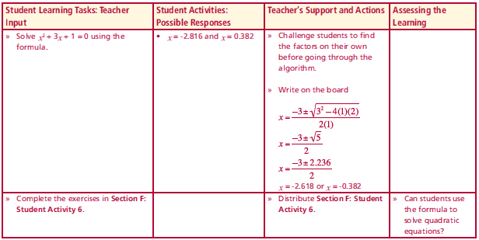
Section F: Introduction
e.g. 2 $x^{2}+3x+1=0$
$$x=\frac{−b±\sqrt{b^{2}−4ac}}{2a}$$
$$a=$$
$$b=$$
$$c=$$
$$1$$
$$3$$
$$1$$
Lesson interaction
$$x=\frac{−(3)±\sqrt{{(3)}^{2}−4(1)(1)}}{2(1)}$$
$$x=\frac{−3±\sqrt{5}}{2}$$
$$x=−2.618 0r −0.382$$
Complete the exercises in Section F:Student Activity 6.

Slide 46
Section F: Student Activity 6
1. Using the formula solve the following equations:
$x^{2}+5x+4=0$
$x^{2}+4x+3=0$
$x^{2}+4x−3=0$
$x^{2}−4x+3=0$
$x^{2}−4x−3=0$
$x^{2}−4=0$
$x^{2}+3x=4$
$x^{2}+2x−3=0$
2. Solve the equation $x^{2}−5x−2=0$. Write the roots in the form$a±\sqrt{b}$
3. Given $2+\sqrt{3}$ is a solution to the equation ${ax}^{2}+bx+c=0$ find the
other solution

Slide 47
Section F: Student Activity 6
4. When using the quadratic formula to solve an equation and you know
x = 3 is a solution, does that mean that x = -3 is definitely the other
solution? Explain your reasoning with examples.
5.
a. Solve the equation${ x}^{2}+5x+6=0$ by using a:
i. Table.
ii. Graph.
iii. Factors.
iv. Formula.
b. Did you get the same solutions using all four methods?

Slide 48
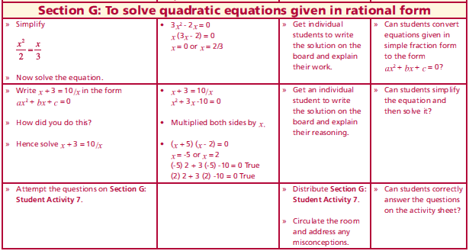
Section G: Introduction
Simplify $\frac{x^{2}}{2}=\frac{x}{3}$
$3x^{2}=2x$
$3x^{2}−2x=0$
Now solve the equation.:
$$x\left(3x−2\right)=0$$
$x=0 or 3x−2=0$
$3x=2$
$x=\frac{2}{3}$
$$\left(6\right) (6)$$
Lesson interaction
$$−2x −2x$$

Slide 49
Section G: Introduction
Simplify $x+3=\frac{10}{x}$
$x^{2}+3x=10$
$x^{2}+3x−10=0$
Hence solve.: $x+3=\frac{10}{x}$
$$x^{2}+3x−10=0$$
$$\left(x+5\right)\left(x−2\right)=0$$
$x+5=0 or x−2=0$
$$x=−5 x=2$$
$$\left(x\right) (x)$$
Lesson interaction
$$−10 −10$$

Slide 50
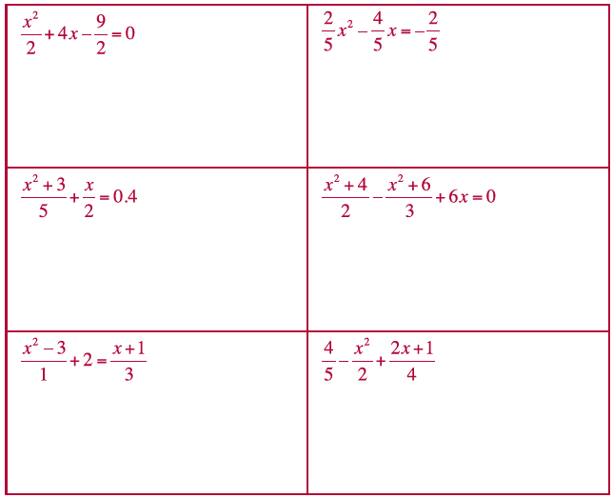
Section G: Student Activity 7
Solve the following equations:

Slide 51
Section G: Student Activity 7
2. Square a number add 9, divide the result by 5. The result is equal to twice the number. Write an equation to represent this and solve the equation.
3. A prize is divided equally among five people. If the same prize money is divided among six people each prize winner would get
€2 less than previously. Write an equation to represent this and solve the equation.

