Slide 1
Introduction to the
Cartesian Plane

Slide 2
Introduction: Get to the point
Student Activity 1: Find the fly
Student Activity 2: Negative Coordinates
Student Activity 3: The completed Cartesian Plane
Student Activity 4: Coordinates
Student Activity 5: Shapes
Student Activity 6: Break the Code
Student Activity 7: Make your own code

Slide 3
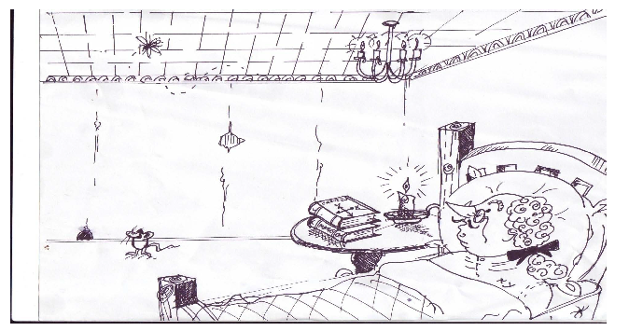
Coordinate Geometry: Get to the point!
A very famous mathematician called Rene Descartes lay in bed one night. As he lay there, he looked up at the ceiling in his bedroom. He noticed a fly was asleep on the ceiling. Descartes, being a mathematician wondered if he could figure out a way of stating where exactly the fly was on the ceiling. Obviously it has to be a precise description he thought. I can’t really say, “To the left” or “Near the right “or “In the middle”.

Slide 4
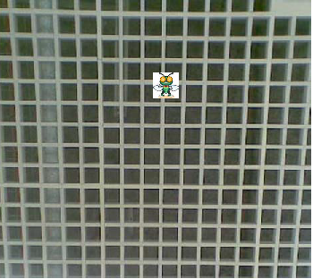
When Descartes looked up at his ceiling, this is what he saw. A fly resting there. He began to think about how he might be able to describe the exact position of the fly.

Slide 5
Descartes decided that if he drew two lines at right angles to each other, then he might be able to come up with a way of describing the exact position of the fly.
How do you think this would have helped him?
____________________________________________________________________________________________________________________________________________________________________________________

Slide 6
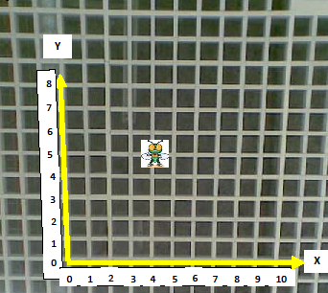
Descartes decided to place numbers on the bottom (horizontal) row and on the side (vertical) row. He could now state accurately where exactly the fly was on the ceiling.
But there was a problem, should he give the vertical number of tiles followed by horizontal? i.e. go up 5 squares and move across 4 squares, or should he give the horizontal number first, then the vertical? i.e. go across 4 squares then move up 5?

Slide 7
He decided to give the
HORIZONTAL NUMBER FIRST and
THE VERTICAL NUMBER SECOND.
To help people remember this he called the horizontal line X and the vertical line Y
(Because X comes before Y in the alphabet)
So, in this diagram, the position of the fly
can be found by moving
4 units across, then 5 units up.
These are known as X, Y values and are written like this
Position of fly = (4, 5)
X value , Y value
(First) (Second)
In honour of Rene Descartes, the graph showing the coordinates of the fly is known as the Cartesian Plane (or X Y Plane).

Slide 8
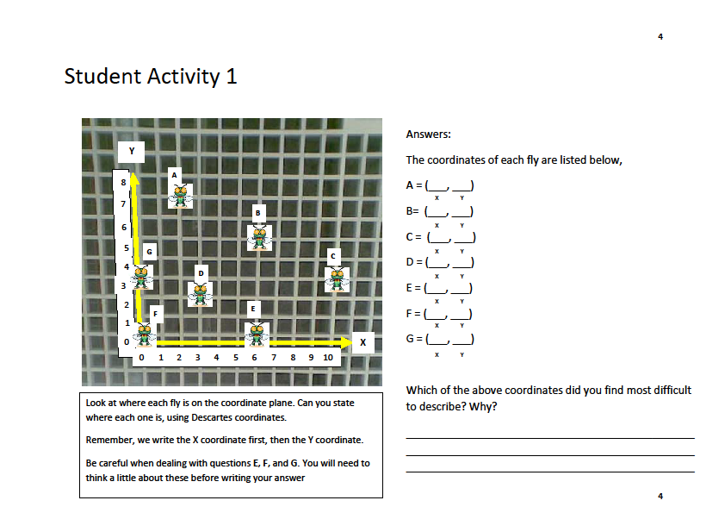
Student Activity 1

Slide 9
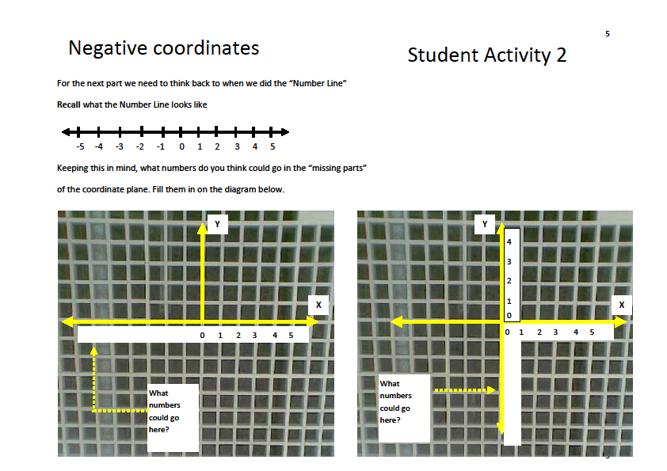
Student Activity 2 Negative Coordinates
For the next part we need to think back to when we did the “Number Line”
Recall what the Number Line looks like
Keeping this in mind, what numbers do you think could go in the “missing parts” of the coordinate plane. Fill them in on the diagram below.

Slide 10
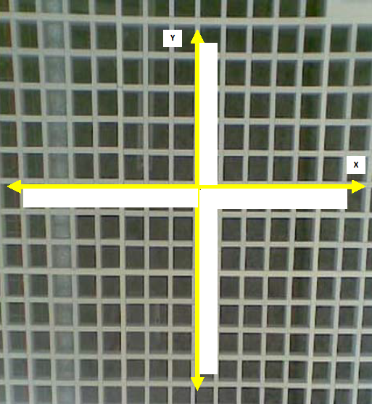
Student Activity 3
The completed Cartesian Plane
Fill in the numbers that should go on each axis

Slide 11
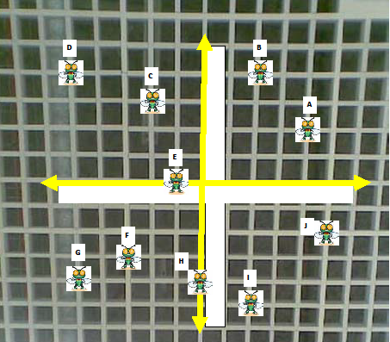
Student Activity 4
Fill in the missing numbers on each of the X and Y axes. Then write the coordinates of each fly.
A | = | ( ____ , ____ )
B | = | ( ____ , ____ )
C | = | ( ____ , ____ )
D | = | ( ____ , ____ )
E | = | ( ____ , ____ )
F | = | ( ____ , ____ )
G | = | ( ____ , ____ )
H | = | ( ____ , ____ )
I | = | ( ____ , ____ )
J | = | ( ____ , ____ )

Slide 12
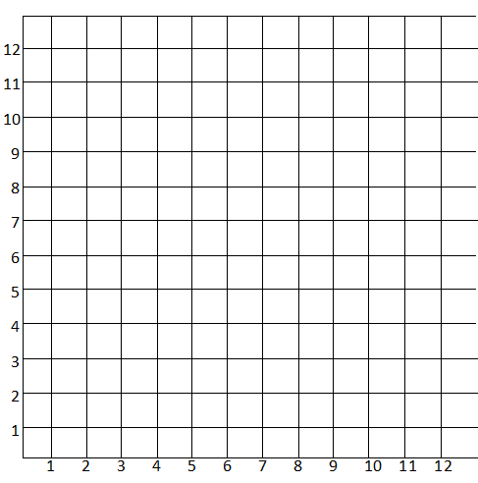
Student Activity 5
Drawing a point is similar to reading a point. You start by moving across the X axes, then move up the Y axis until you get where you need to be.
Directions: Plot the following points on the grid. Then draw a straight line to connect from one to the next
1. | (8 , 6) | to | (4, 10)
2. | (4 , 2) | to | (8 , 2)
3. | (4 , 4) | to | (10 , 4)
4. | (2 , 4) | to | (4 , 4)
5. | (4 , 6) | to | (4 , 10)
6. | (8 , 6) | to | (4 , 6)
7. | (4 , 2) | to | (2 , 4)
8. | (8 , 2) | to | (10 , 4)
9. | (4 , 4) | to | (4 , 6)

Slide 13
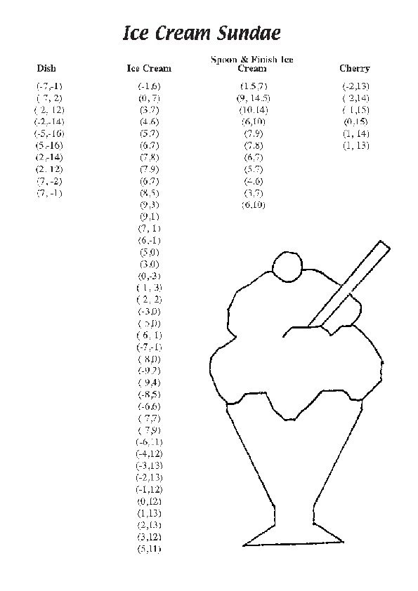
Ice Cream Sunday
Directions: Plot the following points on the grid. Then draw a straight line to connect from one to the next

Slide 14
Ice Cream Sunday
Dish
Ice Cream
( | -7 | , | -1 | )
( | 7 | , | 2 | )
( | 2 | , | 12 | )
( | -2 | , | -14 | )
( | 5 | , | -16 | )
( | 2 | , | -14 | )
( | 2 | , | 12 | )
( | 7 | , | -2 | )
( | 7 | , | -1 | )
( | -1 | , | 6 | )
( | 0 | , | 7 | )
( | 3 | , | 7 | )
( | 4 | , | 6 | )
( | 5 | , | 7 | )
( | 6 | , | 7 | )
( | 7 | , | 8 | )
( | 7 | , | 9 | )
( | 6 | , | 7 | )
( | 8 | , | 5 | )
( | 9 | , | 3 | )
( | 9 | , | 1 | )
( | 7 | , | 1 | )
( | 6 | , | -1 | )
( | 5 | , | 0 | )
( | 3 | , | 0 | )
( | 0 | , | -3 | )
( | 1 | , | 3 | )
( | 2 | , | 2 | )
( | -3 | , | 0 | )
( | 5 | , | 0 | )
( | 6 | , | 1 | )
( | -7 | , | -1 | )
( | 8 | , | 0 | )
( | -9 | , | -7 | )
( | 9 | , | 4 | )
( | -8 | , | 5 | )
( | -6 | , | 6 | )
( | 7 | , | 7 | )
( | 7 | , | 9 | )
( | -6 | , | 11 | )
( | -4 | , | 12 | )
( | -3 | , | 13 | )
( | -2 | , | 13 | )
( | -1 | , | 12 | )
( | 0 | , | 12 | )
( | 1 | , | 13 | )
( | 2 | , | 13 | )
( | 3 | , | 12 | )
( | 5 | , | 11 | )

Slide 15
Ice Cream Sunday
Spoon & Finish
Cherry
( | 15 | , | 7 | )
( | 9 | , | 14.5 | )
( | 10 | , | 14 | )
( | 6 | , | 10 | )
( | 7 | , | 9 | )
( | 7 | , | 8 | )
( | 6 | , | 7 | )
( | 5 | , | 7 | )
( | 4 | , | 6 | )
( | 3 | , | 7 | )
( | 6 | , | 10 | )
( | -2 | , | 13 | )
( | 2 | , | 14 | )
( | 1 | , | 15 | )
( | 0 | , | 15 | )
( | 1 | , | 14 | )
( | 1 | , | 13 | )

Slide 16
Student Activity 6 Break the code
Break the code:
Question: Why did the teacher always wear sun glasses in her classroom?
To find the answer, you must use the Cartesian plane below. Each coordinate on the grid represents a letter. You must use the activity sheet below which will give you a list of the coordinates. As you find each coordinate, you must write the corresponding letter above it.
When you have completed this, you will have cracked the code

Slide 17
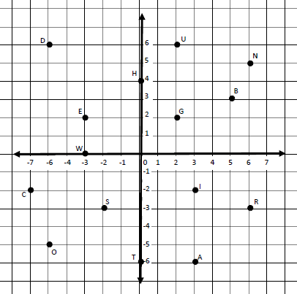
Student Activity 6 Break the code
Answer: (5,3) (-3,2) (-7,-2) (3,-6) (2,6) (-2,-3) (-3,2) ------------(0,4) (-3,2) (6,-3)
(-2,-3) (0,-6) (2,6) (-6,6) (-3,2) (6,5) (0,-6) (-2,-3 ) ----- (-3,0) (-3,2) (6,-3) (-3,2)
------------(-2,-3) (-6,-5) ------------ (5,3) (6,-3) (3,-2) (2,2) (0,4) (0,-6)

Slide 18
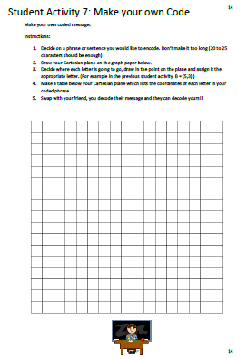
Student Activity 7 Make your own Code
Make your own coded message:
Instructions:
Decide on a phrase or sentence you would like to encode. Don’t make it too long
(20 to 25 characters should be enough)
2. Draw your Cartesian plane on the graph paper below.
Decide where each letter is going to go, draw in the point on the plane and assign
it the appropriate letter. (For example in the previous student activity, B = (5,3) )
Make a table below your Cartesian plane which lists the coordinates of each letter in your coded phrase.
5. Swap with your friend, you decode their message and they can decode yours!!

