Slide 1


Slide 2
Index
Student Activity 1: Me and my shadow
Student Activity 2: Labelling Sides in Right Angled Triangles
Student Activity 3 : Calculating ratios for similar right angled triangles with angles of 30°
Student Activity 4: Calculating ratios for similar right angled triangles with angles of 40°
Student Activity 5: Calculating ratios for similar right angled triangles with angles of 45°
Student Activity 6: Calculating ratios for similar right angled triangles with angles of 50°
Student Activity 7: Calculating ratios for similar right angled triangles with angles of 60°
Student Activity 8: Calculating ratios for similar right angled triangles with angles of 70°
Student Activity 9:: Master table of class results for ratios of sides in
right angled triangles
Student Activity 10: Using the master table of class results answer the following questions

Slide 3
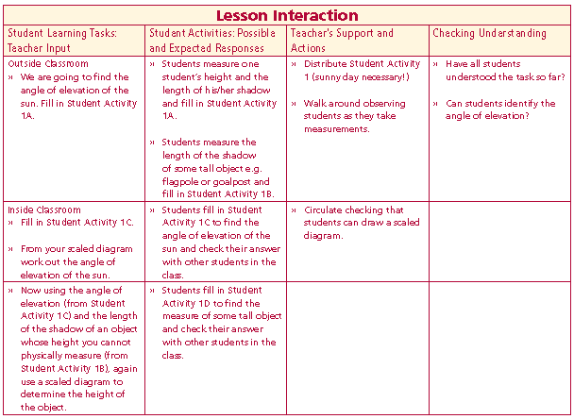
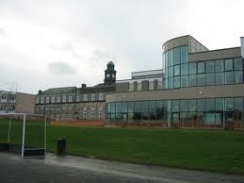
Student Activity 1
We are going to find the
angle of elevation of the sun.
OUTSIDE
Fill in Student Activity 1A
Lesson interaction

Slide 4
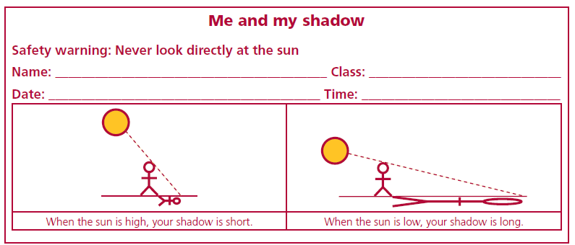
Lesson interaction

Slide 5
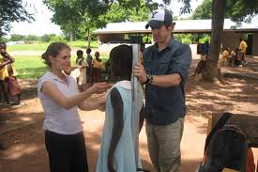
Lesson interaction
Student Activity 1A
• Show the angle of elevation of the sun on the above diagram. Call it A.
• Describe the angle of elevation of the sun in terms of the two arms of the angle. ____________________________________________________________________________________________________________________________________________________________________________________________________________________________________________________________________________
• Measure the height of one of the students in your group and the length of their shadow.
• Height of the student: __________cm. Length of the shadow ____________cm.
• Draw a rough sketch of a right-angled triangle to model the situation and write in the measurements.

Slide 6
Student Activity 1 B
Measure the length of the shadow of some tall object e.g. flagpole or goalpost.
Length of the shadow of a tall object which you cannot physically measure e.g. goalpost ______________________________cm
Lesson interaction

Slide 7
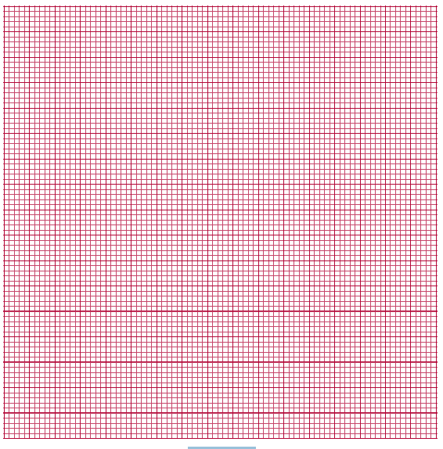
Student Activity 1 C
Back in class – Measuring the angle of elevation of the sun
• Decide what scale to use.
• Draw an accurate diagram on graph paper.
Lesson interaction
Diagram 1
• Measure the angle of elevation of the sun from Diagram 1 above using a protractor.
• Angle of elevation of the sun at _________ (time) on _______ (date) was _____.
• Check your answer with other students in the class.
• If you were to measure the angle of elevation of the sun at 10 a.m. and another class measured the angle at 11 a.m. what would be the difference in the measurements?_______________________________

Slide 8
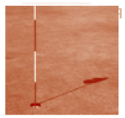
Student Activity 1 D
Knowing the angle of elevation of the sun, measure the height of a tall object using the length of its shadow as previously measured.
• Decide what scale to use. Scale: ______________________
• Draw an accurate diagram on graph paper using the length of the shadow, the
angle of elevation of the sun and forming right-angled triangle (ASA).

Slide 9
Diagram 2
• Measure the height of the goalpost from Diagram 2 above and using the scale factor convert to its actual height.
• Check the answer with other students in the class.
Conclusion for part 2:
The height of the goalpost is ___________________cm approximately.
Would you expect the same answer if you took the measurements at different times of the day?
Explain your answer. ________________________________________________________________
________________________________________________________________________________________________________________________________
Lesson interaction

Slide 10
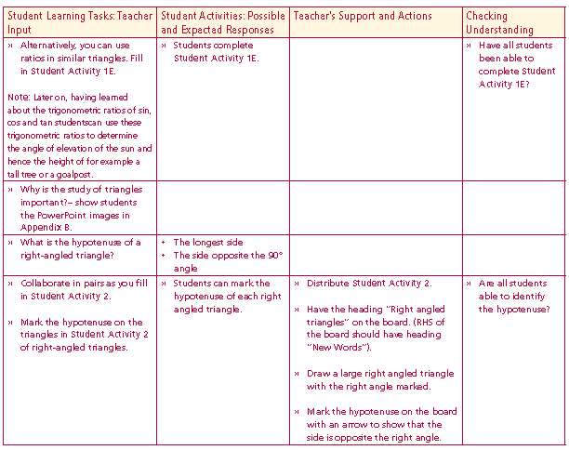
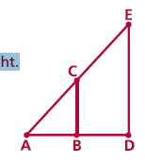
Student Activity 1 E
Using Similar Triangles
• Using graph paper draw the above 2 diagrams overlapping, with the angles of
elevation of the sun superimposed as shown by example in the diagram on the right.
Label the diagram on the graph paper as in the diagram on the right.
Lesson interaction

Slide 11
• What do you notice about the 2 vertical lines in the triangles? ____________________________________________________________________________________________________________________________
• Measure the heights of the 2 vertical lines |ED| and |CB|.
• Measure the 2 horizontal lines |AB| and |AD|.
• What do you notice about the two ratios? ______________________________________________________________
____________________________________________________________________________________________________________________________
• Knowing |AB| and |CB| and the distance |AD| how could you find |ED| without knowing the angle of elevation |∠EAD| of the sun?
Lesson interaction
|ED|
|CB|
=
|AB|
|AD|
=

Slide 12
Ratios in Similar Triangles
• Draw 3 different right angled triangles with the arms of the 90 degree angle being vertical and horizontal line segments, using the same angle of elevation which you calculated for the sun. Call the triangles T1, T2, T3.
Lesson interaction

Slide 13
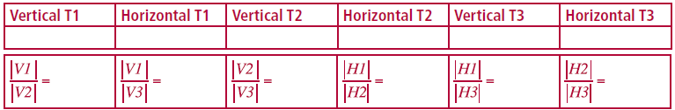
Measure the length of the vertical and horizontal line segments in these triangles
What do you notice about the ratios of any 2 vertical line segments of any 2 of these triangles and the ratio of the corresponding horizontal line segments?________________________________________________________________________________________________________________________________________________________________________________________________________________________________________________________________________________________________________
Lesson interaction

Slide 14
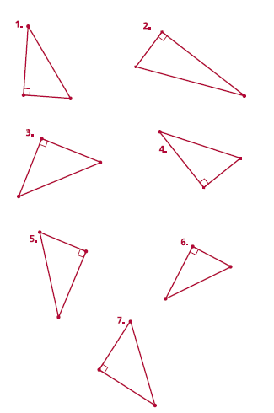
Student Activity 2
Labelling Sides in
Right Angled Triangles
Lesson interaction
What is the hypotenuse of
a right-angled triangle?
Mark the hypotenuse on the
triangles in Student Activity 2
of right-angled triangles.
How many other angles are in
the triangle?
How many degrees do they
add up to?
What are these angles called?

Slide 15
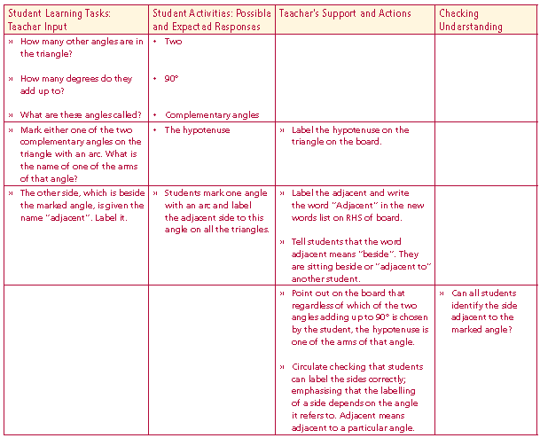
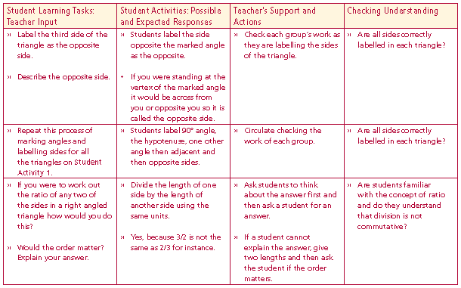
Student Activity 2
Labelling Sides in
Right Angled Triangles
Lesson interaction
Mark either one of the two
complementary angles on the
triangle with an arc. What is
the name of one of the arms
of that angle?
Lesson interaction
The other side, which is beside
the marked angle, is given the
name “adjacent”. Label it.
Label the third side of the
triangle as the opposite side.
Describe the opposite side.

Slide 16

Repeat this process of marking angles and labelling sides for all the triangles on Student Activity 1.
If you were to work out the ratio of any two of the sides in a right angled triangle how would you do this?
Would the order matter?
Explain your answer.
How many possible ratios could be worked out for a right angled triangle?
When giving the ratios use the names for the sides.
What is the relationship between the first pair?
If I knew the answer to the first ratio was ½, what would be the answer to the second one?
Lesson interaction
Lesson interaction
Opp
Hyp
Hyp
Opp
Adj
Hyp
Hyp
Adj
Opp
Adj
Adj
Opp

Slide 17
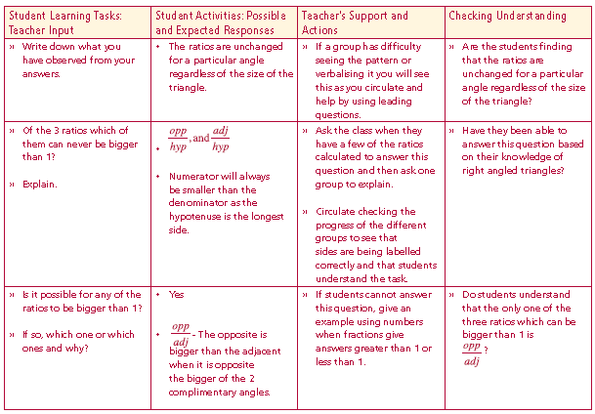
Student Activities 3, 4, 5, 6, 7 and 8:
For each triangle of the five triangles mark the 90° angle and one other given angle (given on the sheet). Label the sides of the right angled triangles as hyp (hypotenuse), adj (adjacent), and opp (opposite). Measure each side correct to the nearest mm and calculate the ratios opp/hyp, adj/hyp, opp/adj.
One student is to measure, one to calculate ratios and one to double check changing roles on each triangle.
Lesson interaction
Lesson interaction

Slide 18
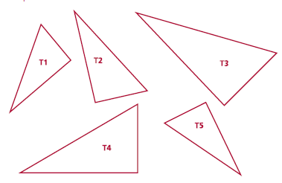
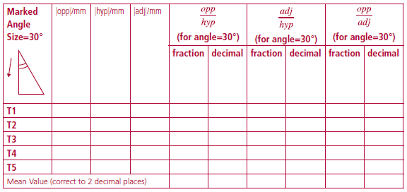
Student Activity 3
Calculating ratios for similar right angled triangles with angles of 30°
• Measure and label the 90° and the 30° angles in the following triangles. What is the measure of the third angle?
• Label the hypotenuse as “hyp”. With respect to the 30° angle, label the other sides as “adj” for adjacent and “opp” for Opposite
• Complete the table below.

Slide 19
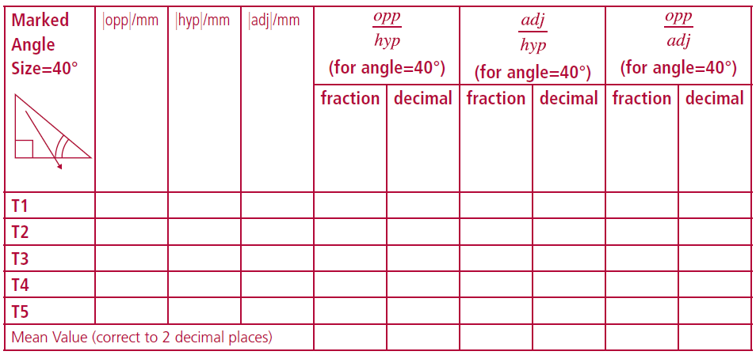
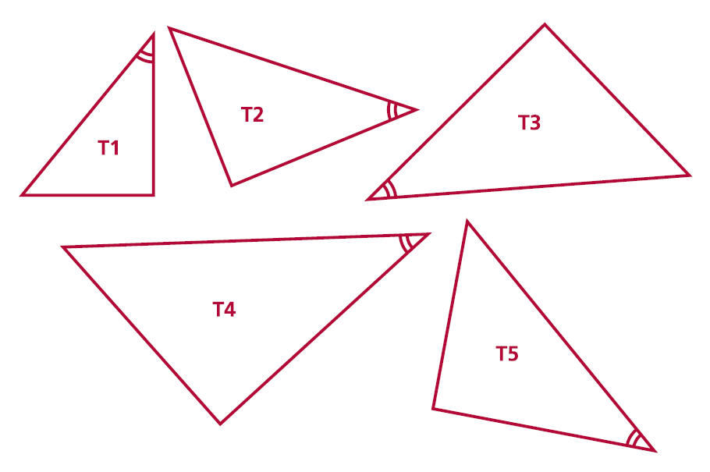
Student Activity 4
Calculating ratios for similar right angled triangles with angles of 40°
• Measure and label the 90° and the 40° angles in the following triangles. What is the measure of the third angle?
• Label the hypotenuse as “hyp”. With respect to the 40° angle, label the other sides as “adj” for adjacent and “opp” for opposite.
• Complete the table below.

Slide 20
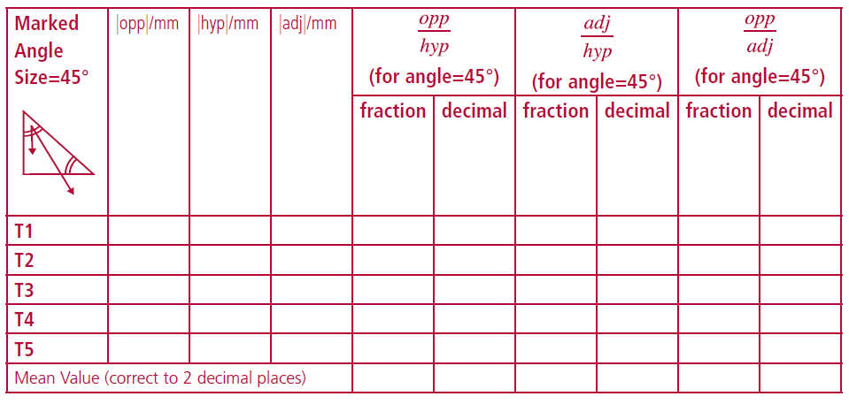
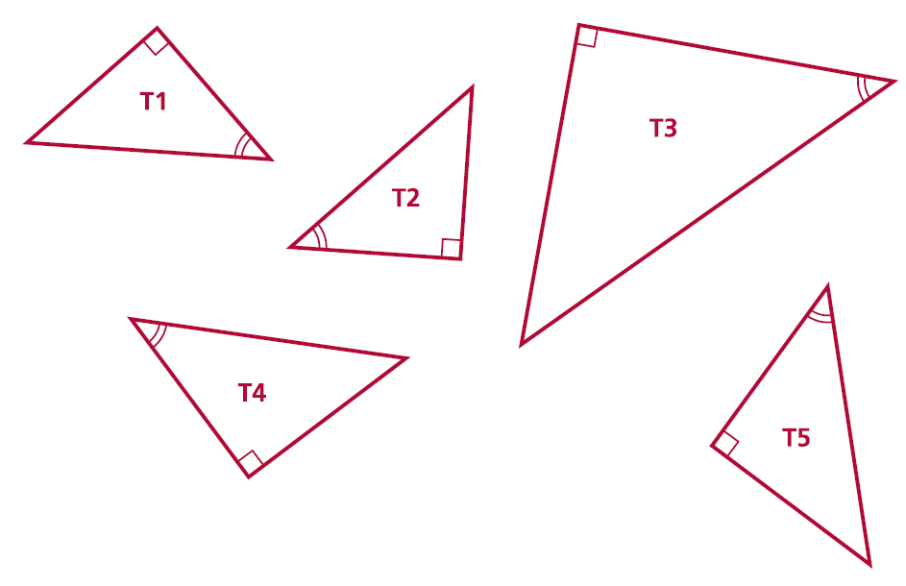
Student Activity 5
Calculating ratios for similar right angled triangles with angles of 45°
• Measure and label the 90° and the 45° angles in the following triangles. What types of right angled triangle are these triangles?_________________________
• Label the hypotenuse as “hyp”. With respect to the 45° angle, label the other sides as “adj” for adjacent and “opp” for opposite.
• Complete the table below.

Slide 21
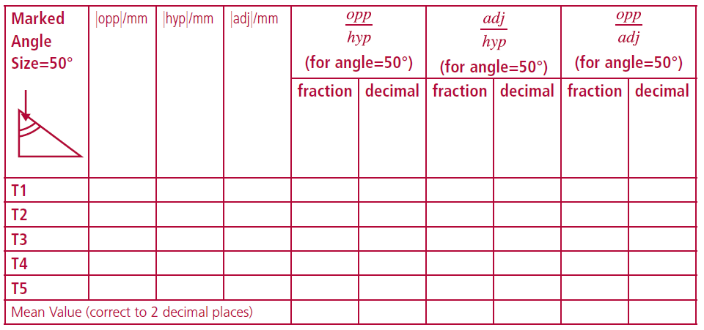
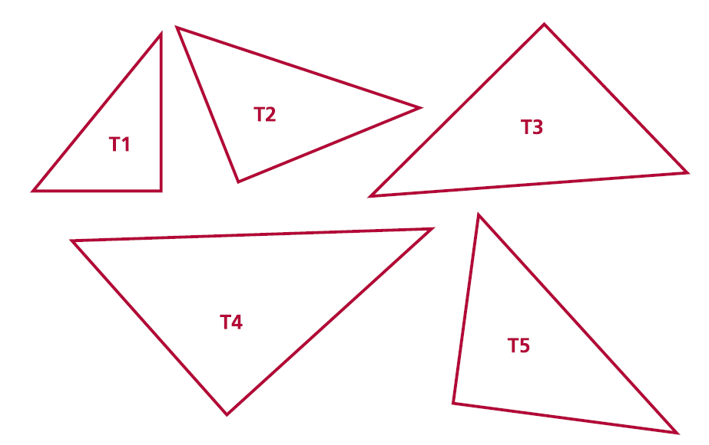
Student Activity 6
Calculating ratios for similar right angled triangles with angles of 50°
• Label the 90° and the 50° angles in the following triangles. What is the measure of the third angle? __________________________________________________
• Label the hypotenuse as “hyp”. With respect to the 50° angle, label the other sides as “adj” for adjacent and “opp” for opposite.
• Complete the table below.

Slide 22
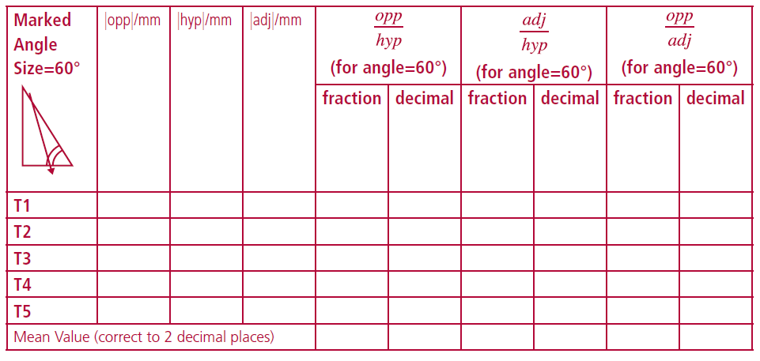
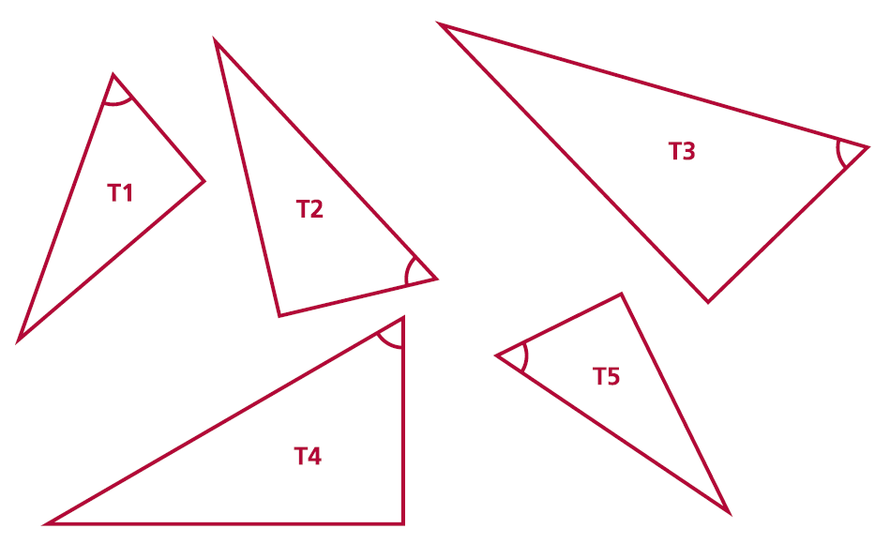
Student Activity 7
Calculating ratios for similar right angled triangles with angles of 60°
• Measure and label the 90° and the 60° angles in the following triangles. What is the measure of the third angle?________________________________________
• Label the hypotenuse as “hyp”. With respect to the 60° angle, label the other sides as “adj” for adjacent and “opp” for opposite.
• Complete the table below.

Slide 23
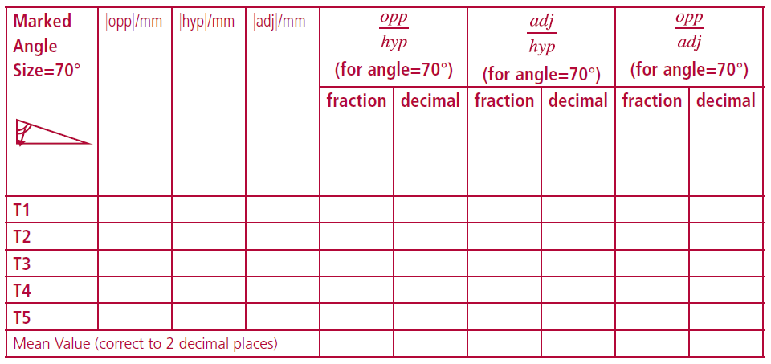
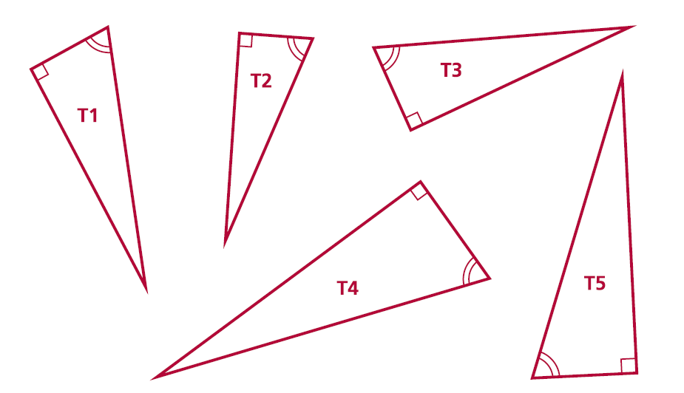
Student Activity 8
Calculating ratios for similar right angled triangles with angles of 70°
• Measure and label the 90° and the 70° angles in the following triangles. What is the measure of the third angle? ____________________________
• Label the hypotenuse as “hyp”. With respect to the 70° angle, label the other sides as “adj” for adjacent and “opp” for opposite.
• Complete the table below.

Slide 24
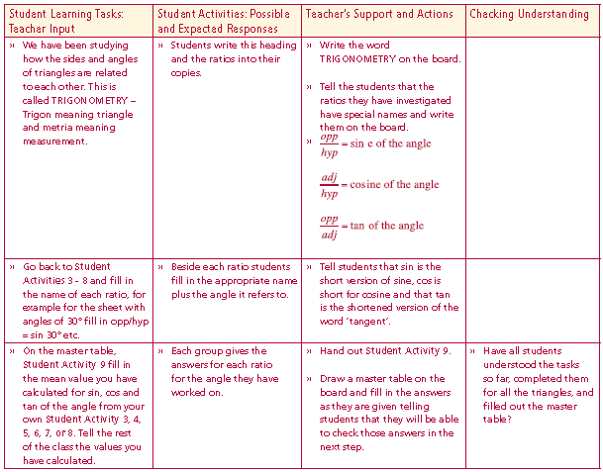
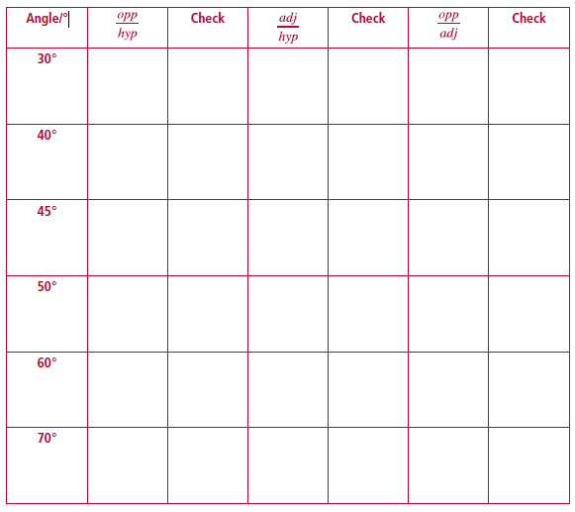
Student Activity 9
Master table of class results for ratios of sides in right angled triangles
Lesson interaction

Slide 25
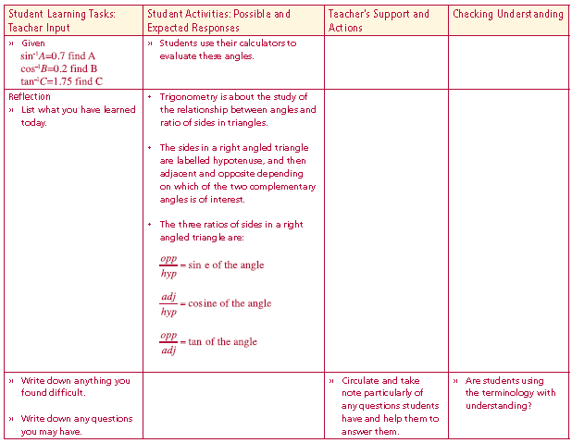
Student Activity 10
Using the master table of class results answer the following questions
1. What do you notice about sin 30° and cos 60°? __________________________
__________________________________________________________________
2. What do you notice about cos 30° and sin 60°? __________________________
__________________________________________________________________
3. Can you explain what you have noticed using diagrams?
4. How would you describe angles 30° and 60°? ___________________________
__________________________________________________________________
5. Can you find similar examples in the master table? ____________________________________________________________________________________________________________________________________
6. For what angle in a right angled triangle is the opposite side one half of the
hypotenuse? _____________________________________________________
__________________________________________________________________
Draw a diagram to illustrate your answer.
7. For what angle in a right angled triangle are the opposite and adjacent sides equal? _______________________________________________________________
Lesson interaction

Slide 26
7. For what angle in a right angled triangle are the opposite and adjacent sides equal? ____________________________________________________________________
8. Calculate for each angle A. Compare this to the value of Tan A. What do
you notice? Can you justify the answer?
sin A
Cos A

Slide 27
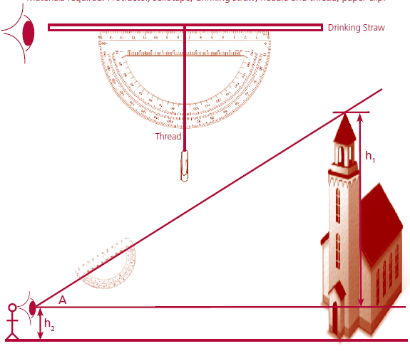
Making and using a clinometer to find the
height of a tall structure
Materials required: Protractor, sellotape, drinking straw, needle and thread, paper clip.

Slide 28
Finding the height of a wall/spire/ flagpole using a clinometer
Work in threes – one holding the clinometer, one reading the angle of elevation, one recording the angle of elevation.
• Measure the height of the observer from eye to ground level.
• Measure the distance from the observer to the base of the building (under
the highest point).
• Mark the position of the observer on the ground.
• Hold the clinometer so that the string is vertical.
• Now tilt the clinometer looking through the drinking straw so that the
highest point on the top of the wall/flagpole/spire is visible.
• Read the angle of elevation of this highest point to the nearest degree.
• Draw a rough sketch of the situation marking in the distances measured
and the angle of elevation.

