Slide 2
Index
Student Activity 1: Tossing a coin
Student Activity 2: Tossing two coins

Slide 3
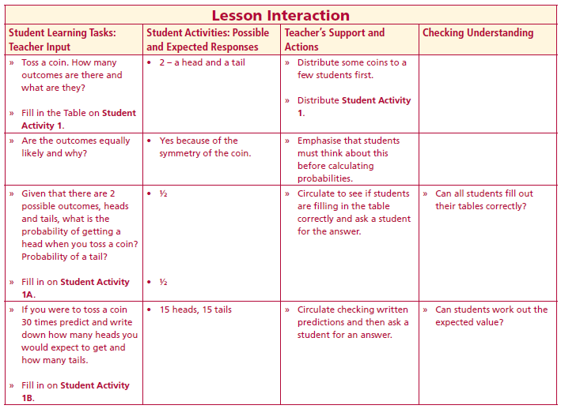
Student Activity 1
Toss a coin. How many outcomes are there and what are they?
Are the outcomes equally likely and why?
Lesson interaction
Now, working in pairs, toss a coin 30 times and fill in the table on Student Activity 1C.
You have a time limit of _____________

Slide 4
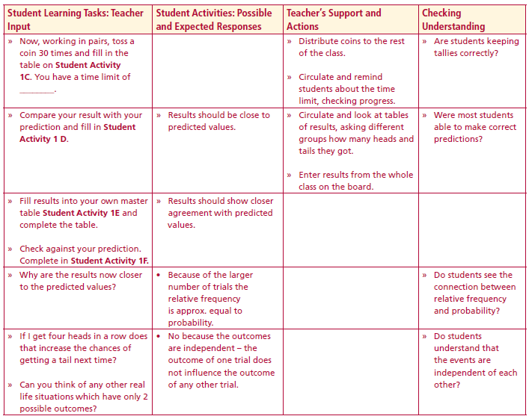
Now, working in pairs, toss a coin 30 times and fill in the table on Student Activity 1C.
You have a time limit of __________
Lesson interaction

Slide 5
Lesson interaction
Why are the results now closer to the predicted values?
If I get four heads in a row does that increase the chances of getting a tail next time?
Can you think of any other real life situations which have only 2 possible outcomes?

Slide 6
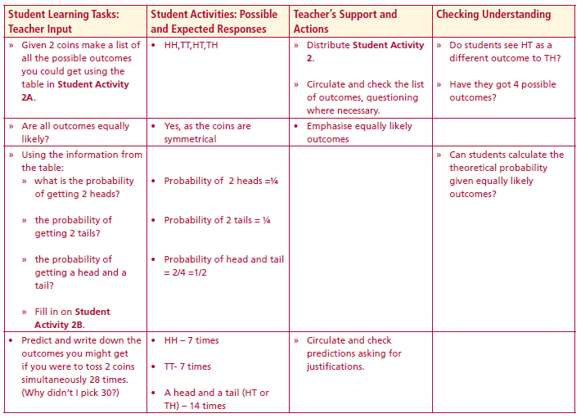
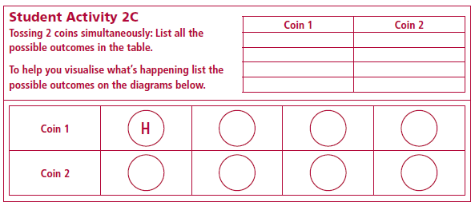
Student Activity 2
Student Activity 2A
Lesson interaction
Are all outcomes equally likely?
Student Activity 2B

Slide 7
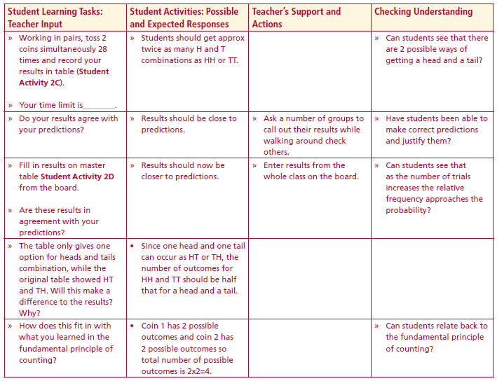
Predict and write down the outcomes you might get if you were to toss 2 coins simultaneously 28 times. (Why didn’t I pick 30?)
Working in pairs, toss 2 coins simultaneously 28 times and record your
results in table
Lesson interaction
Student Activity 2C
Do your results agree with your predictions?

Slide 8
Student Activity 2D
Lesson interaction
Are these results in agreement with your predictions?
The table only gives one option for heads and tails combination, while the original table showed HT and TH. Will this make a difference to the results?
Why?
How does this fit in with what you learned in the fundamental principle of counting?

Slide 9
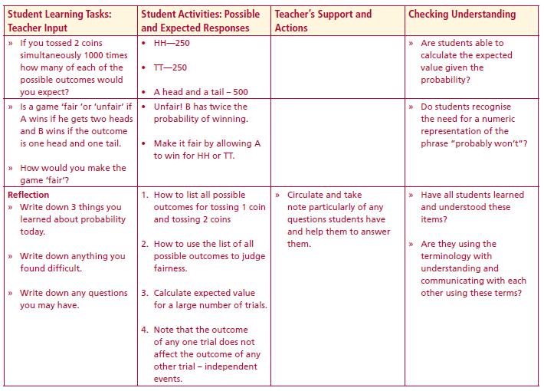
If you tossed 2 coins simultaneously 1000 times how many of each of the possible outcomes would you expect? Is a game ‘fair ‘or ‘unfair’ if A wins if he gets two heads and B wins if the outcome is one head and one tail.
How would you make the game ‘fair’? Reflection
Write down 3 things you learned about probability today.
Write down anything you found difficult.
Write down any questions you may have
Lesson interaction

