Slide 1
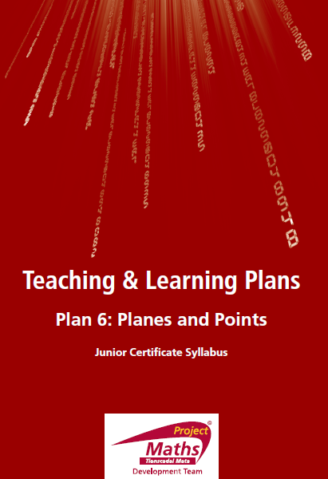

Slide 2
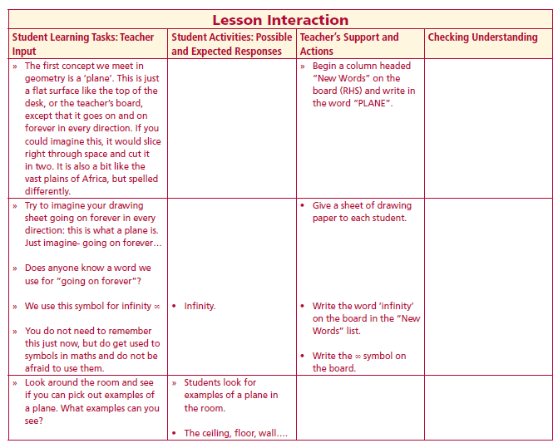
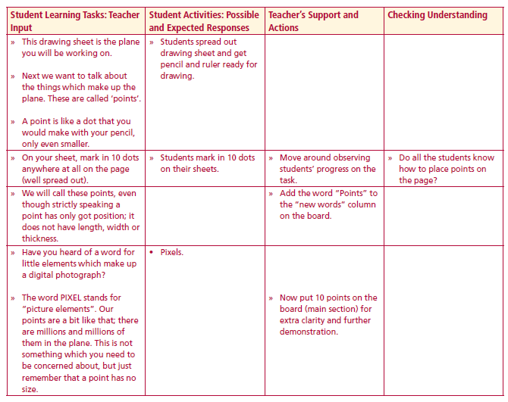
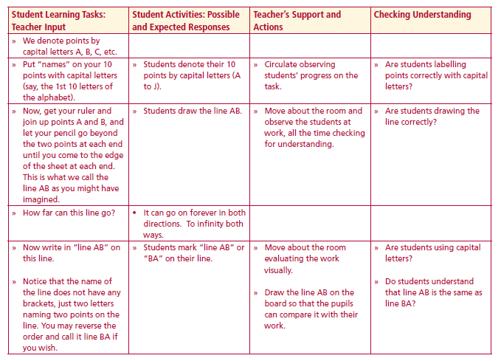
New words
Planes
Infinity
Point
line AB
On your sheet, mark in 10 dots anywhere at all on the page.
Denote the points by capital letters A, B, C, etc
Lesson interaction
Lesson interaction
Using ruler and join up points A and B, and let your pencil go beyond the two points at each end until you come to the edge of the sheet at each end. This is what we call the line AB
How far can this line go?
Could I draw a different line through A and B?
Lesson interaction

Slide 3
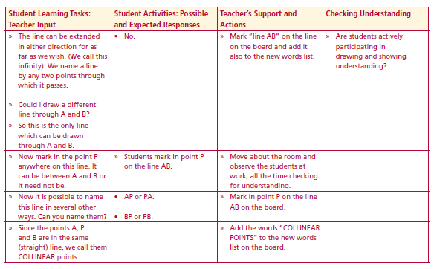
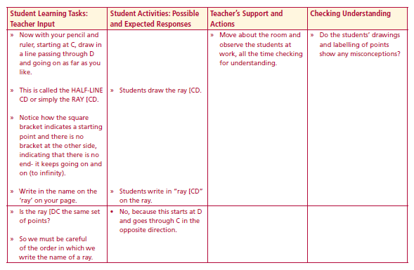
New words
Planes
Infinity
Point
line AB
Collinear
Ray [CD
Lesson interaction
Lesson interaction
Now mark in the point P anywhere on this line. It can be between A and B or it need not be.
Since the points A, P and B are in the same (straight) line, we call them COLLINEAR points
Now with your pencil and ruler, starting at C, draw in a line passing through D and going on as far as you like.
This is called the HALF-LINE CD or simply the RAY [CD.
Is the ray [DC the same set of points?

Slide 4
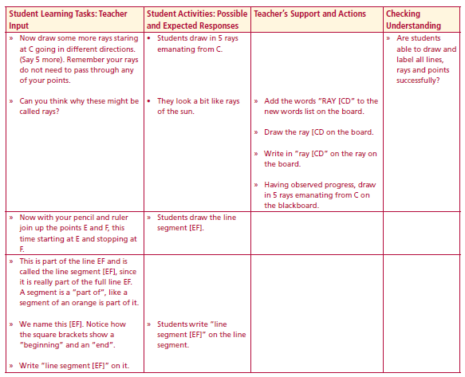
New words
Planes
Infinity
Point
line AB
Collinear
Ray [CD
line segment [EF]
Lesson interaction
Draw some more rays staring at C going in different directions. (Say 5 more). Remember your rays do not need to pass through any of your points.
Now with your pencil and ruler join up the points E and F, this time starting at E and stopping at F.
This is part of the line EF and is called the line segment [EF], since it is really part of the full line EF. A segment is a “part of”, like a segment of an orange is part of it.
We name this [EF]. Notice how the square brackets show a “beginning” and an “end”.

Slide 5
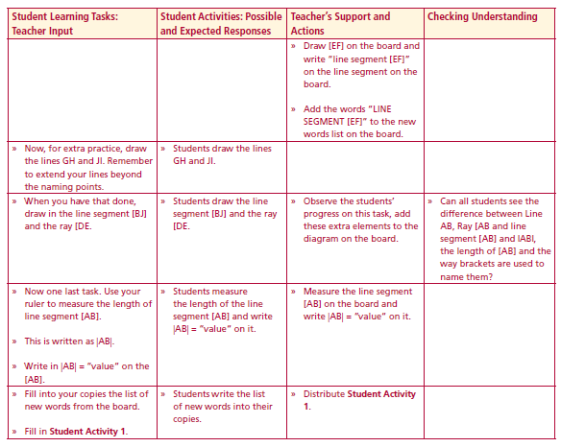
New words
Planes
Infinity
Point
line AB
Collinear
Ray [CD
line segment [EF]
Lesson interaction
Now, for extra practice, draw the lines GH and JI. Remember to extend your lines beyond the naming points.
When you have that done, draw in the line segment [BJ] and the ray [DE.
Now one last task. Use your ruler to measure the length of line segment [AB].
This is written as |AB|.
Write in |AB| = “value“ on the [AB].

Slide 6
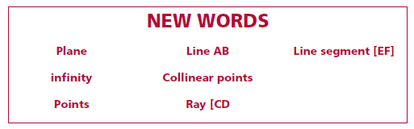

Slide 7
Join A to C. This is [AC]. Measure the length of [AC]. Write your answer in cm. and mm. _________________. How do we name the length of [AC]?________
2. Join D to E. This is [DE]. Measure the length of [DE]. Write your answer in cm.
and mm. _________________. How do we name the length of [DE]?__________
3. Draw line AB.
4. Draw ray [DE.
5. How big is a point?__________________________________________________

Slide 8
6. Write down the symbol for infinity._____________________________________
7. How many points are on a line?________________________________________
8. How many points do you need to know to define a line?____________________
Answer true/false to the following questions.
9. Line AB contains H.___________________________________________________
10. Line CD contains B__________________________________________________
11. Line AB and F lie in the same plane_____________________________________

Slide 9
12. A, B and H are collinear______________________________________________
13. C,D and B are collinear.______________________________________________
14. More than one line can be drawn through E and H?_______________________
15. More than one line can be drawn through B and D?_______________________
16. CG intersects EG at G________________________________________________

Slide 10
17. Points A,B,C,D,E,F,G,H all lie in the same plane which I will call X_____________
18. Points A,B,C,D,E,F,G,H are the only points in plane X.______________________
19. [CH is the same as [HC.______________________________________________
20. Line AB is the same as line BA.________________________________________

Slide 11
Write down 3 things you learned about planes and points today.
Write down anything you found difficult.
Write down any questions you may have.

