Slide 1
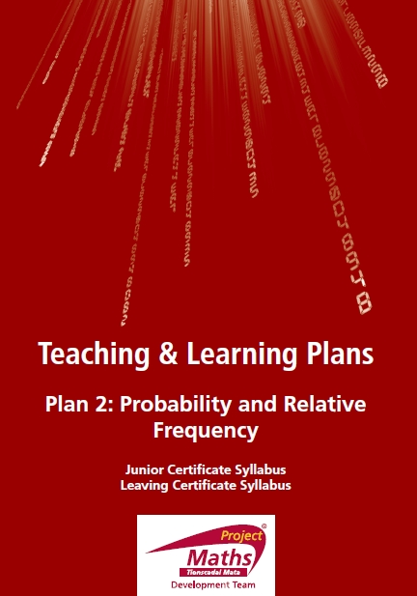

Slide 2
Index
Section 1: Rolling a die
Section 2: Master table

Slide 3
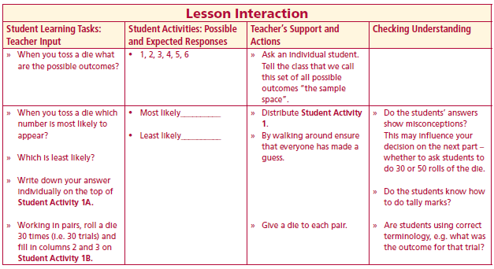
Student Activity 1
When you toss a die what are the possible outcomes?
Lesson interaction
Student Activity 1A
My prediction:
Which number is most likely to appear________________?
Which number is least likely to appear________________?

Slide 4
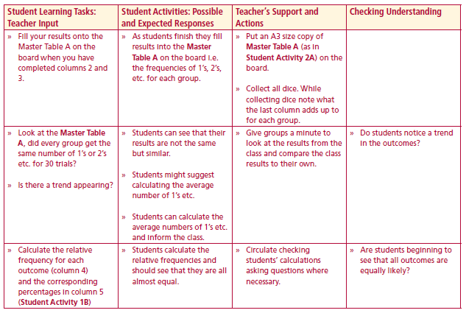
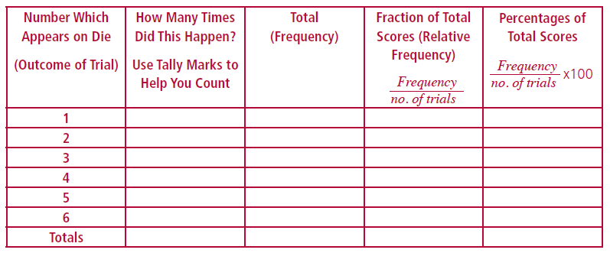
Student Activity 1B
Working in pairs, roll a die 30 times (i.e. 30 trials)
and fill in columns 2 and 3
Lesson interaction
Lesson interaction

Slide 5
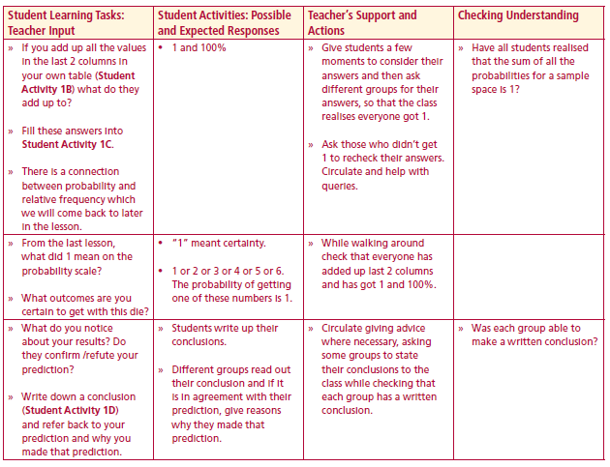
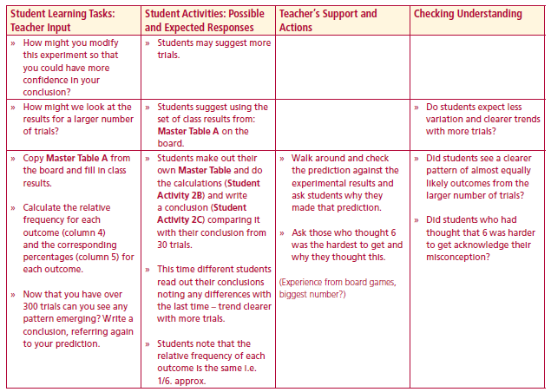
Student Activity 1C
The sum of all the relative frequencies is ________________?
The sum of all the percentages is ________________?
Lesson interaction
From the last lesson, what did 1 mean on the probability scale?
What outcomes are you certain to get with this die?
What do you notice about your results? Do they confirm /refute your prediction?
Lesson interaction
Student Activity 1D
Conclusion: (Refer to prediction)
_____________________________________________________________________________________________________________________________________________________________________________________

Slide 6
Student Activity 2
How might you modify this experiment so that you could have more confidence in your conclusion?
How might we look at the results for a larger number of trials?
Lesson interaction

Slide 7
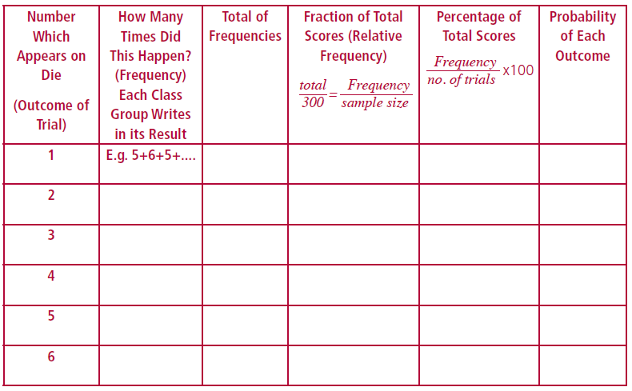
Student Activity 2
Student Activity 2A Master Table
Lesson interaction

Slide 8
Did every group get the same number of 1’s or 2’s etc. for 30 trials?
Is there a trend appearing?
Calculate the relative frequency for each outcome (column 4) and the corresponding percentages in column 5
Lesson interaction

Slide 9
Calculate the relative frequency for each outcome (column 4) and the corresponding percentages in column 5
Lesson interaction

Slide 10
Student Activity 2B
The sum of all the relative frequencies is ________________?
The sum of all the percentages is ________________?
Lesson interaction
Now that you have over 300 trials can you see any pattern emerging?
Student Activity 2C
Conclusion: (Refer to prediction)
______________________________________________________________________
______________________________________________________________________
______________________________________________________________________
______________________________________________________________________

Slide 11
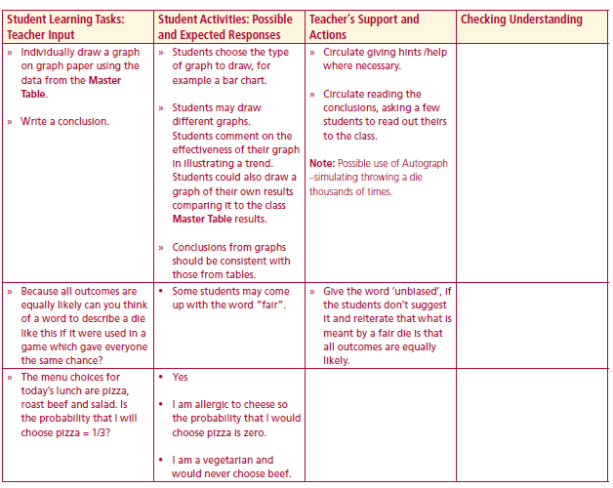
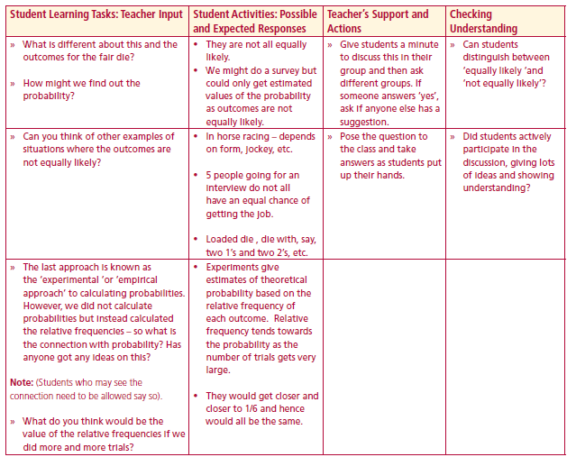
Individually draw a graph on graph paper using the data from the Master Table.
Write a conclusion
Because all outcomes are equally likely can you think of a word to describe a die like this if it were used in a game which gave everyone the same chance?
The menu choices for today’s lunch are pizza, roast beef and salad. Is the probability that I will choose pizza = 1/3?
What is different about this and the outcomes for the fair die?
How might we find out the probability?
Lesson interaction
Lesson interaction

Slide 12
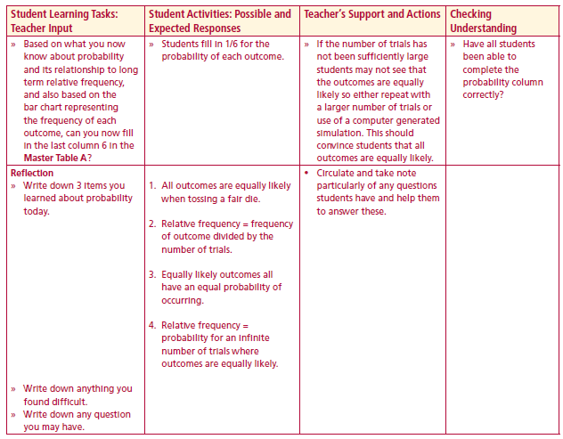
Can you think of other examples of situations where the outcomes are not equally likely?
The last approach is known as the ‘experimental ‘or ‘empirical approach’ to calculating probabilities. However, we did not calculate probabilities but instead calculated the relative frequencies – so what is the connection with probability? Has anyone got any ideas on this?
What do you think would be the value of the relative frequencies if we did more and more trials?
Based on what you now know about probability and its relationship to long term relative frequency, and also based on the bar chart representing the frequency of each outcome, can you now fill in the last column 6 in the Master Table A?
Lesson interaction
Lesson interaction

Slide 13
Calculate the relative frequency for each outcome (column 4) and the corresponding percentages in column 5
Lesson interaction

Slide 14
Reflection
Write down 3 items you learned about probability today.
Write down anything you found difficult.
Write down any question you may have.
Lesson interaction

