Slide 2
INDEX
Section A: | The difference between relative and absolute comparisons and the concept of ratios and proportions
Section B: | Dividing a number into a given ratio
Section C: | Ratios of more than two quantities
Section D: | (a) The relationship between the length of the diagonal of a square and its side length(b) The relationship between the diameter of a circle and the length of its circumference
Section E: | The ratio of consecutive numbers in the Fibonacci sequence
Section F: | The Fibonacci sequence, the golden rectangle and the link to the nautilus shell
Section G: | Similar rectangles
Section H: | Introduction of rate – comparing two quantities by division, which have different units
Section I: | Direct Proportion v Inverse Proportion
Section J: | Multiplicative v Additive relationships
Section K | Is it always necessary to use unit rate?
Section L: | Using both methods (unit rate and factor of change) where the factor of change is not an integer
Section M: | Speed, distance and time
Section N: | Inverse Proportion (See also Section I)
Section O: | Two rates compared

Slide 3
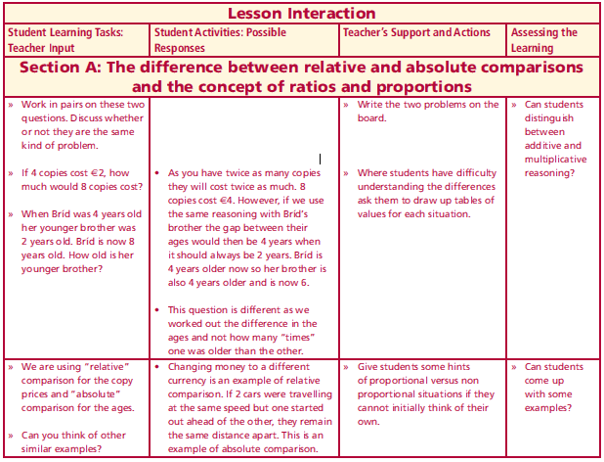
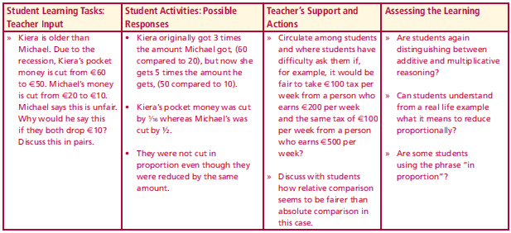
Section A: Introduction
Work in pairs on these two questions. Discuss whether or not they are the same kind of problem.
If 4 copies cost €2, how much would 8 copies cost?
When Bríd was 4 years old her younger brother was 2 years old. Bríd is now 8 years old. How old is her younger brother?
We are using “relative” comparison for the copy prices and “absolute” comparison for the ages. Can you think of other similar examples?
Kiera is older than Michael. Due to the recession, Kiera’s pocket money is cut from €60 to €50. Michael’s money is cut from €20 to €10. Michael says this is unfair. Why would he say this if they both drop €10?
Discuss this in pairs.
Lesson interaction
Lesson interaction

Slide 4
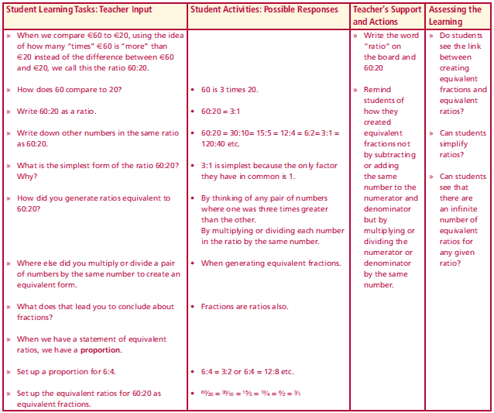
Section A: Introduction
When we compare €60 to €20, using the idea of how many “times” €60 is “more” than €20 instead of the difference between €60 and €20, we call this the ratio 60:20.
How does 60 compare to 20?
Write 60:20 as a ratio.
Write down other numbers in the same ratio as 60:20.
What is the simplest form of the ratio 60:20?
Why?
How did you generate ratios equivalent to 60:20?
Where else did you multiply or divide a pair of numbers by the same number to create an equivalent form.
What does that lead you to conclude about fractions?
When we have a statement of equivalent ratios, we have a proportion.
Set up a proportion for 6:4.
Set up the equivalent ratios for 60:20 as equivalent fractions.
Lesson interaction

Slide 5
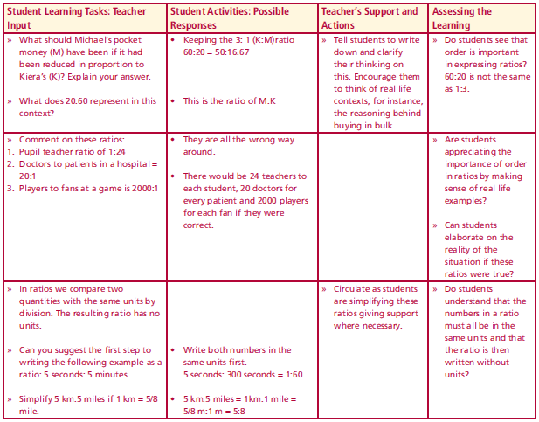
Section A: Introduction
What should Michael’s pocket money (M) have been if it had been reduced in proportion to Kiera’s (K)? Explain your answer.
What does 20:60 represent in this context?
Comment on these ratios:
1. Pupil teacher ratio of 1:24
2. Doctors to patients in a hospital = 20:1
3. Players to fans at a game is 2000:1
In ratios we compare two quantities with the same units by division. The resulting ratio has no units.
Can you suggest the first step to writing the following example as a ratio: 5 seconds: 5 minutes.
Simplify 5 km:5 miles if 1 km = 5/8 mile.
Lesson interaction

Slide 6
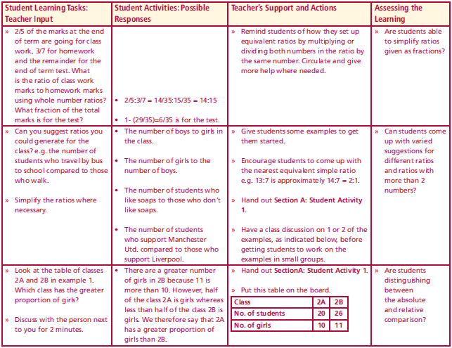
Section A: Introduction
2/5 of the marks at the end of term are going for class work, 3/7 for homework and the remainder for the end of term test. What is the ratio of class work marks to homework marks using whole number ratios? What fraction of the total marks is for the test?
Can you suggest ratios you could generate for the class? e.g. the number of students who travel by bus to school compared to those who walk. Simplify the ratios where necessary.
Look at the table of classes 2A and 2B in example 1.
Which class has the greater proportion of girls?
Lesson interaction

Slide 7
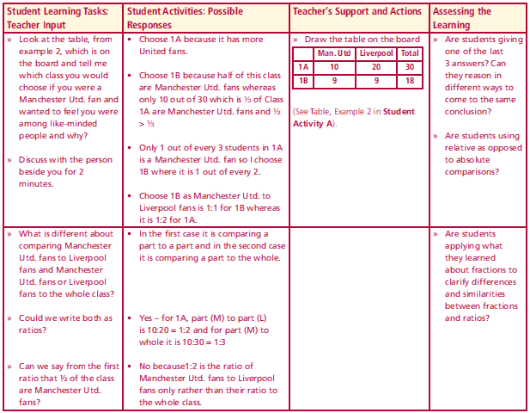
Section A: Introduction
Look at the table, from example 2, which is below, which class you would choose if you were a Manchester Utd. fan and wanted to feel you were among like-minded people and why?
What is different about comparing Manchester Utd. fans to Liverpool fans and Manchester Utd. fans or Liverpool fans to the whole class?
Could we write both as ratios?
Can we say from the first ratio that ½ of the class are Manchester Utd. fans?
Fractions are called rational numbers because they express the ratio of a pair of integers where the denominator cannot be zero. Why not?
Are percentages ratios? Explain.
Work in pairs to complete Section A: Student Activity 1.
Lesson interaction

Slide 8
Section A: Student Activity 1
1. Which class has more girls? Which class has the greater proportion of girls?
2. You are a Manchester Utd. fan. Which class, 1A or 1B, would you prefer to be in? Explain.
3. Simplify the following ratio
9 : 15
60 : 84
0.25 : 0.8
0.4 kg : 500g
$$\frac{5}{2}:\frac{5}{4}$$
$$\text{3}\frac{1}{2}:1.4$$
$$\text{ 4}:\frac{5}{8}$$

Slide 9
3. Simplify the following ratio
9 : 15
60 : 84
0.25 : 0.8
0.4 kg : 500g
$$\frac{5}{2}:\frac{5}{4}$$
$$\text{3}\frac{1}{2}:1.4$$
$$\text{ 4}:\frac{5}{8}$$
4. Six students in a class of 32 are absent. Find the ratio of
a) The number absent to the number present
b) The number absent to the total number of students in the class
c) The number present to the total number of students in the class
Which ratios could be written as fractions? Explain your answer.
5. Two baby snakes are measured in the zoo. One measures 8cm and the other measures 12cm. Two weeks later they are measured again and the first one now measures 11cm while the second one measures 15cm. Did the snakes grow in proportion? Explain your answer.

Slide 10
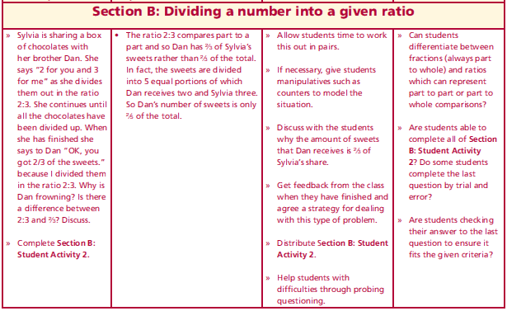
Section B: Introduction
Sylvia is sharing a box of chocolates with her brother Dan. She says “2 for you and 3 for me” as she divides them out in the ratio 2:3. She continues until all the chocolates have been divided up. When she has finished she says to Dan “OK, you got 2/3 of the sweets.” because I divided them in the ratio 2:3. Why is Dan frowning? Is there a difference between 2:3 and 2/3? Discuss.
Complete Section B: Student Activity 2.
Lesson interaction

Slide 11
Section B: Student Activity 2
Divide €20 between Patrick and Sarah in the ratio 3:2
2. Divide €20 between Patrick and Sarah in the ratio 4:3. Give your answer to the nearest cent.
3. A sum of money is divided between Laura and Joan in the ratio
2:3. Laura gets €8. How much did Joan get?
4. Joe earns €3,500 per month. The ratio of the amount he saves to the amount he spends is 2:5. How much does he spend? Work out how much he saves in two different ways.
5. The total area of a site is 575m2. Anne is building a house on the site. The ratio of house area to garden area is 5:8. Find the area of the garden.
6. Julianne and Kevin inherit €5,500. Julianne is 24 and Kevin is 9. The money is to be divided in the ratio of their ages. How much will each receive?

Slide 12
6. Julianne and Kevin inherit €5,500. Julianne is 24 and Kevin is 9. The money is to be divided in the ratio of their ages. How much will each receive?
7. In class A, $\frac{3}{4}$ of the class watch American Idol. In class B, $\frac{9}{10}$of the class watch American Idol. What is the ratio of the students who do not watch American Idol in class A to those who do not watch American Idol in class B?
8. In a 1,000ml mixture of fruit concentrate and water there is 40ml of fruit concentrate.
a. What is the ratio of the amount of fruit concentrate to the amount of water?
b. If 200ml of concentrate is added to the mixture, what is the ratio of the amount of fruit concentrate to the total volume of mixture.
c. What is the ratio of concentrate to water in the new mixture?
9. Two containers, one large and one small, contain a total of 4 kilograms of bath salts. One quarter of the bath salts from the large container is transferred to the small container so that the ratio of bath salts in the large container to that in the small one becomes 3:2. How many kilograms of bath salts were originally in each container?

Slide 13
Section C: Introduction
If $a:b = 3:5$and $b:c = 4:7$, find the ratio of $a:b:c$.
If $\frac{x}{y}=3 and y=3z find x:y:z$
$$\frac{x}{y}=3$$
$$x=3y$$
$$\left(4\right) (4)$$
$$\left(5\right) (5)$$
Lesson interaction
$$a:b =12:20$$
$$b:c =20:35$$
$$a:b:c=12:20:35$$
$$y:z=1:3$$
$$\left(y\right) (y)$$
$$\left(3\right) (3)$$
$$x:y=1:3$$
$$y:z=3:9$$
$$x:y:z=1:3:9$$

Slide 14
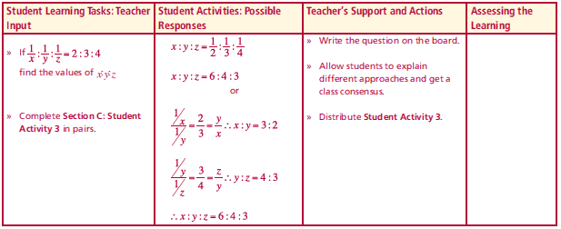
Section C: Introduction
If $\frac{1}{x}:\frac{1}{y}:\frac{1}{z}=2:3:4$, find the ratio of $x:y:z$.
Complete Section C: Student Activity 3 in pairs.
Lesson interaction
$$x:y:z=\frac{1}{2}:\frac{1}{3}:\frac{1}{4}$$
$$x:y:z=\frac{}{12}:\frac{}{12}:\frac{}{12}$$
$$x:y:z=\frac{6}{12}:\frac{}{12}:\frac{}{12}$$
$$x:y:z=\frac{6}{12}:\frac{4}{12}:\frac{}{12}$$
$$x:y:z=\frac{6}{12}:\frac{4}{12}:\frac{3}{12}$$
$$x:y:z=6:4:3$$

Slide 15
Section C: Student Activity 3
1. The heights of Derek, Alan and Jim are 1.7m, 180cm and 150cm.
Find the ratio of the heights of Derek, Alan and Jim.
2. €45 is divided among 4 children in the ratio 1:2:3:9. How much did each child receive?
3. An apartment has an area of 47m². It is divided into living, sleeping and dining areas in the ratio of $\frac{1}{5}:\frac{1}{4}:\frac{1}{3}$.
What is the area of the smallest section?
4. If a:b:c = 5:10:9, divide 3700 in the ratio $\frac{1}{a}:\frac{1}{b}:\frac{1}{c}$.
5. €144 is divided between Jean, Alice and Kevin. Jean gets half as much as Alice and one third as much as Kevin. How much does each of them get?
6. Write a similar question to Q1 and solve.

Slide 16
6. Write a similar question to Q1 and solve.
7. Write a similar question to Q2 and solve.
8. Write a similar question to Q3 and solve.
9. Write a similar question to Q4 and solve.
10. Write a similar question to Q5 and solve.

Slide 17
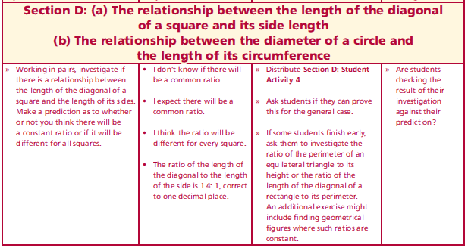
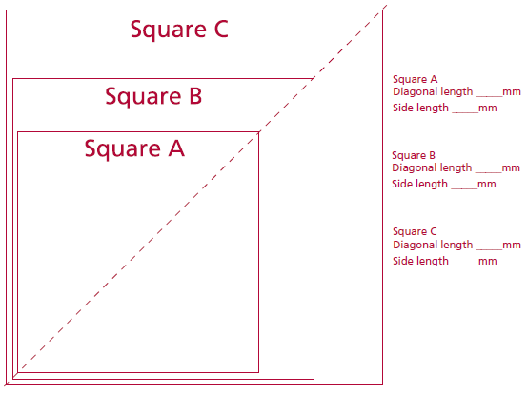
Section D: Student Activity 4
Measure the length of the side of each square in mm and the length of the diagonal in mm. Find the ratio of the length of the diagonal to the length of the side and write the equivalent ratio in the form x:1 where x is written correct to one decimal place.
Lesson interaction

Slide 18
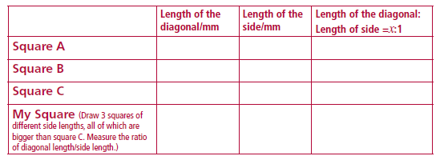
Section D: Student Activity 4
Measure the length of the side of each square in mm and the length of the diagonal in mm. Find the ratio of the length of the diagonal to the length of the side and write the equivalent ratio in the form x:1 where x is written correct to one decimal place.
What pattern have you observed?

Slide 19
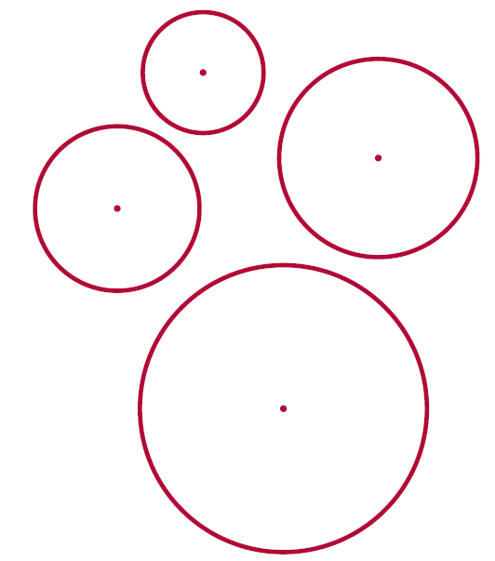
Section D: Student Activity 4
Measure the lengths of the diameters and circumferences of the following circles to the nearest millimetre. Find the ratio of the length of the circumference to the length of the diameter. What do you notice?
Draw another circle with a different diameter and again find the ratio of circumference to diameter. What do you notice? Put findings into a table of values.

Slide 20
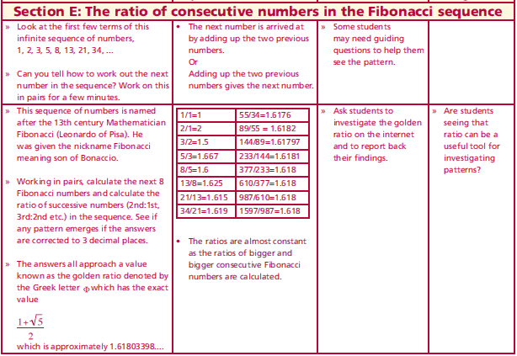
Section E:
Look at the first few terms of this infinite sequence of numbers, 1, 2, 3, 5, 8, 13, 21, 34, ...
Can you tell how to work out the next number in the sequence? Work on this in pairs for a few minutes.
This sequence of numbers is named after the 13th century Mathematician Fibonacci (Leonardo of Pisa). He was given the nickname Fibonacci meaning son of Bonaccio. Working in pairs, calculate the next 8 Fibonacci numbers and calculate the ratio of successive numbers (2nd:1st, 3rd:2nd etc.) in the sequence. See if any pattern emerges if the answers are corrected to 3 decimal places.
The answers all approach a value known as the golden ratio denoted by the Greek letter $Φ$ which has the exact value $\frac{1+\sqrt{5}}{2}$ which is approximately 1.61803398....
Lesson interaction

Slide 21
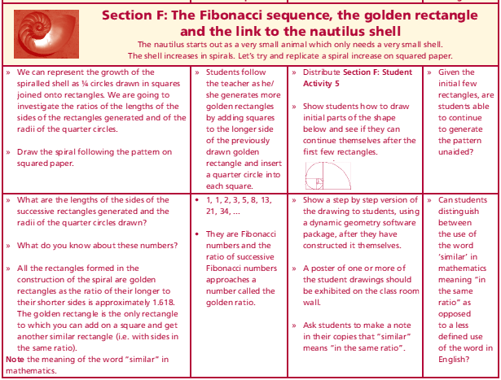
Section F: Student Activity 5
Lesson interaction

Slide 22
Section F: Student Activity 5
We can represent the growth of the spiralled shell as ¼ circles drawn in squares joined onto rectangles. We are going to investigate the ratios of the lengths of the sides of the rectangles generated and of the radii of the quarter circles.
Draw the spiral following the pattern on squared paper.
The nautilus starts out as a very small animal, which only needs a very small shell. As it grows it needs a bigger shell. Using squared paper, we can model a spiral growth using a square of side 1 unit in which we draw a ¼ circle representing the growth of the spiral.
As the spiral grows, draw another square of side 1 on top of the first one and draw ¼ of a circle in this, continuing on from the first quarter circle.
For the next stage of growth draw a square of side 2 beside the 2 small squares and draw a quarter circle in this square to represent the continued growth of the spiral.
Next draw a square of side 3 onto the rectangle formed by the first 3 squares and again draw a quarter circle in this square to show the continued growth of the spiral.
Lesson interaction

Slide 23
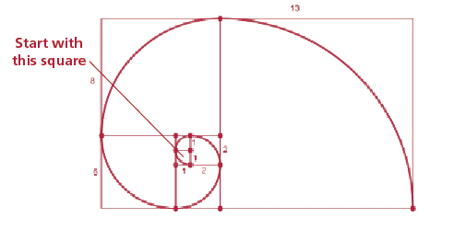
Section F: Student Activity 5
Then, a square of side 5 is annexed onto the 4 squares, (which forms a rectangle), and again the quarter circle is drawn to represent the spiral growth.
This pattern carries on, continuously annexing a square of side equal to the longer side of the last rectangle formed, (the sum of the sides of the last two squares formed), and filling a quarter circle into this square. ]
Lesson interaction

Slide 25
Section F: Student Activity 5
The spiral shape which we get is not a true spiral as it is made up of fragments which are parts of circles but it is a good approximation of spirals which are often seen in nature, like that of the nautilus shell.
What are the lengths of the sides of the successive rectangles generated and the radii of the quarter circles drawn?
Lesson interaction
Width | Length |  | Radii

Slide 27
Section F: Student Activity 5
The spiral shape which we get is not a true spiral as it is made up of fragments which are parts of circles but it is a good approximation of spirals which are often seen in nature, like that of the nautilus shell.
What are the lengths of the sides of the successive rectangles generated and the radii of the quarter circles drawn?
Lesson interaction
Width | Length |  | Radii
Width | Length |  | Radii
1 | 1 |  | 1
Width | Length |  | Radii
1 | 1 |  | 1
1 | 2 |  | 1
Width | Length |  | Radii
1 | 1 |  | 1
1 | 2 |  | 1
2 | 3 |  | 2
Width | Length |  | Radii
1 | 1 |  | 1
1 | 2 |  | 1
2 | 3 |  | 2
3 | 5 |  | 3
Width | Length |  | Radii
1 | 1 |  | 1
1 | 2 |  | 1
2 | 3 |  | 2
3 | 5 |  | 3
5 | 8 |  | 5
Width | Length |  | Radii
1 | 1 |  | 1
1 | 2 |  | 1
2 | 3 |  | 2
3 | 5 |  | 3
5 | 8 |  | 5
8 | 13 |  | 8
Width | Length |  | Radii
1 | 1 |  | 1
1 | 2 |  | 1
2 | 3 |  | 2
3 | 5 |  | 3
5 | 8 |  | 5
8 | 13 |  | 8
13 | 21 |  | 13
Width | Length | $$\frac{Length}{Width}$$ | Radii
1 | 1 |  | 1
1 | 2 |  | 1
2 | 3 |  | 2
3 | 5 |  | 3
5 | 8 |  | 5
8 | 13 |  | 8
13 | 21 |  | 13
Width | Length | $$\frac{Length}{Width}$$ | Radii
1 | 1 | 1 | 1
1 | 2 | 2 | 1
2 | 3 | 1.5 | 2
3 | 5 | 1.667 | 3
5 | 8 | 1.6 | 5
8 | 13 | 1.625 | 8
13 | 21 | 1.615 | 13

Slide 28
Section F: Student Activity 5
The spiral shape which we get is not a true spiral as it is made up of fragments which are parts of circles but it is a good approximation of spirals which are often seen in nature, like that of the nautilus shell.
What are the lengths of the sides of the successive rectangles generated and the radii of the quarter circles drawn?
What do you know about these numbers?
All the rectangles formed in the construction of the spiral are golden rectangles as the ratio of their longer to their shorter sides is approximately 1.618.
The golden rectangle is the only rectangle to which you can add on a square and get another similar rectangle (i.e. with sides in the same ratio).
Note the meaning of the word “similar” in mathematics.
Lesson interaction

Slide 29
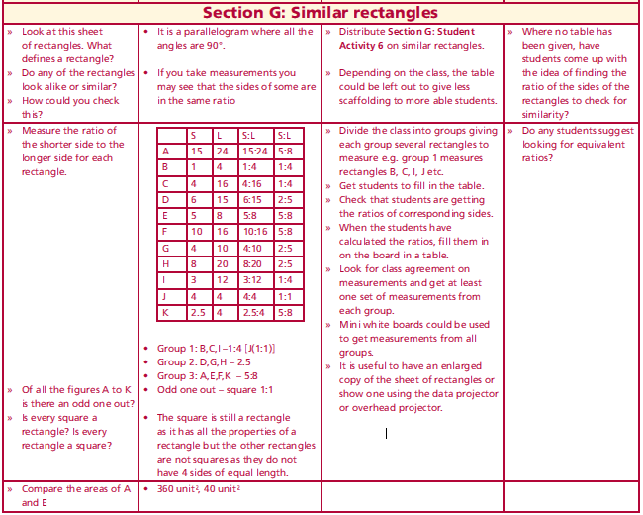
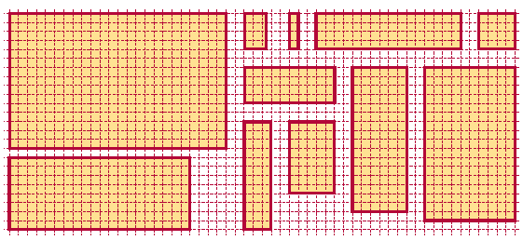
Section G: Student Activity 6
Which rectangles look-alike or are similar? Make a guess first and write down your guesses at the bottom of the page. Then justify by taking measurements of lengths of sides of each rectangle; short side (S) first, then longer side (L). (Use the length of a unit square on the grid as a unit of measurement.) Are there any odd ones out?
Lesson interaction

Slide 30
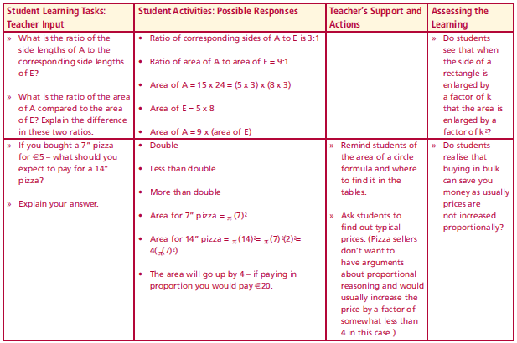
Lesson interaction
My guesses on which rectangles look-alike:_______________________
Having filled in the table above, which rectangles do I now think look-alike or are similar?
Put them into groups and say why you put them into these groups.
Group 1: ___________________ Why? ______________________________
Group 2: ___________________ Why? ______________________________
Group 3: ___________________ Why? ______________________________
Lesson interaction
If you bought a 7” pizza for €5 – what should you expect to pay for a 14” pizza? Explain your answer.

Slide 31
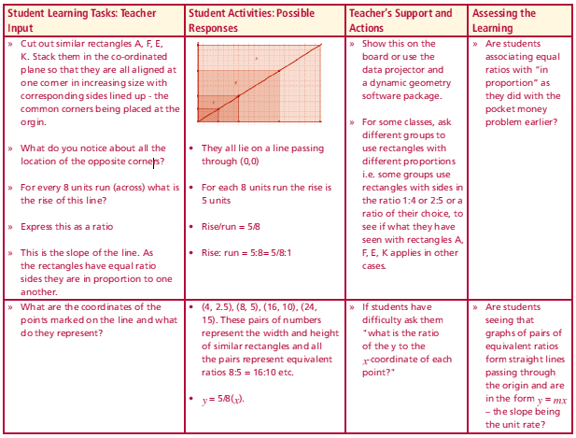
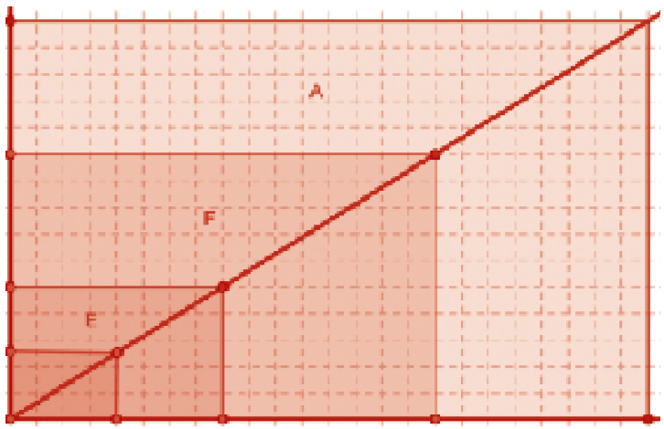
Cut out similar rectangles A, F, E, K. Stack them in the co-ordinated plane so that they are all aligned at one corner in increasing size with corresponding sides lined up - the common corners being placed at the origin.
Lesson interaction
What do you notice about all the location of the opposite corners?
For every 8 units run (across) what is the rise of this line?
Express this as a ratio
This is the slope of the line. As the rectangles have equal ratio sides they are in proportion to one another.
Lesson interaction
What are the coordinates of the points marked on the line and what do they represent?
Superimpose rectangle H (ratio of sides = 2:5) with one corner aligned with the other rectangles (ratio of sides = 2:5) – what do you notice?
Can you explain why this is so as 5 - 3 = 8 - 5?

Slide 32
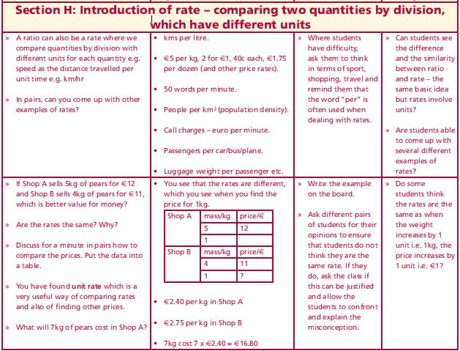
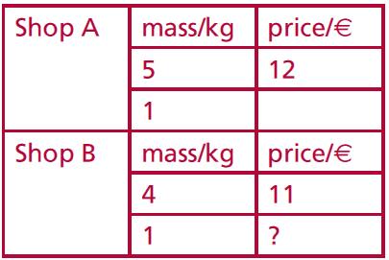
Section H: Introduction of rate – comparing two quantities by division, which have different units
Lesson interaction
A ratio can also be a rate where we compare quantities by division with different units for each quantity e.g. speed as the distance travelled per unit time e.g. km/hr.
In pairs, can you come up with other examples of rates?
If Shop A sells 5kg of pears for €12 and Shop B sells 4kg of pears for €11, which is better value for money?
Are the rates the same? Why?
Discuss for a minute in pairs how to compare the prices. Put the data into a table.
You have found unit rate which is a very useful way of comparing rates and also of finding other prices. What will 7kg of pears cost in Shop A?

Slide 33
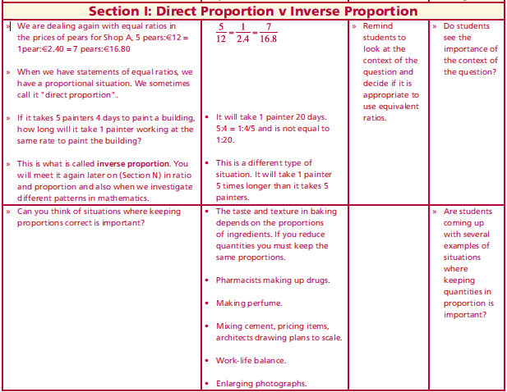
Section I: Direct Proportion v Inverse Proportion
We are dealing again with equal ratios in the prices of pears for Shop A, 5 pears: €12 = 1pear : €2.40 = 7 pears : €16.80
When we have statements of equal ratios, we have a proportional situation. We sometimes call it "direct proportion". If it takes 5 painters 4 days to paint a building, how long will it take 1 painter working at the same rate to paint the building?
This is what is called inverse proportion. You will meet it again later on Section N) in ratio and proportion and also when we investigate different patterns in mathematics.
Can you think of situations where keeping proportions correct is important?
I am making pastry. I need twice as much flour as I do butter. Express this as a ratio.
I only need a small amount of pastry and I only have 110g of flour. How much butter will I need?
Write these values as a ratio equivalent to the 2:1 ratio.
Lesson interaction
Lesson interaction

Slide 34
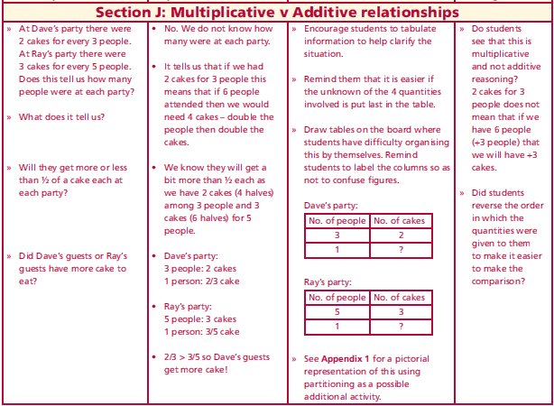
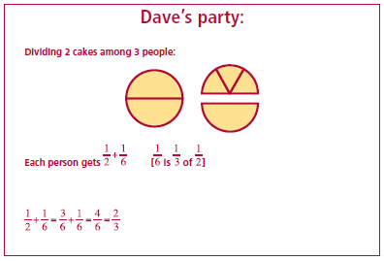
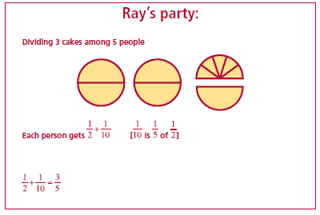
Section J: Multiplicative v Additive relationships
Lesson interaction
At Dave’s party there were 2 cakes for every 3 people. At Ray’s party there were 3 cakes for every 5 people. Does this tell us how many people were at each party? What does it tell us?
Will they get more or less than ½ of a cake each at each party?
Did Dave’s guests or Ray’s guests have more cake to eat?.

Slide 35
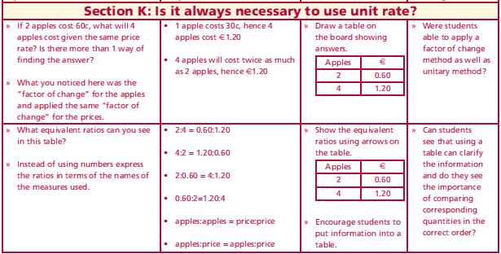
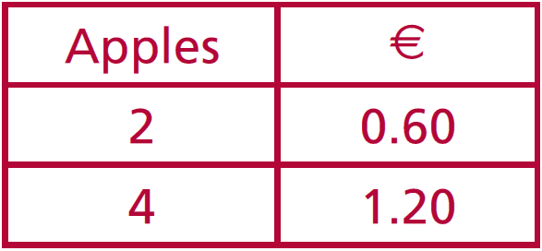
Section K: Is it always necessary to use unit rate?
Lesson interaction
If 2 apples cost 60c, what will 4 apples cost given the same price rate? Is there more than 1 way of finding the answer?
What you noticed here was the “factor of change” for the apples and applied the same “factor of change” for the prices.
What equivalent ratios can you see in this table?
Instead of using numbers express the ratios in terms of the names of the measures used.

Slide 36
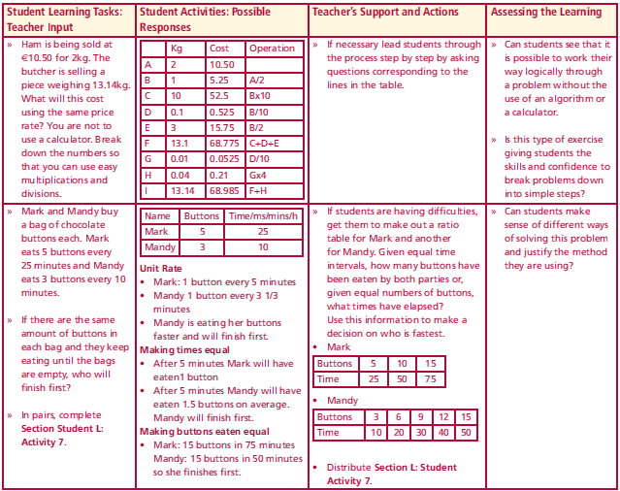
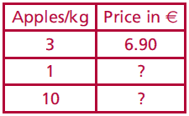
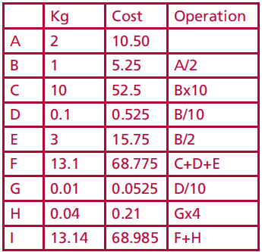
Section L: Introduction
Maeve bought 3kg of apples for €6.90. What would 10kg cost her at the same price rating? Work in pairs and use more than 1 method to solve this.
Which method is most efficient/user friendly and why do you think so?
Ham is being sold at €10.50 for 2kg. The butcher is selling a piece weighing 13.14kg. What will this cost using the same price rate? You are not to use a calculator. Break down the numbers so that you can use easy multiplications and divisions.
Lesson interaction
Lesson interaction

Slide 37
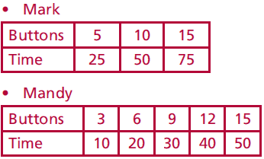
Section L: Introduction
Mark and Mandy buy a bag of chocolate buttons each. Mark eats 5 buttons every 25 minutes and Mandy eats 3 buttons every 10 minutes. If there are the same amount of buttons in each bag and they keep eating until the bags are empty, who will finish first?
Complete Section Student L:Activity 7.
Lesson interaction

Slide 38
Section L: Student Activity 7
1. In which of the following examples is the ratio of the number of apples to
the number of cents the same? How will you compare them?
Make out tables for the following questions to show the information given.
2. A shop is selling 4 apples for €2.
a) How much does one apple cost? b) How many apples will I get for €1?
c) How much will 7 apples cost?
3. If copies cost €5 for 10 copies, what will 25 copies cost? Work this out by
unit rate and by another method.
4. Luke bought 10 pens for €2.40. What would 12 pens cost him at the same
rate? Show two methods of working out the answer.
5. Five out of every eight students in a local college are living away from
home. Of the 200 students studying mathematics in the college, how
many will be living away from home if the same ratio is maintained?

Slide 39
5. Five out of every eight students in a local college are living away from home. Of the 200 students studying mathematics in the college, how many will be living away from home if the same ratio is maintained?
6. Elaine can cycle 4km in 14.7 minutes. How far can she cycle in 23 minutes if she keeps cycling at the same rate?
7. The Arts Council is funding a new theatre for the town. They have a scaled down model on show in the local library. The building is rectangular in shape. The dimensions of the model are 1m x 0.75m. If the longer side of the actual building is to be 40m, what will be the length of the shorter side? What is the ratio of the floor area of the actual building to the floor area of the model?
8. Aidan cycles 4km in 12 minutes. Karen can cycle 2km in 5 minutes. Which of them is cycling fastest? Explain. Give at least three different methods for finding the answer.

Slide 40
8. Aidan cycles 4km in 12 minutes. Karen can cycle 2km in 5 minutes. Which of them is cycling fastest? Explain. Give at least three different methods for finding the answer.
9. Which is the stronger coffee or do any of the following represent the same strength coffee?
a) 3 scoops of coffee added to 12 litres of water
b) 2 scoops of coffee added to 8 litres of water
c) 4 scoops of coffee added to 13 litres of water

Slide 41
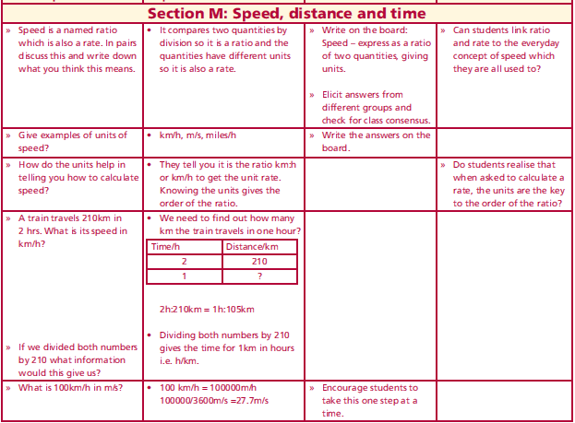
Section M: Introduction
Speed is a named ratio which is also a rate. In pairs discuss this and write down what you think this means.
Give examples of units of speed?
How do the units help in telling you how to calculate speed?
A train travels 210km in 2 hrs. What is its speed in km/h?
If we divided both numbers by 210 what information would this give us?
What is 100km/h in m/s?
Lesson interaction

Slide 42
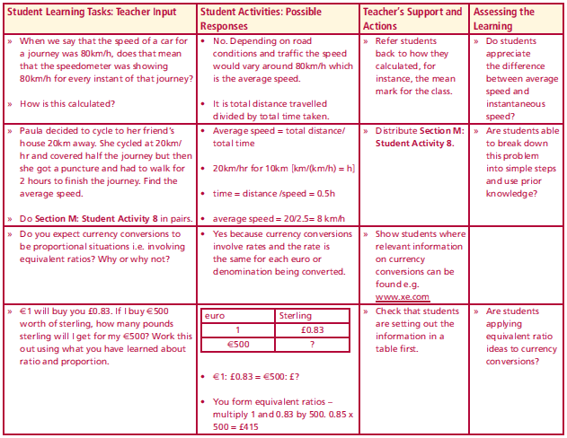
Section M: Introduction
When we say that the speed of a car for a journey was 80km/h, does that mean that the speedometer was showing 80km/h for every instant of that journey?
How is this calculated?
Paula decided to cycle to her friend’s house 20km away. She cycled at 20km/hr and covered half the journey but then she got a puncture and had to walk for 2 hours to finish the journey. Find the average speed.
Do Section M: Student Activity 8 in pairs.
Lesson interaction

Slide 43
Section M: Student Activity 8
1. Find the value of x in the following proportions:
$$a) 8:3 = 24:x b) 9:2 = x:12 c) 3:x = 15:10$$
$d) x:6 = 6:18 e) 9:12 = 6:x f) 3:2 = (x+5):x$
2. Eight cows graze a field of 2 hectares. Express this rate as hectares/cow.
Express it as cows/hectare.
3. The average fuel consumption of Joe’s Audi A1 1.4 TF SI is approximately 18 km/litre. Joe fills the tank with 40 litres of fuel. How far can Joe travel before the tank is empty? The average CO2 emission rate is 126 g/km. How many grams of CO2 are emitted by the car in consuming 40 litres of fuel?
4. If I travel 700km in 3.5 hours, express this as a rate in:
a) kilometres per hour b) kilometres per second c) metres per second
5. The speed of sound is approximately 340 m/s. Express this speed in km/hour.
6. Usain Bolt won the 200m in the Beijing Olympics in 19.30 seconds breaking Michael Johnson’s 1996 record by two hundredths of a second. What was his average speed in km/hour? What was Johnson’s average speed in km/hour?

Slide 44
5. The speed of sound is approximately 340 m/s. Express this speed in km/hour.
6. Usain Bolt won the 200m in the Beijing Olympics in 19.30 seconds breaking Michael Johnson’s 1996 record by two hundredths of a second. What was his average speed in km/hour? What was Johnson’s average speed in km/hour?
7. The legendary American racehorse Seabiscuit completed the 1.1875 mile long course at Pimlico Race Track in 1 minute 56.6 seconds. This was a track record at the time. What was his average speed in miles/hour correct to one decimal place?
8. Marian drives at a speed of 80km/hr for ¾ of an hour and at 100 km/ hour for 1.5 hours.
a) What distance has she travelled in total?
b) What is her average speed in km/hour?
9. Derek took half an hour to drive from Tullamore to Athlone. His average speed for the entire journey was 80km/hour. If his speed for 1/5 of the journey was 120 km/hour, find:
a) the time taken to drive this section of the journey
b) what his speed was, in km/hour, to the nearest whole number, for
the remainder of the journey if it was completed at a constant speed.

Slide 45
Section M: Student Activity 8 Homework/Class work
1. Patrick ran 4 laps of a track in 10 minutes. Ian ran 8 laps in 21 minutes.
Who ran fastest? Explain.
2. Compare the performance of 2 players, David and Andy. David scored 20 goals out of 40 shots at goal whereas Andy scored 25 goals out of 50 shots at goal.
3. In the car park there are 12 silver cars and 8 blue cars.
a) What is the ratio of silver cars to blue cars in its simplest terms?
b) What is the ratio of blue cars to silver cars in its simplest terms?
4. Which is the better deal: €18 for 3 bracelets or €30 for 5 bracelets?
5. Which is the better deal: 4 hours worked for €12 or 7 hours worked for €28? Discuss.

Slide 46
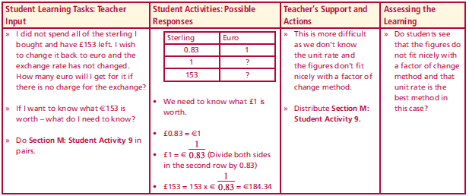
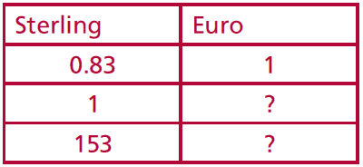
Section M: Activity 9 Introduction
Do you expect currency conversions to be proportional situations i.e. involving equivalent ratios? Why or why not?
€1 will buy you £0.83. If I buy €500 worth of sterling, how many pounds sterling will I get for my €500? Work this out using what you have learned about ratio and proportion.
I did not spend all of the sterling I bought and have £153 left. I wish to change it back to euro and the exchange rate has not changed.
How many euro will I get for it if there is no charge for the exchange? If I want to know what €153 is worth – what do I need to know?
Do Section M: Student Activity 9 in pairs.
Lesson interaction
Lesson interaction

Slide 47
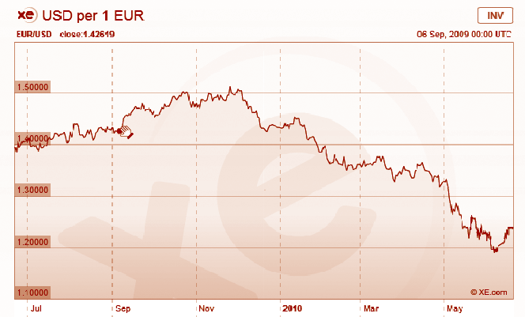
Section M: Student Activity 9
For currency conversion rates see: www.xe.com
Jean has a sister in America whom she planned to visit in May 2010. She had been watching the currency markets from July 2009 to May 2010 to decide when to buy US dollars (US$) for her trip.
a) When should she have bought dollars to give her the maximum amount of dollars for her euro in this period. Using the above chart, for reference
http://www.xe.com/currencycharts/?from=EUR&to=USD&view=1Y
b) Estimate from the chart the exchange rate at that time in US$/€.
c) How many US$ would she have got for €500 at that exchange rate?
d) Jean returned to Ireland in mid June 2010. Looking at the trend in the above chart do you think it was wise for her to change her leftover dollars to euro immediately? Explain.

Slide 48
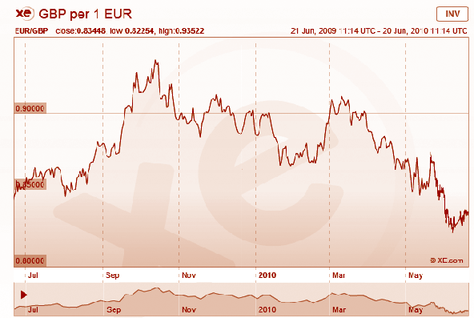
2. Some shoppers in the south of Ireland decided to shop in Northern
Ireland due to changes in the currency exchange rate between the euro
and pound sterling. Using the chart below, can you decide when they
would have benefited most from this decision? Justify your answer.

Slide 49
3. Tom works for Agrimachines in Carlow. He has made a deal with a customer in Northern Ireland to sell him a machine for €15,000. At the time the deal was made the euro was worth £0.89. When the customer was paying a short time later the euro had fallen from £0.89 to £0.83. Was this good news for the customer? Justify your answer by calculating how much he would have paid in pounds sterling at both exchange rates.
4. Without using a calculator determine how much a machine costing €10,000 in Carlow would cost a customer in Northern Ireland when the exchange rate is £0.83/€. How much would a machine costing €5,000 in Carlow cost in Northern Ireland at the same exchange rate? Hence, how many £ sterling correspond to €15,000?
5. Colette is a currency trader for National Bank. Each day she buys and sells currencies in order to make a profit. In order to trade profitably she needs to know the conversion rates for several currencies. Can you help her answer some of the questions she has to deal with on a particular day? (If you wish, you can insert the actual conversion rates on the day you are doing these questions by checking on www.xe.com or any other relevant site or source of information.)

Slide 50
5. Colette is a currency trader for National Bank. Each day she buys and sells currencies in order to make a profit. In order to trade profitably she needs to know the conversion rates for several currencies. Can you help her answer some of the questions she has to deal with on a particular day? (If you wish, you can insert the actual conversion rates on the day you are doing these questions by checking on www.xe.com or any other relevant site or source of information.)
a) Colette knows that on a particular day €1 buys 112.177 Japanese Yen. How much would it cost Colette’s bank to buy 1,000,000 Yen? Use a table to show the information.
b) The Thailand Baht (THB) is at a low of 0.38 Mexican Pesos (MXN). How many
THB can Colette purchase for 1,000,000 MXN?
c) Colette knows that one euro will buy 1.42 Australian Dollars (AUD). How many euros will 1AUD buy? The Australian Dollar has dropped from 1.79 AUD/€ to 1.42 AUD /€. Is this a good time for Colette to trade AUD for euro or euro for AUD? Justify your answer.

Slide 51
d) €1 will buy 57 Indian Rupees (INR). €1 will buy US$1.24 (USD). How many INR will one USD buy? Before calculating, predict whether it will be more or less than 57 INR.
e) Colette went on a trip to London. While shopping there, she saw a pair of shoes identical to a pair she had bought in Dublin for €88. In the London shop they cost £76. She knew that the exchange rate was £0.83/€. Which city was giving the better deal on the shoes? Explain.
f) From London Colette was due to visit Switzerland and then Norway. She decided to cancel her trip to Norway and changed the 1,000 Norwegian Kroner (NOK) she had for Swiss Francs (CHF). At the currency exchange she received 174.22 CHF for her 1,000 NOK (no commission charge included). How many Norwegian Kroner did 1 Swiss Franc buy?
g) Her hotel room in Zurich cost her 179 Swiss Francs per night. How much is this in euro if the exchange rate was €1 = 1.23 Swiss Francs? Predict first whether the answer in euro will be greater than or less than €179

Slide 52
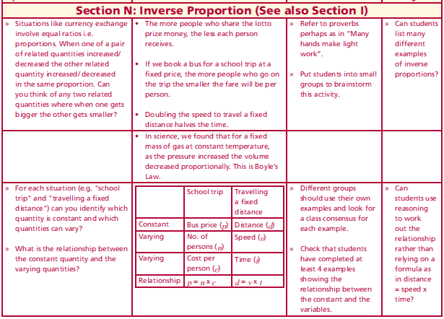
Section N: Inverse Proportion (See also Section I)
Lesson interaction
Situations like currency exchange involve equal ratios i.e. proportions. When one of a pair of related quantities increased/decreased the other related quantity increased/ decreased in the same proportion. Can you think of any two related quantities where when one gets bigger the other gets smaller?
For each situation (e.g. "school trip" and "travelling a fixed distance") can you identify which quantity is constant and which quantities can vary?
What is the relationship between the constant quantity and the varying quantities?
 | School trip | Travelling a fixed distance
Constant
Varying
Varying
Relationship

Slide 53
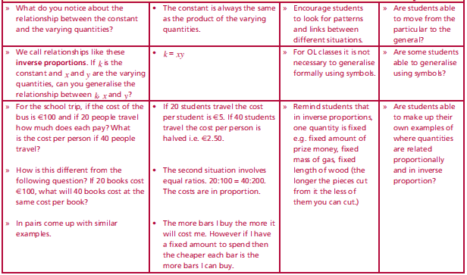
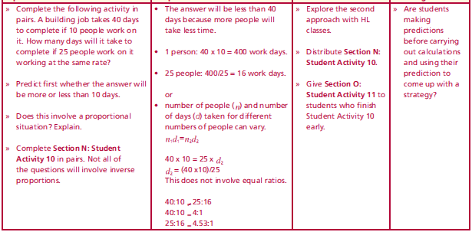
Section N: Inverse Proportion (See also Section I)
What do you notice about the relationship between the constant and the varying quantities?
We call relationships like these inverse proportions. If k is the constant and x and y are the varying quantities, can you generalise the relationship between k, x and y?
For the school trip, if the cost of the bus is €100 and if 20 people travel how much does each pay? What is the cost per person if 40 people travel?
How is this different from the following question? If 20 books cost €100, what will 40 books cost at the same cost per book?
In pairs come up with similar examples.
A building job takes 40 days to complete if 10 people work on it. How many days will it take to complete if 25 people work on it w1orking at the same rate? Predict first whether the answer will be more or less than 10 days.
Does this involve a proportional situation? Explain.
Complete Section N: Student Activity 10 in pairs. Not all of the questions will involve inverse proportions.
Lesson interaction
Lesson interaction

Slide 54
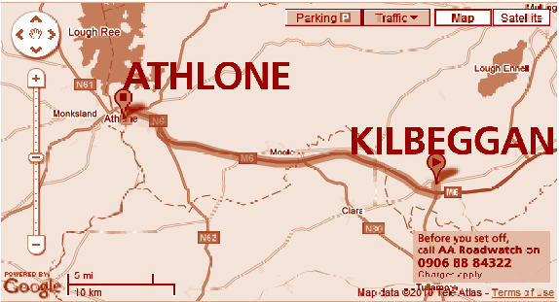
Section N: Student Activity 10
1. It takes 30 people 60 working days to build a small bridge. How many people
are needed if the bridge is to be built in 40 working days, assuming that they
all work at the same rate. First decide whether your answer will be more or
less than 30. How long would it take one person to build the bridge if it were
possible for them to do it alone?
2. Using the scale given on the
map to the right, work out the
distance between Kilbeggan and
Athlone in both km and miles.
Use this to find the approximate
ratio of miles to km in the form
1:n. Check that your answer is
close to the true ratio.
3. A prize of €10,000 is shared among 20 people. How much does each person
get? How much would each person get if the prize were shared among 80
people?

Slide 55
3. A prize of €10,000 is shared among 20 people. How much does each person
get? How much would each person get if the prize were shared among 80
people?
4. A group of workers in an office do the Lotto each week. One week they
won €400 and they received €16 each in prize money. If the prize had been
€2,800, how much would each one have received? Solve this problem in two
different ways.
5. A group of five tourists have sailed to a remote island, which has been cut off
from the mainland due to stormy weather. They have enough food for 5 days
if they eat 1kg per day. How many days will their food last if they eat (i) 200g
per day (ii) 1.5kg per day?
6. The scale on a map is 1: 20,000. Find the distance in centimetres on the map
representing an actual distance of 1km.
7. A room needs 500 tiles measuring 15cm x 15cm to cover the floor. How many
tiles measuring 25cm x 25cm would be needed to tile the same floor?

Slide 56
7. A room needs 500 tiles measuring 15cm x 15cm to cover the floor. How many
tiles measuring 25cm x 25cm would be needed to tile the same floor?
8. Two students go on holidays planning to spend €40 per day for a holiday
lasting 8 days. They end up spending €60 per day. How many days can the money last at this rate of spending?
9. Mark drives home in 2 hours if he drives at an average speed of 75km/h. If he
drives at an average speed of 80km/h, how long will the journey take him?
10. The water supply for a community is stored in a water tower. A pumping
station can fill the tower’s tank at 600 litres per minute in 3 hours if no water is being drawn from the tank. How long will the tank take to fill if water is being drawn off at the rate of (i) 200 litres per minute (ii) 400 litres per minute?

Slide 57
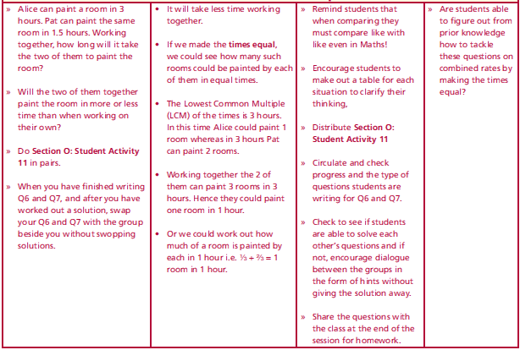
Section O : Introduction
Alice can paint a room in 3 hours. Pat can paint the same room in 1.5 hours. Working together, how long will it take the two of them to paint the room? Will the two of them together paint the room in more or less time than when working on their own?
Do Section O: Student Activity11 in pairs.
When you have finished writing Q6 and Q7, and after you have worked out a solution, swap your Q6 and Q7 with the group beside you without swopping solutions.
Lesson interaction

Slide 58
Section O: Student Activity 11
1. A chef can make 3 apple tarts in an hour. His helper can make 3 apple tarts in 2 hours. They need to make 27 apple tarts. How long will this take them working together?
2. Two taps are filling a bath. It takes one tap 4 minutes to fill the bath and the other tap 5 minutes. How long will it take to fill the bath with both taps filling at the given rates?
3. Olive has a report to type which is 10,000 words long. She can type at an average speed of 50 words per minute. How long will it take her to type the report typing at this speed? Her friend George can type at 60 words per minute. She gives George 3/5 of the report to type while she types the remainder. How long will it take now to type the report?
4. One combine harvester can harvest a field of corn in 4.5 hours. Another
harvester can harvest the same field in 3 hours. If the farmer uses the two
harvesters at the same time how long will it take to harvest the entire field?

Slide 59
4. One combine harvester can harvest a field of corn in 4.5 hours. Another
harvester can harvest the same field in 3 hours. If the farmer uses the two
harvesters at the same time how long will it take to harvest the entire field?
5. A fruit grower estimates that his crop of strawberries should yield 70 baskets.
His three children agree to pick the strawberries. On average, one child can pick 2 baskets in 1.5 hours, another child can pick 4 baskets in 2.5 hours and his third child can pick 5 baskets in 4 hours. How long will it take the 3 of them working together to pick 70 baskets of the fruit?
6. Write a question that involves combining 2 different rates.
7. Write a question that involves combining 3 different rates.

