Slide 1
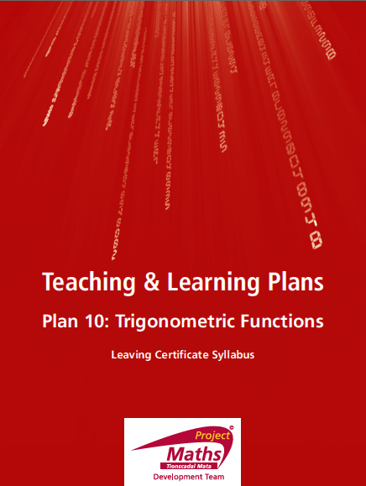

Slide 2
INDEX
Student Activity 1: | Introduction
Student Activity 2: | Angles in the first quadrant 0° < θ < 90°
Student Activity 3: | Angles in the second quadrant 90° < θ < 180°
Student Activity 4: | Angles in the third quadrant 180° < θ < 270°
Student Activity 5: | Angles in the fourth quadrant 270° < θ < 360°
Student Activity 6: | Summary on finding trig functions of all angles
Student Activity 7: | Solving trig equations
Reflection & Appendix

Slide 3
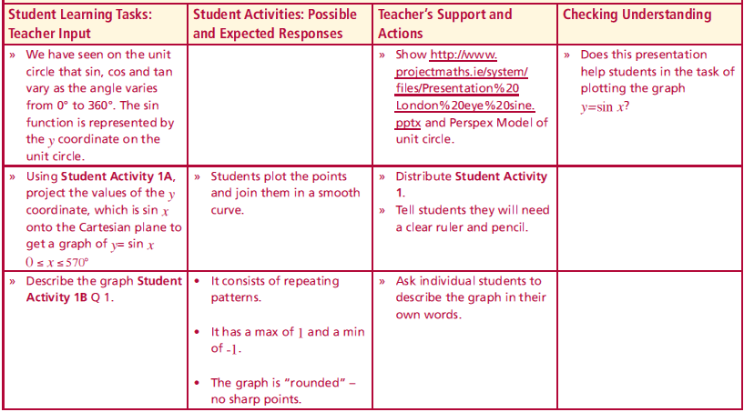
Student Activity 1: Introduction
We have seen on the unit circle that sin, cos and tan vary as the angle varies from 0° to 360°. The sin function is represented by the y coordinate on the unit circle.
Lesson interaction

Slide 4
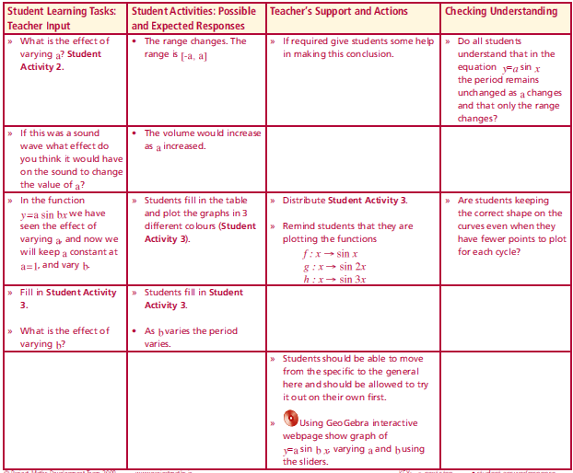
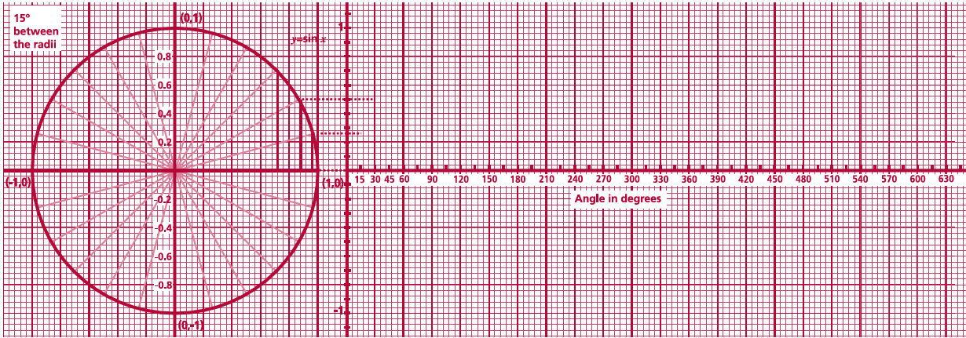
Student Activity 1: Introduction
Graph of y= sin x
Complete the projection of sin values from the unit circle onto the Cartesian plane on the right and then join the points with a smooth curve.
Lesson interaction

Slide 5
Student Activity 1: Introduction
Graph of y= sin x
Complete the projection of sin values from the unit circle onto the Cartesian plane on the right and then join the points with a smooth curve.
Lesson interaction

Slide 6
Student Activity 1: Introduction
Graph of y= sin x
Complete the projection of sin values from the unit circle onto the Cartesian plane on the right and then join the points with a smooth curve.
Lesson interaction

Slide 7
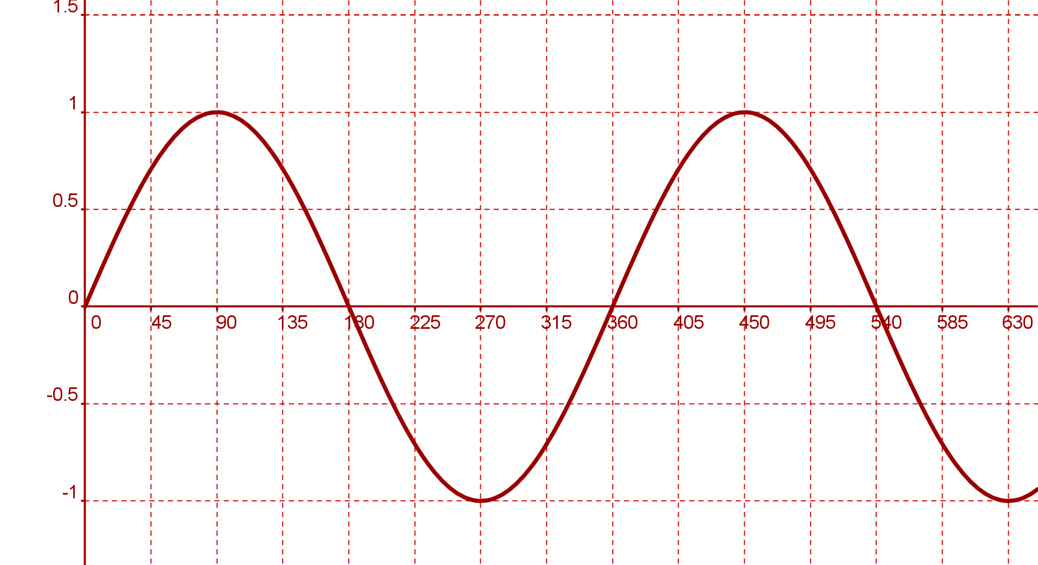
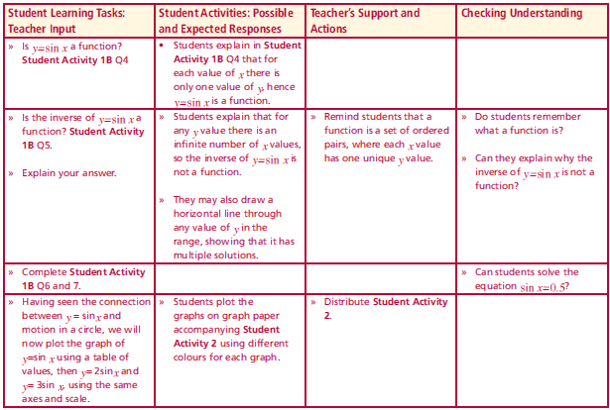
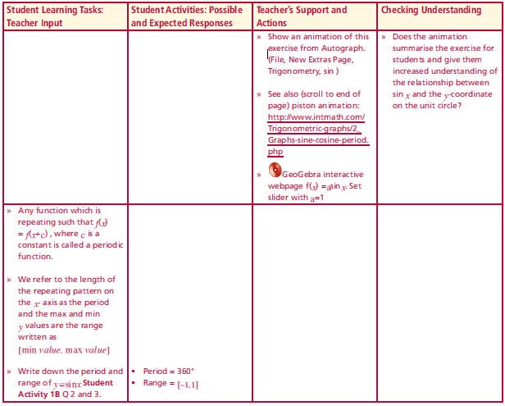
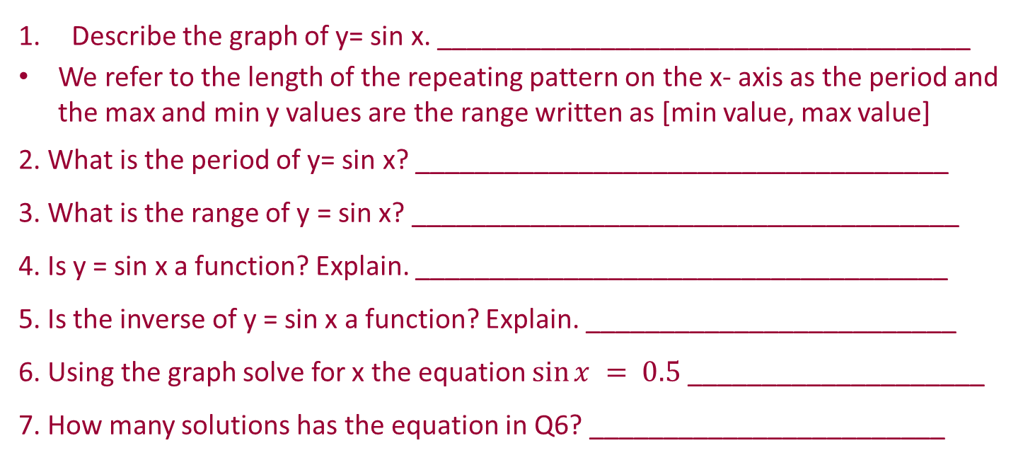
Student Activity 1: Introduction
Graph of $y= sin⁡x$
Lesson interaction
Describe the graph of y= sin x. ____________________________________
We refer to the length of the repeating pattern on the x- axis as the period and the max and min y values are the range written as [min value, max value]
2. What is the period of y= sin x? ____________________________________
3. What is the range of y = sin x? _____________________________________
4. Is y = sin x a function? Explain. ____________________________________
5. Is the inverse of y = sin x a function? Explain. _________________________
6. Using the graph solve for x the equation $sin⁡x = 0.5$____________________
7. How many solutions has the equation in Q6? ________________________
Lesson interaction

Slide 8
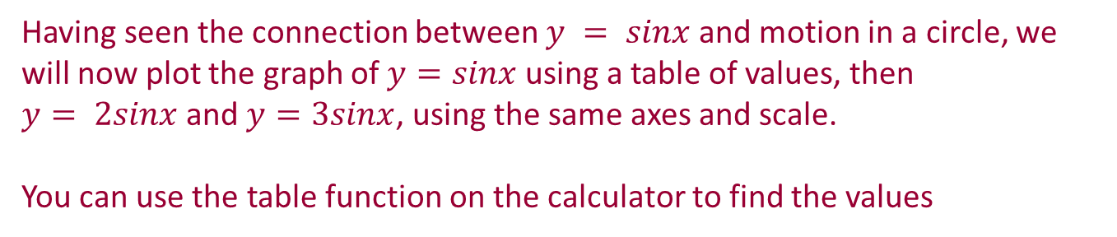
Student Activity 2
Having seen the connection between $y = sinx$and motion in a circle, we will now plot the graph of $y=sinx$using a table of values, then
$y= 2sinx$and $y=3sinx$, using the same axes and scale.
You can use the table function on the calculator to find the values

Slide 9
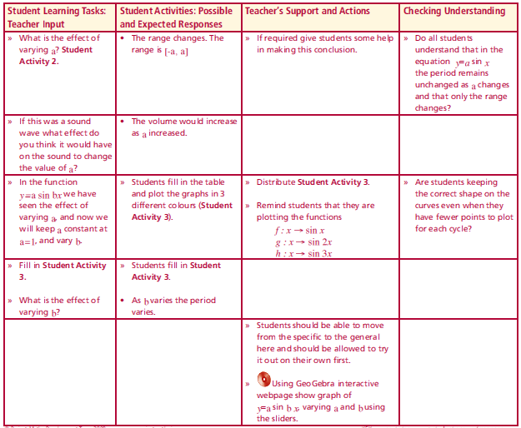
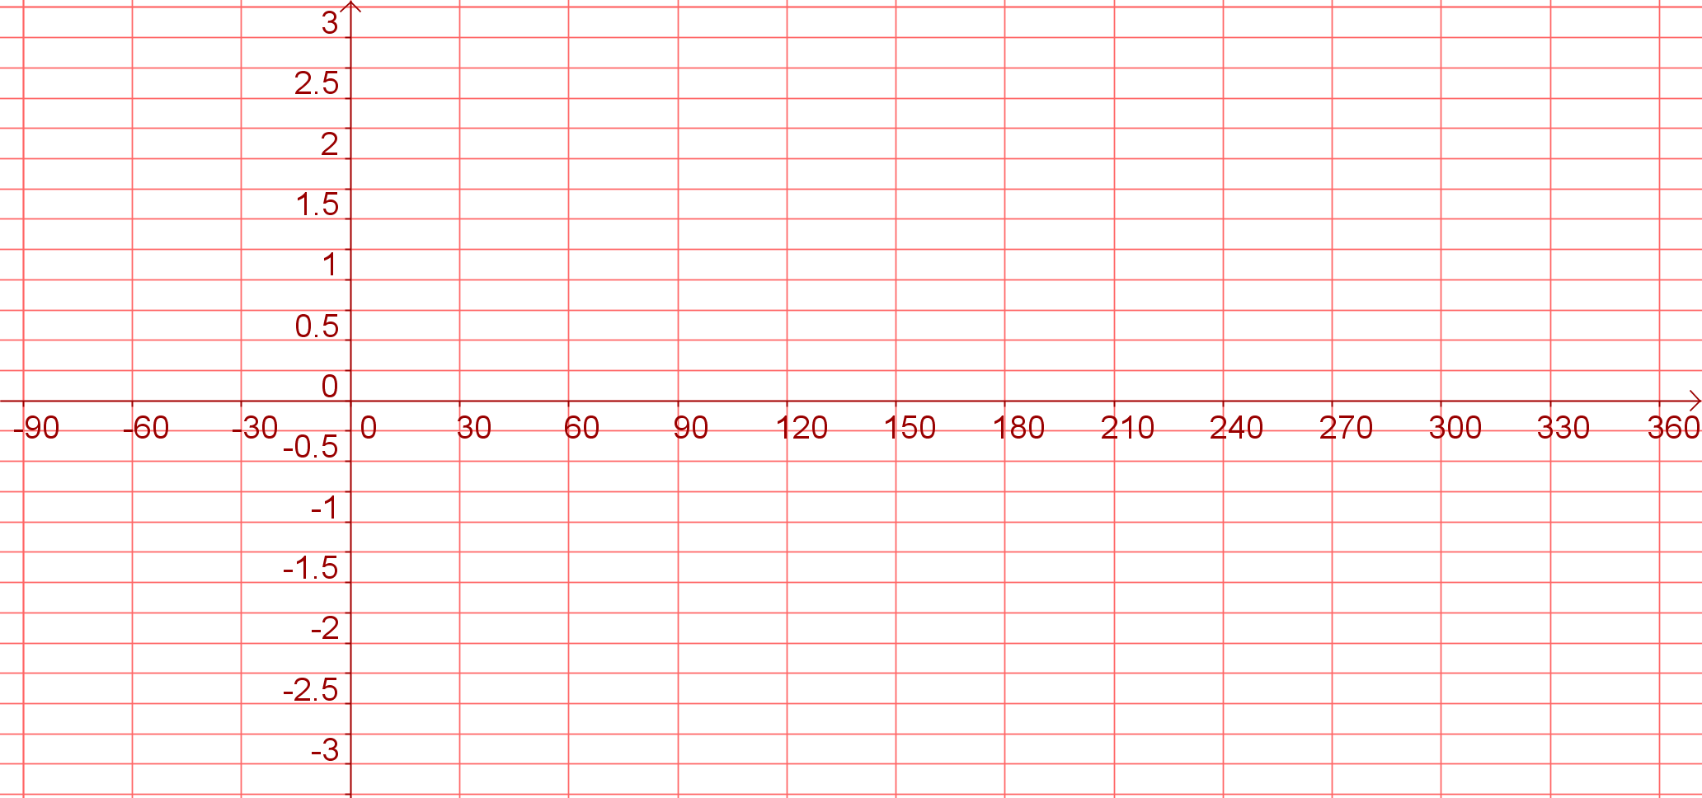
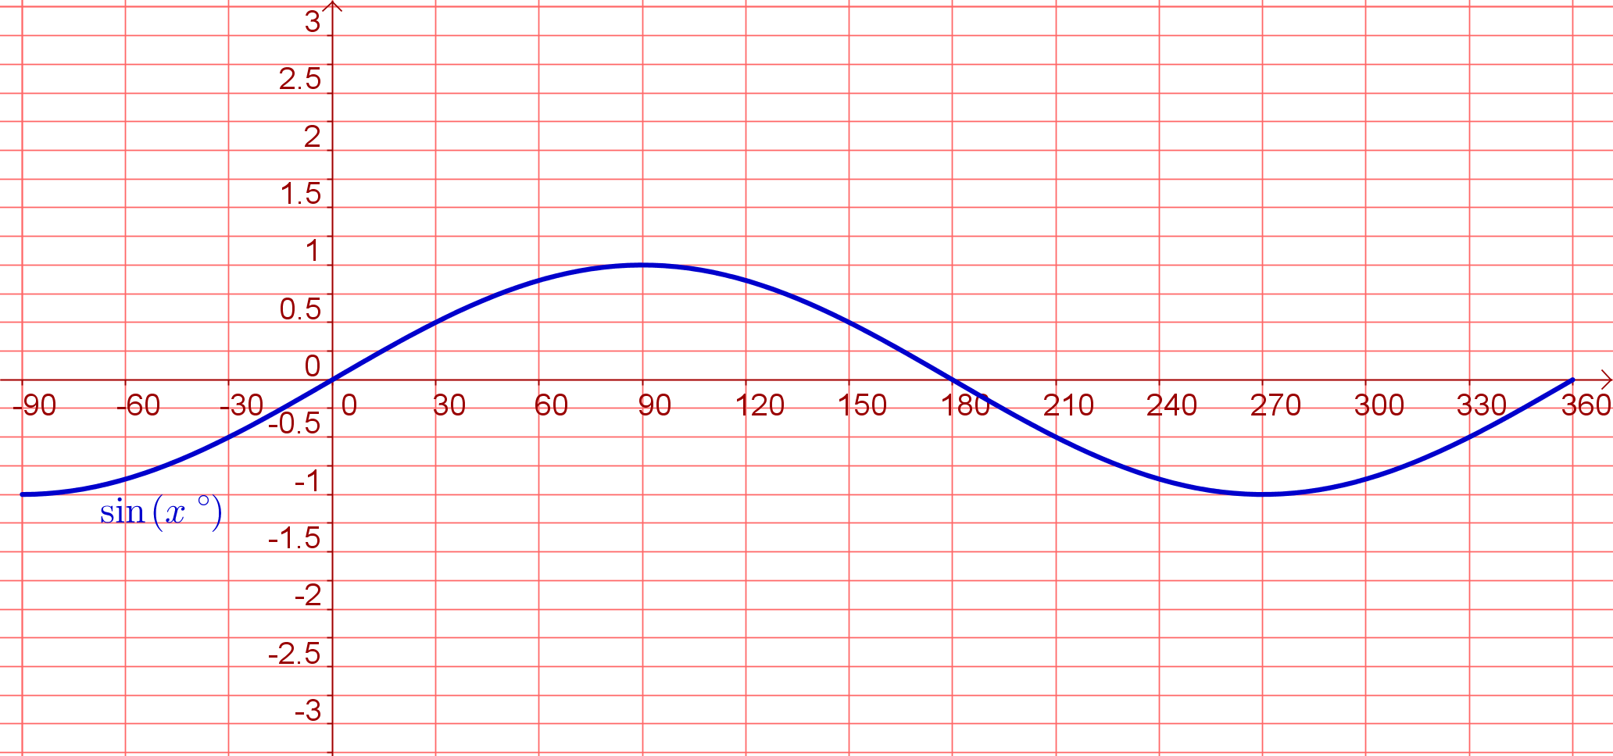
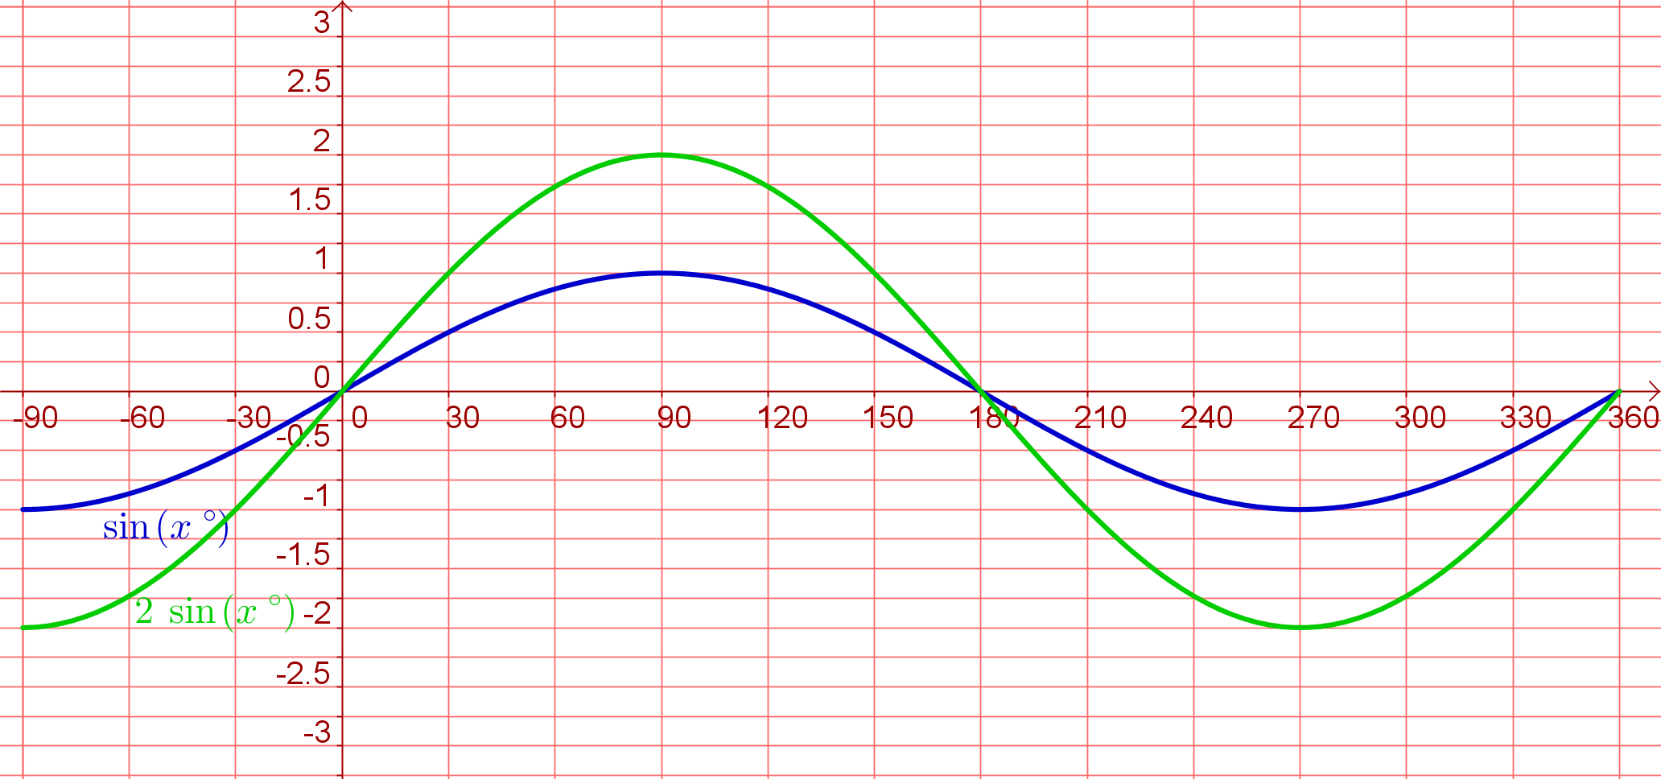
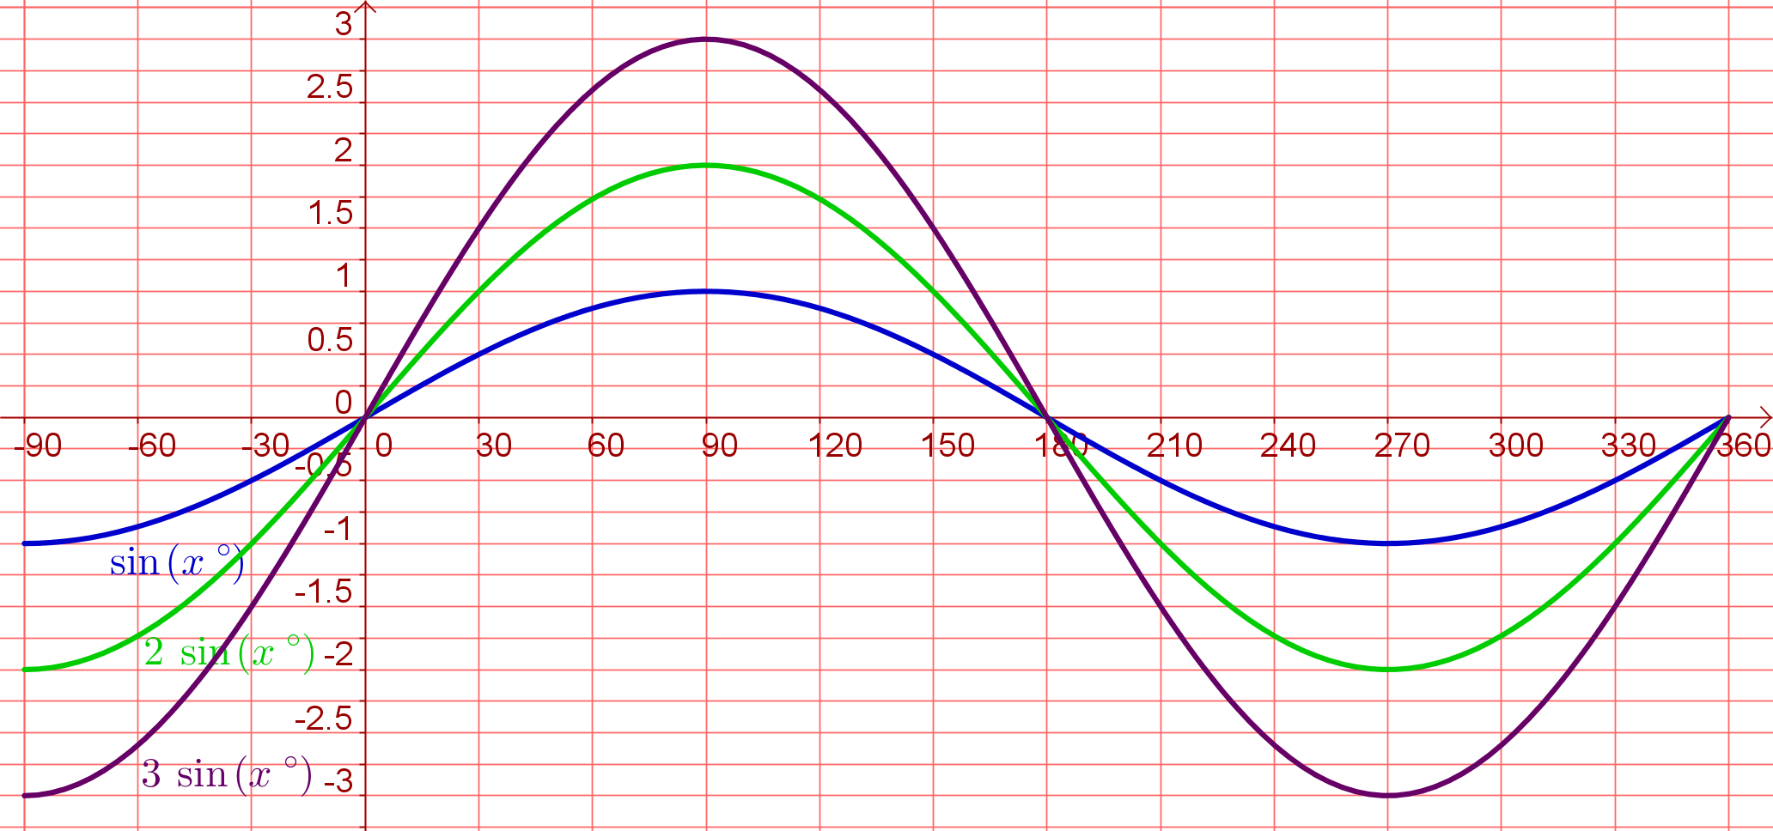
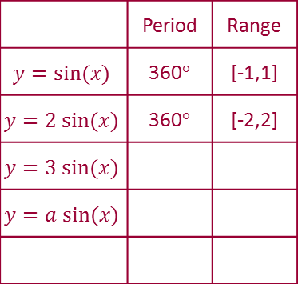
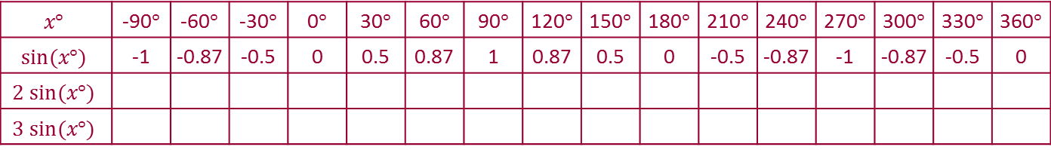
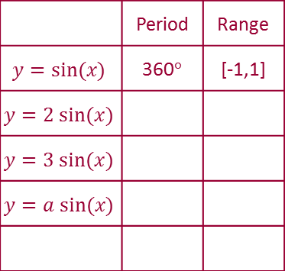
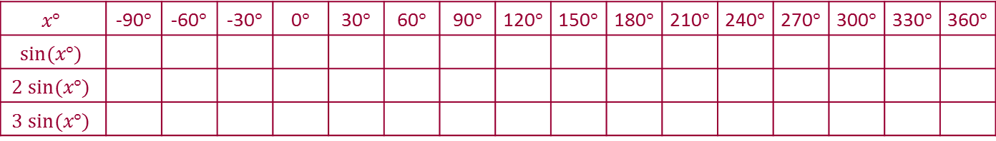
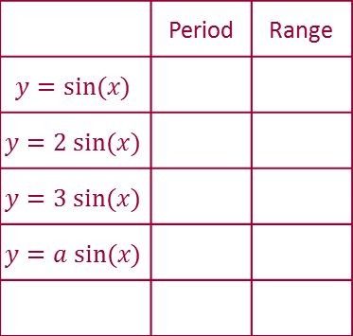
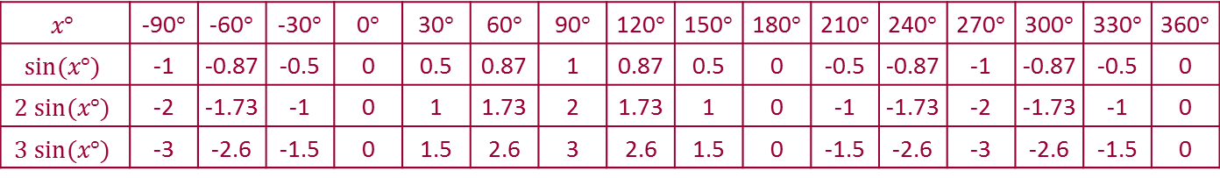
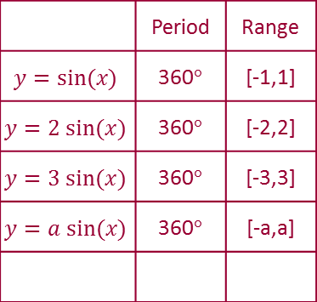
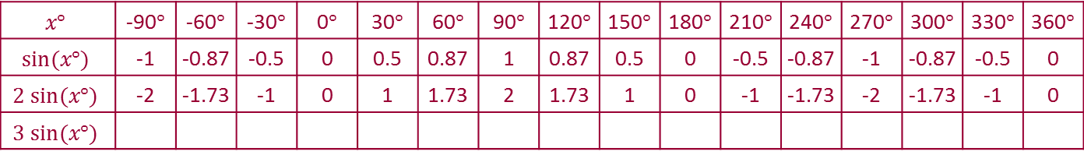
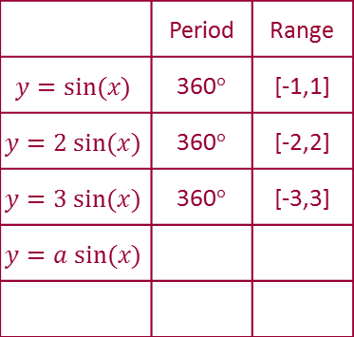
Student Activity 2
Using a calculator, or the unit circle, fill in the table for the following graphs and plot all of them using the same axes.
y = sin x, y = 2sin x, y = 3sin x
Use different colours for each graph.
Lesson interaction
$$x°$$ | -90$°$ | -60$°$ | -30$°$ | 0$°$ | 30$°$ | 60$°$ | 90$°$ | 120$°$ | 150$°$ | 180$°$ | 210$°$ | 240$°$ | 270$°$ | 300$°$ | 330$°$ | 360$°$
$$sin⁡(x°)$$
$$2 sin⁡(x°)$$
$$3 sin⁡(x°)$$
$$x°$$ | -90$°$ | -60$°$ | -30$°$ | 0$°$ | 30$°$ | 60$°$ | 90$°$ | 120$°$ | 150$°$ | 180$°$ | 210$°$ | 240$°$ | 270$°$ | 300$°$ | 330$°$ | 360$°$
$$sin⁡(x°)$$ | -1 | -0.87 | -0.5 | 0 | 0.5 | 0.87 | 1 | 0.87 | 0.5 | 0 | -0.5 | -0.87 | -1 | -0.87 | -0.5 | 0
$$2 sin⁡(x°)$$
$$3 sin⁡(x°)$$
$$x°$$ | -90$°$ | -60$°$ | -30$°$ | 0$°$ | 30$°$ | 60$°$ | 90$°$ | 120$°$ | 150$°$ | 180$°$ | 210$°$ | 240$°$ | 270$°$ | 300$°$ | 330$°$ | 360$°$
$$sin⁡(x°)$$ | -1 | -0.87 | -0.5 | 0 | 0.5 | 0.87 | 1 | 0.87 | 0.5 | 0 | -0.5 | -0.87 | -1 | -0.87 | -0.5 | 0
$$2 sin⁡(x°)$$ | -2 | -1.73 | -1 | 0 | 1 | 1.73 | 2 | 1.73 | 1 | 0 | -1 | -1.73 | -2 | -1.73 | -1 | 0
$$3 sin⁡(x°)$$
$$x°$$ | -90$°$ | -60$°$ | -30$°$ | 0$°$ | 30$°$ | 60$°$ | 90$°$ | 120$°$ | 150$°$ | 180$°$ | 210$°$ | 240$°$ | 270$°$ | 300$°$ | 330$°$ | 360$°$
$$sin⁡(x°)$$ | -1 | -0.87 | -0.5 | 0 | 0.5 | 0.87 | 1 | 0.87 | 0.5 | 0 | -0.5 | -0.87 | -1 | -0.87 | -0.5 | 0
$$2 sin⁡(x°)$$ | -2 | -1.73 | -1 | 0 | 1 | 1.73 | 2 | 1.73 | 1 | 0 | -1 | -1.73 | -2 | -1.73 | -1 | 0
$$3 sin⁡(x°)$$ | -3 | -2.6 | -1.5 | 0 | 1.5 | 2.6 | 3 | 2.6 | 1.5 | 0 | -1.5 | -2.6 | -3 | -2.6 | -1.5 | 0
 | Period | Range
$$y=sin⁡(x)$$
$$y=2 sin⁡(x)$$
$$y=3 sin⁡(x)$$
$$y=a sin⁡(x)$$
 | Period | Range
$$y=sin⁡(x)$$ | 360$°$ | [-1,1]
$$y=2 sin⁡(x)$$
$$y=3 sin⁡(x)$$
$$y=a sin⁡(x)$$
 | Period | Range
$$y=sin⁡(x)$$ | 360$°$ | [-1,1]
$$y=2 sin⁡(x)$$ | 360$°$ | [-2,2]
$$y=3 sin⁡(x)$$
$$y=a sin⁡(x)$$
 | Period | Range
$$y=sin⁡(x)$$ | 360$°$ | [-1,1]
$$y=2 sin⁡(x)$$ | 360$°$ | [-2,2]
$$y=3 sin⁡(x)$$ | 360$°$ | [-3,3]
$$y=a sin⁡(x)$$
 | Period | Range
$$y=sin⁡(x)$$ | 360$°$ | [-1,1]
$$y=2 sin⁡(x)$$ | 360$°$ | [-2,2]
$$y=3 sin⁡(x)$$ | 360$°$ | [-3,3]
$$y=a sin⁡(x)$$ | 360$°$ | [-a,a]

Slide 10
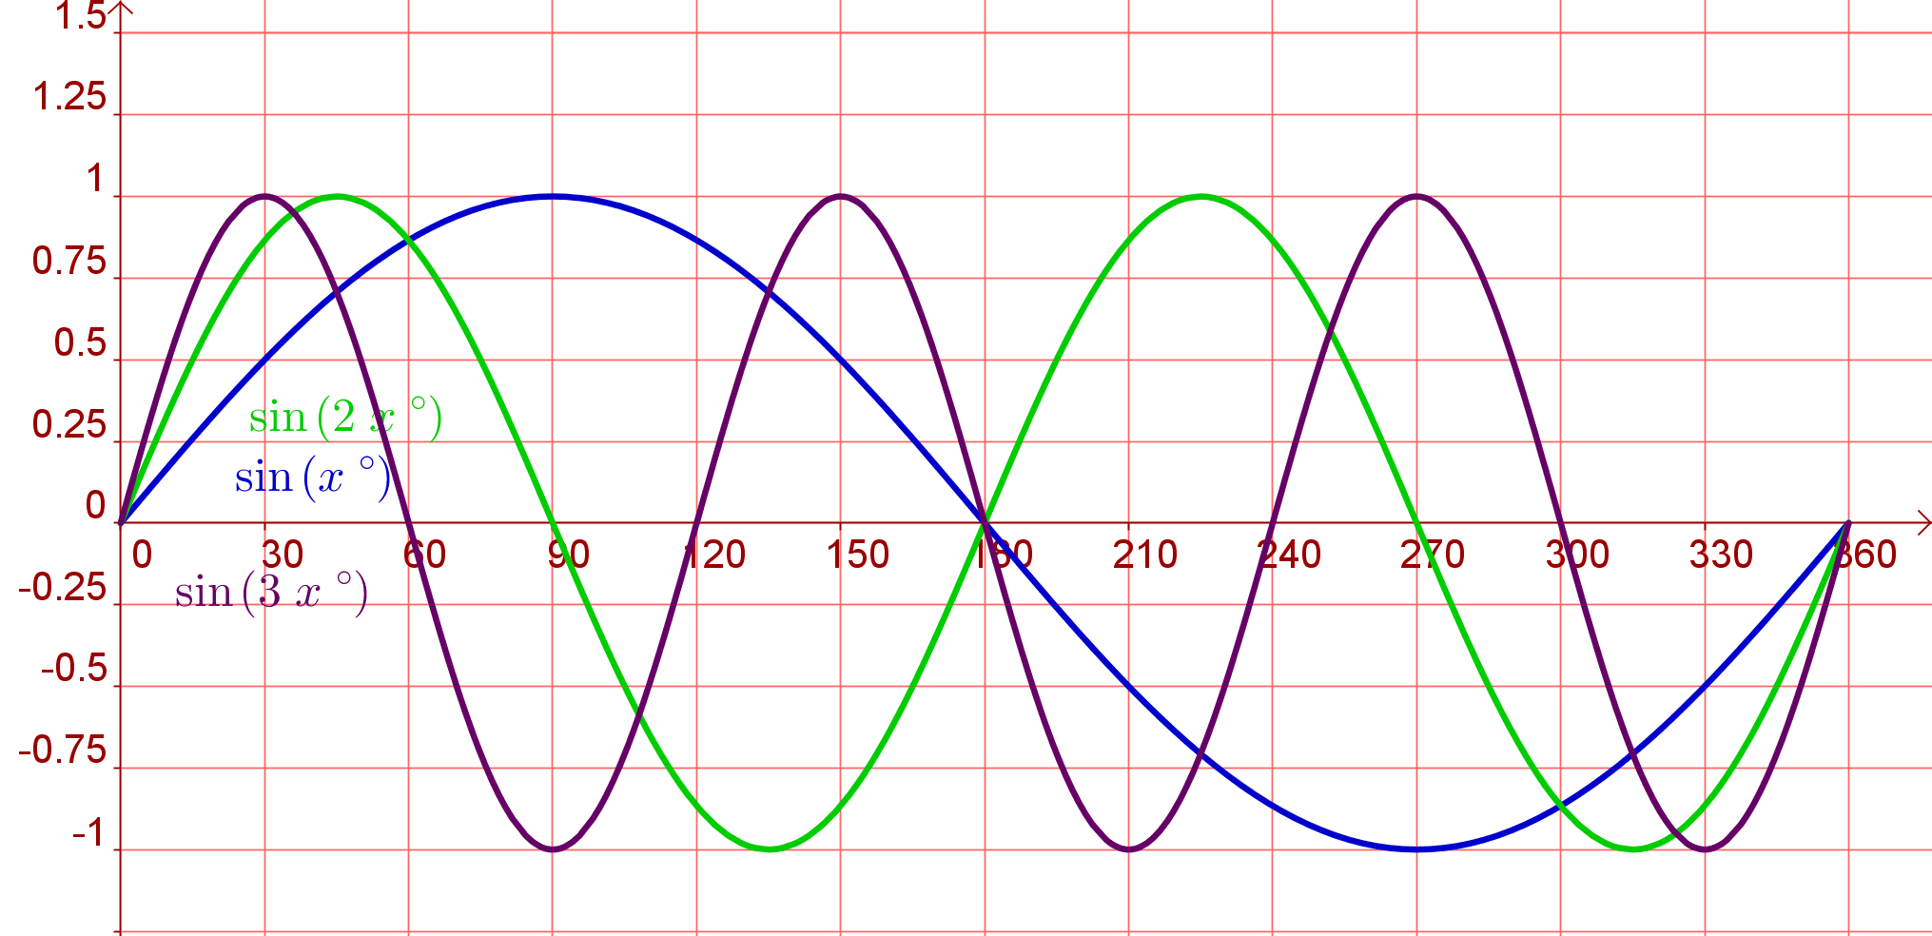
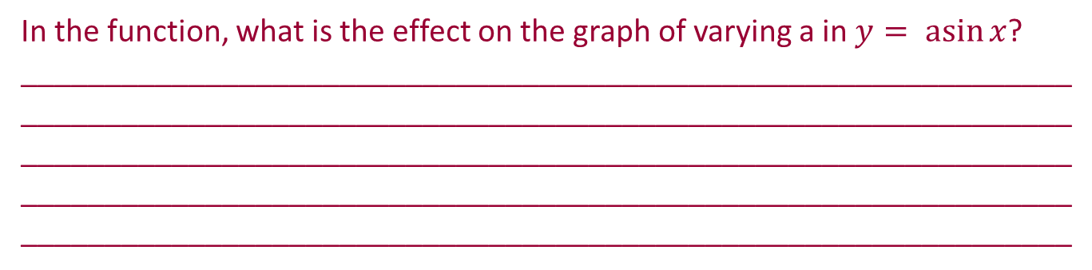

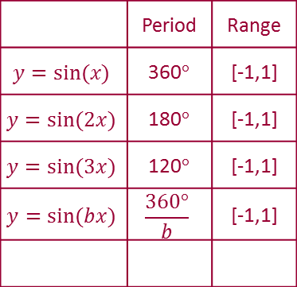
$$y= asin⁡x$$
 | Period | Range
$$y=sin⁡(x)$$ | 360$°$ | [-1,1]
$$y=sin⁡(2x)$$ | 180$°$ | [-1,1]
$$y=sin⁡(3x)$$ | 120$°$ | [-1,1]
$$y=sin⁡(bx)$$ | $$\frac{360°}{b}$$ | [-1,1]
Lesson interaction
In the function, what is the effect on the graph of varying a in $y= asin⁡x$? ___________________________________________________________________________________________________________________________________________________________________________________________________________________________________________________________________________________________________________________________

Slide 11
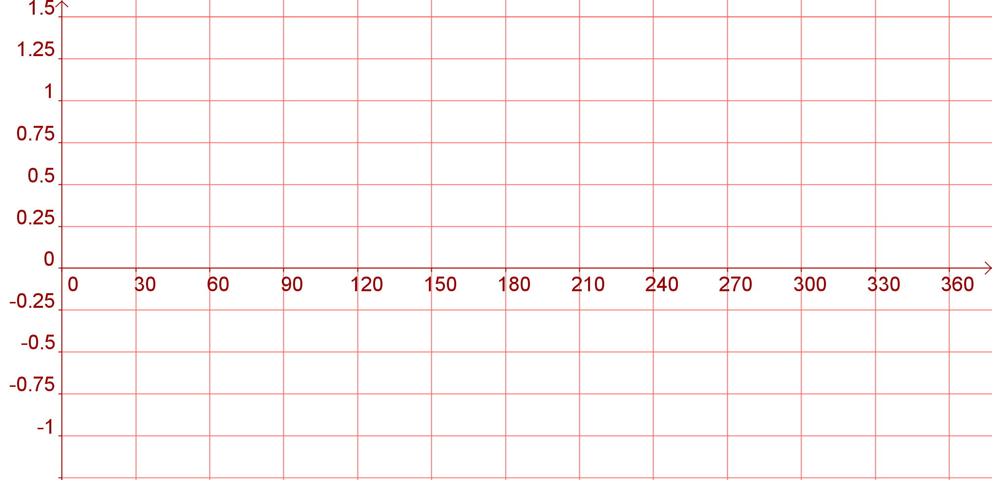
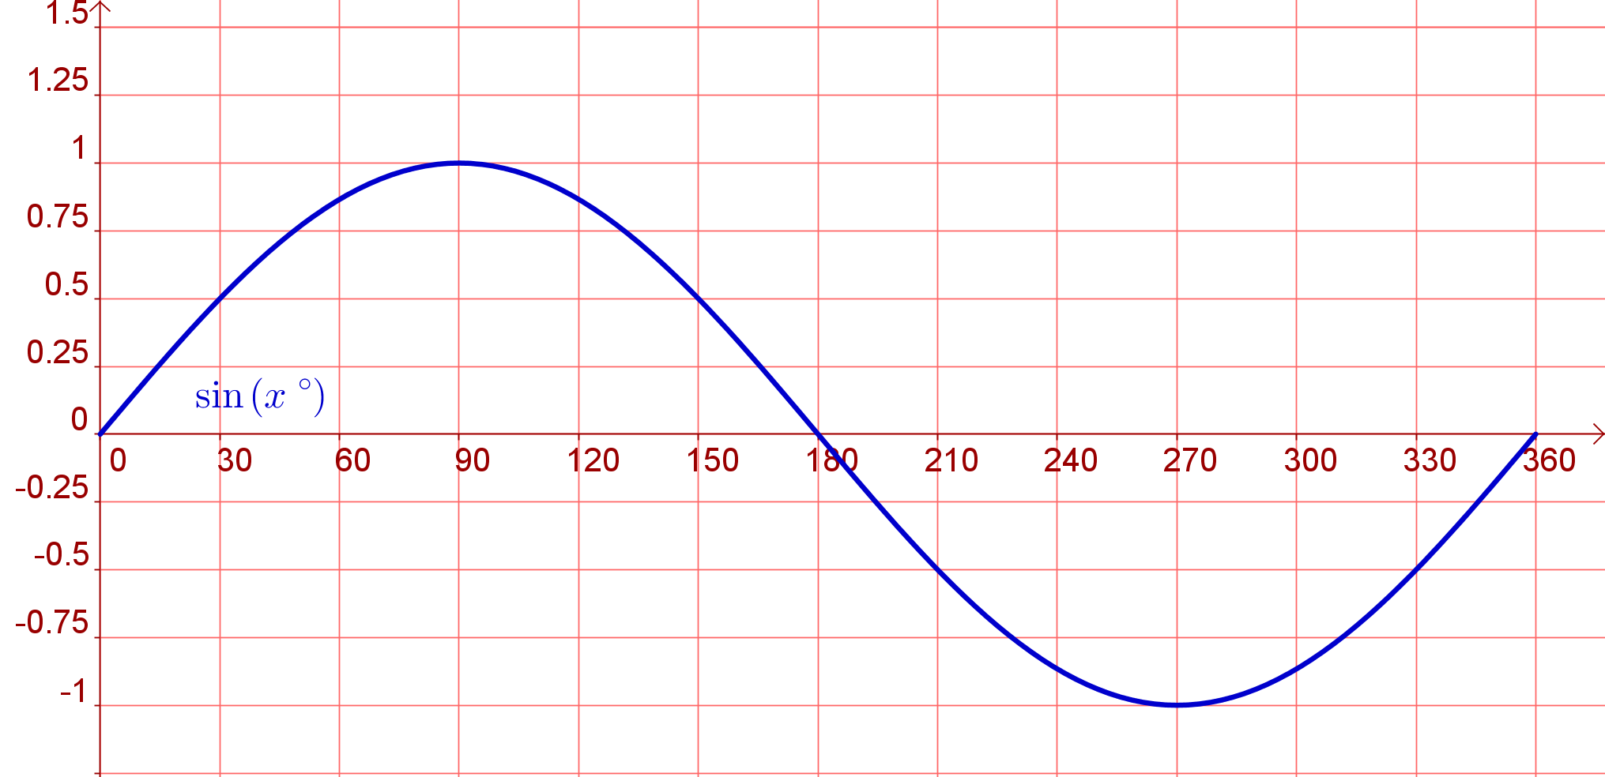
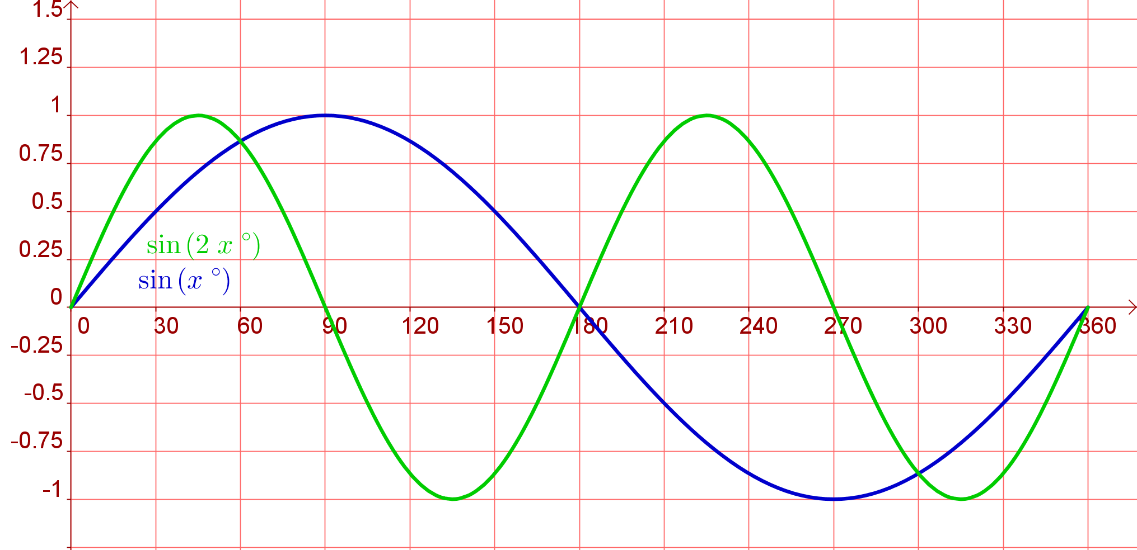
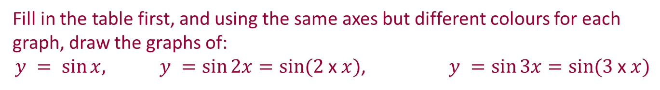
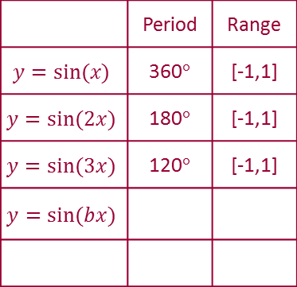
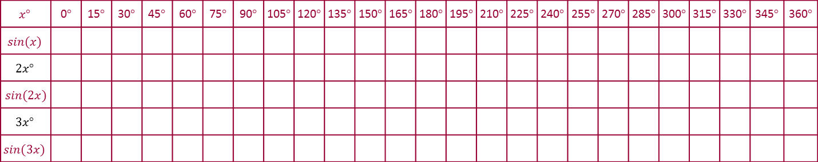

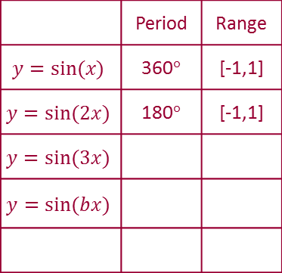
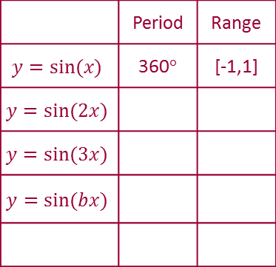
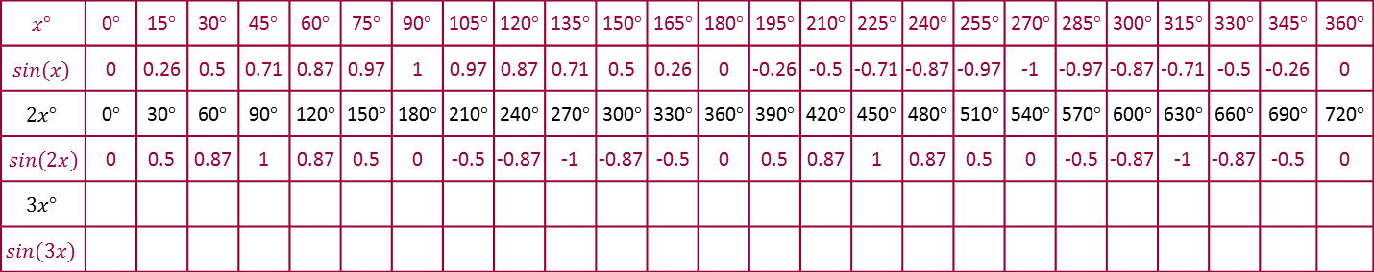
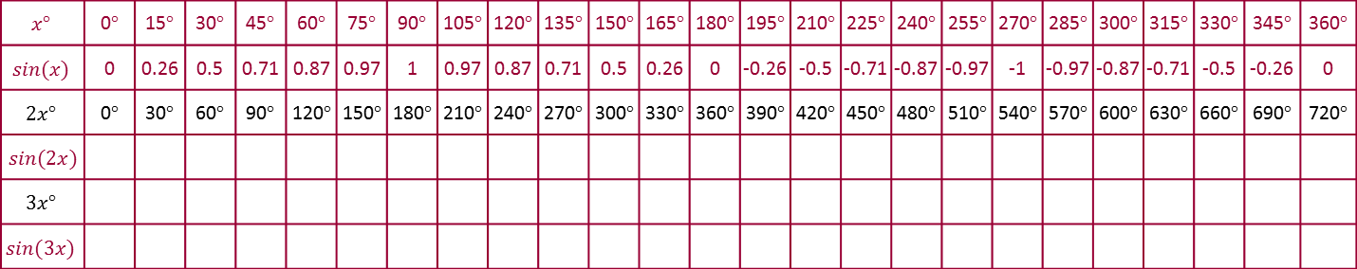
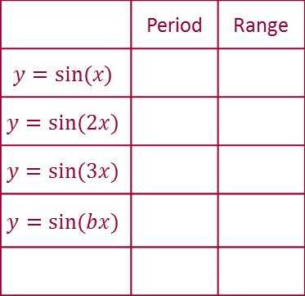
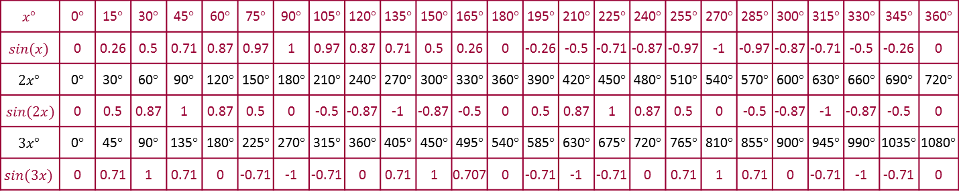
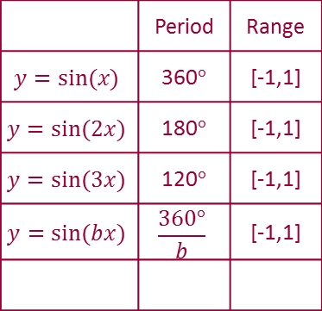
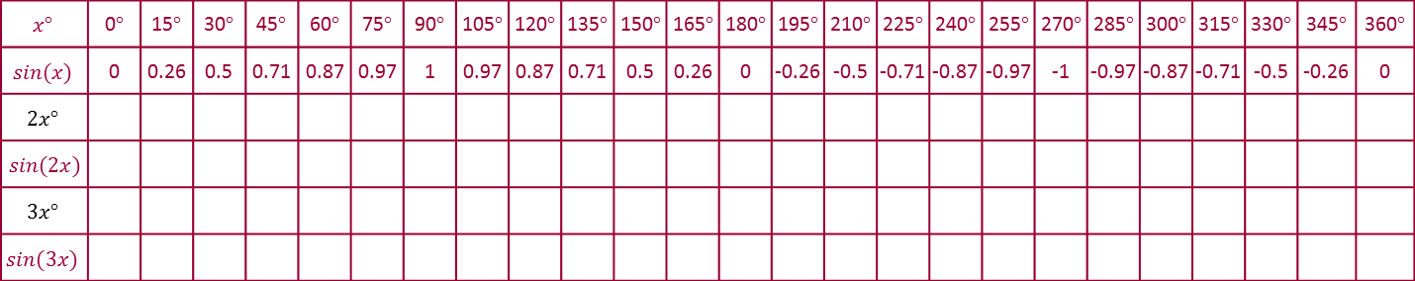
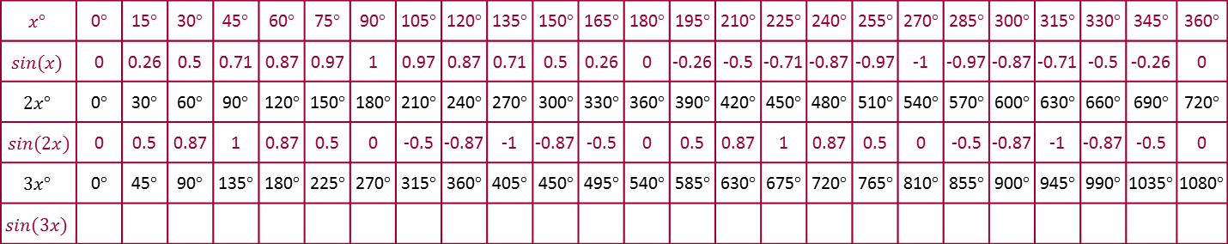
Student Activity 3
Graphs of the form $y = sin⁡bx$
Fill in the table first, and using the same axes but different colours for each graph, draw the graphs of:
$y = sin⁡x,$ $y =\sin{2x}=\sin{(2 \text{x} x)}$, $y =\sin{3x}=\sin{(3 \text{x} x)}$
$$x°$$ | 0$°$ | 15$°$ | 30$°$ | 45$°$ | 60$°$ | 75$°$ | 90$°$ | 105$°$ | 120$°$ | 135$°$ | 150$°$ | 165$°$ | 180$°$ | 195$°$ | 210$°$ | 225$°$ | 240$°$ | 255$°$ | 270$°$ | 285$°$ | 300$°$ | 315$°$ | 330$°$ | 345$°$ | 360$°$
$$sin⁡(x)$$
$$2x°$$
$$sin⁡(2x)$$
$$3x°$$
$$sin⁡(3x)$$
$$x°$$ | 0$°$ | 15$°$ | 30$°$ | 45$°$ | 60$°$ | 75$°$ | 90$°$ | 105$°$ | 120$°$ | 135$°$ | 150$°$ | 165$°$ | 180$°$ | 195$°$ | 210$°$ | 225$°$ | 240$°$ | 255$°$ | 270$°$ | 285$°$ | 300$°$ | 315$°$ | 330$°$ | 345$°$ | 360$°$
$$sin⁡(x)$$ | 0 | 0.26 | 0.5 | 0.71 | 0.87 | 0.97 | 1 | 0.97 | 0.87 | 0.71 | 0.5 | 0.26 | 0 | -0.26 | -0.5 | -0.71 | -0.87 | -0.97 | -1 | -0.97 | -0.87 | -0.71 | -0.5 | -0.26 | 0
$$2x°$$
$$sin⁡(2x)$$
$$3x°$$
$$sin⁡(3x)$$
$$x°$$ | 0$°$ | 15$°$ | 30$°$ | 45$°$ | 60$°$ | 75$°$ | 90$°$ | 105$°$ | 120$°$ | 135$°$ | 150$°$ | 165$°$ | 180$°$ | 195$°$ | 210$°$ | 225$°$ | 240$°$ | 255$°$ | 270$°$ | 285$°$ | 300$°$ | 315$°$ | 330$°$ | 345$°$ | 360$°$
$$sin⁡(x)$$ | 0 | 0.26 | 0.5 | 0.71 | 0.87 | 0.97 | 1 | 0.97 | 0.87 | 0.71 | 0.5 | 0.26 | 0 | -0.26 | -0.5 | -0.71 | -0.87 | -0.97 | -1 | -0.97 | -0.87 | -0.71 | -0.5 | -0.26 | 0
$$2x°$$ | 0$°$ | 30$°$ | 60$°$ | 90$°$ | 120$°$ | 150$°$ | 180$°$ | 210$°$ | 240$°$ | 270$°$ | 300$°$ | 330$°$ | 360$°$ | 390$°$ | 420$°$ | 450$°$ | 480$°$ | 510$°$ | 540$°$ | 570$°$ | 600$°$ | 630$°$ | 660$°$ | 690$°$ | 720$°$
$$sin⁡(2x)$$
$$3x°$$
$$sin⁡(3x)$$
$$x°$$ | 0$°$ | 15$°$ | 30$°$ | 45$°$ | 60$°$ | 75$°$ | 90$°$ | 105$°$ | 120$°$ | 135$°$ | 150$°$ | 165$°$ | 180$°$ | 195$°$ | 210$°$ | 225$°$ | 240$°$ | 255$°$ | 270$°$ | 285$°$ | 300$°$ | 315$°$ | 330$°$ | 345$°$ | 360$°$
$$sin⁡(x)$$ | 0 | 0.26 | 0.5 | 0.71 | 0.87 | 0.97 | 1 | 0.97 | 0.87 | 0.71 | 0.5 | 0.26 | 0 | -0.26 | -0.5 | -0.71 | -0.87 | -0.97 | -1 | -0.97 | -0.87 | -0.71 | -0.5 | -0.26 | 0
$$2x°$$ | 0$°$ | 30$°$ | 60$°$ | 90$°$ | 120$°$ | 150$°$ | 180$°$ | 210$°$ | 240$°$ | 270$°$ | 300$°$ | 330$°$ | 360$°$ | 390$°$ | 420$°$ | 450$°$ | 480$°$ | 510$°$ | 540$°$ | 570$°$ | 600$°$ | 630$°$ | 660$°$ | 690$°$ | 720$°$
$$sin⁡(2x)$$ | 0 | 0.5 | 0.87 | 1 | 0.87 | 0.5 | 0 | -0.5 | -0.87 | -1 | -0.87 | -0.5 | 0 | 0.5 | 0.87 | 1 | 0.87 | 0.5 | 0 | -0.5 | -0.87 | -1 | -0.87 | -0.5 | 0
$$3x°$$
$$sin⁡(3x)$$
$$x°$$ | 0$°$ | 15$°$ | 30$°$ | 45$°$ | 60$°$ | 75$°$ | 90$°$ | 105$°$ | 120$°$ | 135$°$ | 150$°$ | 165$°$ | 180$°$ | 195$°$ | 210$°$ | 225$°$ | 240$°$ | 255$°$ | 270$°$ | 285$°$ | 300$°$ | 315$°$ | 330$°$ | 345$°$ | 360$°$
$$sin⁡(x)$$ | 0 | 0.26 | 0.5 | 0.71 | 0.87 | 0.97 | 1 | 0.97 | 0.87 | 0.71 | 0.5 | 0.26 | 0 | -0.26 | -0.5 | -0.71 | -0.87 | -0.97 | -1 | -0.97 | -0.87 | -0.71 | -0.5 | -0.26 | 0
$$2x°$$ | 0$°$ | 30$°$ | 60$°$ | 90$°$ | 120$°$ | 150$°$ | 180$°$ | 210$°$ | 240$°$ | 270$°$ | 300$°$ | 330$°$ | 360$°$ | 390$°$ | 420$°$ | 450$°$ | 480$°$ | 510$°$ | 540$°$ | 570$°$ | 600$°$ | 630$°$ | 660$°$ | 690$°$ | 720$°$
$$sin⁡(2x)$$ | 0 | 0.5 | 0.87 | 1 | 0.87 | 0.5 | 0 | -0.5 | -0.87 | -1 | -0.87 | -0.5 | 0 | 0.5 | 0.87 | 1 | 0.87 | 0.5 | 0 | -0.5 | -0.87 | -1 | -0.87 | -0.5 | 0
$$3x°$$ | 0$°$ | 45$°$ | 90$°$ | 135$°$ | 180$°$ | 225$°$ | 270$°$ | 315$°$ | 360$°$ | 405$°$ | 450$°$ | 495$°$ | 540$°$ | 585$°$ | 630$°$ | 675$°$ | 720$°$ | 765$°$ | 810$°$ | 855$°$ | 900$°$ | 945$°$ | 990$°$ | 1035$°$ | 1080$°$
$$sin⁡(3x)$$
$$x°$$ | 0$°$ | 15$°$ | 30$°$ | 45$°$ | 60$°$ | 75$°$ | 90$°$ | 105$°$ | 120$°$ | 135$°$ | 150$°$ | 165$°$ | 180$°$ | 195$°$ | 210$°$ | 225$°$ | 240$°$ | 255$°$ | 270$°$ | 285$°$ | 300$°$ | 315$°$ | 330$°$ | 345$°$ | 360$°$
$$sin⁡(x)$$ | 0 | 0.26 | 0.5 | 0.71 | 0.87 | 0.97 | 1 | 0.97 | 0.87 | 0.71 | 0.5 | 0.26 | 0 | -0.26 | -0.5 | -0.71 | -0.87 | -0.97 | -1 | -0.97 | -0.87 | -0.71 | -0.5 | -0.26 | 0
$$2x°$$ | 0$°$ | 30$°$ | 60$°$ | 90$°$ | 120$°$ | 150$°$ | 180$°$ | 210$°$ | 240$°$ | 270$°$ | 300$°$ | 330$°$ | 360$°$ | 390$°$ | 420$°$ | 450$°$ | 480$°$ | 510$°$ | 540$°$ | 570$°$ | 600$°$ | 630$°$ | 660$°$ | 690$°$ | 720$°$
$$sin⁡(2x)$$ | 0 | 0.5 | 0.87 | 1 | 0.87 | 0.5 | 0 | -0.5 | -0.87 | -1 | -0.87 | -0.5 | 0 | 0.5 | 0.87 | 1 | 0.87 | 0.5 | 0 | -0.5 | -0.87 | -1 | -0.87 | -0.5 | 0
$$3x°$$ | 0$°$ | 45$°$ | 90$°$ | 135$°$ | 180$°$ | 225$°$ | 270$°$ | 315$°$ | 360$°$ | 405$°$ | 450$°$ | 495$°$ | 540$°$ | 585$°$ | 630$°$ | 675$°$ | 720$°$ | 765$°$ | 810$°$ | 855$°$ | 900$°$ | 945$°$ | 990$°$ | 1035$°$ | 1080$°$
$$sin⁡(3x)$$ | 0 | 0.71 | 1 | 0.71 | 0 | -0.71 | -1 | -0.71 | 0 | 0.71 | 1 | 0.707 | 0 | -0.71 | -1 | -0.71 | 0 | 0.71 | 1 | 0.71 | 0 | -0.71 | -1 | -0.71 | 0
 | Period | Range
$$y=sin⁡(x)$$
$$y=sin⁡(2x)$$
$$y=sin⁡(3x)$$
$$y=sin⁡(bx)$$
 | Period | Range
$$y=sin⁡(x)$$ | 360$°$ | [-1,1]
$$y=sin⁡(2x)$$
$$y=sin⁡(3x)$$
$$y=sin⁡(bx)$$
 | Period | Range
$$y=sin⁡(x)$$ | 360$°$ | [-1,1]
$$y=sin⁡(2x)$$ | 180$°$ | [-1,1]
$$y=sin⁡(3x)$$
$$y=sin⁡(bx)$$
 | Period | Range
$$y=sin⁡(x)$$ | 360$°$ | [-1,1]
$$y=sin⁡(2x)$$ | 180$°$ | [-1,1]
$$y=sin⁡(3x)$$ | 120$°$ | [-1,1]
$$y=sin⁡(bx)$$
 | Period | Range
$$y=sin⁡(x)$$ | 360$°$ | [-1,1]
$$y=sin⁡(2x)$$ | 180$°$ | [-1,1]
$$y=sin⁡(3x)$$ | 120$°$ | [-1,1]
$$y=sin⁡(bx)$$ | $$\frac{360°}{b}$$ | [-1,1]

Slide 12
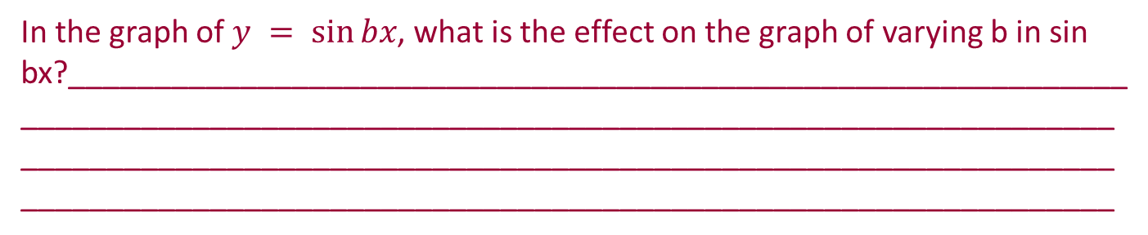


$$y = sin⁡bx$$
 | Period | Range
$$y=sin⁡(x)$$ | 360$°$ | [-1,1]
$$y=sin⁡(2x)$$ | 180$°$ | [-1,1]
$$y=sin⁡(3x)$$ | 120$°$ | [-1,1]
$$y=sin⁡(bx)$$ | $$\frac{360°}{b}$$ | [-1,1]
In the graph of $y = sin⁡bx$, what is the effect on the graph of varying b in sin bx?______________________________________________________________________________________________________________________________________________________________________________________________________________________________________________________________

Slide 13
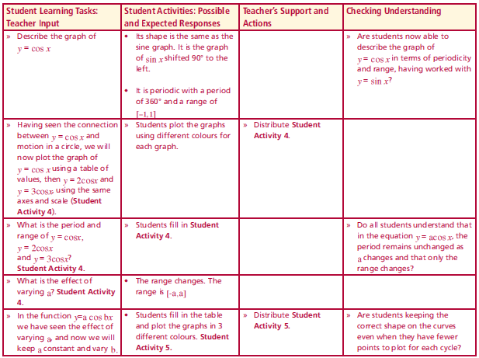
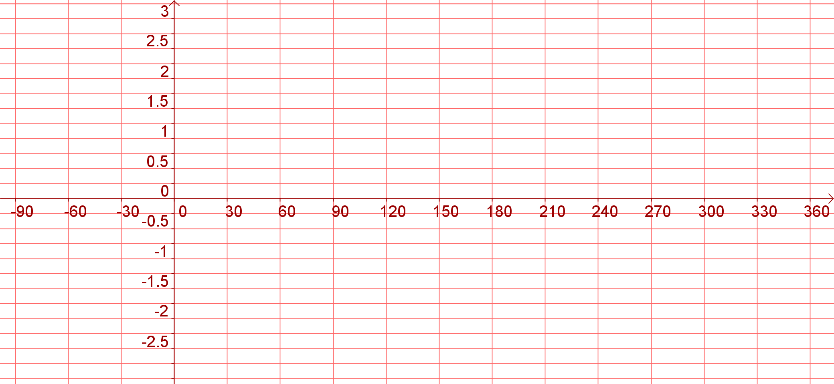
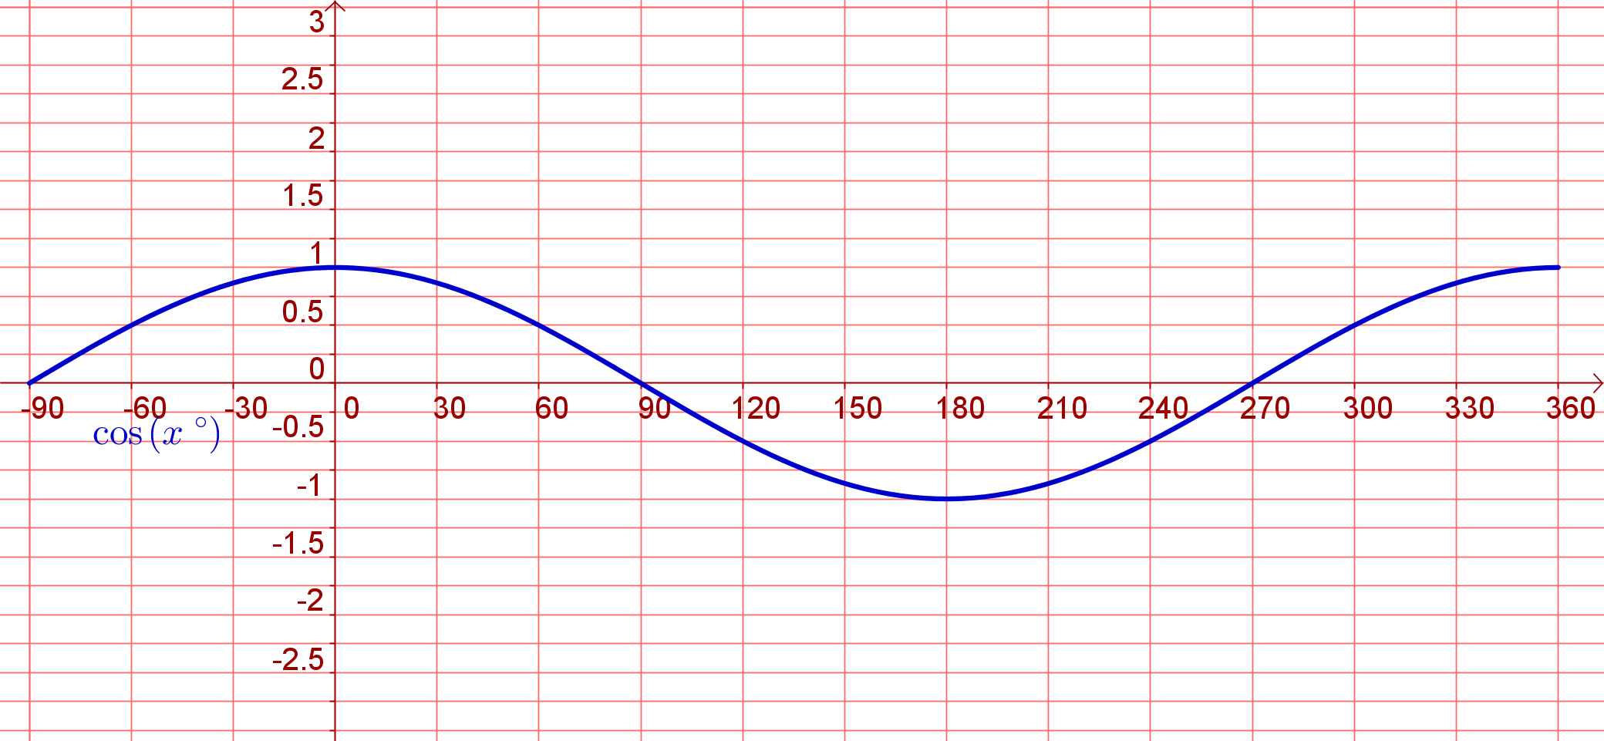
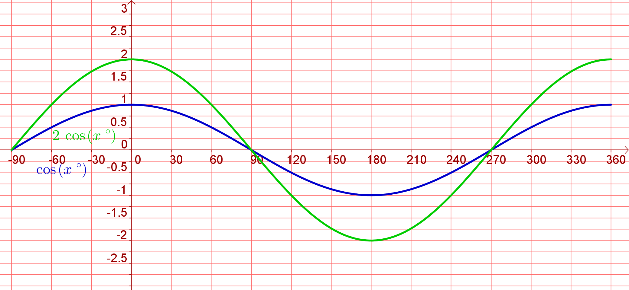
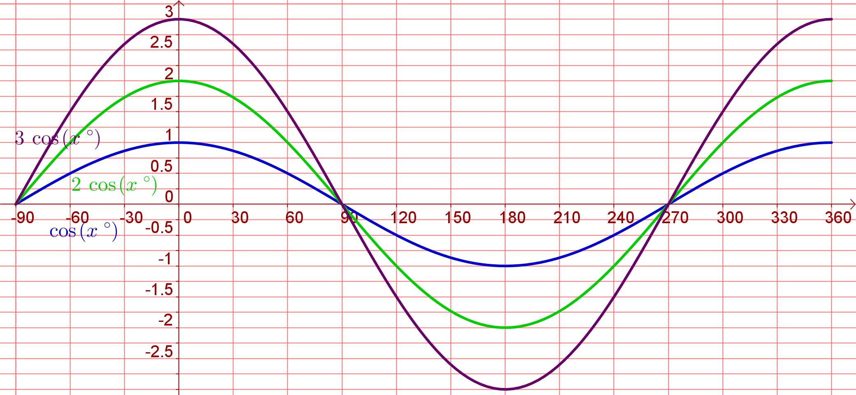
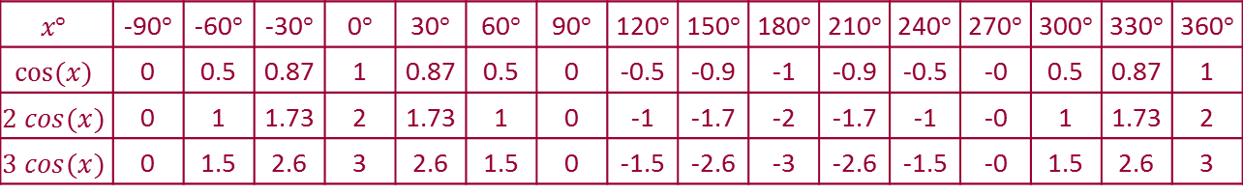
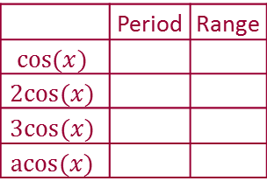
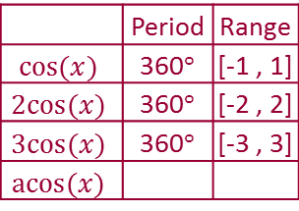







Student Activity 4
Using a table, find the coordinates for the following graphs and plot all of them using the same axes:
$$y = cos⁡x, y = 2cos⁡x, y =3cos⁡x$$
Lesson interaction
$$x°$$ | -90$°$ | -60$°$ | -30$°$ | 0$°$ | 30$°$ | 60$°$ | 90$°$ | 120$°$ | 150$°$ | 180$°$ | 210$°$ | 240$°$ | 270$°$ | 300$°$ | 330$°$ | 360$°$
$$cos⁡(x)$$
$$2 cos(x)$$
$$3 cos⁡(x)$$
$$x°$$ | -90$°$ | -60$°$ | -30$°$ | 0$°$ | 30$°$ | 60$°$ | 90$°$ | 120$°$ | 150$°$ | 180$°$ | 210$°$ | 240$°$ | 270$°$ | 300$°$ | 330$°$ | 360$°$
$$cos⁡(x)$$ | 0 | 0.5 | 0.87 | 1 | 0.87 | 0.5 | 0 | -0.5 | -0.9 | -1 | -0.9 | -0.5 | -0 | 0.5 | 0.87 | 1
$$2 cos(x)$$
$$3 cos⁡(x)$$
$$x°$$ | -90$°$ | -60$°$ | -30$°$ | 0$°$ | 30$°$ | 60$°$ | 90$°$ | 120$°$ | 150$°$ | 180$°$ | 210$°$ | 240$°$ | 270$°$ | 300$°$ | 330$°$ | 360$°$
$$cos⁡(x)$$ | 0 | 0.5 | 0.87 | 1 | 0.87 | 0.5 | 0 | -0.5 | -0.9 | -1 | -0.9 | -0.5 | -0 | 0.5 | 0.87 | 1
$$2 cos⁡(x)$$ | 0 | 1 | 1.73 | 2 | 1.73 | 1 | 0 | -1 | -1.7 | -2 | -1.7 | -1 | -0 | 1 | 1.73 | 2
$$3 cos(x)$$
$$x°$$ | -90$°$ | -60$°$ | -30$°$ | 0$°$ | 30$°$ | 60$°$ | 90$°$ | 120$°$ | 150$°$ | 180$°$ | 210$°$ | 240$°$ | 270$°$ | 300$°$ | 330$°$ | 360$°$
$$cos⁡(x)$$ | 0 | 0.5 | 0.87 | 1 | 0.87 | 0.5 | 0 | -0.5 | -0.9 | -1 | -0.9 | -0.5 | -0 | 0.5 | 0.87 | 1
$$2 cos⁡(x)$$ | 0 | 1 | 1.73 | 2 | 1.73 | 1 | 0 | -1 | -1.7 | -2 | -1.7 | -1 | -0 | 1 | 1.73 | 2
$$3 cos⁡(x)$$ | 0 | 1.5 | 2.6 | 3 | 2.6 | 1.5 | 0 | -1.5 | -2.6 | -3 | -2.6 | -1.5 | -0 | 1.5 | 2.6 | 3
 | Period | Range
$$cos⁡(x)$$
$$2cos⁡(x)$$
$$3cos⁡(x)$$
$$acos⁡(x)$$
 | Period | Range
$$cos⁡(x)$$ | 360$°$ | [-1 , 1]
$$2cos⁡(x)$$
$$3cos⁡(x)$$
$$acos⁡(x)$$
 | Period | Range
$$cos⁡(x)$$ | 360$°$ | [-1 , 1]
$$2cos⁡(x)$$ | 360$°$ | [-2 , 2]
$$3cos⁡(x)$$
$$acos⁡(x)$$
 | Period | Range
$$cos⁡(x)$$ | 360$°$ | [-1 , 1]
$$2cos⁡(x)$$ | 360$°$ | [-2 , 2]
$$3cos⁡(x)$$ | 360$°$ | [-3 , 3]
$$acos⁡(x)$$
 | Period | Range
$$cos⁡(x)$$ | 360$°$ | [-1 , 1]
$$2cos⁡(x)$$ | 360$°$ | [-2 , 2]
$$3cos⁡(x)$$ | 360$°$ | [-3 , 3]
$$acos⁡(x)$$ | 360$°$ | [-a , a]

Slide 14



$$y = a cos⁡x$$
 | Period | Range
$$cos⁡(x)$$ | 360$°$ | [-1 , 1]
$$2cos⁡(x)$$ | 360$°$ | [-2 , 2]
$$3cos⁡(x)$$ | 360$°$ | [-3 , 3]
$$acos⁡(x)$$ | 360$°$ | [-a , a]
In the function $y = a cos⁡x$, what is the effect on the graph of varying a in
a cos x? ________________________________________________________________________________________________________________________________________________________________________________________________________________________________________________

Slide 15
















Student Activity 5
Lesson interaction
By filling in a table first, and using the same axes but different colours for each graph, draw the graphs of
$$x°$$ | 0$°$ | 15$°$ | 30$°$ | 45$°$ | 60$°$ | 75$°$ | 90$°$ | 105$°$ | 120$°$ | 135$°$ | 150$°$ | 165$°$ | 180$°$ | 195$°$ | 210$°$ | 225$°$ | 240$°$ | 255$°$ | 270$°$ | 285$°$ | 300$°$ | 315$°$ | 330$°$ | 345$°$ | 360$°$
$$cos⁡(x)$$
$$2x°$$
$$cos⁡(2x)$$
$$3x°$$
$$cos⁡(3x)$$
$$x°$$ | 0$°$ | 15$°$ | 30$°$ | 45$°$ | 60$°$ | 75$°$ | 90$°$ | 105$°$ | 120$°$ | 135$°$ | 150$°$ | 165$°$ | 180$°$ | 195$°$ | 210$°$ | 225$°$ | 240$°$ | 255$°$ | 270$°$ | 285$°$ | 300$°$ | 315$°$ | 330$°$ | 345$°$ | 360$°$
$$cos⁡(x)$$ | 1 | 0.97 | 0.87 | 0.71 | 0.5 | 0.26 | 0 | -0.26 | -0.5 | -0.71 | -0.87 | -0.97 | -1 | -0.97 | -0.87 | -0.71 | -0.5 | -0.26 | -0 | 0.26 | 0.5 | 0.71 | 0.87 | 0.97 | 1
$$2x°$$
$$cos⁡(2x)$$
$$3x°$$
$$cos⁡(3x)$$
$$x°$$ | 0$°$ | 15$°$ | 30$°$ | 45$°$ | 60$°$ | 75$°$ | 90$°$ | 105$°$ | 120$°$ | 135$°$ | 150$°$ | 165$°$ | 180$°$ | 195$°$ | 210$°$ | 225$°$ | 240$°$ | 255$°$ | 270$°$ | 285$°$ | 300$°$ | 315$°$ | 330$°$ | 345$°$ | 360$°$
$$cos⁡(x)$$ | 1 | 0.97 | 0.87 | 0.71 | 0.5 | 0.26 | 0 | -0.26 | -0.5 | -0.71 | -0.87 | -0.97 | -1 | -0.97 | -0.87 | -0.71 | -0.5 | -0.26 | -0 | 0.26 | 0.5 | 0.71 | 0.87 | 0.97 | 1
$$2x°$$ | 0$°$ | 30$°$ | 60$°$ | 90$°$ | 120$°$ | 150$°$ | 180$°$ | 210$°$ | 240$°$ | 270$°$ | 300$°$ | 330$°$ | 360$°$ | 390$°$ | 420$°$ | 450$°$ | 480$°$ | 510$°$ | 540$°$ | 570$°$ | 600$°$ | 630$°$ | 660$°$ | 690$°$ | 720$°$
$$cos⁡(2x)$$
$$3x°$$
$$cos⁡(3x)$$
$$x°$$ | 0$°$ | 15$°$ | 30$°$ | 45$°$ | 60$°$ | 75$°$ | 90$°$ | 105$°$ | 120$°$ | 135$°$ | 150$°$ | 165$°$ | 180$°$ | 195$°$ | 210$°$ | 225$°$ | 240$°$ | 255$°$ | 270$°$ | 285$°$ | 300$°$ | 315$°$ | 330$°$ | 345$°$ | 360$°$
$$cos⁡(x)$$ | 1 | 0.97 | 0.87 | 0.71 | 0.5 | 0.26 | 0 | -0.26 | -0.5 | -0.71 | -0.87 | -0.97 | -1 | -0.97 | -0.87 | -0.71 | -0.5 | -0.26 | -0 | 0.26 | 0.5 | 0.71 | 0.87 | 0.97 | 1
$$2x°$$ | 0$°$ | 30$°$ | 60$°$ | 90$°$ | 120$°$ | 150$°$ | 180$°$ | 210$°$ | 240$°$ | 270$°$ | 300$°$ | 330$°$ | 360$°$ | 390$°$ | 420$°$ | 450$°$ | 480$°$ | 510$°$ | 540$°$ | 570$°$ | 600$°$ | 630$°$ | 660$°$ | 690$°$ | 720$°$
$$cos⁡(2x)$$ | 1 | 0.87 | 0.5 | 0 | -0.5 | -0.87 | -1 | -0.87 | -0.5 | -0 | 0.5 | 0.87 | 1 | 0.87 | 0.5 | 0 | -0.5 | -0.87 | -1 | -0.87 | -0.5 | -0 | 0.5 | 0.87 | 1
$$3x°$$
$$cos⁡(3x)$$
$$x°$$ | 0$°$ | 15$°$ | 30$°$ | 45$°$ | 60$°$ | 75$°$ | 90$°$ | 105$°$ | 120$°$ | 135$°$ | 150$°$ | 165$°$ | 180$°$ | 195$°$ | 210$°$ | 225$°$ | 240$°$ | 255$°$ | 270$°$ | 285$°$ | 300$°$ | 315$°$ | 330$°$ | 345$°$ | 360$°$
$$cos⁡(x)$$ | 1 | 0.97 | 0.87 | 0.71 | 0.5 | 0.26 | 0 | -0.26 | -0.5 | -0.71 | -0.87 | -0.97 | -1 | -0.97 | -0.87 | -0.71 | -0.5 | -0.26 | -0 | 0.26 | 0.5 | 0.71 | 0.87 | 0.97 | 1
$$2x°$$ | 0$°$ | 30$°$ | 60$°$ | 90$°$ | 120$°$ | 150$°$ | 180$°$ | 210$°$ | 240$°$ | 270$°$ | 300$°$ | 330$°$ | 360$°$ | 390$°$ | 420$°$ | 450$°$ | 480$°$ | 510$°$ | 540$°$ | 570$°$ | 600$°$ | 630$°$ | 660$°$ | 690$°$ | 720$°$
$$cos⁡(2x)$$ | 1 | 0.87 | 0.5 | 0 | -0.5 | -0.87 | -1 | -0.87 | -0.5 | -0 | 0.5 | 0.87 | 1 | 0.87 | 0.5 | 0 | -0.5 | -0.87 | -1 | -0.87 | -0.5 | -0 | 0.5 | 0.87 | 1
$$3x°$$ | 0$°$ | 45$°$ | 90$°$ | 135$°$ | 180$°$ | 225$°$ | 270$°$ | 315$°$ | 360$°$ | 405$°$ | 450$°$ | 495$°$ | 540$°$ | 585$°$ | 630$°$ | 675$°$ | 720$°$ | 765$°$ | 810$°$ | 855$°$ | 900$°$ | 945$°$ | 990$°$ | 1035$°$ | 1080$°$
$$cos⁡(3x)$$
$$x°$$ | 0$°$ | 15$°$ | 30$°$ | 45$°$ | 60$°$ | 75$°$ | 90$°$ | 105$°$ | 120$°$ | 135$°$ | 150$°$ | 165$°$ | 180$°$ | 195$°$ | 210$°$ | 225$°$ | 240$°$ | 255$°$ | 270$°$ | 285$°$ | 300$°$ | 315$°$ | 330$°$ | 345$°$ | 360$°$
$$cos⁡(x)$$ | 1 | 0.97 | 0.87 | 0.71 | 0.5 | 0.26 | 0 | -0.26 | -0.5 | -0.71 | -0.87 | -0.97 | -1 | -0.97 | -0.87 | -0.71 | -0.5 | -0.26 | -0 | 0.26 | 0.5 | 0.71 | 0.87 | 0.97 | 1
$$2x°$$ | 0$°$ | 30$°$ | 60$°$ | 90$°$ | 120$°$ | 150$°$ | 180$°$ | 210$°$ | 240$°$ | 270$°$ | 300$°$ | 330$°$ | 360$°$ | 390$°$ | 420$°$ | 450$°$ | 480$°$ | 510$°$ | 540$°$ | 570$°$ | 600$°$ | 630$°$ | 660$°$ | 690$°$ | 720$°$
$$cos⁡(2x)$$ | 1 | 0.87 | 0.5 | 0 | -0.5 | -0.87 | -1 | -0.87 | -0.5 | -0 | 0.5 | 0.87 | 1 | 0.87 | 0.5 | 0 | -0.5 | -0.87 | -1 | -0.87 | -0.5 | -0 | 0.5 | 0.87 | 1
$$3x°$$ | 0$°$ | 45$°$ | 90$°$ | 135$°$ | 180$°$ | 225$°$ | 270$°$ | 315$°$ | 360$°$ | 405$°$ | 450$°$ | 495$°$ | 540$°$ | 585$°$ | 630$°$ | 675$°$ | 720$°$ | 765$°$ | 810$°$ | 855$°$ | 900$°$ | 945$°$ | 990$°$ | 1035$°$ | 1080$°$
$$cos⁡(3x)$$ | 1 | 0.71 | 0 | -0.71 | -1 | -0.71 | -0 | 0.71 | 1 | 0.71 | 0 | -0.71 | -1 | -0.71 | -0 | 0.71 | 1 | 0.71 | 0 | -0.71 | -1 | -0.71 | 0 | 0.71 | 1
 | Period | Range
$$y=cos⁡(x)$$
$$y=cos(2x)$$
$$y=cos(3x)$$
$$y=cos⁡(bx)$$
 | Period | Range
$$y=cos⁡(x)$$ | 360$°$ | [-1,1]
$$y=cos(2x)$$
$$y=cos(3x)$$
$$y=cos⁡(bx)$$
 | Period | Range
$$y=cos⁡(x)$$ | 360$°$ | [-1,1]
$$y=cos(2x)$$ | 180$°$ | [-1,1]
$$y=cos(3x)$$
$$y=cos⁡(bx)$$
 | Period | Range
$$y=cos⁡(x)$$ | 360$°$ | [-1,1]
$$y=cos(2x)$$ | 180$°$ | [-1,1]
$$y=cos(3x)$$ | 120$°$ | [-1,1]
$$y=cos⁡(bx)$$
 | Period | Range
$$y=cos⁡(x)$$ | 360$°$ | [-1,1]
$$y=cos(2x)$$ | 180$°$ | [-1,1]
$$y=cos(3x)$$ | 120$°$ | [-1,1]
$$y=cos⁡(bx)$$ | $$\frac{360°}{b}$$ | [-1,1]

Slide 16



$$y = cos⁡bx$$
 | Period | Range
$$y=cos⁡(x)$$ | 360$°$ | [-1,1]
$$y=cos(2x)$$ | 180$°$ | [-1,1]
$$y=cos(3x)$$ | 120$°$ | [-1,1]
$$y=cos⁡(bx)$$ | $$\frac{360°}{b}$$ | [-1,1]
In the graph of $y = cos⁡bx$, what is the effect on the graph of varying b
in cosbx? ________________________________________________________________________________________________________________________________________________________________________________________________________________________________________________________

Slide 17



Student Activity 6
Sketch the following graph: $(0°≤x ≤360°) y = 4sin⁡x$ Period =_________ Range =_________
Sketch the following graph: $\left(0°≤x ≤360°\right)y =2+4sin⁡x$ Period =_________ Range =_________

Slide 18



Student Activity 6
Sketch the following graph: $(0°≤x ≤360°) y =\cos{4x}$ Period =_________ Range =_________
Sketch the following graph: $\left(0°≤x ≤360°\right)y =−1+\cos{4x}$ Period =_________ Range =_________

Slide 19


Student Activity 6
Sketch the following graph: $(0°≤x ≤360°) y =2sin{3x}$ Period =_________ Range =_________
Sketch the following graph: $\left(0°≤x ≤360°\right) y =3.5+2sin3x$ Period =_________ Range =_________

Slide 20






Student Activity 7
$$\left|∠AOA′\right|$$ | $$\left|∠AOA′′\right|$$ | $$\left|∠AOA′′′\right|$$ | $$\left|∠AOA′′′′\right|$$ | $$\left|∠AOA′′′′′′\right|$$
$$30.00°$$ | $$60.00°$$ | $$75.00°$$ | $$80.00°$$ | $$85.00°$$
Lesson interaction
$$y=tan⁡x$$
Using the diagram of the unit circle, read the approximate value of the tan of the angles in the table using the trigonometric ratios.
Angle $θ°$ | $$0°$$ | 30° | 60° | 75° | 80° | 85°
$$tanθ$$
Lesson interaction

Slide 21






Student Activity 7B
By filling in a table first, and using the same axes but different colours for each graph, draw the graphs of
$$x$$ | -90$°$ | -75$°$ | -60$°$ | -45$°$ | -30$°$ | -15$°$ | 0$°$ | 15$°$ | 30$°$ | 45$°$ | 60$°$ | 75$°$ | 90$°$ | 105$°$ | 120$°$ | 135$°$ | 150$°$ | 165$°$ | 180$°$ | 195$°$ | 210$°$ | 225$°$ | 240$°$ | 255$°$ | 270$°$ | 285$°$ | 300$°$ | 315$°$ | 330$°$ | 345$°$ | 360$°$
$$tan⁡(x)$$
$$x$$ | -90$°$ | -75$°$ | -60$°$ | -45$°$ | -30$°$ | -15$°$ | 0$°$ | 15$°$ | 30$°$ | 45$°$ | 60$°$ | 75$°$ | 90$°$ | 105$°$ | 120$°$ | 135$°$ | 150$°$ | 165$°$ | 180$°$ | 195$°$ | 210$°$ | 225$°$ | 240$°$ | 255$°$ | 270$°$ | 285$°$ | 300$°$ | 315$°$ | 330$°$ | 345$°$ | 360$°$
$$tan⁡(x)$$ | - | -3.73 | -1.73 | -1.00 | -0.58 | -0.27 | 0.00 | 0.27 | 0.58 | 1.00 | 1.73 | 3.73 | - | -3.73 | -1.73 | -1.00 | -0.58 | -0.27 | 0.00 | 0.27 | 0.58 | 1.00 | 1.73 | 3.73 | - | -3.73 | -1.73 | -1.00 | -0.58 | -0.27 | 0.00
Student Activity 7C
 | Period | Range
$$y=tan⁡(x)$$
 | Period | Range
$$y=tan⁡(x)$$ | 180$°$ | [-$∞ , ∞$]

Slide 22


Using TABLE MODE to find the coordinates of a function
$$x°$$ | -90$°$ | -60$°$ | -30$°$ | 0$°$ | 30$°$ | 60$°$ | 90$°$ | 120$°$ | 150$°$ | 180$°$ | 210$°$ | 240$°$ | 270$°$ | 300$°$ | 330$°$ | 360$°$
$$sin⁡(x°)$$
$$2 sin⁡(x°)$$
$$3 sin⁡(x°)$$
We are required to graph the function initially of
$f\left(x\right):→\sin{x}$ in the domain $−90°≤x≤360° ( in steps of 30°)$

Slide 23




E.g.
Graph the function
$f\left(x\right):→\sin{x}$
In the domain
$−90°≤x≤360°$
$$( in steps of 30°)$$
Ensure that the calculator is SETUP to do calculations using degrees
A small D appears on the top line

Slide 24




E.g.
Graph the function
$f\left(x\right):→\sin{x}$
In the domain
$−90°≤x≤360°$
$$( in steps of 30°)$$
Change the mode of the calculator
Choose Table
Change the mode of the calculator

Slide 25

















E.g.
Graph the function
$f\left(x\right):→\sin{x}$
In the domain
$−90°≤x≤360°$
$$( in steps of 30°)$$
Press sin first
X is in red we need to press Alpha first
We start at -90$°$
We end at 360$°$
In steps of 30 $°$
Arrow down to find all the coordinates

Slide 26









For the next part of the question we need to graph the function
$f\left(x\right):→2sin{x}$
In the domain
$−90°≤x≤360°$
$( in steps of 30°)$ rather than type everything in again we can edit the equation we have.
Press AC
Right arrow to arrive at the place we wish to be
Keep pressing = as nothing else has changed

Slide 27
For your information the table function can also work in radians

Slide 28




Table Mode in Radians
E.g.
Graph the function
$$f\left(x\right):→3\sin{2x}$$
In the domain $0≤x≤4π$
We can SETUP the calculator in Radians and find then coordinates of a trig function
(It does also work in
Degree Mode)

Slide 29
E.g.
Graph the function
$$f\left(x\right):→3\sin{2x}$$
In the domain $0≤x≤4π$
Change the mode of the calculator
Choose Table
Change the mode of the calculator

Slide 30











E.g.
Graph the function
$$f\left(x\right):→3\sin{2x}$$
In the domain $0≤x≤4π$
X is in red
so we need to press Alpha first
Start at 0 and finish at 4$π$
Best to go in steps of $\frac{π }{4}$
Then press

