Slide 1
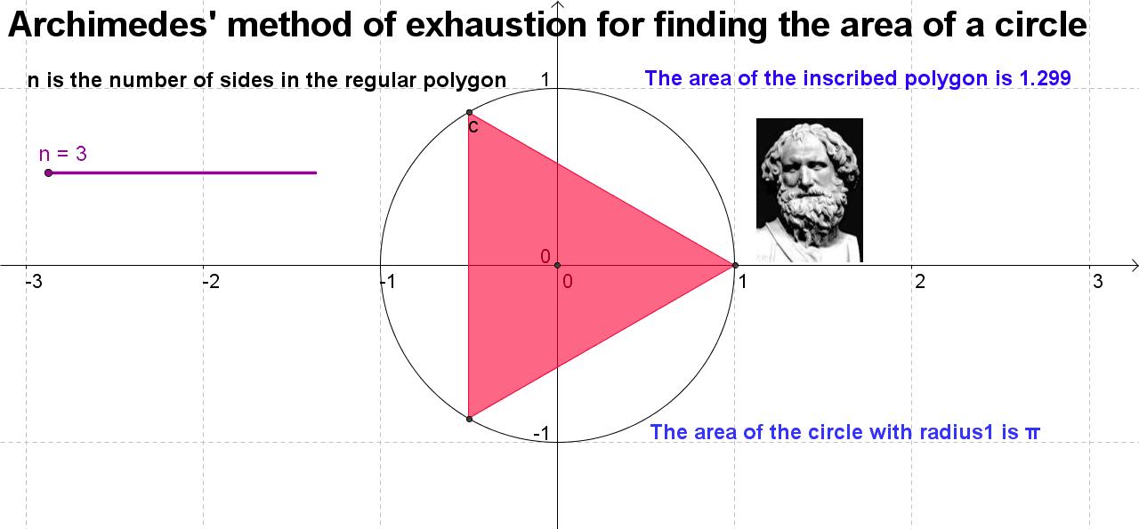
Early engagement with formulas for regions
with curvilinear boundaries

