Slide 1
Algebraic Expressions and Equations that have Fractions in them
Problem
Mary starts with €3 in her money box and puts €2 in each week. John starts with €2 in his money box and puts €2 in each week.
They both want to save to buy a computer game that costs €37.
Mary says she will give half of the money in her money box.
John says he will give a quarter of the money in his money box.
After how many weeks will they have enough money for the game?

Slide 2
Algebraic Expressions and Equations that have Fractions in them
Problem
Mary starts with €3 in her money box and puts €2 in each week. John starts with €2 in his money box and puts €2 in each week.
They both want to save to buy a computer game that costs €37.
Mary says she will give half of the money in her money box.
John says he will give a quarter of the money in his money box.
After how many weeks will they have enough money for the game?

Slide 3
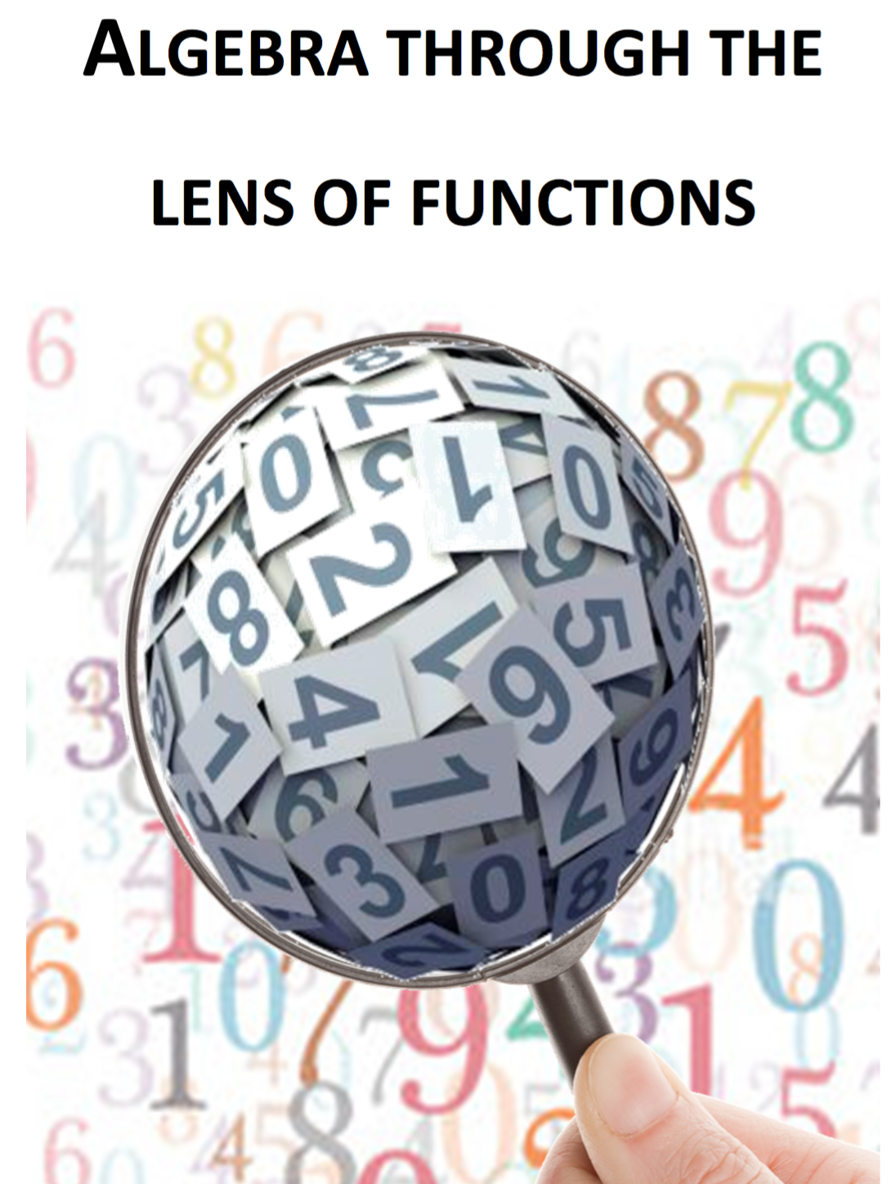
Note for Teachers
Suggestions on how students can tackle the problem(s) are detailed in the Introduction, General Overview and Unit 10 of Algebra Through the Lens of Functions Part 1

