Slide 1
Comparing Linear Functions
Information
Problem 1
Problem 2
Problem 3
Problems on Single Page
Questions with Grid

Slide 2
Comparing Linear Functions
Sunflower A
Starting height 3 cm and grows 2 cm per day each day thereafter.
Sunflower B
Starting height 6 cm and grows 2 cm per day each day thereafter.
Sunflower C
Starting height 6 cm and grows 3 cm per day each day thereafter.
Sunflower D
Starting height 8 cm and grows 2 cm per day each day thereafter.

Slide 3
Comparing Linear Functions
Problem 1
When will sunflowers C and D have the same height?

Slide 4
Comparing Linear Functions
Problem 2
When will sunflower C be taller than sunflower D?

Slide 5
Comparing Linear Functions
Problem 3
When will Sunflower A have a height between 17 cm and 29 cm inclusive?

Slide 6
Comparing Linear Functions
Problem 1
When will sunflowers C and D have the same height?
Problem 2
When will sunflower C be taller than sunflower D?
Problem 3
When will Sunflower A have a height between 17 cm and 29 cm inclusive?

Slide 7
Comparing Linear Functions
Problem 3
When will Sunflower A have a height between 17 cm and 29 cm inclusive?
Problem 2
When will sunflower C be taller than sunflower D?
Problem 1
When will sunflowers C and D have the same height?

Slide 8
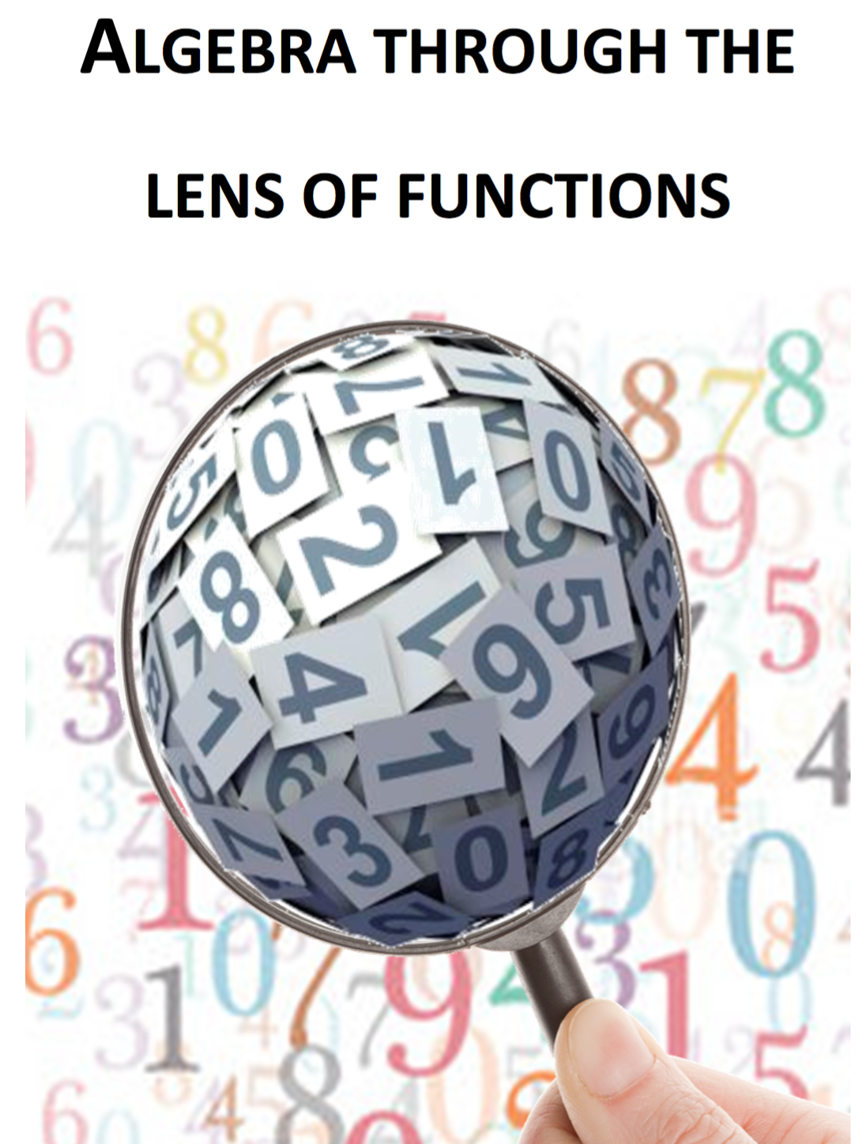
Note for Teachers
Suggestions on how students can tackle the problem(s) are detailed in the Introduction, General Overview and Unit 8 of Algebra Through the Lens of Functions Part 1

