Slide 1
Elimination Method for Solving Simultaneous Equations
Problem 1
There are 25 toys in a playground.
The toys are either bicycles (2 wheels) or tricycles (3 wheels).
In total in the playground there are 61 wheels.
How many bicycles are in the playground?

Slide 2
Elimination Method for Solving Simultaneous Equations
Problem 1
There are 25 toys in a playground.
The toys are either bicycles (2 wheels) or tricycles (3 wheels).
In total in the playground there are 61 wheels.
How many bicycles are in the playground?

Slide 3
Elimination Method for Solving Simultaneous Equations
Problem 2
Can you work out what value $x$ or $y$ has in the following sets of equations?
$5x+2y=35$ $x+3y=24$
$5x+8y=95$ $6x+3y=39$

Slide 4
Elimination Method for Solving Simultaneous Equations
Problem 2
Can you work out what value $x$ or $y$ has in the following sets of equations?
$5x+2y=35$ $x+3y=24$
$5x+8y=95$ $6x+3y=39$

Slide 5
Elimination Method for Solving Simultaneous Equations
Problem 3
Lisa is putting up flags for a party. The flags are all the same size and are spaced equally along the string. What is the width of the base of each flag? What is the length of the space between each flag?

Slide 6
Elimination Method for Solving Simultaneous Equations
Problem 3
Lisa is putting up flags for a party. The flags are all the same size and are spaced equally along the string. What is the width of the base of each flag? What is the length of the space between each flag?

Slide 7
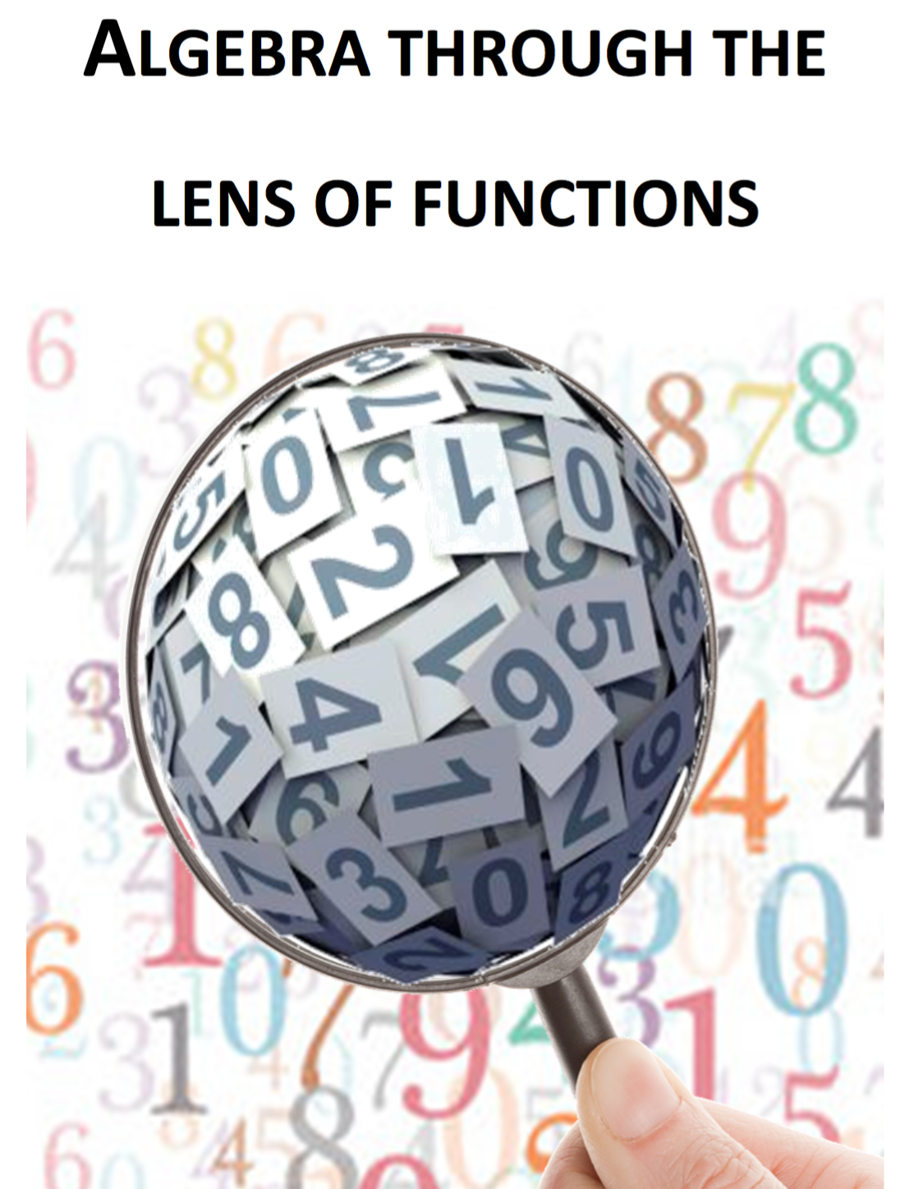
Note for Teachers
Suggestions on how students can tackle the problem(s) are detailed in the Introduction, General Overview and Unit 9 of Algebra Through the Lens of Functions Part 1

