Slide 1

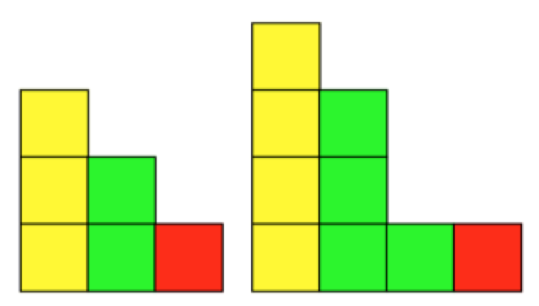
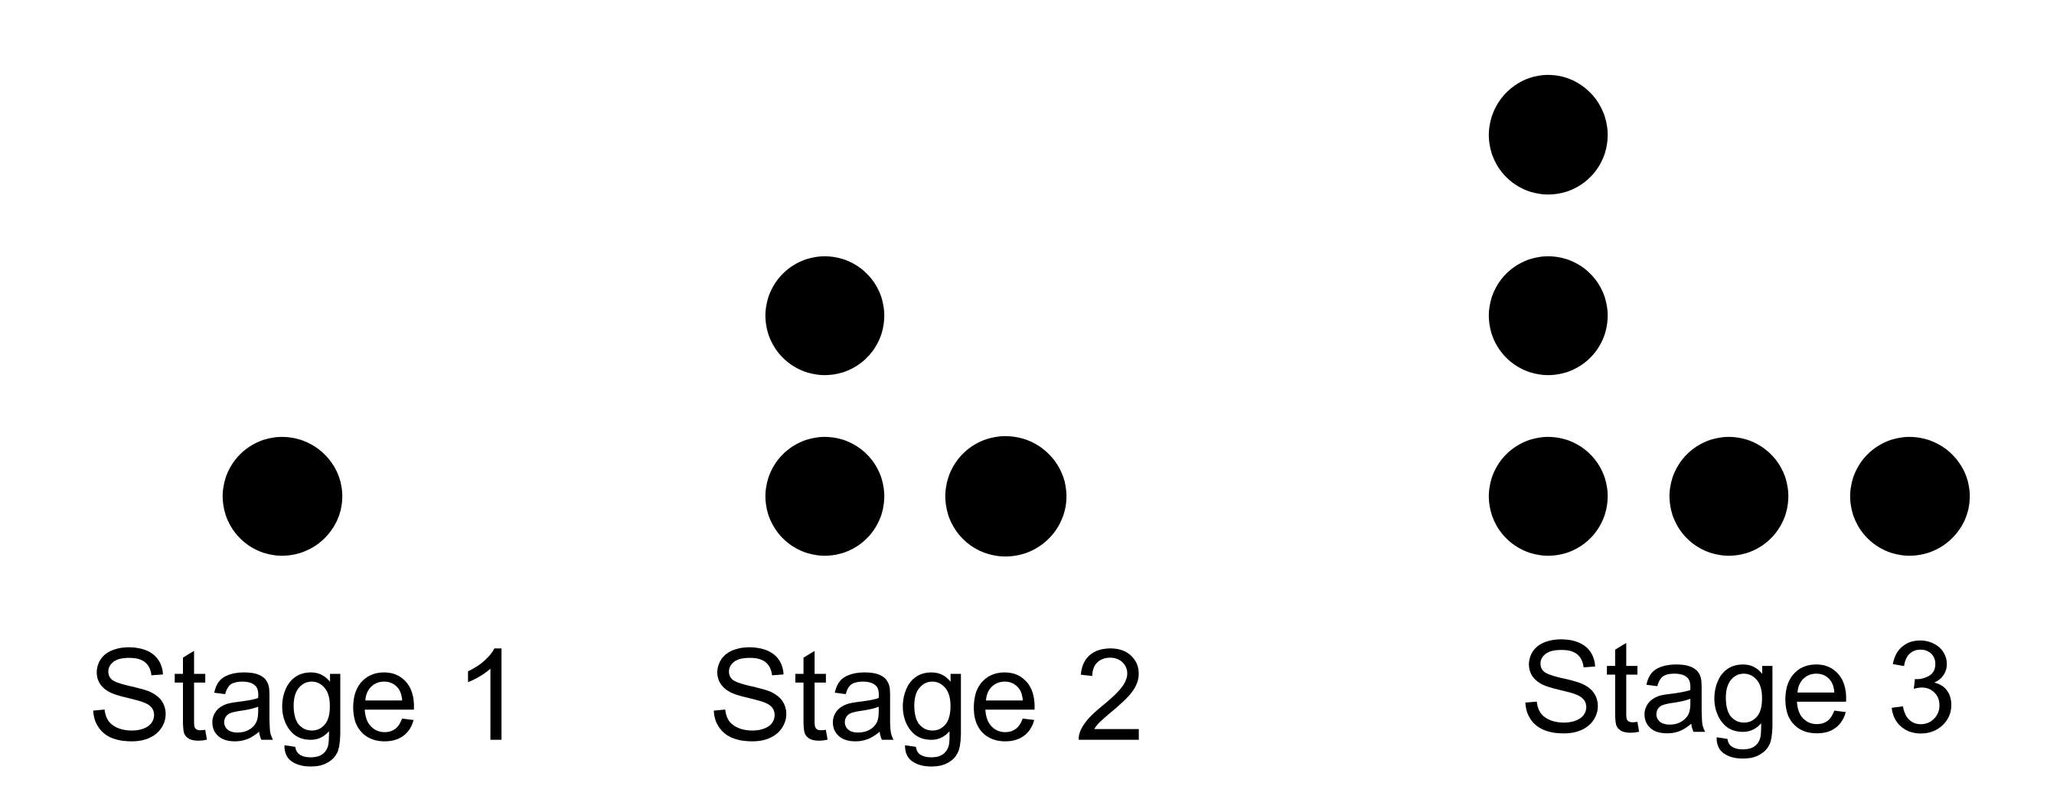
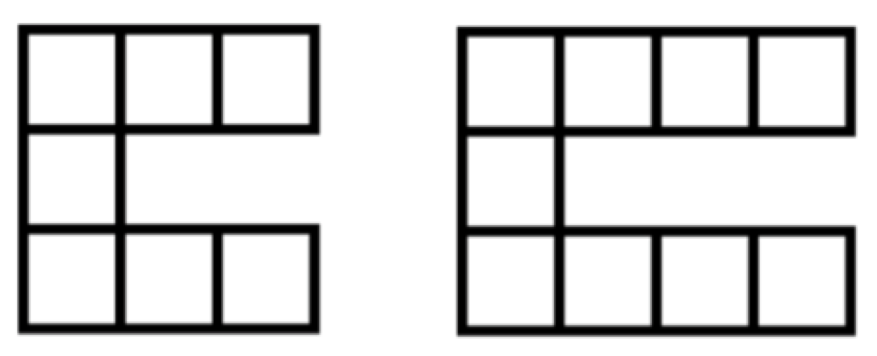
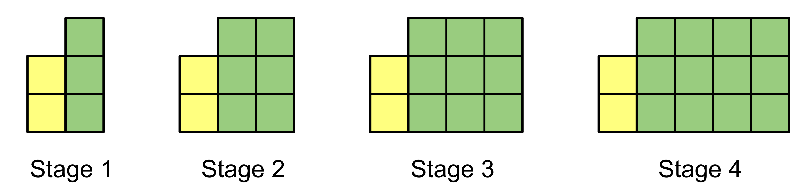

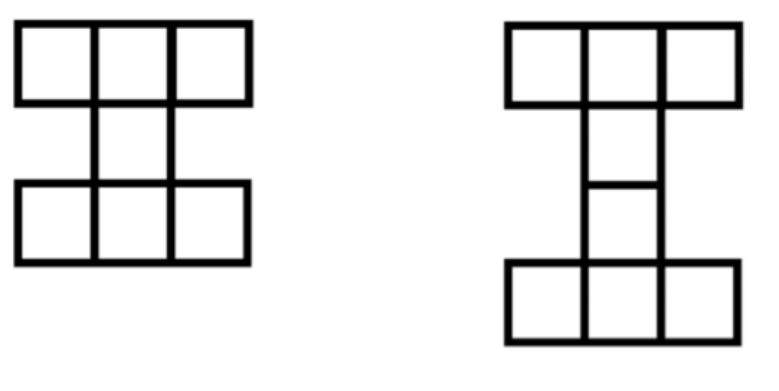
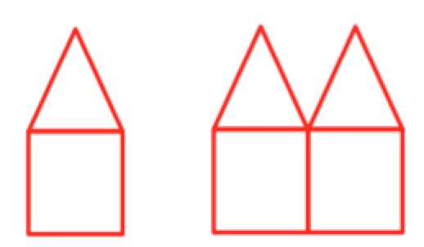
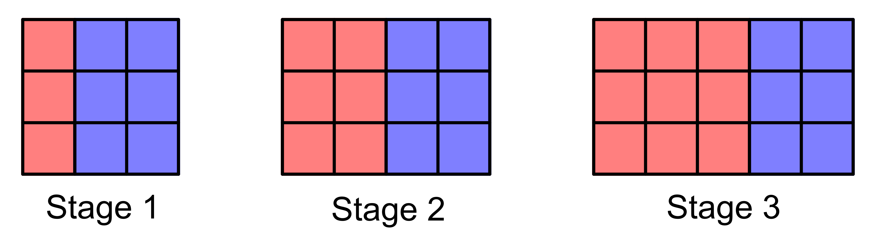


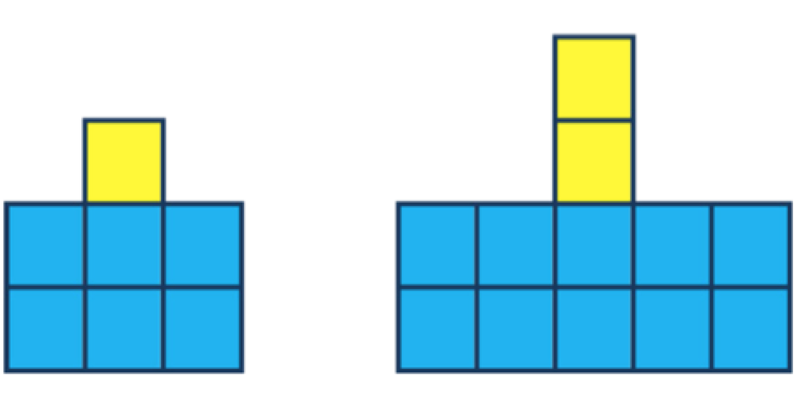
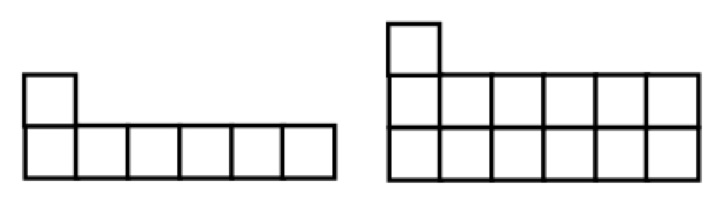


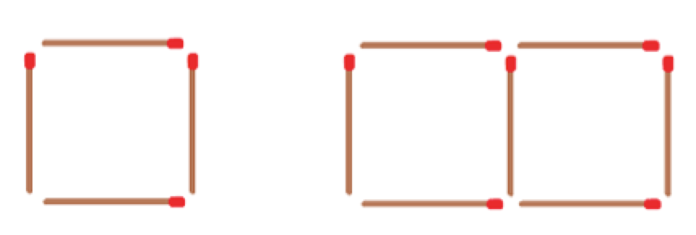
Growing Visual Linear Patterns
Supporting Student Workbook on Linear Patterns Available Online
Click on the Pattern
www.projectmaths.ie

Slide 2

Pattern 1

Slide 3
Pattern 2

Slide 4
Pattern 3

Slide 5
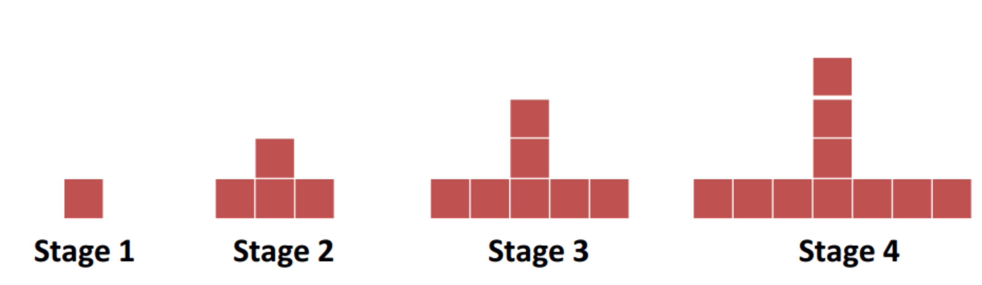
Pattern 4

Slide 6

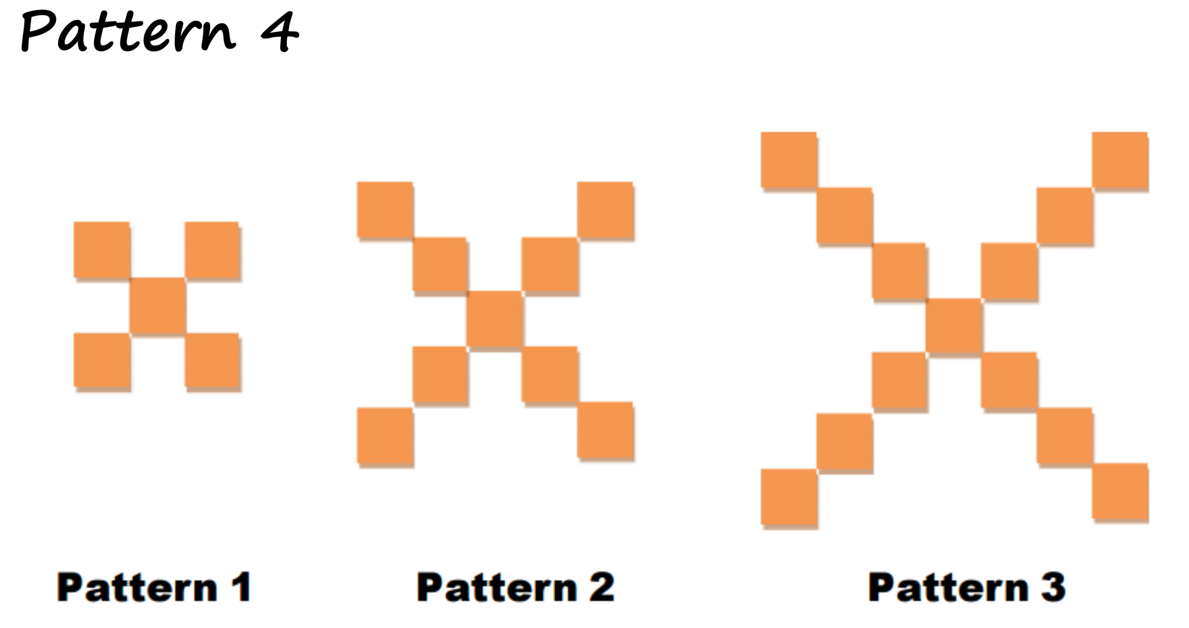
Pattern 5

Slide 7
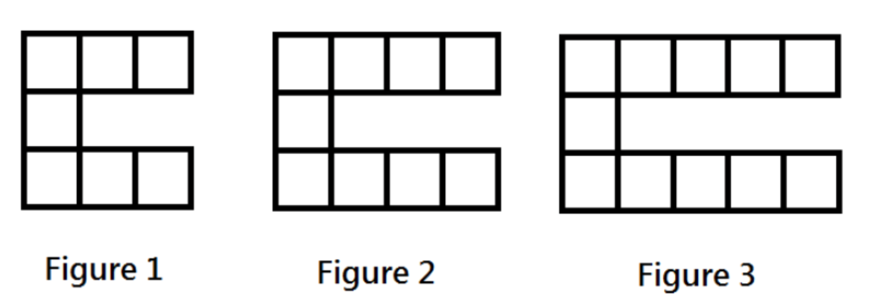
Pattern 6

Slide 8
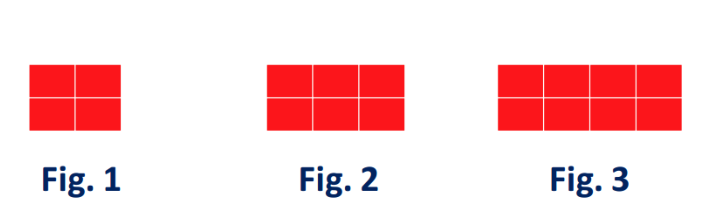
Pattern 7

Slide 9
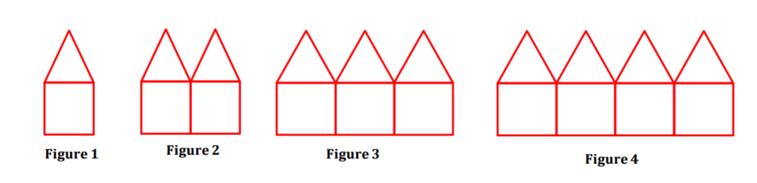
Pattern 8

Slide 10
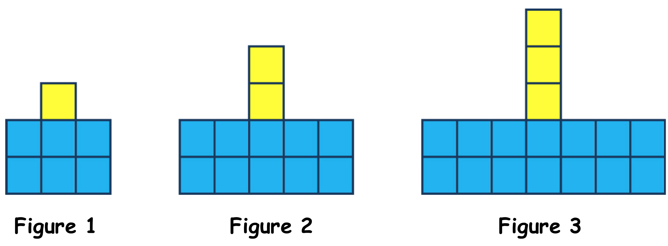
Pattern 9

Slide 11

Pattern 10
John wants to save up for a school tour which will happen at the end of the school year. He speaks to his parents about it and they agree that he can get a part-time job to help him afford the trip. His parents give him €100 to start him off and each week he saves €20 of his wages.

Slide 12
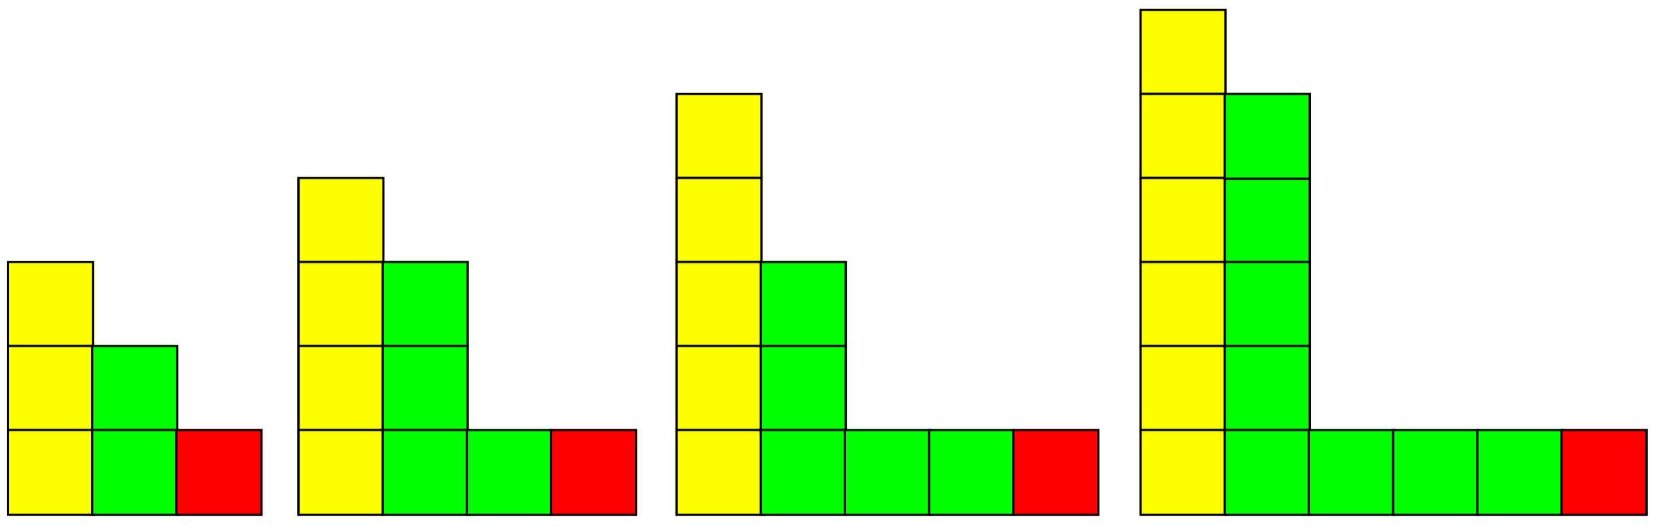
Figure 1
Figure 2
Figure 3
Figure 4

Slide 13
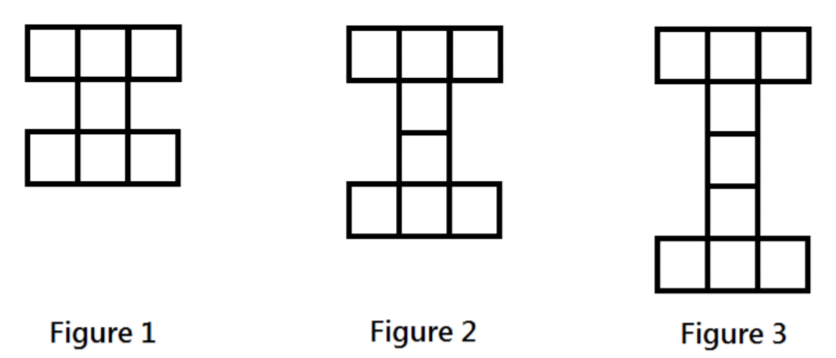

Slide 14
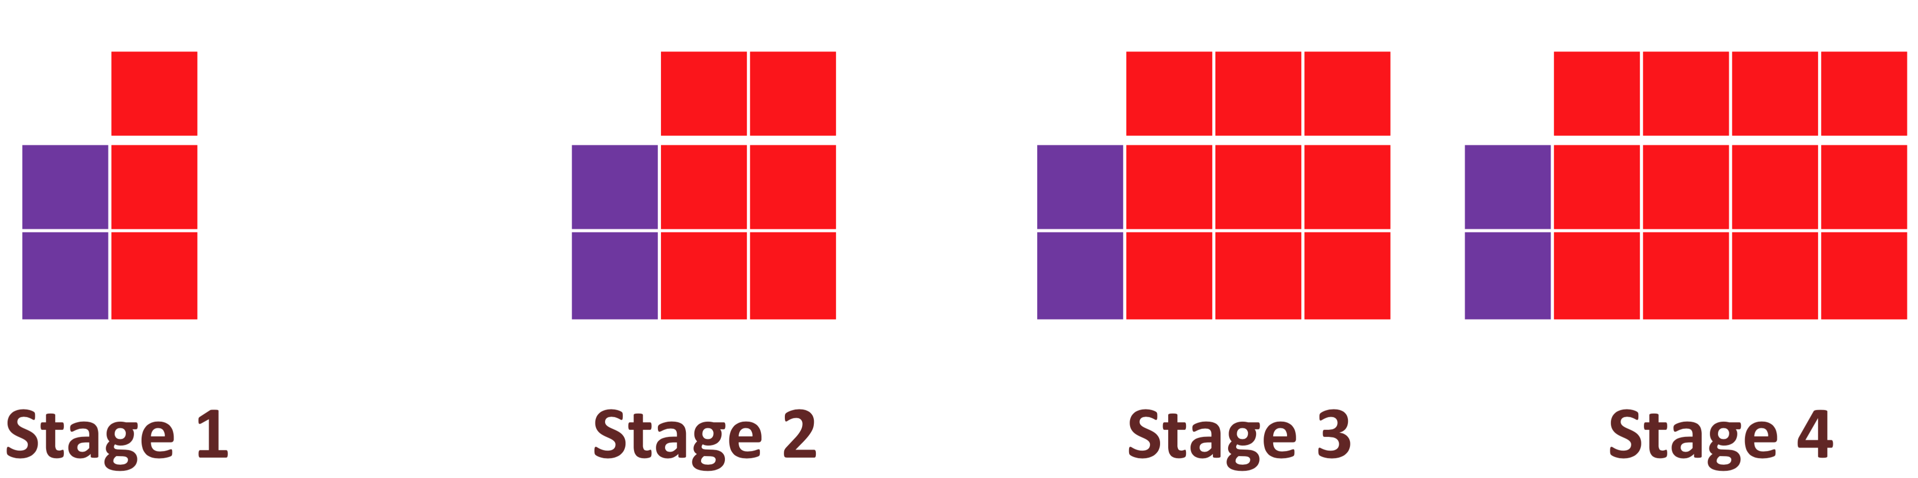

Slide 15
Figure 1
Figure 2
Figure 3
Figure 4

Slide 16
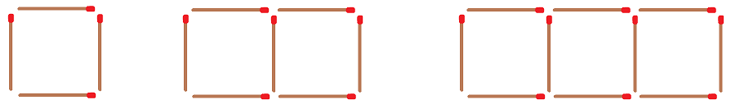
Figure 1
Figure 2
Figure 3

