Slide 1
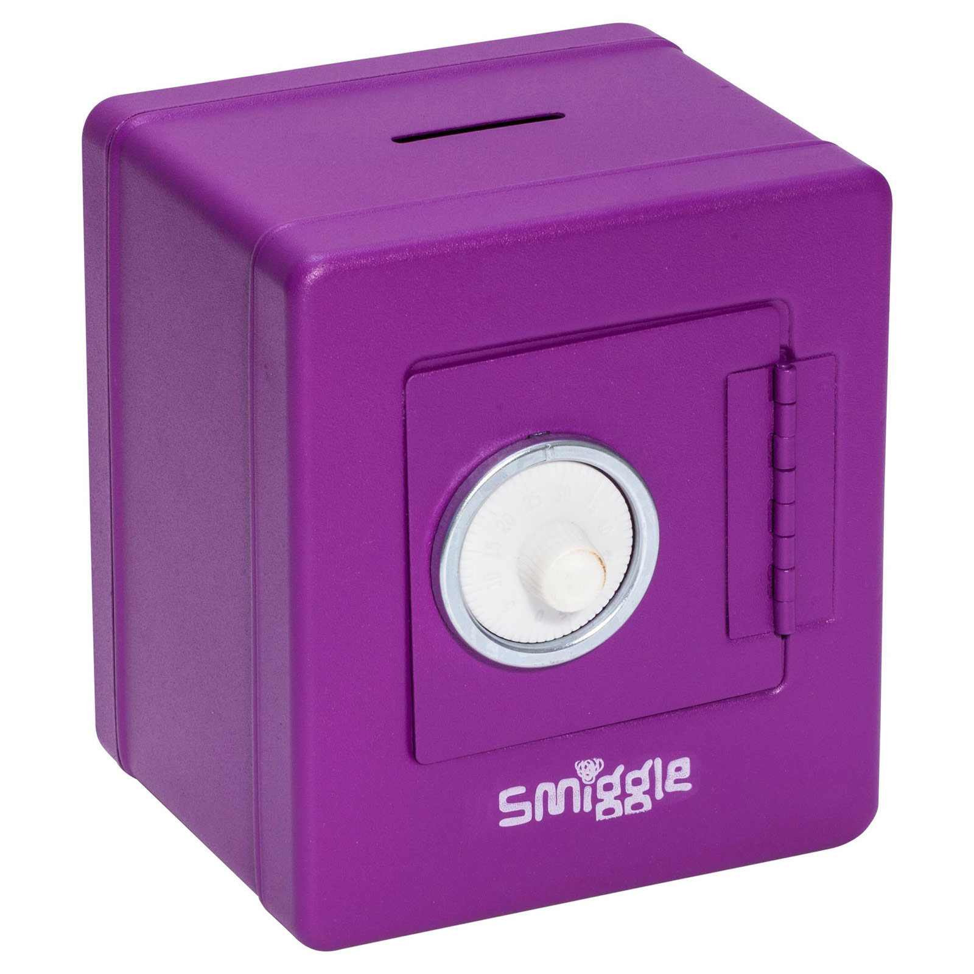
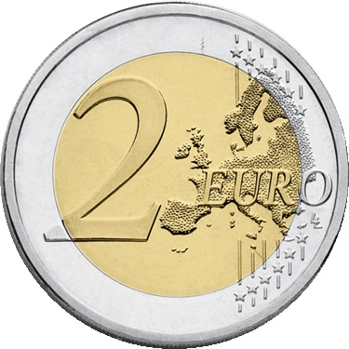
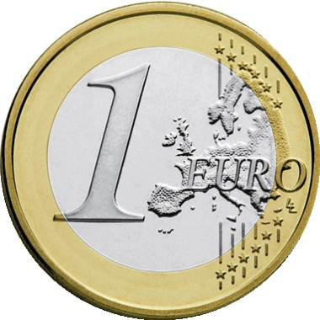
The Money Box Activity
Problem 1
Problem 2
Problem 3
Problem 4
Problems on Single Page
Questions with Grid

Slide 2
The Money Box Activity
Problem 1
John receives a gift of a money box containing €3 for his birthday.
John decides he will save €2 every day, beginning the day immediately following his birthday.
Represent this pattern by drawing a table, or diagram.

Slide 3
The Money Box Activity
Problem 2
How much money does John have in his money box 4 days after he got the box?

Slide 4
The Money Box Activity
Problem 3
John wants to buy a new book. The book costs €13. What is the minimum number of days John will have to save so that he has enough money to buy the book?

Slide 5
The Money Box Activity
Problem 4
John wants to buy a new computer game. The game costs €69. What is the minimum number of days John will have to save so that he has enough money to buy the computer game?

Slide 6
The Money Box Activity
Problem 1
John receives a gift of a money box containing €3 for his birthday.
John decides he will save €2 every day, beginning the day immediately following his birthday. Represent this pattern by drawing a table, or diagram.
Problem 2
How much money does John have in his money box 4 days after he got the box?
Problem 3
John wants to buy a new book. The book costs €13. What is the minimum number of days John will have to save so that he has enough money to buy the book?
Problem 4
John wants to buy a new computer that costs €69. What is the minimum number of days John will have to save so that he has enough money to buy the computer game?

Slide 7
The Money Box Activity
Problem 1
John receives a gift of a money box containing €3 for his birthday. John decides he will save €2 every day, beginning the day immediately following his birthday. Represent this pattern by drawing a table, or diagram.
Problem 3
John wants to buy a new book. The book costs €13. What is the minimum number of days John will have to save so that he has enough money to buy the book?
Problem 2
How much money does John have in his money box 4 days after he got the box?
Problem 4
John wants to buy a computer game that costs €69. What is the minimum number of days John will have to save so that he has enough money to buy the game?

Slide 8
Note for Teachers
Suggestions on how students can tackle the problem(s) are detailed in the Introduction, General Overview and Unit 5 of Algebra Through the Lens of Functions Part 1

