Slide 1
Problem
John receives a gift of a money box containing €3 for his birthday.
John decides he will save €2 every day, beginning the day immediately following his birthday.
After how many days will John have
(i) €23 (ii) €45 and (iii) €125 in his money box?

Slide 2
Problem
John receives a gift of a money box containing €3 for his birthday.
John decides he will save €2 every day, beginning the day immediately following his birthday.
After how many days will John have
(i) €23 (ii) €45 and (iii) €125 in his money box?

Slide 3
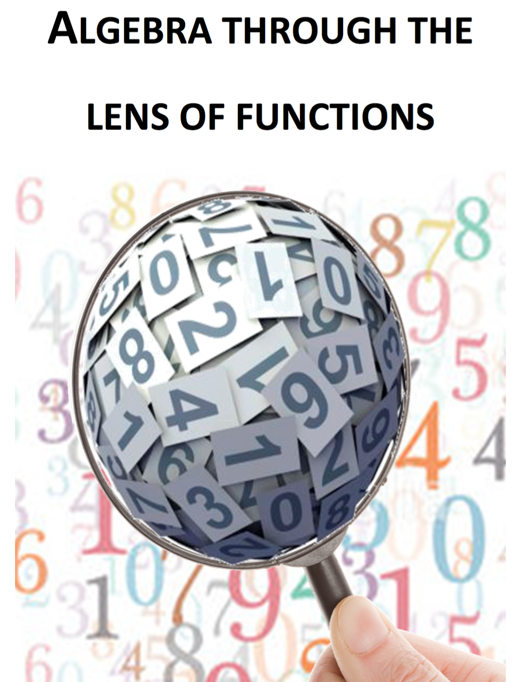
Note for Teachers
Suggestions on how students can tackle the problem(s) are detailed in the Introduction, General Overview and Unit 6 of Algebra Through the Lens of Functions Part 1

