Slide 1
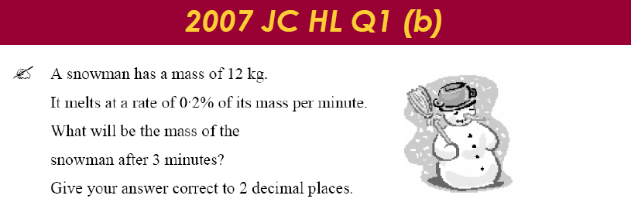
One morning a man wakes up and there is a heap of snow in front of his door that has mass of 12kg. He gets his shovel to clear it away. His shovel scoops .5kg of snow away each time. How many scoops will it take to clear the heap of snow?
In both of these questions the mass of snow is decreasing. Is there a difference in how it decreases?
Notes:
Just read through the 2 questions and ask the teachers to see the difference…..

Slide 2
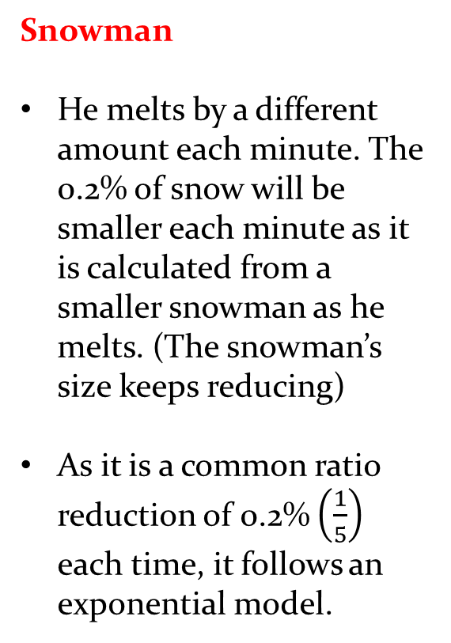
Heap of snow
We always reduce by a constant of .5kg
Therefore this is a linear model for reducing
Snowman
He melts by a different amount each minute. The 0.2% of snow will be smaller each minute as it is calculated from a smaller snowman as he melts. (The snowman’s size keeps reducing)
As it is a common ratio reduction of 0.2% $\left(\frac{1}{5}\right)$ each time, it follows an exponential model.

Slide 3
