Slide 1
Percentages
Decimals
Multiply divide fractions
Add Subtract
Equivalence
Ordering fractions
Fractions
Partitioning
Diagnostic Test
Overview

Slide 2
Strand/Topic Title | Learning Outcomes Students will be able to
Strand 3 : 3.1 Number systems Students will devise strategies for computation that can be applied to any number. Implicit in such computational methods are generalisations about numerical relationships with the operations being used. Students will articulate the generalisation that underlies their strategy, firstly in common language and then in symbolic language. | generalise observations of arithmetic operations investigate models to help think about the operations of addition, subtraction, multiplication and division of rational numbers consolidate the idea that equality is a relationship in which two mathematical expressions have the same value analyse solution strategies to problems begin to look at the idea of mathematical proof calculate percentages use the equivalence of fractions, decimals and percentages to compare proportions

Slide 3
Fraction Concepts
Part whole relationship
- role of the denominator and numerator
Partitioning into equal sized parts is an important concept which lies at the heart of fractions, decimals and percentages.
Ordering or comparing fractions

Slide 4
Oral language
Pictures
Manipulative
Models
Written symbols
Real life contexts

Slide 5
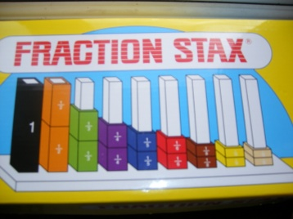

Slide 6
1 unit or 1 “whole”
 |  |  |  |  |  |  |  |  |  |  |  |  |  |  |  | fraction wall
What is 2/3 + 3/5?

Slide 7
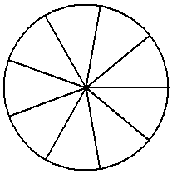
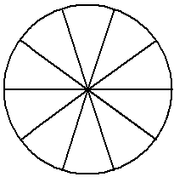
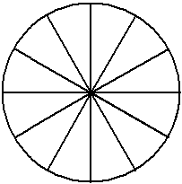
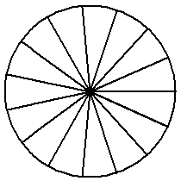

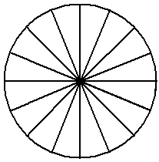

Slide 8
Fraction concepts
Ordering strategies
Fraction Operations
Sense making of the algorithms
Fraction Equivalence

Slide 9
Jane got 10 out of 15 for her test and Mark got 15 out of 20. Anita said they both did equally well because they both got 5 wrong. Is Anita correct?

Slide 10
Marian won a prize in the local lotto.
She put ½ of her winnings into a savings account.
She gave 1/3 of the remainder to her sister
She spent the rest on buying a car.
Her sister received €2000 from Mary. How much did Marian win ? How much did she spend on the car?
(Use fraction strips if necessary to model the problem.)

Slide 11
Ordering Strategies
-not relying on common denominators
Compare
Same denominator, different numerator
Compare
Same numerator, different denominator
Compare
Using 1/2 , 0, and 1 as benchmarks
4. Using equivalent fractions

Slide 12

Have they got the concepts?
Diagnostic Test
Activity on Partitioning

Slide 13
Where there are difficulties ...
Identify what the unit or “whole” is
Parts which make up the unit must be equal in area
Develop meaning for fractions using concrete models – fraction strips, circles, uni fix cubes

Slide 14
Where there are difficulties......
Good ordering strategies in order to make estimates and make sense of answers
Strong mental representations of equivalence of fractions

Slide 15
Why not? .
Using a Picture – Fraction Wall
Using ordering strategies – estimate the answer
What to do? What type of fractions can you add and how do you add them ?
How do you create equivalent fractions?

Slide 16
Equivalent fractions
Activities on generating equivalent fractions

Slide 17
Research indicates that trouble spots in Algebra come from an incomplete understanding of fraction concepts!
Example:

Slide 18
Addition and Subtraction
First estimate using ordering strategies
When finding common denominators use strategies for generating equivalent fractions

Slide 19
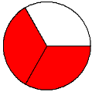
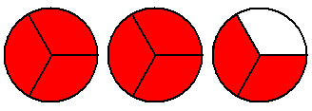
Multiplication (rational numbers)
What does 4 x 3 mean?
4 x 2/3 = 4 groups of 2/3 each
=
4X2/3 =2/3+2/3+2/3+2/3+2/3 = 8/3
Why is it not 8/12?

Slide 20

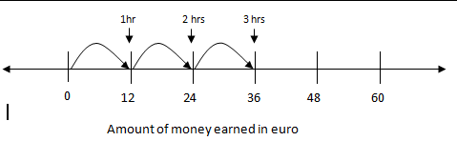
Multiplication – number line model
Aoife earns €12 per hour. What would she earn in 2, 3, 4, 3/4 hours?
Notice “of “ becoming multiplication
3/4 x12 = 12 x ¾ =9

Slide 21
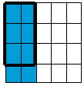
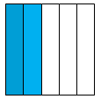
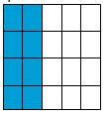
Multiplication – Area Model
Cara had 2/5 of her birthday cake left from her party. She ate ¾ of the leftover cake. How much of the original cake did she eat?
Divide into quarters
¾ of 2/5
2/5 cake
Multiplication making smaller!
Area of 3x2 out of area of 4x5
http://www.learner.org/courses/learningmath/number/session9/part_a/try.html

Slide 22
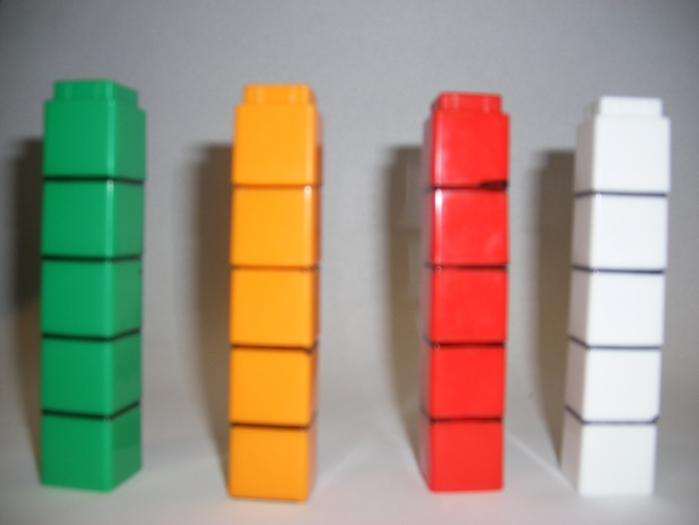
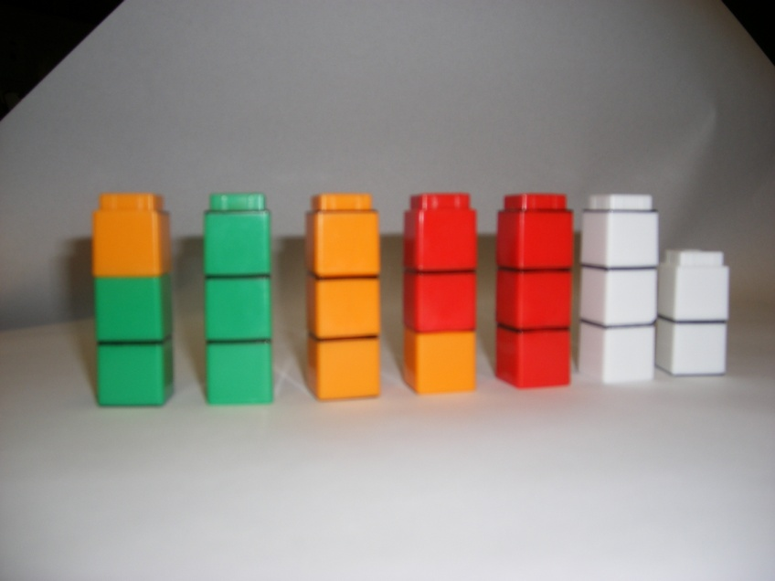
Division by a fraction – making sense of “invert and multiply”
Cara has 4 pizzas for her party. She decides that a serving will be 3/5 of a pizza. How many servings from 4 pizzas?
Answer

Slide 23
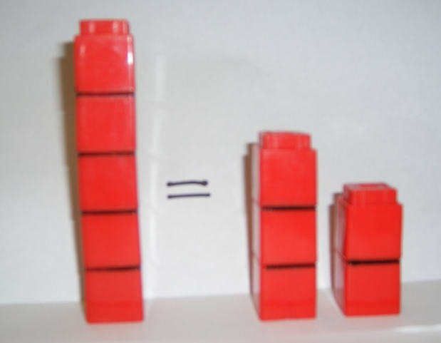
Making sense of “invert and multiply”
How many servings will one pizza give ?
How many servings from 4 pizzas?

Slide 24
A fraction as a part of a whole
A fraction helps us measure continuous quantities
Unit fractions – equal sized portions or fair shares
Equivalent fractions
Common denominators (common subdivisions)
Mixed numbers
Improper fractions

Slide 25
Adding and subtracting fractions
Multiplying a fraction by a whole number, a whole number by a fraction and a fraction by a fraction
Dividing a whole number by a fraction

