Slide 1
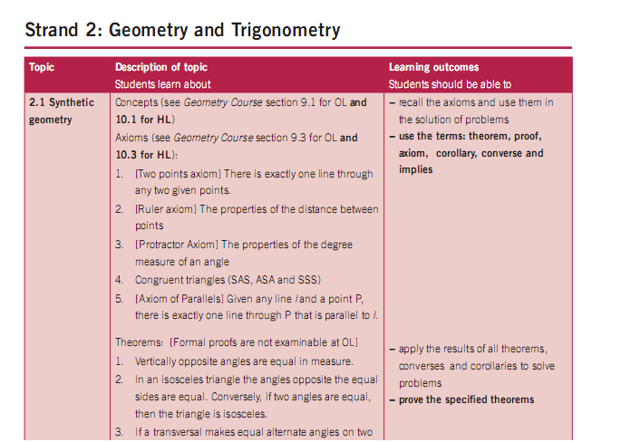
Strand 2: Synthetic Geometry Geostrips & Student CD
“Theorems are full of potential for surprise and delight. Every theorem can be taught by considering the unexpected matter which theorems claim to be true. Rather than simply telling students what the theorem claims, it would be helpful if we assumed we didn’t know it...it is the mathematics teacher’s responsibility to recover the surprise embedded in the theorem and convey it to the pupils. The method is simple: just imagine you do not know the fact. This is where the teacher meets the students.”
“The geometrical results listed in the following pages(18-19) should first be encountered by learners through investigation and discovery.” (Syllabus)

Slide 2
Convince themselves through investigation that theorems 1 – 6 are true
2.1 Synthetic Geometry-C.I.C
Proof Required JC (H/L)
Vertically opposite angles are equal in measure.
In an isosceles triangle the angles opposite the equal sides are equal (and converse).
If a transversal makes equal alternate angles on two lines then the lines are parallel (and converse).
The angles in any triangle add to 180º.
Two lines are parallel if and only if, for any transversal, the corresponding angles are equal.
Each exterior angle of a triangle is equal to the sum of the interior opposite angles.
Notes:
Relative vocabulary list. In Synthetic Geometry the students have to convince themselves through investigation
that Theorems 1-6 are true, the students CD is an excellent resource to accomplish this
where all 6 Theorems are laid out in interactive form.

Slide 3
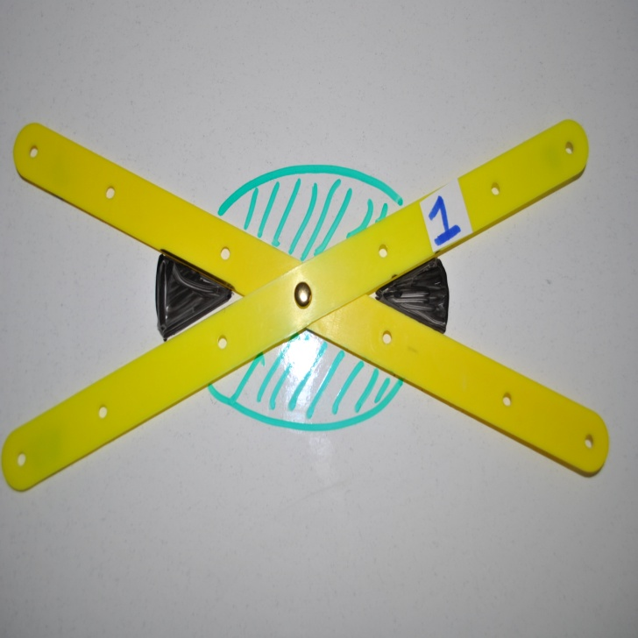
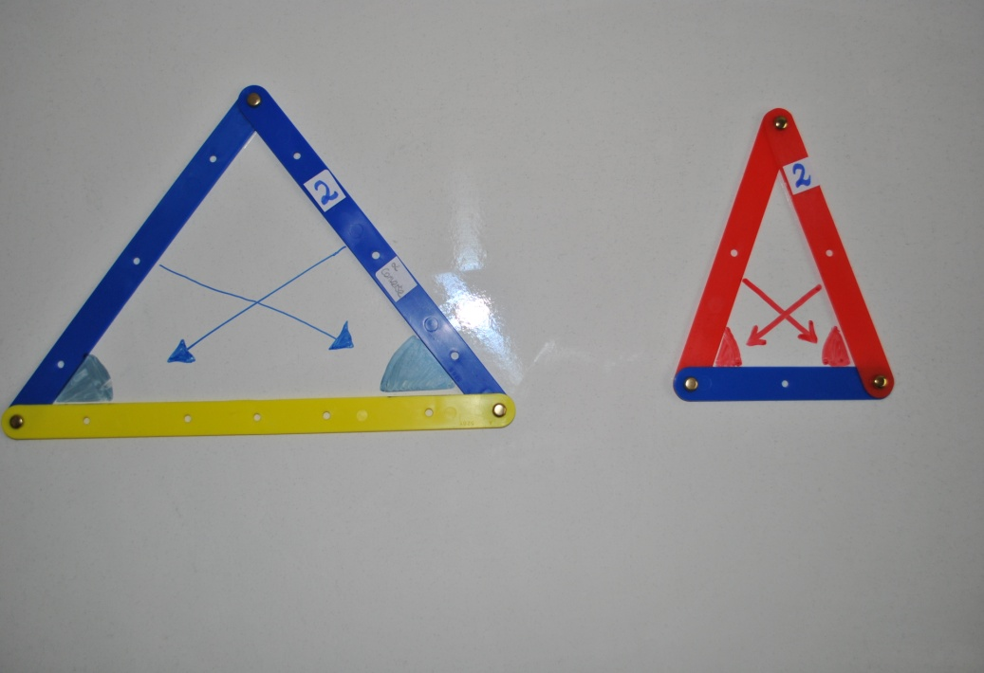
Images of Geostrips (C.I.C)
Vertically opposite angles
are equal in measure. (C.I.C)
In an isosceles triangle the angles opposite the equal sides are equal. Conversely, if two angles are equal, then the triangle is isosceles. (C.I.C)
Reminder
Word Bank & Student CD

Slide 4
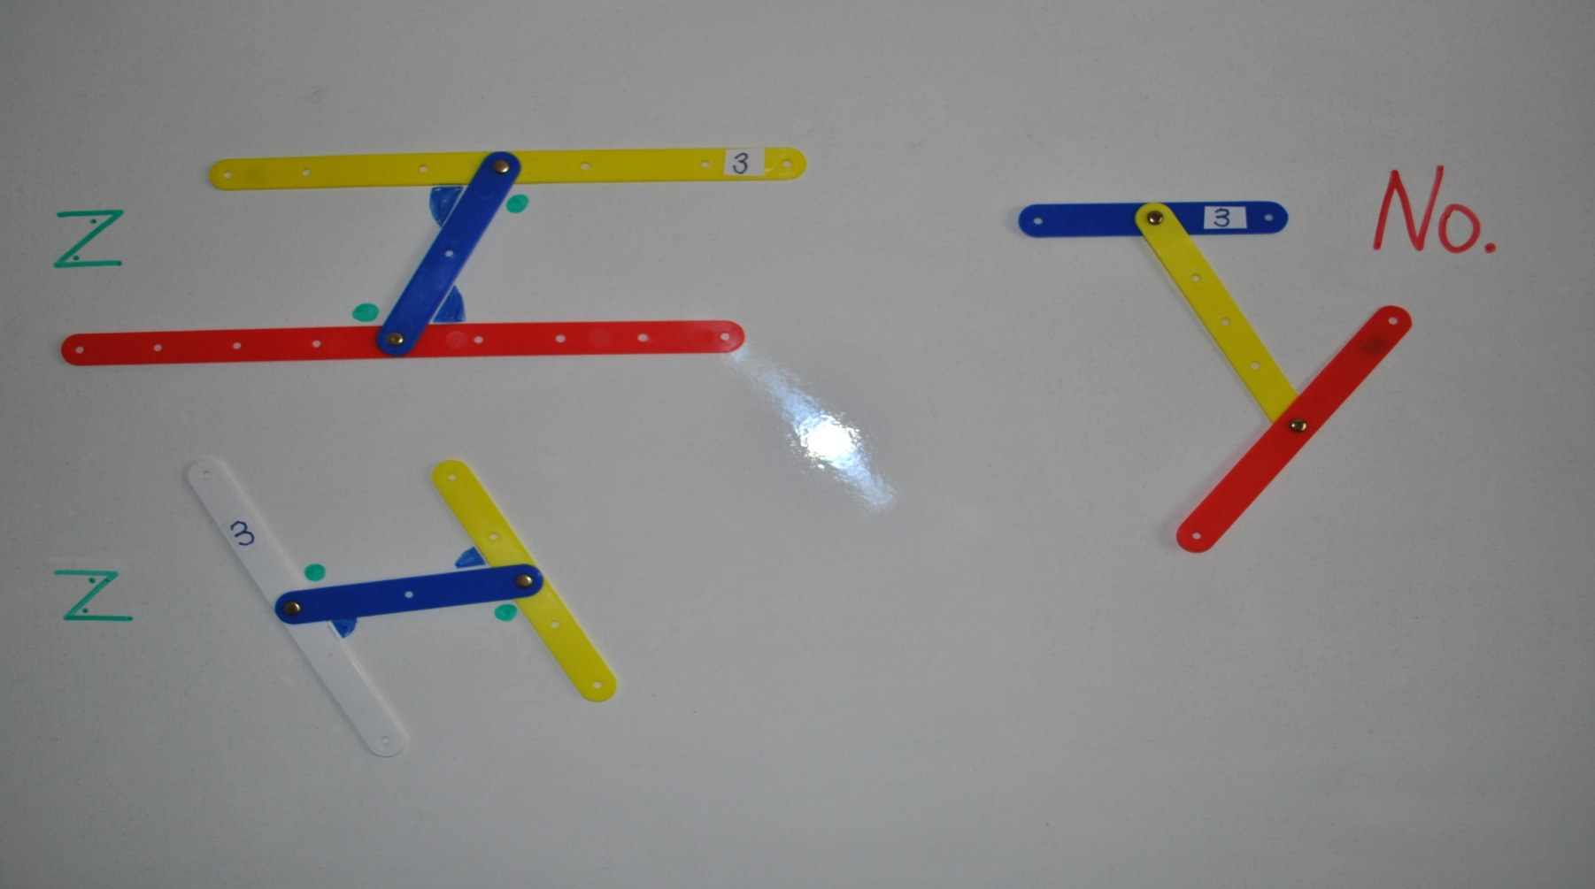
If a transversal makes equal alternate angles on two lines then the lines are parallel. Conversely, if two lines are parallel, then any transversal will make equal alternate angles with them. (C.I.C)

Slide 5
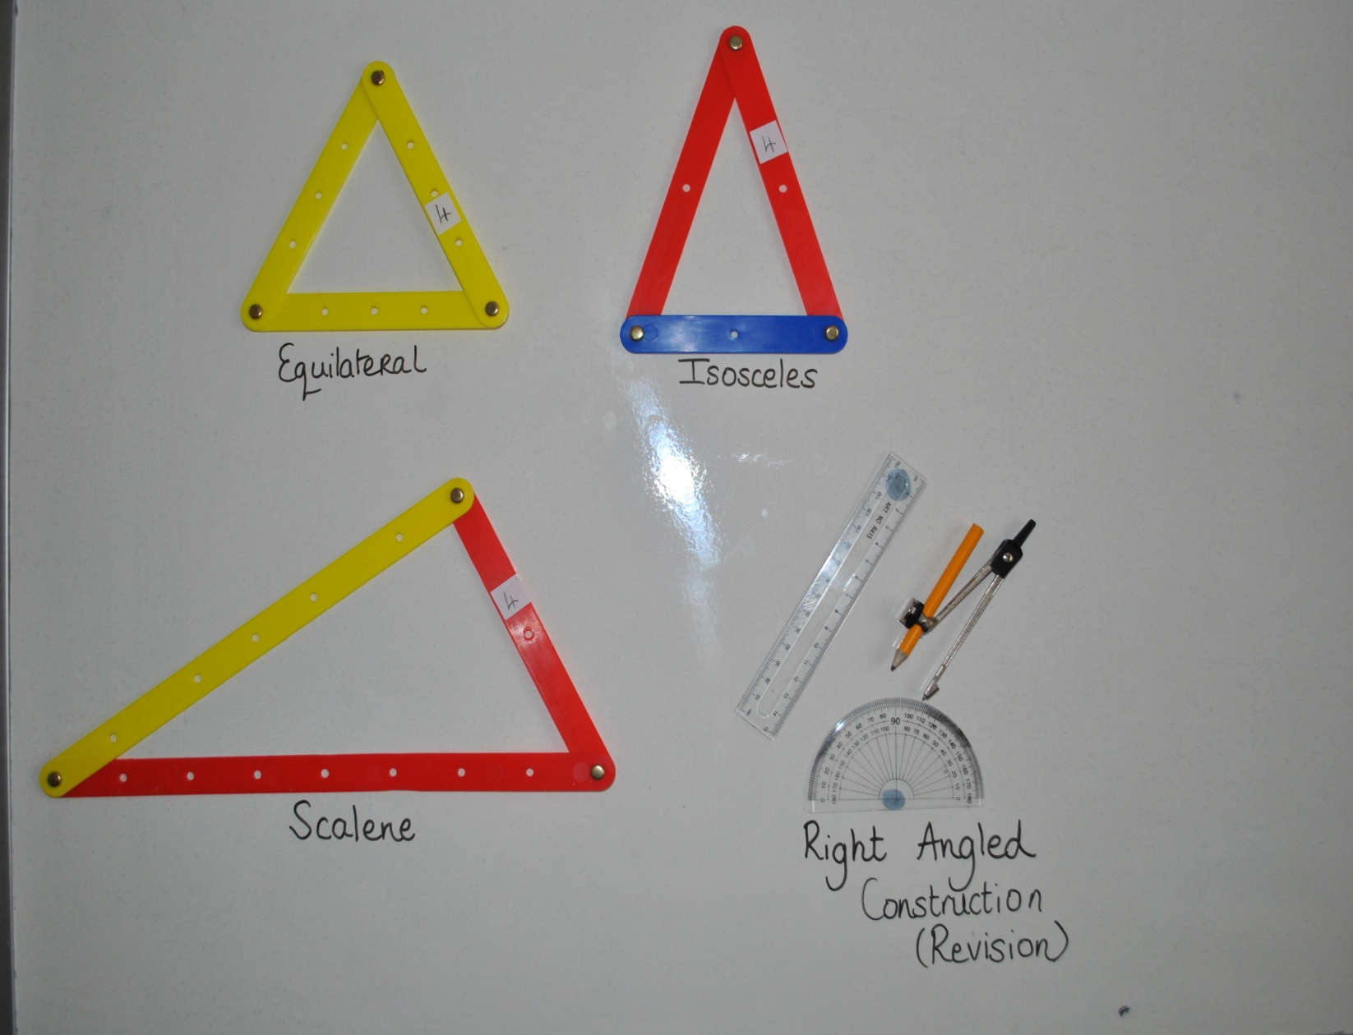
Note: Could use the same triangles to investigate the following Theorem.
The angle opposite the greater of two sides is greater than the angles opposite the lesser. Conversely, the side opposite the greater of two angles is greater than the side opposite the lesser angle. (LC O/L & H/L)
*The angles in any triangle add to 180° (C.I.C)
*Proof H/L JC

Slide 6
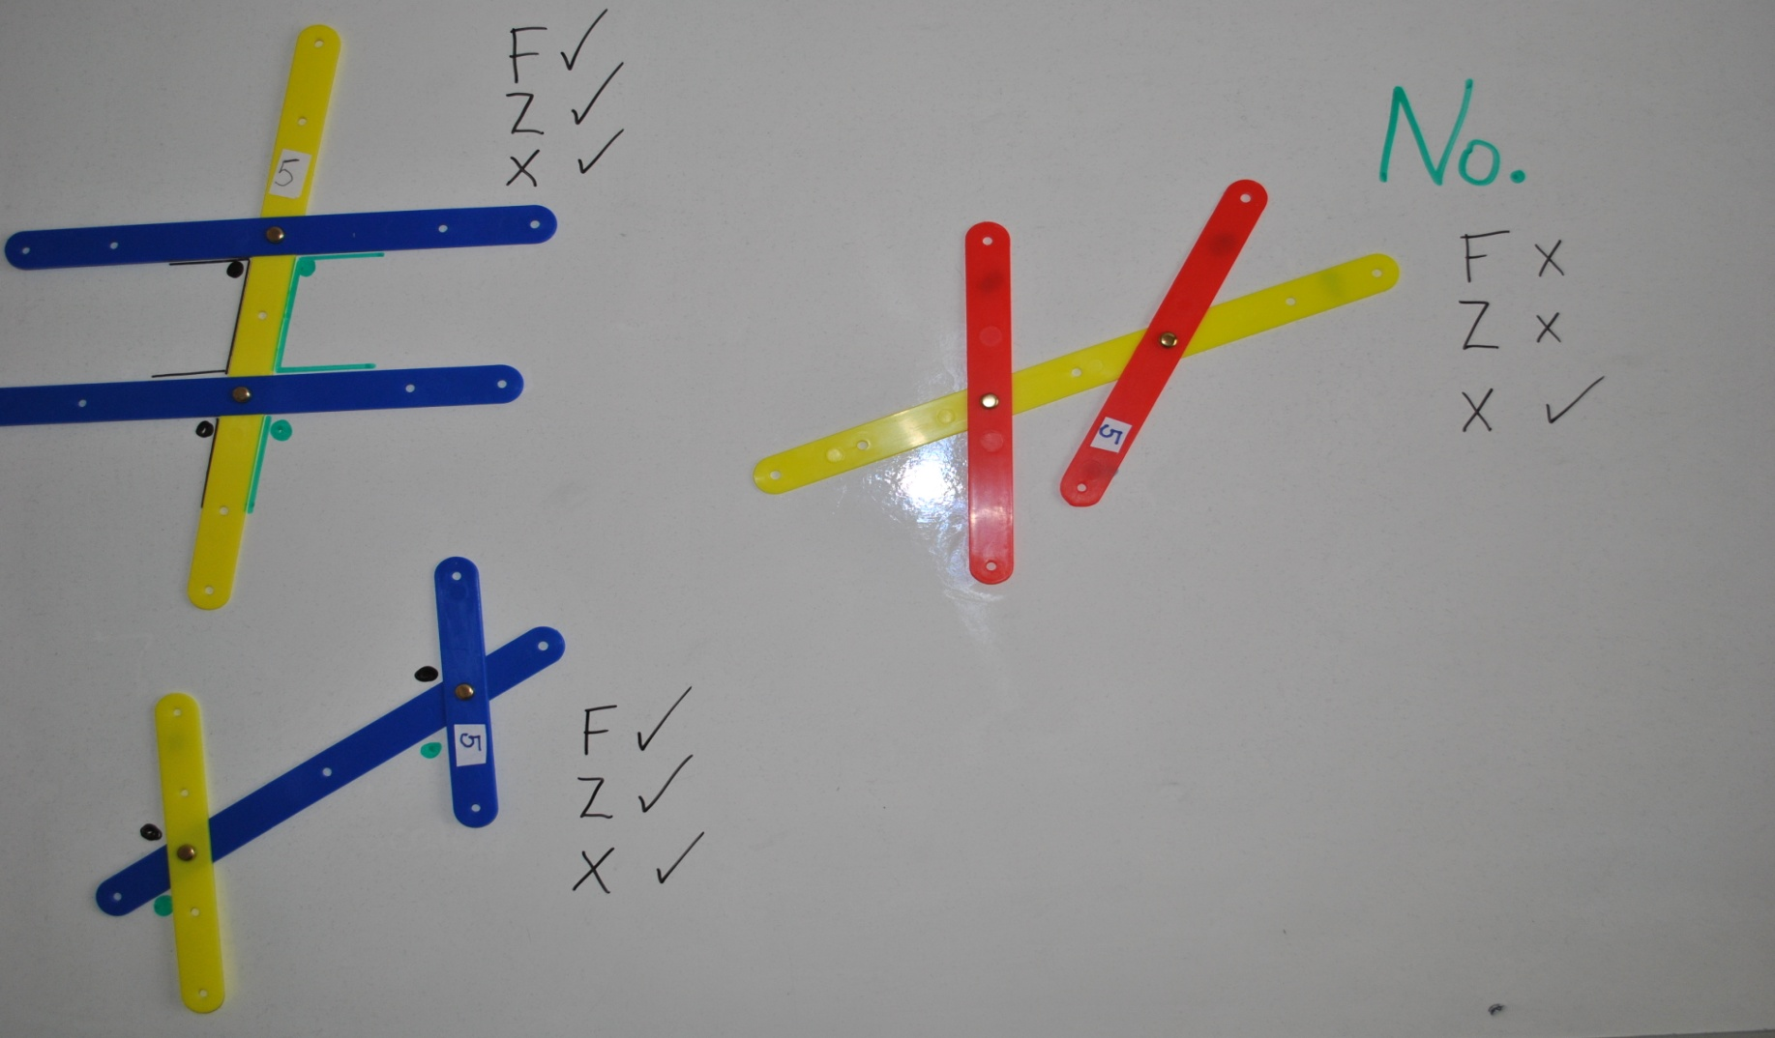
Two lines are parallel, if and only if, for any transversal, corresponding angles are equal. (C.I.C)

Slide 7
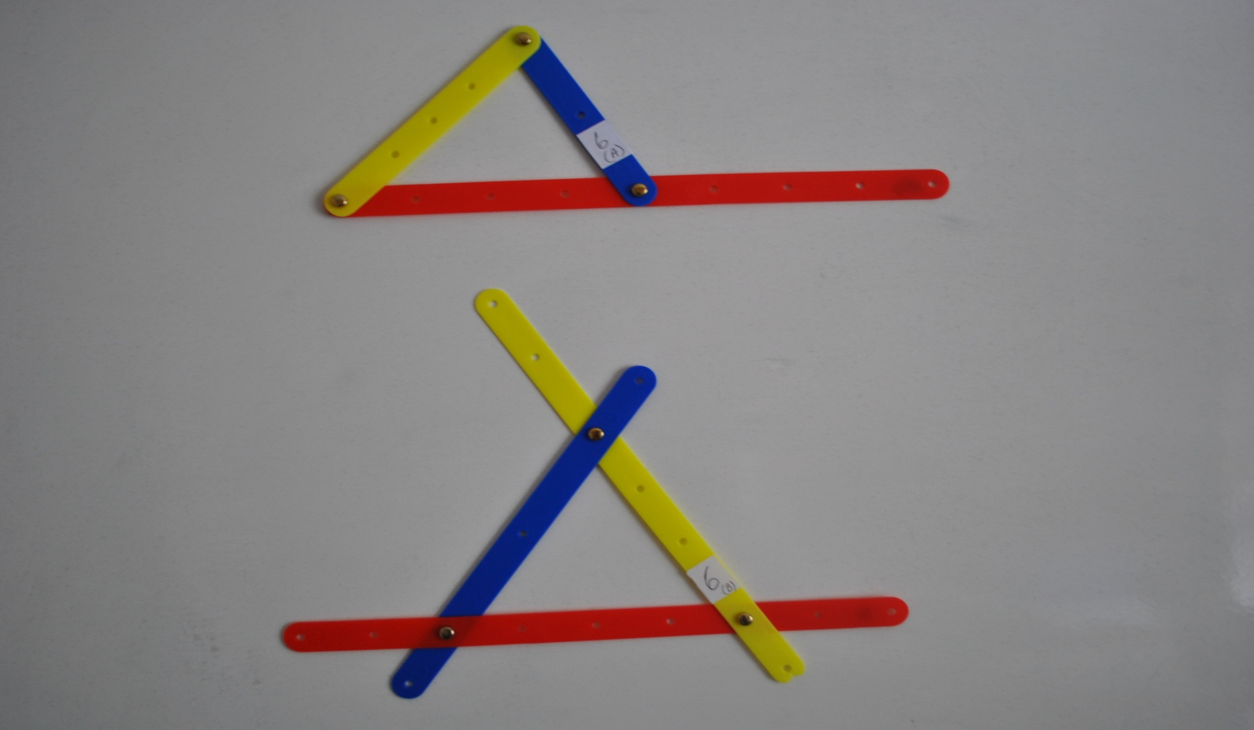
* Each exterior angle of a triangle is equal to the sum of the interior opposite angles. (C.I.C)
* Proof H/L JC

Slide 8
Theorem 8-WS2-LC (O/L&H/L)
What is the title of this theorem?

Slide 9
Theorem Title
Two Sides of a Triangle
are Together
Greater than the Third

Slide 10
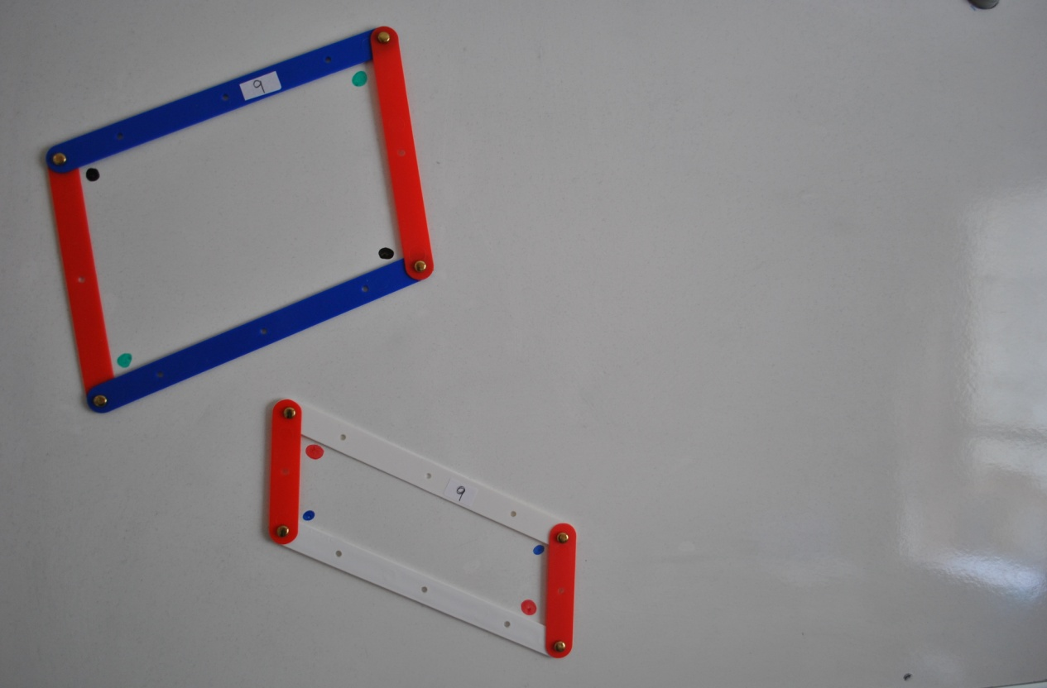
* In a parallelogram, opposite sides are equal, and opposite angles are equal.
Conversely (1) If the opposite angles of a convex quadrilateral are equal, then it is a parallelogram;
(2) If the opposite sides of a convex quadrilateral are equal, then it is a parallelogram. (All Levels)
* Proof H/L JC

Slide 11
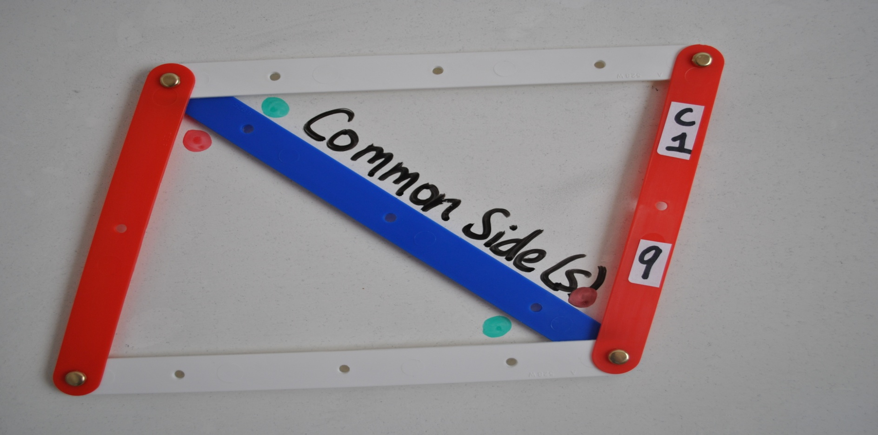
Theorem 9: Corollary 1
A diagonal divides a parallelogram into two congruent triangles. (JC H/L & LC H/L)

Slide 12
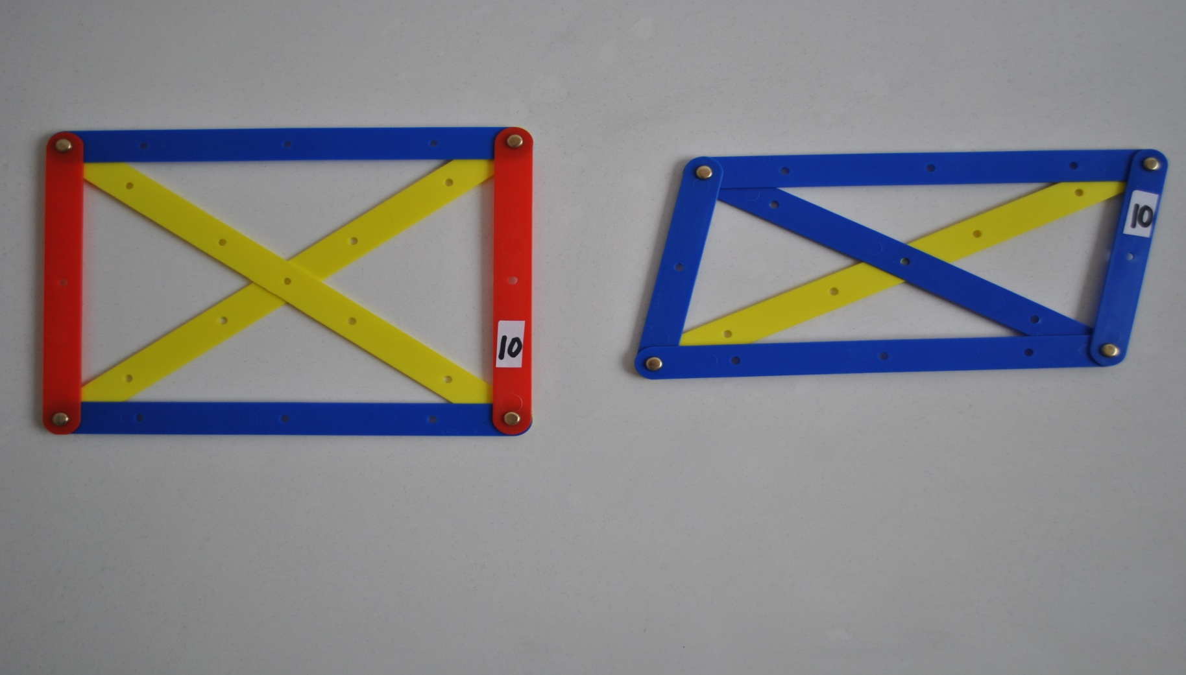
The diagonals of a parallelogram bisect each other. Conversely, if the diagonals of a quadrilateral bisect one another, then the quadrilateral is a parallelogram. (All Levels)

Slide 13
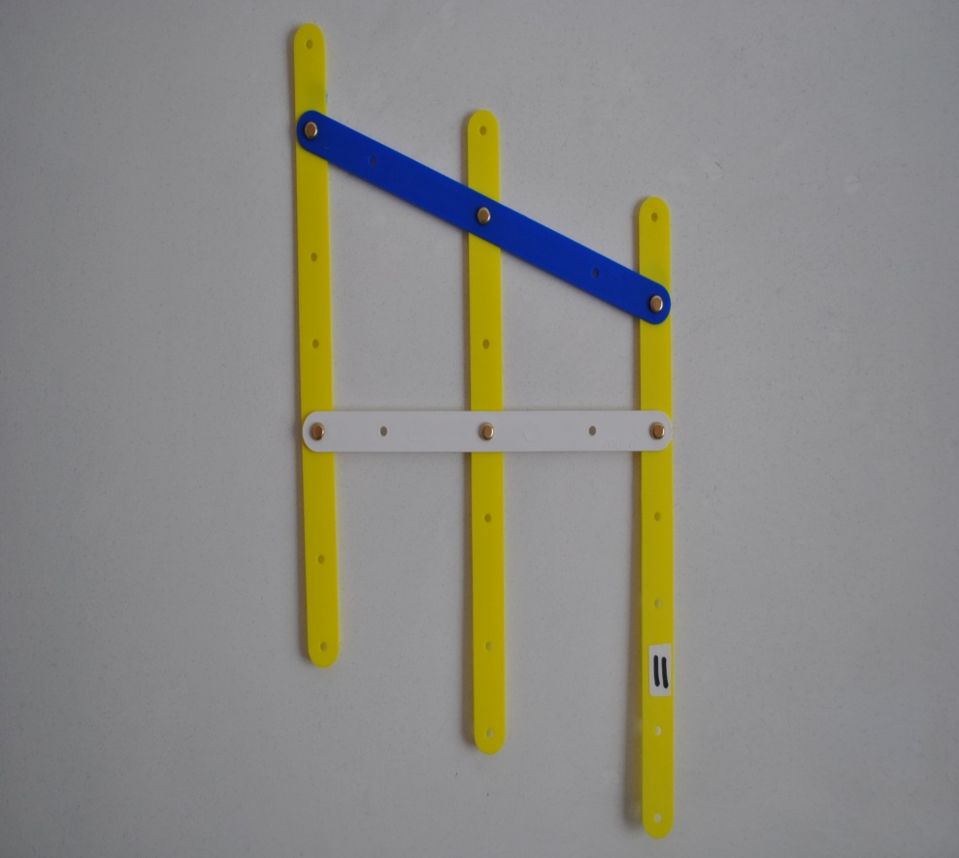
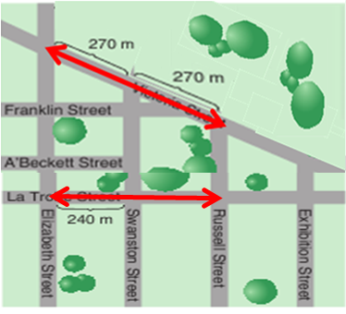
If three parallel lines cut off equal segments on some transversal line, then they will cut off equal segments on any other transversal (JC H/L + LC O/L & H/L). * Proof Required LC H/L
How far is it from Elisabeth St to Russell St?

Slide 14
Theorem 18
The area of a parallelogram is the
base x height.
LC (O/L & H/L).
* In a parallelogram, opposite sides are equal, and opposite angles are equal.
Conversely (1) If the opposite angles of a convex quadrilateral are equal, then it is a parallelogram;
(2) If the opposite sides of a convex quadrilateral are equal, then it is a parallelogram. (All Levels)
* Proof H/L JC

Slide 15
Theorem 17:
A diagonal of a parallelogram bisects the area. LC (O/L & H/L)
Theorem 9: Corollary 1
A diagonal divides a parallelogram into two congruent triangles. (JC H/L & LC H/L)

Slide 16
The diagonals of a parallelogram bisect each other. Conversely, if the diagonals of a quadrilateral bisect one another, then the quadrilateral is a parallelogram. (All Levels)

Slide 17
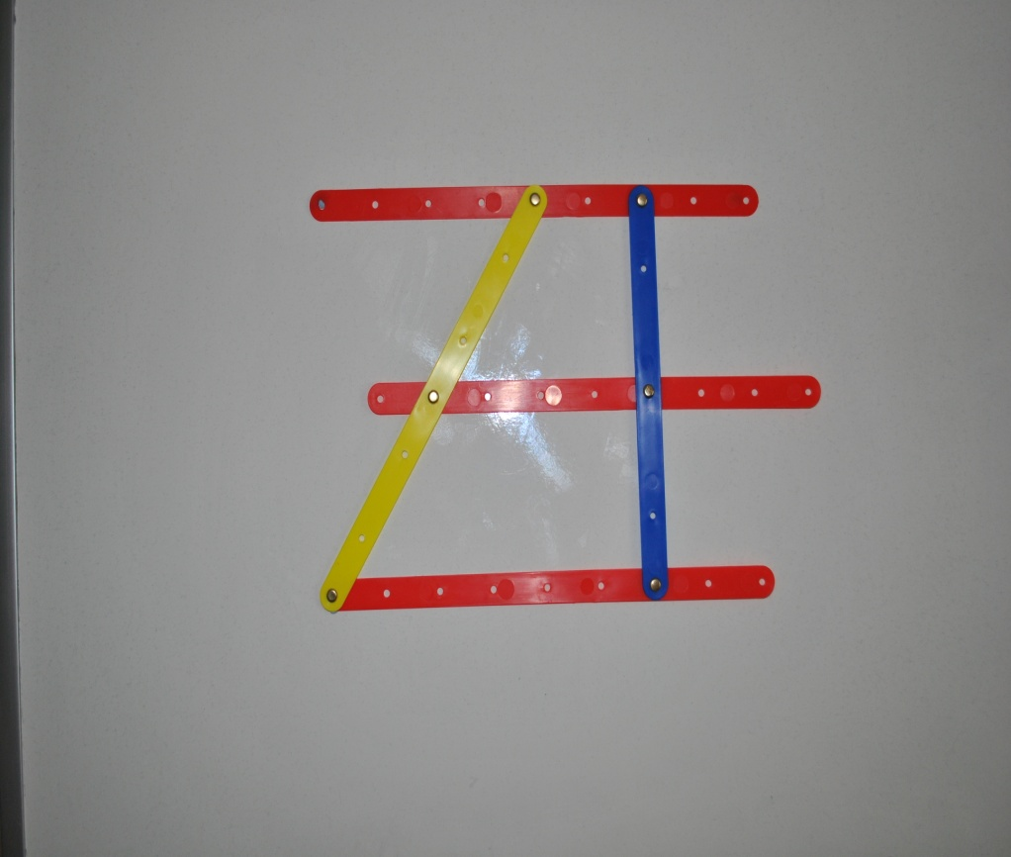
If three parallel lines cut off equal segments on some transversal line, then they will cut off equal segments on any other transversal (JC H/L + LC O/L & H/L). * Proof Required LC H/L
How far is it from Elisabeth St to Russell St?

Slide 18
Purpose
Can you put a title to this theorem?

Slide 19
Student Activity –Theorem 13 All LEVELS * Proof Required H/L LC

Slide 20
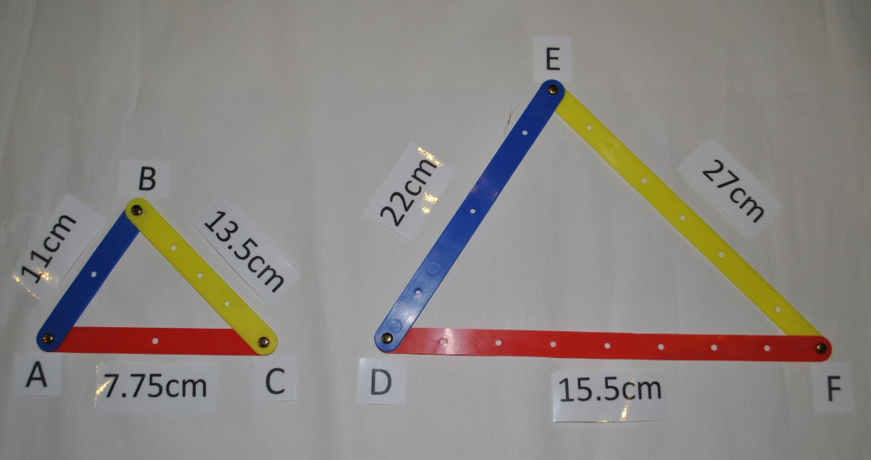
Student Activity

Slide 21
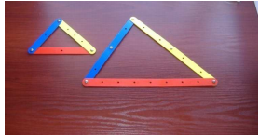
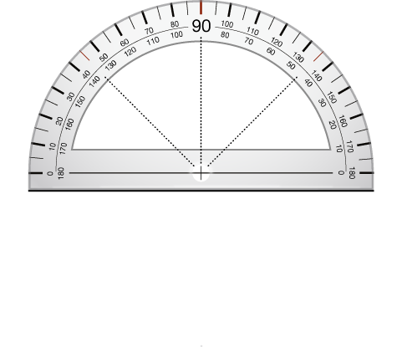
Student Activity
B
A C
E
D F
Notes:
Can you replace the front picture here with the new picture on the previous slide?

Slide 22
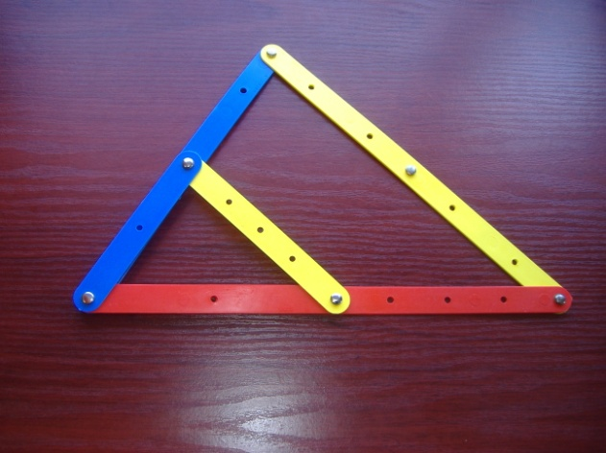
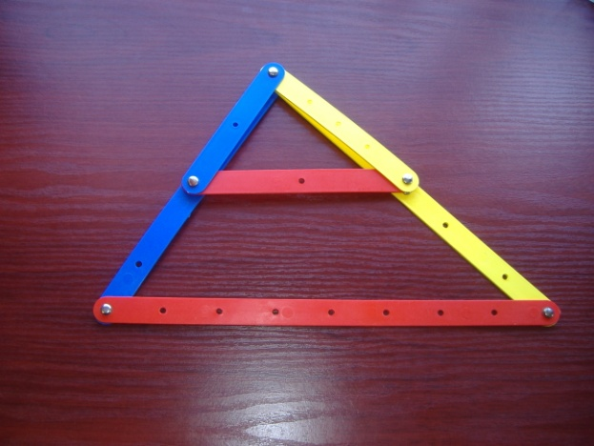
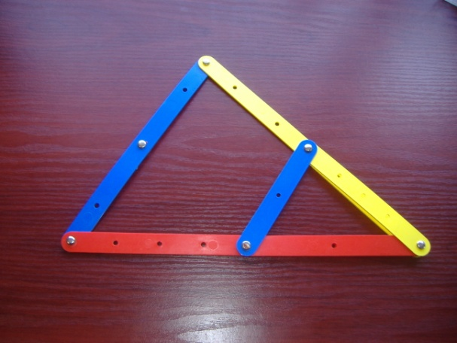
B
A C
E
D F

Slide 23
58⁰
58⁰
78⁰
78⁰
44⁰
44⁰

Slide 24
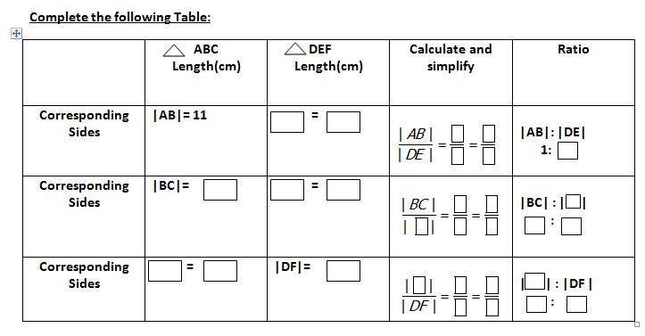
Student Activity 1 Continued
|AB|
=
|DE|
11
1
=
=
2
22
2
|BC|:| |
:
|BC|=
13.5 cm
|BC|
=
|EF|
|BC| | |
13.5
1
EF
EF
=
=
27
2
1
2
| | |DF|
15.5
1
| |:|DF|
:
=
=
AC
AC
|AC|
15.5 cm
|AC|
|DF|
=
=
31
2
1
2
Notes:
New version of Student Activity 1 to go in here

Slide 25
Purpose
Can you put a title to this theorem?

Slide 26
Theorem 13
If two triangles are similar, then their sides are proportional, in order.

Slide 27
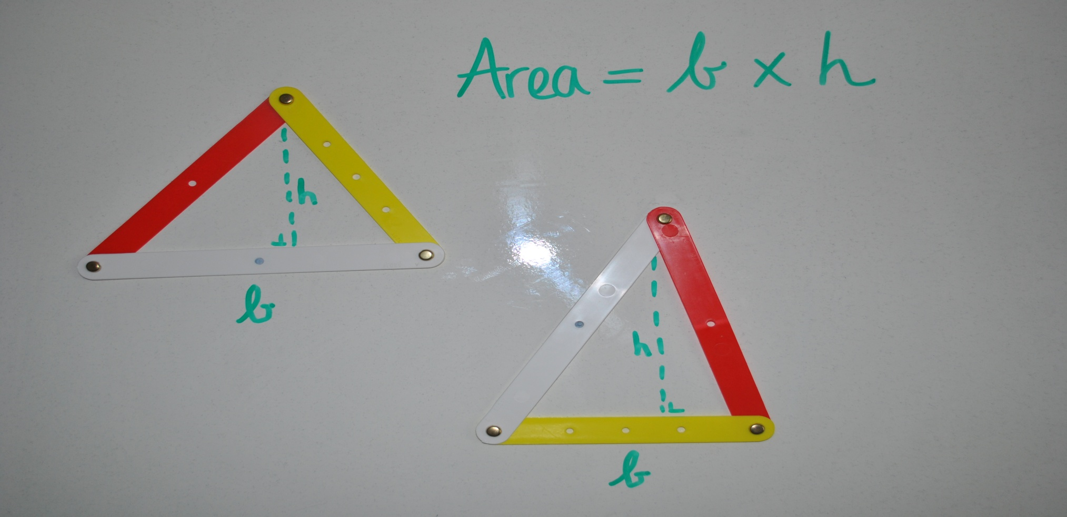
For a triangle , base times height does not depend on the choice of base.
LC (O/L & H/L)
$$\frac{1}{2}$$

Slide 28
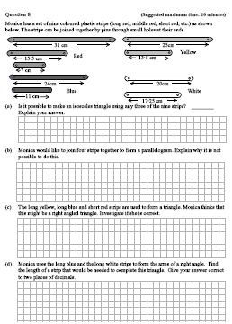
Exam Question 2011 Sample Paper JC H/L Q8 Paper 2 Pg 13

Slide 29
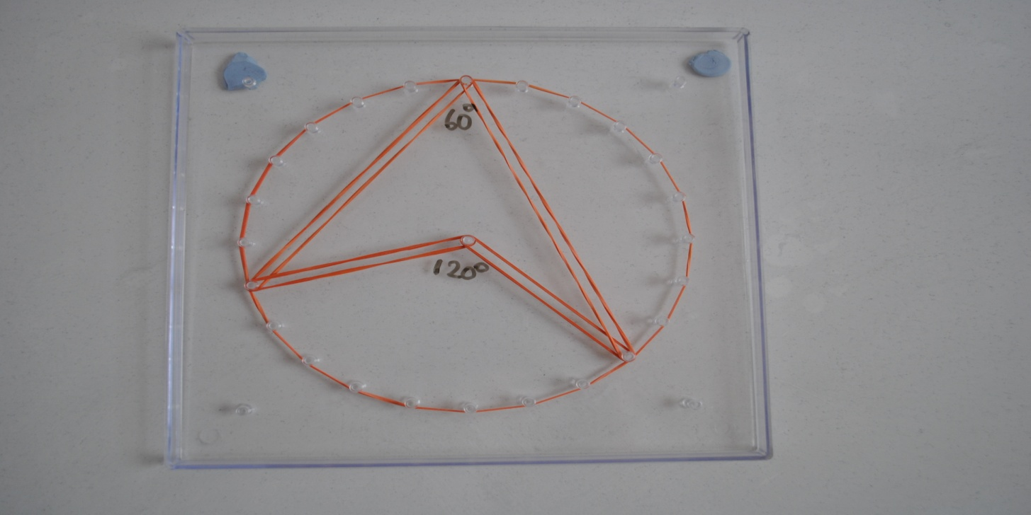
Circular Geoboards-Circle Theorems
Examples Theorems 19+ 4 Corollaries & Theorem 21.
The angle at the centre of the circle standing on a given arc is twice the angle at any point of the circle standing on the same arc. (H/L JC + H/L LC)
* Proof Required JC H/L

Slide 30
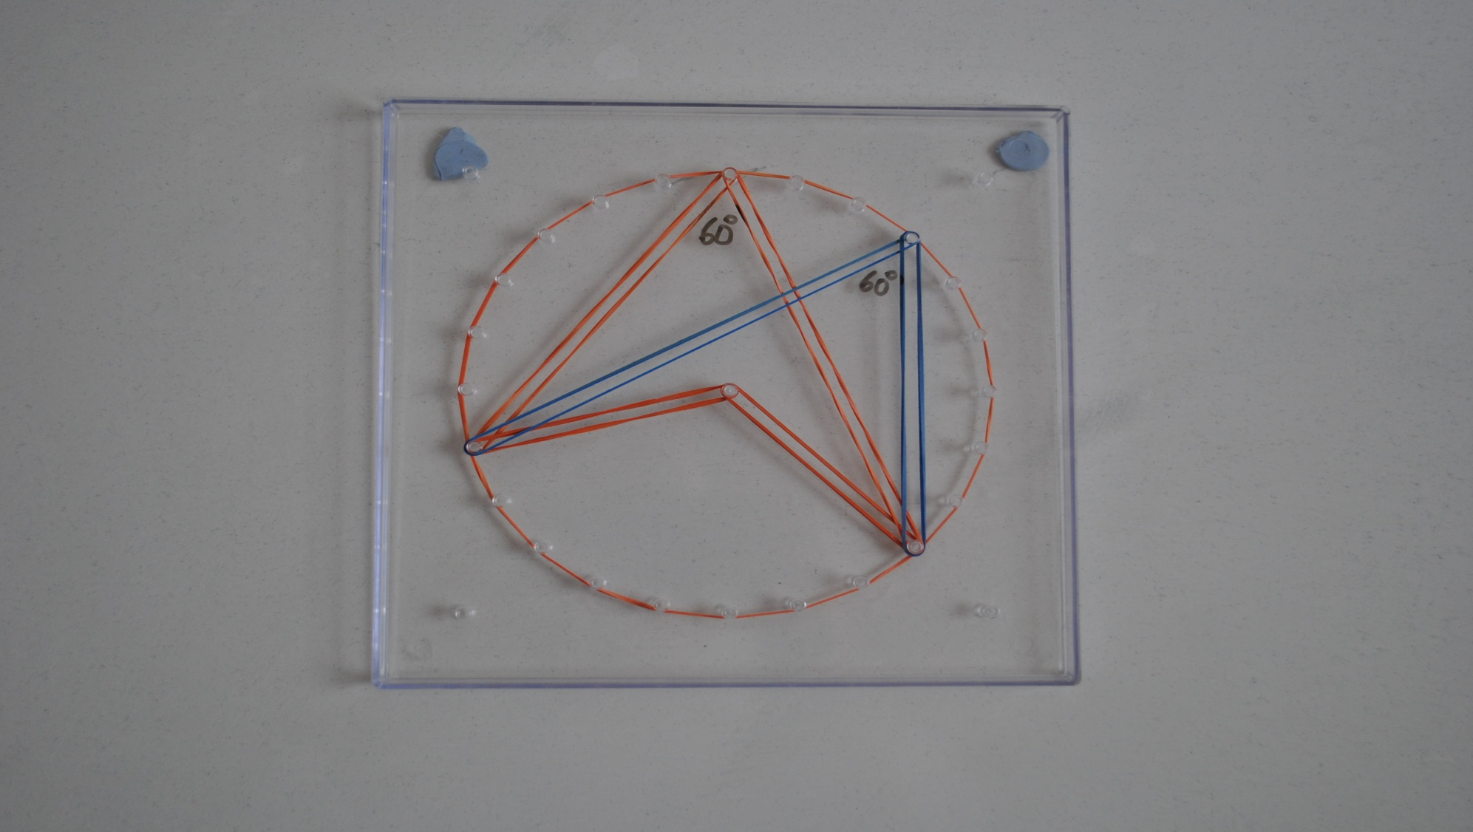
All angles at points of a circle, standing on the same arc are equal (and converse). (H/L JC + H/L LC)

Slide 31
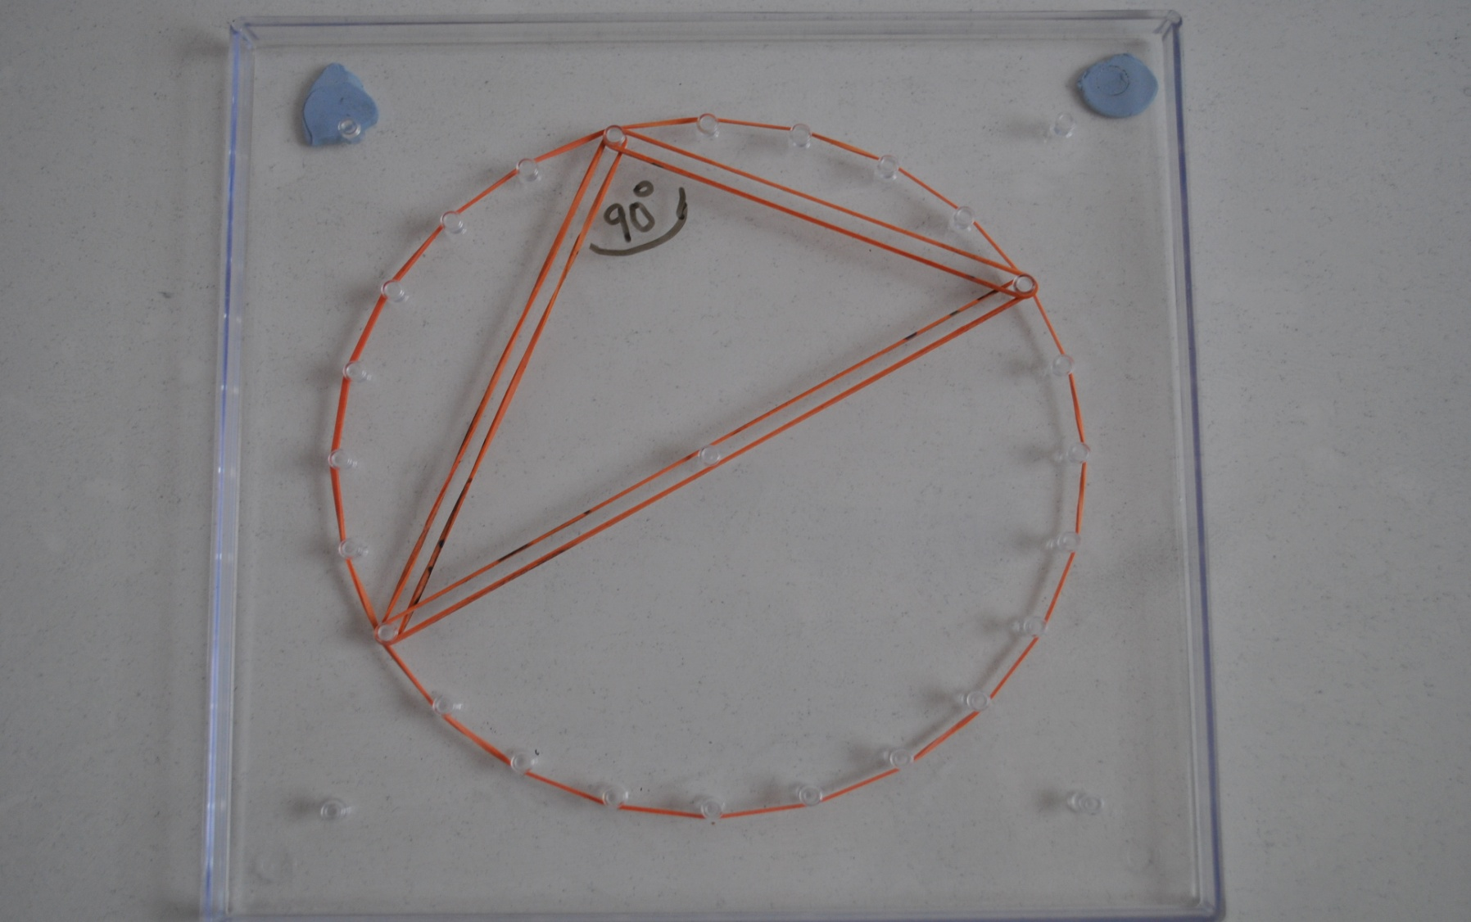
Each angle in a semi-circle is a right angle. (ALL Levels)

Slide 32
If ABCD is a cyclic quadrilateral, then opposite angles sum to 180°. (H/L JC + H/L LC)

Slide 33
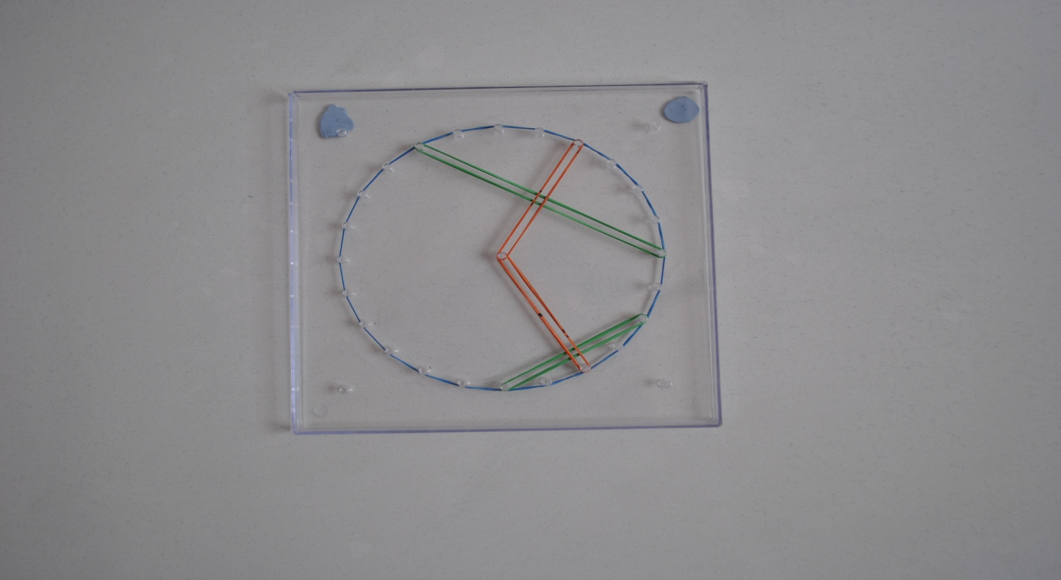
(i) The perpendicular from the centre to a chord bisects the chord. (ii) The perpendicular bisector of a chord passes through the centre . (O/L LC + H/L LC)

Slide 34
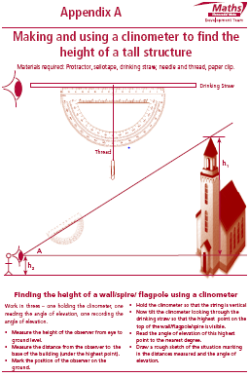
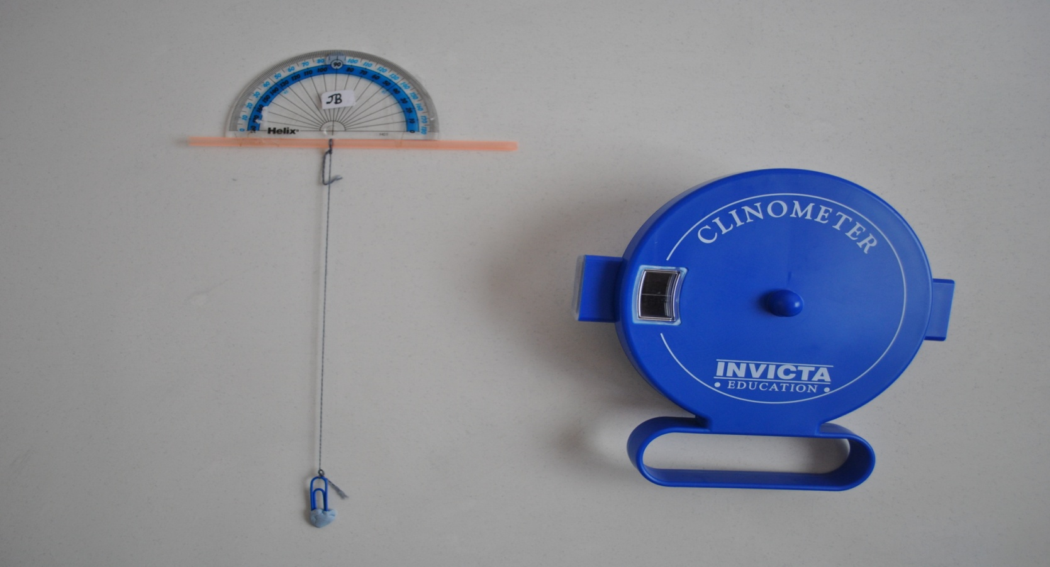
Making and using a Clinometer Teaching & Learning Plan 8
Making a clinometer (Appendix A: T&L 8)
Materials required:
Protractor, sellotape, drinking straw, thread, paper clip & blu-tak
Solution

Slide 35
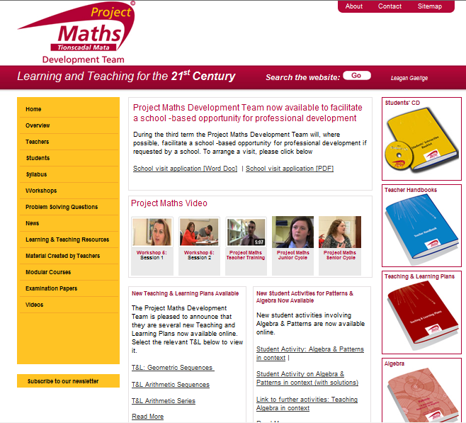
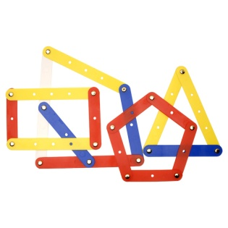
How best to use the Student CD! www.projectmaths.ie
Simply click on the image for “Student Cd”

