Slide 1
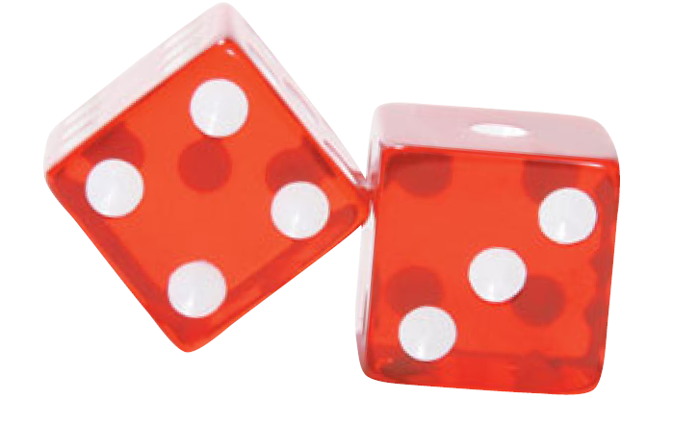
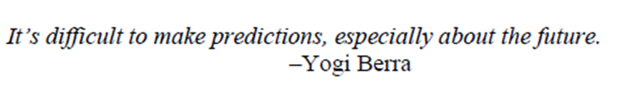
Expected Value and Fair Games

Slide 2
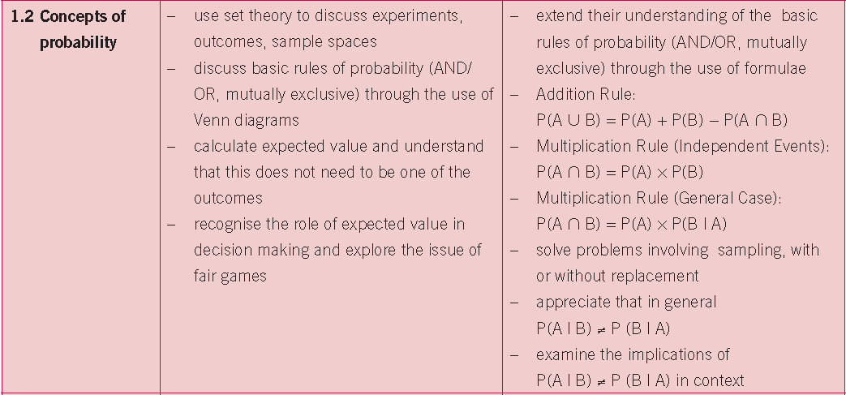
Syllabus
Prior Knowledge: Understanding of basic Probability theory

Slide 3

Numbers Up!
A funfair game called Numbers Up! involves
rolling a single die. Here are the rules:
You win the number that
appears on the die in €uro
€4 for a 4
€6 for a 6 etc

Slide 4


Activity 1
How much did you win?
2. Work out your average(mean) amount you won per
game having played the game 20 times.
3. When you have the value for the class mean, fill in
the table below:

Slide 5

Activity 1
4. Does your average differ from that of the class?
What could explain this?
5. What do you think the class average figure represents
in the context of the game?
6. Would you pay €3 to play this game? Give a reason for
your answer.
7. If you ran the Numbers Up! game at the funfair, how
much would you charge people to play it? Explain your
answer.
8. What do you think would be a fair price to pay
to play this game? Why?

Slide 6

A Fair Price?
If I roll a standard die many times what is the average score I can expect?

Slide 7



Probability Distribution Table
Score (X) | 1 | 2 | 3 | 4 | 5 | 6
Probability P(X) | 1/6 | 1/6 | 1/6 | 1/6 | 1/6 | 1/6
Numbers Up!

Slide 8
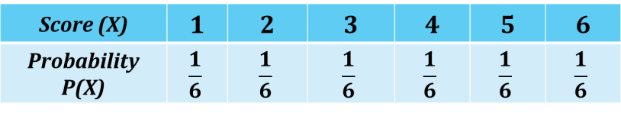
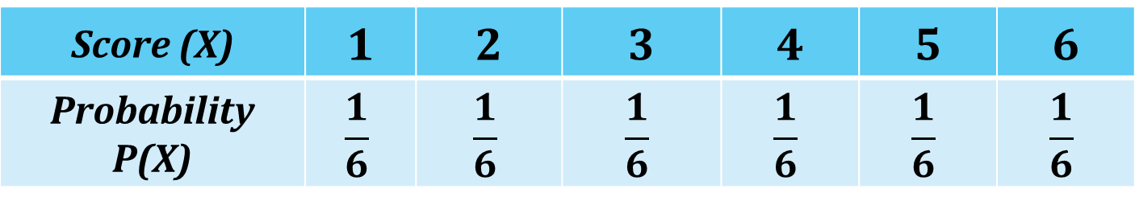
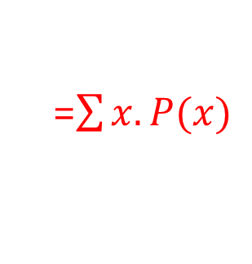
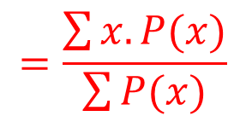
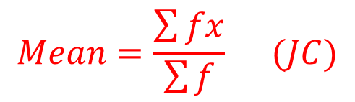
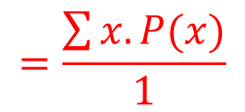
Probability Distribution Table
Score (X) | 1 | 2 | 3 | 4 | 5 | 6
Probability P(X) | $$\frac{1}{6}$$ | $$\frac{1}{6}$$ | $$\frac{1}{6}$$ | $$\frac{1}{6}$$ | $$\frac{1}{6}$$ | $$\frac{1}{6}$$
$$Mean=\frac{\sum{fx}}{\sum{f}} (JC)$$
$$=\frac{\sum{x.P(x)}}{\sum{P(x)}}$$
$$=\frac{\sum{x.P(x)}}{1}$$
Numbers Up!
=$\sum{x.P(x)}$

Slide 9
Expected Value
How much money a player can expect to win/lose in the long run on a particular bet
“The House Edge”/ Risk Analysis and
Insurance/ Economics (Decision Theory)
Mean: average of what HAS happened
Expected Value: average of WHAT IS GOING to happen

Slide 10
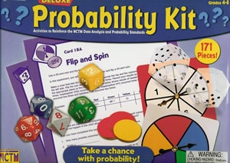
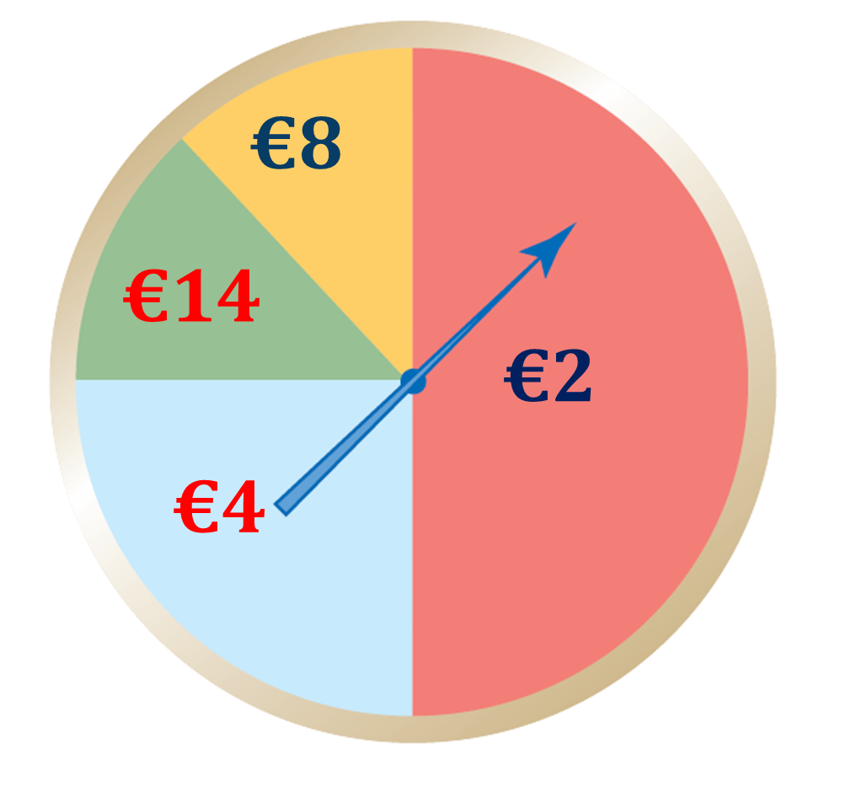
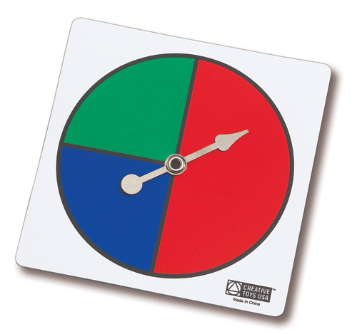
Teaching Idea

Slide 11
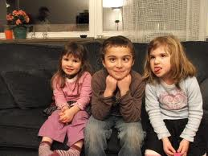
Mathematical Expectation
Suppose a couple decide to have three children.
How many boys can they expect to have?
Assume boys and girls are equally likely.

Slide 12
Sample Space
3rd
2nd
BBB
Start
B
B
G
G
B
B
G
G
B
G
B
G
B
G
1st
BBG
BGB
BGG
GBB
GBG
GGB
GGG

Slide 13

Mathematical Expectation
No of Boys | 0 | 1 | 2 | 3
Probability
No of Boys | 0 | 1 | 2 | 3
Probability | 1/8 | 3/8 | 3/8 | 1/8

Slide 14


Fair or Unfair?
€5 to play
€8
€2

Slide 15
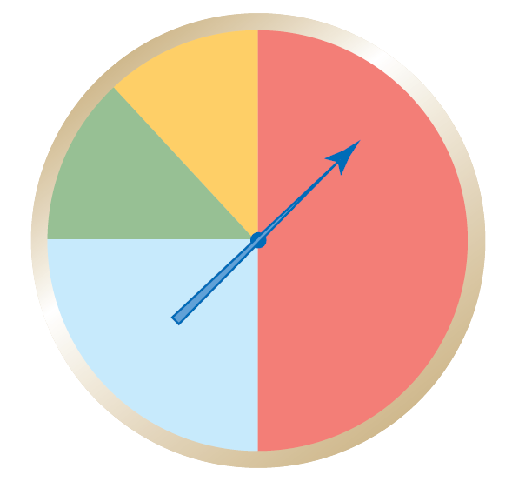

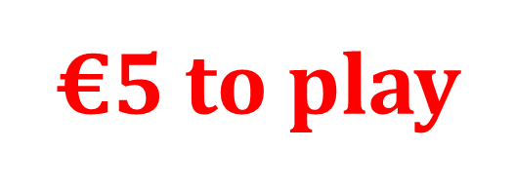
Fair or Unfair? Use Two Methods
€8
€14
€2
€4

Slide 16

Fair Games
Fair Game
A game is said to be fair if the expected value (after considering the cost) is 0. If this value is positive, the game is in your favour; and if this value is negative, the game is not in your favour.

Slide 17
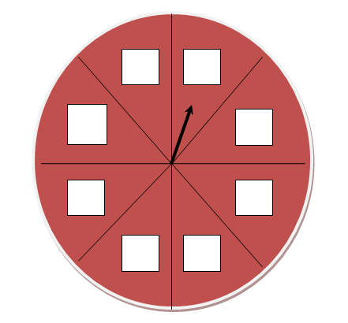
Teaching Idea: Designing Games

Slide 18
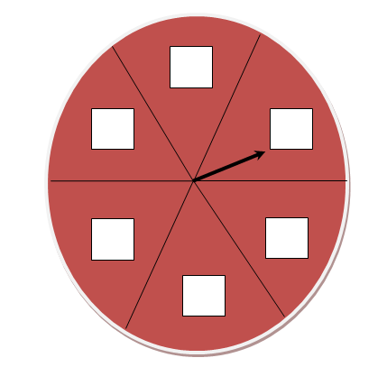
Teaching Idea: Designing Games

Slide 19

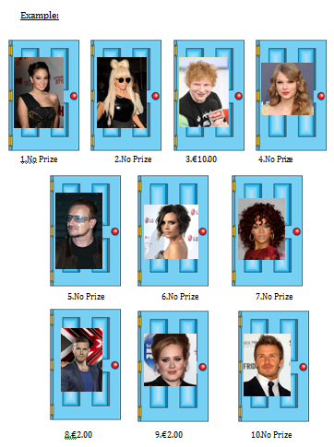
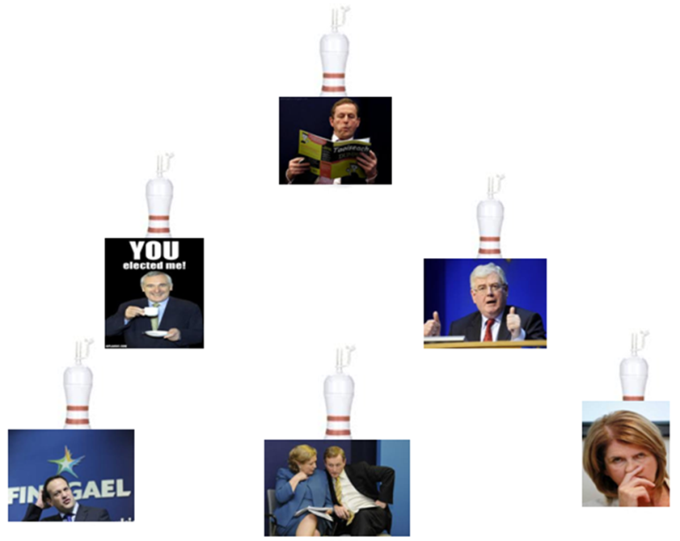
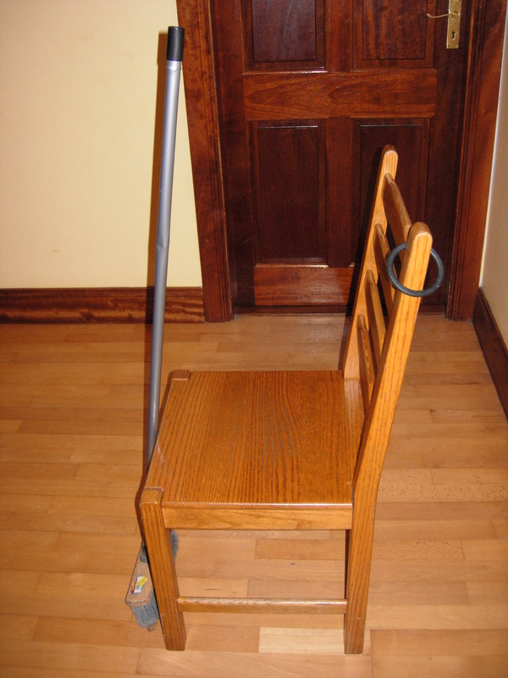
Teaching Idea-Carnival Games
Maths Counts
Insights into Lesson Study
Notes:
Powerpoint available at www.projectmaths.ie

Slide 20
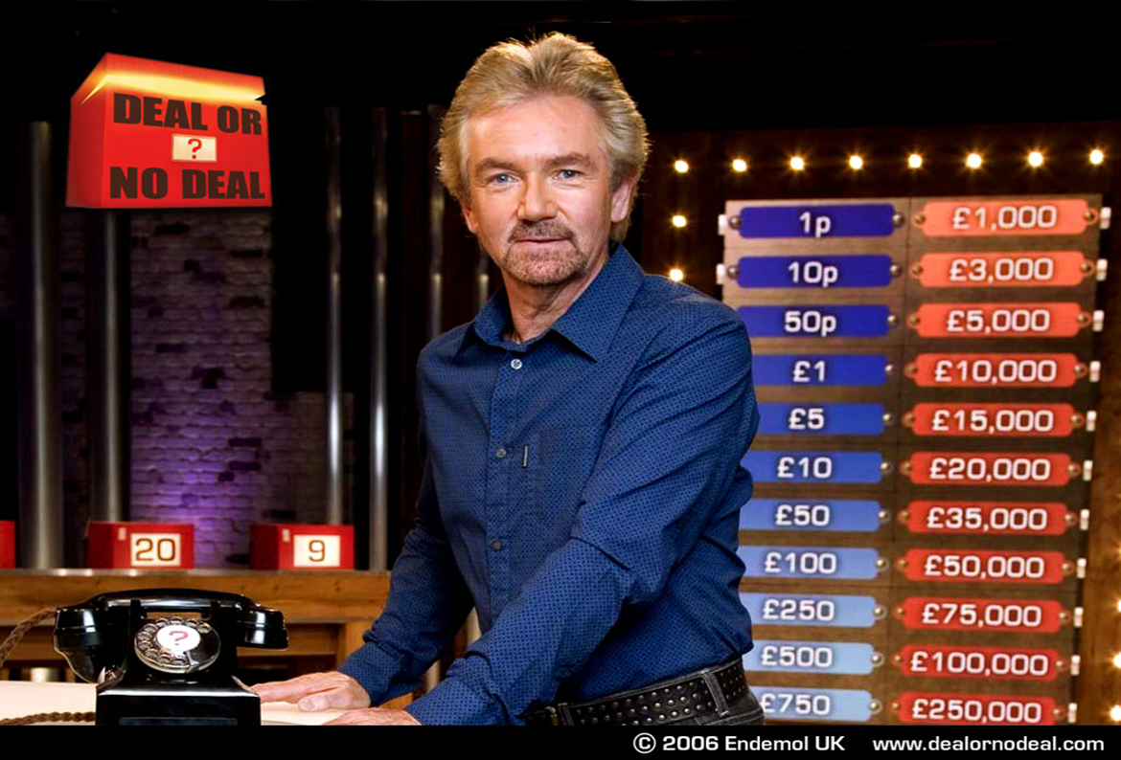
Expected Value: Towards a Deeper Understanding

Slide 21
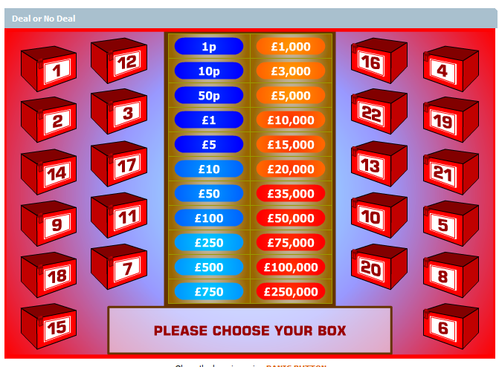
Expected Value: Towards a Deeper Understanding

Slide 22
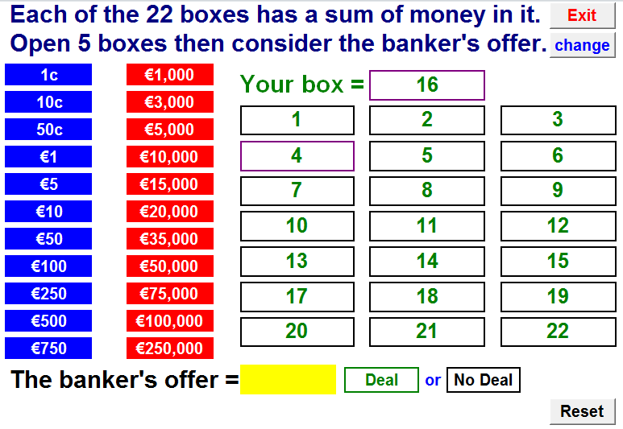
Let’s Play!!

Slide 23

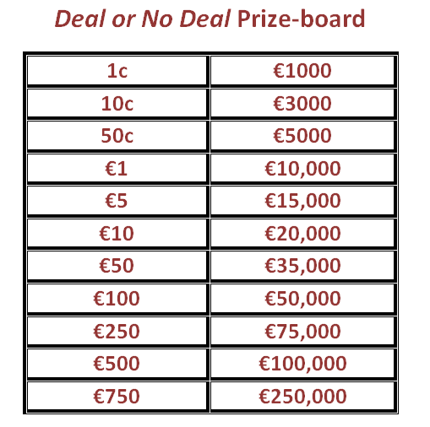
Prize Board: What’s the Expected Value?

Slide 24
Expected Value

Slide 25
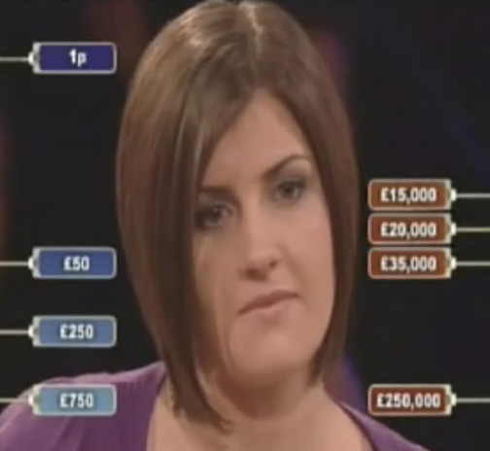
Expected Value and Fair Games
Notes:
Link to video file

Slide 26
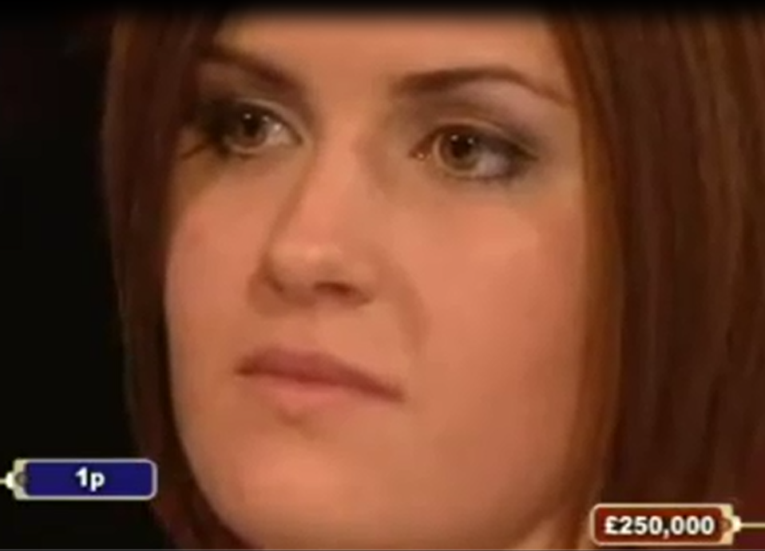
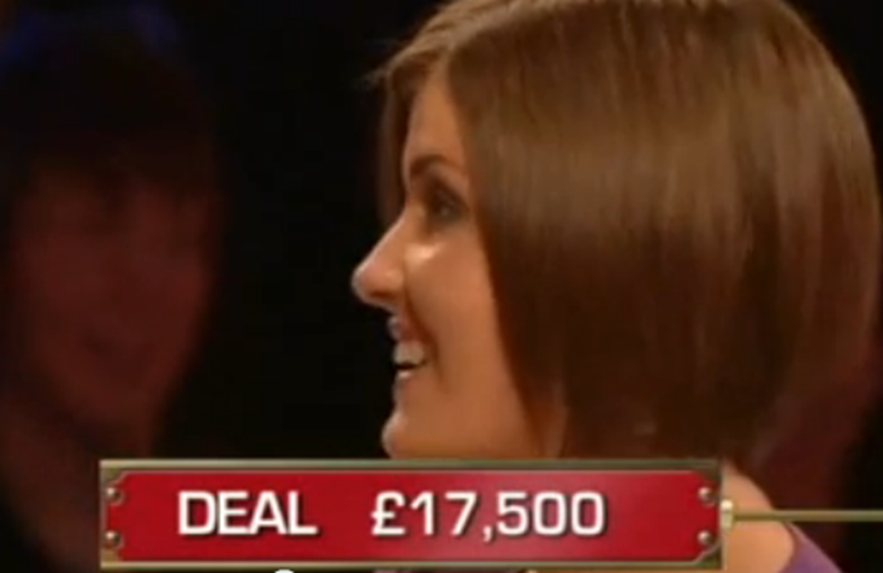
A Sting in the Tale!!
Notes:
Link to video file

Slide 27
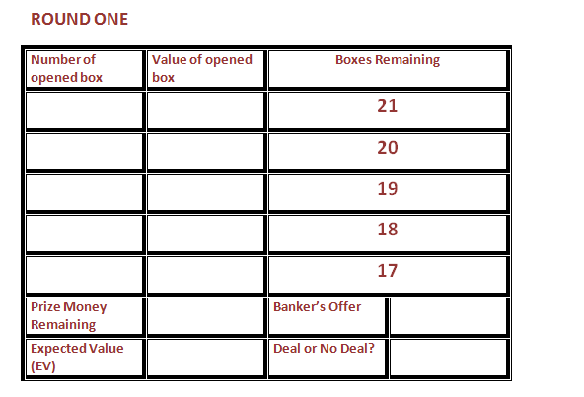
Teaching Idea: Let’s Track a Game

Slide 28
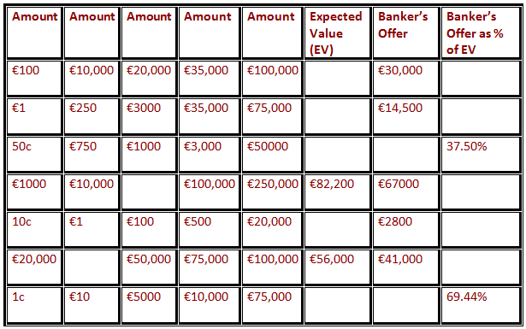
Teaching Idea: Working Backwards

Slide 29

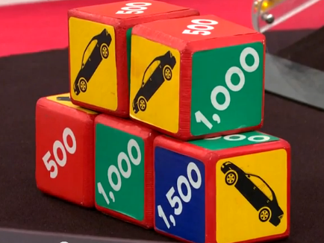
“Let Em Roll”

Slide 30
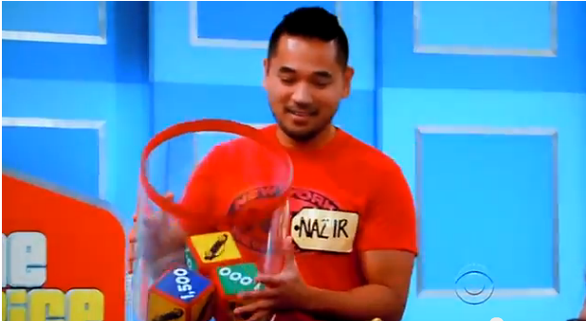
Nazir “Let Em Roll” Feb 2013
On Nazir’s final roll of the dice, what is the probability that he doesn’t win the car?

Slide 31
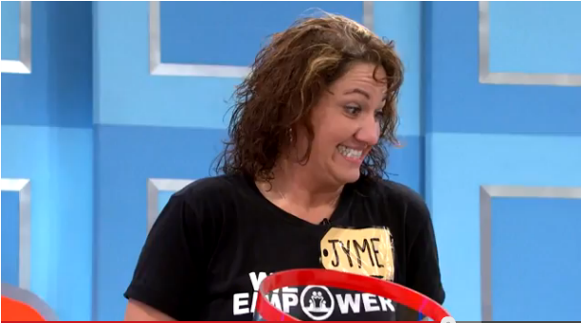
Jyme “Let Em Roll” Oct 2013

Slide 32
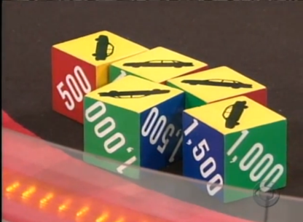
Problem Solving with Expected Value
Jyme has three cars with one roll remaining. Assuming the car is worth €15,000,
Find the probability that she’ll win the car on the last roll.
Find her expected pay-off based on re-rolling the last two dice.
How much money would you need to have showing on those remaining dice after the second roll not to risk it?

Slide 33
Two Way Table
 | Car | Car | Car | 500 | 1000 | 1500
Car | CAR | CAR | CAR | 500 | 1000 | 1500
Car | CAR | CAR | CAR | 500 | 1000 | 1500
Car | CAR | CAR | CAR | 500 | 1000 | 1500
500 | 500 | 500 | 500 | 1000 | 1500 | 2000
1000 | 1000 | 1000 | 1000 | 1500 | 2000 | 2500
1500 | 1500 | 1500 | 1500 | 2000 | 2500 | 3000

Slide 34

Solution
X | 500 | 1000 | 1500 | 2000 | 2500 | 3000 | 15,000
P(X) | 6/36 | 7/36 | 8/36 | 3/36 | 2/36 | 1/36 | 9/36
The expected payoff if you re-roll the two dice is
$500(6/36) + $1000(7/36) + … + $15,000(9/36) = $4,750
But if you have exactly three cars showing after two rolls, the largest money amount you could win is $3000. So, based on expected value, you should re-roll the last two dice no matter what.

Slide 35


Making Decisions
Should I buy that extended warranty on my new €99.99 printer?
Notes:
Argos are keen for me to buy the insurance- the cost of the warranty to me is greater than the expected cost to Argos to fix the printer. If this wasn’t the truth then they wouldn’t be selling it as aggressively!
On average you will pay more for the warranty than to fix or replace the printer.
Core lesson: I should only insure myself against any adverse contingency that I can’t afford to withstand. I should skip buying insurance on everything else!
Should Bill Gates purchase any insurance?

Slide 36
In Summary
The Expected Value of a random variable X is the weighted average of the values that X can take on, where each possible value is weighted by its respective probability
Informally, an attempt at describing the mean of what is going to happen.
Expected Value need not be one of the outcomes.

