Slide 1
A Quote
“Teachers spend much more time
worrying about what they are going
to tell students than thinking about what
experiences they are going to provide
for students. To ensure that students learn
in class requires carefully designed
experiences that keep them engaged
and make them think”
Weisman

Slide 2
Chief Inspector’s Report
Teach for Understanding
Mathematical Rigour
Students Collaborating
Making Connections
Challenge Able Students
Justify Reasoning

Slide 3
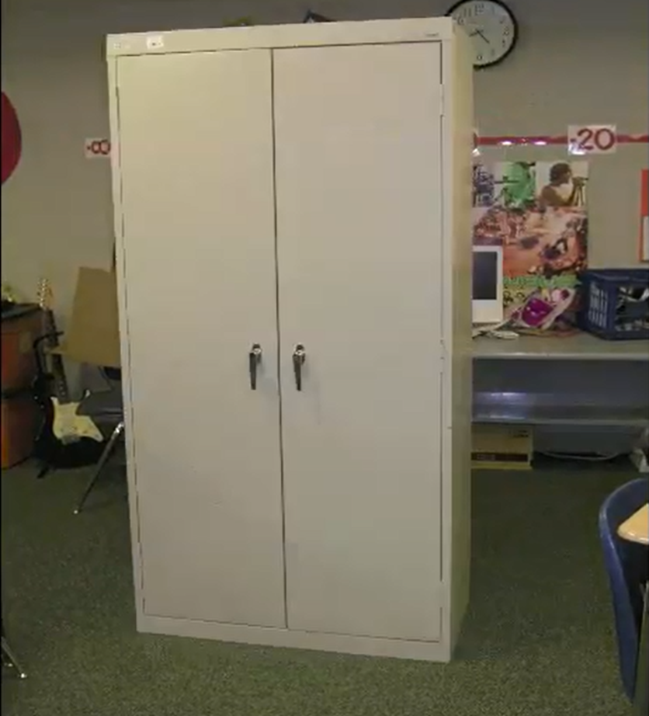
A Different Type of Lesson 1
Watch the video
and try to guess
the question I’m
going to ask!!

Slide 4
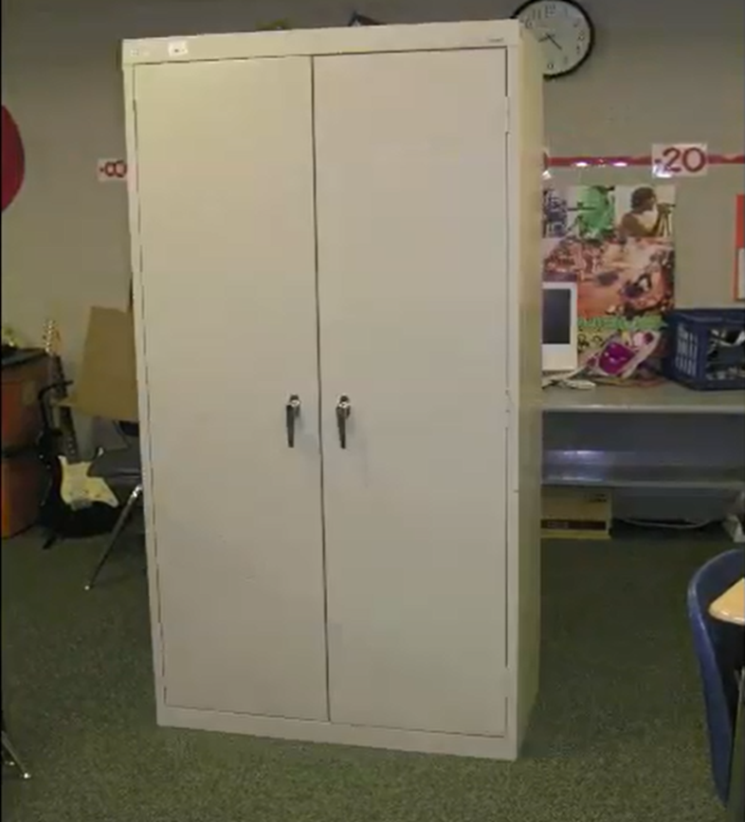
Guesstimation!
Without any calculations, guesstimate how
many Post-its are needed to cover all sides
of the file cabinet apart from the base?
(P.S. you are allowed to get it wrong!!!)

Slide 5
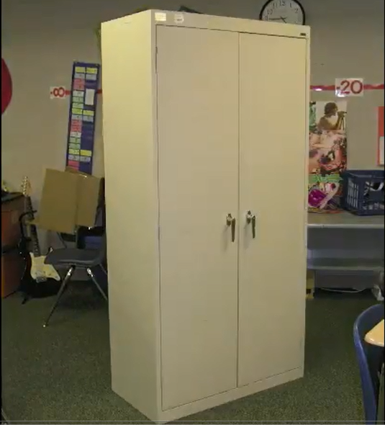
What information would be useful to know?

Slide 6
A Different Type of Lesson
7.618cm

Slide 7
A Different Type of Lesson

Slide 8
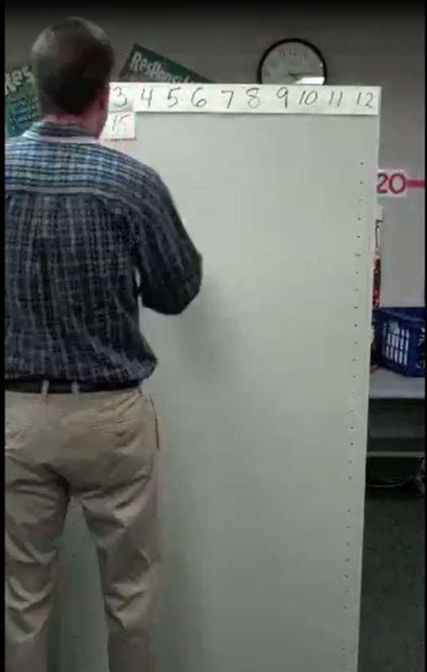
A Hint!!

Slide 9
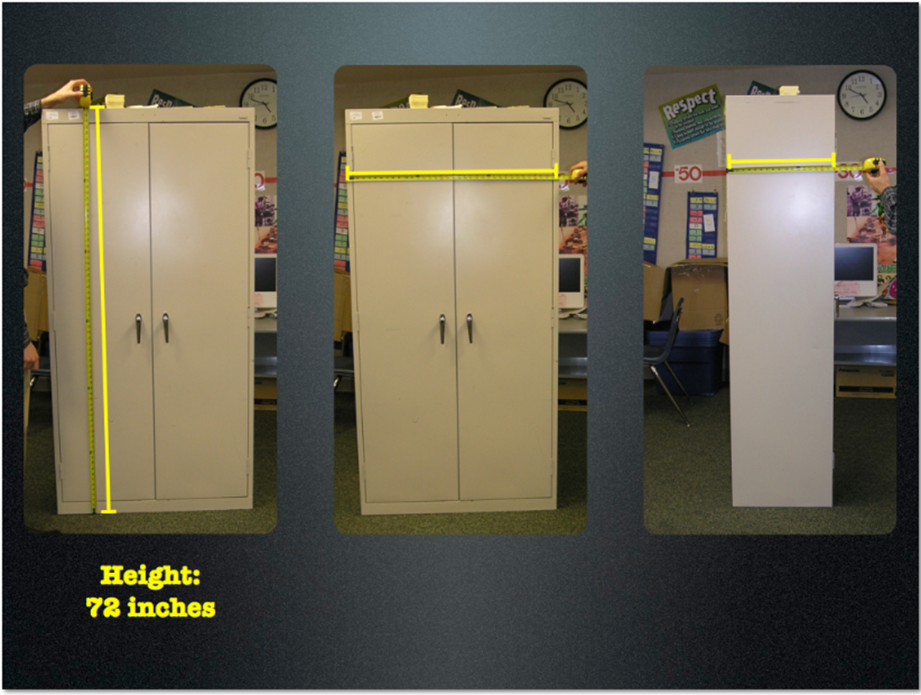
Actual Dimensions
Height
183cm
Width
91 cm
Depth
46 cm
Width
91 cm

Slide 10
Do the Math!!!

Slide 11
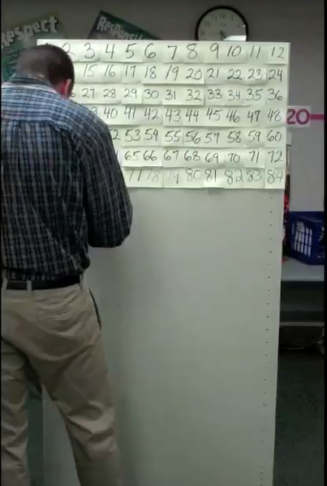
Were you right????

Slide 12
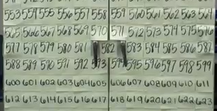
Were you right ?

Slide 13
Can you come up with further questions?
If the WIDTH of the cabinet was doubled, how many more post-its would be needed?
If the HEIGHT of the cabinet was doubled, how many more post-its would be needed?
If the DEPTH of the cabinet was doubled, how many more post-its would be needed?
How long would it take to cover if it took 40 seconds for every 5 Post-its?
If you had 1,000,000 Post-its, what kind of file cabinet could you cover?

Slide 14
Teaching this Way
Engaging for students
Covers the Learning Outcome(s). (3.4 Applied Measure)
Accessible to most abilities
“Realistic”
Differentiation: Challenging extension questions
Notes:
Idea adapted from Andrew Stadel’s blog Divisible by 3

Slide 15
A Different Type of Lesson 2
Notes:
Quote from mathematician Paul Halmos
A different type of lesson 2. Investigative style lesson

Slide 16
Challenge 1
Notes:
Square Lattice Paper
Important to keep stressing to teachers that the vertices must sit on points on the paper.
A common student error here is to join 5 dots instead of 6.
This question could also be answered in a hands-on fashion using a Geoboard and elastics.

Slide 17
Challenge 1
Notes:
Common student error is to join up 5 dots

Slide 18
Challenge 2
Notes:
Link to “Steps to Area 29” Geo file
Students to try it on their own first and then to compare with a neighbour

Slide 19
Method 1
5
1
1
1
1
1
1
5
5
1
1
1
5
Notes:
Invite different students to share their methods

Slide 20
Method 2
5
5
5
5
Notes:
This is the most common answer from students.

Slide 21
Method 3

Slide 22
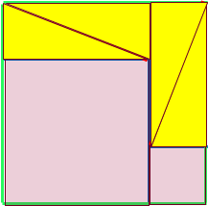
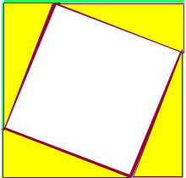
Method 3
Notes:
Other Methods:
Sqrt 29 by sqrt 29
Coordinate Geom: attach coordinates and use formula to get area of a triangle and double it
3. 0.5 abSinC

Slide 23
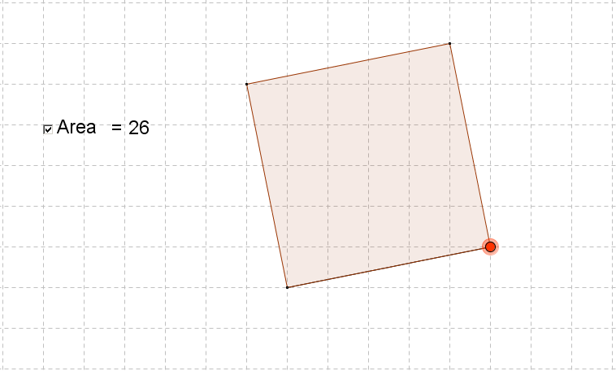
Student Misconception

Slide 24
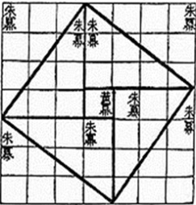
Class Investigation

Slide 25
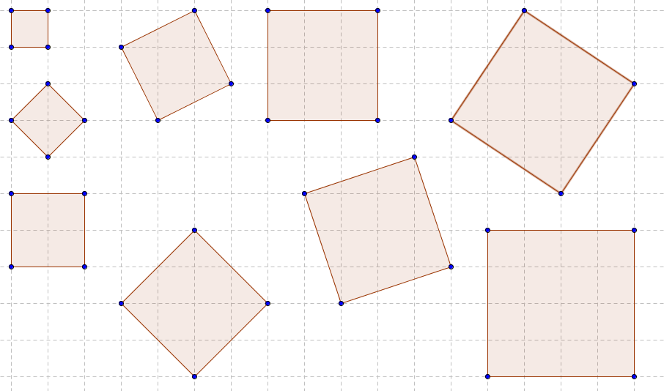
Possible Areas
1
5
9
13
2
4
10
8
16

Slide 26
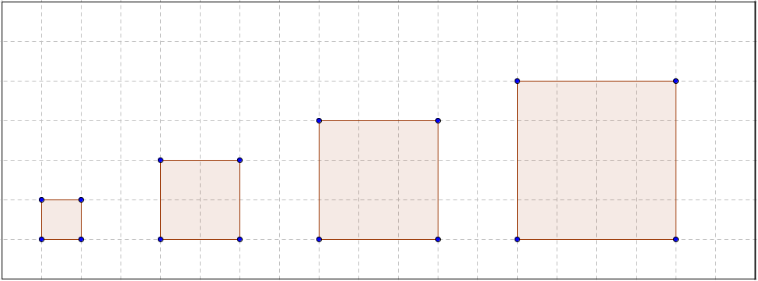
Searching for Patterns: Regular Squares
16
9
4
1
Square | 1 | 2 | 3 | 4 | ……………. | n
Area | 1 | 4 | 9 | 16 | …………….

Slide 27
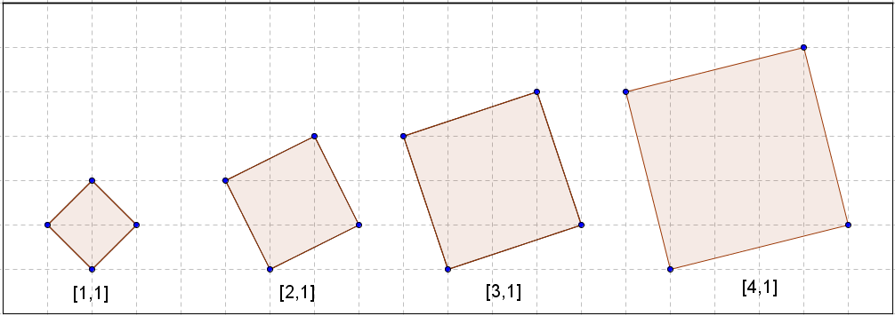
Searching for Patterns: “1-up” Tilted Squares
17
10
5
2
Square | 1 | 2 | 3 | 4 | ……………. | n
Area | 2 | 5 | 10 | 17 | …………….

Slide 28
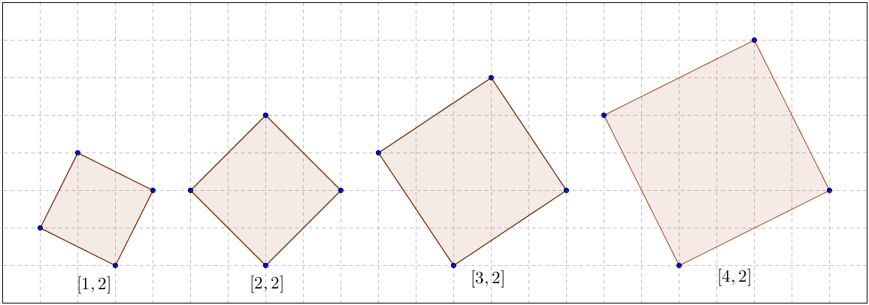
Your Turn: “2-up” Tilted Squares
20
13
8
5
Square | 1 | 2 | 3 | 4 | ……………. | n
Area |  |  |  |  | …………….
Square | 1 | 2 | 3 | 4 | ……………. | n
Area | 5 | 8 | 13 | 20 | …………….
Notes:
Questions for class:
What is the area of the 13th 2-up tilted square? (173 sq units)
Which 2-up tilted square has area of 580 square units? (24th )

Slide 29
Searching for Patterns
Square | 1 | 2 | 3 | 4 | ……………. | n
Regular | 1 | 4 | 9 | 16 | …………….
1-Up | 2 | 5 | 10 | 17 | …………….
2-Up | 5 | 8 | 13 | 20 | …………….
3-Up | 10 | 13 | 18 | 25 | …………….
4-Up | 17 | 20 | 25 | 32 | …………….

Slide 30
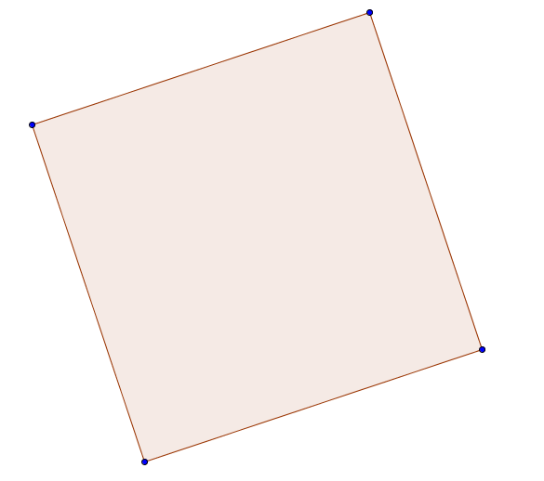
Proof: Area of a Tilted Square

Slide 31
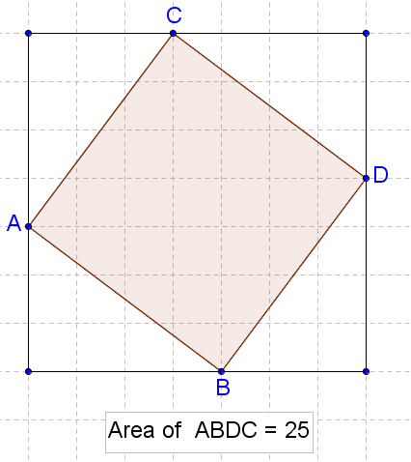
Extension Question
Notes:
100, 169 and 225. Hypotenuse squared of next three Pythagorean triples.

Slide 32
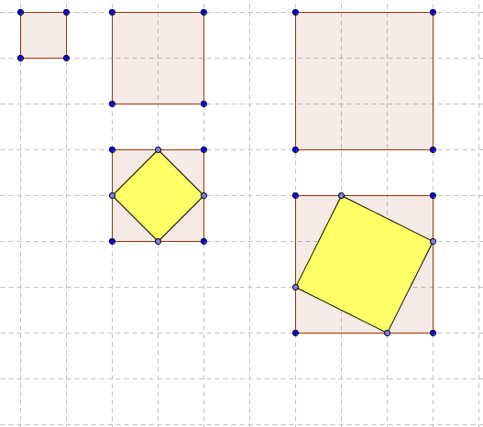
Further Investigation 1
2
5

Slide 33
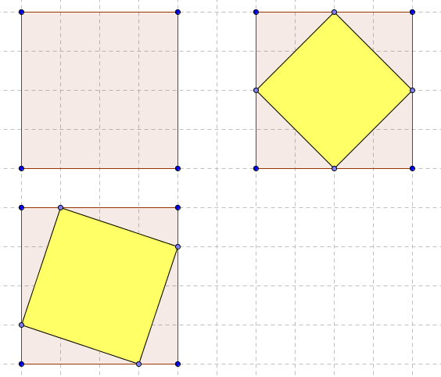
Further Investigation 1
8
10

Slide 34
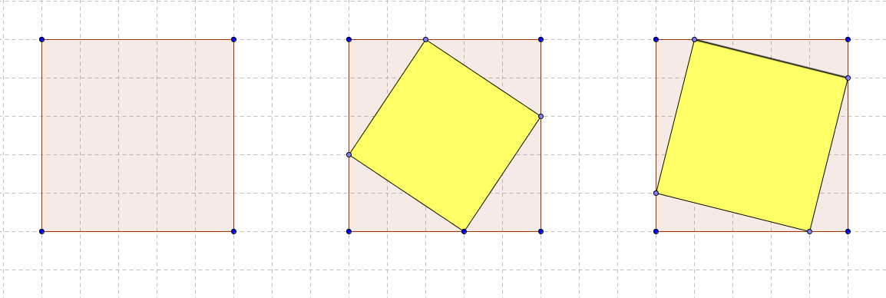
Further Investigation 1
13
17

Slide 35
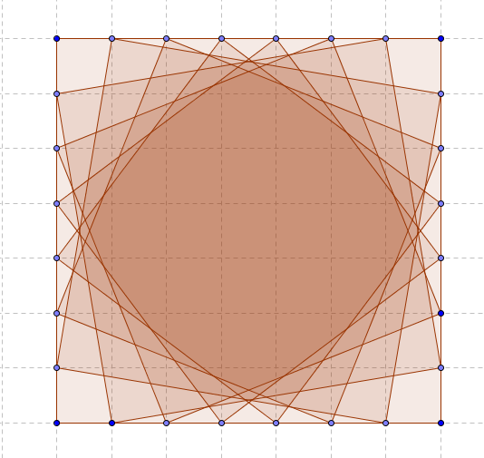
Further Investigation 1
Notes:
Double counting of tilted squares [6,1] [5,2] [4,3] [3,4] [2,5] [1,6]

Slide 36
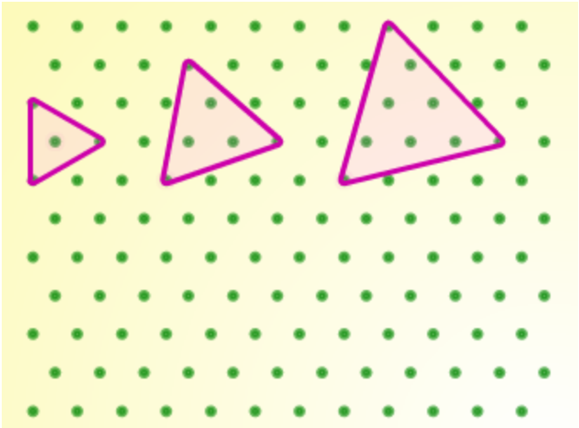
Further Investigation 2

Slide 37
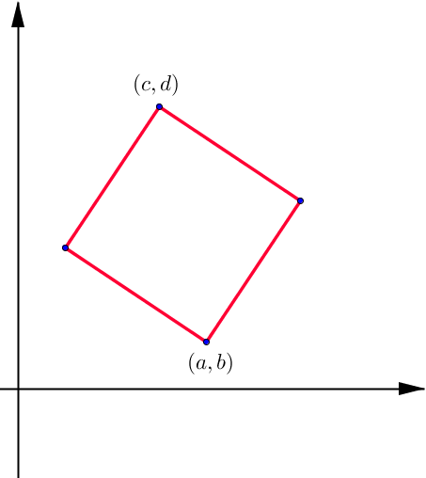
Extension 1: Pushing Brighter Students

Slide 38
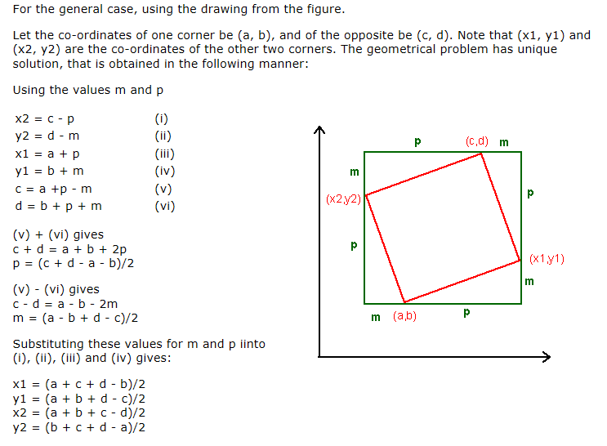
Extension 1: Pushing Brighter Students

Slide 39
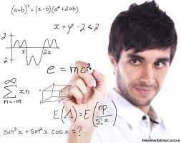
Extension 2: Pushing Brighter Students
1. Can you prove that numbers of the form 4n+3 are not possible areas of tilted squares?
2. When is a number expressible as the sum of two squares?
Notes:
Q1. It is possible to conjecture some patterns in these sequences. All square numbers leave a remainder of
0 or 1 when divided by 4. So sums of two square numbers (our areas) must leave a remainder of 0, 1,
or 2 when divided by 4. This means that if a number takes the form 4n+3 then it cannot be a tilted
area. So this tells us that 3, 7, 11, 15, … cannot be tilted areas.
Q2. A number n is expressible as a sum of two squares if, and only if, in the prime factorization of n, every prime of
the form (4k+3) occurs an even number of times! (Euler)

Slide 40
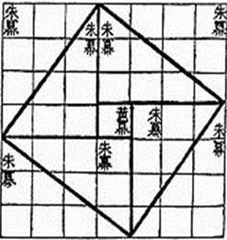
Content
Slopes of Perpendicular and Parallel lines
Pythagoras’s Theorem
Area of Squares and Right Angled Triangles
Finding areas by “dissection” methods
Surds/ Number Theory
Investigating and Collecting Data
Searching for Patterns
Generalising to a method
Proof
Reasoning, Problem Solving, Persevering.

Slide 41
Teaching this Way
Connects to other areas of the syllabus
Similar to doing “real” mathematics
Can be adapted to all levels
Level Playing Pitch (entry point is accessible for all)
Enjoyable for Students/Teacher as “guide on the side”
Preparation for exams e.g. Jigsaw question

