Slide 1
Statistics & Probability
Descriptive Statistics: descriptive statistics to summarise the data in a sample (Workshop 5)
Inferential Statistics: Using the sample statistics to infer a description of the population (Workshop 10)

Slide 2

Recap of workshop 5
Important prior knowledge

Slide 3
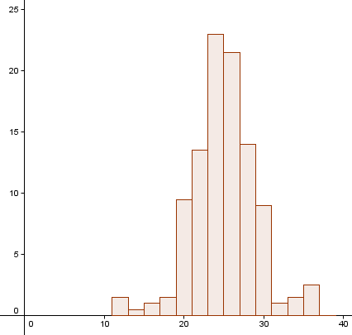
We analysed Right Foot Lengths as an example of continuous data that would be normally distributed
Notes:
Back in Workshop 5 we discovered the Empirical Rule in a similar way to how it was discovered in France almost 300 years ago by DeMoivre.
We don’t have time to repeat this activity again. You will find it in the Workshop 5 page of the website.
It’s important that we look at it again as the Empirical Rule is prior knowledge for inferential statistics.
We looked at a diagram of the distribution.
Once students discover the empirical rule and make decisions based on it they can quantify chances.
At LCOL they will quantify probabilities for the empirical rule, confidence intervals and hypothesis testing. (The figures 95%, ± 2 standard deviations/errors, 0.05 are all important here.)
At LCHL they will quantify probabilities for the empirical rule (the z-tables too), confidence intervals and hypothesis testing. . (The figures 95%, ± 1.96 standard deviations/errors, 0.05 are all important here.)

Slide 4
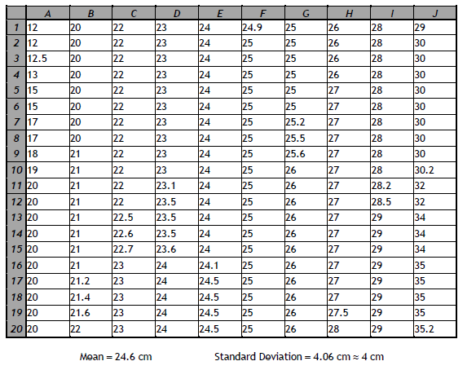
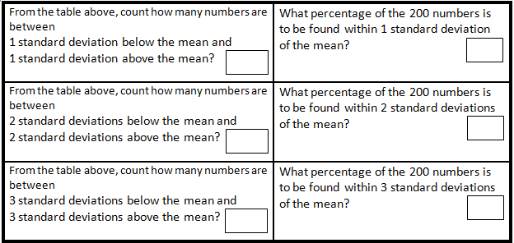
Mean
24.6
1 s.d.
20.6 | 28.6
2 s.d.
16.6 | 32.6
3 s.d.
12.6 | 36.6
144
72%
186
93%
197
98.5%

Slide 5
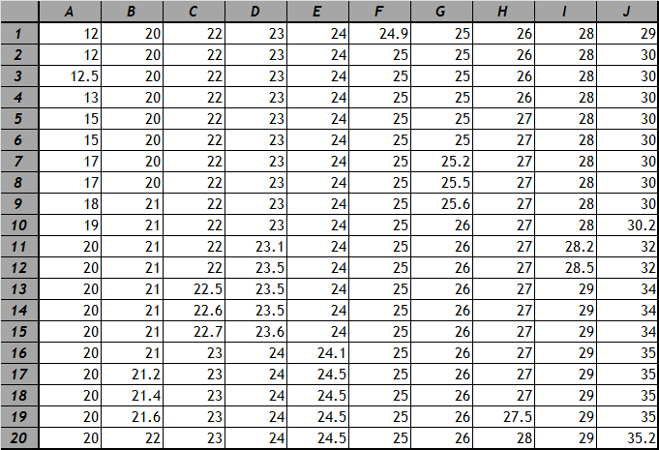
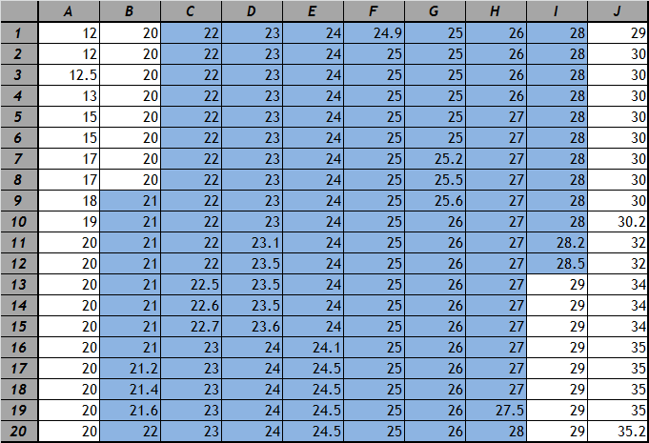
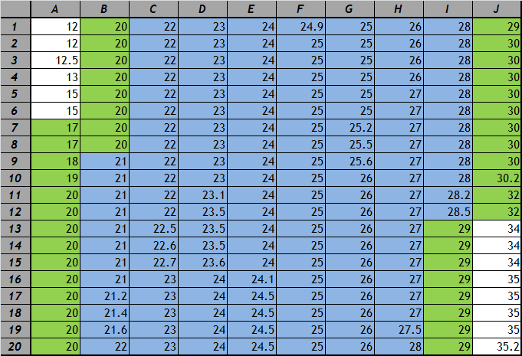
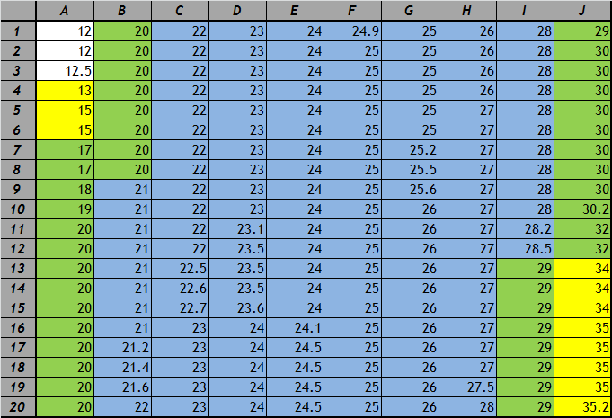
After our investigation we confirmed the Empirical Rule for normally distributed data
Notes:
From looking at the graph, table and percentages do you think a right foot length of 40cm is possible?
From looking at the graph, table and percentages do you think a right foot length of 40cm is probable?
The empirical rule quantifies how probable a length of 40cm is.

Slide 6
Empirical Rule
68%
95%
99.7%
Notes:
Showing students that some of their own data is approximately normally distributed would be a very powerful way of helping them believe, understand and remember the empirical rule.

Slide 7
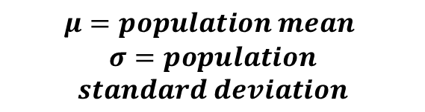
Empirical Rule
$$μ=population mean$$
$$σ=population$$
$$standard deviation$$
68%
95%
99.7%
Notes:
Proper notation

Slide 8
Most Important for Inferential Stats on our Syllabus
95%
95% of normal data lies within 2 standard deviations of the mean

Slide 9
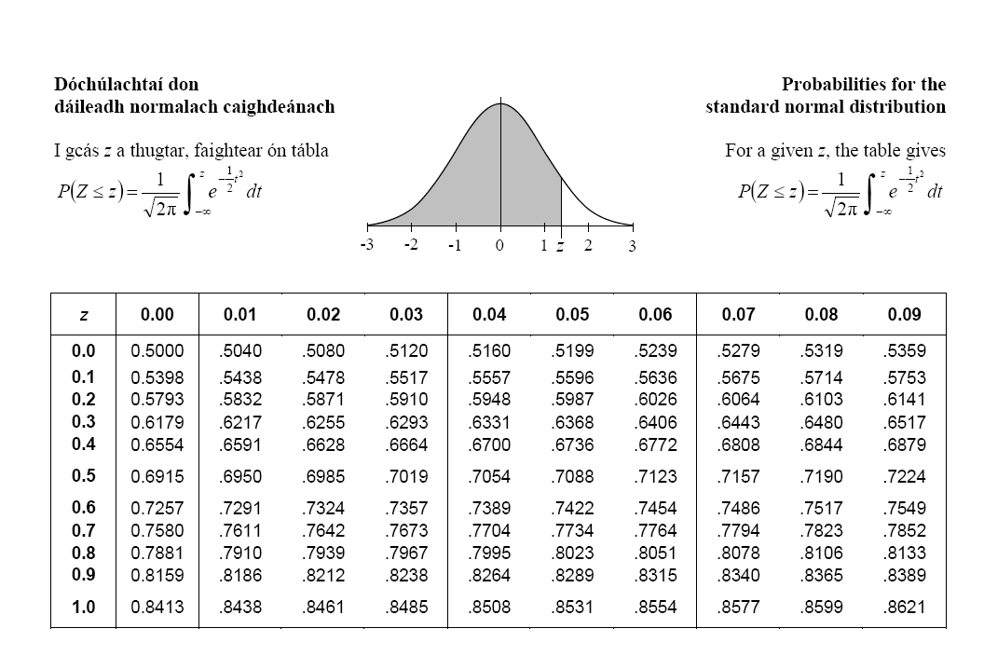
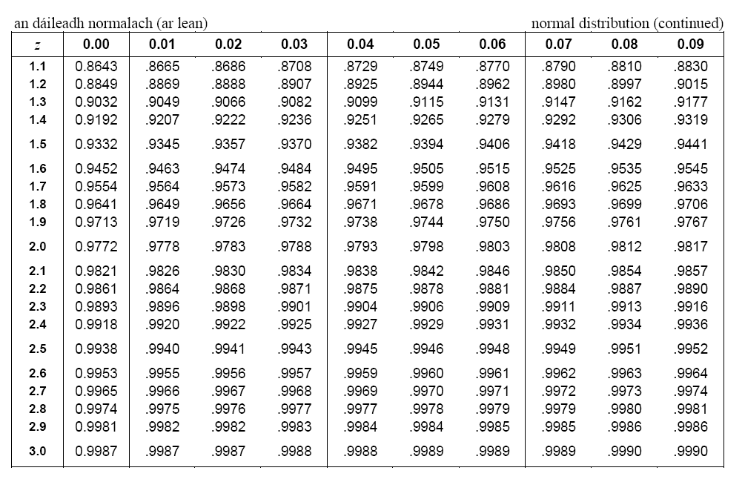
For Honours Leaving Cert use z scores
Pg. 36
Pg. 37
95%
2.5%
2.5%
Module 5.21

Slide 10
First, build on the informal language we already know.

Slide 11
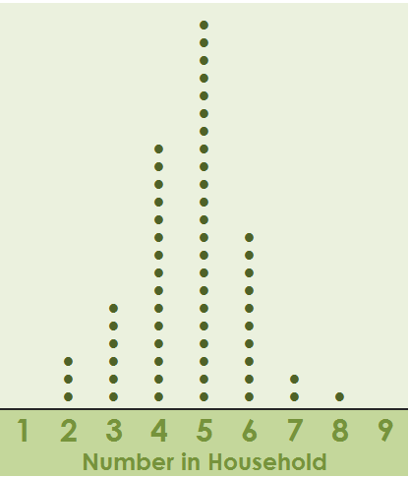
Data is collected from a class on the number of people in each of their households.
The above dot plot represents the data.

Slide 12
1 student was absent on the day the sample was collected.
A 100 euro prize is offered to guess how many are in his family.
Which answer would you chose and why?
A. 5
B. 8

Slide 13
1 student was absent on the day the sample was collected.
A 100 euro prize is offered to guess how many are in his family.
How confident are you that 5 is the answer?
Answer in words.
Quite confident
Not that confident, but its my best guess…

Slide 14
1 student was absent on the day the sample was collected.
A 100 euro prize is offered to guess how many are in his family.
In which statement are you more confident? Why?
The number is 5.
The number lies in the following interval:
4 ≤ number ≤ 6 {4,5,6}

Slide 15
1 student was absent on the day the sample was collected.
A 100 euro prize is offered to guess how many are in his family.
In which statement are you more confident? Why?
The number lies in the following interval:
  3 ≤ number ≤ 7 {3,4,5,6,7}
The number lies in the following interval:
4 ≤ number ≤ 6 {4,5,6}

Slide 16
1 student was absent on the day the sample was collected.
A 100 euro prize is offered to guess how many are in his family.
A. The number lies in the following interval:
  3 ≤ number ≤ 7 {3,4,5,6,7}
Are you 100% confident in this answer? Why?

Slide 17

Mobile Phones
You wanted to work out which mobile phone company is the most popular among Irish second level students. You used a sample of 100 students and found that Meteor topped the survey with 42%.
What percentage of all second level students in the country use Meteor?
(Can we use the sample to talk about the population?)
Notes:
Can we say that 42% of all second level students use Meteor?
No.
Why???
Sample Variation (done in WS %)

Slide 18
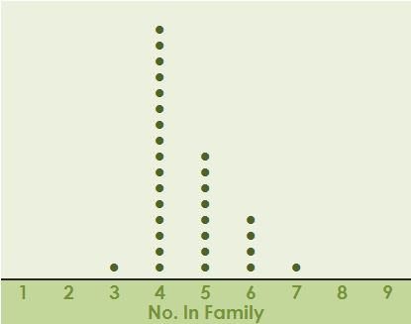
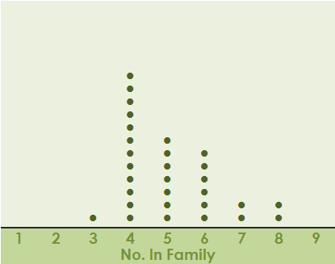
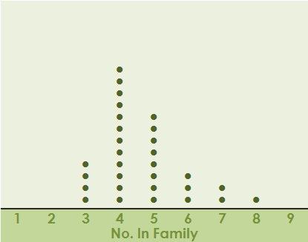
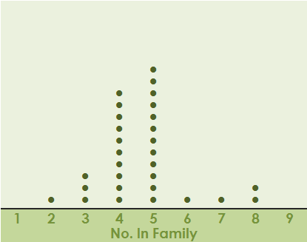
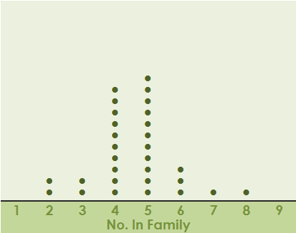
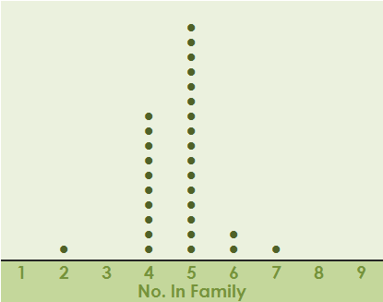
Sample Variation from Workshop 5
Notes:
In workshop 5 groups took samples of size 30 from a population of size 200 to answer the question “What is the typical number of people in Irish households that have a post-primary student?”
Each group drew a line plot and we noticed similarities and differences due to sampling variation (a hugely important concept in strand 1).
We answered questions about the line plots. The most important one was one where we described the data in many different ways. This is the first question I want you to do now. You have 9 questions to answer.

Slide 19
Important with Inferential Statistics
Indeterminate Language when inferring from a sample to a population
…around
…tends to
…approximately
  Around 42% of students in Ireland use Meteor
Notes:
The first important lesson about Inferential statistics is using the correct language.

Slide 20
New Terminology
You wanted to work out which mobile phone company is the most popular among Irish second level students. You used a sample of 100 students and found that Meteor topped the survey with 42%.
What percentage of all second level students in the country use Meteor?
(Can we use the sample to talk about the population?)

Slide 21

New Terminology
What percentage of all second level students in the country use Meteor?
Categorical Data: Yes, I use Meteor
No, I don’t use Meteor
How can I represent categorical data (yes/no) with a number?
By using a Sample Proportion: 42% use Meteor
(58% do not use Meteor)
0.42
(1-0.42) = 0.58
$$\hat{p}$$

Slide 22
Confidence
Words:
  Around 42% of students in Ireland use Meteor
How confident are you in your statistic?
  I am reasonably confident that the percentage of students using meteor is around to 42%

Slide 23
Quantify
Sample:
infer
Full Population
Words: I’m fairly confident that around 42% use Meteor
LCOL & LCHL
Quantify: Use an interval balanced with confidence in that interval
I am…
100% confident that between 0% and 100% use Meteor
50% confident that between 40% and 45% use Meteor

Slide 24

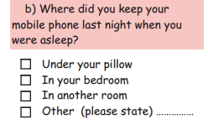

Q: Where do you keep your mobile phone at night?
A simulation activity
The 200 cubes in the bag represent all 200 students in a school.
The yellow ones represent the students who kept their mobile phone under their pillow last night when they were asleep.
Take a sample of 25 cubes from the bag and see what proportion (percentage) are yellow.
Notes:
This Question is from Census at School.
We will use the question as categorical data :
Yes- I keep my phone under my pillow
No – All 3 other answers represented as one - I don’t keep my phone under my pillow
Over 7000 were surveyed, but we will use just 200 as our population to do a simulation on confidence intervals.
The yellow discs represent those who keep their phone under their pillow.
Select a sample of 25.
Get their proportion
The calculations are easy. It’s the picture that the students’ have in their minds that is important. This picture starts at Junior Cycle e.g. with “W” questions.
We spent some time on this using a similar question to tease out the concepts of variability, sample size, confidence level and margin of error.
If the sample of 25 has 9 yellow ones then an answer like you are fairly confident that around 36% of all post-primary students keep their phone under their pillow would be a good one.
If this is unclear let’s look at the next slide where we look at more samples of size 25.

Slide 25
My Sample
N=25 | Yellow | Not Yellow
Mobile Phone | Under pillow | Not under pillow
How many? | 9 | 16
Proportion % | 36% | 64%
Proportion (dec) | 0.36 | 1-0.36 = 0.64
Inferring to the population (200 students)
Can we say that 36% of these 200 students sleep with their phone under their pillow? Why?
No - Sample variation

Slide 26

If we took another sample of 25…
Could you get a sample proportion of 4%?
  How likely is this?
Could you get a sample proportion of 40%
  How likely is this?
If we retook the sample 300 times where would most of the proportions lie?
Notes:
These questions are to get them thinking about the geogebra file they will be about to see.
Hopefully they will appreciate that there will be a few unusual sample proportions, but that the majority will be around the 30s.
When this happens the shape is generally normal.
Go to the geogebra file on the workshop 10 tab on www.projectmaths.ie

Slide 27
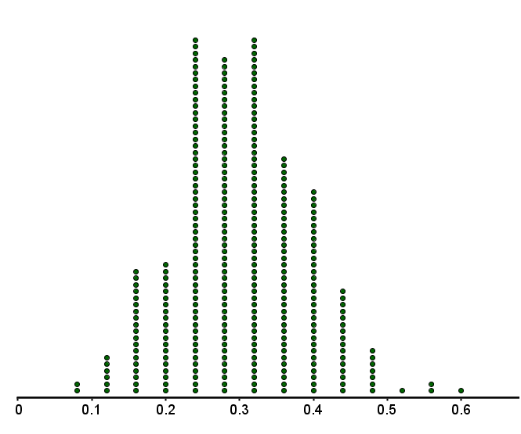
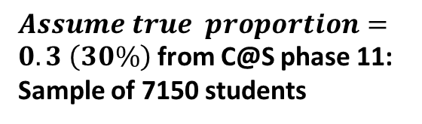
Empirical Rule: 95% of the sampled proportions (%) will lie
within 2 sd of the true population proportion
95%
$Assume true proportion=0.3 \left(30\%\right)$ from C@S phase 11: Sample of 7150 students
Results lie around the true population proportion

Slide 28
Approximately 95% of the sample proportions are between 10% and 50%
Confidence
Therefore I can say,
“I am 95% confident that the true proportion lies between 10% and 50%”

Slide 29





In Reality…
we have 1 sample, not 300
we don’t have the true population proportion – this is what we are looking for
so we create an interval of 2 sd around the proportion we have from our 1 sample as our best estimate.
$$−\frac{1}{\sqrt{n}}$$
Best estimate
Sample%
( =36%)
$$+\frac{1}{\sqrt{n}}$$
I am
95%
confident
$$\hat{p}$$
$$\hat{p}$$
-2sd% True % +2sd%
$$\hat{p}$$
True %
(30%)
This interval around a sample statistic is called the Margin of Error

Slide 30
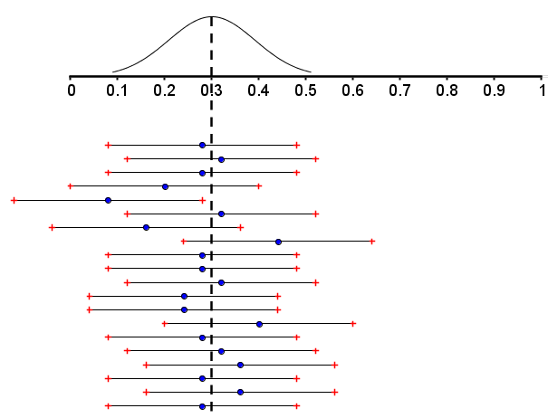



“95% confidence intervals” using the margin of error around the sampled proportion (blue dot)
$$−\frac{1}{\sqrt{n}}$$
$$+\frac{1}{\sqrt{n}}$$
95% of the time, the true population is in the interval I made with my sampled proportion and the margin of error interval.
20 different 95% confidence intervals
$$p$$
Population Proportion

Slide 31

“95% confidence intervals” using the margin of error around the sampled proportion (blue dot)
$$−\frac{1}{\sqrt{n}}$$
$$+\frac{1}{\sqrt{n}}$$
If I took lots of random samples of this size and created confidence intervals at the 95% level of confidence around the sample proportions, 95% of the intervals would capture the true population proportion.
20 different 95% confidence intervals
$$p$$
Population Proportion

Slide 32

Sample Size and Error
$\frac{1}{\sqrt{n}}$
Why does n=sample size feature in the formula
for building a confidence interval?
Question for intuitive understanding:
What do you think happens the margin of error as the sample size increases?
There is a direct relationship between
sample size and the margin of error around your statistic

Slide 33
Sample Size & Margin of Error
As we increase the sample size what happens the margin of error?

Slide 34
Level of Confidence 95%
Sample Size Margin of Error
25 ±20%
64 ±12.5%
100 ±10%
256 ±6.25%
400 ±5%
625 ±4%
1111 ±3%
1600 ±2.5%
2500 ±2%
10000 ±1%

Slide 35
Inferential Statistics
Real Life Big Question: (Pose a Question)
What percentage of all post-primary students keep their phone under their pillow?
Let’s answer our question using different sample sizes.

Slide 36
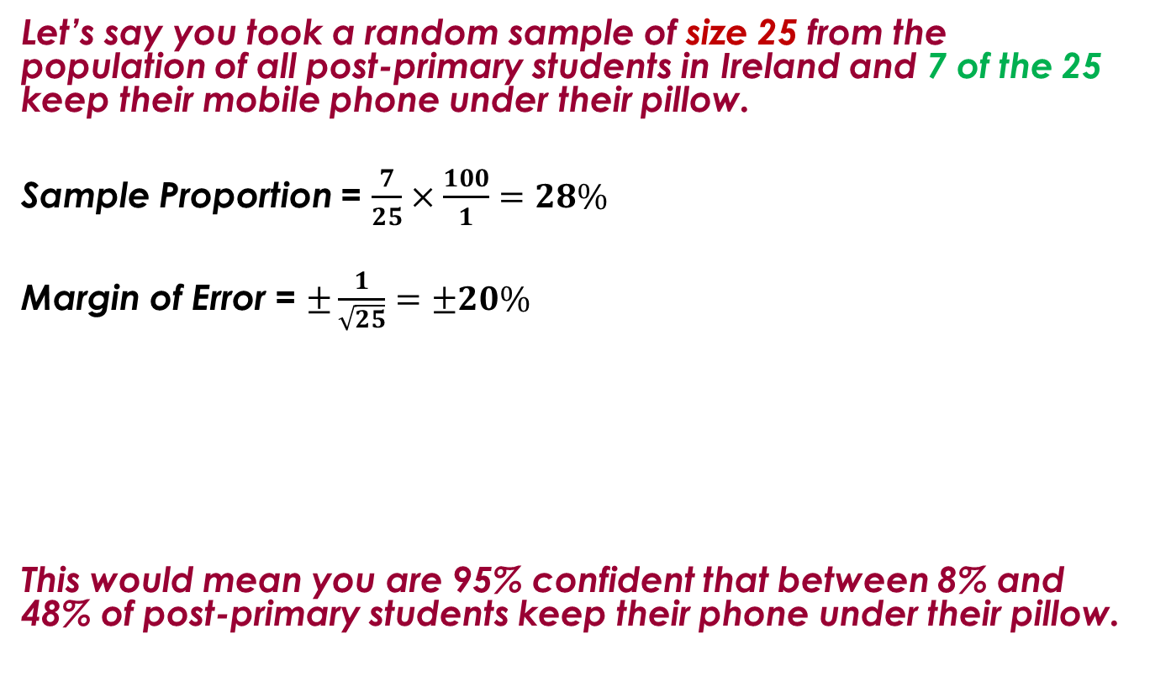
Sample Size 25
Let’s say you took a random sample of size 25 from the population of all post-primary students in Ireland and 7 of the 25 keep their mobile phone under their pillow.
Sample Proportion = $\frac{7}{25}×\frac{100}{1}=28\%$
Margin of Error = $±\frac{1}{\sqrt{25}}=±20\%$
This would mean you are 95% confident that between 8% and 48% of post-primary students keep their phone under their pillow.
0.28±0.2
8% 28% 48%
Notes:
The next 3 slides ill show that increasing the sample size reduces the margin of error.
8% to 48% - not a very valuable statistic

Slide 37
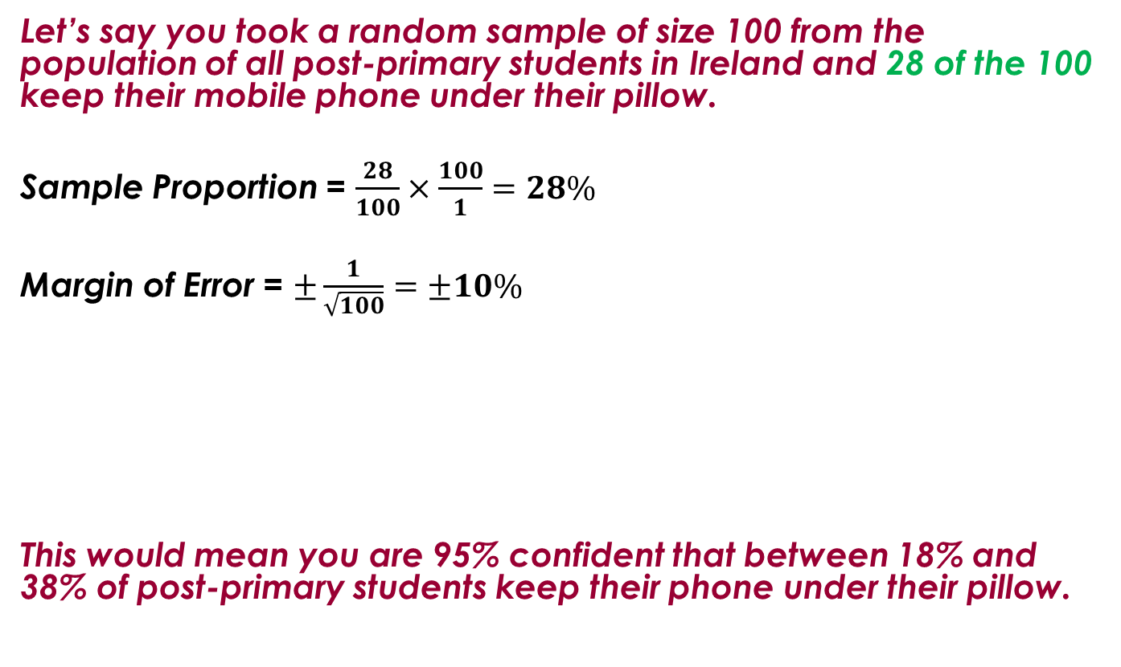
Sample Size 100
Let’s say you took a random sample of size 100 from the population of all post-primary students in Ireland and 28 of the 100 keep their mobile phone under their pillow.
Sample Proportion = $\frac{28}{100}×\frac{100}{1}=28\%$
Margin of Error = $±\frac{1}{\sqrt{100}}=±10\%$
This would mean you are 95% confident that between 18% and 38% of post-primary students keep their phone under their pillow.
0.28±0.1
18% 28% 38%
Notes:
18% to 38% is a little more valuable as an interval

Slide 38
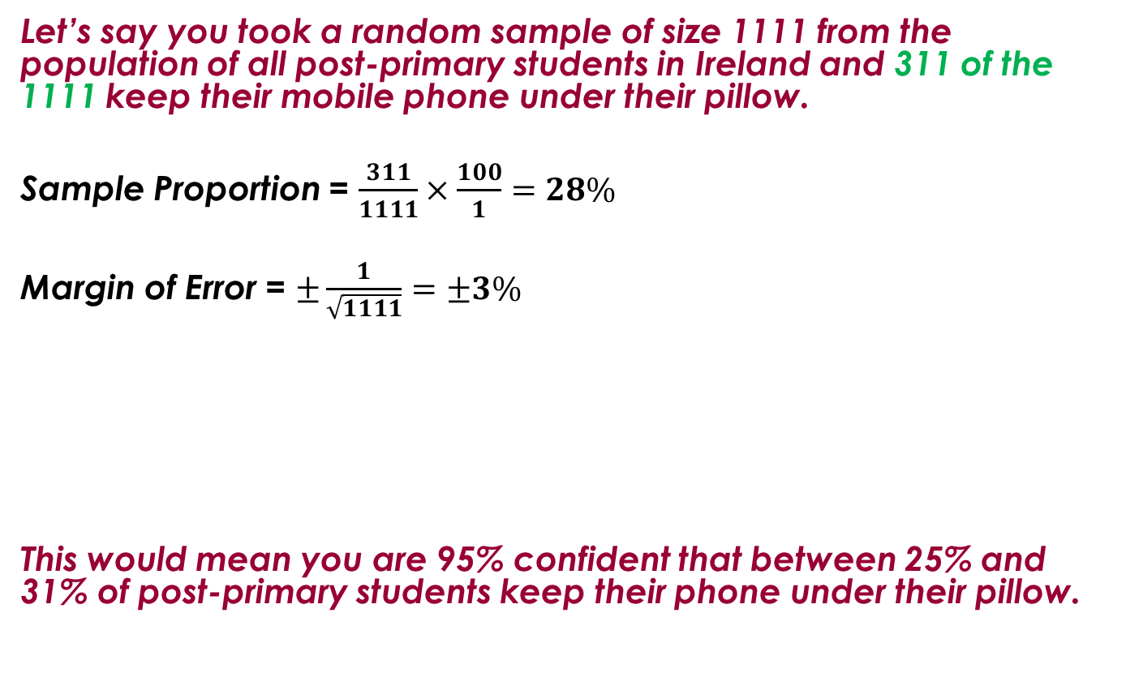
Sample Size 1111
Let’s say you took a random sample of size 1111 from the population of all post-primary students in Ireland and 311 of the 1111 keep their mobile phone under their pillow.
Sample Proportion = $\frac{311}{1111}×\frac{100}{1}=28\%$
Margin of Error = $±\frac{1}{\sqrt{1111}}=±3\%$
This would mean you are 95% confident that between 25% and 31% of post-primary students keep their phone under their pillow.
0.28±0.03
25% 28% 31%
Notes:
25% to 31% is a very valuable statistic.
It is achieved from a sample of 1111 – often used in political polls.

Slide 39
LCHL: $\frac{1}{\sqrt{n}}$ made more accurate using z scores
Pg. 36
Pg. 37
95%
2.5%
2.5%
Module 5.21
Notes:
LCHL just need to be a little more accurate using z values.
1 over root n is a simplified formula using 2 instead of 1.96
LCHL will use 1.96 properly

Slide 40

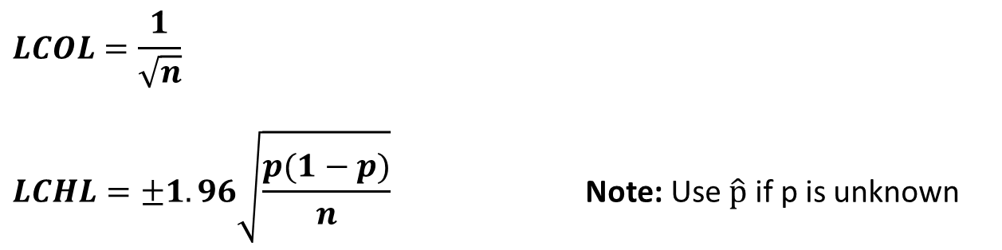



Revisit Margin of Error
$$−\frac{1}{\sqrt{n}}$$
$$+\frac{1}{\sqrt{n}}$$
-2sd% True % +2sd%
Sample %
True %
$$LCOL=\frac{1}{\sqrt{n}}$$
$$LCHL=±1.96\sqrt{\frac{p(1−p)}{n}} \text{Note}\text{: }\text{Use} \hat{p} \text{if} \text{p} \text{is} \text{unknown}$$
$$−1.96\sqrt{\frac{p(1−p)}{n}}$$
$$+1.96\sqrt{\frac{p(1−p)}{n}}$$
$$−\frac{1}{\sqrt{n}}$$
$$+\frac{1}{\sqrt{n}}$$
-2sd% True % +2sd%
Sample %
True %

Slide 41
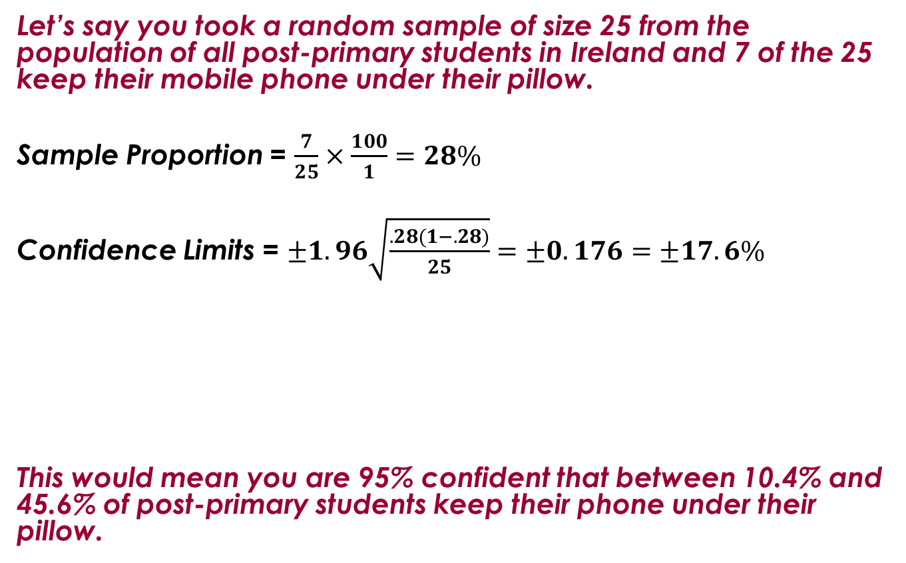
Higher Level
Let’s say you took a random sample of size 25 from the population of all post-primary students in Ireland and 7 of the 25 keep their mobile phone under their pillow.
Sample Proportion = $\frac{7}{25}×\frac{100}{1}=28\%$
Confidence Limits = $±1.96\sqrt{\frac{.28(1−.28)}{25}}=±0.176=±17.6\%$
This would mean you are 95% confident that between 10.4% and 45.6% of post-primary students keep their phone under their pillow.
0.28±0.176
10.4% 28% 45.6%

Slide 42
NCCA
Find additional information about Inferential Statistics on the NCCA website under frequently asked questions

Slide 43
Recap of workshop 5
In WS 5 we did Hypothesis Testing for Higher Level.
Now, Hypothesis Testing is on also for Ordinary Level.
Therefore, we will revisit Hypothesis Testing from WS 5.

Slide 44
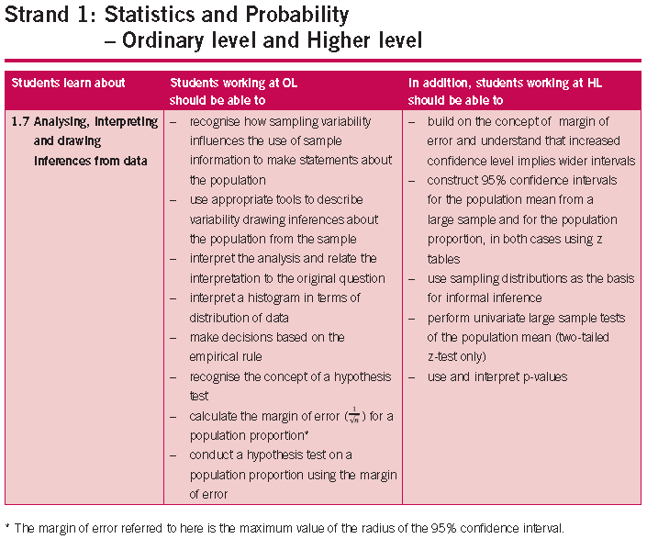

Slide 45
Hypothesis Testing
Testing claims about a population
Null Hypothesis: The Null hypothesis, denoted by H₀ is a statement about a population.
We assume this statement is true until proven otherwise.

Slide 46

A Claim
CLAIM (H₀) : The new drug relieves migraine 70% of the time.
SAMPLE: A newspaper investigates this claim by getting migraine sufferers to try the new drug.
They get 100 results that say it relieves migraine 62% of the time.
MARGIN OF ERROR: $\frac{1}{\sqrt{100}}=±10\%$
Fail
to
Reject
70%
$$\hat{p}$$
TEST: 52% 62% 72%

Slide 47

A Claim
CLAIM (H₀) : 30% of second level students in Ireland are 180cm or taller.
SAMPLE: Of the 200 students in the C@S sample, 34 are 180cm or taller. Is this sufficient evidence to reject the teacher’s claim, at the 5% level of significance?
Reject
MARGIN OF ERROR: $\frac{1}{\sqrt{200}}=±7\%$
$$\frac{34}{200}=17\% are 180cm or taller$$
30%
$$\hat{p}$$
TEST: 10% 17% 24%
Notes:
What could you say about the effectiveness of the drug?
What can you say about the company’s claim?
Can you be 100% confident in what you say about the company’s claim?
Can statistics tell us that they are lying?
Can statistics tell us that they are telling the truth?
The sample size is 100. Make a comment.
Have we seen anything about sample(s) during the day that might help us with our understanding about what we can/can’t say?
If the sample of 100 results had said that the drug relieves migraine 68% of the time would it change your conclusion?
For Hypothesis tests the essential attitude is scepticism.
Cling to the null’s assertion that there is nothing unusual
“Fail to reject”
Never declare the null hypothesis to be true
Must make a decision after doing a hypothesis test.

Slide 48
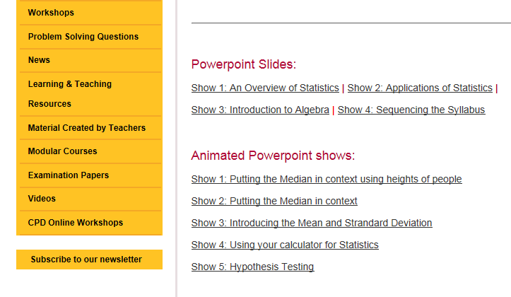
On-line
Under workshop 5

Slide 49
Testing a Claim about a Proportion using a Sample Proportion
        Go Fast Airlines provides internal flights in Ireland, short haul flights to Europe and long haul flights to America and Asia. Each month the company carries out a survey among 1000 passengers. The company repeatedly advertises that 70% of their customers are satisfied with their overall service. 640 of the sample stated they were satisfied with the overall service.

Slide 50
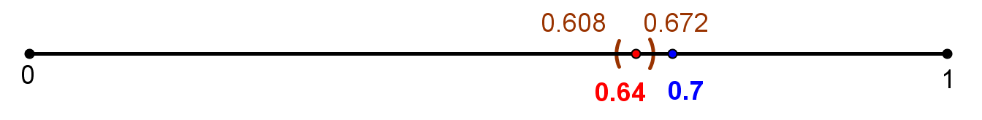
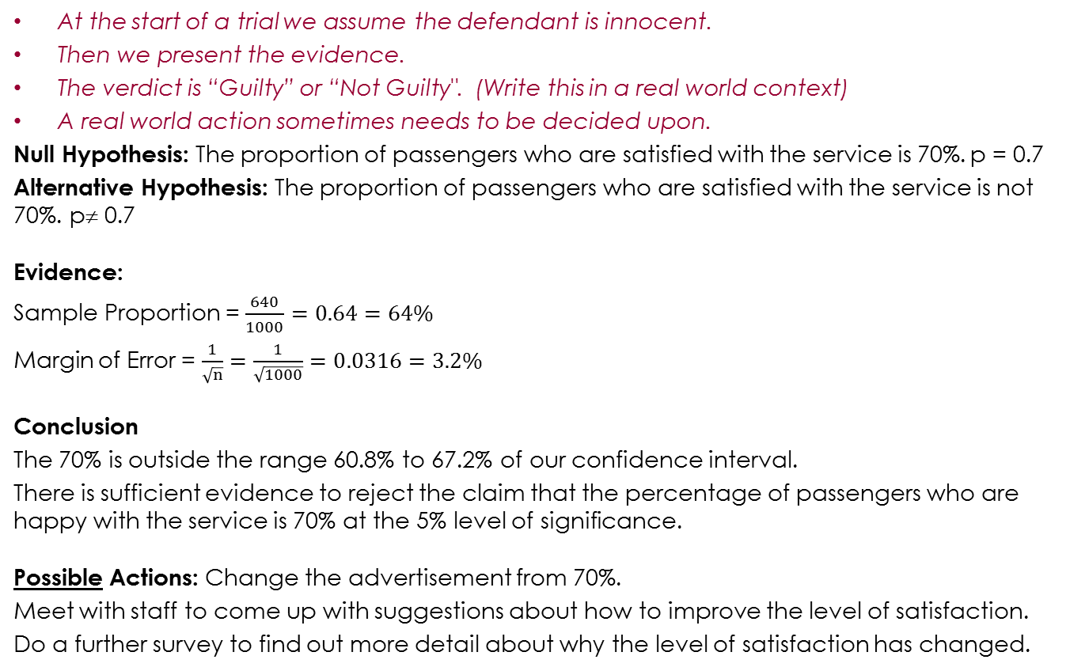
Courtroom Analogy to Teach Formal Language
At the start of a trial we assume the defendant is innocent.
Then we present the evidence.
The verdict is “Guilty” or “Not Guilty". (Write this in a real world context)
A real world action sometimes needs to be decided upon.
Null Hypothesis: The proportion of passengers who are satisfied with the service is 70%. p = 0.7
Alternative Hypothesis: The proportion of passengers who are satisfied with the service is not 70%. p≠ 0.7
Evidence:
Sample Proportion = $\frac{640}{1000}=0.64=64\%$
Margin of Error = $\frac{1}{\sqrt{n}}=\frac{1}{\sqrt{1000}}=0.0316=3.2\%$
Conclusion
The 70% is outside the range 60.8% to 67.2% of our confidence interval.
There is sufficient evidence to reject the claim that the percentage of passengers who are happy with the service is 70% at the 5% level of significance.
Possible Actions: Change the advertisement from 70%.
Meet with staff to come up with suggestions about how to improve the level of satisfaction.
Do a further survey to find out more detail about why the level of satisfaction has changed.

Slide 51
Overview
Confidence Intervals and Hypothesis Testing for Proportions
Analysing the Relationship Between Sample Means and the Population Mean
Using the Relationship for Confidence Intervals for Means

Slide 52
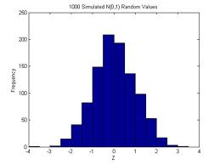
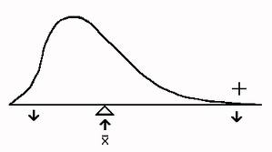
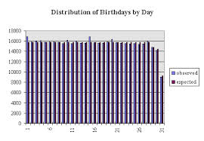
Some Distributions

Slide 53
Question
A sample size n=30 was taken of the weights of school bags of post-primary students.
The mean of the sample is 4.5 kg.
The standard deviation of the sample is 2.5 kg.
Write a statement about the population mean (stating the level of confidence you are using).

Slide 54
Our Findings
 | Shape | Centre | Spread
Population
One Large Sample
All Sample Means
Notes:
We will fill this summary sheet in after doing the next task (and while answering verbal questions about a GeoGebra file).

Slide 55
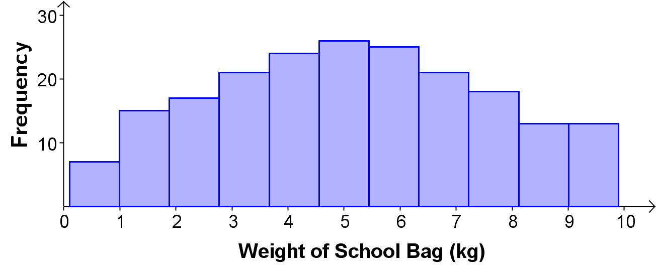
Analysing the Relationship Between Sample Means and the Population Mean
The distribution of weights of school bags of all 200 students in a school is shown in the diagram. We will call this our population distribution.
Notes:
The distribution of the weights of the school bags of all 200 students is shown. In the real world it is too costly to survey a whole population. We usually take a sample.
In the next activity we will investigate lots of samples to see we can use one sample effectively.
It says it in bold just before question 4 but just in case I’ll draw your attention to the fact that you should use STAT mode on your calculator as much as you can. This will be good revision for your students.

Slide 56
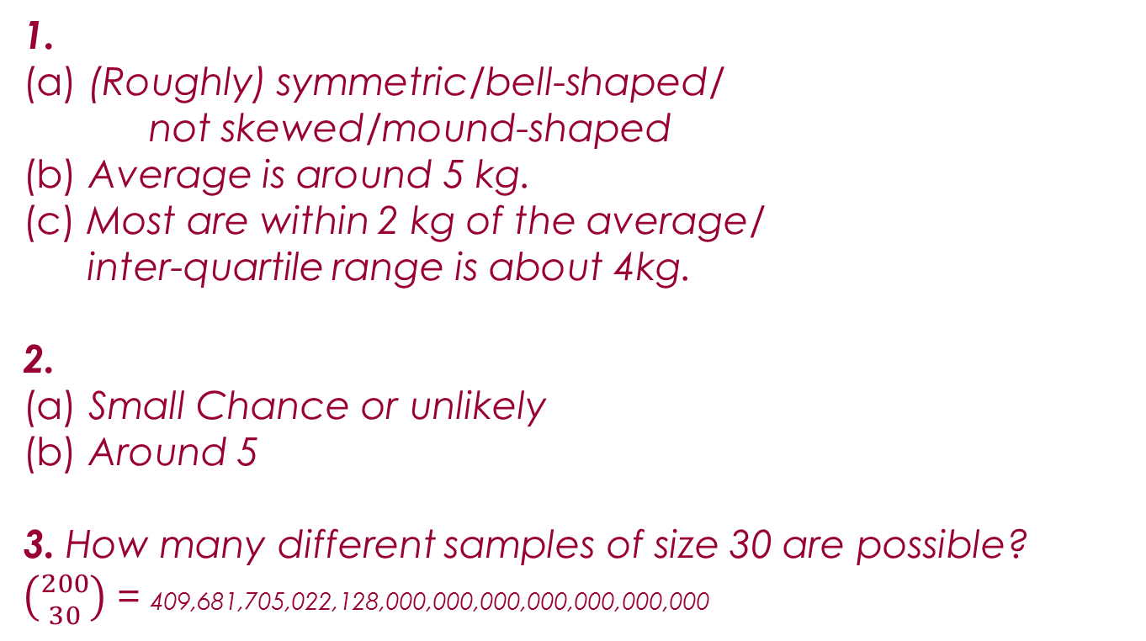
Feedback and Answers
1.
(a) (Roughly) symmetric/bell-shaped/
not skewed/mound-shaped
(b) Average is around 5 kg.
(c) Most are within 2 kg of the average/
inter-quartile range is about 4kg.
2.
(a) Small Chance or unlikely
(b) Around 5
3. How many different samples of size 30 are possible?
$\left({200 \atop 30}\right)$ = 409,681,705,022,128,000,000,000,000,000,000,000
Notes:
For question 1 the descriptions of the Shape, Centre and Spread should be sufficient that a person who read them could sketch the distribution.
e.g. if a group says the distribution is symmetrical, has a centre of 5, and range between 0.1 and 9.9 then draw a uniform distribution with these correct (but insufficient) characteristics. (Link to Geometry Necessary and Sufficient).
Centre of Data: A balancing point.
Encourage teachers to look again at the Report on the Trialling of the Sample Paper to get ideas for describing distributions.

Slide 57
Feedback and Answers
7.
(b) The mean of the sample means
(c) It is close to 5.1 kg.
8.
(b) The range of the sample means
(c) It is much smaller. It is much narrower.
9.
(b) The standard deviation of the sample means.
(c) It is much smaller. It is much narrower.
Notes:
7. It is good that students come up with phrases like the “mean of the sample means” themselves. The sample means are all quite close to the population mean.
8.
9. The sample means are all quite close to one another i.e. they aren’t spread out much i.e. the standard deviation of the sample means is smaller than the standard deviation of the population.
10. Table
11. Histogram
It might be a good idea to show more samples using GeoGebra or Powerpoint to answer the “Shape” question in question 12. GeoGebra or Powerpoint would also be useful for question 13.

Slide 58
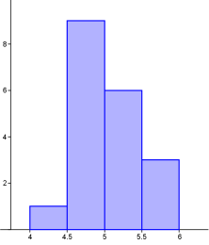
Feedback and Answers
12.
The distribution has one mode. (If we look at more sample means we will see the distribution
roughly symmetric). The sample means is centred around the centre of the population distribution. The spread is narrower than the spread of the population distribution.
13.
(a) it is possible to get a mean between 1 kg and 2 kg but it is not very likely.
(b) The mean of a sample will be close to the mean of the population. Some will be closer than others.

Slide 59
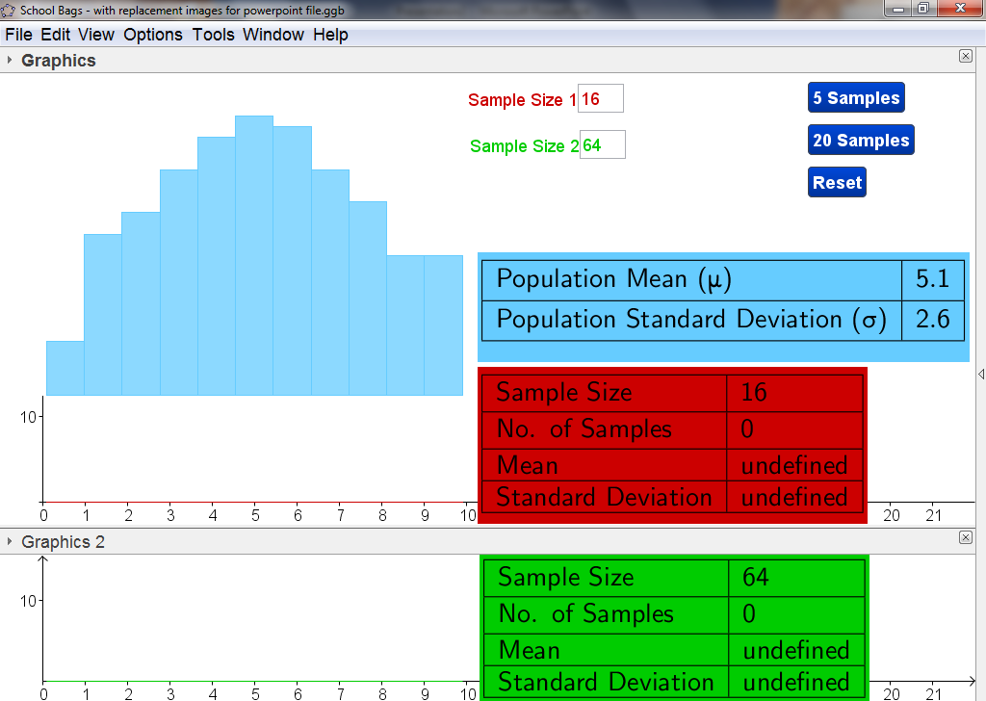
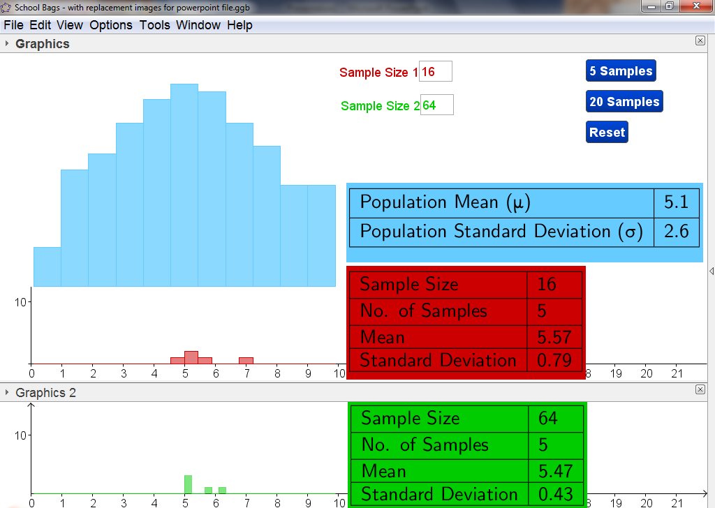

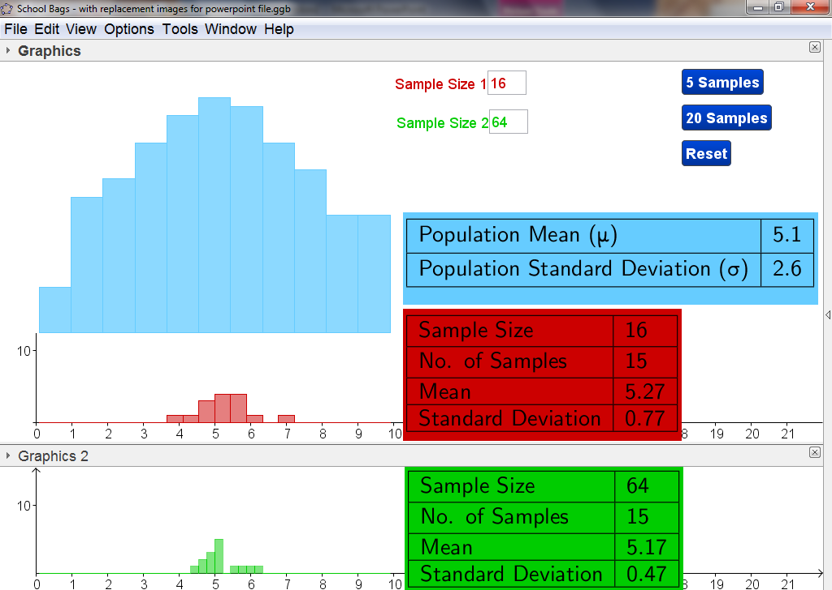













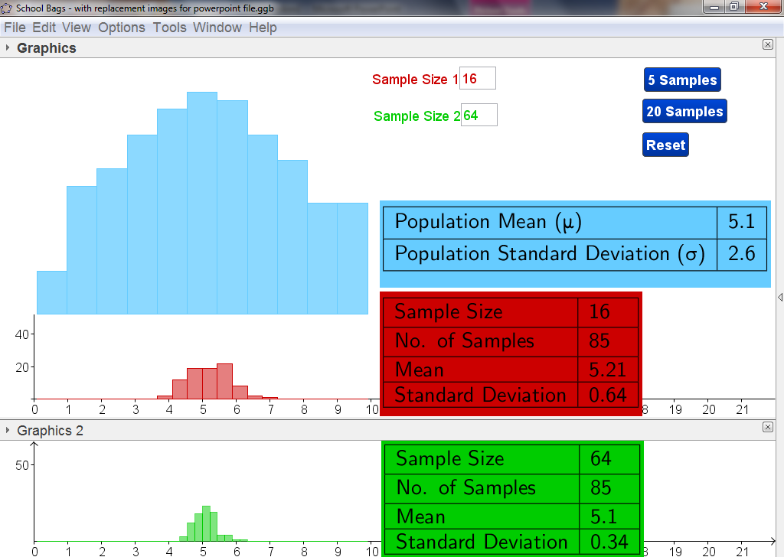


































Slide 60
ICT
Show that the sampling distribution of the means will eventually become symmetrical with one mode.
Show that when n is large the standard error is narrow.
Sample size of 30 is very important to mention.

Slide 61
Compare the Standard Deviations of the Samples to the Population Standard Deviation
Population Standard Deviation = 2.6
2.4
2.5
2.6
2.5
2.4
2.7
2.9
2.6
2.5
2.9
2.8
2.8
2.6
2.6
2.6
2.4
2.5
2.5
2.7

Slide 62
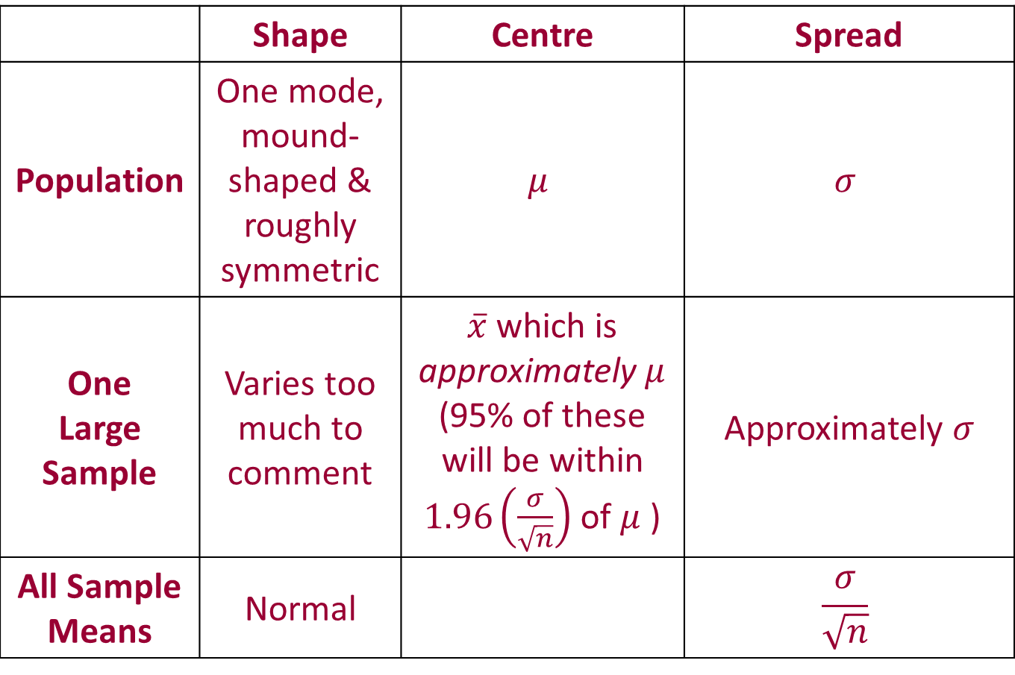
School Bags: Our Findings
 | Shape | Centre | Spread
Population | One mode, mound-shaped & roughly symmetric | $$μ$$ | $$σ$$
One Large Sample | Varies too much to comment | $\overline{x}$ which is approximately $μ$ (95% of these will be within $1.96\left(\frac{σ}{\sqrt{n}}\right)$ of $μ$ ) | Approximately $σ$
All Sample Means | Normal |  | $$\frac{σ}{\sqrt{n}}$$

Slide 63

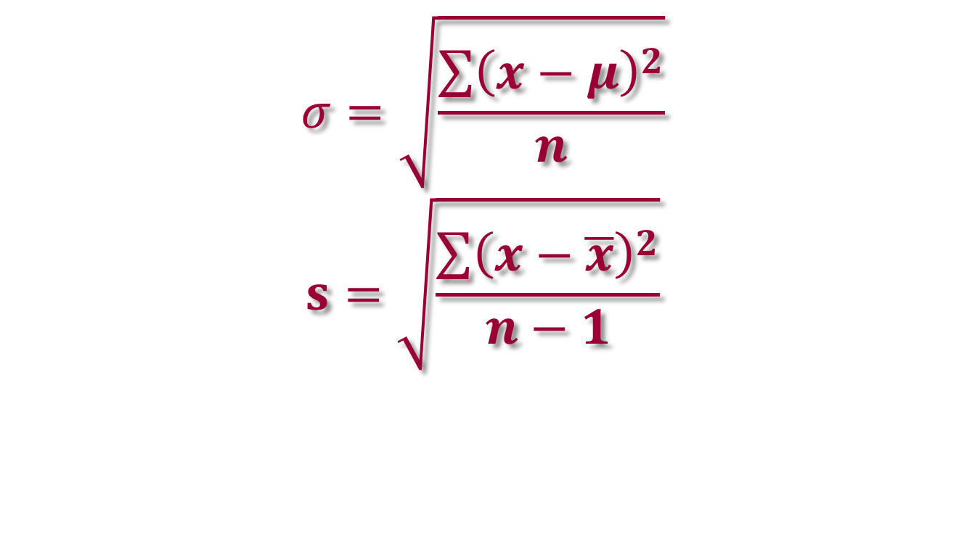
Note about $σ$ or s
$$σ=\sqrt{\frac{\sum{{\left(x−μ\right)}^{2}}}{n}}$$
$$s=\sqrt{\frac{\sum{{\left(x−\overline{x}\right)}^{2}}}{n−1}}$$

Slide 64
Why we chose this approach
Guided activities where students make their own discoveries, share and discuss them. Co-construction
Revision of Shape, Centre and Spread
Prediction so important
Difficult to visualise the Central Limit Theorem
Strikes a balance between some physical sampling and use of ICT. All of one wouldn’t be ideal.
Students come up with phrases like “mean of the sample means” themselves.
After this work it is easier to picture a confidence interval and a hypothesis test (not just a list of steps).

Slide 65
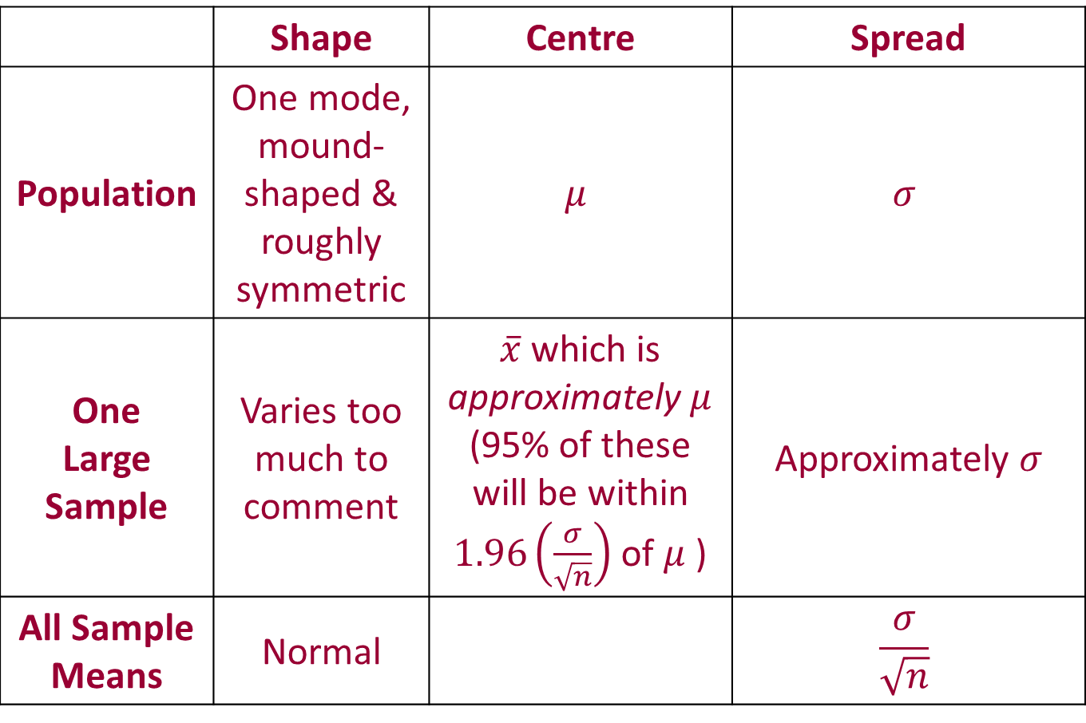
Key Ideas
 | Shape | Centre | Spread
Population | One mode, mound-shaped & roughly symmetric | $$μ$$ | $$σ$$
One Large Sample | Varies too much to comment | $\overline{x}$ which is approximately $μ$ (95% of these will be within $1.96\left(\frac{σ}{\sqrt{n}}\right)$ of $μ$ ) | Approximately $σ$
All Sample Means | Normal |  | $$\frac{σ}{\sqrt{n}}$$

Slide 66
Overview
Confidence Intervals and Hypothesis Testing for Proportions
Analysing the Relationship Between Sample Means and the Population Mean
Using the Relationship for Confidence Intervals for Means
Notes:
We will use a task to use the new knowledge we have constructed together.

Slide 67
Task
In reality we don’t know the population mean.
We have a sample.
A sample size n=30 was taken of the weights of school bags of post-primary students.
The mean of the sample is 4.5 kg.
The standard deviation of the sample is 2.5 kg.
What could we say about the population mean?
Hints: What do we know?
What can we determine?
What links these?
Notes:
The reality is we usually don’t have the population mean and we must use just one sample to make an inference about the population mean.
We physically took one random sample. We looked at 19 others as well and many more using GeoGebra. We also learned about the shape of the distribution of all the sample means.
This was to help us see how we can use one sample effectively.
Note: Some students will try to use 1/root(n) to answer this question. 1/root(n) is for proportions not means.
George Polya’s Questions
What do we know and what do we not know?
What do we need to know to find what we do not know?
What do I know that can be helpful?
What’s similar about this problem to what I already know, and what’s different?
What is changing and what is staying the same?
etc.

Slide 68

Solution to Task
1. The population mean is around 4.5kg.
3. I am 95% confident that the population mean school bag weight is between 3.6 kg and 5.4 kg.
Notes:
Hints:
We know the sample mean,
We want to say something about the population mean.
The sampling distribution of the means links these.

Slide 69
Solution to Task
Notes:
We don’t know the population. The 3 coloured sampling distributions of the means are 3 of many possibilities, depending on the population mean which we don’t know.
We don’t know where the population mean is.
The first animation shows what the Sampling Distribution of the means would look like if the population mean was 4.5 (the same as our sample mean).
The second animation shows what the Sampling Distribution of the means would look like if the population mean was 3.7 (which is inside our confidence interval).
The third animation shows what the Sampling Distribution of the means would look like if the population mean was 5.9 (which is outside our confidence interval). Emphasise: There is a 5% chance of that our 95% confidence interval won’t contain the population mean.

Slide 70
Solution to Task
Notes:
We don’t know where the population mean is.
The first animation shows what the Sampling Distribution of the means would look like if the population mean was 4.5 (the same as our sample mean).
The second animation shows what the Sampling Distribution of the means would look like if the population mean was 3.7 (which is inside our confidence interval).
The third animation shows what the Sampling Distribution of the means would look like if the population mean was 5.9 (which is outside our confidence interval). Emphasise: There is a 5% chance of that our 95% confidence interval won’t contain the population mean.

Slide 71

Solution to Task
 | Shape | Centre | Spread
Population | We don’t know this shape | $$μ$$ | $$σ$$
One Large Sample | We don’t care about this | $\overline{x}$ and this is our best estimate for $μ$ (95% of these will be within $1.96\left(\frac{σ}{\sqrt{n}}\right)$ of $μ$) | s We know this is our best estimate for $σ$
All Sample Means | Normal |  | $$\frac{σ}{\sqrt{n}}$$
Notes:
Centre Column: We know that x bar is our best estimate of $μ$. $μ$ is the mean of the population and the mean of all the sample means.
Spread Column: s is our best estimate for $σ$. $σ$ is the standard deviation of the population and we $\frac{σ}{\sqrt{n}}$ is the standard error (standard deviation of the sample means).
Shape Column: (In many cases we could draw the shape of the sample distribution) . We don’t know the shape of the population distribution. We know that the shape of the distribution of the sample means is normal.
This shape means that 95% of all the sample means will be within 1.96($\frac{σ}{\sqrt{n}}$) of $μ$.
It’s the shape of the distribution of the sample means that allows to quantify how confident we are.

Slide 72

Confidence Intervals for the Population Mean

Slide 73
Key Ideas
 | Shape | Centre | Spread
Population | We don’t know this shape | $$μ$$ | $$σ$$
One Large Sample | We don’t care about this | $\overline{x}$ and this is our best estimate for $μ$ (95% of these will be within $1.96\left(\frac{σ}{\sqrt{n}}\right)$ of $μ$) | s We know this is our best estimate for $σ$
All Sample Means | Normal |  | $$\frac{σ}{\sqrt{n}}$$
Notes:
[Point out that to do this confidence interval accurately, we need to use the population standard deviation; we don’t know this number, so we are forced to use our best guess based on the sample; it turns out that you can prove mathematically that using n-1 here gives a better guess than using n, so that’s why we do it.]

Slide 74
A Task on Hypothesis Testing
3 newspapers investigate a claim by a parents group that the mean weight of school bags of post-primary students in Ireland is 8kg.
All 3 take a sample size of 100.
Group A
Newspaper A finds a mean weight of 7.5kg with a standard deviation of 2.7kg.
Group B
Newspaper B finds a mean weight of 8.2kg with a standard deviation of 2.5kg.
Group C
Newspaper C finds a mean weight of 7.3kg with a standard deviation of 3.2kg.
        Use an hypothesis test at the 5% level of significance to decide whether there is sufficient evidence to conclude that their claim is valid. State the null hypothesis and state your conclusion clearly.
Notes:
This task is an idea you can give students
For this task the teachers would divide the room in 3, groups A, B and C.
Newspaper A: 6.9708kg to 8.0292kg. There isn’t enough evidence to reject the claim that the mean weight is 8kg at the 5% level of significance.
Newspaper B: 7.71kg to 8.69kg. There isn’t enough evidence to reject the claim that the mean weight is 8kg at the 5% level of significance.
Newspaper C: 6.6728kg to 7.9272kg. Based on the evidence we reject the claim at the 5% level of significance.

Slide 75
Overview
Confidence Intervals and Hypothesis Testing for Proportions
Analysing the Relationship Between Sample Means and the Population Mean
Using the Relationship for Confidence Intervals for Means
Notes:
We looked at confidence intervals for proportions and later we did a hypothesis test based on proportions.
We began part 2. with a question we wanted to answer. We analysed the relationship between… in order to use the relationship to use a sample to make a statement about the population mean with 95% confidence.
We did work on hypothesis testing for proportions and you have the knowledge to do hypothesis testing for means.

Slide 76
Modular Courses
Notes for previous course on Strand 1 online.
New course on Functions, Calculus and the Deferred Material
will begin in many education centres from March.
Sign up to the Project Maths Newsletter to find where and when.

