Slide 1


Lesson Study
www.projectmaths.ie
Lesson Study
Notes:
Lesson Study - We hope to incorporate the principles of Japanese Lesson Study, a form of professional development to bring teachers together as a professional community to improve teacher practice.
The Lesson Study approach to professional development builds on teachers' knowledge and experiences and provides a structure for continual improvement of teaching focused on student learning. It's based on...
Maintaining a constant focus on student learning goals where the goal of improving teaching is to improve student learning.
Reflecting on the practice of teaching as a community of professionals with the belief that long-term improvement of teaching depends on the development of effective teaching methods.
Encouraging teachers to keep track of changes in practice so that their learning can be shared with the broader teaching community.
Providing support within the context of school because improvements in teaching will be most successful if they are developed in classrooms where teachers teach and students learn.
Valuing teachers as the driving force behind school improvement because teachers are the only ones who can ensure that students' learning improves in the classroom.

Slide 2
Lesson Study
What is Lesson Study?
Based on:
Collaborative Planning
Discuss and plan a lesson to support a common goal
Teaching and Observing
Observe students working during the plan by one of the team of teachers
Analytic Reflection
Selected work of students lesson summarised by the teacher
Ongoing Revision
Based on Japanese Lesson Study
Introduced through TIMSS (1995)
School level: Same year level
One teacher teaches lesson , others observe lesson
Cluster of schools
Conferences
Revolves around a broad goal….develop problem solving, Groups of teachers meet to discuss mathematical content, explore methods of teaching, and anticipate student reaction. Building on individual experience and collective strategies a viable Lesson Plan is created
Notes:
The Lesson Study Process
Lesson study is a teacher-directed professional development model developed in Japan. “Lesson “when translated from Japanese into English means “investigation or inquiry”. The lesson study process is grounded in teacher research and is not like traditional lesson planning. The following steps have been developed to help teachers engage in lesson study research

Slide 3
Lesson Study
Lesson Observation: A team member teaches the lesson as the other teachers view (in classroom/video) and record the unfolding plan and student reaction
Reflection: Teachers meet for a critical analysis session
Post discussion begins with the teacher who taught the lesson self assessment
Revision: Another team member might teach the lesson and revise the lesson for further feedback
Lesson Study is not about perfecting a single lesson but about improving teaching and learning.
Providing insights into :
the many connections among teachers, students, mathematics and the classroom experience

Slide 4

Process Step 1: Identify the problem & establish a focus
Stage 1: Develop an overarching goal for the lesson
Stage 2: Develop the research question in the Lesson Study Group
Notes:
Step I - Identifying the problem and establishing a focus
The lesson study process begins by teachers looking critically at their mathematics curriculum. Teachers need to look at the mathematics curriculum in their schools in relationship to what they know about their students' learning. Curriculum is not just material in books but the interaction of students with the learning opportunities being provided. This is a two-sided problem that involves looking at both what students are having trouble learning and at how these concepts are currently being taught. We suggest:
Stage 1: Developing an Overarching goal for the Lesson
Thinking about and engage in designing a lesson for understanding:
What are the enduring understandings we want our students to have?
How will we assess students to know if they have these understandings?
What learning opportunities can be designed to support students' gaining this understanding?
Stage 2 - Develop the research question in the Lesson Study Group
Reflect back on the overarching goal your team has developed for your students. How can you relate this goal to the learning needs you identified in stage one? Clearly identify the problem area you want to address. Then develop your question for the research you will be doing through lesson study. Examples:
Problem area: Students have a limited repertoire of learning strategies for problem solving
The Question: Will teaching problem solving help students use more learning strategies?
Problem area: Students don't seem to be able to visualize mathematics problems.
The Question: Will more work with visualization of mathematical relationships help students solve problems?
Problem area- Students are not using GeoGebra or other software applications.
The Question- How can we teach students to use GeoGebra? What impact will this have on student learning?

Slide 5


Step 2: Design & Plan the research lesson
Agree on a goal
Choose a strand
Choose a topic / lesson
Notes:
Step 2 - Designing the research lesson
Once you have identified the student learning problem you want to address it is time for planning.
Plan the context for the research lesson by considering:
The mathematics or other content you want students to learn
The communication and discourse you intend students to engage in
The kinds of data you want to gather to answer your questions
Use the research lesson format to plan the actual observation lesson. Spend time on each of the steps and put a special emphasis on what questions or problems your students might have during the lesson.
Prior to doing the lesson share it with your RDO and other teachers via school visit/email and ask for ideas and feedback. Also be clear about what data you want to gather and who will gather it.

Slide 6

Step 3:Teach & Observe/Video the lesson
During T & L Lessons
Academic Learning
How did students’ images of ….. change after the ………..?
Did students shift from …….to …………?
What did students learn about ………….. as expressed in their copies?
Motivation
Percent of students who raised their hands
Body language, “aha” comments, shining eyes
Social Behaviour
How many times do students refer to and build on classmates’ comments?
Are students friendly and respectful?
How often do 5 quietist students speak up?
Student Attitudes towards the lesson
What did you like and dislike about the lesson?
What would you change the next time it is taught?
How did it compare with your usual lessons in_____?
Notes:
Step 3- Doing and Observing the Lesson
The research lesson is the opportunity to try out your ideas in the real world of teaching practice. The time spent completing steps 1-2 should help you to realize your goals for student learning in the observed lesson. [Two rounds of lessons are usually done with an opportunity to revise between the lessons. This is optional]
Observation Guide: Peer Observation
The data that observers from your team collect is an integral part of the research lesson process and should be driven by what it is the research group wants to know.
Prior to the observation, each observer should read through the lesson plan developed by the research group. The lesson will be put online on the project maths website once it has been submitted by the Lesson Study group. The observer(s) should take note of the mathematical focus of the lesson and the sequence of activities the teacher and students will be engaged in during the lesson. They should participate in a session prior to observing the research lesson and be sure they have a clear understanding of what it is they are expected to observe and how and why they are being asked to make the kinds of focused observations that they asked to do.
Observer(s) should not interfere with the process of the lesson. They should not help students with the problem or give clarifying instructions to the students. The lesson should flow as if the observer(s) were not present in the room. All observers should plan to participate in the debriefing session with the RDO and be able to provide a neat, organized, detailed summary of the data that they have collected. This data and the conversation that surrounds it, will then help the research lesson team to reflect upon, revise, and summarize what they have learned via their lesson study.
The key is that the focus should be driven by what it is the research group wants to know and by what constitutes good data towards the answering of their questions. If this is done, then there is lots of specific evidence that can be discussed in relation to how well the research lesson met the goals of the lesson.
There may be only one research focus during the research lesson or there may be more than one. For instance, if teachers have a goal of having students actively engaged in their own learning and they design a research lesson that they hope will meet this goal, they should discuss what evidence of engagement is. Other examples of data that are to be collected could be: Are students participating by discussing and answering questions? Are students actively problem solving, writing down ideas and solutions?
There may be one main goal and each observer may want to focus on a group of students and gather evidence about them? One observer may want to write down numbers of students from the class who participate? The teachers may be interested in a close look at what one student does during the lesson. Maybe, there are other things the research group wants to investigate. One observer may focus on engagement and another might focus on understanding.
The bottom line again is that the data that is to be collected should be driven by what it is the research team wants to know. During lesson study planning, before the facilitation of the research lesson there should be explicit discussion of what kind of data will help the research team gather evidence in regards to what they hope to accomplish from their research lesson. These goals should be communicated as specific data that observers should look for and notate.
Data to Collect (this will contribute to the final reflection)
Academic
How did students’ images of …..change after the …..?
Did students shift from ……to …….?
What did students learn about …….as expressed in their copies?
Are students using the correct vocabulary?
Is there understanding of the maths content?
Are they actively demonstrating and explaining within their group/board? How? What are they saying and doing?
Motivation
1. How many times are students’ hands raised?
2. Are they asking questions of each other?
3. Are they asking questions of the teacher?
4. Are they answering questions?
5. Are there any 'aha' comments
Social Behaviour
What is the frequency of interaction? (How many times do students refer to and build on classmates' comments?
Is everyone valuing peer input? (How or how not?)
Is everyone participating?
Student Attitudes towards the Lesson
What did you like most about the lesson? Why?
What did you like least about the lesson? Why?

Slide 7

Step 4 & 5 :Share what you have learned
Write a reflection
For more information on Lesson Study
Notes:
Step 4 - Debriefing, reflecting and revising the lesson
Immediately after the lesson all those who observed the lesson should spend time in a short debrief of the lesson. The debriefing should start by allowing first the teacher who taught the lessons to comment on their reactions to what happened followed by the team who designed the lesson. Then comments should be encouraged from the team.
Ideally, some time should be set aside for both observers and the lesson study group to take a break and gather their thoughts prior to the debrief discussion. Some questions to think about for the debriefing include the following:
What parts of the lesson design helped to achieve the lesson goals?
What examples of student responses/reactions show how they were engaged in the lesson?
What could be added or changed in the lesson to better achieve lesson goals?
How would you expect students to respond to these changes?
The discussion during the debriefing should focus on the different aspects of the lesson and how well the planned activities (i.e. introduction, launch, student exploration, etc.) helped achieve the lesson goals. The Lesson Plan itself should be used as a lens for the observation and debriefing.
For refection purposes: One way to begin this meeting is to look back at your research question and then the process you used in the designing a lesson related to the question
Design: What was the planned learning for students?
Content- What was the concept you wanted students to learn? What evidence do you have of their understanding or lack of understanding?
Discourse: What discourse was planned and what kind of communication occurred?
Environment: What did you learn about your learning environment?
Hopefully the data gathered by the observers will help answer these questions as well as your own experiences in doing the lesson.
Step 5 - Sharing what you've learned
As teacher researchers you have learned valuable knowledge about how students learn and what kinds of teaching strategies seem to be most powerful for improving student learning. Just as sharing what they learned is an important part of student learning sharing teacher research is a necessary final stage to each research lesson cycle. You have much to offer to the field and to your colleagues.
Final Reflection Guidelines
These guidelines provide an overview of the type of questions that we would like teachers from participating Lesson Study teams to discuss and reflect upon. All research reports should be written in complete sentences and paragraphs and be understandable by educators who have not seen the lesson before and should cover the following areas: mathematics learning, teaching strategies, and the lesson study process. These areas should explicitly be incorporated into data collection activities during the observation cycle of the lesson study process. Answers to each section should be supported by data that has been collected during observation and discussed during reflection and revision meetings. The final research reports will be made available on-line at www.projectmaths.ie.

Slide 8
Uses of Lesson Study
Support the teacher, by providing a detailed outline of the lesson and its logistical details (such as time, materials).
Guide observers, by specifying the "points to notice" and providing appropriate data collection forms and copies of student activities.
Help observers understand the rationale for the research lesson, including the lesson's connection to goals for subject matter and students, and the reasons for particular pedagogical choices.
Record your group's thinking and planning to date, so that you can later revisit them and share them with others.

Slide 9





Maths Counts
Insights into Lesson Study
Notes:
Example from a project school

Slide 10
Insights into Lesson Study
Introduction: Focus of lesson
Student Learning : What we learned about students’ understanding based on data collected
Teaching Strategies: What we noticed about our own teaching
Strengths & Weaknesses of adopting the Lesson Study process

Slide 11
Introduction: mathematical focus
To inform us as teachers and our students, on misconceptions in simplifying algebraic fractions (inappropriate use of “cancelling”)

Slide 12
Introduction: mathematical focus
Why did we choose to focus on this mathematical area?
Students were making recurring errors in simplifying algebraic fractions.
This was hampering work not only in algebra but also in coordinate geometry, trigonometry and would hamper their future work in calculus.

Slide 13
Introduction
Planning:
We discussed typical errors in simplifying algebraic fractions
We compiled a background document on the topic
We designed a set of questions to confront students’ common misconceptions ( diagnostic test)
Resources used:
  Diagnostic test
  Lesson to develop a common strategy for simplifying fractions
  Document with diagnostic test answers to be corrected by students following the lesson

Slide 14
Introduction
Learning Outcome:
An understanding of what simplifying any fraction means
A general strategy for simplifying any fraction

Slide 15
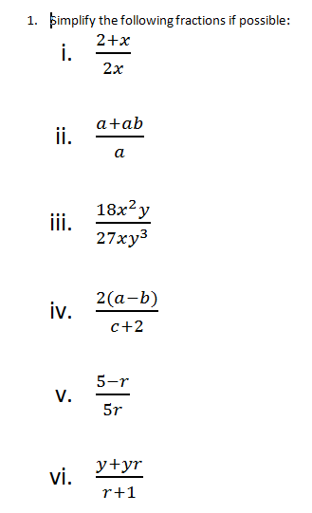
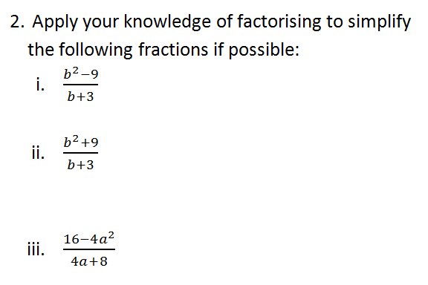

Slide 16
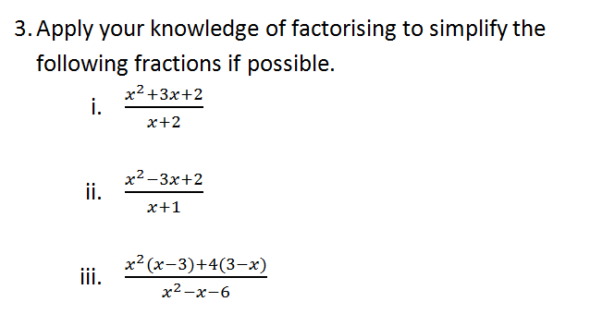
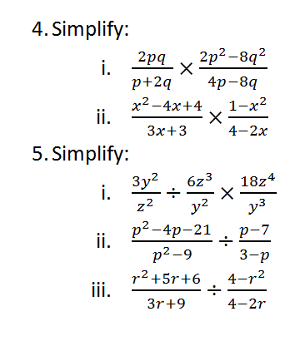

Slide 17
Reflections on the Lesson
Student Learning : What we learned about students’ understanding based on data collected
Teaching Strategies: What we noticed about our own teaching

Slide 18
Student Learning
Data Collected from the Lesson:
Academic e.g. samples of students’ work
Motivation
Social Behaviour

Slide 19
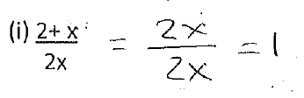
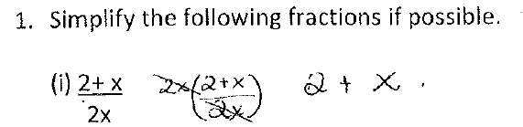
Common Misconceptions
Q1(i)

Slide 20
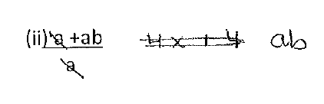
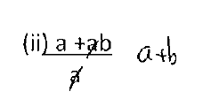
Common Misconceptions
Q1(ii)
The above misconception was shown in 13 scripts.

Slide 21
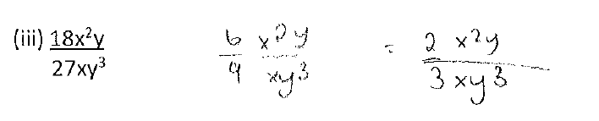
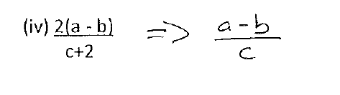
Common Misconceptions
Q1(iii)
Q1(iv)

Slide 22
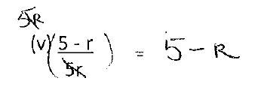
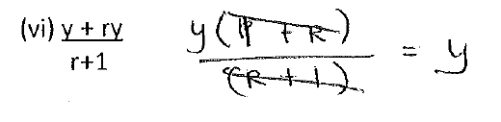
Common Misconceptions
Q1(v) The following appeared in many scripts:
Q1(vi): From one of the students who made the above error in part (v):

Slide 23
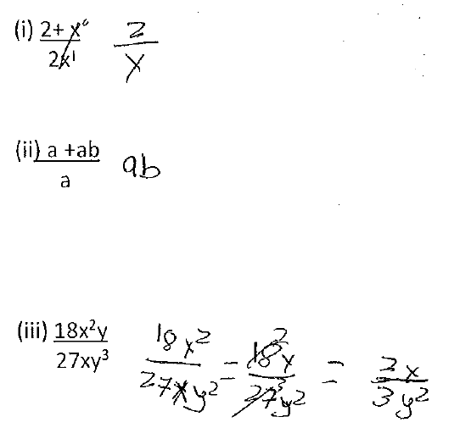
Common Misconceptions
This student answered Q1(i), Q1(ii) incorrectly but Q1(iii) correctly.
The same strategy should be applied in all three situations.
The student is not aware of the process they are using/not thinking about the thinking!

Slide 24
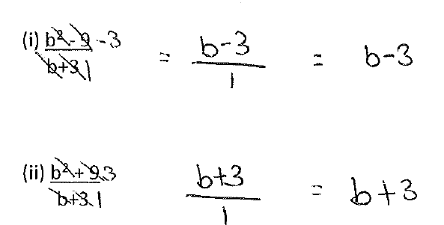
Common Misconceptions
Q2(i) This was one of the better answered questions but there were still some errors.
Part (i) Correct answer but incorrect procedure; it would not be identified by substitution
Part (ii) Same erroneous procedure applied. It would be identified by substitution.

Slide 25
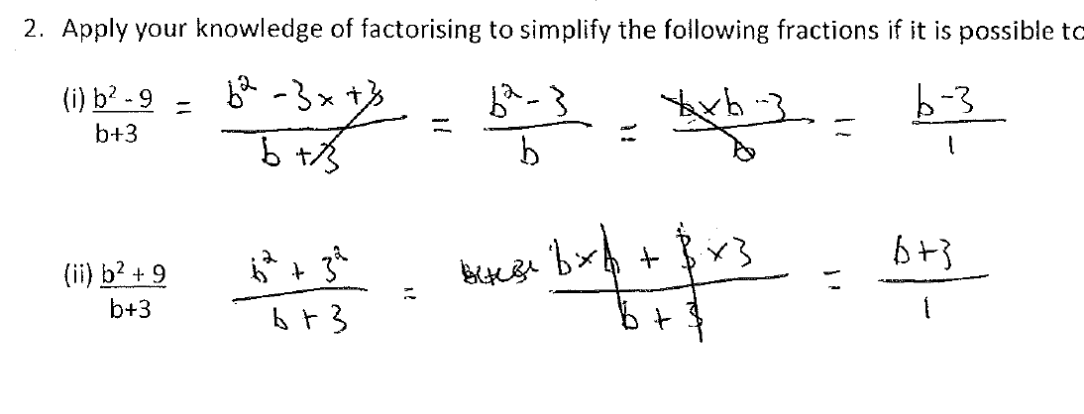
Common Misconceptions
Q2(i) Not linking simplifying fractions to creating an equivalent fraction and/or not knowing how to create an equivalent fraction

Slide 26
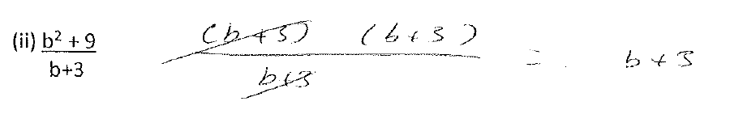
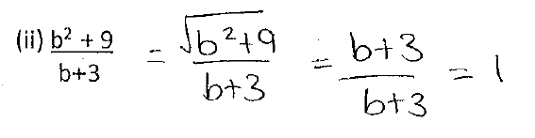
Common Misconceptions
Q2(ii) Not checking if factors are correct;
Misunderstanding the concept of an equivalent fraction and the underlying concept of creating an equal ratio; no checking strategy!

Slide 27
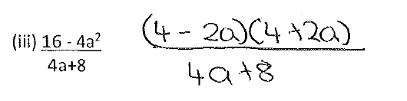
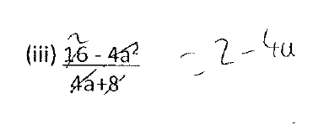
Common Misconceptions
Q2(iii) Not factorising the denominator and hence failing to simplify:
Q2(iii) Failing to see the numerator and denominator as one number
Is dividing by (3+2) the same as dividing by 3 and dividing by 2?

Slide 28
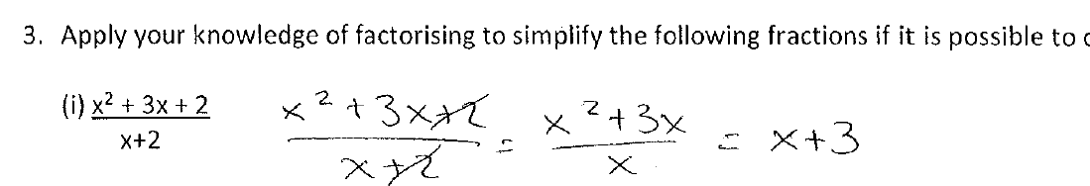
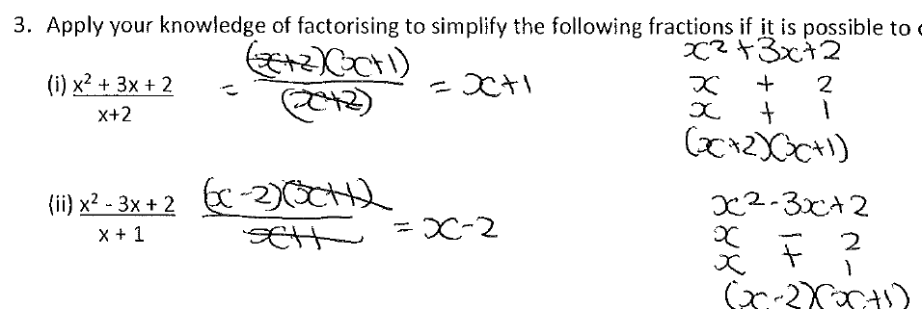
Common Misconceptions
Q3 (i): One of the better answered questions but still some misunderstandings of cancellation and the underlying concept of ratio:
Q3(i) and (ii): Part (i) correct ;
Part (ii) Error in factorisation - possibly due to wanting to simplify even if it wasn’t possible.

Slide 29
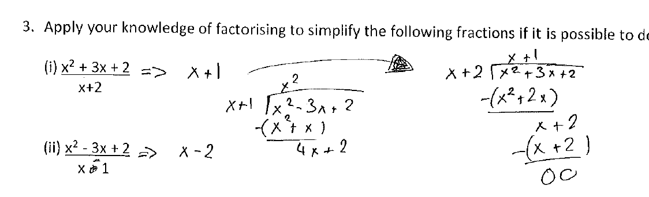
Common Misconceptions
Q3 Part (i) correct using long division but ignored requirement to use factorisation
Q3 Part (ii) Denominator changed to x -1 to make it work!

Slide 30
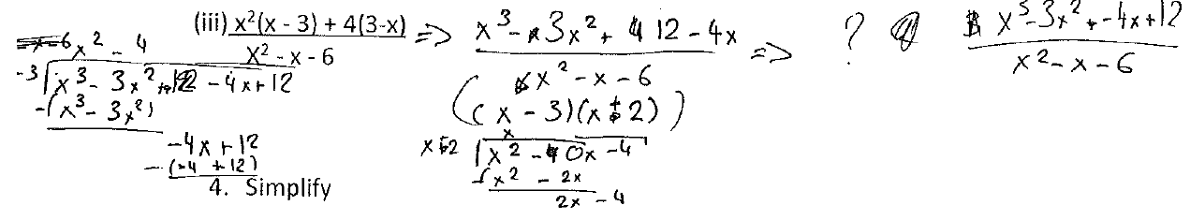
Common Misconceptions
Q3(iii) Didn’t capitalise on the fact that the numerator was partly factorised. No overall strategy

Slide 31
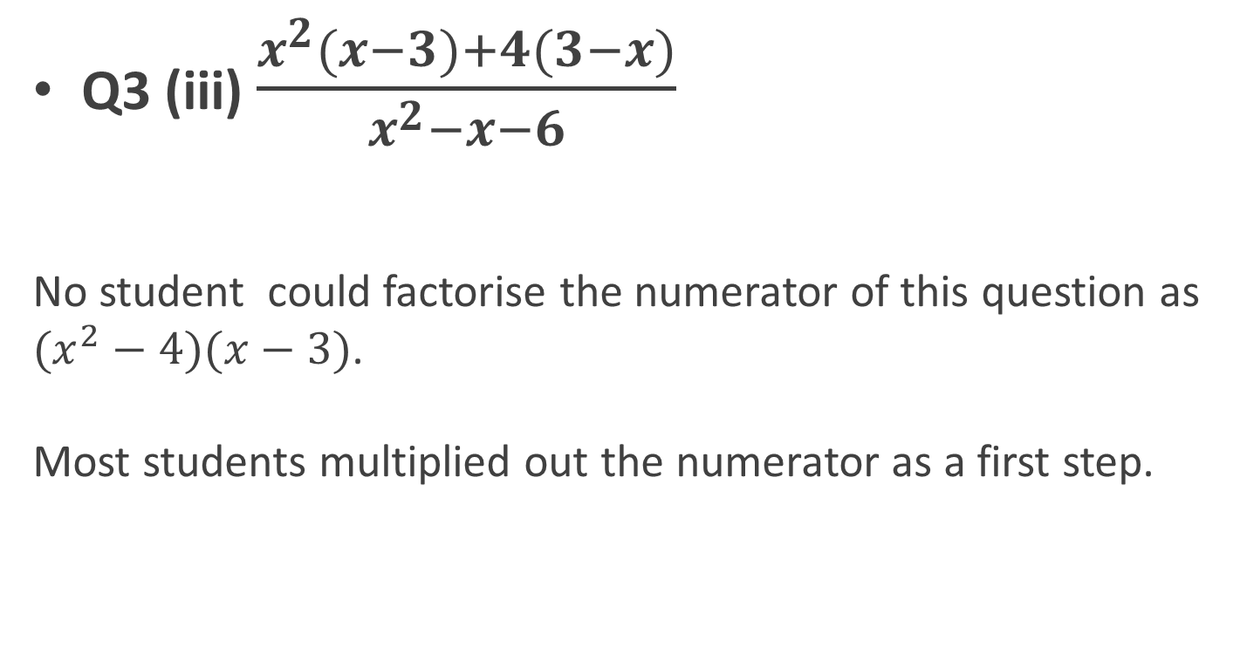
Common Misconceptions
Q3 (iii) $\frac{x^{2}(x−3)+4(3−x)}{x^{2}−x−6}$
No student could factorise the numerator of this question as $(x^{2}−4)(x−3)$.
Most students multiplied out the numerator as a first step.

Slide 32
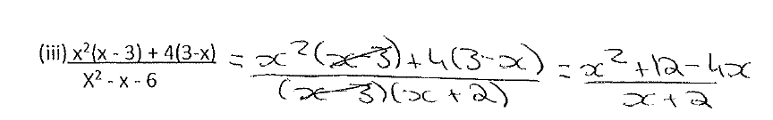
Common Misconceptions
Q3(iii) Two students did the following “cancellation”:

Slide 33
Common Misconceptions
Problems with simplifying single fractions were compounded when students had to simplify products and quotients of fractions. (Q4 &Q5)

Slide 34
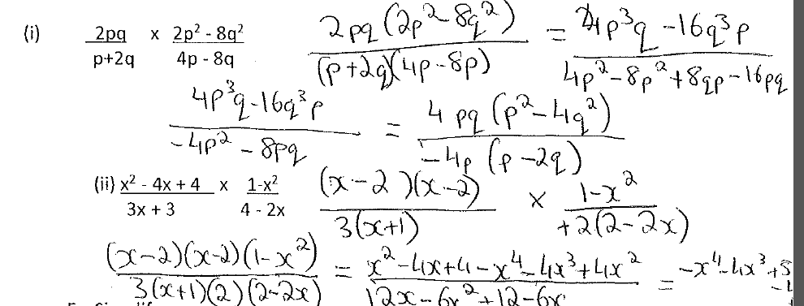
Common Misconceptions
Q4(i) The student is multiplying out the factors and then starting to factorise all over again.
(p has also been substituted for q also).
What am I being asked to do here?
What is my strategy in this type of situation?

Slide 35
Common Misconceptions
The student from the previous slide had answered Q1 and Q2 very well but when the question involved the multiplication of two fractions, they failed to understand the significance of the factors in the question, even though they correctly created a single fraction.
They abandoned earlier successful strategies

Slide 36
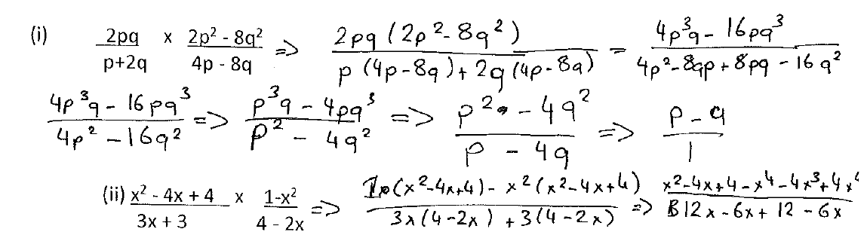
Common Misconceptions
Q4(i)

Slide 37
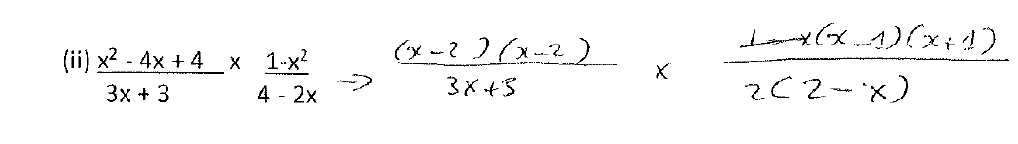

Common Misconceptions
Q4(ii) $(1−x^{2}$) treated as ($x^{2}$-1)
Not seeing $\left(2−x\right)=−1\left(x−2\right)$
(Seen in other scripts also)

Slide 38
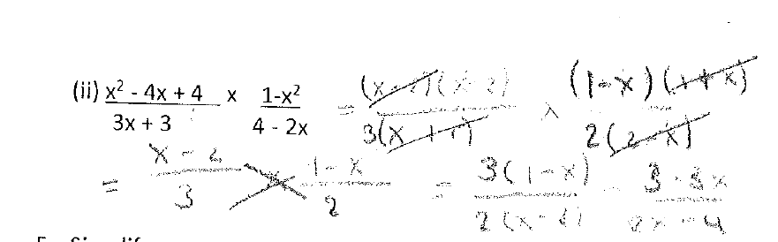

Common Misconceptions
Equating $\left(2−x\right)and \left(x−2\right)$
Cross- multiplication as it was never intended !!

Slide 39
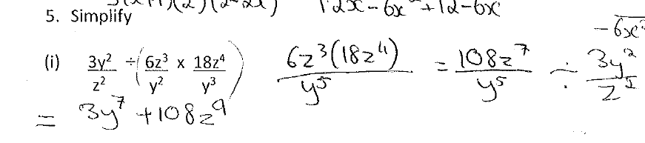
Common Misconceptions
Q5(i)
Brackets inserted which were not in the question.
Treating division as commutative which it is not.
Not linking division for algebraic fractions to division for numeric fractions
Cross multiplication used incorrectly

Slide 40
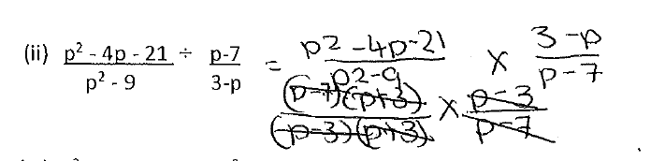
Common Misconceptions
Q5 (ii)
(3-p) treated as being equal to (p-3).
Final answer which in this case, given the error, would be 1, is not written. This was the case with all students who got this far.
They seemed to be “crossing out” pairs of equal factors but not associating the process with division.

Slide 41
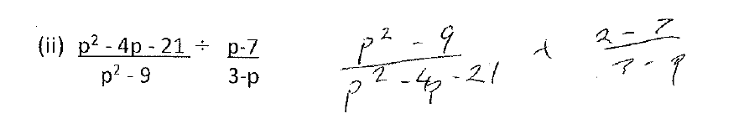
Common Misconceptions
Inverting the wrong fraction!
Gap in knowledge of division of numeric fractions
Transcription error

Slide 42
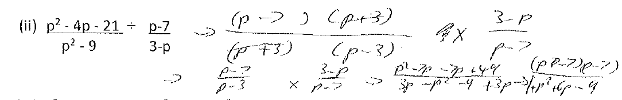
Common Misconceptions
Nearly there but then began multiplying out factors and a degenerative form of cross processes!

Slide 43
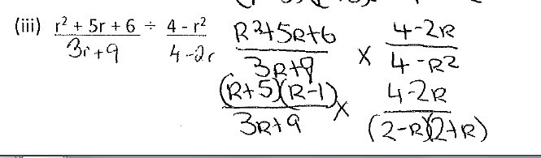
Common Misconceptions
Incorrect factorisation & not factorising fully

Slide 44
Addressing Misconceptions
Recommendations
  Students develop a general strategy
  `
  This strategy needs to be developed for numeric fractions first and then generalised to algebraic fractions
  Students need to use checking strategies

Slide 45
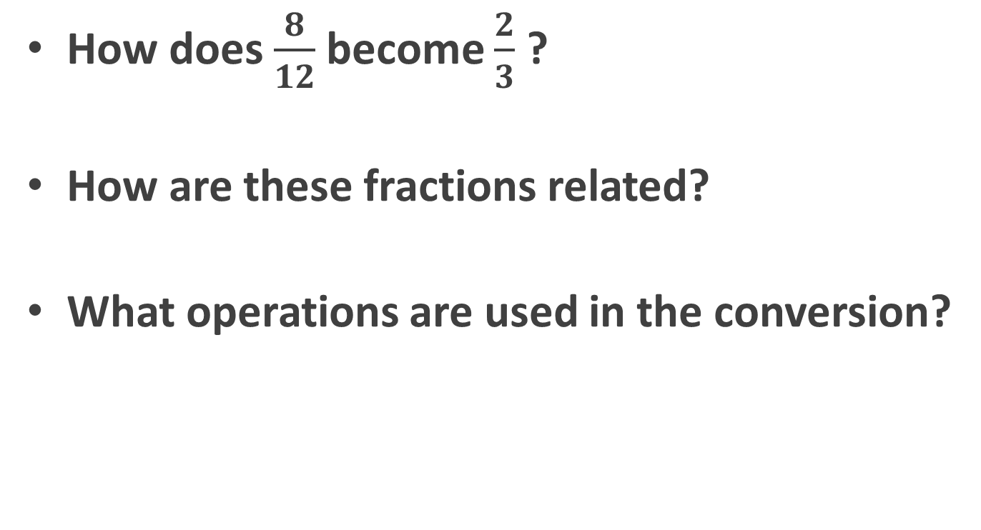
How can we address the problem?
How does $\frac{8}{12}$ become $\frac{2}{3}$ ?
How are these fractions related?
What operations are used in the conversion?

Slide 46
Strategy for simplifying fractions
The strategy for simplifying a single fraction:
  Factorise the numerator and denominator fully.
  Divide the numerator and denominator by the highest common factor of both numerator and denominator.
  When the HCF of the numerator and denominator is 1, then the fraction is simplified.

Slide 47
Effective Student Understanding
What effective understanding of this topic looks like:
Knowing what simplifying a fraction means
  Being able to simplify any algebraic fraction with confidence using this general strategy including recognising factors when given algebraic fractions

Slide 48
Summary
The understandings we gained regarding students’ learning simplifying algebraic fractions, as a result of being involved in the research lesson:
  Students lacked a general strategy as they were not making connections to number .
  They used random techniques which could be applied in particular instances but they were unable to see an overall strategy.
  Students were not relating algebraic procedures back to procedures in number.
  Metacognition missing!

Slide 49
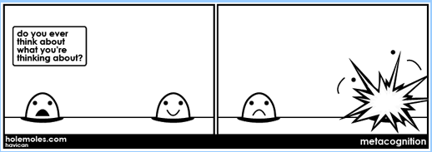
Notes:
Metacognition = The ability to be aware of your own learning processes

Slide 50
Summary
What did we learn about this content to ensure we had a strong conceptual understanding of this topic?
  We had to figure out the student thinking behind the misconceptions and the gaps in knowledge which gave rise to them.

Slide 51
Teaching Strategies
What was difficult?
Finding the time to do the remediation work
Was it hard to work out different ideas presented by students by contrasting/discussing them to help bring up their level of understanding?
  It was clear that the difficulties lay with basic fraction concepts and with making connections between number and algebra.
  Students were not thinking about the processes they were using in number and transferring the thinking to algebra.

Slide 52
Teaching Strategies
  How did I put closure to the lesson?
    Following the lesson on “arriving at a general strategy” we asked students to correct work from the diagnostic test and to justify their reasoning. This was a new type of activity for students
    It was difficult to get students to justify their reasoning. When work was incorrect they often gave as a reason “No, because it is incorrect.”

Slide 53
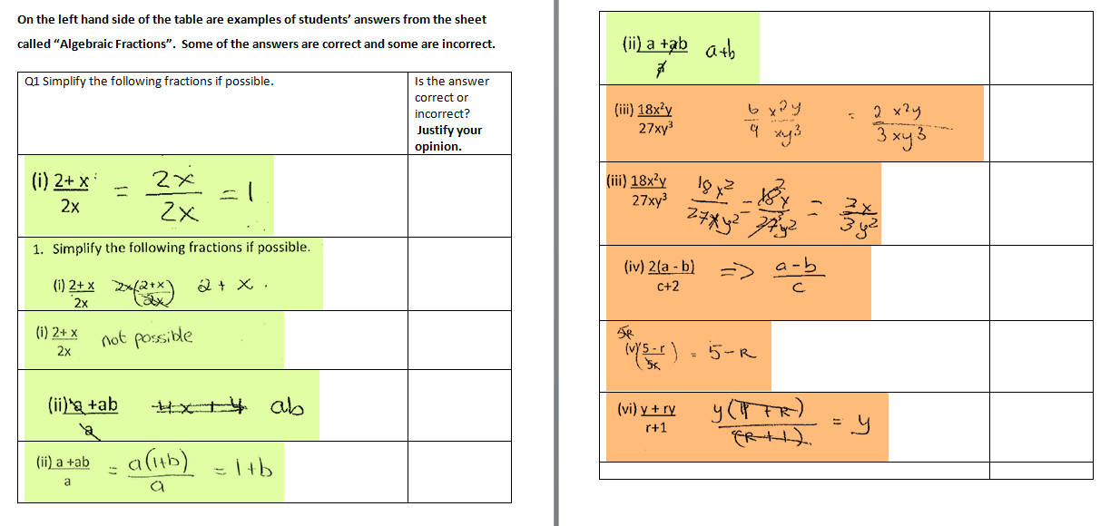
Assessing the learning

Slide 54
Teaching Strategies
What changes would I make in the future, based on what I have learned in my teaching, to address students’ misconceptions?
  The topic of the creation of equivalent fractions and the verbalisation of the operations used to be emphasised in first year (and every year )with a view to its impact on the simplification of algebraic fractions later on
  It is also important that students identify the operations which do not create equivalent fractions.
  We need to disseminate the evidence from this lesson study to all of the Maths department
  Use of the word “cancelling” needs to be discussed at department level. The issues identified here must filter back to JC.

Slide 55
Introduction
Enduring understandings:
  Understanding the concept of equivalent fractions and how they are created
  Seeing algebra as generalised arithmetic and in particular understanding simplification of algebraic fractions as a generalisation of simplification of numeric fractions
  Looking for patterns and generalising

Slide 56
Reflections on Lesson Study Process
Strengths & Weaknesses
  This was the first time we compared and contrasted 5th yr. HL and 6th yr. HL and identified the same problems in both classes which had its source back in JC.
  Increased sharing of ideas with colleagues
  Leads to agreed approaches to teaching concepts
  Its use in the future may lead to our “homing in” on similar problems and using earlier intervention.
  It takes time but in the long term recognises and addresses recurring misconceptions

Slide 57
’ What do we mean by ‘CANCELLING’

Slide 58
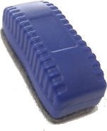
What do we mean by ‘CANCELLING’
‘CANCELLING’

