Slide 1
Session1 Cultivating Skills for problem solving
Teaching the concept and notation of Number Systems
using an understanding of basic rules and skills approach.

Slide 2
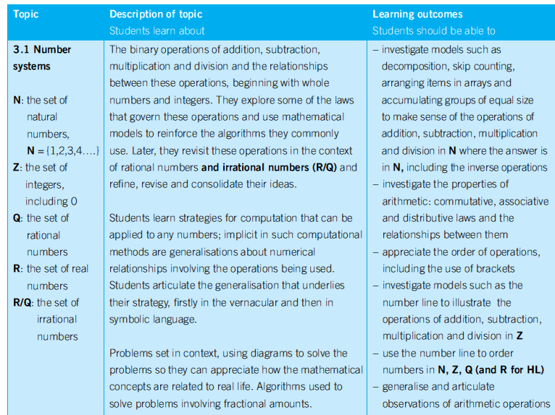
Junior Certificate-All Levels
Notes:
Syllabus

Slide 3
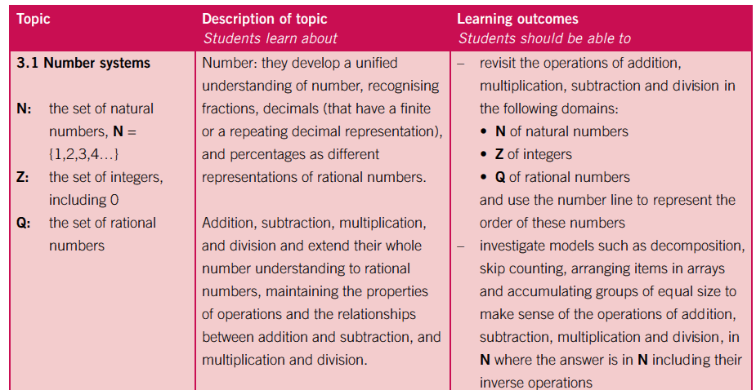
Leaving Certificate- Foundation Level

Slide 4
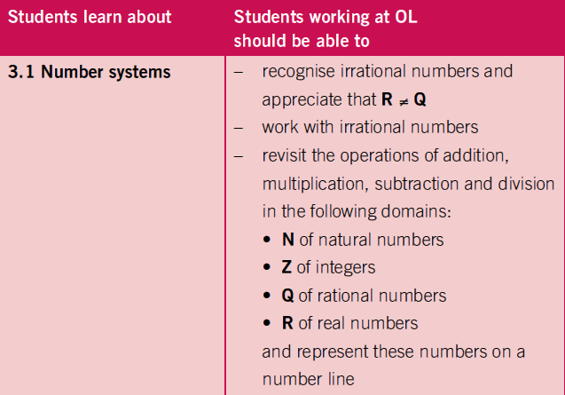
Leaving Certificate- Ordinary & Higher Level

Slide 5
Section 1 Number Systems
Within Strands
Curriculum
Subjects
Future
Prior Knowledge
Number Systems (ℕ, ℤ & ℚ)
Real
World
Across Strands
Past

Slide 6
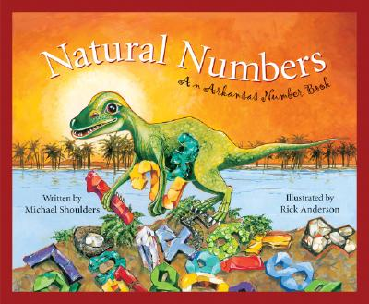
Assessment
Quiz Time…………
The Natural numbers are…..
A. The set of all whole numbers , positive, negative and 0.
B. The set of all positive whole numbers (excluding 0).
B. The set of all positive whole numbers (excluding 0).
C. The set of all positive whole numbers (including 0).
Notes:
Quiz: Working in Pairs- Discuss question. Hold up answer on whiteboard.
Ask further questions to ensure all students understand.
Eg. Give me examples of natural numbers.
Eg. Give me an example of something that is not a natural number
Is “0” a natural number ? What is the smallest natural number?
Explain why ½ is not a natural no.
Is 4.25 a natural no. ?
Is 2/1 a natural number?
Ah so we can only have whole numbers.
Does anyone remember the symbol for the natural numbers?
How many natural numbers are there? Infinite amount
Why do we need the natural numbers? They are the numbers for counting 1, 2, etc
What is the smallest natural number? 1
Needed to solve questions such as x+2=5
6

Slide 7
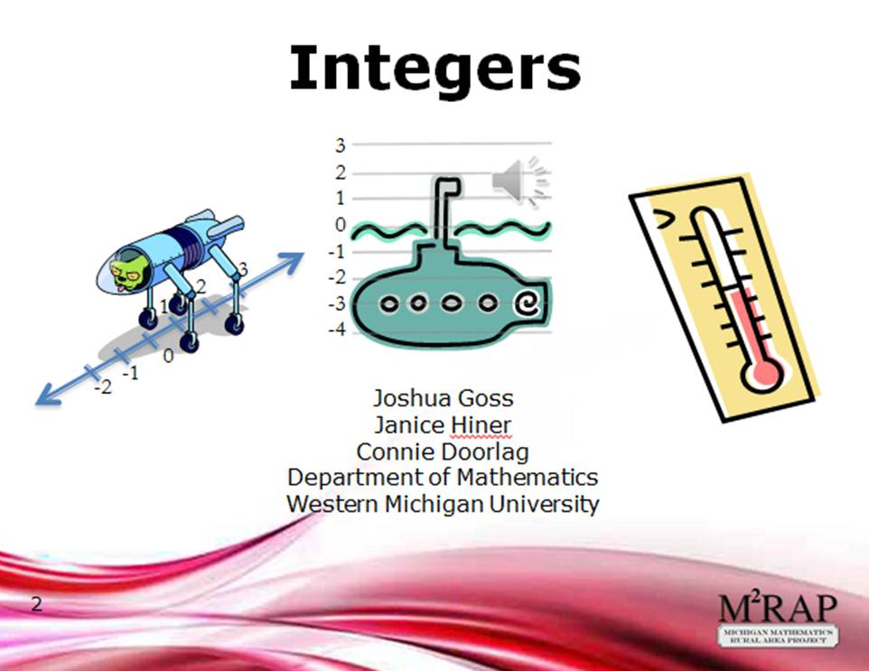
The Integers are……
A. The set of all whole numbers , positive, negative and 0.
A. The set of all whole numbers , positive, negative and 0.
B. The set of all positive whole numbers only.
C. The set of all negative whole numbers only.
Notes:
Give me some examples of integers.
Can you explain then why B is not an answer.
Can anyone remember its symbol.
Z- comes from the German word Zahl-meaning number.
How many integers are there? Infinite amount
Why do we need the integers?
Historically, the ﬁrst occurrence of a negative number is connected with the notion of a debt.
To do some basic computing: such as the sum of two numbers together and also
to subtract one number from another number. Little reﬂection shows that to be
able to do this for all numbers, negative numbers needed to be introduced. Suppose
we would like subtract 1000 from 500. Then without the negative numbers, this
subtraction would not be deﬁned because there exists no natural number which
is equal to 500−1000.
Needed Integer numbers to solve eg. x+5=3
7

Slide 8
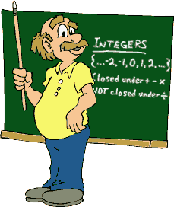
Answer True or False to the following:
‘The natural numbers are a subset of the integers’.
TRUE
TRUE
FALSE
Notes:
Explain why that is so.
What does subset mean?
Could that statement be correct if it was the converse, if I swapped integers with natural numbers ‘No’, why??
It is so important that when we use True/False questions that we ask students to justify their answer as students often guess true or false.
8

Slide 9



Which number is not an integer?
A. -1
B. 0
C. $\frac{7}{1}$
D. 4.$\dot{3}$
D. 4.$\dot{3}$
Notes:
A.
Why is ‘A’ not an integer? Not a whole number. What does a whole no. mean? Could I write 4.$\dot{3}$ in another way? 4.33333333 .
What name do we give to this type of decimal? Recurring or repeating decimal.
Is 7/1 an integer? Yes as it can be simplified to a whole number.
9

Slide 10
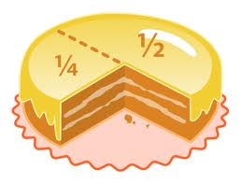
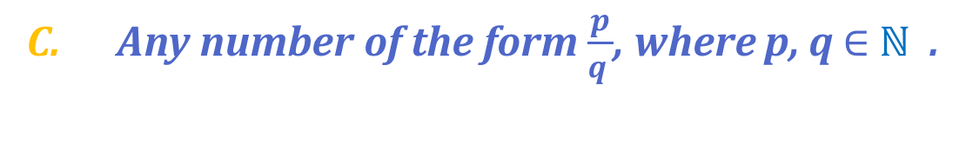
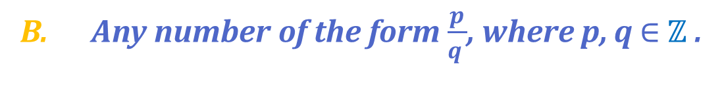
The Rational numbers are…….
A. Any number of the form $\frac{p}{q }$, where p, q $∈$ ℤ and q≠0.
A. Any number of the form $\frac{p}{q }$, where p, q $∈$ ℤ and q≠0.
B. Any number of the form $\frac{p}{q }$, where p, q $∈$ ℤ .
C. Any number of the form $\frac{p}{q }$, where p, q $∈$ ℕ .
Notes:
Ok let’s mention another type of number, the rational numbers.
Why do we need the rational numbers?
The integers form a pretty comprehensive set of numbers. We can add them, subtract them and multiply them. Only when we want to divide two integers it doesn’t always work.
The ratio 10 / 2 = 5 is simple. 8 / 2 = 4 is also simple. But what about if we wanted to divide 9 by 2: 9 / 2 is not quite as obvious. It has to be somewhere in between 4 and 5 – but unfortunately there aren’t any integers between 4 and 5.
Therefore 9/2 must belong to a new group of numbers. These are called rational numbers and represented by the symbol (for quotients).
So that’s why we choose A.
Give me an examples of a rational number.
Fractions usually have many representations. For example 1/2 = 2/4 = 3/6 and so on, therefore there is an infinite amount of rational numbers . In addition they can be written as decimal numbers such as 1/2 = 0.5 or 1/3 = 0.3333333… The decimal expansion of rational numbers is either finite (like 0.73), or it eventually consists of repeating blocks of digits (like 0.73454545…).
10

Slide 11

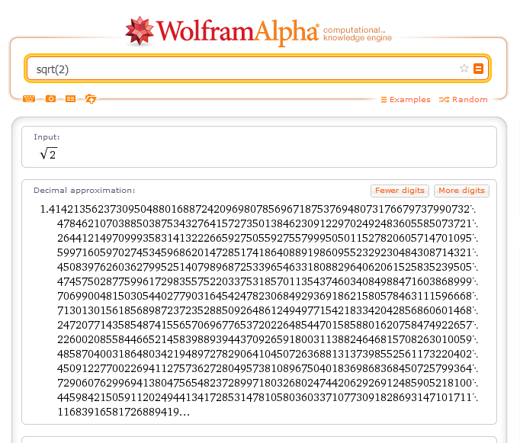
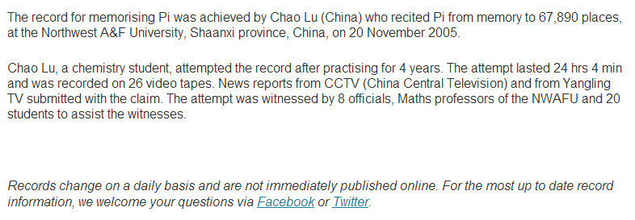
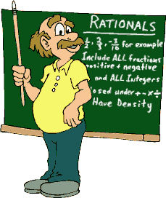
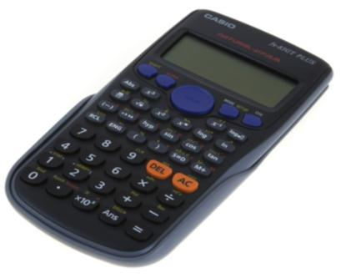
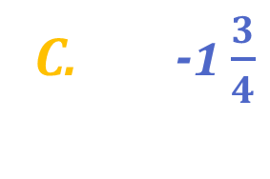


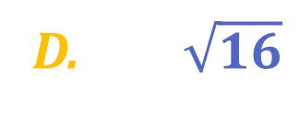

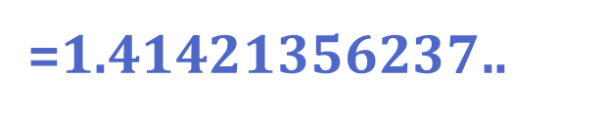
Which number is not a rational number?
Terminating
Decimal
A. 0.3
B. $\frac{2}{5}$
Terminating
Decimal
$$\sqrt{2}$$
C. -1 $\frac{3}{4}$
Terminating
Decimal
D. $\sqrt{16}$
Terminating
Decimal
E. 0.$\dot{1}$
Recurring
Decimal
Decimal expansion that can go on forever without recurring
$\text{ =}\text{1.41421356237}$..
F. $\sqrt{2}$
F. $\sqrt{2}$
Notes:
11

Slide 12
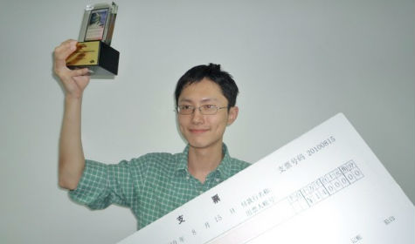
Which number is not a rational number?
$$\sqrt{2}$$
Notes:
12

Slide 13
The value of n for which $\sqrt{n}$ is rational
A. 2
B. 3
C. 5
D. 4
D. 4
D. 4
Notes:
Answer: D
13

Slide 14
How many rational numbers are there between 0 and 1?
A. 100
B. 10
C. Infinitely many
C. Infinitely many
D. 5
Notes:
Answer: C
Give me an example of a rational number between 0 and 1. Repeat the process until students realise there are an infinite amount of rationals.
14

Slide 15
Answer True or False to the following:
‘All rational numbers are a subset of the integers’.
TRUE
FALSE
Notes:
False.
This statement should be the other way around.
Explain this to me? Justify this to me by giving me examples .
Why can a ‘7’ be called rational and an integer?
7=7/1
15

Slide 16
Consider whether the following statements are True or False?
Statement | True or False
Every integer is a natural number
Every natural number is a rational number
Every rational number is an integer
Every integer is a rational number
Every natural number is an integer
False
True
False
True
True

Slide 17
Which of the following venn-diagrams is correct?
ℤ
ℚ
ℕ
A.
ℚ
ℤ
B.
ℕ
Natural
ℕ
ℚ
ℤ
C.
ℕ
Notes:
17

Slide 18
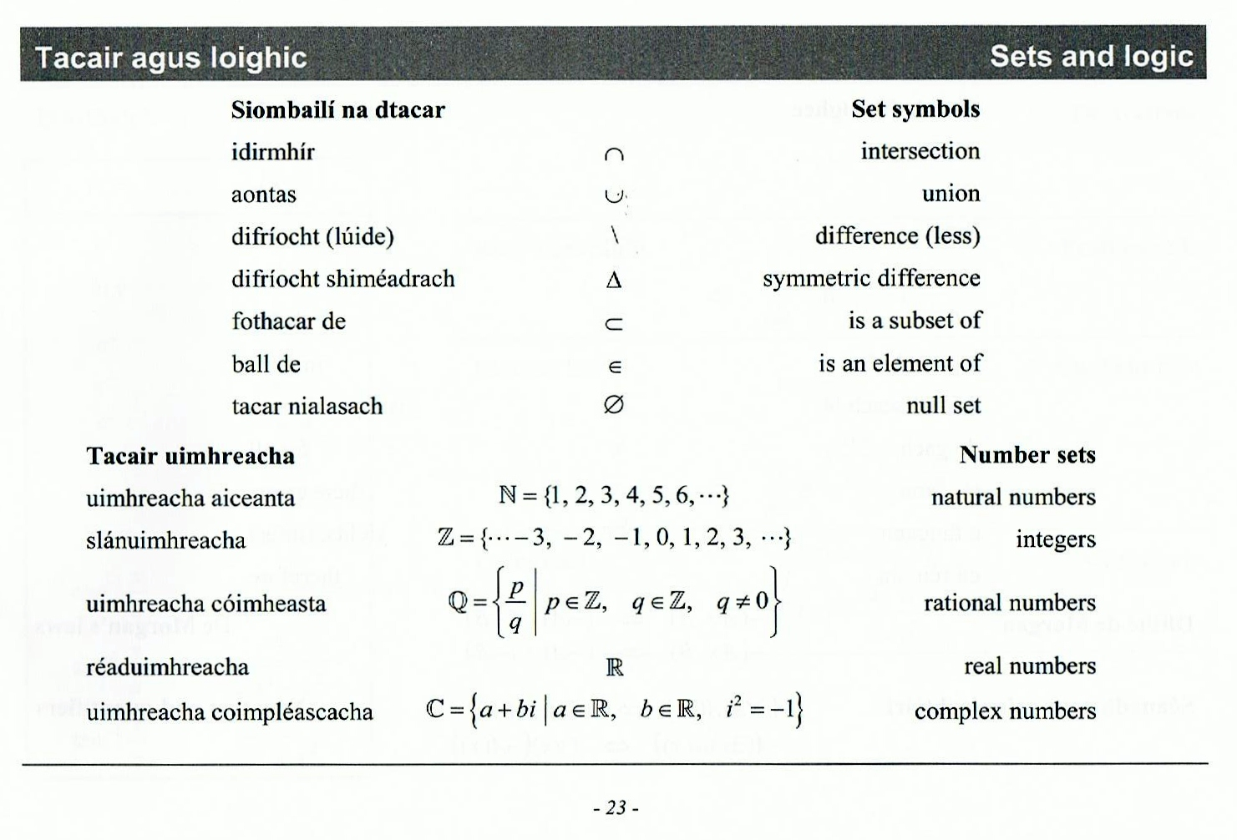
Venn Diagram & Number Line ℕ and ℤ.
Page 23
Natural
ℕ

Slide 19
Venn Diagram & Number Line ℕ and ℤ.
Page 23
Integers
ℤ

Slide 20
Which symbol can we use for the ‘grey ‘ part of the Venn-diagram?
ℤ ℕ
Page 23
A. ℚ\ℕ
B. ℕ\ℤ
C. ℤ\ℕ
C. ℤ\ℕ
Notes:
Revision of Sets here (symbols).

Slide 21
Consider whether the following statement is Always, Sometimes or Never True
‘An integer is a whole number.’
Always
Notes:
To improve reasoning skills with students we can ask always, sometimes, never style questions.

Slide 22
Consider whether the following statement is Always, Sometimes or Never True
‘Negative numbers are Natural numbers.’
Never

Slide 23
Consider whether the following statement is Always, Sometimes or Never True
‘The square of a number is greater than that number’
Sometimes

Slide 24
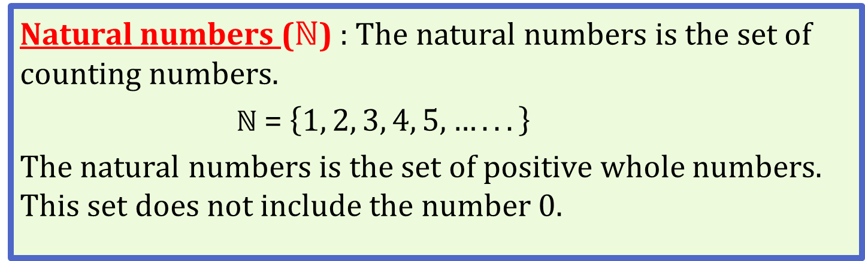
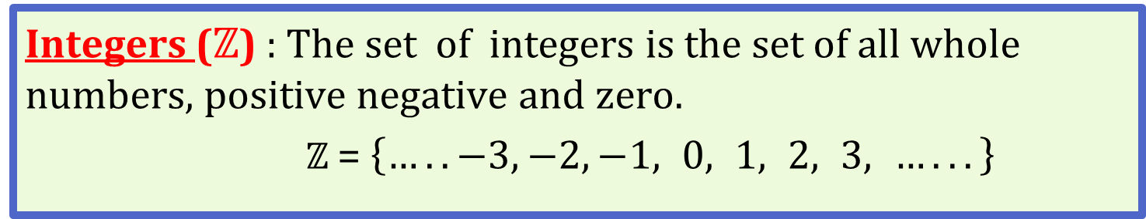
Natural Numbers (N)
Summary Number Systems
Natural numbers (ℕ) & Integers (ℤ)
Natural numbers (ℕ) : The natural numbers is the set of counting numbers.
ℕ = $\left\{1, 2, 3, 4, 5, …..\left..\right\} \right.$
The natural numbers is the set of positive whole numbers. This set does not include the number 0.
Page 23
Integers (ℤ) : The set of integers is the set of all whole numbers, positive negative and zero.
ℤ = $\left\{…..−3,−2,−1, 0, 1, 2, 3, …..\left..\right\} \right.$

Slide 25
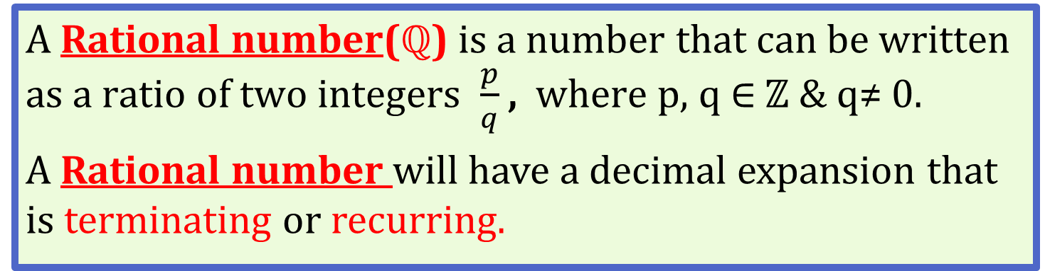
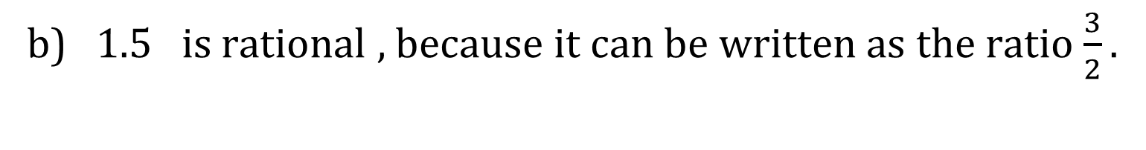
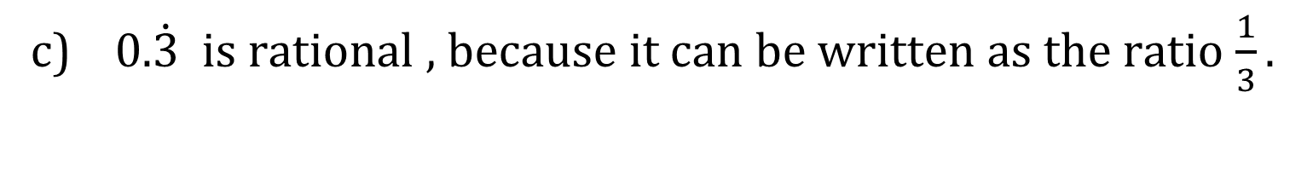
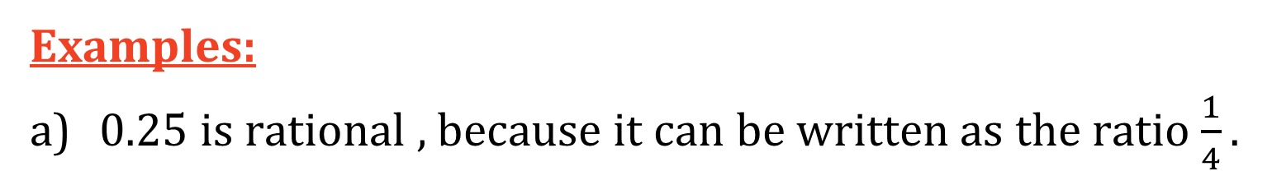
Rational Numbers (ℚ)
A Rational number(ℚ) is a number that can be written as a ratio of two integers $\frac{p}{q}$ , where p, q $∈$ ℤ & q≠ 0.
A Rational number will have a decimal expansion that is terminating or recurring.
Examples:
0.25 is rational , because it can be written as the ratio $\frac{1}{4}.$
b) 1.5 is rational , because it can be written as the ratio $\frac{3}{2}.$
c) 0.$\dot{3}$ is rational , because it can be written as the ratio $\frac{1}{3}.$

Slide 26



Interesting Rational Numbers
$$\frac{1 }{7}=0.142857142857142857$$
$$\frac{53}{83}$$
$0.\dot{6}$385542168674698795180722891566265060240$\dot{9}$
$\frac{1 }{7}=0.\dot{1}$428$\dot{7}$

Slide 27
Literacy Considerations Word Bank
Natural number
Integer
Rational number
Ratio
Whole Number
Recurring/Repeating decimal
Terminating decimal
Subset

Slide 28
Venn Diagram & Number Line ℕ, ℤ and ℚ.
Page 23
Natural
ℕ

Slide 29
Venn Diagram & Number Line ℕ, ℤ and ℚ.
Page 23
Integers
ℤ
ℤ\ℕ

Slide 30
Venn Diagram & Number Line ℕ, ℤ and ℚ.
Page 23
Rational
ℚ
ℚ\ℤ

Slide 31




$$\frac{2}{2}$$
$$\frac{3}{2}$$
$$\frac{4}{2}$$
$$\frac{5}{2}$$
$$\frac{6}{2}$$
Page 23
Rational
ℚ

Slide 32

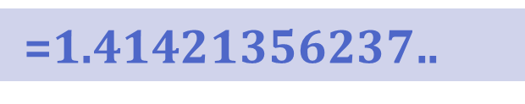
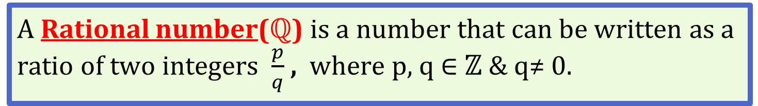
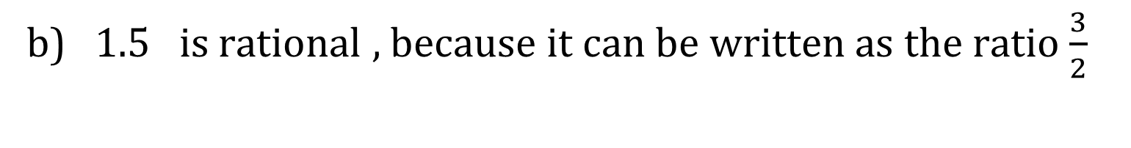
$$\frac{4}{4}$$
$$\frac{5}{4}$$
$$\frac{6}{4}$$
$$\frac{7}{4}$$
$$\frac{8}{4}$$
$$\frac{9}{4}$$
$$\frac{10}{4}$$
$$\frac{11}{4}$$
$$\frac{12}{4}$$
Page 23
Rational
ℚ

Slide 33





$$\frac{4}{4}$$
$$\frac{5}{4}$$
$$\frac{6}{4}$$
$$\frac{7}{4}$$
$$\frac{8}{4}$$
Page 23
Rational
ℚ
Notes:
Rational numbers are everywhere along the number line. However close you look, there will be lots and lots more. So surely there is no space let for any other numbers? Unfortunately this assumption is wrong.

Slide 34









$$\frac{8}{8}$$
$$\frac{9}{8}$$
$$\frac{10}{8}$$
$$\frac{11}{8}$$
$$\frac{12}{8}$$
$$\frac{13}{8}$$
$$\frac{14}{8}$$
$$\frac{15}{8}$$
$$\frac{16}{8}$$
Page 23
Rational
ℚ
Notes:
Rational numbers are everywhere along the number line. However close you look, there will be lots and lots more. So surely there is no space let for any other numbers? Unfortunately this assumption is wrong.

Slide 35



$$\frac{8}{8}$$
$$\frac{10}{8}$$
$$\frac{12}{8}$$
Page 23
Rational
ℚ

Slide 36





$$\frac{16}{16}$$
$$\frac{18}{16}$$
$$\frac{20}{16}$$
$$\frac{22}{16}$$
$$\frac{24}{16}$$
Page 23
Rational
ℚ

Slide 37
$$\frac{16}{16}$$
$$\frac{18}{16}$$
$$\frac{20}{16}$$
$$\frac{22}{16}$$
$$\frac{24}{16}$$
2
Page 23
Rational
ℚ

Slide 38
Number Systems
Learning Outcomes
Extend knowledge of number systems from first year to include:
Irrational numbers
Surds
Real number system
Within Strands
Curriculum
Subjects
Future
Real
World
Across Strands
Past

Slide 39
Junior Certificate-All Levels

Slide 40
Leaving Certificate- Ordinary & Higher Level

Slide 41
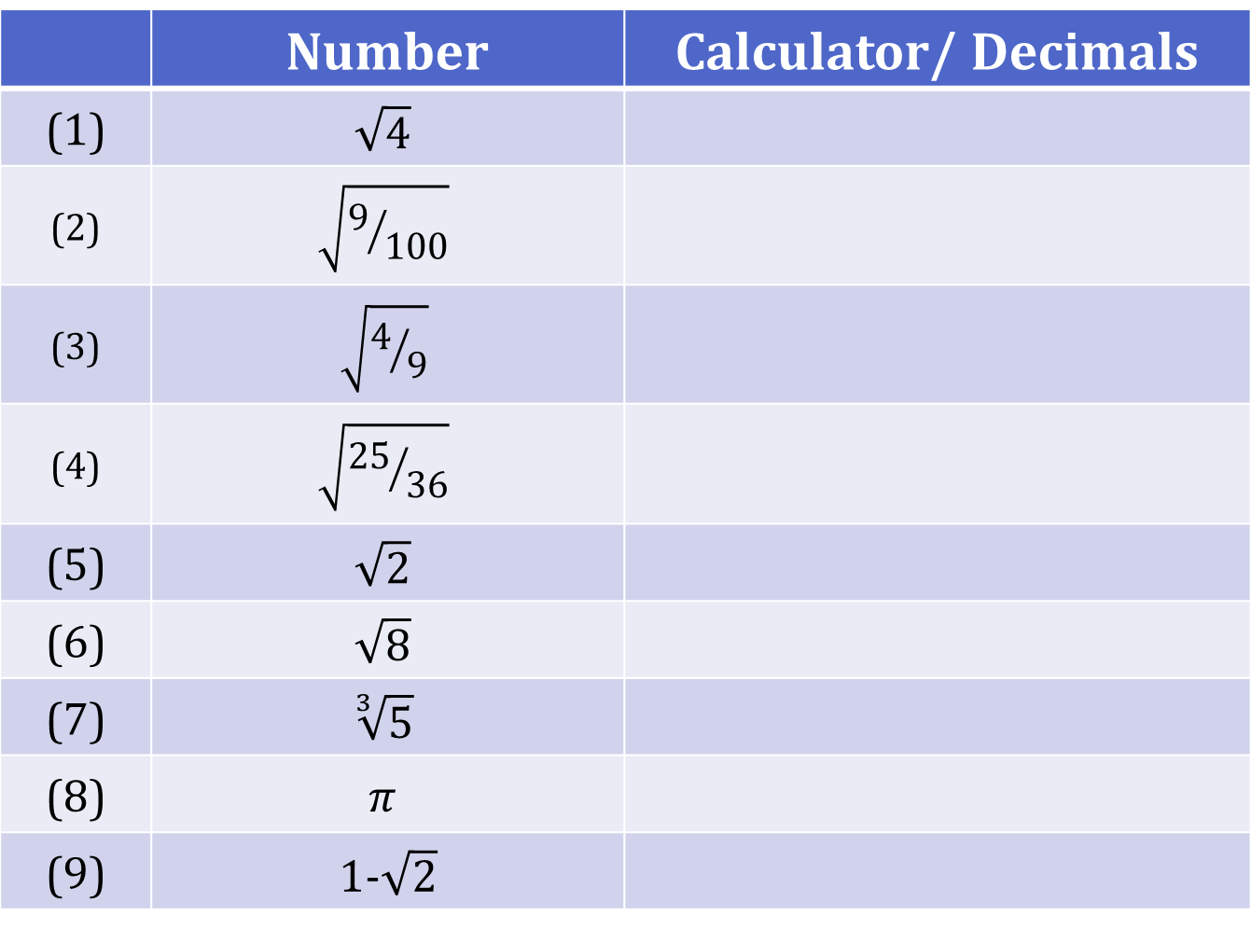
Student Activity 1 Calculator Activity
 | Number | Calculator/ Decimals
(1) | $$\sqrt{4}$$
(2) | $$\sqrt{9/{100}}$$
(3) | $$\sqrt{4/9}$$
(4) | $$\sqrt{{25}/{36}}$$
(5) | $$\sqrt{2}$$
(6) | $$\sqrt{8}$$
(7) | $$\sqrt[3]{5}$$
(8) | $$π$$
(9) | 1-$\sqrt{2}$

Slide 42

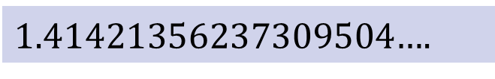
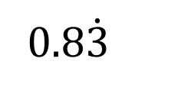
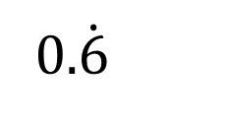
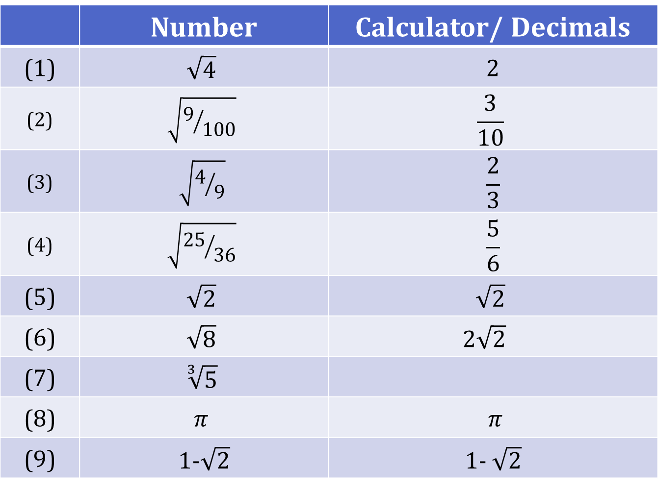
Student Activity 1 Calculator Activity
 | Number | Calculator/ Decimals
(1) | $$\sqrt{4}$$ | 2
(2) | $$\sqrt{9/{100}}$$ | $$\frac{3}{10}$$
(3) | $$\sqrt{4/9}$$ | $$\frac{2}{3}$$
(4) | $$\sqrt{{25}/{36}}$$ | $$\frac{5}{6}$$
(5) | $$\sqrt{2}$$ | $$\sqrt{2}$$
(6) | $$\sqrt{8}$$ | 2$\sqrt{2}$
(7) | $$\sqrt[3]{5}$$
(8) | $$π$$ | $π$
(9) | 1-$\sqrt{2}$ | 1- $\sqrt{2}$
Rational
0.3
Terminating
Or
Recurring
0.$\dot{6}$
0.8$\dot{3}$
Irrational
1.414213562....
$\text{1.41421356237}\text{309504}$….
Decimal expansion that can go on forever without recurring
2.828427125….
2.82842712474619009….
1.709975947….
1.70997594667669681….
$$\text{1.}\text{709975947}$$
1.709975947
3.141592654….
3.14159265358979323….
3.141592654….
-0.41421356237497912.…
-0.4142135624…

Slide 43
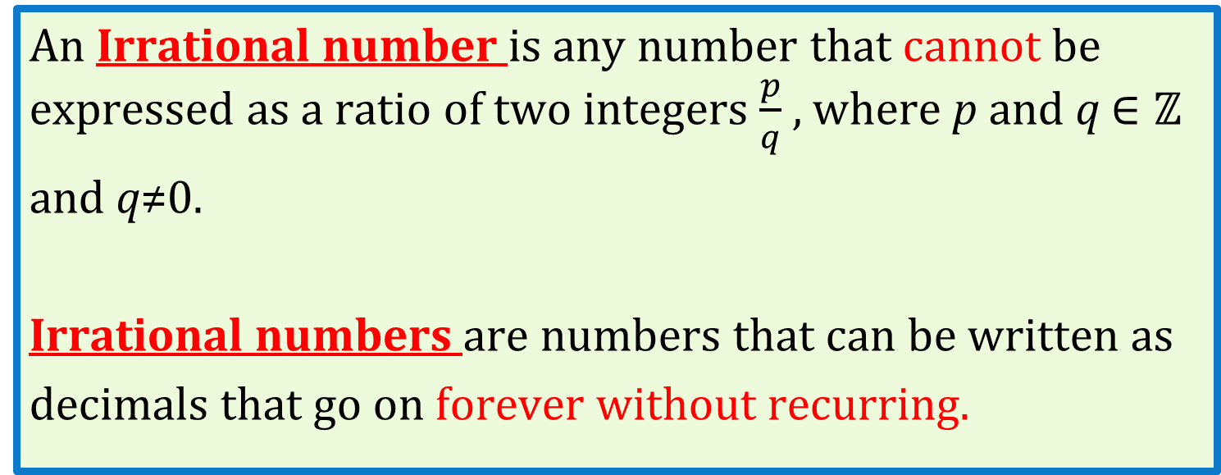
Irrational Numbers
So some numbers cannot be written as a ratio of two integers…….
Page 23
An Irrational number is any number that cannot be expressed as a ratio of two integers $\frac{p}{q}$ , where p and q $∈\text{ℤ}$
and q≠0.
Irrational numbers are numbers that can be written as
decimals that go on forever without recurring.
Notes:
What about 1.252525….. ? Explain repeating decimal here.
What about √5? Try on your calculator.
Can you think of any others??
So in summary √2, √3,√5, √6, √7,√8, √10, √11,√12, √13, √14, or √15 are all irrational numbers, but √1 = 1/1 or √4 = 2/1 or √9 = 3/1 or √16 = 4/1 are all rational numbers.

Slide 44
What is a Surd?
A Surd is an irrational number containing a root term.

Slide 45


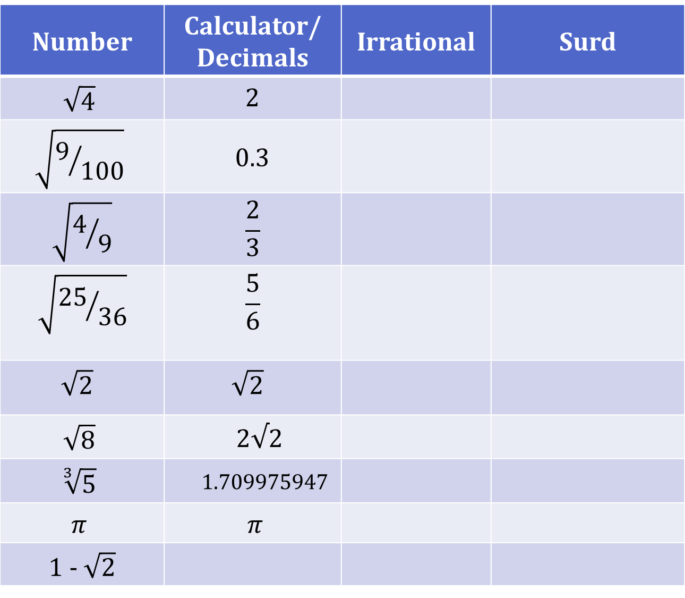
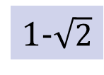

Number | Calculator/ Decimals | Irrational | Surd
$$\sqrt{4}$$ | 2
$$\sqrt{9/{100}}$$ | 0.3
$$\sqrt{4/9}$$ | $$\frac{2}{3}$$
$$\sqrt{{25}/{36}}$$ | $$\frac{5}{6}$$
$$\sqrt{2}$$ | $$\sqrt{2}$$
$$\sqrt{8}$$ | 2$√2$
$$\sqrt[3]{5}$$ | 1.709975947
$$π$$ | $π$
1 - $\sqrt{2}$
0.$\dot{6}$
0.8$\dot{3}$
1.414213562
2.828427125
3.141592654
-0.4142135624
1-$\sqrt{2}$

Slide 46
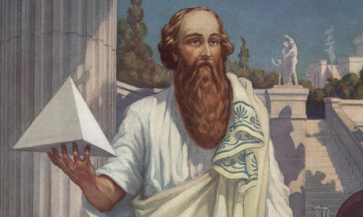
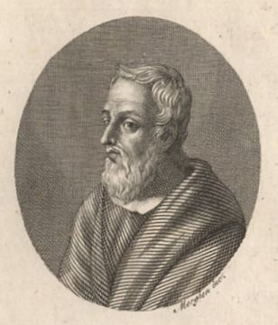

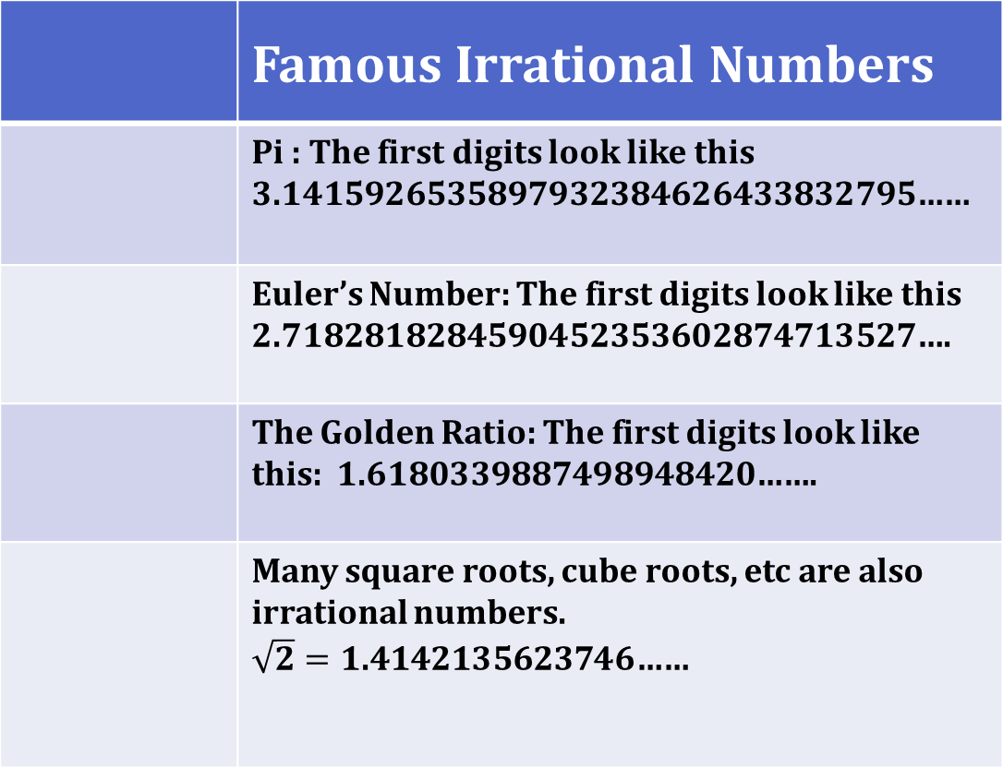




Best known Irrational Numbers
 | Famous Irrational Numbers
 | Pi : The first digits look like this 3.1415926535897932384626433832795……
 | Euler’s Number: The first digits look like this 2.7182818284590452353602874713527….
 | The Golden Ratio: The first digits look like this: 1.6180339887498948420…….
 | Many square roots, cube roots, etc are also irrational numbers. $\sqrt{2}=\text{1.41421356237}$46……
$$\sqrt{2}$$
$\text{1.41421356237}$46……
$$π$$
$$e$$
$$φ$$
Pythagoras
Hippassus
$$√2$$
Notes:
Pi: We have all met pi- even in primary school and is the ratio of the circumference of a circle to its diameter, is also an irrational number. It was not until the 18th Century That Lambert, a Swiss mathematician, proved that pi was irrational.
The popular approximation of ²²/₇ = 3.1428571428571... is close but not accurate.
Eulers number: This number you will not meet in LC H/L maths. For teachers information you will remember we did a lovely activity on discovering “e” in ws 7.
Golden Ratio: the greek letter phi. Some artists and architects believe the Golden Ratio makes the most pleasing and beautiful shapes.
√2: The first man to recognize the existence of irrational numbers might have died for his discovery.
Hippassus (5th Century BC) was a student of Pythagoras. He supposedly, used his teacher’s famous theorem to find the diagonal of a unit square and realised that this length could not be expressed as a fraction. Pythagoras and his followers only believed in the existence of rational numbers and they threw Hippassus overboard on a sea voyage and vowed to keep the existence of irrational numbers an official secret of their sect. According to legend, the finding that there was no number, remember that at that time that meant rational number to express the length of a line so disturbed the world of pythagoras that they swore their members to secrecy. The sect believed that all things could be described by and apprehended through rational numbers. If you believed that all numbers are rational numbers and that rational numbers are the basis of all things in the universe, then having something that cannot be expressed as a fraction is like discovering a gaping void in the universe.
These historical links make it fitting that learning about surds should be strongly linked with geometry,

Slide 47







Irrational Numbers
Familiar irrationals
$$\sqrt{2}$$
$$\sqrt{3}$$
$$\sqrt{5}$$
$$\sqrt{7}$$
$$e$$
$$π$$
Page 23
Rational
ℚ
Are these the only irrational numbers
based on these numbers?

Slide 48












$$\sqrt{2}$$
$$\sqrt{3}$$
$$\sqrt{5}$$
$$\sqrt{7}$$
$$e$$
$$π$$
Page 23
Rational
ℚ
$$\frac{\sqrt{2}}{2}$$
$$\frac{\sqrt{3}}{2}$$
$$\frac{\sqrt{5}}{2}$$
$$\frac{\sqrt{7}}{2}$$
$$\frac{e}{2}$$
$$\frac{π}{2}$$

Slide 49




$$\frac{\sqrt{5}}{2}$$
$$\frac{\sqrt{7}}{2}$$
$$\frac{e}{2}$$
$$\frac{π}{2}$$
Page 23
Rational
ℚ

Slide 50





$$\frac{\sqrt{5}}{2}$$
$$\frac{\sqrt{7}}{2}$$
$$\frac{e}{2}$$
$$\frac{π}{2}$$
Page 23
Rational
ℚ
$$\frac{3\sqrt{5}}{4}$$

Slide 51
Learning Outcomes
Extend knowledge of number systems from first year to include:
Irrational numbers
Surds
Real number system

Slide 52
Real Number System (ℝ)
The set of Rational and Irrational numbers together make up the Real number system (ℝ).

Slide 53






Real Number System (ℝ)
Real
ℝ
$$\sqrt{8}$$
$$\sqrt{3}+\sqrt{5}$$
Rational
ℚ
Irrational Numbers
ℝ\ℚ
$$−\sqrt{11}$$
$$π$$
$$1−\sqrt{2}$$

Slide 54

Student Activity
Classify all the following numbers as natural, integer, rational, irrational or real using the table below. List all that apply.
 | Natural ℕ | Integer ℤ | Rational ℚ | Irrational ℝ\ℚ | Real ℝ
5
$$1+\sqrt{2}$$
$$−9.6403915…$$
$−$ $\frac{1}{2}$
6.$\dot{3}\dot{6}$
2
-3
$$\sqrt[3]{8}$$
0
-$\sqrt{3}$
✓ | ✓ | ✓ |  | ✓
✓ | ✓
 | ✓ | ✓
✓ |  | ✓
✓ |  | ✓
✓ | ✓
✓ | ✓ |  | ✓
✓ | ✓ | ✓ |  | ✓
✓ | ✓ |  | ✓
✓ | ✓

Slide 55
Now place these numbers as accurately as possible on the number line below.

Slide 56
Now place them as accurately as possible on the number line below.
What would help us here?
-10
-7.5
-5
-2.5
0
2.5
5
7.5
10

Slide 57

The diagram represents the sets: Natural Numbers $ℕ,$
Integers $ℤ,$Rational Numbers$ℚ and$Real Numbers ℝ.
Insert each of the following numbers in the correct place on the diagram:
5$, 1+\sqrt{2}, −9.6403915..…, −$ $\frac{1}{2}$, 6.$\dot{3}\dot{6}$ , 2$π$, -3, $\sqrt[3]{8}$, 0 and -$\sqrt{3}.$
ℝ
ℚ
ℚ
ℤ
ℕ
ℕ
Notes:
Adapt this to include whatever numbers you wish.

Slide 58




The diagram represents the sets: Natural Numbers $ℕ,$
Integers $ℤ,$Rational Numbers$ℚ and$Real Numbers ℝ.
Insert each of the following numbers in the correct place on the diagram:
5$, 1+\sqrt{2}, −9.6403915..…, −$ $\frac{1}{2}$, 6.$\dot{3}\dot{6}$, 2$π$ , -3, $\sqrt[3]{8}$ , 0 and -$\sqrt{3}.$
ℝ
1+$\sqrt{2}$
ℚ
ℤ
ℕ
6.$\ddot{36}$
-3
$$\sqrt[3]{8}$$
$$−\frac{1}{2}$$
5
$$2π$$
0
-$\sqrt{3}$
-9.6403915…

Slide 59
Session 2 Investigating Surds
Pythagoras
Hippassus

Slide 60
Show that$\sqrt{8 }$ $+ \sqrt{18}$ = $\sqrt{50}$without the use of a calculator.

Slide 61








Show that$\sqrt{8 }$ $+ \sqrt{18}$ = $\sqrt{50}$without the use of a calculator.
$\sqrt{8 }$ $+ \sqrt{18}$
$$\sqrt{50 }$$
$$\sqrt{4 x 2} + \sqrt{9 x 2}$$
$$\sqrt{25 x 2}$$
$$\sqrt{4 }\sqrt{2 } + \sqrt{9} \sqrt{2}$$
$$\sqrt{25 }\sqrt{2}$$
2$\sqrt{2} +$ 3$\sqrt{2}$
$5\sqrt{2}$
5$\sqrt{2}$
$⇒\sqrt{8 }$ $+ \sqrt{18}$ = $\sqrt{50}$

Slide 62
Investigating Surds
Prior Knowledge
Number Systems
(ℕ, ℤ ,ℚ, ℝ\ℚ & ℝ).
Trigonometry
Geometry/Theorems
Co-ordinate Geometry
Algebra

Slide 63



Investigating Surds
Plot A (0,0), B (1,1) &
C (1,0) and join them.
Write and Wipe
Desk Mats

Slide 64

















Taking a closer look at surds graphically
Length Formula (Distance)
Plot A (0,0), B (1,1) &
C (1,0) and join them.
Find $|AB|$
$$\left|AB\right|=\sqrt{{\left(x_{2}−x_{1}\right)}^{2}+{\left(y_{2}−y_{1}\right)}^{2}}$$
$$y$$
$$\left|AB\right|=\sqrt{{\left(1−0\right)}^{2}+{\left(1−0\right)}^{2}}$$
$$B$$
$$(1,1)$$
$$\left|AB\right|=\sqrt{{\left(1\right)}^{2}+{\left(1\right)}^{2}}$$
$${ (x}_{2}\text{,}y_{2}\text{)}$$
$$\left|AB\right|=\sqrt{1+1}$$
$$x$$
$$\left|AB\right|=\sqrt{2}$$
$$C$$
$$A$$
$$(1,0)$$
$$(0,0)$$
$${ (x}_{1}\text{,}y_{1}\text{)}$$

Slide 65











Taking a closer look at surds graphically
Pythagoras’ Theorem
$$c^{2}=a²+b²$$
$$y$$
$$c^{2}=1²+1²$$
$$c^{2}=1+1$$
$$1$$
$$c^{2}=2$$
$$c$$
$$a$$
$$\sqrt{c^{2}}=\sqrt{2}$$
$$x$$
$$1$$
$$b$$
$$c = \sqrt{2}$$

Slide 66
Investigating Surds
Plot D (2,2) and E (2,0).
Join (1,1) to (2,2) and join (2,2) to (2,0).
Write and Wipe
Desk Mats

Slide 67
















Taking a closer look at surds graphically
Pythagoras’ Theorem
Plot D (2,2) and E (2,0).
Join (1,1) to (2,2) and join (2,2) to (2,0).
Find $|AD|$
$$c^{2}=a²+b²$$
$$D$$
$$c^{2}=2²+2²$$
?
$$c^{2}=4+4$$
$$c$$
$$\sqrt{8}$$
$$c^{2}=8$$
$$B$$
2
$$a$$
$$\sqrt{2}$$
$$\sqrt{c^{2}}=\sqrt{8}$$
$$E$$
$$c = \sqrt{8}$$
$$A$$
2
$$b$$

Slide 68






(1) Length Formula (Distance)
$${ (x}_{2}\text{,}y_{2}\text{)}$$
(2, 2$\text{)}$
$${ (x}_{1}\text{,}y_{1}\text{)}$$
$$D$$
$$\left|AB\right|=\sqrt{{ (x}_{2}\text{−}x_{1}\text{)²+} { (y}_{2}\text{−}y_{1}\text{)² }}$$
$$\sqrt{2}$$
(1, $1\text{)}$
$$B$$
$$\left|AB\right|=\sqrt{ \text{(2− 1}\text{)²} \text{+}\text{ ( 2− 1}\text{)² }}$$
$$\left|AB\right|=\sqrt{\text{ (1}\text{)²} \text{+}\text{ (1}\text{)² }}$$
$$\left|AB\right|=\sqrt{\text{ 1} \text{+}\text{ 1} }$$
|AB| = $\sqrt{2}$

Slide 69








(2) Pythagoras’ Theorem
$$c^{2}=a²+b²$$
D
$${\left|BD\right|}^{2}=1²+1²$$
$${\left|BD\right|}^{2}=1+1$$
$${\left|BD\right|}^{2}=2$$
$$B$$
$$C$$
$$\sqrt{{\left|BD\right|}^{2}}=\sqrt{2}$$
$$\left|BD\right|= \sqrt{2}$$

Slide 70







(2) Pythagoras’ Theorem
$c^{2}$ = a² + b²
$$c$$
$$\sqrt{2}$$
$c^{2}$ =1²+ 1²
1
$$a$$
$c^{2}$ = 1 + 1
1
$$b$$
$c^{2}$ = 2
$\sqrt{c^{2} }$= $\sqrt{2}$
c = $\sqrt{2}$

Slide 71


(3) Congruent Triangles
SAS
Two sides and the included angle
$$\sqrt{2}$$
1
$$\sqrt{2}$$
1
1
1

Slide 72



(4) Similar Triangles
$$\frac{x}{\sqrt{2}}=\frac{1}{1}$$
$$\frac{x}{\sqrt{2}}=1$$
$$\sqrt{2}.\frac{x}{\sqrt{2}}=\frac{1}{1}.\sqrt{2}$$
$$x=\sqrt{2}$$
$$x$$
45°
1
45°
$$\sqrt{2}$$
1
45°
1
45°
1

Slide 73






(5) Trigonometry
Page 16
$$\sin{θ}=\frac{a}{c}$$
$$\sin{{45}^{0}}=\frac{1}{x}$$
$$x.\sin{{45}^{0}}=\frac{1}{x}.x$$
$$x\sin{{45}^{0}}=1$$
$$\frac{x\sin{{45}^{0}}}{\sin{{45}^{0}}}=\frac{1}{\sin{{45}^{0}}}$$
$$x=\sqrt{2}$$
$$c$$
$$a$$
$$x$$
1
45°
1
$$b$$
$$\sin{θ}=\frac{a}{c} \cos{θ=\frac{b}{c}} \tan{θ=\frac{a}{b}}$$

Slide 74










What are the possible misconceptions with
$\sqrt{2}+\sqrt{2}$ ?
Multiplication of surds
Graphically
$\sqrt{8}=\sqrt{2}+\sqrt{2}$
$$\sqrt{2}$$
$\sqrt{8}$
$\sqrt{8}=2\sqrt{2}$
Algebraically
$$\sqrt{2}$$
$\sqrt{8}=2\sqrt{2}$
$$\sqrt{8}=\sqrt{4 }\sqrt{2}$$
$$\sqrt{4 x 2}=\sqrt{4 }\sqrt{2}$$
$$\sqrt{a b}=\sqrt{a }\sqrt{b}$$

Slide 75











Division of Surds
Graphically
$$\frac{\sqrt{8}}{\sqrt{2}}$$
$$\frac{\sqrt{8}}{\sqrt{2}}=\frac{2\sqrt{2}}{\sqrt{2}}$$
$$\sqrt{2}$$
= 2
$$\text{or}$$
$$=2$$
$\sqrt{8}$
Algebraically
$$\sqrt{2}$$
$$=\sqrt{\frac{8}{2}}=\sqrt{4}=2$$
$$\frac{\sqrt{8}}{\sqrt{2}}$$
$$=\frac{\sqrt{4 x 2}}{\sqrt{2}}$$
$$=\frac{\sqrt{4 } \sqrt{2} }{\sqrt{2}}$$
$\sqrt{\frac{a}{b}}$ = $\frac{\sqrt{a}}{\sqrt{b}}$
$$= \sqrt{4}$$
$$=2$$

Slide 76

Student Activity-White Board
Continue using the same whiteboard:
Plot (3,3).
Join (2,2) to (3,3) and join (3,3) to (3,0).
(3) Using (0,0), (3,0) and (3,3) as your triangle verify that the length of the hypotenuse of this triangle is $\sqrt{18.}$
(4) Simplify $\sqrt{18}$ without the use of a calculator.
(5) Simplify $\frac{\sqrt{18}}{\sqrt{2}}$ without the use of a calculator.
(6) Simplify $\frac{\sqrt{18}}{\sqrt{8}}\text{without} \text{the} \text{use} \text{of} \text{a} \text{calculator}\text{.}$

Slide 77








Q1,2 &3
$c^{2}$= a² + b²
c
$c^{2}$= 3²+ 3²
$\sqrt{18}$
3
$c^{2}$= 9 + 9
a
$c^{2}$= 18
$\sqrt{c^{2} }$= $\sqrt{18}$
3
c = $\sqrt{18}$
b
Notes:
Solutions to Student Activity.

Slide 78





Q4 Simplify $\sqrt{18}$ without the use of a calculator.
Graphically
√2
$\sqrt{18}$
$\sqrt{18}$ = $\sqrt{2}$ + $\sqrt{2}$ +$\sqrt{2}$
√2
$\sqrt{18}$ = $3\sqrt{2}$
3
√2
Algebraically
$\sqrt{ab}$ = $\sqrt{a }\sqrt{b}$
3
$\sqrt{18}$ = $\sqrt{9} \sqrt{ 2}$
$\sqrt{18}$ = $3 \sqrt{2}$

Slide 79


Q5. Simplify $\frac{\sqrt{18}}{\sqrt{2}}$ without the use of a calculator.
Graphically
$$\frac{\sqrt{18}}{\sqrt{2}}$$
= 3
$$\sqrt{2}$$
$$\sqrt{18}$$
Algebraically
$$\sqrt{2}$$
$$\frac{\sqrt{18}}{\sqrt{2}}$$
$$=\frac{\sqrt{9 x 2}}{\sqrt{2}}$$
= $\sqrt{\frac{18}{2}} =\sqrt{9 }$= 3
$$\sqrt{2}$$
$$=\frac{\sqrt{9 } \sqrt{2} }{\sqrt{2}}$$
$\sqrt{\frac{a}{b}}$ = $\frac{\sqrt{a}}{\sqrt{b}}$
$$= \sqrt{9}$$
= 3

Slide 80






Q6. Simplify $\frac{\sqrt{18}}{\sqrt{8}}$ without the use of a calculator.
Graphically
$$\frac{\sqrt{18}}{\sqrt{8}}$$
$\frac{\sqrt{18}}{\sqrt{8}}$ = $\frac{3\sqrt{2}}{2\sqrt{2}}$
= $\frac{3}{2}$
or
= $\frac{3}{2}$
$$\sqrt{18}$$
Algebraically
$$\sqrt{8}$$
$$\frac{\sqrt{18}}{\sqrt{8}}$$
= $\sqrt{\frac{18}{8}} =\sqrt{\frac{9 x 2 }{4 x 2}}$= $\sqrt{\frac{9}{4}}$ =$\frac{3}{2}$
$$=\frac{\sqrt{9 x 2}}{\sqrt{4 x 2}}$$
$$=\frac{\sqrt{9 } \sqrt{2} }{\sqrt{4} \sqrt{2}}$$
$\sqrt{\frac{a}{b}}$ = $\frac{\sqrt{a}}{\sqrt{b}}$
$$=\frac{\sqrt{9}}{\sqrt{4}}$$
= $\frac{3}{2}$

Slide 81




What other surds could we illustrate if we extended this diagram ?
$\sqrt{2}$=1$\sqrt{2}$
$\sqrt{8}$=2$\sqrt{2}$
$\sqrt{18}$=3$\sqrt{2}$
=4$\sqrt{2}$
$\sqrt{2}$=1$\sqrt{2}$
$\sqrt{8}$=2$\sqrt{2}$
$\sqrt{18}$=3$\sqrt{2}$
$\sqrt{2}$ =1$\sqrt{2}$
$\sqrt{8}$ =2$\sqrt{2}$
$\sqrt{18}$ =3$\sqrt{2}$
$\sqrt{32}$ =4$\sqrt{2}$
$$\sqrt{2}$$
$\sqrt{32}$
$$\sqrt{2}$$
4
$$\sqrt{2}$$
3
$$\sqrt{2}$$
2
1
1
2
3
4

Slide 82



What other surds could we illustrate if we extended this diagram ?
√2 =1√2
√8 =2√2
√18 =3√2
√32 =4√2
√50 = 5√2
= 5√2
$$\sqrt{2}$$
$\sqrt{50}$
$$\sqrt{2}$$
√72 = 6√2
√98 = 7√2
√128 = 8√2
√162 = 9√2
√200 =10√2
$$\sqrt{2}$$
5
$$\sqrt{2}$$
$$\sqrt{2}$$
5

Slide 83









Division of Surds
Graphically
$$\frac{\sqrt{50}}{\sqrt{32}}$$
= $\frac{5}{4}$
$$\sqrt{50}$$
Algebraically
$$\frac{\sqrt{50}}{\sqrt{32}}$$
$$=\frac{\sqrt{25 X 2}}{\sqrt{16 X 2}}$$
$$\sqrt{32}$$
$$=\frac{\sqrt{25 } \sqrt{2} }{\sqrt{16 } \sqrt{2}}$$
$$=\frac{5}{4}$$

Slide 84
Show that$\sqrt{8 }$ $+ \sqrt{18}$ = $\sqrt{50}$without the use of a calculator.
$\sqrt{8 }$ $+ \sqrt{18}$
$$\sqrt{50 }$$
$$\sqrt{4 x 2} + \sqrt{9 x 2}$$
$$\sqrt{25 x 2}$$
$$\sqrt{4 }\sqrt{2 } + \sqrt{9} \sqrt{2}$$
$$\sqrt{25 }\sqrt{2}$$
2$\sqrt{2} +$ 3$\sqrt{2}$
$5\sqrt{2}$
5$\sqrt{2}$
$⇒\sqrt{8 }$ $+ \sqrt{18}$ = $\sqrt{50}$

Slide 85





$\sqrt{8 }$ $+ \sqrt{18}$
$$\sqrt{18}$$
$$3\sqrt{2}$$
2$\sqrt{2}$
$$\sqrt{8}$$
3
2
2
3
$\sqrt{8 }$ $+ \sqrt{18}$
$= 2\sqrt{2 }$+ $3\sqrt{2}$
= 5$\sqrt{2}$

Slide 86








$2\sqrt{2 }$+ $3\sqrt{2}$= $5\sqrt{2}$
$\sqrt{8 } + \sqrt{18} \text{=}5\sqrt{2}$= $\sqrt{50}$
Pythagoras Theorem
$$\sqrt{2}$$
$$\sqrt{50}$$
$$\sqrt{2}$$
$$5\sqrt{2}$$
$$\sqrt{2}$$
$$5$$
$$\sqrt{2}$$
$$\sqrt{2}$$
$$5$$
$\sqrt{8 }$ $+ \sqrt{18}$ = $\sqrt{50}$

Slide 87








$$\sqrt{5}$$
$c^{2}$= a² + b²
b
$c^{2}$= 2²+ 1²
$$\sqrt{5}$$
$c^{2}$= 4 + 1
1
$c^{2}$= 5
a
c
$\sqrt{c²}$ = $\sqrt{5}$
2
c = $\sqrt{5}$

Slide 88








$$\sqrt{3}$$
$c^{2}$= a² + b²
$$\sqrt{3}$$
$c^{2}$=$(\sqrt{2}$)²+ 1²
1
√3
1
$c^{2}$= 2 + 1
$$\sqrt{2}$$
$c^{2}$= 3
$\sqrt{c^{2}}$= $\sqrt{3}$
c = $\sqrt{3}$
Notes:
How might I move now to have a triangle with hypotenuse √3 ? Discuss this leading to the LC H/L Construction.

Slide 89













$$\sqrt{5}$$
$$\sqrt{20}$$
$$\sqrt{5}$$
2
$$\sqrt{5}$$
4
Graphically
Algebraically
$$\sqrt{20}$$
= $2\sqrt{5}$
$$\sqrt{20}$$
= $\sqrt{5 }$+$\sqrt{5}$
$\sqrt{20}$ = $\sqrt{4 }$ $\sqrt{5 }$
$$\sqrt{20}$$
= $2\sqrt{5}$
$\sqrt{4 X 5}$ = $\sqrt{4 }$ $\sqrt{5 }$
$\sqrt{ab}$ = $\sqrt{a }$ $\sqrt{b }$

Slide 90














$\sqrt{5}$
$$\sqrt{45}$$
$$\sqrt{5}$$
$$\sqrt{5}$$
3
$$\sqrt{5}$$
√45
6
Graphically
Algebraically
$$\sqrt{45}$$
= $\sqrt{5 }$+$\sqrt{5}$+$\sqrt{5}$
$$\sqrt{45}$$
= $3\sqrt{5}$
$\sqrt{45}$ = $\sqrt{9 }$ $\sqrt{5 }$
$$\sqrt{45}$$
= $3\sqrt{5}$
$\sqrt{9 X 5}$ = $\sqrt{9 }$ $\sqrt{5 }$
$\sqrt{ab}$ = $\sqrt{a }$ $\sqrt{b }$

Slide 91









Division of Surds
Graphically
$$\frac{\sqrt{45}}{\sqrt{5}}$$
= 3
Algebraically.
$$\sqrt{45}$$
$$\frac{\sqrt{45}}{\sqrt{5}}$$
= $\sqrt{\frac{45}{5}} =\sqrt{9 }$= 3
$$=\frac{\sqrt{9 X 5}}{\sqrt{5}}$$
$$\sqrt{5}$$
$$=\frac{\sqrt{9 } \sqrt{5} }{ \sqrt{5}}$$
$\frac{\sqrt{a}}{\sqrt{b}}$= $\sqrt{\frac{a}{b}}$
$$=\sqrt{9 }$$
= 3
Notes:
How many √5 in √45?? i.e 3

Slide 92







































The Spiral of Theodorus
1
1
1
1
$$\sqrt{5}$$
$$\sqrt{4}$$
$$\sqrt{3}$$
$$\sqrt{6}$$
1
$$\sqrt{2}$$
1
$$\sqrt{7}$$
$$\sqrt{18}$$
1
1
$$\sqrt{8}$$
$$\sqrt{17}$$
$$\sqrt{9}$$
$$\sqrt{16}$$
1
1
$$\sqrt{10}$$
$$\sqrt{15}$$
1
$$\sqrt{11}$$
$$\sqrt{12}$$
$$\sqrt{14}$$
1
$$\sqrt{13}$$
1
1
1
1
1

Slide 93

An Appreciation for students
For positive real numbers a and b:
$\sqrt{ab}$ =$\sqrt{a}\sqrt{b}$
$\sqrt{\frac{a}{b}}=\frac{\sqrt{a}}{\sqrt{b}}$
Adding /Subtracting Like Surds
Simplifying Surds
Notes:
So what do you think as teachers were the learning outcomes in this lesson??
Sometimes we don’t have to share the learning intentions in the beginning of the lesson-sometimes it gives the game away.

Slide 94


Spiral Staircase Problem
Each step in a science museum's spiral staircase is an isosceles right triangle whose leg matches the hypotenuse of the previous step, as shown in the overhead view of the staircase. If the first step has an area of 0.5 square feet, what is the area of the eleventh step?
Prior Knowledge
Area of a triangle= $\frac{1}{2}$ ah

Slide 95









Solution
Step 1
Step 2
Step 3
Area
Step 1= $\frac{1}{2}$
Step 2 = 1
Step 3 = 2
Multiplied by 2
Step 4 =4
Step 5 =8
Step 6 =16
Step 7 =32
Step 8 =64
Step 9 =128
Step 10 =256
Step 11=512
2
$\frac{1}{2}$ a b= $\frac{1}{2}$
a² = 1
$$⇒a=1$$
$$\sqrt{2}$$
2
2
$$\sqrt{8}$$
$$\sqrt{2}$$
$\frac{1}{2}$ $\sqrt{2}$²=1
$\frac{1}{2}$ (2)²=2
$$\sqrt{2}$$
1
1
Area= $\frac{1}{2}$sq.foot
Area= 1sq.foot
Area= 2sq.feet
Area
(11th Step) 512sq.feet

Slide 96
Solution
512 square feet. Using the area of a triangle formula, the first step's legs are each 1 foot long. Use the Pythagorean theorem to determine the hypotenuse of each step, which in turn is the leg of the next step. Successive Pythagorean calculations show that the legs double in length every second step: step 3 has 2-foot legs, step 5 has 4-foot legs, step 7 has 8-foot legs, and so on. Thus, step 11 has 32-foot legs, making a triangle with area 0.5(32)² = 512 sq. ft. Alternatively, students might recognize that each step can be cut in half to make two copies of the previous step. Hence, the area double with each new step, giving an area of 512 square feet by the eleventh step.

