Slide 1
Learning Outcomes
Understanding the Mean of a Distribution through Fair Share.
Engaging with Variability in a Distribution.
Measuring Variability through counting the amount of moves needed to make a Distribution fair.
Introducing Standard Deviation as a more sophisticated way of measuring Variability.

Slide 2
Key Words
Distribution
Fair
Unfair
Mean
Variability
Spread of a Distribution

Slide 3





The following represents a distribution of 45 sweets shared among 9 students.
Is this a fair distribution of the sweets?

Slide 4
Lets make it fair.
We need to move around some sweets.
How many times will we need to move a sweet
to make it fair?

Slide 5
How many moves?
6 moves
How many sweets are in a Fair Share?
5 sweets
We say “The Mean of the distribution is 5”
3 moves
1 move
2 moves

Slide 6
What’s the Median of the Distribution?

Slide 7
What’s the Median of the Distribution?
5

Slide 8
Recap: In the below Distribution of Sweets
            A Fair Share/Mean = 5
            No of Moves to make it fair = 6
            Median = 5

Slide 9
Here are 6 more Distributions of the 45 sweets
 | 1 | 2 | 3 | 4 | 5 | 6 | 7 | 8 | 9 | Ranking | Median | Moves | Mean
A | 6 | 5 | 5 | 4 | 5 | 5 | 6 | 5 | 4
B | 1 | 10 | 10 | 1 | 1 | 10 | 1 | 10 | 1
C | 2 | 4 | 8 | 3 | 4 | 6 | 6 | 7 | 5
D | 4 | 4 | 7 | 4 | 4 | 5 | 6 | 7 | 4
E | 1 | 4 | 8 | 4 | 4 | 6 | 6 | 8 | 4
F | 8 | 1 | 7 | 7 | 4 | 1 | 3 | 7 | 7
Each row totals 45

Slide 10
Which one looks like the most fair distribution?
 | 1 | 2 | 3 | 4 | 5 | 6 | 7 | 8 | 9 | Ranking | Median | Moves | Mean
A | 6 | 5 | 5 | 4 | 5 | 5 | 6 | 5 | 4
B | 1 | 10 | 10 | 1 | 1 | 10 | 1 | 10 | 1
C | 2 | 4 | 8 | 3 | 4 | 6 | 6 | 7 | 5
D | 4 | 4 | 7 | 4 | 4 | 5 | 6 | 7 | 4
E | 1 | 4 | 8 | 4 | 4 | 6 | 6 | 8 | 4
F | 8 | 1 | 7 | 7 | 4 | 1 | 3 | 7 | 7
Each row totals 45

Slide 11
With your unifix cubes find ……
The Mean/Fair Share of the Distribution.
Find how many Moves it takes to make set A fair.
Find the Median of the Distribution.
Set A

Slide 12
Set A
Set B
Set C
Set D
Mean/Fair Share = 5
Moves to make fair = 2
Median = 5
Set E
Set F

Slide 13
Which one looks like the most unfair distribution?
 | 1 | 2 | 3 | 4 | 5 | 6 | 7 | 8 | 9 | Ranking | Median | Moves | Mean
A | 6 | 5 | 5 | 4 | 5 | 5 | 6 | 5 | 4
B | 1 | 10 | 10 | 1 | 1 | 10 | 1 | 10 | 1
C | 2 | 4 | 8 | 3 | 4 | 6 | 6 | 7 | 5
D | 4 | 4 | 7 | 4 | 4 | 5 | 6 | 7 | 4
E | 1 | 4 | 8 | 4 | 4 | 6 | 6 | 8 | 4
F | 8 | 1 | 7 | 7 | 4 | 1 | 3 | 7 | 7
Each row totals 45

Slide 14
Set B
Why is Set B most unfair?
Because there is a lot more
Variability
in the Distribution of the sweets

Slide 15
Set B
With your unifix cubes find the Mean, the Moves and the Median of Set B.
I wonder will the answers be different because there is a lot more Variability in the Spread of Set B ????

Slide 16
Set A
Set B
Set C
Set D
Mean/Fair Share = 5
Moves to make fair = 20
Median = 1
Set E
Set F

Slide 17


How do we think the number of moves might be affected by the variability in a Distribution?
Discuss
“The more variability in a distribution,
the more moves it takes to make it fair”

Slide 18
Find the Median, Moves & Mean for C, D, E, F
 | 1 | 2 | 3 | 4 | 5 | 6 | 7 | 8 | 9 | Ranking | Median | Moves | Mean
A | 6 | 5 | 5 | 4 | 5 | 5 | 6 | 5 | 4
B | 1 | 10 | 10 | 1 | 1 | 10 | 1 | 10 | 1
C | 2 | 4 | 8 | 3 | 4 | 6 | 6 | 7 | 5
D | 4 | 4 | 7 | 4 | 4 | 5 | 6 | 7 | 4
E | 1 | 4 | 8 | 4 | 4 | 6 | 6 | 8 | 4
F | 8 | 1 | 7 | 7 | 4 | 1 | 3 | 7 | 7
Each row totals 45

Slide 19
Answers
 | 1 | 2 | 3 | 4 | 5 | 6 | 7 | 8 | 9 | Ranking | Median | Moves | Mean
A | 6 | 5 | 5 | 4 | 5 | 5 | 6 | 5 | 4 | 1
B | 1 | 10 | 10 | 1 | 1 | 10 | 1 | 10 | 1 | 6
C | 2 | 4 | 8 | 3 | 4 | 6 | 6 | 7 | 5 | 3
D | 4 | 4 | 7 | 4 | 4 | 5 | 6 | 7 | 4 | 2
E | 1 | 4 | 8 | 4 | 4 | 6 | 6 | 8 | 4 | 4
F | 8 | 1 | 7 | 7 | 4 | 1 | 3 | 7 | 7 | 5
Each row totals 45

Slide 20
Answers
 | 1 | 2 | 3 | 4 | 5 | 6 | 7 | 8 | 9 | Ranking | Median | Moves | Mean
A | 6 | 5 | 5 | 4 | 5 | 5 | 6 | 5 | 4 | 1 | 5
B | 1 | 10 | 10 | 1 | 1 | 10 | 1 | 10 | 1 | 6 | 1
C | 2 | 4 | 8 | 3 | 4 | 6 | 6 | 7 | 5 | 3 | 5
D | 4 | 4 | 7 | 4 | 4 | 5 | 6 | 7 | 4 | 2 | 4
E | 1 | 4 | 8 | 4 | 4 | 6 | 6 | 8 | 4 | 4 | 4
F | 8 | 1 | 7 | 7 | 4 | 1 | 3 | 7 | 7 | 5 | 7
Each row totals 45

Slide 21
Answers
 | 1 | 2 | 3 | 4 | 5 | 6 | 7 | 8 | 9 | Ranking | Median | Moves | Mean
A | 6 | 5 | 5 | 4 | 5 | 5 | 6 | 5 | 4 | 1 | 5 | 2
B | 1 | 10 | 10 | 1 | 1 | 10 | 1 | 10 | 1 | 6 | 1 | 20
C | 2 | 4 | 8 | 3 | 4 | 6 | 6 | 7 | 5 | 3 | 5 | 7
D | 4 | 4 | 7 | 4 | 4 | 5 | 6 | 7 | 4 | 2 | 4 | 5
E | 1 | 4 | 8 | 4 | 4 | 6 | 6 | 8 | 4 | 4 | 4 | 8
F | 8 | 1 | 7 | 7 | 4 | 1 | 3 | 7 | 7 | 5 | 7 | 11
Each row totals 45

Slide 22
Answers
 | 1 | 2 | 3 | 4 | 5 | 6 | 7 | 8 | 9 | Ranking | Median | Moves | Mean
A | 6 | 5 | 5 | 4 | 5 | 5 | 6 | 5 | 4 | 1 | 5 | 2 | 5
B | 1 | 10 | 10 | 1 | 1 | 10 | 1 | 10 | 1 | 6 | 1 | 20 | 5
C | 2 | 4 | 8 | 3 | 4 | 6 | 6 | 7 | 5 | 3 | 5 | 7 | 5
D | 4 | 4 | 7 | 4 | 4 | 5 | 6 | 7 | 4 | 2 | 4 | 5 | 5
E | 1 | 4 | 8 | 4 | 4 | 6 | 6 | 8 | 4 | 4 | 4 | 8 | 5
F | 8 | 1 | 7 | 7 | 4 | 1 | 3 | 7 | 7 | 5 | 7 | 11 | 5
Each row totals 45

Slide 23
Do the mean and median always have to be the same in a Distribution?
Discuss

Slide 24
Looking at our Distributions…..
The number of moves gives us a
Measure of the Variability
in the Spread of the Distribution

Slide 25
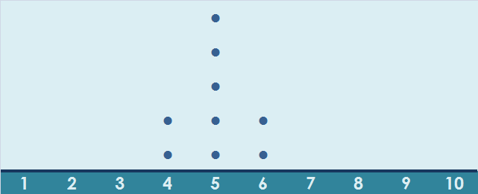
Set A
2
moves
Set B
Set C
See how the spread looks when the sweets are represented on a Dot Plot
Set D
Set E
Set F

Slide 26
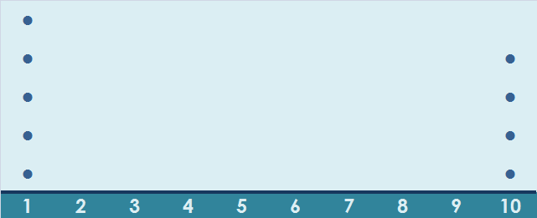
Set A
20
moves
Set B
Set C
Set D
Set E
Set F

Slide 27


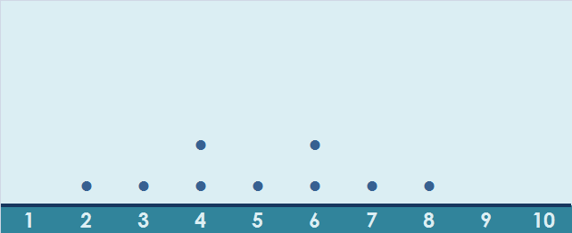
Set A
7
moves
Set B
Set C
Set D
Set E
Set F

Slide 28
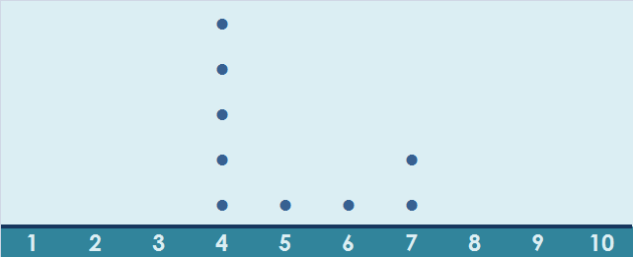
Set A
5
moves
Set B
Set C
Set D
Set E
Set F

Slide 29
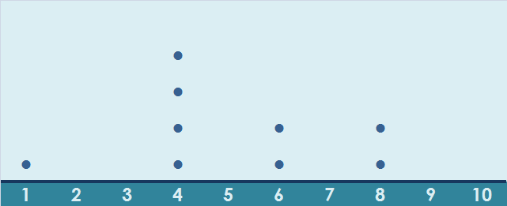
Set A
8
moves
Set B
Set C
Set D
Set E
Set F

Slide 30
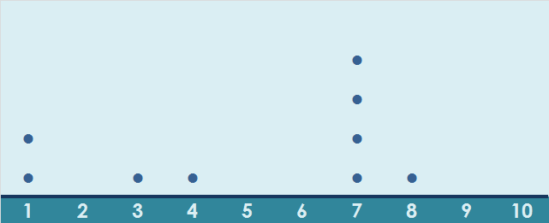
Set A
11
moves
Set B
Set C
Set D
Set E
Set F

Slide 31
A more sophisticated way of measuring variability or spread is
Standard Deviation

Slide 32
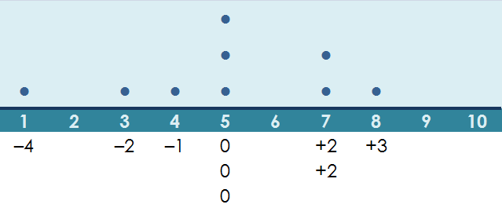
Deviations from the Mean

Slide 33
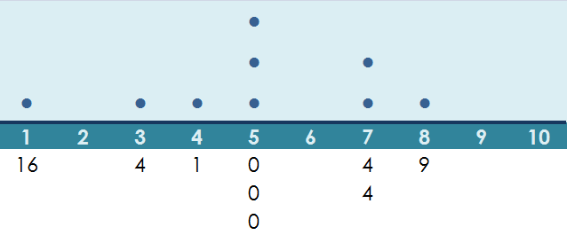
Standard Deviation
= 2.049

Slide 34
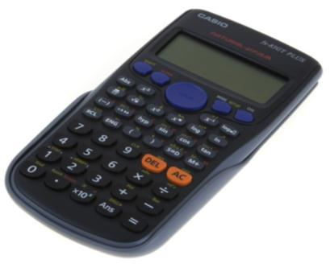
Standard Deviation using Calculator
Use your calculator to calculate the standard deviation of the various sets
given in the table.

Slide 35
Unfair Allocations
 | 1 | 2 | 3 | 4 | 5 | 6 | 7 | 8 | 9 | Ranking | Median | Moves | Mean | S.D.
A | 6 | 5 | 5 | 4 | 5 | 5 | 6 | 5 | 4 | 1 | 5 | 2 | 5 | 0.67
B | 1 | 10 | 10 | 1 | 1 | 10 | 1 | 10 | 1 | 6 | 1 | 20 | 5 | 4.47
C | 2 | 4 | 8 | 3 | 4 | 6 | 6 | 7 | 5 | 3 | 5 | 7 | 5 | 1.83
D | 4 | 4 | 7 | 4 | 4 | 5 | 6 | 7 | 4 | 2 | 4 | 5 | 5 | 1.25
E | 1 | 4 | 8 | 4 | 4 | 6 | 6 | 8 | 4 | 4 | 4 | 8 | 5 | 2.11
F | 8 | 1 | 7 | 7 | 4 | 1 | 3 | 7 | 7 | 5 | 7 | 11 | 5 | 2.62
Each row totals 45

