Slide 1
“Sna blianta atá romhainn, bainfidh tábhacht thar na bearta leis an gcumas sonraí a ghlacadh, a thuiscint, agus a phróiseáil, luach a bhaint astu, agus iad a shamhlú agus a chur in iúl”
Hal Varian*, 2009
*Hal Varian
“Beidh machnamh statisticiúl chomh riachtanach do shaoránacht éifeachtach is atá an cumas léitheoireachta agus scríofa” H.G. Wells
Notes:
Inference is a vital element of advancement since it provides a prediction. It improves the quality of the data.
Data is cheap but how do we use it effectively. The important thing is the ability to analyse the data. This depends on the capabilities of the individual.

Slide 2
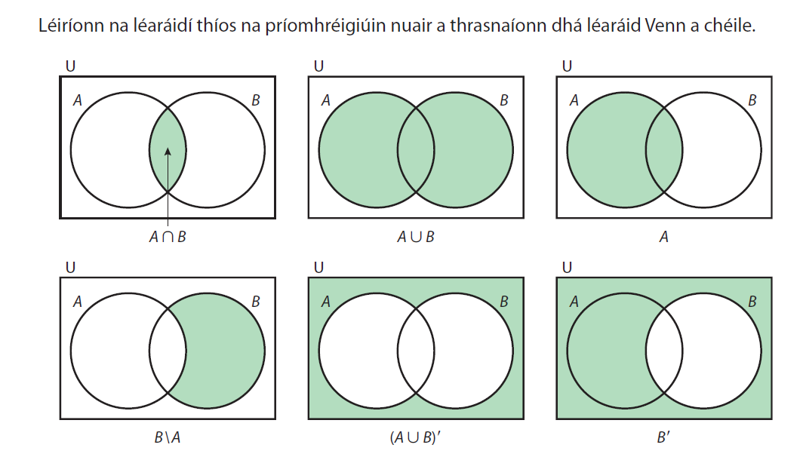

Slide 3
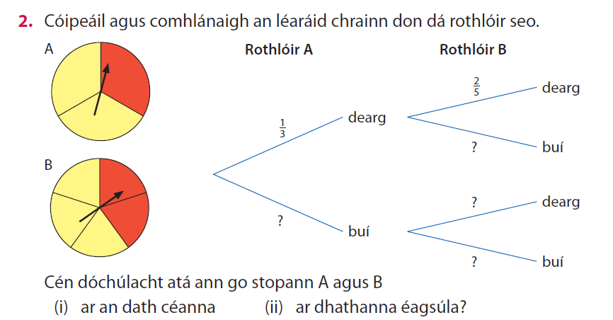

Slide 4
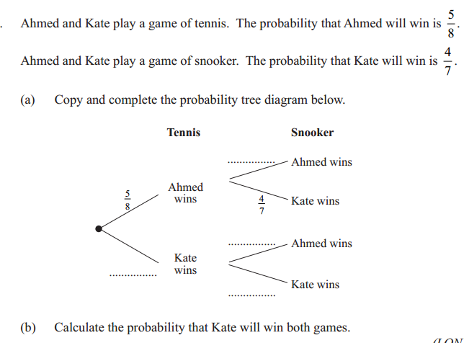

Slide 5
An Timthriall Láimhseála Sonraí
Sonraí a bhailiú
Sonraí a anailísiú
Sonraí a léirmhíniú
Ceist a chur
Cá fhad atá an seomra?
Notes:
CEIST A CHUR: Is mian linn ceist a chur faoinár rang – n’fheadar céard iad na hairdí tipiciúla ag ár rang?
Tig linn ceist a chur freisin i dtaobh na hairdí tipiciúla ag scoláirí atá ar comhaois sa phobal.
Beidh mórán ceisteanna eile le cur againn faoinár rang, mar shampla: “Céard iad na modhanna taistil tipiciúla chun na scoile ag scoláirí, conas a dhéanann siad cumarsáid lena gcairde, céard é an t-ábhar is rogha leo, etc. Braitheann gach rud ar an gceist cheart a chur. Trí bheith ar an eolas maidir leis an gceist cheart le cur, tig linn idirdhealú idir úsáid cheart agus úsáid mhícheart na Staitistice. Is anseo a thagann deacrachtaí do scoláirí chun cinn.
BAILIÚ: Ós rud é gur i gcomhthéacs is intuigthe uimhreacha, ba chóir dúinn sonraí réadúla a úsáid i gcomhthéacsanna a thuigeann scoláirí.
ANAILÍSIÚ: Braitheann ár gcur chuige ar an gcineál sonraí agus ar chuspóir ár n-iniúchta.
LÉIRMHÍNIÚ: Is é a bhíonn sa chéim dheireanach d’aon iniúchadh staitistiúil ná scrúdú ar conas gaol a bhunú idir na conclúidí agus an bhuncheist. Léirmhíniú matamaiticiúil atá ann.

Slide 6

LAOFACHT
Notes:
ACCURACY HAS 2 ELEMENTS: RELIABILITY(REPEAT MEASUREMENT) & LACK OF BIAS. DVD Bias 17.30 – 19.23
Do you think school holidays are too long? Biased if you only ask teachers/students.

Slide 7
√
×
An bhfuil imní ort faoi chailliúint postanna i do cheantar?
An aontaíonn tú go gcruthaíonn tógáil ollmhargaí móra fostaíocht áitiúil?
An bhfuil siopaí grósaeireachta beaga iomaíoch i dtaca le praghsanna `na n-ollmhargaí móra?
Ar chóir dúinn, dar leat, an líon ollmhargaí móra inár mbailte a laghdú?
√
×
An bhfuil imní ort maidir le tionchar ollmhargaí móra ar ghnóthaí beaga i do cheantar?
An aontaíonn tú go dtagann meath ar lár na mbailte móra de bharr na n-ollmhargaí móra?
An gcreideann tú go bhfuil an iomarca cumhachta ag ollmhargaí móra ar sholáthróirí áitiúla?
Ar chóir dúinn, dar leat, an líon ollmhargaí móra inár mbailte a laghdú?
Notes:
Ach má theastaíonn ó scoláirí a gceistneoir féin a dhearadh? Baineann 2 ghné le cruinneas: iontaofacht agus easpa laofachta.

Slide 8
“You can’t fix by analysis what you bungled by design”
Light, Singer and Willett

Slide 9
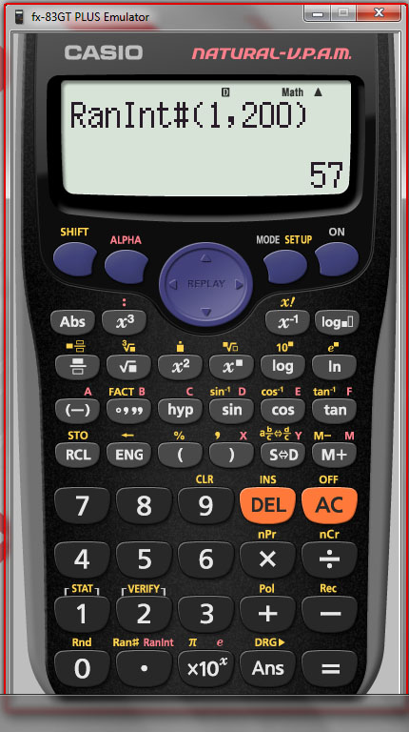
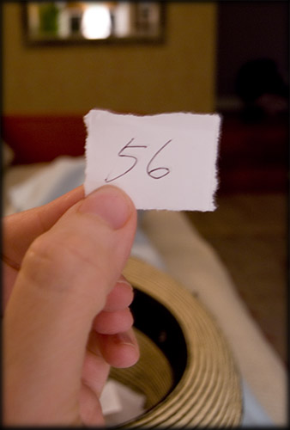
Sampláil Randamach Simplí: Dóchúlacht
Cad leis a gceanglóidh na daltaí é seo?

Slide 10
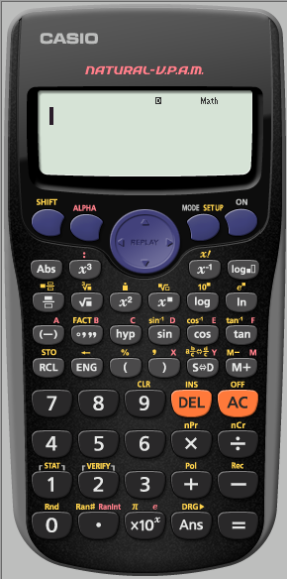
Glan an
t-áireamhán

Slide 11
Sampláil Randamach Simplí ag baint úsáid as Ran#
Brúigh an cnaipe Ran# : buí

Slide 12

Sampláil randamach le háireamhán
Gineann áireamhán uimhir bhréagach 3 dhigit níos lú ná 1.
i.e. gineann sé uimhir randamach sa raon [0, 1]
Nóta: Taispeántar an toradh mar chodán nuair a
roghnaítear ‘Natural Display/WriteView’.
Sampla: Chun uimhreacha a ghiniúint idir 1 agus 200
199 x [0, 1] = [0, 199]
199 x [0, 1] + 1 = [1, 200]
Notes:
Cliceáil le nótaí a bhreacadh

Slide 13
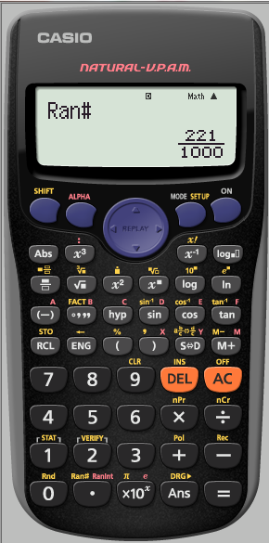
Cumraigh (Set Up):buí

Slide 14
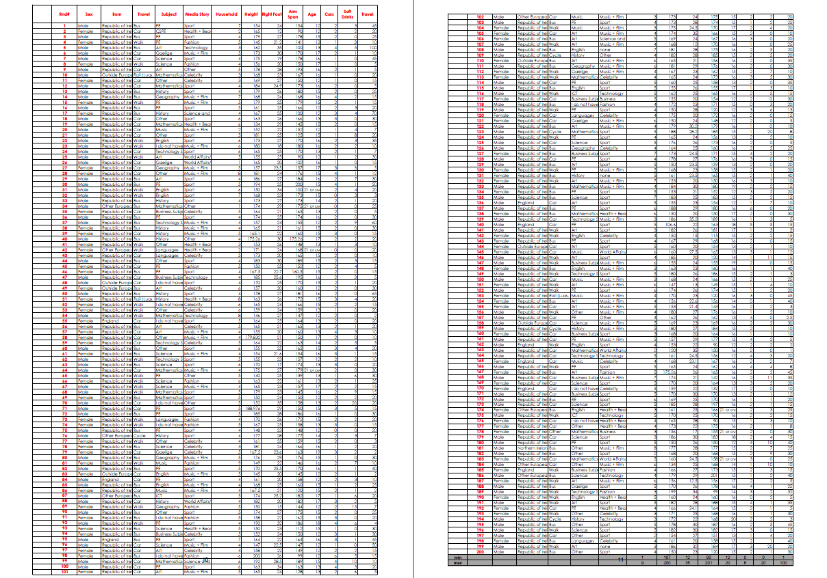
200 Scoláire, 13 Chlár Sonraí
Leathnach: 5,6
Notes:
*Dáil amach an tacar sonraí do 200 scoláire.
Gheobhaidh tú é seo ar ais. Féach go bhfuil sonraí réadúla go deas normálta agus ordaithe mar a chuirfí i láthair i dtéacsleabhar iad.

Slide 15
Uasuimhir/Íosuimhir/Marcanna Scóir/ Sampláil 30
Líon iomlán sa Teaghlach | Marcanna Scóir
1
2
3 | //
4 | ///
5 | ////////
6 | ///
7
8 | /
9
8
Frequency
7
6
5
4
3
2
1
0

Slide 16
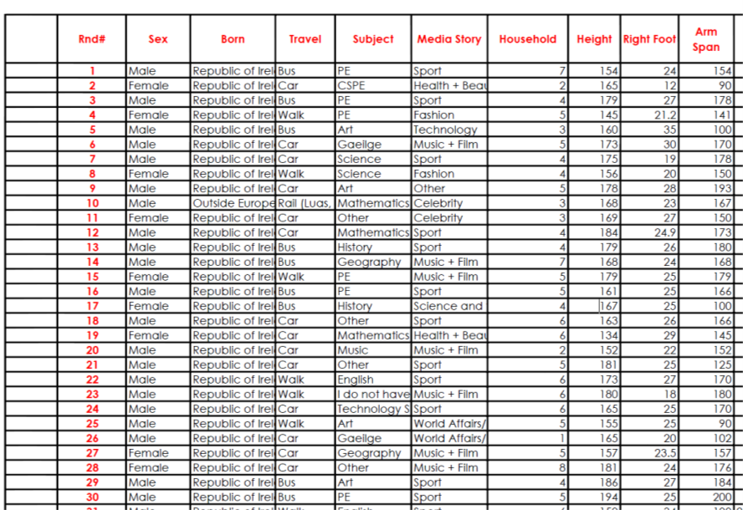
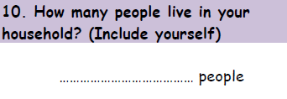
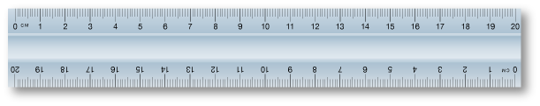
Sample 30 of Household
Obair Bheirte
Tasc : Sampláil de 30
Clár Sonraí (Lth 5,6), Rialóir, Peann
Áireamhán, Tábla
23
4

Slide 17
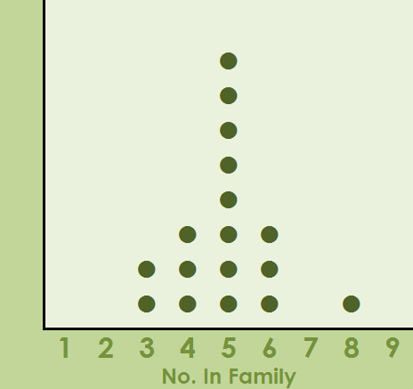
Líneghraf(Breacadh Poncanna)
Líon Iomlán sa Teaghlach | Marcanna Scóir
1
2
3 | //
4 | ///
5 | ////////
6 | ///
7
8 | /
9
8
Frequency
7
6
5
4
3
2
1
0
Leathnach: 7

Slide 18
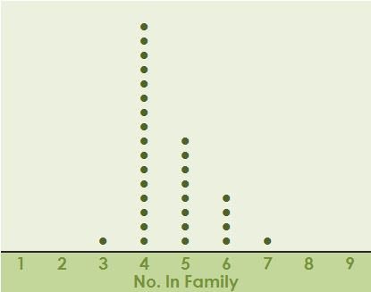
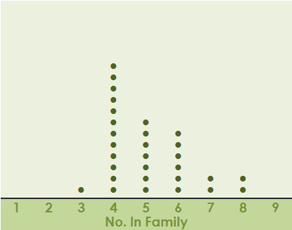
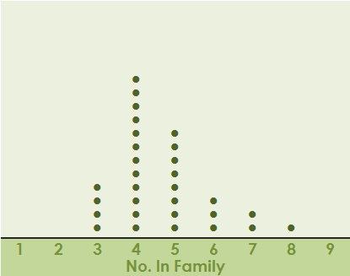
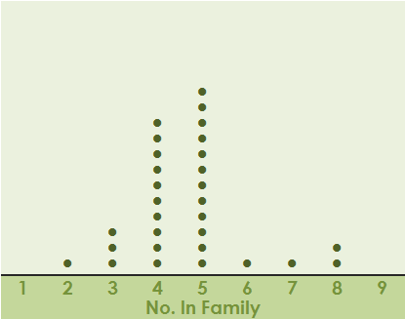
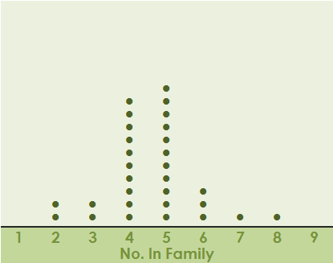
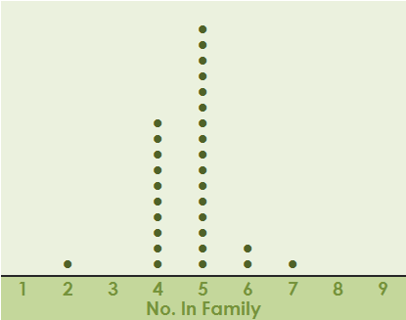
Comhathrú
Cad atá mar an gcéanna?: Cruth, Raon

Slide 19
Anailís á déanamh ar do líneghraf: C. 12
Déan cur síos ar na sonraí ar a oiread bealaí is féidir leat agus úsáid á baint agat as cur síos cruthach agus uimhriúil
Leathnach 7

Slide 20
Anailís á déanamh ar do líneghraf: C. 12

Slide 21
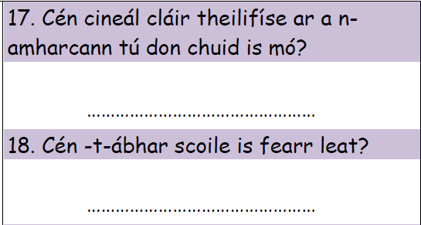
M
Tomhais ar Chlaonadh Lárnach agus Leathadh
ód
Notes:
Cliceáil le nótaí a bhreacadh

Slide 22
Soiléiriú a dhéanamh ar an bhfadhb láithreach
Cé mhéad sa teaghlach tipiciúil in ár scoil?
Sonraí a bhailiú
Sonraí a anailísiú
Sonraí a léirmhíniú
Ceist a chur
Notes:
CEIST A CHUR: Is mian linn ceist a chur faoinár rang – n’fheadar céard iad na hairdí tipiciúla ag ár rang?
Tig linn ceist a chur freisin i dtaobh na hairdí tipiciúla ag scoláirí atá ar comhaois sa phobal.
Beidh mórán ceisteanna eile le cur againn faoinár rang, mar shampla: “Céard iad na modhanna taistil tipiciúla chun na scoile ag scoláirí, conas a dhéanann siad cumarsáid lena gcairde, céard é an t-ábhar is rogha leo, etc. Braitheann gach rud ar an gceist cheart a chur. Trí bheith ar an eolas maidir leis an gceist cheart le cur, tig linn idirdhealú idir úsáid cheart agus úsáid mhícheart na Staitistice. Is anseo a thagann deacrachtaí do scoláirí chun cinn.
BAILIÚ: Ós rud é gur i gcomhthéacs is intuigthe uimhreacha, ba chóir dúinn sonraí réadúla a úsáid i gcomhthéacsanna a thuigeann scoláirí.
ANAILÍSIÚ: Braitheann ár gcur chuige ar an gcineál sonraí agus ar chuspóir ár n-iniúchta.
LÉIRMHÍNIÚ: Is é a bhíonn sa chéim dheireanach d’aon iniúchadh staitistiúil ná scrúdú ar conas gaol a bhunú idir na conclúidí agus an bhuncheist. Léirmhíniú matamaiticiúil atá ann.

Slide 23
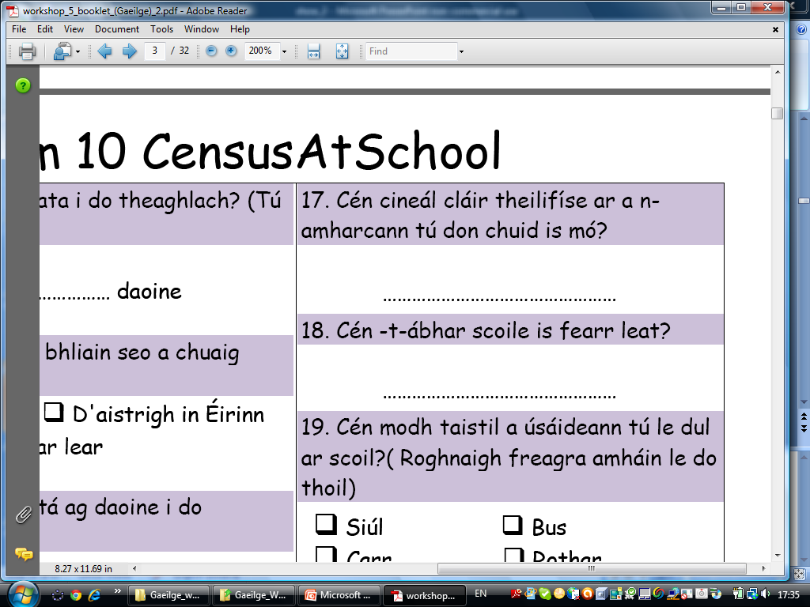
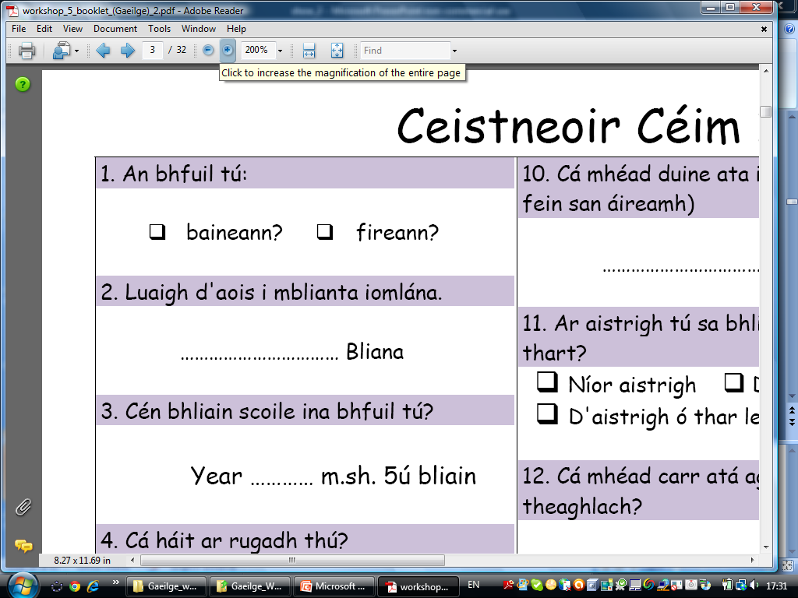
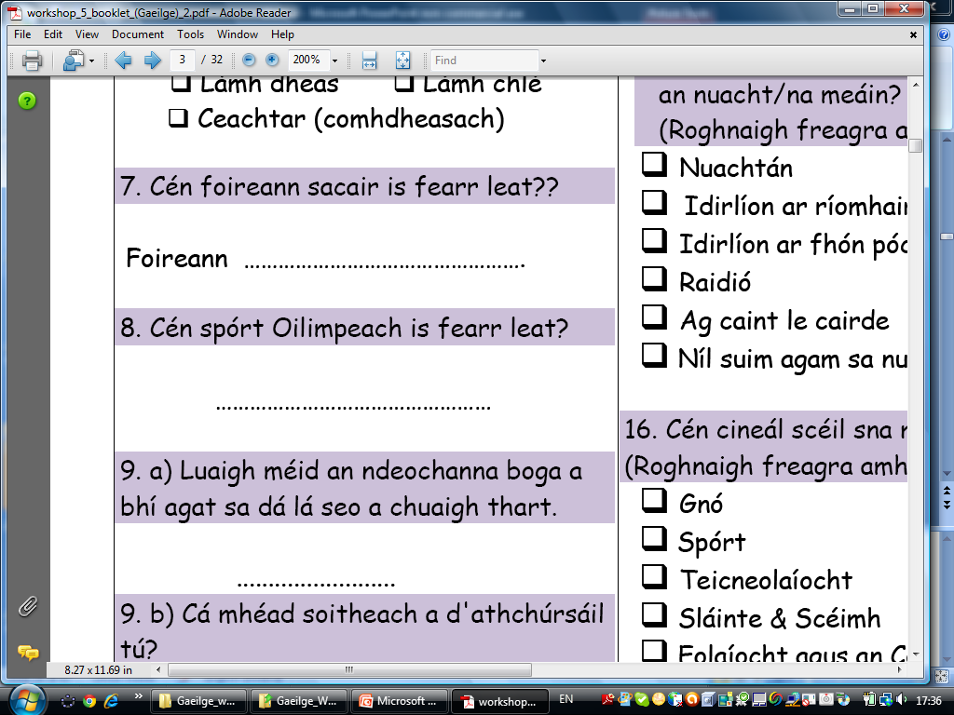
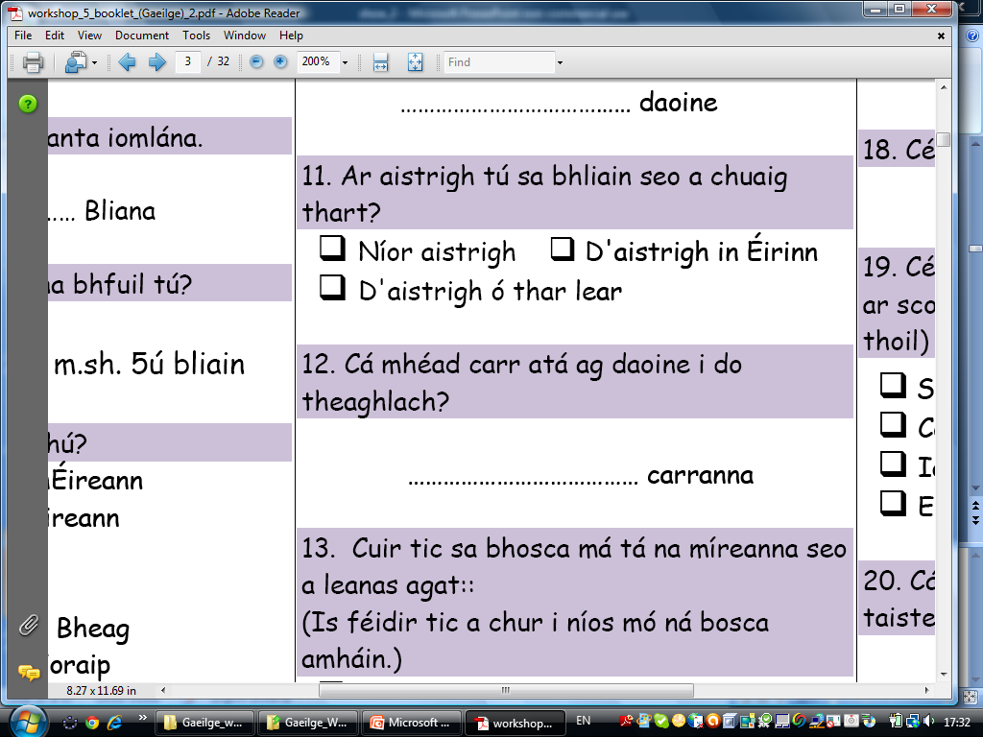
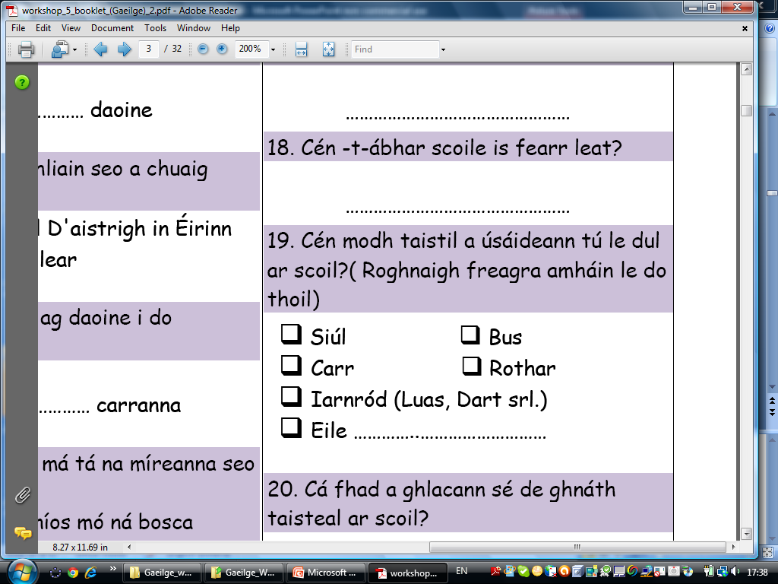
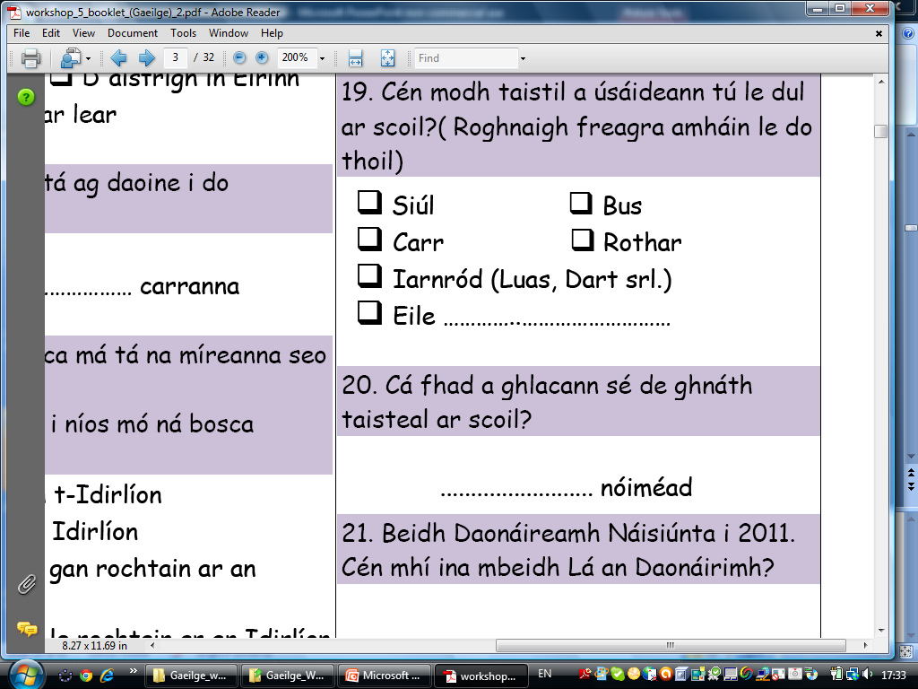
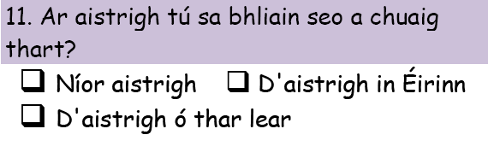
Leathnach 2
Cén cineál sonraí a gheofá ó na ceisteanna seo :Focail, Uimhreacha

Slide 24
Sonraí Catagóireacha
Sonraí Catagóireacha in ord
An gceart go mbeadh laethanta saoire níos faide ag daltaí bunscoile?
Sonraí Uimhriúla
Scoite
Leanaúnach

Slide 25
Cinéalacha Ceisteanna Imscrúdaitheacha
Achoimre
Comparáid
Gaolmhaireacht
3,5,7
2,4,6
1,8
Léiriú Grafach
Notes:
Following C@S questionnaire, the DHC shows the importance of posing a question. Identify if we have 3 main types; SUMMARY,COMPARISON,RELATIONSHIP.

Slide 26
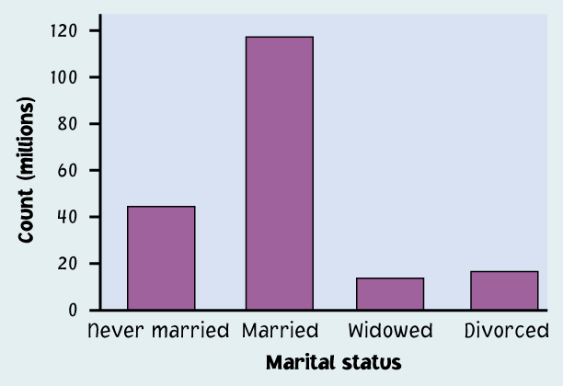
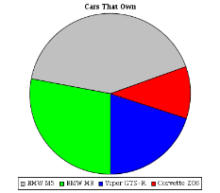
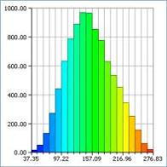
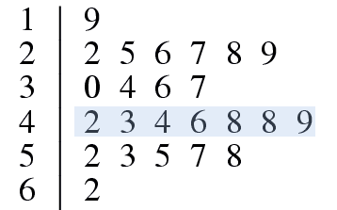
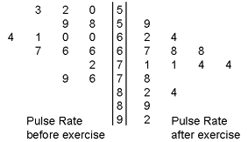
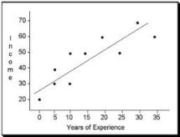
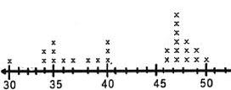
Cé acu Léiriú Grafach?
Key: 1|9 = 19 cm
Key: 5|9 = 59 beats
TSAL, AT
ATGL, ATAL
Cad air a mbunaítear ár rogha?
Notes:
Beidh an rogha a dhéanfar maidir leis an léiriú grafach agus an saghas ceisteanna bunaithe ar an gcineál sonraí. Más ceist chomparáide do shonraí leanúnacha uimhriúla atá i gceist, tig linn úsáid a bhaint as 2 phoncléaráid nó as learáid ghais is duillí cúl-le-cúl. Más ceist chomparáide do shonraí catagóireacha atá ann, tig linn barrachairt ilchodach a úsáid. Braithfidh an rogha a dhéanfar ar an gcineál sonraí. Tá cur amach ag múinteoirí ar a bhformhór seo cheana – beimid ag plé leis na cinn nua i rith an lae.
Poncléaráidí .. Coinníonn an grúpa mar aonaráin agus leiríonn cruth.
Ach na sonraí a bheith bailithe, tá orainn an cineál sonraí a anailísiú ionas gur féidir cinneadh a dhéanamh maidir leis an modh ceart le cur síos ar na sonraí. Níl aon ordlathas anseo ach tá graif áirithe níos úsáidí ná a chéile ag brath ar na sonraí. Ba chóir do scoláirí é seo a fhoghlaim go himfhiosach. Níor éiligh an seansiollabas orainn an cineál léiriú grafach a chinneadh ach anois ...(Roghnaigh modhanna grafacha nó uimhriúla cuí le cur síos ar na sonraí ... Aonathráideach amháin (Siollabas an TS 1.6)
Graf 1:
Airdí scoláirí Éireannacha (suirbhé 2009)
Graf 2:
Barrachairt ilchodach.
Ní féidir a bheith ag rá leo de shíor cad ba chóir dóibh a tharraingt.
TREOCHLÁR: Tá sé seo ann do na múinteoirí ach ach níor chóir go mbeadh scoláirí á chur de ghlanmheabhair.

Slide 27
Líne Graf
Tarraing boscaí timpeall na poncanna

Slide 28
Líne Graf
8
Frequency
7
6
5
4
3
2
1
0
Cad atá agat?

Slide 29
8
Frequency
7
6
5
4
3
2
1
0
An leor na boscaí
Dá mbeadh 200 sonraí ?

Slide 30
Barrachairt go Barrachairt Mhinicíochta Coibhneasta
Minicíocht Choibhneasta %
48
42
36
30
24
18
12
6
0
Notes:
Cliceáil le nótaí a bhreacadh

Slide 31
Cuspóir: Dé-athráideacha
Gaolmhaireacht a léiriú go grafach:
Scaipghraif
Neart na gaolmhaireachta a chainníochtú Comhéifeacht Chomhghaolaithe
Ag úsáid samhail líne chun tuar a dhéanamh:
An Líne is Fearr Oiriúnt

Slide 32

Réise Géag Láimhe agus Airde
Tasc: A
Marcáil meán na réisí lámhghéag ar an ais chothrománach: 159.5cm
Tarraing líne ingearacha ón bpointe seo
Arm Span (cm) | Height (cm)
172 | 175
160 | 165.1
165 | 155
200 | 194
170 | 173
158 | 161
150 | 152
186 | 180
145 | 134
149 | 147
160 | 155
166 | 161
128 | 165
166 | 174
159 | 150
158 | 160
162 | 162
161 | 165
150 | 150
177 | 177
141 | 145
150 | 153
148 | 153
147 | 147
Leathnach: 14
Tasc: B
Marcáil meán na n-airdí ar an ais ingearach: 160.5cm
Tarraing líne chothrománach ón bpointe seo
Notes:
Is there a relationship in the data (hoping someone will say graph it)
Giving them a sheet with the data plotted
Is there a relationship in the data
Mark in the mean of the x’s mean of the y’s point
What does that point means in context
Draw in the quadrants
What do each of the quadrants mean in context (above average and above average, below average and below average and the two other ones)
Count up the number of dots in each quadrant.
Colouring in or highlighting the dots
If I said that I knew a person from the same population had an arm span of 160cm could you comment on their height? (Trying and get the participants to see a need for drawing in a line of best fit)
Before drawing in a line of best fit; would it make sense that the line of best fit would pass through the point (mean of the arm spans, mean of the heights)?
Draw in the line of best fit. Mention (if there is a linear relationship) the line of best fit goes through the 2 quadrants with the highest % of data.
Estimate the height of someone with an arm span of 170cm
(Calculate the slope of the line of best fit)

Slide 33
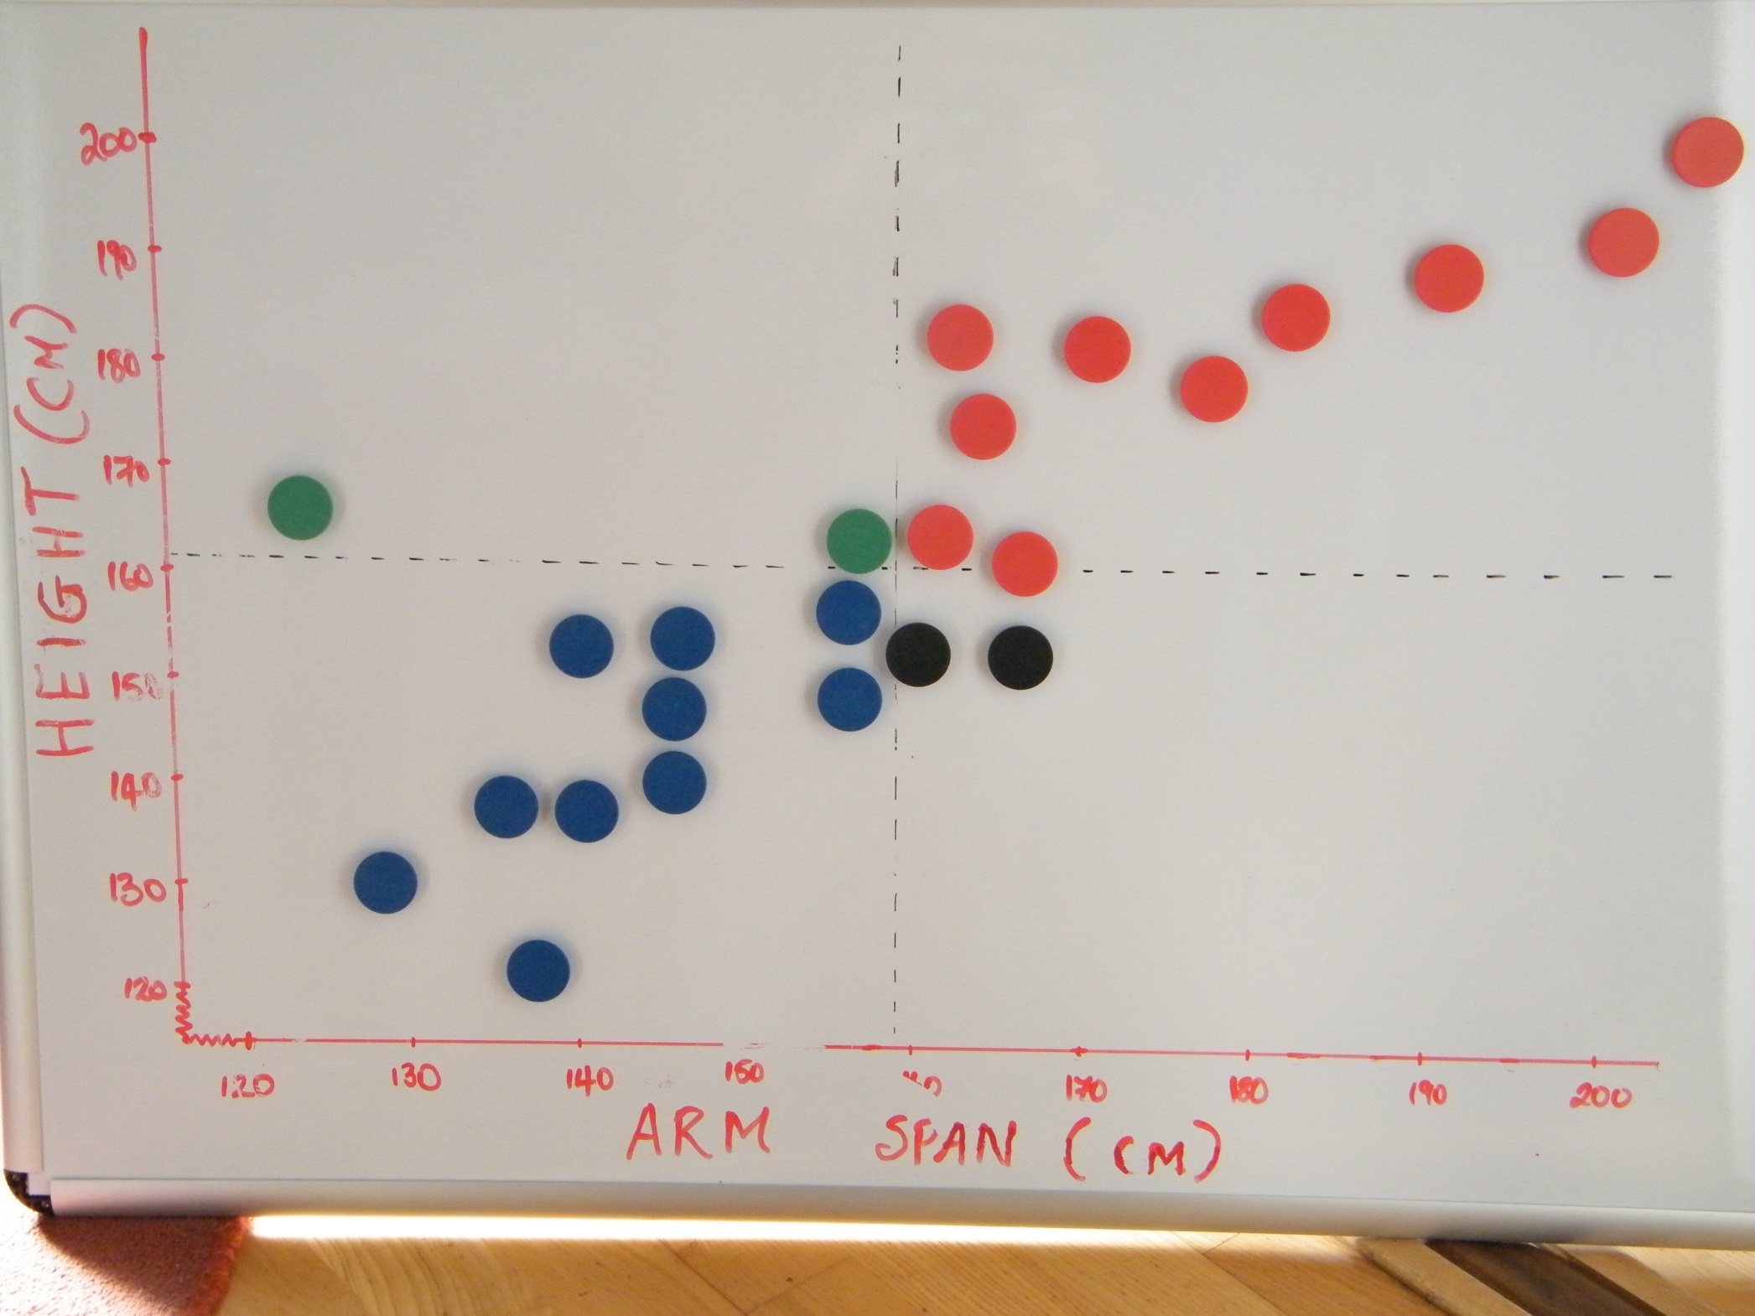
Comhairigh líon na bpointí i ngach cearthú
Cóimheas Uimhir na Ceathrún
Pearson Product Moment Correlation Coefficient

Slide 34

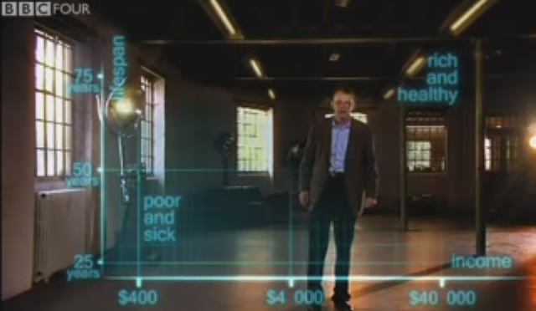
http://www.getstats.org.uk/
http://www.open.ac.uk/openlearn/whats-on/the-joy-stats
Notes:
Why do we do statistics?? What does a statistician do?? What is statistics used for? Can you give me examples of people that use statistics in their work?? Actuary, research, Economists, Engineers(enables one to effectively predict/control phenomena subject to variations-strengths below design limit), Medics, Solicitors, Psychologists, Health care professionals, Marketing, Education, Military.
It plays a major role in improving the quality of any product or service.
Statistics is more alive, more accurate and more useful than ever. Over 140,000 calculations were computed during this video. This would have been beyond comprehension 10,15,20 years ago. By making it more relevant and realistic for our students it encourages them to engage with the data.
http://www.youtube.com/watch?v=jbkSRLYSojo&feature=player_embedded

Slide 35
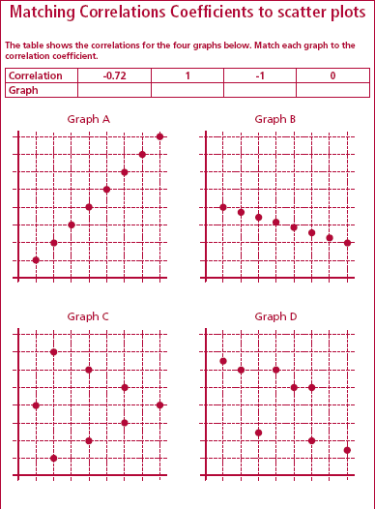

T&F ar Chomhéifeacht an Chomhghaolaithe http://www.istics.net/stat/Correlations

Slide 36
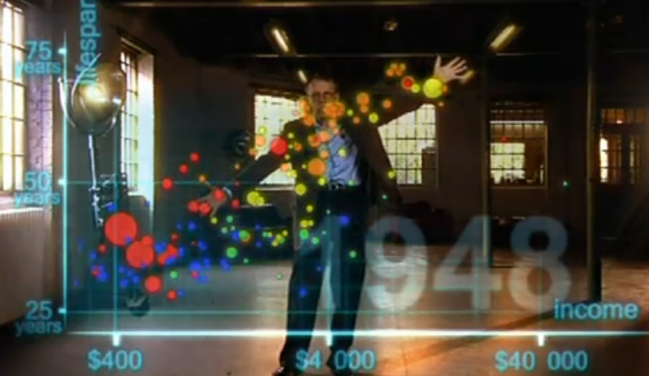
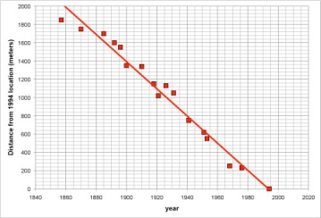
An Líne is Fearr Oiriúnt
http://www.shodor.org/interactivate/activities/Regression/

Slide 37
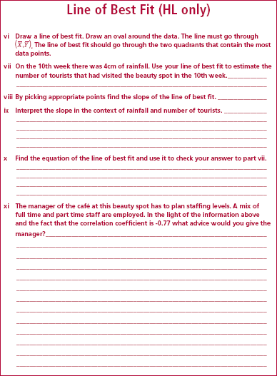
Line of best fit:
A straight line used as a best approximation of a summary of all the points in a scatter-plot.
“We draw this line only when we have a strong positive or strong negative correlation “
http://www.shodor.org/interactivate/activities/Regression/

Slide 38
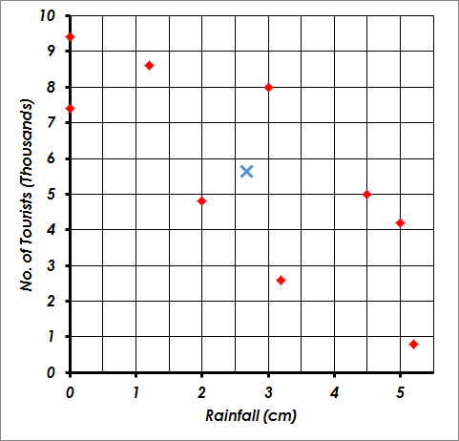
T&F: Comhéifeacht an Chomhghaolaithe
Líón Turasóirí
Méíd Báistí (cm)

Slide 39
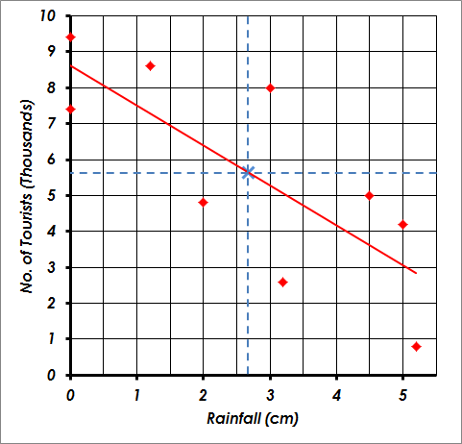
T&F: Comhéifeacht an Chomhghaolaithe
Líón Turasóirí
Méíd Báistí (cm)

Slide 40
T&F: Comhéifeacht an Chomhghaolaithe
Líón Turasóirí
Méíd Báistí (cm)

Slide 41
Sample 30 of Household - Probability
199q.+1=
=
=
=
23
4

Slide 42
Sample 30 of Household - Replacement
23
4

Slide 43
AM
Tomhais ar Chlaonadh Lárnach agus Leathadh
irmheán

Slide 44
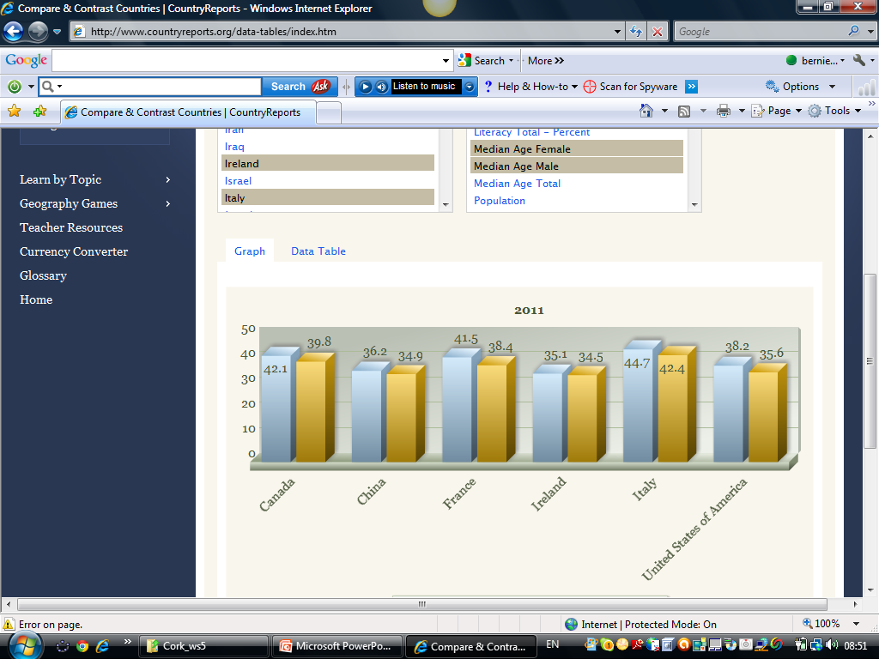

Slide 45
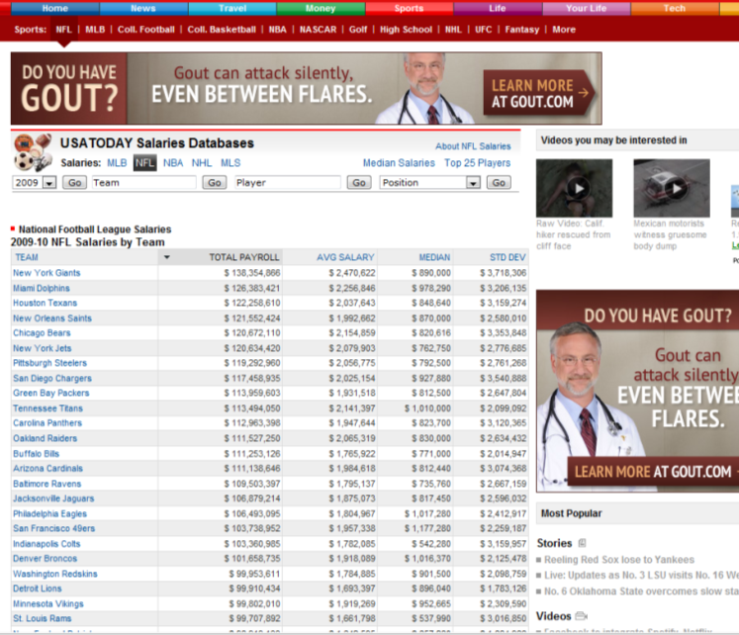
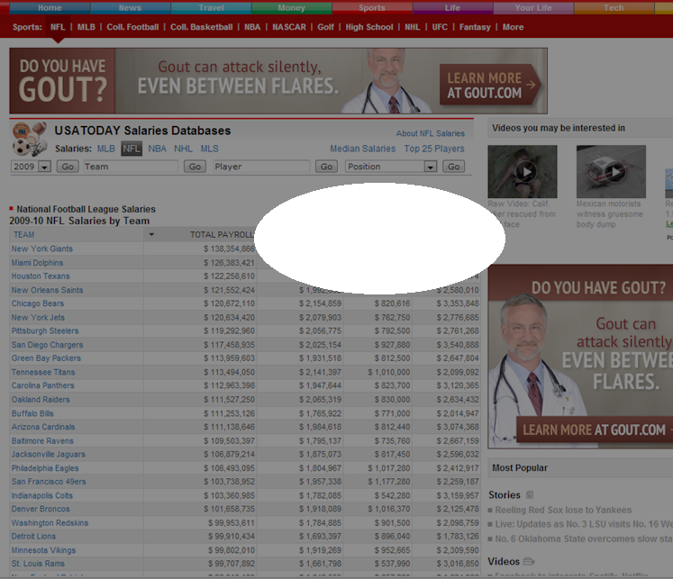
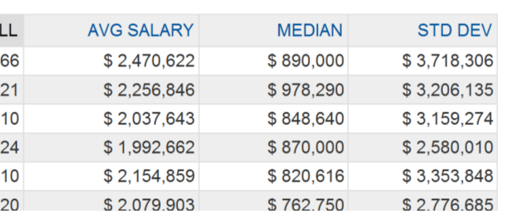
Notes:
Nice example that Gary sent showing the importance of median versus mean

Slide 46
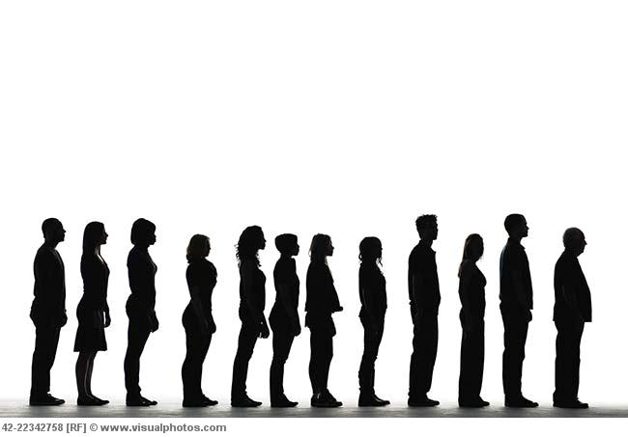

Bar Chart to Relative Frequency Bar Chart
Relative Frequency %
48
42
36
30
24
18
12
6
0

Slide 47












An Achoimre Chúig Uimhir

Slide 48

1. Uasuimhir
2. Íosuimhir
6’4”
5’3”
An Achoimre Chúig Uimhir

Slide 49
3. Airmheán
5’6.5”
5’7”
Airmheán = 5’6.75”
An Achoimre Chúig Uimhir

Slide 50
4. 1^{ú} Cheathairíl
5. 3^{ú} Cheathairíl
5’4”
5’4.8”
5’11”
6’
Q1 = 5’4.4”
Q3 = 5’11.5”
An Achoimre 5
Uimhir

Slide 51
Anailís á déanamh ar do líneghraf: C. 12

Slide 52
M
Leathnach: 8
eán

Slide 53
Leithdháiltí Neamhchóra
 | 1 | 2 | 3 | 4 | 5 | 6 | 7 | 8 | 9 | Rang-ord | Airmheán | Bearta | Meán
A | 6 | 5 | 5 | 4 | 5 | 5 | 6 | 5 | 4
B | 1 | 10 | 10 | 1 | 1 | 10 | 1 | 10 | 1
C | 2 | 4 | 8 | 3 | 4 | 6 | 6 | 7 | 5
D | 4 | 4 | 7 | 4 | 4 | 5 | 6 | 7 | 4
E | 1 | 4 | 8 | 4 | 4 | 6 | 6 | 8 | 4
F | 8 | 1 | 7 | 7 | 4 | 1 | 3 | 7 | 7
Iomlán gach sraithe: 45

Slide 54
Leithdháiltí Neamhchóra
 | 1 | 2 | 3 | 4 | 5 | 6 | 7 | 8 | 9 | Rang-ord | Airmheán | Bearta | Meán
A | 6 | 5 | 5 | 4 | 5 | 5 | 6 | 5 | 4 | 1
B | 1 | 10 | 10 | 1 | 1 | 10 | 1 | 10 | 1 | 6
C | 2 | 4 | 8 | 3 | 4 | 6 | 6 | 7 | 5 | 3
D | 4 | 4 | 7 | 4 | 4 | 5 | 6 | 7 | 4 | 2
E | 1 | 4 | 8 | 4 | 4 | 6 | 6 | 8 | 4 | 4
F | 8 | 1 | 7 | 7 | 4 | 1 | 3 | 7 | 7 | 5
Iomlán gach sraithe: 45

Slide 55
Leithdháiltí Neamhcóra
 | 1 | 2 | 3 | 4 | 5 | 6 | 7 | 8 | 9 | Rang-ord | Airmheán | Bearta | Meán
A | 6 | 5 | 5 | 4 | 5 | 5 | 6 | 5 | 4 | 1 | 5
B | 1 | 10 | 10 | 1 | 1 | 10 | 1 | 10 | 1 | 6 | 1
C | 2 | 4 | 8 | 3 | 4 | 6 | 6 | 7 | 5 | 3 | 5
D | 4 | 4 | 7 | 4 | 4 | 5 | 6 | 7 | 4 | 2 | 4
E | 1 | 4 | 8 | 4 | 4 | 6 | 6 | 8 | 4 | 4 | 4
F | 8 | 1 | 7 | 7 | 4 | 1 | 3 | 7 | 7 | 5 | 7
Iomlán gach sraithe: 45

Slide 56





Cion Cothrom agus Éagothrom
1.Déan an leithdháileadh éagothrom cothrom
2. Comhairigh líon na ngluaiseachtaí

Slide 57
Leithdháiltí córa agus neamhchóra

Slide 58
Leithdháiltí córa agus neamhchóra
3 bheart
1 bheart
2 bheart

Slide 59
Leithdháiltí Neamhchóra
 | 1 | 2 | 3 | 4 | 5 | 6 | 7 | 8 | 9 | Rang-ord | Airmheán | Bearta | Meán
A | 6 | 5 | 5 | 4 | 5 | 5 | 6 | 5 | 4 | 1 | 5 | 2
B | 1 | 10 | 10 | 1 | 1 | 10 | 1 | 10 | 1 | 6 | 1 | 20
C | 2 | 4 | 8 | 3 | 4 | 6 | 6 | 7 | 5 | 3 | 5 | 7
D | 4 | 4 | 7 | 4 | 4 | 5 | 6 | 7 | 4 | 2 | 4 | 5
E | 1 | 4 | 8 | 4 | 4 | 6 | 6 | 8 | 4 | 4 | 4 | 8
F | 8 | 1 | 7 | 7 | 4 | 1 | 3 | 7 | 7 | 5 | 7 | 11
Each row totals 45

Slide 60
Leithdháiltí Neamhchóra
 | 1 | 2 | 3 | 4 | 5 | 6 | 7 | 8 | 9 | Rang-ord | Airmheán | Bearta | Meán
A | 6 | 5 | 5 | 4 | 5 | 5 | 6 | 5 | 4 | 1 | 5 | 2 | 5
B | 1 | 10 | 10 | 1 | 1 | 10 | 1 | 10 | 1 | 6 | 1 | 20 | 5
C | 2 | 4 | 8 | 3 | 4 | 6 | 6 | 7 | 5 | 3 | 5 | 7 | 5
D | 4 | 4 | 7 | 4 | 4 | 5 | 6 | 7 | 4 | 2 | 4 | 5 | 5
E | 1 | 4 | 8 | 4 | 4 | 6 | 6 | 8 | 4 | 4 | 4 | 8 | 5
F | 8 | 1 | 7 | 7 | 4 | 1 | 3 | 7 | 7 | 5 | 7 | 11 | 5
Iomlán gach sraithe: 45

Slide 61
An Meán & An tAirmheán
Déanaimis codarsnacht anois idir an meán agus an t-airmheán mar thomhas achomaireacha
Bileog le línteghraf do leithdháiltí neamhchóra

Slide 62
Clogchruthach (Simréadach)
Nuari a bhíonn an Meán agus an t-Airmheán cothrom.
Cé acu is mó atá scaipthe amach?
Scrúdaigh na gluaiseachtaí
Notes:
Topics : Normal distribution, skewness, interpreting histograms, Range, Spread, effect of outliers, comparison of measures of central tendency.
Example 1: Seven teenagers at a youth club were asked their age. They gave the following ages:
16, 14, 19, 16, 13, 18, 16
Calculate the mean, median and mode of this group ?
[while the class is doing this. Draw the following on the board]
12 13 14 15 16 17 18 19 20
Do you notice anything ? [mean, median and mode the same]
Now i am going to draw dots to represent the people’s ages
The study we are doing here will work whether we have 7 people, 70 people, 700 people or 70 000 people but it is much easier to work with if we just look at 7.
What does it mean in this case when we say the median is 16 ? [Half of the people in the youth club are below age 16 (or at it) and half are above the age of 16 (or at it). Must put your answer back in context]
Is there anything else you notice about the data ? [Symmetrical]
When this happens it is called a normal distribution or symmetric or bell-shaped.
Many things follow this distribution. E.g. LC results !!
If I were to draw a histogram over all these ages where would the highest box be at ? Which of the following tell you which box in a frequency histogram is going to be the tallest the mean, median or mode ?
I will draw a frequency histogram to represent this type of data (i.e. Normal) NEXT SLIDE

Slide 63
Leithdháiltí Neamhchóra
 | 1 | 2 | 3 | 4 | 5 | 6 | 7 | 8 | 9 | Rang-ord | Airmheán | Bearta | Meán
A | 6 | 5 | 5 | 4 | 5 | 5 | 6 | 5 | 4 | 1 | 5 | 2 | 5
B | 1 | 10 | 10 | 1 | 1 | 10 | 1 | 10 | 1 | 6 | 1 | 20 | 5
C | 2 | 4 | 8 | 3 | 4 | 6 | 6 | 7 | 5 | 3 | 5 | 7 | 5
D | 4 | 4 | 7 | 4 | 4 | 5 | 6 | 7 | 4 | 2 | 4 | 5 | 5
E | 1 | 4 | 8 | 4 | 4 | 6 | 6 | 8 | 4 | 4 | 4 | 8 | 5
F | 8 | 1 | 7 | 7 | 4 | 1 | 3 | 7 | 7 | 5 | 7 | 11 | 5
Iomlán gach sraithe: 45

Slide 64
Sceabhach
Meán = 5; Airmheán = 4
Meán = 5; Airmheán = 7
Cé acu is mó atá scaipaithe amach?
Scrúdaigh na gluaiseachtaí
Notes:
Topics : Normal distribution, skewness, interpreting histograms, Range, Spread, effect of outliers, comparison of measures of central tendency.
Example 1: Seven teenagers at a youth club were asked their age. They gave the following ages:
16, 14, 19, 16, 13, 18, 16
Calculate the mean, median and mode of this group ?
[while the class is doing this. Draw the following on the board]
12 13 14 15 16 17 18 19 20
Do you notice anything ? [mean, median and mode the same]
Now i am going to draw dots to represent the people’s ages
The study we are doing here will work whether we have 7 people, 70 people, 700 people or 70 000 people but it is much easier to work with if we just look at 7.
What does it mean in this case when we say the median is 16 ? [Half of the people in the youth club are below age 16 (or at it) and half are above the age of 16 (or at it). Must put your answer back in context]
Is there anything else you notice about the data ? [Symmetrical]
When this happens it is called a normal distribution or symmetric or bell-shaped.
Many things follow this distribution. E.g. LC results !!
If I were to draw a histogram over all these ages where would the highest box be at ? Which of the following tell you which box in a frequency histogram is going to be the tallest the mean, median or mode ?
I will draw a frequency histogram to represent this type of data (i.e. Normal) NEXT SLIDE

Slide 65
Leithdháiltí Neamhchóra
 | 1 | 2 | 3 | 4 | 5 | 6 | 7 | 8 | 9 | Rang-ord | Airmheán | Bearta | Meán
A | 6 | 5 | 5 | 4 | 5 | 5 | 6 | 5 | 4 | 1 | 5 | 2 | 5
B | 1 | 10 | 10 | 1 | 1 | 10 | 1 | 10 | 1 | 6 | 1 | 20 | 5
C | 2 | 4 | 8 | 3 | 4 | 6 | 6 | 7 | 5 | 3 | 5 | 7 | 5
D | 4 | 4 | 7 | 4 | 4 | 5 | 6 | 7 | 4 | 2 | 4 | 5 | 5
E | 1 | 4 | 8 | 4 | 4 | 6 | 6 | 8 | 4 | 4 | 4 | 8 | 5
F | 8 | 1 | 7 | 7 | 4 | 1 | 3 | 7 | 7 | 5 | 7 | 11 | 5
Iomlán gach sraithe 45

Slide 66
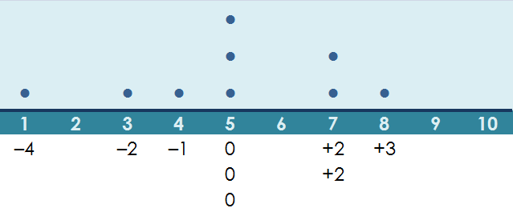
Diallta ón Meán
An fhad ón meán

Slide 67
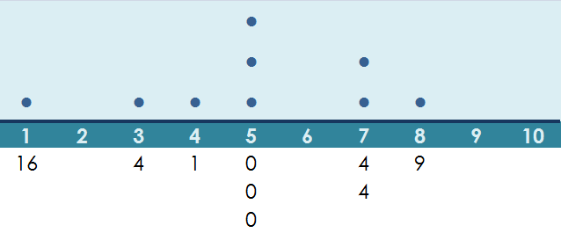
Diall Caighdeánach

Slide 68
Leithdháiltí Neamhchóra
 | 1 | 2 | 3 | 4 | 5 | 6 | 7 | 8 | 9 | Rang-Ord | Airmheán | Bearta | Meán | D.C.
A | 6 | 5 | 5 | 4 | 5 | 5 | 6 | 5 | 4 | 1 | 5 | 2 | 5 | 0.67
B | 1 | 10 | 10 | 1 | 1 | 10 | 1 | 10 | 1 | 6 | 1 | 20 | 5 | 4.47
C | 2 | 4 | 8 | 3 | 4 | 6 | 6 | 7 | 5 | 3 | 5 | 7 | 5 | 1.83
D | 4 | 4 | 7 | 4 | 4 | 5 | 6 | 7 | 4 | 2 | 4 | 5 | 5 | 1.25
E | 1 | 4 | 8 | 4 | 4 | 6 | 6 | 8 | 4 | 4 | 4 | 8 | 5 | 2.11
F | 8 | 1 | 7 | 7 | 4 | 1 | 3 | 7 | 7 | 5 | 7 | 11 | 5 | 2.62
Iomlán gach sraithe 45

Slide 69
Diall Caighdeánach a Bhreathnú ó Ghraf
Diall Caighdeánach Íseal, Ard agus An-ard

Slide 70
Leibhéal | Lár | Spré | Cruth
TSBL/GL | MAM | Raon | Binn, Cnuasaigh, Braislí Scaipthe amach, Bailithe le chéile Bearnaí, Poill
TSAL | MAM | Raon RI | Binn, Cnuasaigh, Braislí Scaipthe amach, Bailithe le chéile,Clogchruthach Bearnaí, Poill, Asluitigh
ATBL | MAM | Raon | Binn, Cnuasaigh, Braislí Scaipthe amach, Bailithe le chéile,Clogchruthach Bearnaí, Poill
ATGL | MAM | Raon RI DC | Binn, Cnuasaigh, Braislí Scaipthe amach, Bailithe le chéile Clogchruthach, Siméadrach, Sceabhach Bearnaí, Poill, Asluitigh Beagnach Normalach
ATAL | MAM | Raon RI DC | Binn, Cnuasaigh, Braislí Scaipthe amach, Bailithe le chéile Clogchruthach, Siméadrach, Sceabhach Bearnaí, Poill, Asluitigh Beagnach Normalach

Slide 71
Anaylsing Your Line Plot - Variation
Describe the data:
A. Shape Descriptions:
Concentration of data: clusters, bumps, hills, peaks (MMM:typical value)
No data: gaps, holes (outliers?)
Overall Distribution: spread out, bunched together (range leading to standard deviation)

Slide 72
Anaylsing Your Line Plot - Variation
Describe the data:
A. Shape Descriptions:
Concentration of data: clusters, bumps, hills, peaks (MMM:typical value)
No data: gaps, holes (outliers?)
Overall Distribution: spread out, bunched together (range leading to standard deviation)

Slide 73
Anaylsing Your Line Plot - Variation
Describe the data:
B. Numerical Descriptions:
Number of data points (sample size)
(2) The largest/smallest household is......(max/min leading to range)
(3) Most of (over a ½ or a large proportion/fraction of...)the household sizes are from...../ the most common household size is...........(MMM:typical value)
Words to Mathematical Symbols
Intervals leading to table

