Slide 1
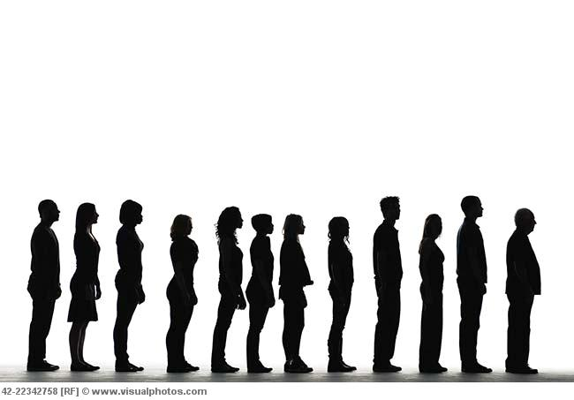
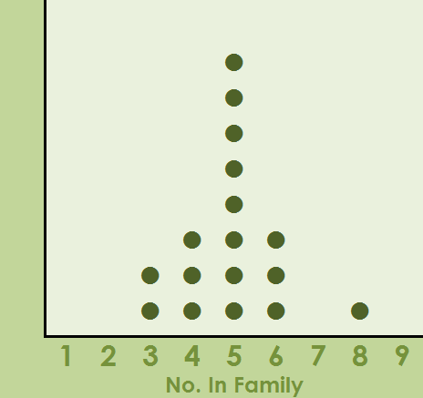
What is the range of heights of people in this office?
Bar Chart to Relative Frequency Bar Chart
What is the median height of the people?
Relative Frequency %
48
What is the range in heights of the middle 50% of people?
42
36
30
24
18
12
6
0

Slide 2
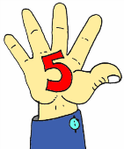
Reorder
Number
Summary

Slide 3
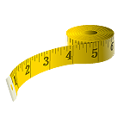
1. Max
2. Min
6’2’’
5’3’’
Number
Summary

Slide 4
3. Median
5’6.5’’
5’7’’
Median Height = 5’6.75’’
Number
Summary

Slide 5
4. 1st Quartile
5. 3rd Quartile
5’4’’
5’4.8’’
5’11’’
6’
Q1 = 5’4.4’’
Q3 = 5’11.5’’
Number
Summary

