Slide 1
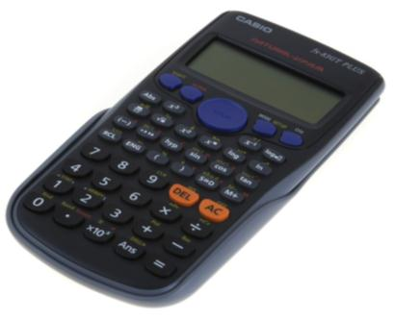
Using your calculator
Writing as a Product of Prime Factors
Using Ran#
Using Ranint
Finding Standard Deviation
Finding Correlation Coefficient
Using a Frequency table
Go
Go
Go
Go
Go
Go
MENU
END

Slide 2
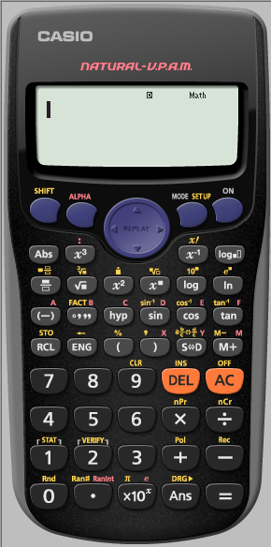
Random Sampling using Ran#
The Ran#: Generates a pseudo random number to 3 decimal places that is less than 1.
i.e. it generates a random number in the range [0, 1]
Ran# is in Yellow
MENU
END

Slide 3
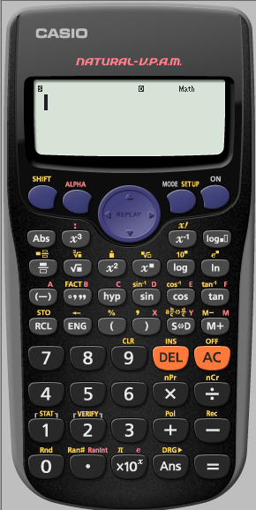
Random Sampling using Ran#
Ran# is in Yellow
MENU
END

Slide 4
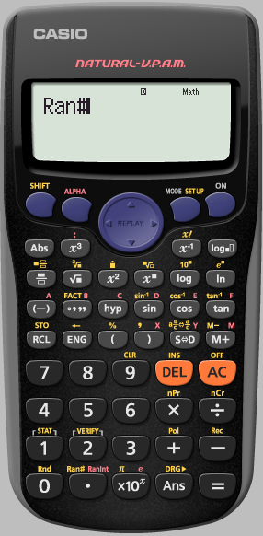
Random Sampling using Ran#
To keep generating a random 3 digit number between
[0,1]
we repeatedly press
=
MENU
END

Slide 5
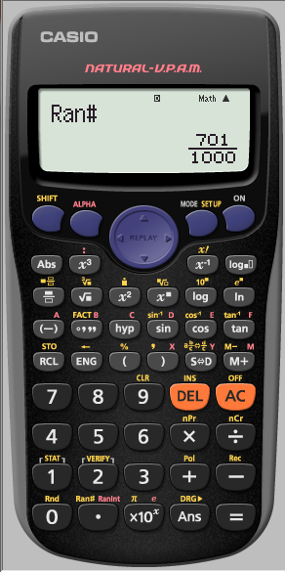
Random Sampling using Ran#
MENU
END

Slide 6
Random Sampling using Ran#
The calculator automatically displays in Natural display.
If we are generating lots of numbers this may become annoying.
We need to SET UP the calculator into Linear Display
(as a single line …Decimals)
MENU
END

Slide 7
Random Sampling using Ran#
The calculator automatically displays in Natural display.
If we are generating lots of numbers this may become annoying.
We need to SET UP the calculator into Linear Display
(as a single line …Decimals)
MENU
END

Slide 8
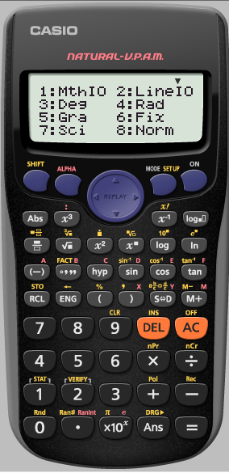
Random Sampling using Ran#
We want it Linear
MENU
END

Slide 9
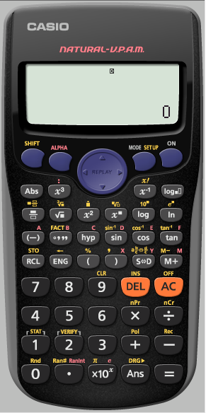
Random Sampling using Ran#
We want a random number again
MENU
END

Slide 10
Random Sampling using Ran#
We want a random number again
MENU
END

Slide 11
Random Sampling using Ran#
To keep generating a random 3 digit number between
[0,1]
we repeatedly press
=
MENU
END

Slide 12
Random Sampling using Ran#
MENU
END

Slide 13
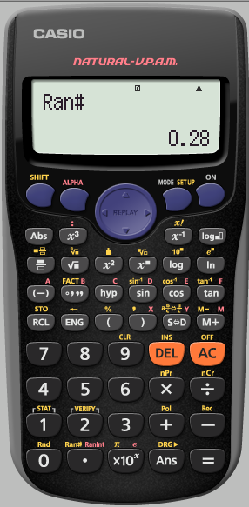
Random Sampling using Ran#
MENU
END

Slide 14
Random Sampling using Ran#
for an interval [1,200]
If we multiply the randomly generated number by 199 then
199 x [0, 1] = [0, 199]
To get it between 1 and 200 we must add 1
199 x [0, 1] + 1 = [1, 200]
But we must first SET UP the calculator to Fix to 0 decimal place
MENU
END

Slide 15
Random Sampling using Ran# for an interval [1,200]
But we must first SET UP the calculator to Fix to 0 decimal place
MENU
END

Slide 16
Random Sampling using Ran# for an interval [1,200]
But we must first SET UP the calculator to Fix to 0 decimal place
MENU
END

Slide 17
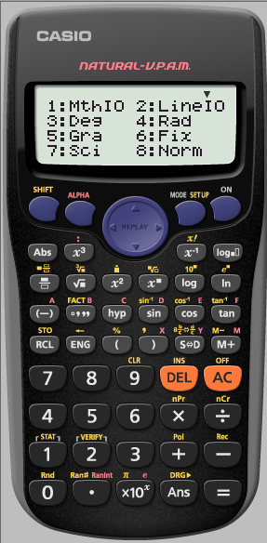
Random Sampling using Ran# for an interval [1,200]
But we must first SET UP the calculator to Fix to 0 decimal place
MENU
END

Slide 18
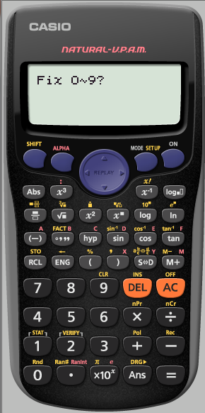
Random Sampling using Ran# for an interval [1,200]
But we must first SET UP the calculator to Fix to 0 decimal place
MENU
END

Slide 19
Random Sampling using Ran# for an interval [1,200]
The calculator tells us it has been
SET UP
To
Fix
We now need to tell it what we want
199 x [0, 1] + 1
MENU
END

Slide 20
Random Sampling using Ran# for an interval [1,200]
MENU
END

Slide 21
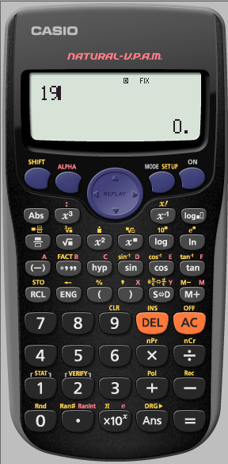
Random Sampling using Ran# for an interval [1,200]
MENU
END

Slide 22
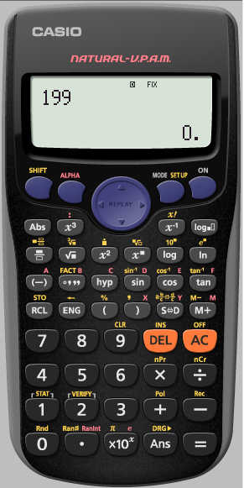
Random Sampling using Ran# for an interval [1,200]
MENU
END

Slide 23
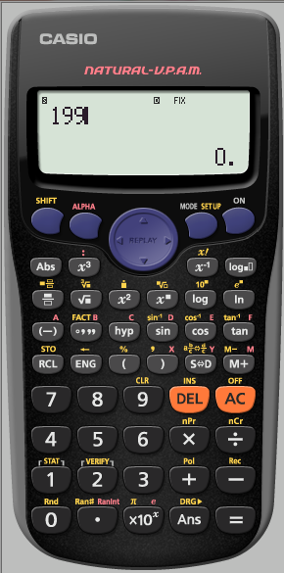
Random Sampling using Ran# for an interval [1,200]
MENU
END

Slide 24
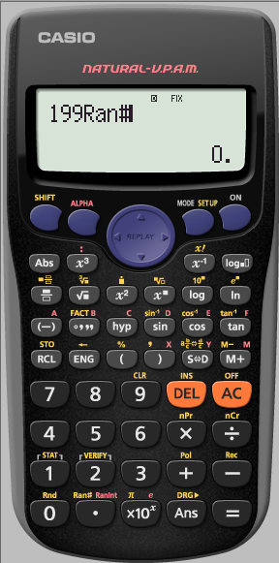
Random Sampling using Ran# for an interval [1,200]
MENU
END

Slide 25
Random Sampling using Ran# for an interval [1,200]
MENU
END

Slide 26
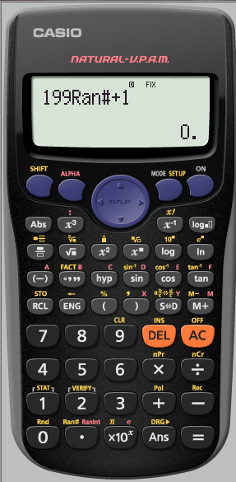
Random Sampling using Ran# for an interval [1,200]
MENU
END

Slide 27
Random Sampling using Ran# for an interval [1,200]
MENU
END

Slide 28
Random Sampling using Ran# for an interval [1,200]
MENU
END

Slide 29
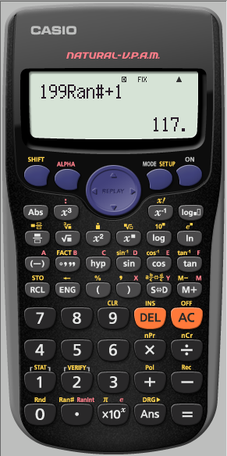
Random Sampling using Ran# for an interval [1,200]
MENU
END

Slide 30
Using your calculator
Writing as a Product of Prime Factors
Using Ran#
Using Ranint
Finding Standard Deviation
Finding Correlation Coefficient
Using a Frequency table
Go
Go
Go
Go
Go
Go
MENU
END

Slide 31
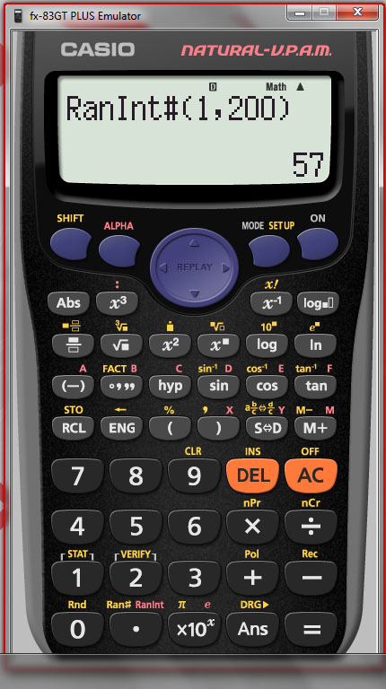
Random Sampling using Ranint for an interval [1,200]
MENU
END

Slide 32
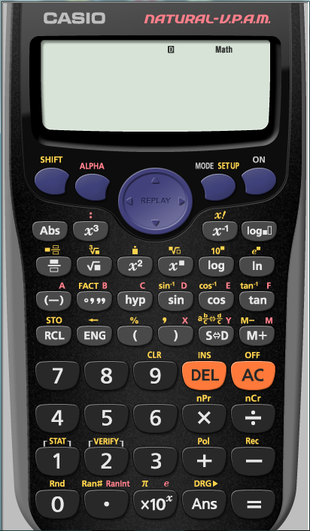
Random Sampling using Ranint for an interval [1,200]
Ranint is in Red
MENU
END

Slide 33
Random Sampling using Ranint for an interval [1,200]
Ranint is in Red
MENU
END

Slide 34
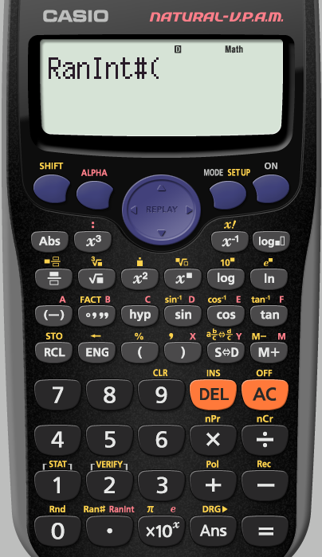
Random Sampling using Ranint for an interval [1,200]
We want our interval to be
[1,200]
MENU
END

Slide 35
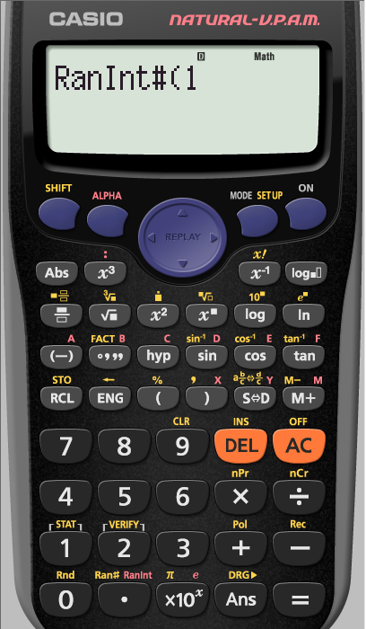
Random Sampling using Ranint for an interval [1,200]
The comma is here in yellow
MENU
END

Slide 36
Random Sampling using Ranint for an interval [1,200]
The comma is here in yellow
MENU
END

Slide 37
Random Sampling using Ranint for an interval [1,200]
MENU
END

Slide 38
Random Sampling using Ranint for an interval [1,200]
MENU
END

Slide 39
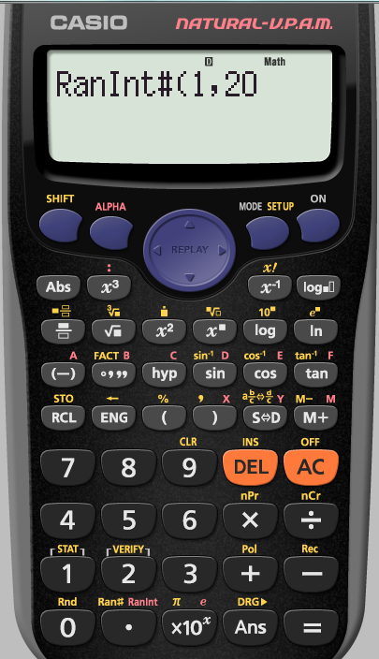
Random Sampling using Ranint for an interval [1,200]
MENU
END

Slide 40
Random Sampling using Ranint for an interval [1,200]
The bracket is here
MENU
END

Slide 41
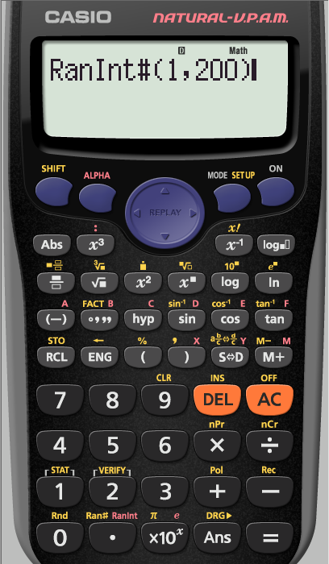
Random Sampling using Ranint for an interval [1,200]
To keep generating a random 3 digit number between
[1,200]
we repeatedly press
=
MENU
END

Slide 42
Random Sampling using Ranint for an interval [1,200]
MENU
END

Slide 43
Random Sampling using Ranint for an interval [1,200]
MENU
END

Slide 44
Using your calculator
Writing as a Product of Prime Factors
Using Ran#
Using Ranint
Finding Standard Deviation
Finding Correlation Coefficient
Using a Frequency table
Go
Go
Go
Go
Go
Go
MENU
END

Slide 45
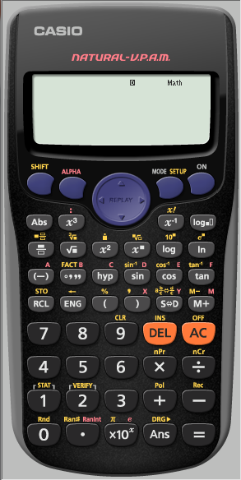
Finding Standard Deviation
Find the
Standard Deviation of
6,5,5,4,5,5,6,5 and 4
We first need to make sure
the calculator is CLeaR of all
previous content
MENU
END

Slide 46
Finding Standard Deviation
Find the
Standard Deviation of
6,5,5,4,5,5,6,5 and 4
We first need to make sure
the calculator is CLeaR of all
previous content
MENU
END

Slide 47
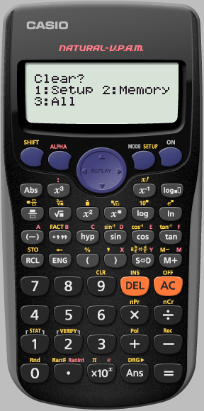
Finding Standard Deviation
Find the
Standard Deviation of
6,5,5,4,5,5,6,5 and 4
We want to clear ALL
MENU
END

Slide 48
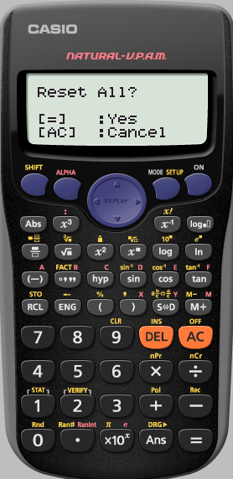
Finding Standard Deviation
Find the
Standard Deviation of
6,5,5,4,5,5,6,5 and 4
Yes reset all
MENU
END

Slide 49
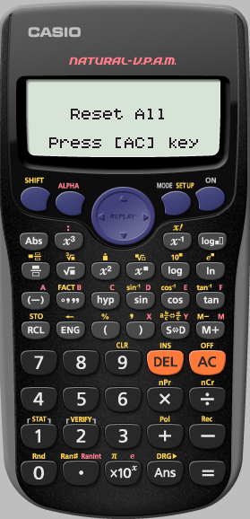
Finding Standard Deviation
Find the
Standard Deviation of
6,5,5,4,5,5,6,5 and 4
We really do agree
AC
MENU
END

Slide 50
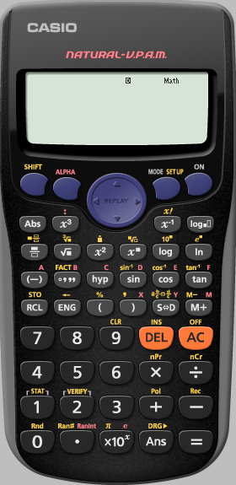
Finding Standard Deviation
Find the
Standard Deviation of
6,5,5,4,5,5,6,5 and 4
We want the calculator
in STATS mode
MENU
END

Slide 51
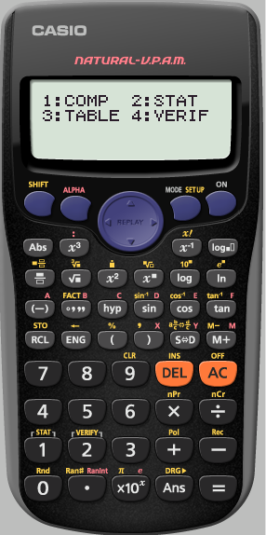
Finding Standard Deviation
Find the
Standard Deviation of
6,5,5,4,5,5,6,5 and 4
We want the calculator
in STATS mode
MENU
END

Slide 52
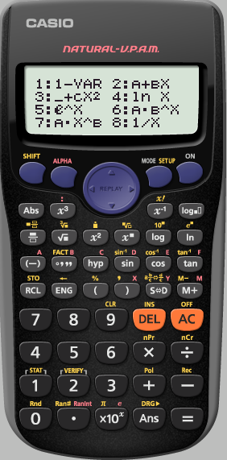
Finding Standard Deviation
Find the
Standard Deviation of
6,5,5,4,5,5,6,5 and 4
We only have 1 variable
MENU
END

Slide 53
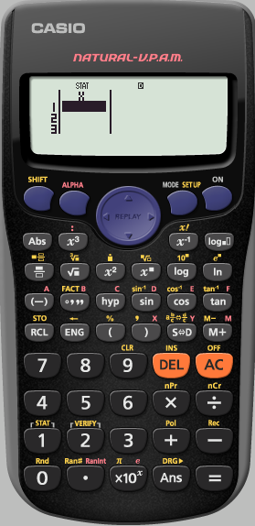
Finding Standard Deviation
Find the
Standard Deviation of
6,5,5,4,5,5,6,5 and 4
We now input
our data pressing
=
after each term
MENU
END

Slide 54
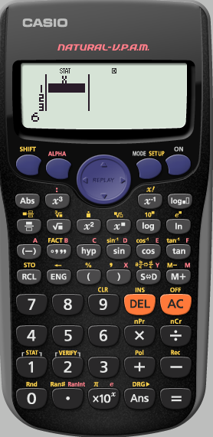
Finding Standard Deviation
Find the
Standard Deviation of
6,5,5,4,5,5,6,5 and 4
MENU
END

Slide 55
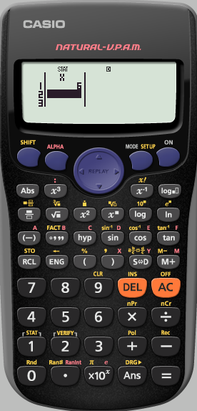
Finding Standard Deviation
Find the
Standard Deviation of
6,5,5,4,5,5,6,5 and 4
MENU
END

Slide 56
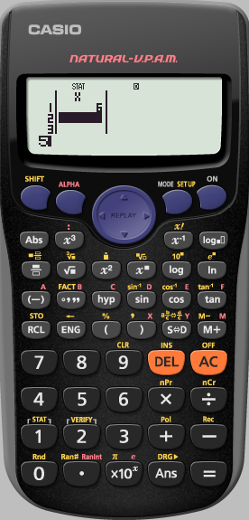
Finding Standard Deviation
Find the
Standard Deviation of
6,5,5,4,5,5,6,5 and 4
MENU
END

Slide 57
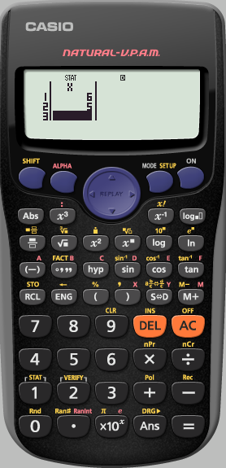
Finding Standard Deviation
Find the
Standard Deviation of
6,5,5,4,5,5,6,5 and 4
Repeat this process
until the data is entered
MENU
END

Slide 58
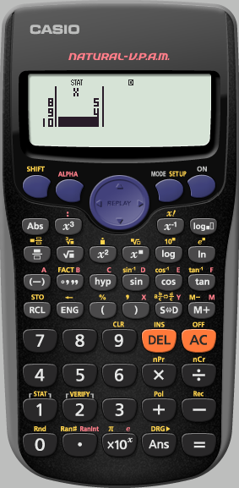
Finding Standard Deviation
Find the
Standard Deviation of
6,5,5,4,5,5,6,5 and 4
We have finished inputting the data.
We now need to get to where we can analyse it
Press
AC
MENU
END

Slide 59
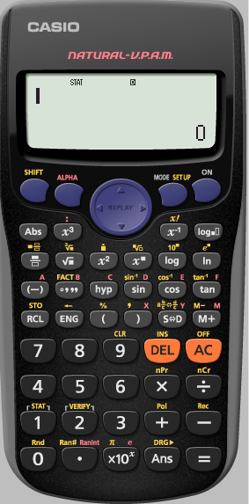
Finding Standard Deviation
Find the
Standard Deviation of
6,5,5,4,5,5,6,5 and 4
We need to analyse
the STATS we have input
MENU
END

Slide 60
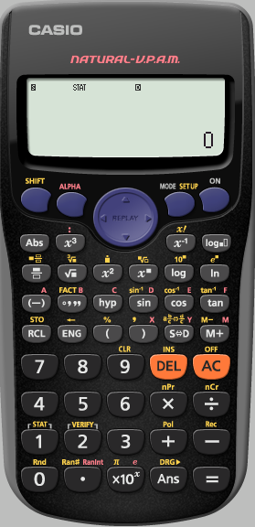
Finding Standard Deviation
Find the
Standard Deviation of
6,5,5,4,5,5,6,5 and 4
We need to analyse
the STATS we have input
MENU
END

Slide 61
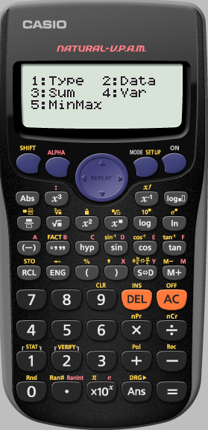
Finding Standard Deviation
Find the
Standard Deviation of
6,5,5,4,5,5,6,5 and 4
We want to see the
Variance
MENU
END

Slide 62
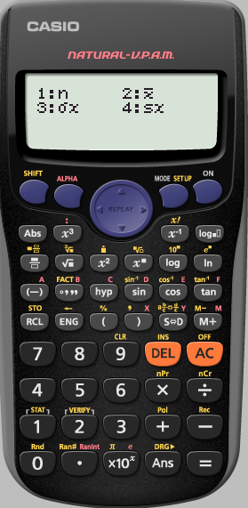
Finding Standard Deviation
Find the
Standard Deviation of
6,5,5,4,5,5,6,5 and 4
n : The number of terms
: The mean of the terms
We want the
standard Deviation
σx
$$\overline{x}$$
MENU
END

Slide 63
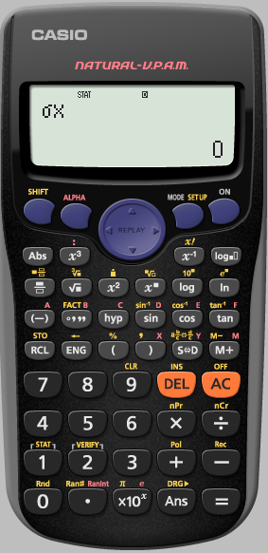
Finding Standard Deviation
Find the
Standard Deviation of
6,5,5,4,5,5,6,5 and 4
MENU
END

Slide 64
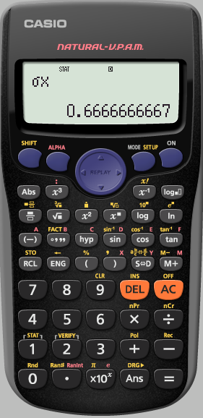
Finding Standard Deviation
Find the
Standard Deviation of
6,5,5,4,5,5,6,5 and 4
This is the
standard deviation
of the data set
To see more analysis details,
analyse the data again
MENU
END

Slide 65
Using your calculator
Writing as a Product of Prime Factors
Using Ran#
Using Ranint
Finding Standard Deviation
Finding Correlation Coefficient
Using a Frequency table
Go
Go
Go
Go
Go
Go
MENU
END

Slide 66
Finding Correlation Coefficient
Find the Correlation Coefficient for the following data
We first need to make sure
the calculator is CLeaR of all
previous content
Rainfall (x cm) | 4.5 | 3.0 | 5.2 | 5.0 | 2.1 | 0 | 0 | 1.2 | 3.2
No. of tourists (1000’s | 5.0 | 8.0 | 0.8 | 4.2 | 4.8 | 7.4 | 9.4 | 8.6 | 2.6
MENU
Finding Correlation Coefficient
END

Slide 67
Rainfall (x cm) | 4.5 | 3.0 | 5.2 | 5.0 | 2.1 | 0 | 0 | 1.2 | 3.2
No. of tourists (1000’s | 5.0 | 8.0 | 0.8 | 4.2 | 4.8 | 7.4 | 9.4 | 8.6 | 2.6
We first need to make sure
the calculator is CLeaR of all
previous content
MENU
Finding Correlation Coefficient
END

Slide 68
Rainfall (x cm) | 4.5 | 3.0 | 5.2 | 5.0 | 2.1 | 0 | 0 | 1.2 | 3.2
No. of tourists (1000’s | 5.0 | 8.0 | 0.8 | 4.2 | 4.8 | 7.4 | 9.4 | 8.6 | 2.6
We want to clear All
MENU
Finding Correlation Coefficient
END

Slide 69
Rainfall (x cm) | 4.5 | 3.0 | 5.2 | 5.0 | 2.1 | 0 | 0 | 1.2 | 3.2
No. of tourists (1000’s | 5.0 | 8.0 | 0.8 | 4.2 | 4.8 | 7.4 | 9.4 | 8.6 | 2.6
Yes Reset all
MENU
Finding Correlation Coefficient
END

Slide 70
Rainfall (x cm) | 4.5 | 3.0 | 5.2 | 5.0 | 2.1 | 0 | 0 | 1.2 | 3.2
No. of tourists (1000’s | 5.0 | 8.0 | 0.8 | 4.2 | 4.8 | 7.4 | 9.4 | 8.6 | 2.6
We really do agree
AC
MENU
Finding Correlation Coefficient
END

Slide 71
Rainfall (x cm) | 4.5 | 3.0 | 5.2 | 5.0 | 2.1 | 0 | 0 | 1.2 | 3.2
No. of tourists (1000’s | 5.0 | 8.0 | 0.8 | 4.2 | 4.8 | 7.4 | 9.4 | 8.6 | 2.6
We want the calculator
in STATS mode
MENU
Finding Correlation Coefficient
END

Slide 72
Rainfall (x cm) | 4.5 | 3.0 | 5.2 | 5.0 | 2.1 | 0 | 0 | 1.2 | 3.2
No. of tourists (1000’s | 5.0 | 8.0 | 0.8 | 4.2 | 4.8 | 7.4 | 9.4 | 8.6 | 2.6
We want the calculator
in stats mode
MENU
Finding Correlation Coefficient
END

Slide 73
Rainfall (x cm) | 4.5 | 3.0 | 5.2 | 5.0 | 2.1 | 0 | 0 | 1.2 | 3.2
No. of tourists (1000’s | 5.0 | 8.0 | 0.8 | 4.2 | 4.8 | 7.4 | 9.4 | 8.6 | 2.6
We have 2 variables
MENU
Finding Correlation Coefficient
END

Slide 74
1 2 3 4 5 6 7 8 9
Rainfall (x cm) | 4.5 | 3.0 | 5.2 | 5.0 | 2.1 | 0 | 0 | 1.2 | 3.2
No. of tourists (1000’s | 5.0 | 8.0 | 0.8 | 4.2 | 4.8 | 7.4 | 9.4 | 8.6 | 2.6
Useful to write the
numbers 1,2,3,…
above each row so
as we can check
we are correct
We now input the first
row of the data
into the first column
of the table
pressing =
after each term
MENU
Finding Correlation Coefficient
END

Slide 75
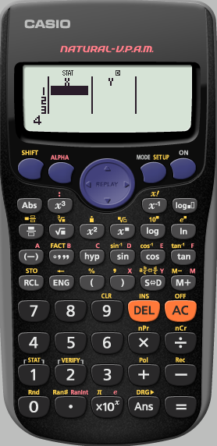
1 2 3 4 5 6 7 8 9
Rainfall (x cm) | 4.5 | 3.0 | 5.2 | 5.0 | 2.1 | 0 | 0 | 1.2 | 3.2
No. of tourists (1000’s | 5.0 | 8.0 | 0.8 | 4.2 | 4.8 | 7.4 | 9.4 | 8.6 | 2.6
MENU
Finding Correlation Coefficient
END

Slide 76
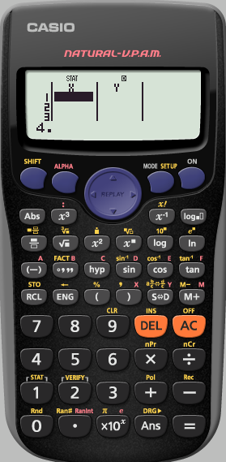
1 2 3 4 5 6 7 8 9
Rainfall (x cm) | 4.5 | 3.0 | 5.2 | 5.0 | 2.1 | 0 | 0 | 1.2 | 3.2
No. of tourists (1000’s | 5.0 | 8.0 | 0.8 | 4.2 | 4.8 | 7.4 | 9.4 | 8.6 | 2.6
MENU
Finding Correlation Coefficient
END

Slide 77
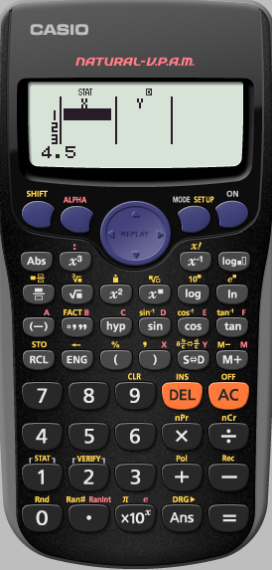
1 2 3 4 5 6 7 8 9
Rainfall (x cm) | 4.5 | 3.0 | 5.2 | 5.0 | 2.1 | 0 | 0 | 1.2 | 3.2
No. of tourists (1000’s | 5.0 | 8.0 | 0.8 | 4.2 | 4.8 | 7.4 | 9.4 | 8.6 | 2.6
MENU
Finding Correlation Coefficient
END

Slide 78
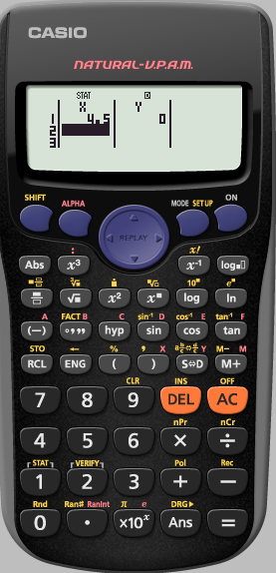
1 2 3 4 5 6 7 8 9
Rainfall (x cm) | 4.5 | 3.0 | 5.2 | 5.0 | 2.1 | 0 | 0 | 1.2 | 3.2
No. of tourists (1000’s | 5.0 | 8.0 | 0.8 | 4.2 | 4.8 | 7.4 | 9.4 | 8.6 | 2.6
MENU
Finding Correlation Coefficient
END

Slide 79
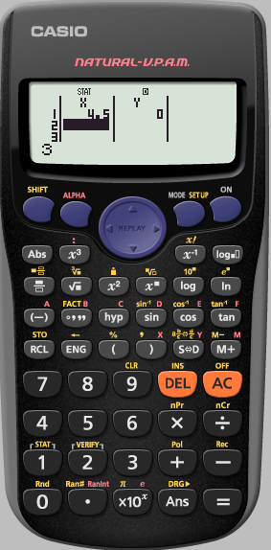
1 2 3 4 5 6 7 8 9
Rainfall (x cm) | 4.5 | 3.0 | 5.2 | 5.0 | 2.1 | 0 | 0 | 1.2 | 3.2
No. of tourists (1000’s | 5.0 | 8.0 | 0.8 | 4.2 | 4.8 | 7.4 | 9.4 | 8.6 | 2.6
MENU
Finding Correlation Coefficient
END

Slide 80
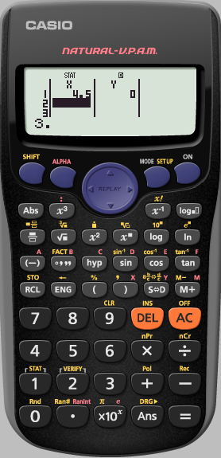
1 2 3 4 5 6 7 8 9
Rainfall (x cm) | 4.5 | 3.0 | 5.2 | 5.0 | 2.1 | 0 | 0 | 1.2 | 3.2
No. of tourists (1000’s | 5.0 | 8.0 | 0.8 | 4.2 | 4.8 | 7.4 | 9.4 | 8.6 | 2.6
MENU
Finding Correlation Coefficient
END

Slide 81
1 2 3 4 5 6 7 8 9
Rainfall (x cm) | 4.5 | 3.0 | 5.2 | 5.0 | 2.1 | 0 | 0 | 1.2 | 3.2
No. of tourists (1000’s | 5.0 | 8.0 | 0.8 | 4.2 | 4.8 | 7.4 | 9.4 | 8.6 | 2.6
MENU
Finding Correlation Coefficient
END

Slide 82
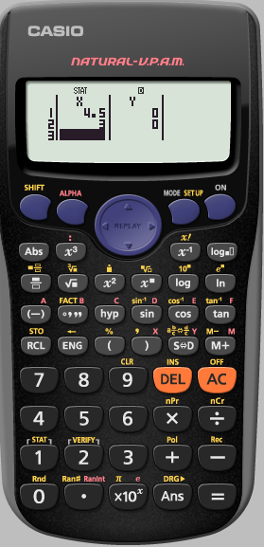
1 2 3 4 5 6 7 8 9
Rainfall (x cm) | 4.5 | 3.0 | 5.2 | 5.0 | 2.1 | 0 | 0 | 1.2 | 3.2
No. of tourists (1000’s | 5.0 | 8.0 | 0.8 | 4.2 | 4.8 | 7.4 | 9.4 | 8.6 | 2.6
Repeat this process
until the first row
has been entered
MENU
Finding Correlation Coefficient
END

Slide 83
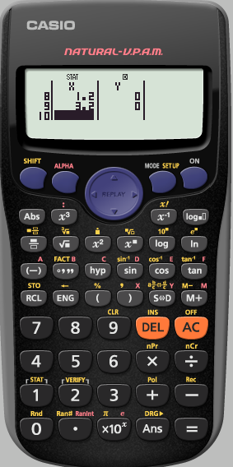
1 2 3 4 5 6 7 8 9
Rainfall (x cm) | 4.5 | 3.0 | 5.2 | 5.0 | 2.1 | 0 | 0 | 1.2 | 3.2
No. of tourists (1000’s | 5.0 | 8.0 | 0.8 | 4.2 | 4.8 | 7.4 | 9.4 | 8.6 | 2.6
Use the cursor
keys to enter
the data from
the second row
MENU
Finding Correlation Coefficient
END

Slide 84
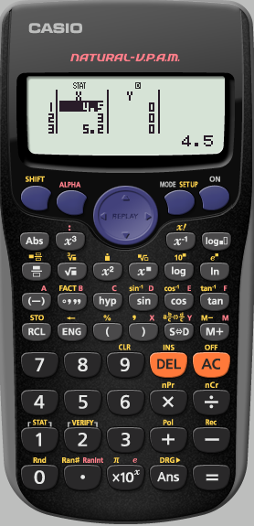
1 2 3 4 5 6 7 8 9
Rainfall (x cm) | 4.5 | 3.0 | 5.2 | 5.0 | 2.1 | 0 | 0 | 1.2 | 3.2
No. of tourists (1000’s | 5.0 | 8.0 | 0.8 | 4.2 | 4.8 | 7.4 | 9.4 | 8.6 | 2.6
Press the right cursor
MENU
Finding Correlation Coefficient
END

Slide 85
1 2 3 4 5 6 7 8 9
Rainfall (x cm) | 4.5 | 3.0 | 5.2 | 5.0 | 2.1 | 0 | 0 | 1.2 | 3.2
No. of tourists (1000’s | 5.0 | 8.0 | 0.8 | 4.2 | 4.8 | 7.4 | 9.4 | 8.6 | 2.6
MENU
Finding Correlation Coefficient
END

Slide 86
1 2 3 4 5 6 7 8 9
Rainfall (x cm) | 4.5 | 3.0 | 5.2 | 5.0 | 2.1 | 0 | 0 | 1.2 | 3.2
No. of tourists (1000’s | 5.0 | 8.0 | 0.8 | 4.2 | 4.8 | 7.4 | 9.4 | 8.6 | 2.6
Input the data from
the second row
MENU
Finding Correlation Coefficient
END

Slide 87
1 2 3 4 5 6 7 8 9
Rainfall (x cm) | 4.5 | 3.0 | 5.2 | 5.0 | 2.1 | 0 | 0 | 1.2 | 3.2
No. of tourists (1000’s | 5.0 | 8.0 | 0.8 | 4.2 | 4.8 | 7.4 | 9.4 | 8.6 | 2.6
We have finished
inputting the data.
We now need to
analyse the STATS
Press
AC
MENU
Finding Correlation Coefficient
END

Slide 88
1 2 3 4 5 6 7 8 9
Rainfall (x cm) | 4.5 | 3.0 | 5.2 | 5.0 | 2.1 | 0 | 0 | 1.2 | 3.2
No. of tourists (1000’s | 5.0 | 8.0 | 0.8 | 4.2 | 4.8 | 7.4 | 9.4 | 8.6 | 2.6
We need to analyse
the STATS we have input
MENU
Finding Correlation Coefficient
END

Slide 89
1 2 3 4 5 6 7 8 9
Rainfall (x cm) | 4.5 | 3.0 | 5.2 | 5.0 | 2.1 | 0 | 0 | 1.2 | 3.2
No. of tourists (1000’s | 5.0 | 8.0 | 0.8 | 4.2 | 4.8 | 7.4 | 9.4 | 8.6 | 2.6
We need to analyse
the STATS we have input
MENU
Finding Correlation Coefficient
END

Slide 90
1 2 3 4 5 6 7 8 9
Rainfall (x cm) | 4.5 | 3.0 | 5.2 | 5.0 | 2.1 | 0 | 0 | 1.2 | 3.2
No. of tourists (1000’s | 5.0 | 8.0 | 0.8 | 4.2 | 4.8 | 7.4 | 9.4 | 8.6 | 2.6
Remember Variance will
get you the
number of terms
the mean
the Standard Deviation
We want use Regression
MENU
Finding Correlation Coefficient
END

Slide 91
1 2 3 4 5 6 7 8 9
Rainfall (x cm) | 4.5 | 3.0 | 5.2 | 5.0 | 2.1 | 0 | 0 | 1.2 | 3.2
No. of tourists (1000’s | 5.0 | 8.0 | 0.8 | 4.2 | 4.8 | 7.4 | 9.4 | 8.6 | 2.6
We want the
Correlation Coefficient
r
MENU
Finding Correlation Coefficient
END

Slide 92
1 2 3 4 5 6 7 8 9
Rainfall (x cm) | 4.5 | 3.0 | 5.2 | 5.0 | 2.1 | 0 | 0 | 1.2 | 3.2
No. of tourists (1000’s | 5.0 | 8.0 | 0.8 | 4.2 | 4.8 | 7.4 | 9.4 | 8.6 | 2.6
Press
=
MENU
Finding Correlation Coefficient
END

Slide 93
1 2 3 4 5 6 7 8 9
Rainfall (x cm) | 4.5 | 3.0 | 5.2 | 5.0 | 2.1 | 0 | 0 | 1.2 | 3.2
No. of tourists (1000’s | 5.0 | 8.0 | 0.8 | 4.2 | 4.8 | 7.4 | 9.4 | 8.6 | 2.6
We have the
Correlation Coefficient
of the data
To see more analysis details
analyse the
STAT
MENU
Finding Correlation Coefficient
END

Slide 94
The line of Best Fit
The calculator uses
y = A + Bx
Instead of
y = mx + c
1: A → the y intercept
2: B → the Slope
Using the Equation of
the line of Best Fit
e.g. To find the value of y
when x is 9
Press 9
Then in regression
choose $\tilde{x}$ (4)
e.g. To find the value of x
when y is 3.2
Press 3.2
Then in regression
choose $\tilde{x}$ (4)
MENU
END

Slide 95
Using your calculator
Writing as a Product of Prime Factors
Using Ran#
Using Ranint
Finding Standard Deviation
Finding Correlation Coefficient
Using a Frequency table
Go
Go
Go
Go
Go
Go
MENU
END

Slide 96
Finding the mean from a frequency table
E.g. the following table shows the mean height of 30 students in our class.
Find the mean height
We first need to make sure
the calculator is CLeaR of all
previous content
Height (x cm) | 130 - 140 | 140 – 150 | 150 – 160 | 160 – 170 | 170 – 180
Frequency | 5 | 7 | 8 | 6 | 4
MENU
Finding the mean from a frequency table
END

Slide 97
Height (x cm) | 130 - 140 | 140 – 150 | 150 – 160 | 160 – 170 | 170 – 180
Frequency | 5 | 7 | 8 | 6 | 4
We first need to make sure
the calculator is CLeaR of all
previous content
MENU
Finding the mean from a frequency table
END

Slide 98
Height (x cm) | 130 - 140 | 140 – 150 | 150 – 160 | 160 – 170 | 170 – 180
Frequency | 5 | 7 | 8 | 6 | 4
We want to clear All
MENU
Finding the mean from a frequency table
END

Slide 99
Height (x cm) | 130 - 140 | 140 – 150 | 150 – 160 | 160 – 170 | 170 – 180
Frequency | 5 | 7 | 8 | 6 | 4
Yes Reset all
MENU
Finding the mean from a frequency table
END

Slide 100
Height (x cm) | 130 - 140 | 140 – 150 | 150 – 160 | 160 – 170 | 170 – 180
Frequency | 5 | 7 | 8 | 6 | 4
We really do agree
AC
MENU
Finding the mean from a frequency table
END

Slide 101
Height (x cm) | 130 - 140 | 140 – 150 | 150 – 160 | 160 – 170 | 170 – 180
Frequency | 5 | 7 | 8 | 6 | 4
We need to SET UP the
Calculator into STATS
to switch ON
the Frequency option
MENU
Finding the mean from a frequency table
END

Slide 102
Height (x cm) | 130 - 140 | 140 – 150 | 150 – 160 | 160 – 170 | 170 – 180
Frequency | 5 | 7 | 8 | 6 | 4
We need to SET UP the
Calculator into STATS
to switch ON
the Frequency option
MENU
Finding the mean from a frequency table
END

Slide 103
Height (x cm) | 130 - 140 | 140 – 150 | 150 – 160 | 160 – 170 | 170 – 180
Frequency | 5 | 7 | 8 | 6 | 4
We need to SET UP the
Calculator into STATS
to switch ON
the Frequency option
MENU
Finding the mean from a frequency table
END

Slide 104
Height (x cm) | 130 - 140 | 140 – 150 | 150 – 160 | 160 – 170 | 170 – 180
Frequency | 5 | 7 | 8 | 6 | 4
We need to SET UP the
Calculator into STATS
to switch ON
the Frequency option
MENU
Finding the mean from a frequency table
END

Slide 105
Height (x cm) | 130 - 140 | 140 – 150 | 150 – 160 | 160 – 170 | 170 – 180
Frequency | 5 | 7 | 8 | 6 | 4
We need to SET UP the
Calculator into STATS
to switch ON
the Frequency option
MENU
Finding the mean from a frequency table
END

Slide 106
Height (x cm) | 130 - 140 | 140 – 150 | 150 – 160 | 160 – 170 | 170 – 180
Frequency | 5 | 7 | 8 | 6 | 4
We want the calculator
in STATS mode
MENU
Finding the mean from a frequency table
END

Slide 107
Height (x cm) | 130 - 140 | 140 – 150 | 150 – 160 | 160 – 170 | 170 – 180
Frequency | 5 | 7 | 8 | 6 | 4
We want the calculator
in STATS mode
MENU
Finding the mean from a frequency table
END

Slide 108
Height (x cm) | 130 - 140 | 140 – 150 | 150 – 160 | 160 – 170 | 170 – 180
Frequency | 5 | 7 | 8 | 6 | 4
We only have 1 variable
MENU
Finding the mean from a frequency table
END

Slide 109
135 145 155 165 175
Height (x cm) | 130 - 140 | 140 – 150 | 150 – 160 | 160 – 170 | 170 – 180
Frequency | 5 | 7 | 8 | 6 | 4
We need to put in the
mid interval values
of the first row
Pressing
=
After each one
MENU
Finding the mean from a frequency table
END

Slide 110
135 145 155 165 175
Height (x cm) | 130 - 140 | 140 – 150 | 150 – 160 | 160 – 170 | 170 – 180
Frequency | 5 | 7 | 8 | 6 | 4
We need to enter the
mid interval values
of the first row
Pressing
=
After each one
MENU
Finding the mean from a frequency table
END

Slide 111
135 145 155 165 175
Height (x cm) | 130 - 140 | 140 – 150 | 150 – 160 | 160 – 170 | 170 – 180
Frequency | 5 | 7 | 8 | 6 | 4
We need to enter the
mid interval values
of the first row
Pressing
=
After each one
MENU
Finding the mean from a frequency table
END

Slide 112
135 145 155 165 175
Height (x cm) | 130 - 140 | 140 – 150 | 150 – 160 | 160 – 170 | 170 – 180
Frequency | 5 | 7 | 8 | 6 | 4
We need to enter the
mid interval values
of the first row
Pressing
=
After each one
MENU
Finding the mean from a frequency table
END

Slide 113
135 145 155 165 175
Height (x cm) | 130 - 140 | 140 – 150 | 150 – 160 | 160 – 170 | 170 – 180
Frequency | 5 | 7 | 8 | 6 | 4
We need enter the
mid interval values
of the first row
Pressing
=
After each one
MENU
Finding the mean from a frequency table
END

Slide 114
135 145 155 165 175
Height (x cm) | 130 - 140 | 140 – 150 | 150 – 160 | 160 – 170 | 170 – 180
Frequency | 5 | 7 | 8 | 6 | 4
Use the cursor
keys to enter
the data from
the second row
The down arrow takes
you to the top
of the column
MENU
Finding the mean from a frequency table
END

Slide 115
135 145 155 165 175
Height (x cm) | 130 - 140 | 140 – 150 | 150 – 160 | 160 – 170 | 170 – 180
Frequency | 5 | 7 | 8 | 6 | 4
Use the cursor
keys to enter
the data from
the second row
The right arrow takes
you to the top
of the next column
MENU
Finding the mean from a frequency table
END

Slide 116
135 145 155 165 175
Height (x cm) | 130 - 140 | 140 – 150 | 150 – 160 | 160 – 170 | 170 – 180
Frequency | 5 | 7 | 8 | 6 | 4
We need to enter the
Frequencies
Pressing
=
After each one
MENU
Finding the mean from a frequency table
END

Slide 117
135 145 155 165 175
Height (x cm) | 130 - 140 | 140 – 150 | 150 – 160 | 160 – 170 | 170 – 180
Frequency | 5 | 7 | 8 | 6 | 4
We need to enter the
Frequencies
Pressing
=
After each one
MENU
Finding the mean from a frequency table
END

Slide 118
135 145 155 165 175
Height (x cm) | 130 - 140 | 140 – 150 | 150 – 160 | 160 – 170 | 170 – 180
Frequency | 5 | 7 | 8 | 6 | 4
We need to enter the
Frequencies
Pressing
=
After each one
MENU
Finding the mean from a frequency table
END

Slide 119
135 145 155 165 175
Height (x cm) | 130 - 140 | 140 – 150 | 150 – 160 | 160 – 170 | 170 – 180
Frequency | 5 | 7 | 8 | 6 | 4
We have finished
inputting the data.
We now need to
analyse the STATS
Press
AC
MENU
Finding the mean from a frequency table
END

Slide 120
135 145 155 165 175
Height (x cm) | 130 - 140 | 140 – 150 | 150 – 160 | 160 – 170 | 170 – 180
Frequency | 5 | 7 | 8 | 6 | 4
We need to analyse
the STATS we have input
MENU
Finding the mean from a frequency table
END

Slide 121
135 145 155 165 175
Height (x cm) | 130 - 140 | 140 – 150 | 150 – 160 | 160 – 170 | 170 – 180
Frequency | 5 | 7 | 8 | 6 | 4
We need to analyse
the STATS we have input
MENU
Finding the mean from a frequency table
END

Slide 122
135 145 155 165 175
Height (x cm) | 130 - 140 | 140 – 150 | 150 – 160 | 160 – 170 | 170 – 180
Frequency | 5 | 7 | 8 | 6 | 4
We want use VARiance
MENU
Finding the mean from a frequency table
END

Slide 123
135 145 155 165 175
Height (x cm) | 130 - 140 | 140 – 150 | 150 – 160 | 160 – 170 | 170 – 180
Frequency | 5 | 7 | 8 | 6 | 4
We want to find the mean
$$\overline{x}$$
MENU
Finding the mean from a frequency table
END

Slide 124
135 145 155 165 175
Height (x cm) | 130 - 140 | 140 – 150 | 150 – 160 | 160 – 170 | 170 – 180
Frequency | 5 | 7 | 8 | 6 | 4
Press
=
MENU
Finding the mean from a frequency table
END

Slide 125
135 145 155 165 175
Height (x cm) | 130 - 140 | 140 – 150 | 150 – 160 | 160 – 170 | 170 – 180
Frequency | 5 | 7 | 8 | 6 | 4
The mean height of
our class is 154cm
MENU
Finding the mean from a frequency table
END

Slide 126
Using your calculator
Writing as a Product of Prime Factors
Using Ran#
Using Ranint
Finding Standard Deviation
Finding Correlation Coefficient
Using a Frequency table
Go
Go
Go
Go
Go
Go
MENU
END

Slide 127
e.g. Write 5880 as a product of Prime Factors
We first need to let the calculator work with the number 5880
So we enter it
pressing
=
after
MENU
END

Slide 128
e.g. Write 5880 as a product of Prime Factors
We first need to let the calculator work with 5880
So we enter it
pressing
=
after
MENU
END

Slide 129
e.g. Write 5880 as a product of Prime Factors
We want to write the number as a product of Prime FACTors
MENU
END

Slide 130
Using your calculator
Writing as a Product of Prime Factors
Using Ran#
Using Ranint
Finding Standard Deviation
Finding Correlation Coefficient
Using a Frequency table
Go
Go
Go
Go
Go
Go
MENU
END

