Slide 1


Slide 2
Prior Knowledge
Level A
Level B
Level C
Notes:
Again, before we begin this work, it is important to remember the prior knowledge needed for this section. The momentum of the lesson may be lost if we have to stop midway to re-look at necessary prior knowledge.
David Ausubel, an educational psychologist, said that if educational psychology was to be condensed into one message, it would be to build on what is already known.
At the beginning of each and every T&L you will find the prior knowledge needed. Remember these are produced with the feedback from the 24 project schools so we can avoid some of the pitfalls they may have encountered on their journey.
We mentioned diagnostic tests before and we don’t have time to model this particular one but it is available online if you wish to use it. You don’t have to use this one or you may decide to use some of it with your own modifications but either way, it is a good way of re-visiting some of the previous topics and it allows for an easy flow through the T&L to reach the learning outcomes as planned.

Slide 3
Index
Section A: Investigating Compound Interest
Section B: Discovering the Formula
Section C: Investigating the Compounding Period
Section D: Depreciation
Section E: Reducing Balance
Appendix: Revision of Prior Knowledge Required
Notes:
Here is the index of the lessons in the T&L.
Today we will model section A and section E.

Slide 4
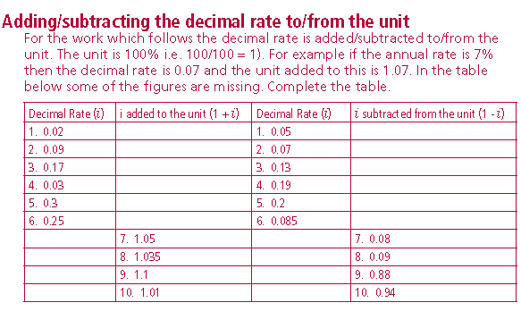
Appendix:
Revision of Prior Knowledge Required
Notes:
Before we start with Section A, I’m just going to draw your attention to the appendix and an exercise which may be of help when working on the student activity. As you can see from the slide, one of the exercises is adding and subtracting the decimal to and from the unit. As we go through the T&L, you will see where this would be helpful. Have a look at the entire appendix and you will see how much of the prior knowledge is covered here with revision exercises.

Slide 5
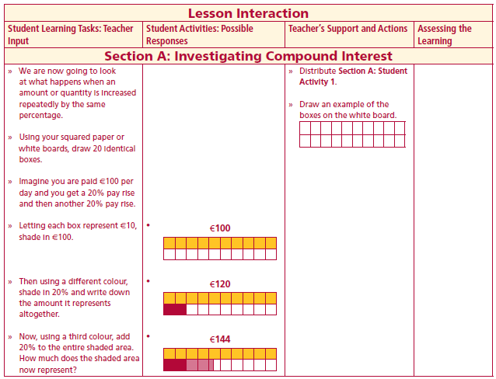




Section A: Student Activity 1
Investigating Compound Interest
1. If each block represents €10, shade in €100.
2. Then, using another colour, add 20% to the original shaded area.
3. Finally, using a third colour, add 20% of the entire shaded area.
4. What is the value of the second shaded area?_____________________________
5. What is the value of the third shaded area?_______________________________
6. Why do they not have the same amount?_______________________________
Lesson interaction
2

Slide 6
Section A: Student Activity 1
Investigating Compound Interest
1. If each block represents €10, shade in €100.
2. Then, using another colour, add 20% to the original shaded area.
3. Finally, using a third colour, add 20% of the entire shaded area.
4. What is the value of the second shaded area?_____________________________
5. What is the value of the third shaded area?_______________________________
6. Why do they not have the same amount?_______________________________
Lesson interaction
2

Slide 7
Section A: Student Activity 1
Investigating Compound Interest
1. If each block represents €10, shade in €100.
2. Then, using another colour, add 20% to the original shaded area.
3. Finally, using a third colour, add 20% of the entire shaded area.
4. What is the value of the second shaded area?_____________________________
5. What is the value of the third shaded area?_______________________________
6. Why do they not have the same amount?_______________________________
Lesson interaction
2

Slide 8
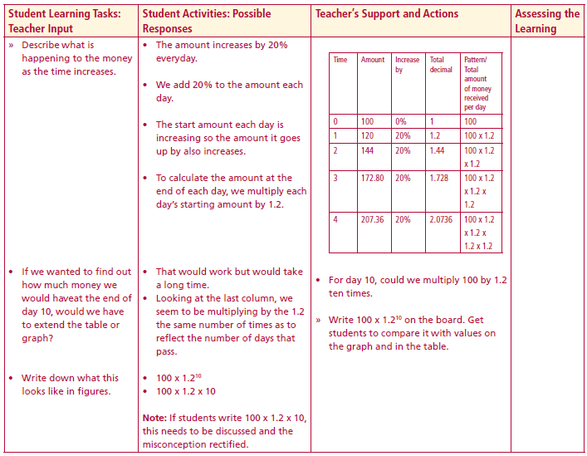
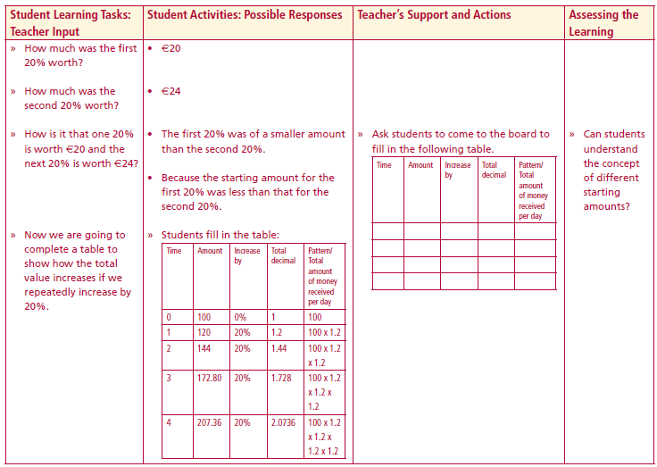
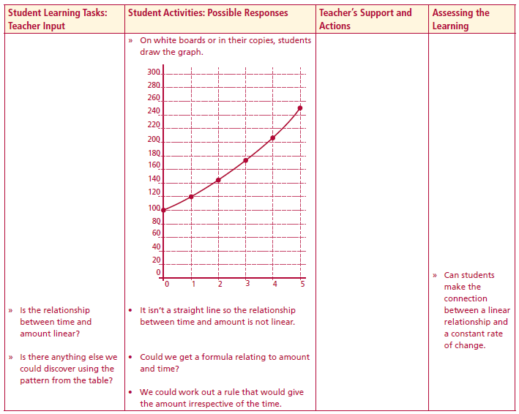
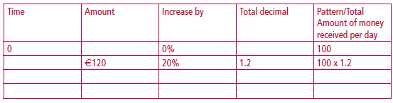
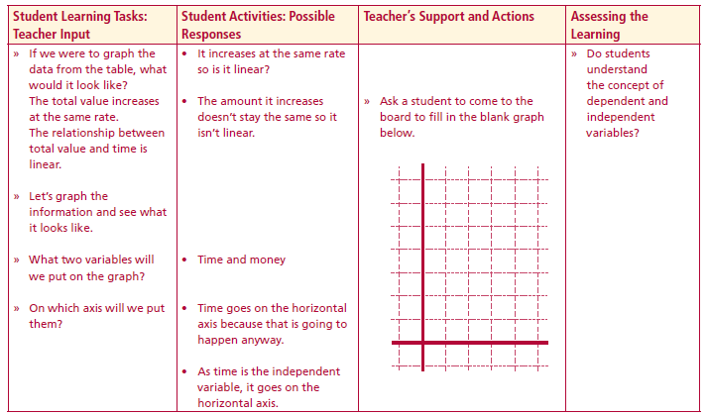

7. Complete the following table and investigate the patterns which appear.
Lesson interaction
Lesson interaction
8. Can you find a way of getting the value for day 10 without having to do the table to day 10? ___________________________________________________________________ ________________________________________________________________________________________________________________________________________
9. Use the diagram on the right to graph time against amount. Is the relationship linear?
Lesson interaction
Lesson interaction
2

Slide 9
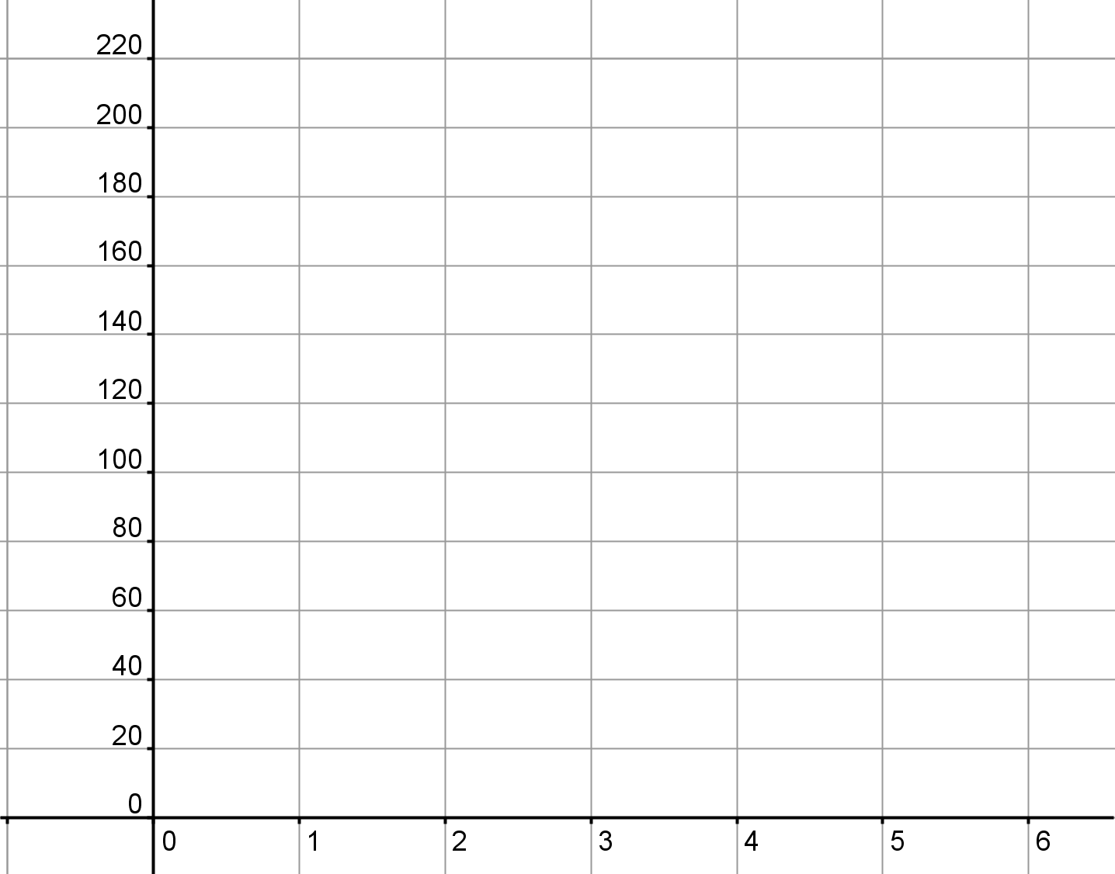
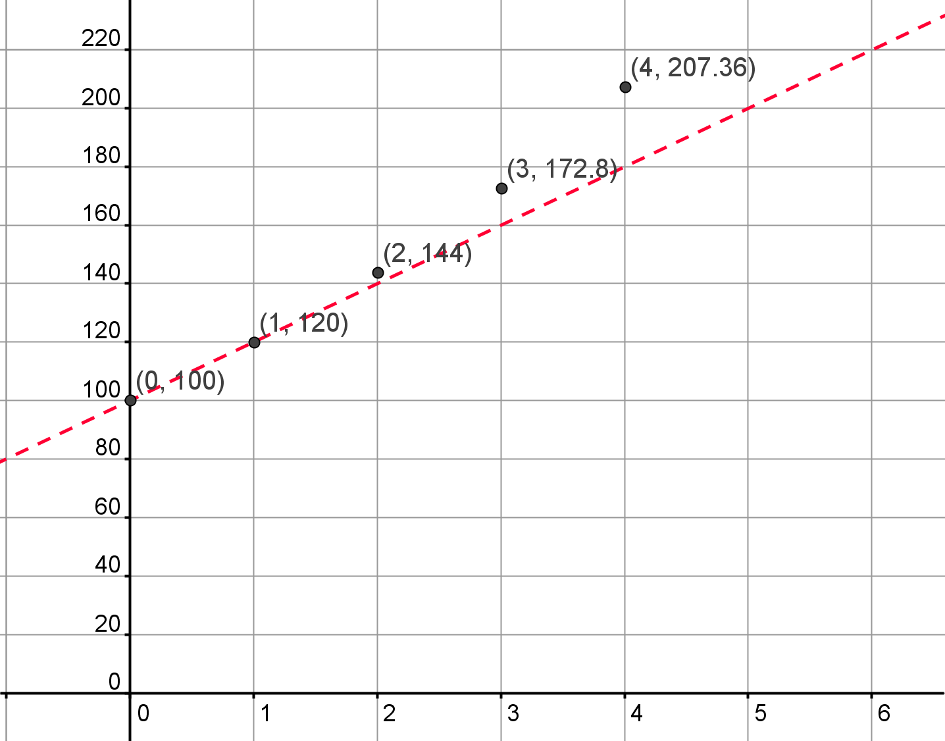
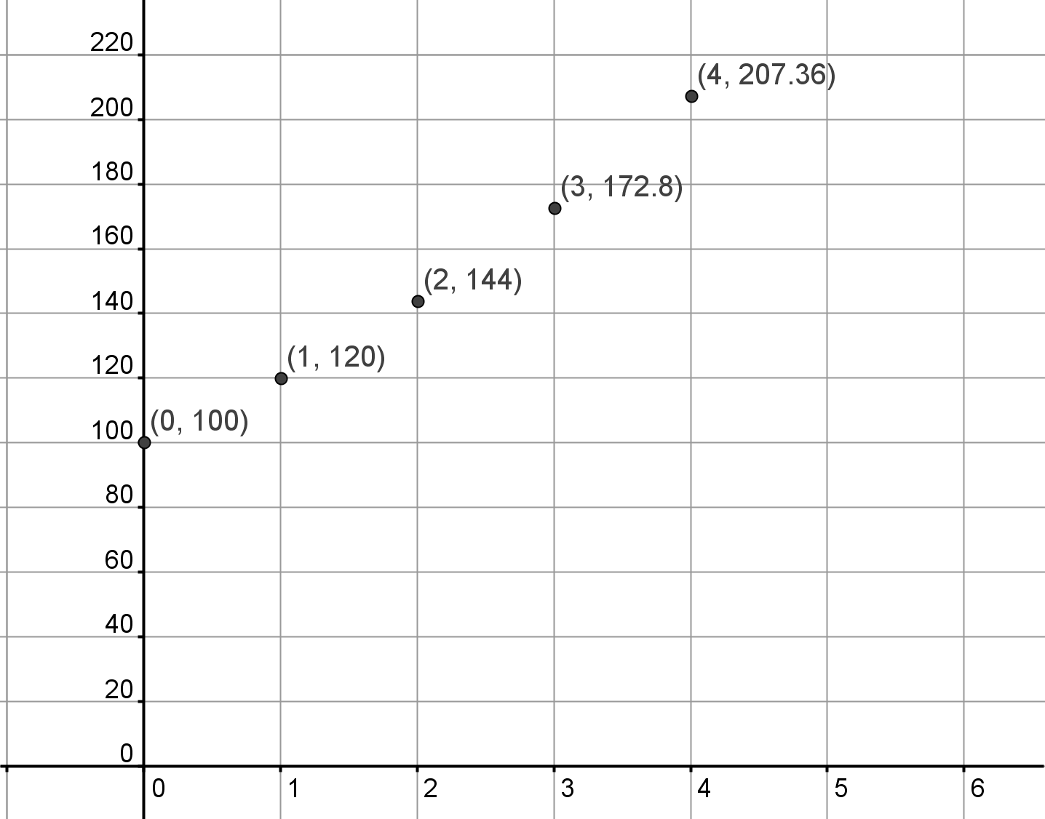
Amount (€)
Time elapsed (Days)
2

Slide 10
Amount (€)
Time | Amount | Change | Change of Change
0 | 100
 |  | 20
1 | 120
 |  | 24
2 | 144
 |  | 28.80
3 | 172.80
 |  | 34.56
4 | 207.36
Time | Amount | Change | Change of Change
0 | 100
1 | 120
2 | 144
3 | 172.80
4 | 207.36
Time | Amount | Change | Change of Change
0 | 100
 |  | 20
1 | 120
 |  | 24
2 | 144
 |  | 28.80
3 | 172.80
 |  | 34.56
4 | 207.36
Time | Amount | Change | Change of Change
0 | 100
 |  | 20
1 | 120
 |  | 24
2 | 144
 |  | 28.80
3 | 172.80
 |  | 34.56
4 | 207.36
Time | Amount | Change | Change of Change
0 | 100
 |  | 20
1 | 120 |  | 4
 |  | 24
2 | 144 |  | 4.80
 |  | 28.80
3 | 172.80 |  | 5.76
 |  | 34.56
4 | 207.36
Time elapsed (Days)
2

Slide 11
Amount (€)
Time | Amount | Multiplier | Change of Change
0 | 100
1 | 120
2 | 144
3 | 172.80
4 | 207.36
Time | Amount | Multiplier | Change of Change
0 | 100
 |  | 1.2
1 | 120
 |  | 1.2
2 | 144
 |  | 1.2
3 | 172.80
 |  | 1.2
4 | 207.36
Time elapsed (Days)
2

Slide 12
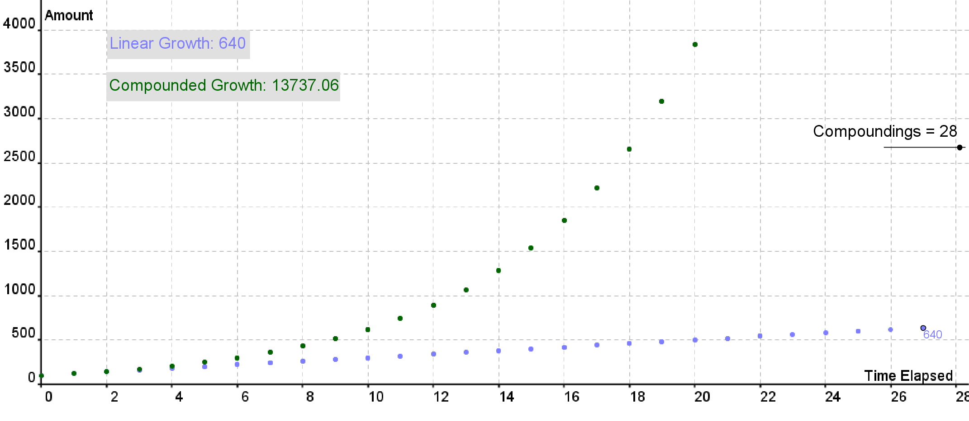

5 days
Linear Growth:
100 + 5(20)
Exponential Growth:
Compound interest
100 (1.2)⁵
Models
for
Growth
(and Decay)

Slide 13
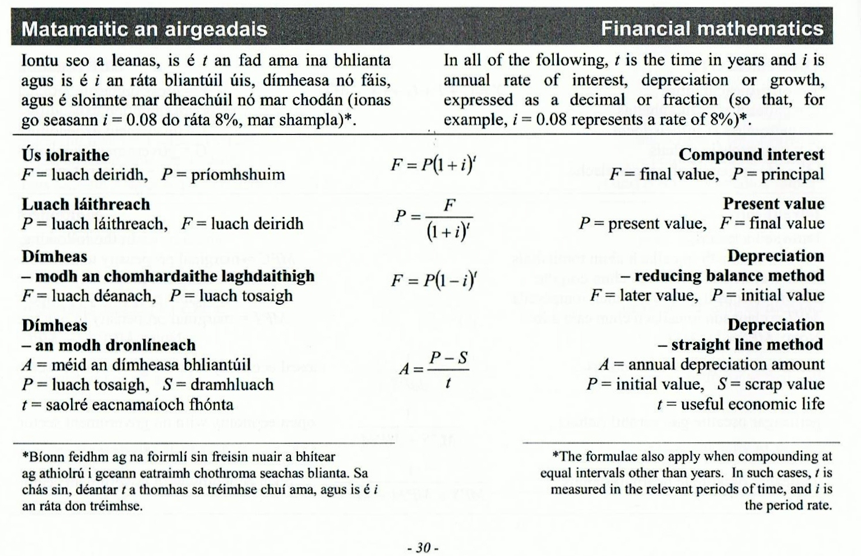
Start | 100
Day 1
Day 2
Day 3
Day 4
Day 10
Day n
100 x 1.2
100 x 1.2 x 1.2
100 x 1.2 x1.2 x 1.2
100 (1.2)⁴
100 (1.2)¹⁰
100 (1.2)^{n}
If
F = Final amount
P = Principal amount
i = interest rate
t= time
Page 30
What would the formula be for day 10?
F = P (1 + i)^{t}
What would the formula be for day n?
What if we started with €150?
What if we started with €527?
What if we increased by 30%?
What if we increased by 100%?
2

Slide 14
Compound Interest
Formula
Page 30
$${\text{F}\text{ = }\text{P}\text{ ( 1 + }\text{i}\text{ )}}^{t}$$
2
Notes:
This is the compound interest formula we are going to discover in section B but looking at it now and using what we’ve done, will this work?

Slide 15
Section E
Student Activity 5
Reducing Balance

Slide 16
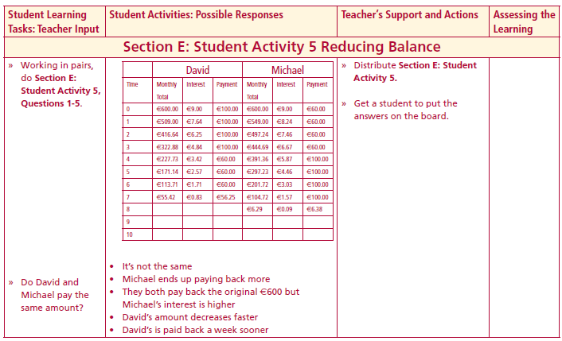
Section E: Student Activity 5
Reducing Balance
David and Michael are going on the school tour this year. They are each taking out a loan of €600, which they hope to pay off over the next year. Their bank is charging a monthly interest rate of 1.5% on loans.
David says that with his part time work at present he will be able to pay €100 for the first 4 months but will only be able to pay off €60 a month after that. Michael says that he can only afford to pay €60 for the first 4 months and then €100 after that. Michael reckons that they are both paying the same amount for the loan. Why? ____________________________________________________________________________________________________________________________________________________________________________________
Note: This problem is posed based on the following criteria:
(a) A loan is taken out
(b) After 1 month interest is added on
(c) The person then makes his/her monthly repayment. This process is then repeated until the loan is fully paid off.
Lesson interaction
2
Notes:
Use the T&L for

Slide 17
 | David |  |  | Michael
Time | Monthly Total | Interest | Payments | Monthly Total | Interest | Payments
1
2
3
4
5
6
7
8
9
10
Lesson interaction

Slide 18
 | David |  |  |  |  | Michael
Time | Monthly Total | Interest | Payments |  | Time | Monthly Total | Interest | Payments
0 |  |  |  |  | 0
1 |  |  |  |  | 1
2 |  |  |  |  | 2
3 |  |  |  |  | 3
4 |  |  |  |  | 4
5 |  |  |  |  | 5
6 |  |  |  |  | 6
7 |  |  |  |  | 7
8 |  |  |  |  | 8
9 |  |  |  |  | 9
10 |  |  |  |  | 10
 | David |  |  |  |  | Michael
Time | Monthly Total | Interest | Payments |  | Time | Monthly Total | Interest | Payments
0 | 600 | 9 | 100 |  | 0
1 |  |  |  |  | 1
2 |  |  |  |  | 2
3 |  |  |  |  | 3
4 |  |  |  |  | 4
5 |  |  |  |  | 5
6 |  |  |  |  | 6
7 |  |  |  |  | 7
8 |  |  |  |  | 8
9 |  |  |  |  | 9
10 |  |  |  |  | 10
 | David |  |  |  |  | Michael
Time | Monthly Total | Interest | Payments |  | Time | Monthly Total | Interest | Payments
0 | 600 | 9 | 100 |  | 0
1 | 509 |  |  |  | 1
2 |  |  |  |  | 2
3 |  |  |  |  | 3
4 |  |  |  |  | 4
5 |  |  |  |  | 5
6 |  |  |  |  | 6
7 |  |  |  |  | 7
8 |  |  |  |  | 8
9 |  |  |  |  | 9
10 |  |  |  |  | 10
Lesson interaction
3

Slide 19
1. What do David and Michael have in common at the beginning of the loan period? ______________________________________________
2. Calculate the first 3 months transactions for each. (How much, in total, had they each paid back after 3 months?)
David ___________ Michael __________
3. What is the total interest paid by each?
David _________ Michael __________
4. Based on your answers to the first 3 questions, when would you recommend making the higher payments and why? ________________________________________________________________________________________________________________________
5. Is Michael’s assumption that they will eventually pay back the same amount valid? ________________________________________________
Lesson interaction
3

Slide 20
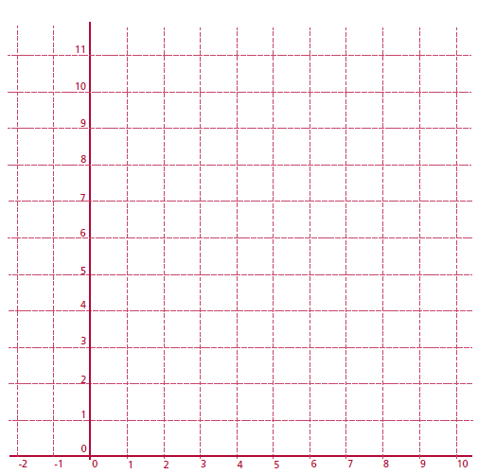
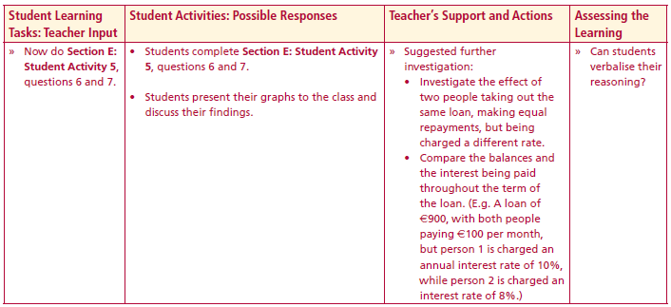
✓
Lesson interaction
Using the graph below, plot the amount of interest added each month to both David‘s and Michael’s account.
Looking at the graph, who will pay the most interest overall? _________
____________________________________________________________________________________________________________________________
3

Slide 21
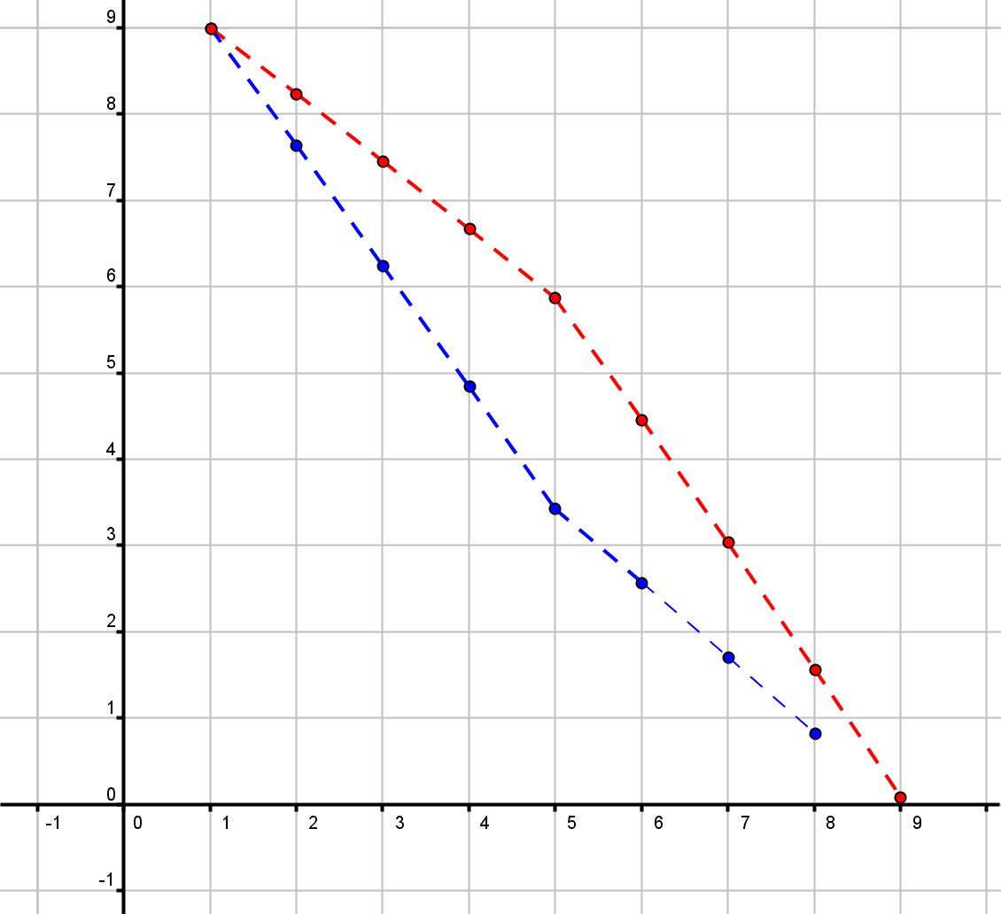
Amount of interest paid
(€)
Michael
David
Time elapsed (months)
Notes:
If we plot the amount of interest added each month, we see that Michael has had more interest added each month because he was paying less off the debt each month initially. He never managed to catch up even though initially he thought it would be the same thing.
If I knew then what I know now, would you make a bigger effort to pay off more initially?

Slide 22
Extension/Further Investigation
David - borrows from Bundlers Bank which charges a rate of 1.5% on loans, David repays €60 per month.
Michael - borrows from Stop start Bank which charges a rate of 1.6% on loans, Michael repays €60 per month.
Who has the best deal?

