Slide 1
Problem Solving
as a “Means” not as an “End”

Slide 2
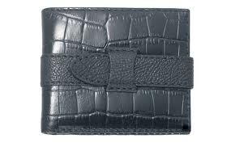
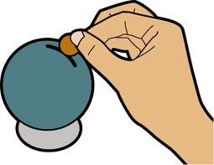
John has 18 ten-cent coins in his wallet and Owen has 22 five-cent coins in his wallet.
Each day, they decide to take one coin from their wallets and put it into a money box, until one of them has no more coins left in their wallet.
When does Owen have more money than John in his wallet?
2

Slide 3
Prior Knowledge
Students have prior knowledge of:
Sets
Number systems
How to represent all number systems on the number line
Order of numbers on the number line
Patterns including: completing tables and drawing graphs of patterns
Linear equations in one unknown

Slide 4
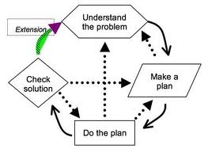
Problem Solving in Junior Cycle

Slide 5
Problem Solving in Junior Cycle
Understand
the problem
Extension
Check solution
Make a plan
Do the plan

Slide 6
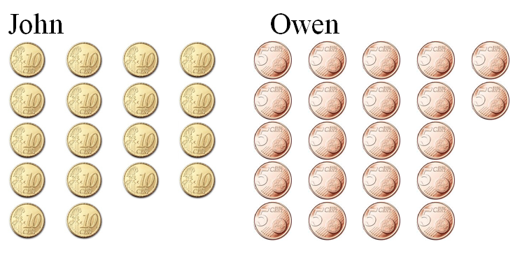
John has 18 ten-cent coins in his wallet and Owen has 22 five-cent coins in his wallet.
Each day, they decide to take one coin from their wallets and put it into a money box, until one of them has no more coins left in their wallet.
When does Owen have more money than John in his wallet?
2

Slide 7

John has 18 ten-cent coins in his wallet and Owen has 22 five-cent coins in his wallet. Each day, they decide to take one coin from their wallets and put it into a money box, until one of them has no more coins left in their wallet.
When does Owen have more money than John in his wallet?
Day | John | Owen
Start
180c
110c
Day 1
170c
105c
Day 2
160c
100c

Slide 8
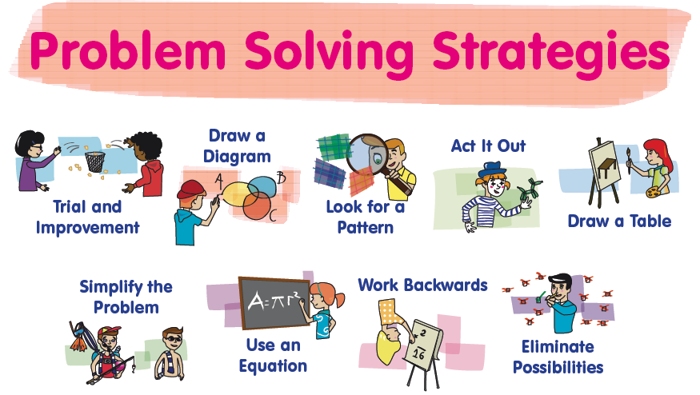

Slide 9
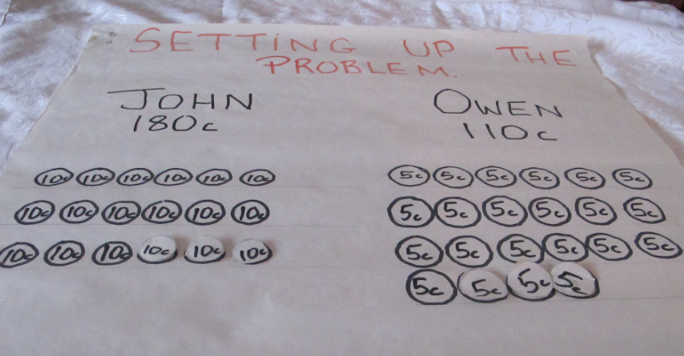

Slide 10
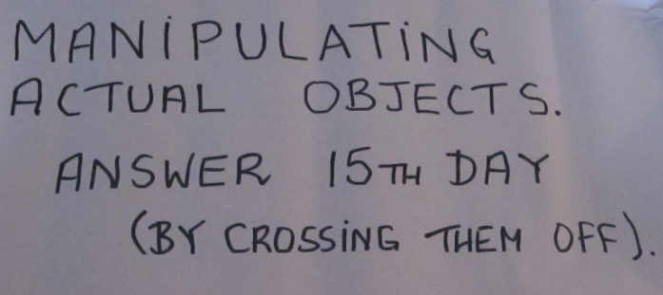

Slide 11
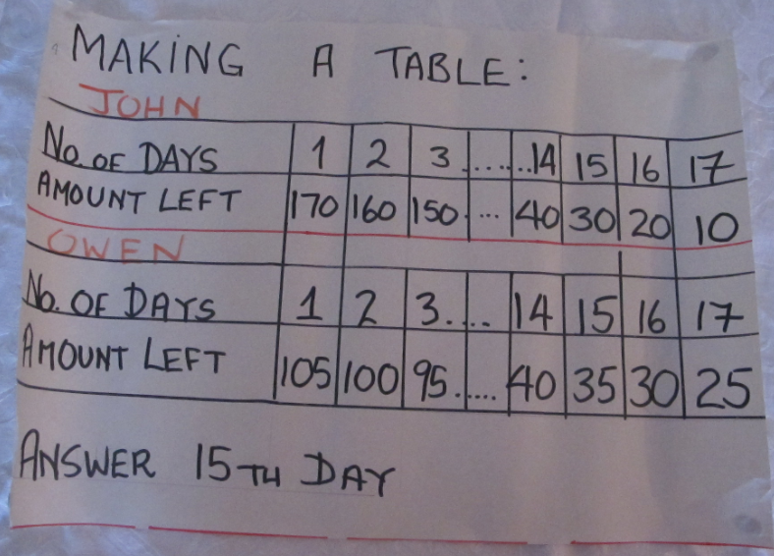

Slide 12
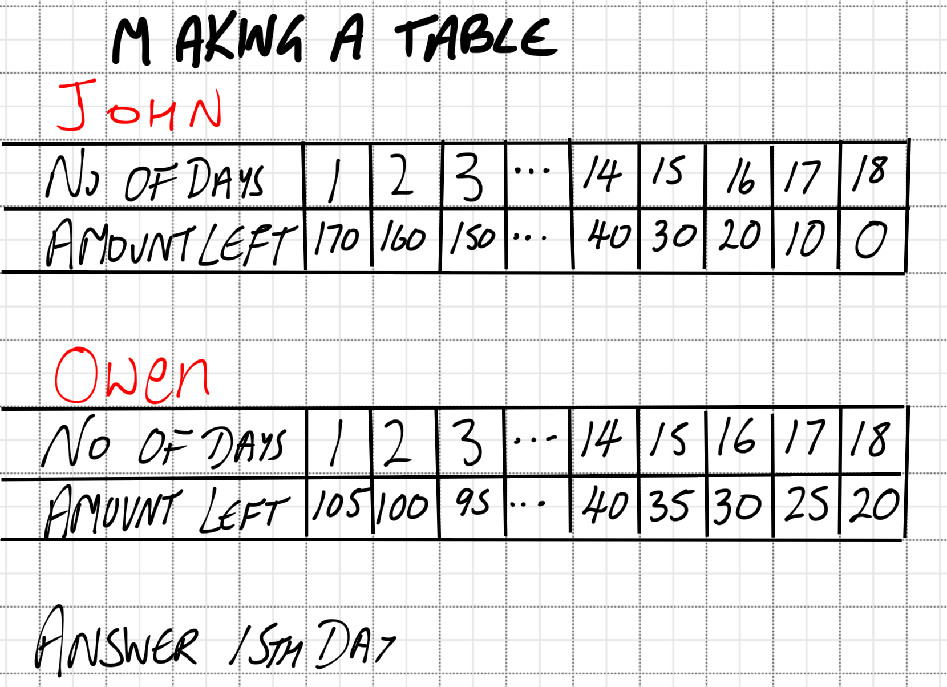

Slide 13
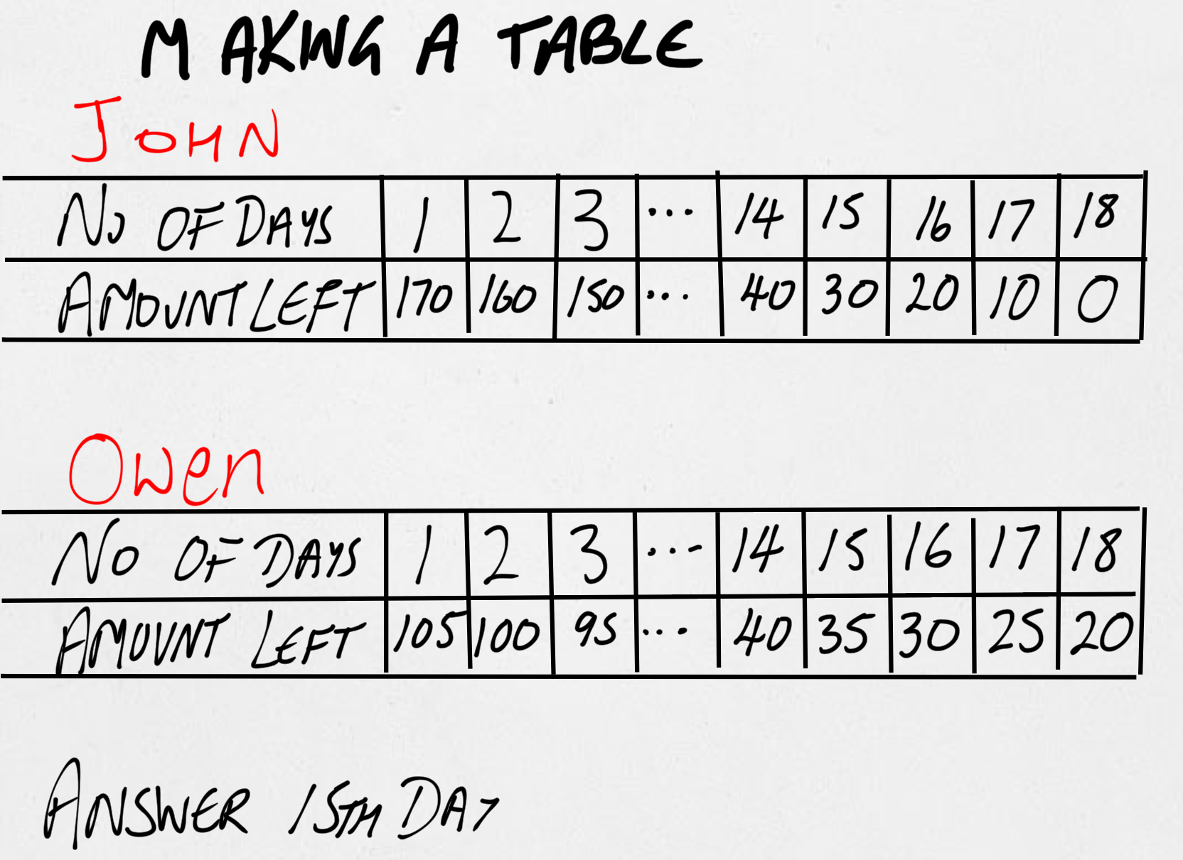

Slide 14
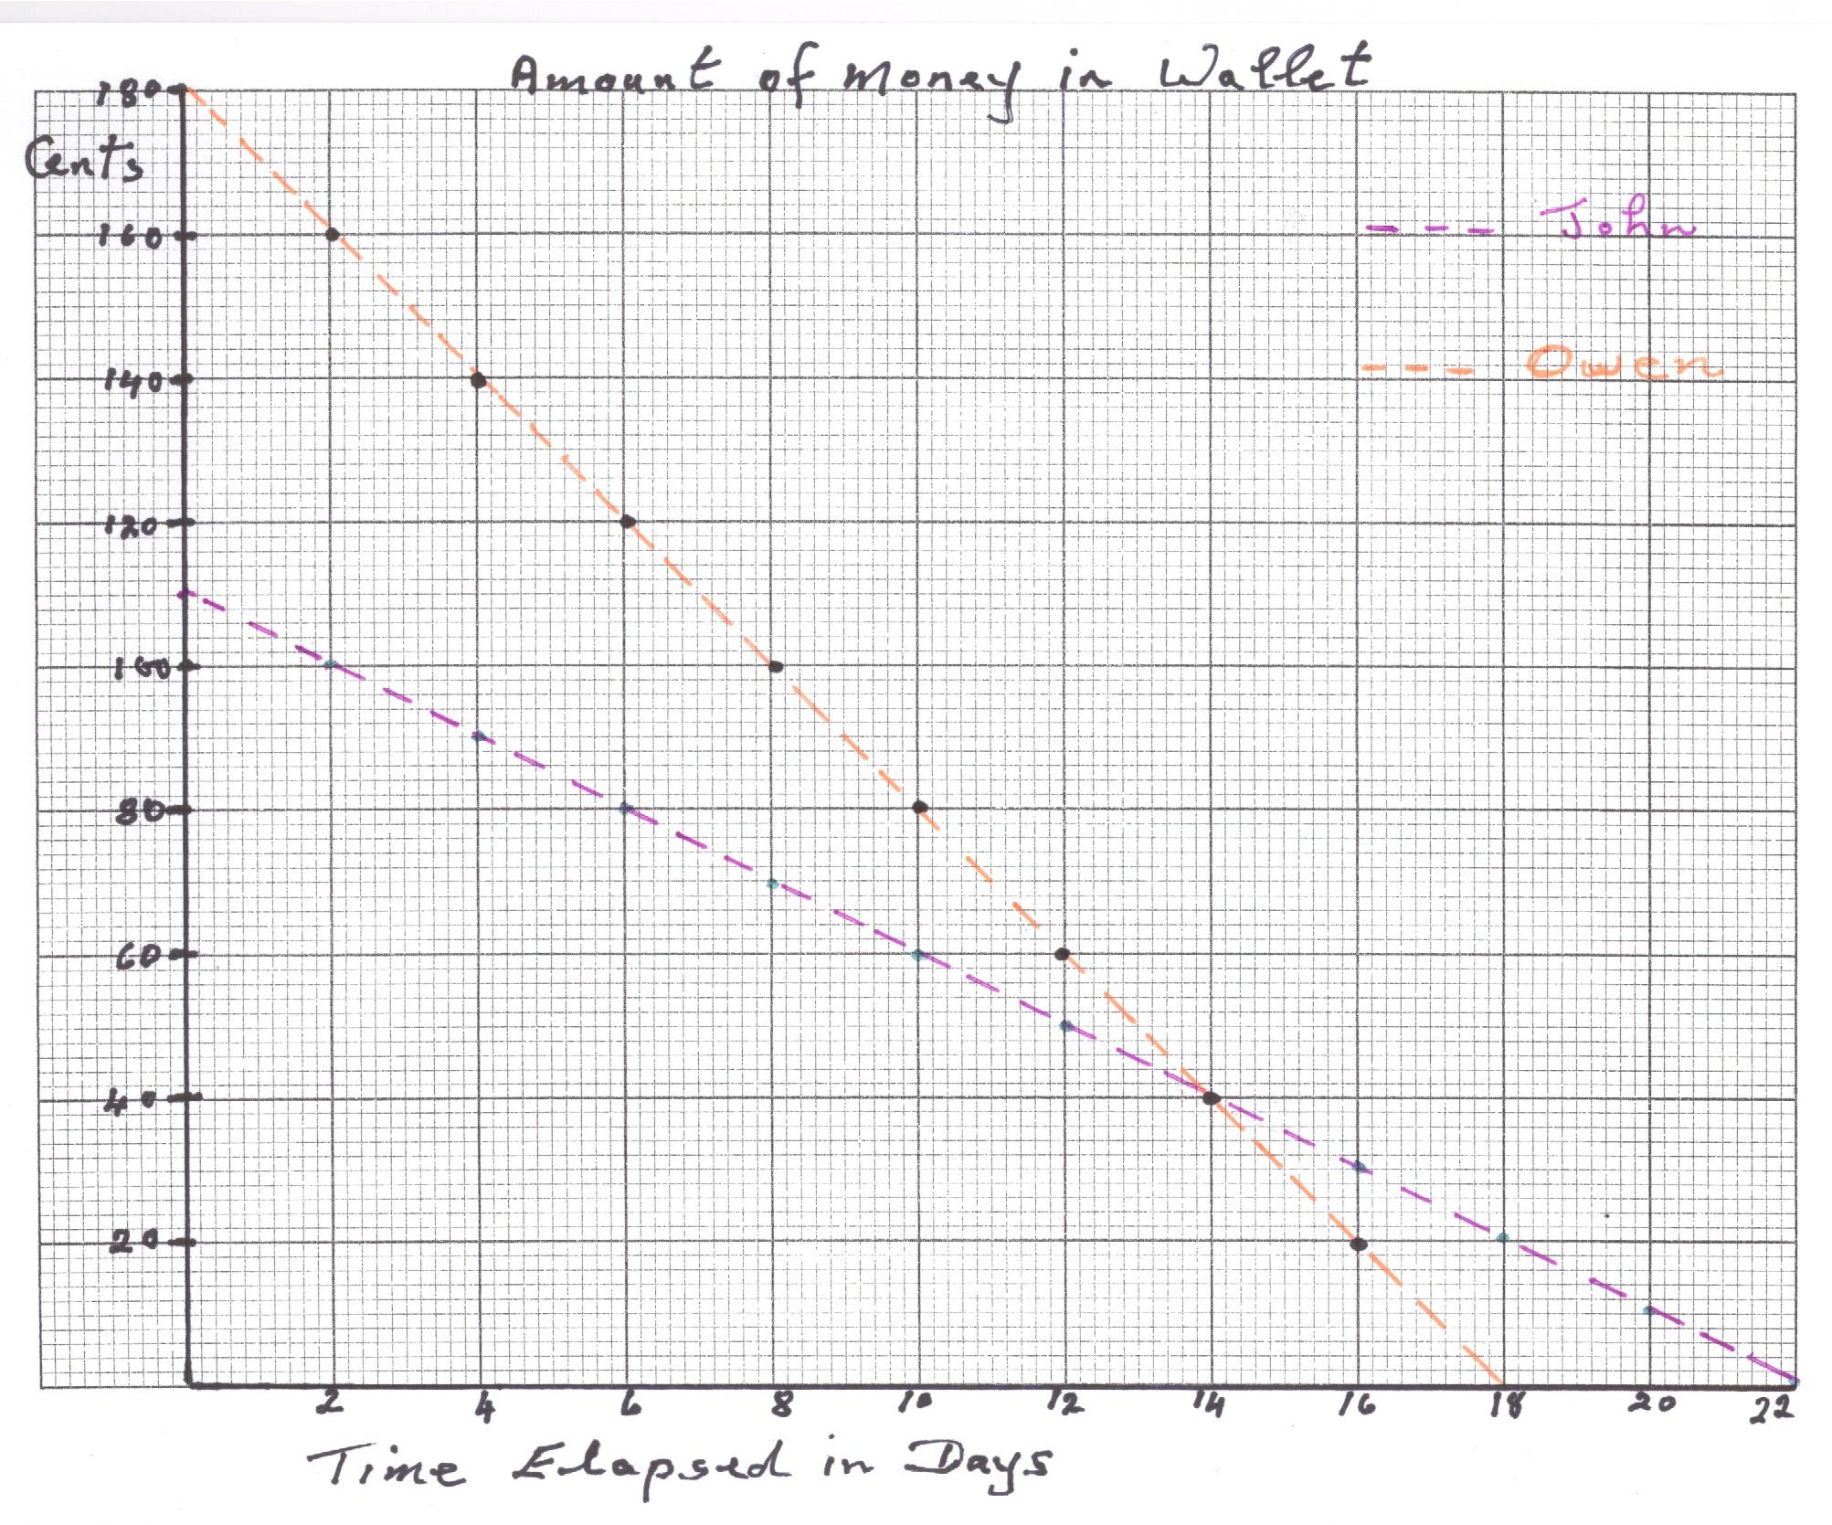

Slide 15
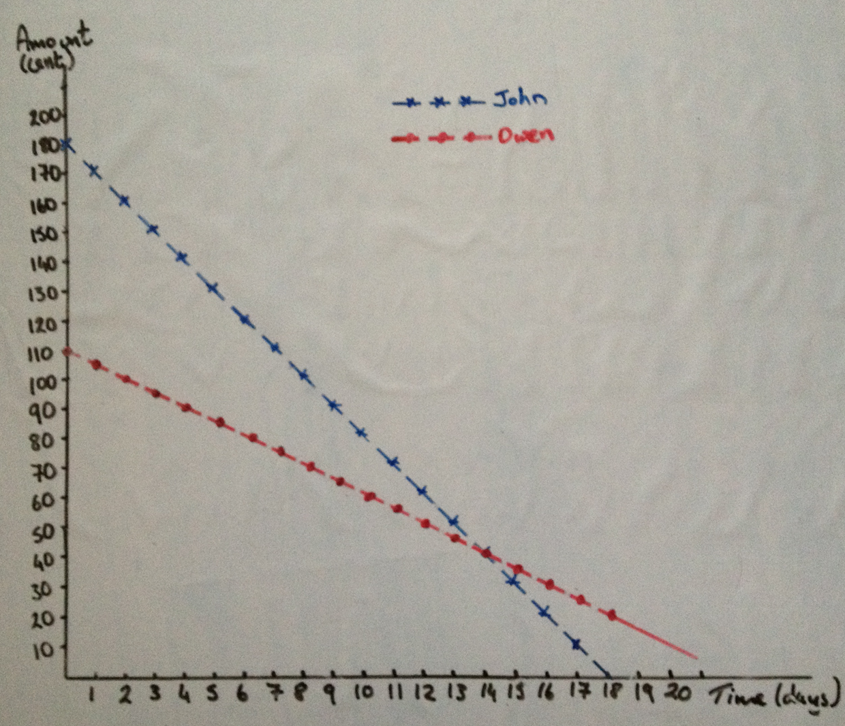

Slide 16
Revisit table

Slide 17
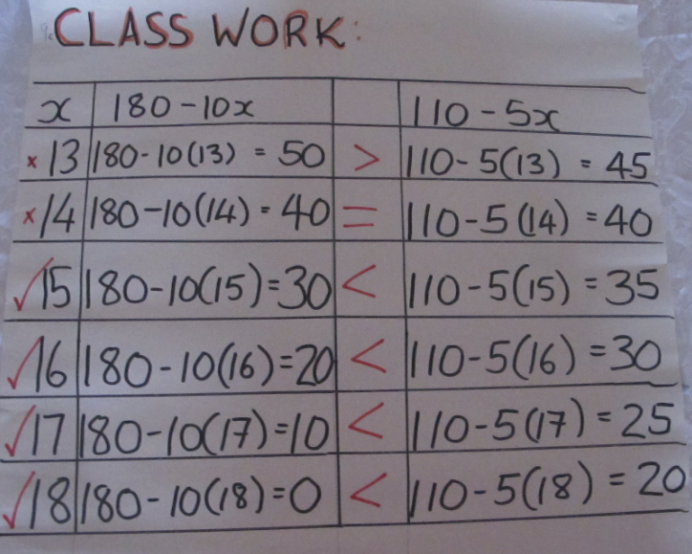

Slide 18



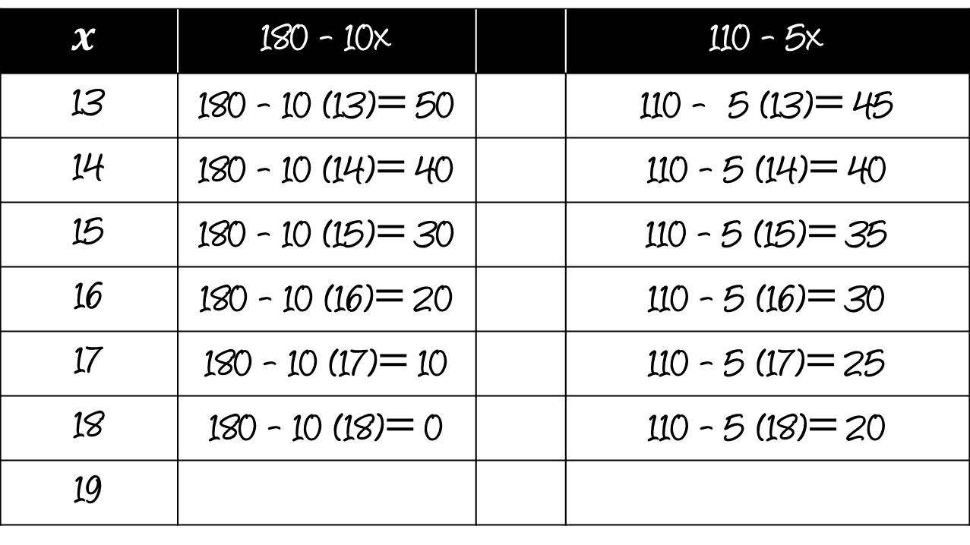





$$x$$ | 180 - 10x |  | 110 - 5x
13 | 180 - 10 (13)$=$ 50 |  | 110 - 5 (13)$=$ 45
14 | 180 - 10 (14)$=$ 40 |  | 110 - 5 (14)$=$ 40
15 | 180 - 10 (15)$=$ 30 |  | 110 - 5 (15)$=$ 35
16 | 180 - 10 (16)$=$ 20 |  | 110 - 5 (16)$=$ 30
17 | 180 - 10 (17)$=$ 10 |  | 110 - 5 (17)$=$ 25
18 | 180 - 10 (18)$=$ 0 |  | 110 - 5 (18)$=$ 20
19
$$>$$
$$=$$
$$<$$
$$<$$
$$<$$
$$<$$
$$Not possible$$

Slide 19
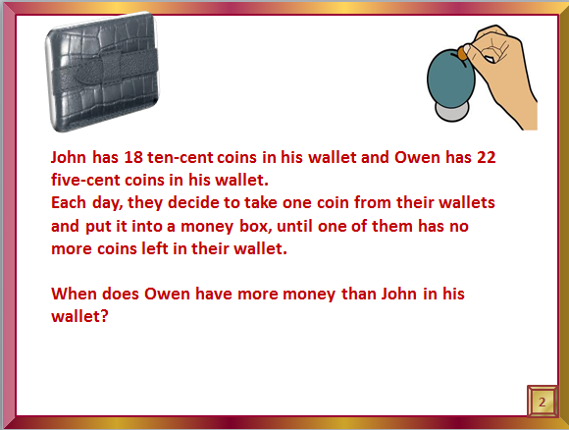











$$Owen>John$$
$$110 −5 d>180 −10 d$$
$$+10 d$$
$$+10 d$$
$$110+5 d>180$$
$$−110$$
$$−110$$
$$5 d>70$$
$$÷5$$
$$÷5$$
$$d>14$$
When does Owen have more money than John in his wallet?
Owen has more money than John on days 15,16, 17 and 18

Slide 20
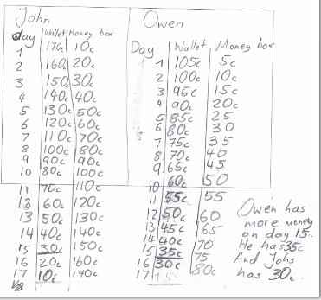

Slide 21
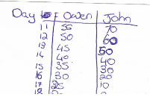

Slide 22
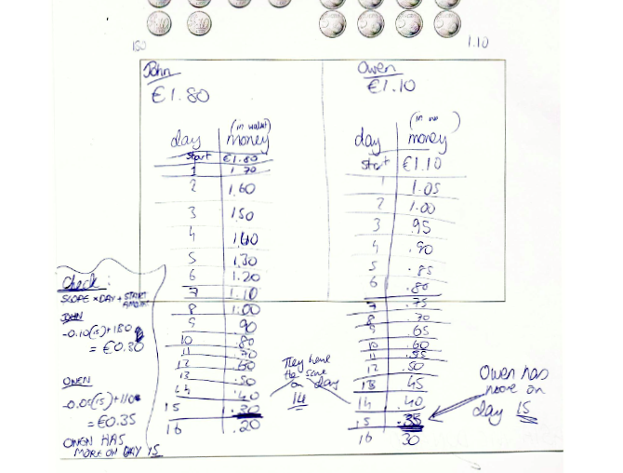

Slide 23
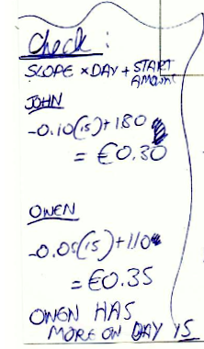

Slide 24
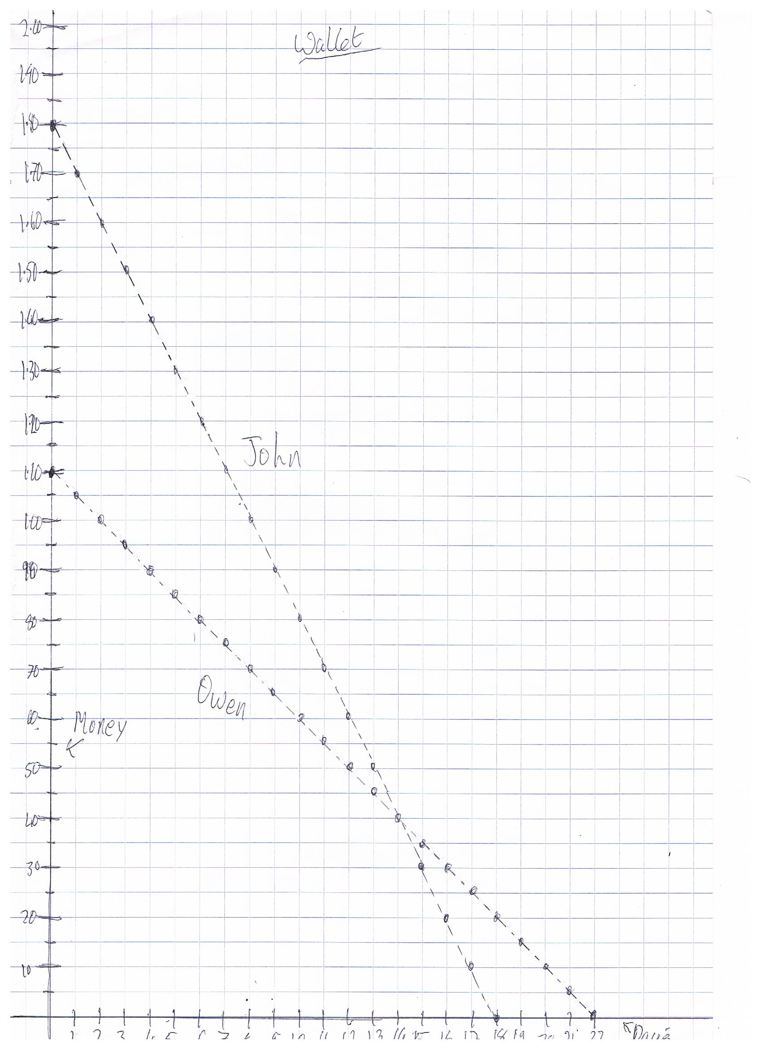

Slide 25
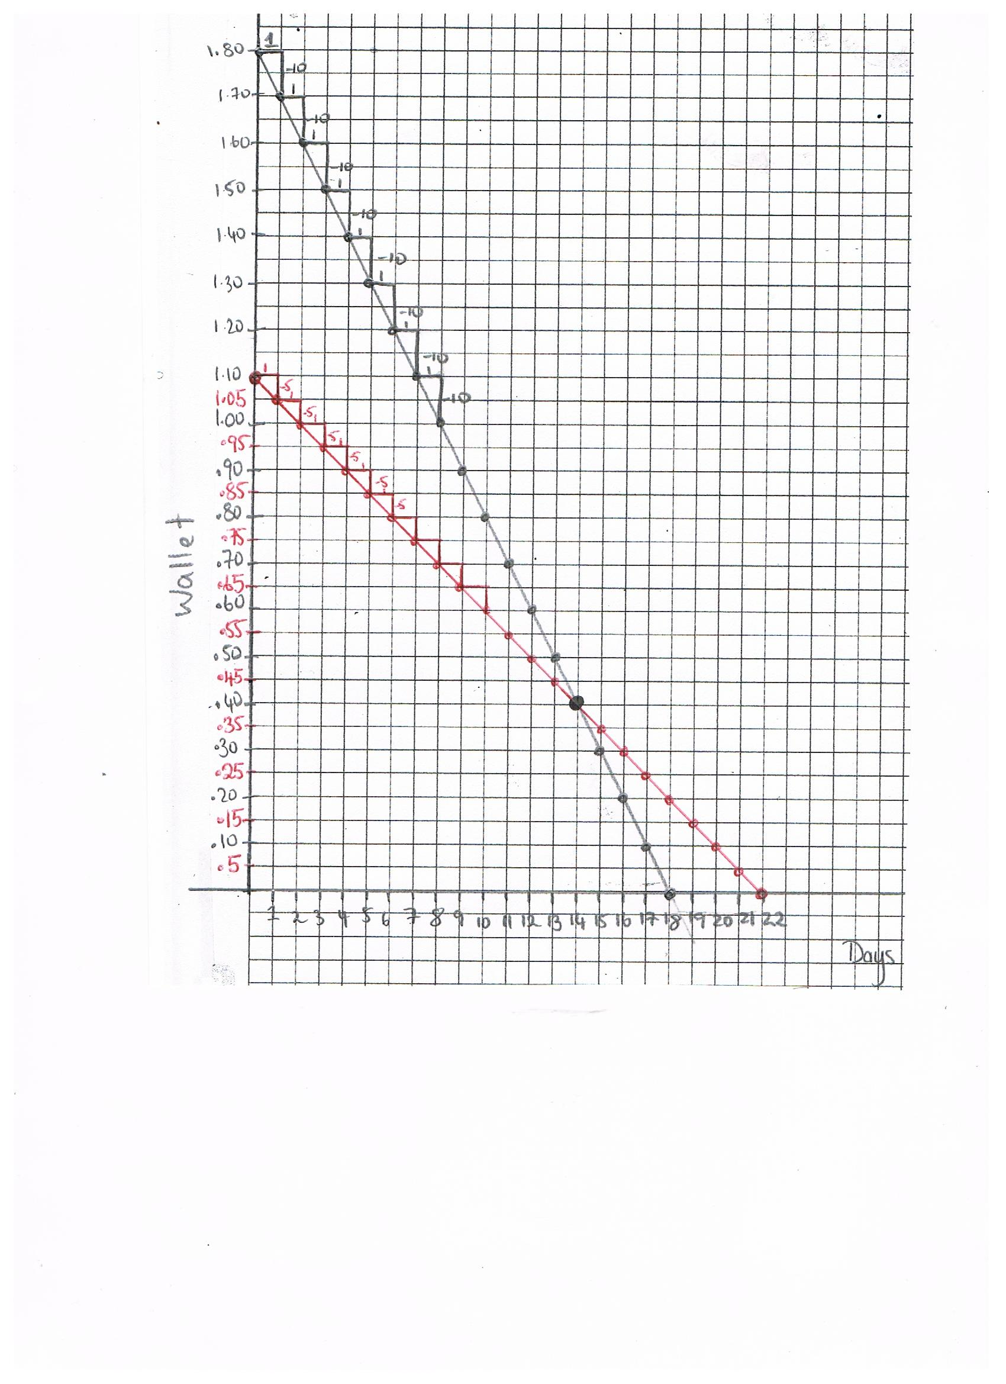

Slide 26
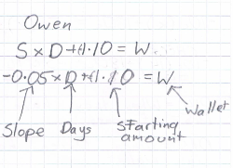

Slide 27
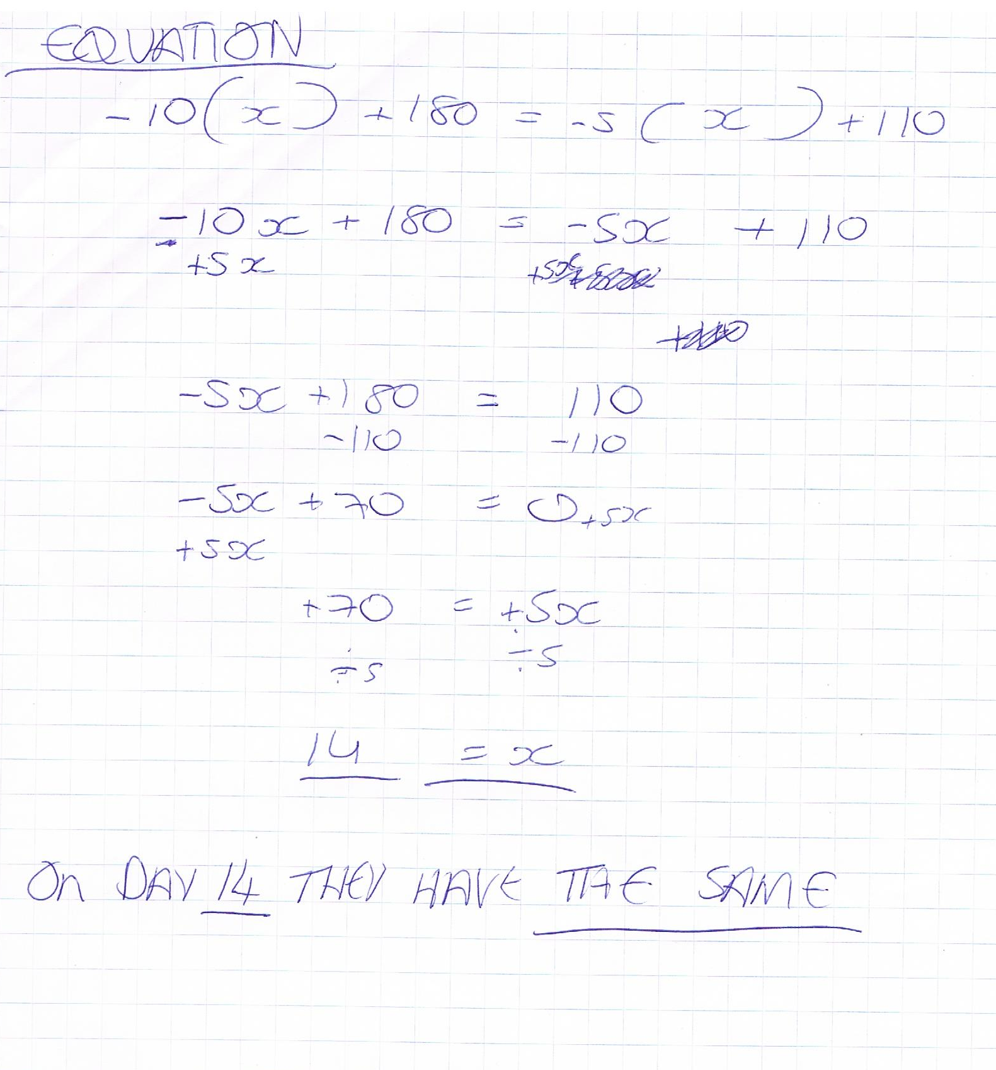

Slide 28
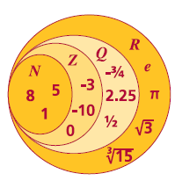
Number Systems

Slide 29

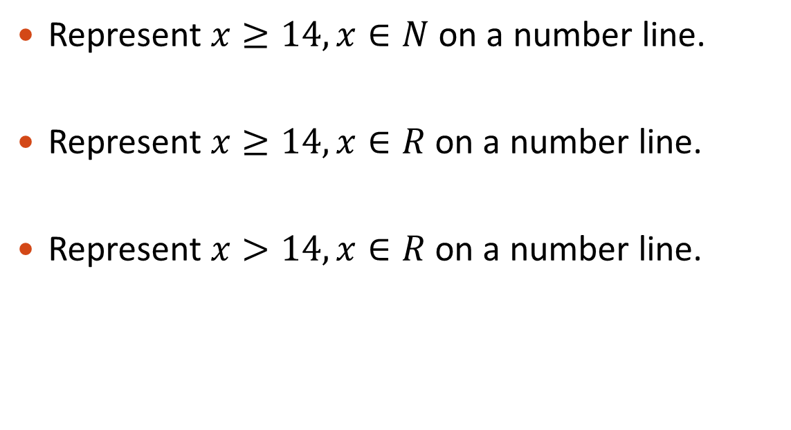
Graphing Inequality Solutions on the Number Line.
Represent $x≥14, x∈N$on a number line.
Represent $x≥14, x∈R$on a number line.
Represent $x>14, x∈R$on a number line.

Slide 30
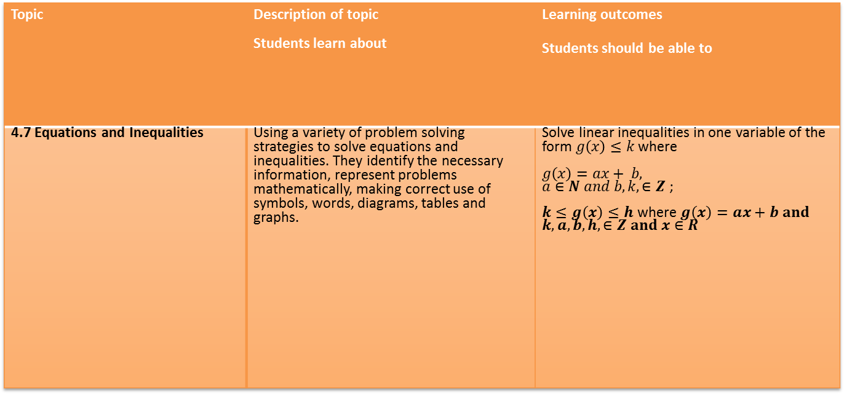
Topic | Description of topic Students learn about | Learning outcomes Students should be able to
4.7 Equations and Inequalities | Using a variety of problem solving strategies to solve equations and inequalities. They identify the necessary information, represent problems mathematically, making correct use of symbols, words, diagrams, tables and graphs. | Solve linear inequalities in one variable of the form $g\left(x\right)≤k$ where $g\left(x\right)=ax+ b,$ $a∈N and b,k, ∈Z$ ; $k≤g\left(x\right)≤h$ where $g\left(x\right)=ax+b and$ $k,a,b,h,∈Z and x∈R$

Slide 31
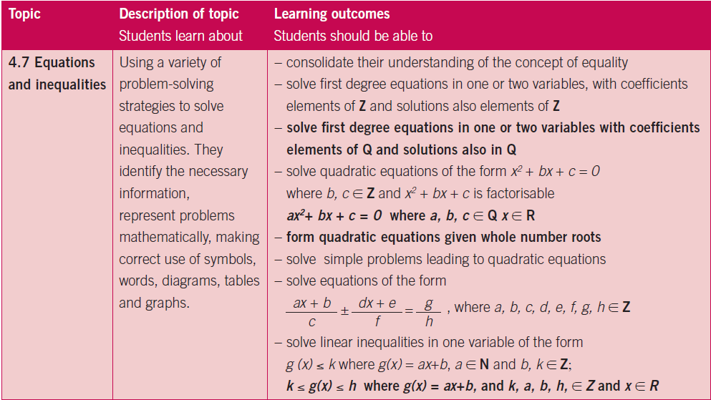
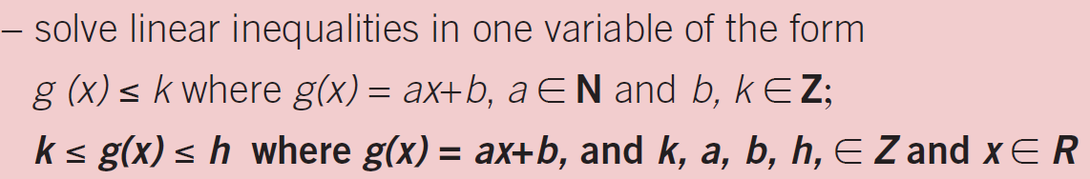

Slide 32


