Slide 1
Purpose
Is there another way to work out the derivative?
Notes:
First Principles (use some of this with the previous slide)
As we know, this works out an equation/function for the slope at all points of the original function.
LCHL: differentiate linear and quadratic functions from first principles
LCOL: Gone. Will discover the rule themselves through patterns.
Both need to “associate derivatives with slopes and tangent lines” so Pendleton and Angry Birds are necessary for LCOL and LCHL.
Limits are in LCOL too. “investigate the concept of the limit of a function”
LCHL has “informally explore limits and continuity of functions”
LCOL “find first and second derivatives of linear, quadratic and cubic functions by rule”
“associate derivatives with slopes and tangent lines”
“apply differentiation to • rates of change • maxima and minima • curve sketching”

Slide 2
Slope Functions- What is
the “Slope” of the Functions below?
4
y
3
2
1
x
-6
-4
-2
2
4
6
-1
-2
-3
-4
Notes:
What is the slope when x=-4? What is the slope when x=1? What is the slope when x=2? What is the slope at all points on the function?
If the slope at all points is 0 what is the function? f’(x)=0

Slide 3
Slope Functions
4
y
3
2
1
x
-6
-4
-2
2
4
6
-1
-2
-3
-4

Slide 4
Slope Functions
4
y
3
2
1
x
-6
-4
-2
2
4
6
-1
-2
-3
-4

Slide 5
Slope Functions
4
y
3
2
1
x
-6
-4
-2
2
4
6
-1
-2
-3
-4

Slide 6
Slope Functions
4
y
3
2
1
x
-6
-4
-2
2
4
6
-1
-2
-3
-4

Slide 7
Slope Functions
12
y
11
1
10
(3, 9)
-3
(-3, 9)
9
8
-6
7
-6
-6
6
1
5
(2, 4)
x | f’(x)
-2
(-2, 4)
4
3
-4
-4
2
-1
1
(1, 1)
(-1, 1)
1
-2
-2
x
-5
-4
-3
-2
-1
(0, 0)
1
2
3
0
0
4
5
-1
1
2
-2
2
4
3
6
Notes:
We’ve spotted the pattern getting the slope functions of constants of linear functions.
They were relatively easy because the slope was the same at all points on the function.
Let’s look at x². It has a different slope at all points. Let’s record the slope (of the tangent) at a few points and see if we can get/derive the slope function.
I want you to forget everything you know about differentiation for the next while and put yourself in a students shoes. (either a student at LCOL who hasn’t worked out the slope function of x² from first principles or a LCHL who has).
Forget what you know about calculus. Put yourself in a student’s shoes.
When they have the table and graph done, you could go to the Discovering Rule GeoGebra file and tick the box on the right hand side beside Question 3 to show a graph similar to their one. Then
MENTION TURNING POINTS HERE
Ruler essential to help read which tangent line you are reading
Show the first triangle in the Powerpoint to get them started.
Watch out for any pair filling in the table as -6, -4, -2, 2, 4, 6 i.e. skipping the tangent at (0,0), as it is hidden by the x-axis.

Slide 8
Slope Functions
12
y
11
10
(3, 9)
(-3, 9)
9
8
7
4
6
4
5
2
x | f’(x)
-3 | -6
-2 | -4
-1 | -2
(-2, 4)
(2, 4)
4
1
3
2
2
2
1
(-1, 1)
(1, 1)
1
1
x
0
0
-5
-4
-3
-2
-1
(0, 0)
1
2
3
4
5
-1
-2
Notes:
We’ve spotted the pattern getting the slope functions of constants of linear functions.
They were relatively easy because the slope was the same at all points on the function.
Let’s look at x². It has a different slope at all points. Let’s record the slope (of the tangent) at a few points and see if we can get/derive the slope function.
I want you to forget everything you know about differentiation for the next while and put yourself in a students shoes. (either a student at LCOL who hasn’t worked out the slope function of x² from first principles or a LCHL who has).
Forget what you know about calculus. Put yourself in a student’s shoes.
MENTION TURNING POINTS HERE
Ruler essential to help read which tangent line you are reading

Slide 9
Slope Functions
12
y
11
10
3
(-3, 9)
(3, 9)
9
8
7
6
6
5
(2, 4)
x | f’(x)
-3 | -6
-2 | -4
-1 | -2
0 | 0
1 | 2
2 | 4
(-2, 4)
4
3
1
2
(1, 1)
(-1, 1)
1
x
-5
-4
-3
-2
-1
(0, 0)
1
2
3
4
5
-1
-2
Notes:
We’ve spotted the pattern getting the slope functions of constants of linear functions.
They were relatively easy because the slope was the same at all points on the function.
Let’s look at x². It has a different slope at all points. Let’s record the slope (of the tangent) at a few points and see if we can get/derive the slope function.
I want you to forget everything you know about differentiation for the next while and put yourself in a students shoes. (either a student at LCOL who hasn’t worked out the slope function of x² from first principles or a LCHL who has).
Forget what you know about calculus. Put yourself in a student’s shoes.
MENTION TURNING POINTS HERE
Ruler essential to help read which tangent line you are reading

Slide 10
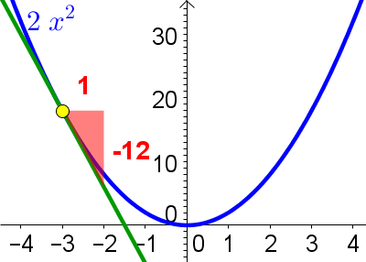
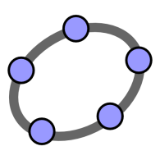
Slope Functions of other Quadratic Equations using GeoGebra
Notes:
To speed up the process and save paper I’m going to show you a GeoGebra file instead of you using paper and a ruler.
This half of the room will record the slopes of the tangent at various points of the function g(x)=2x².
This half of the room will record the slopes of the tangent at various points of the function h(x)=3x².
We can compare answers afterwards.

Slide 11
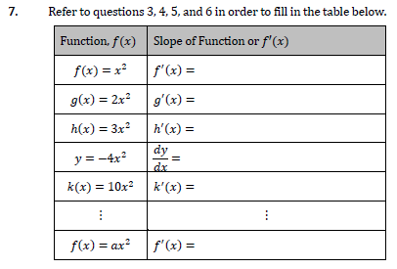
Question 7

Slide 12
8. What is the equation of the slope function of f(x) = x² – x – 6?
7
y
6
5
4
3
2
1
x
-8
-7
-6
-5
-4
-3
-2
-1
-1
1
2
3
4
5
6
7
8
-2
-3
-4
-5
-6
f’(x) = 2x – 1
-7
-8
-9
The slope of the tangent at x = –3 is –7
-10
What is the slope of f(x) for x=1.5?
The slope of the tangent at x = –2 is –5
The slope of the tangent at x = –1 is –3
We can gain information about the slope of f(x) for x=1.5 from
the graph of f(x)
the list of slopes on the left
the graph of f’(x)
the equation of the slope function f’(x)
The slope of the tangent at x = 0 is –1
The slope of the tangent at x = 1 is +1
The slope of the tangent at x = 2 is +3
The slope of the tangent at x = 3 is +5

Slide 13
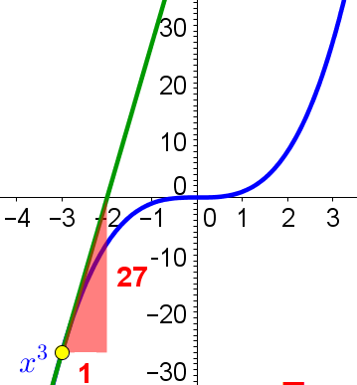
Slope Functions of Cubic Equations using GeoGebra
Notes:
To speed up the process and save paper I’m going to show you a GeoGebra file instead of you using paper and a ruler.
This half of the room will record the slopes of the tangent at various points of the function g(x)=2x².
This half of the room will record the slopes of the tangent at various points of the function h(x)=3x².
We can compare answers afterwards.

Slide 14
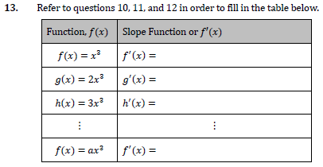
Question 13

Slide 15
Summary and Prediction
What are the slope functions of:
(i) h(x)=x⁸
(ii) g(x)=3x¹⁰
(iii) f(x)=5x²-3x-6

Slide 16
Consistency
Notes:
Consistency of approach is important.
Trusting the rule

Slide 17
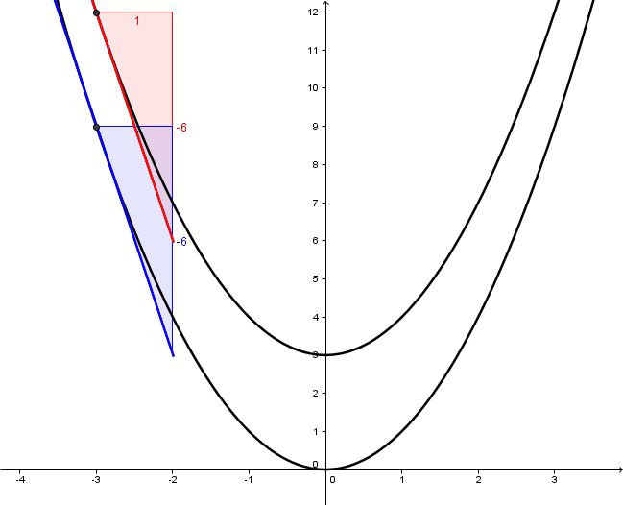
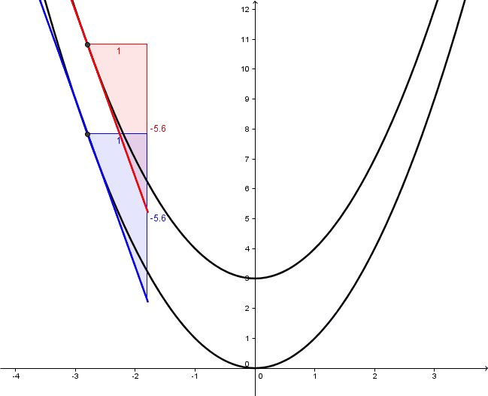
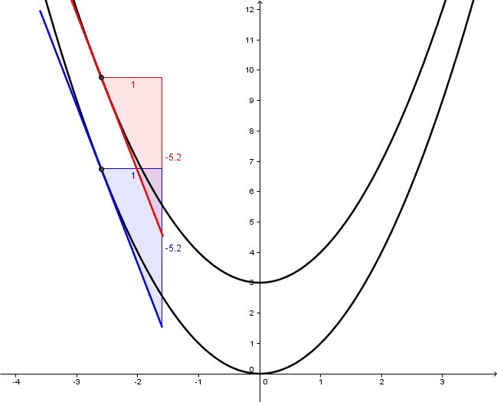
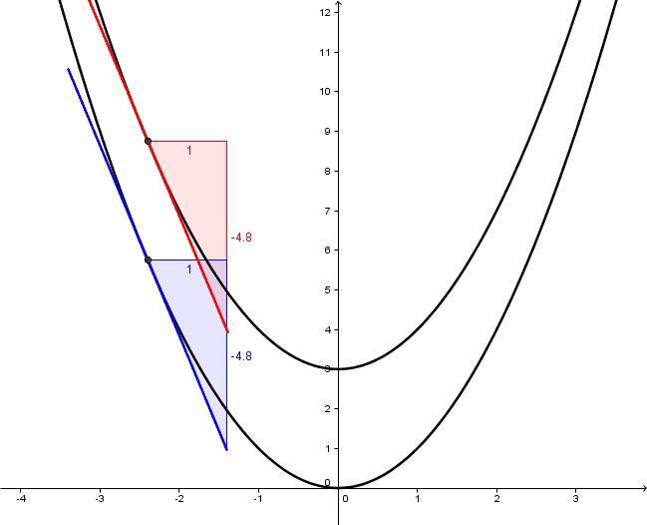
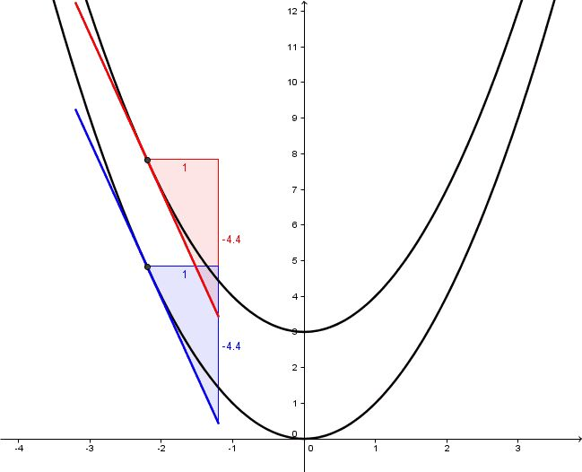
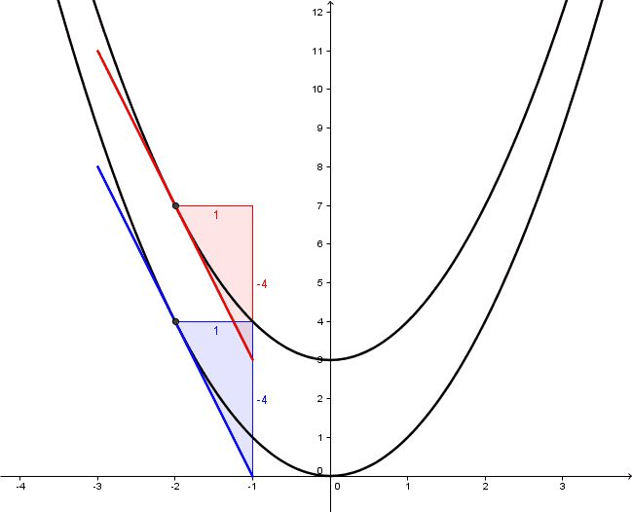
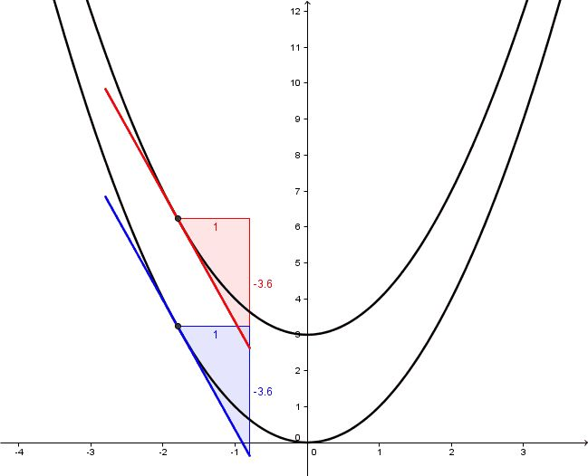
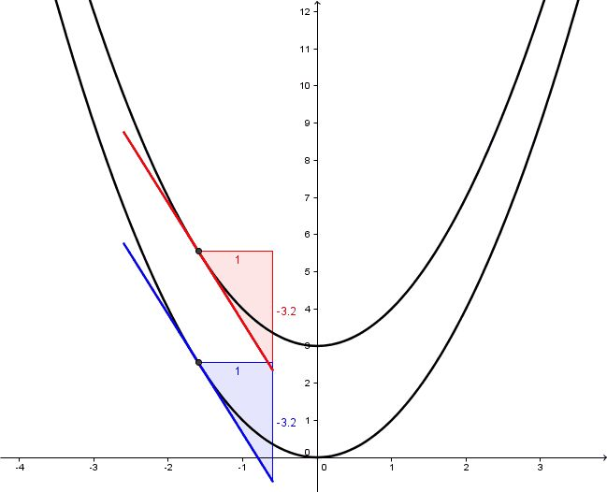
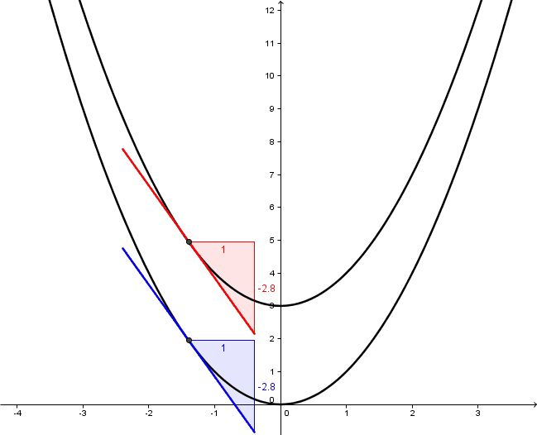
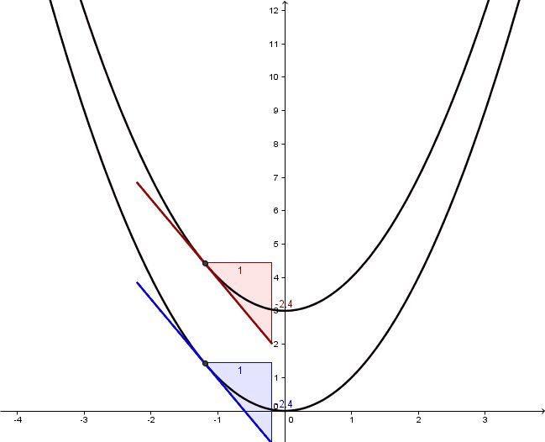
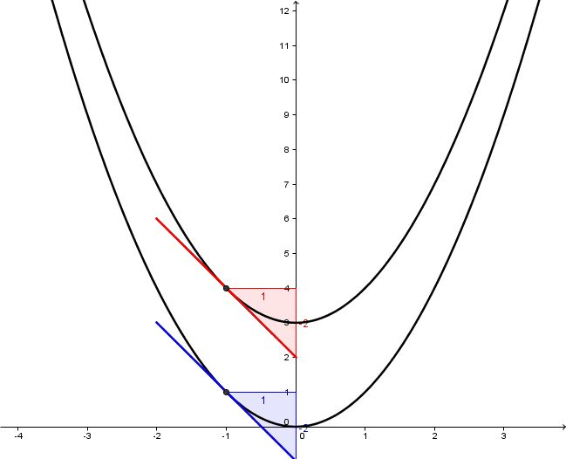
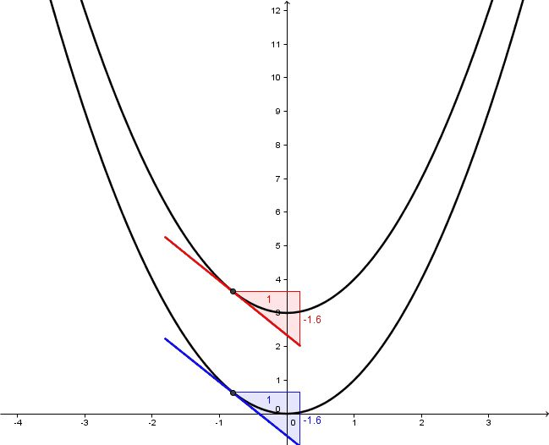
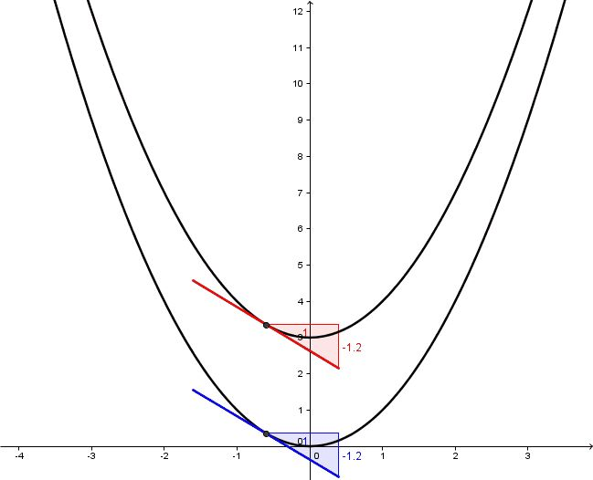
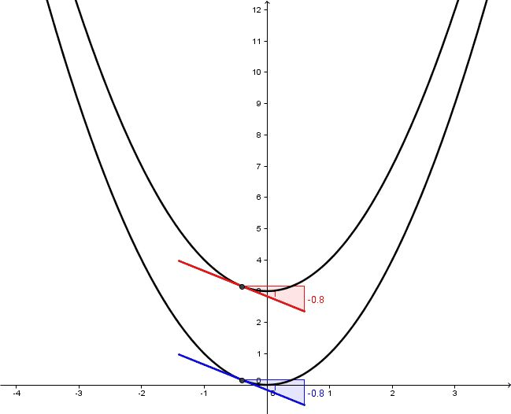
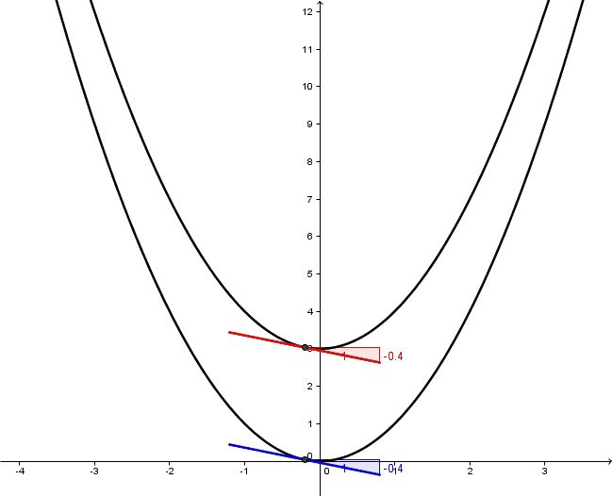
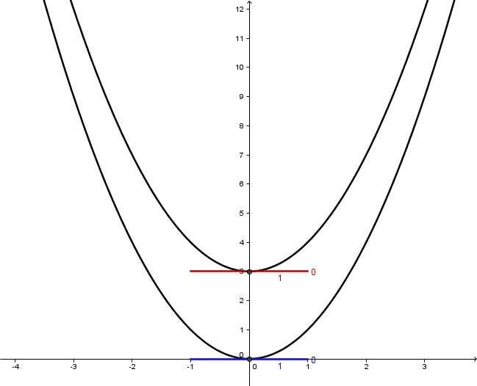
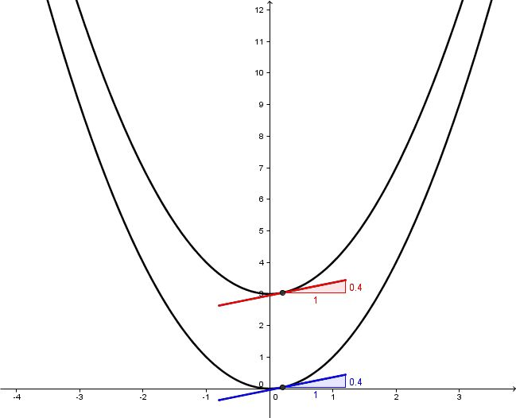
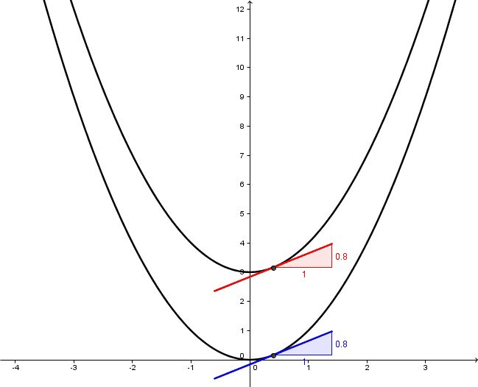
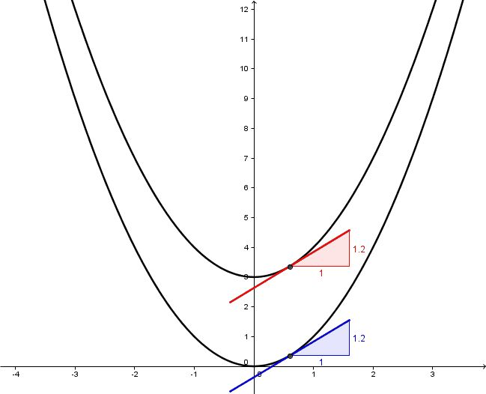
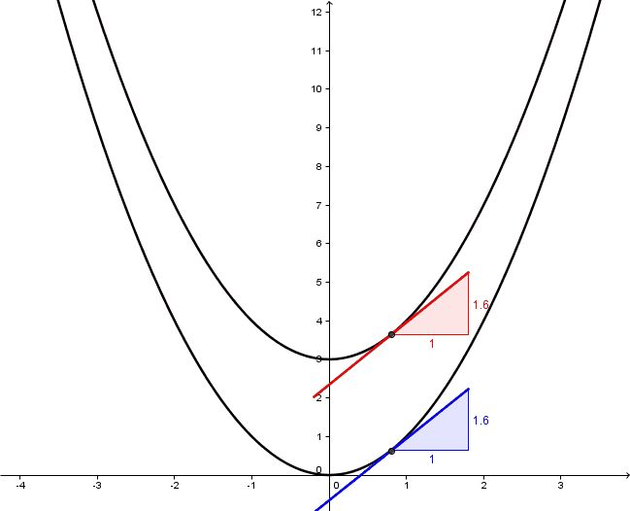
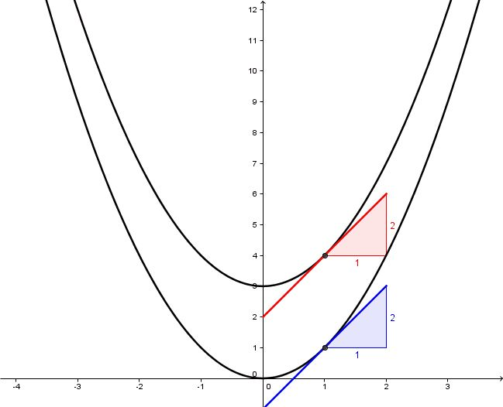
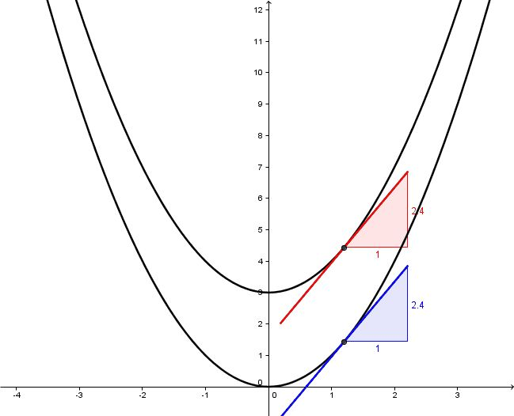
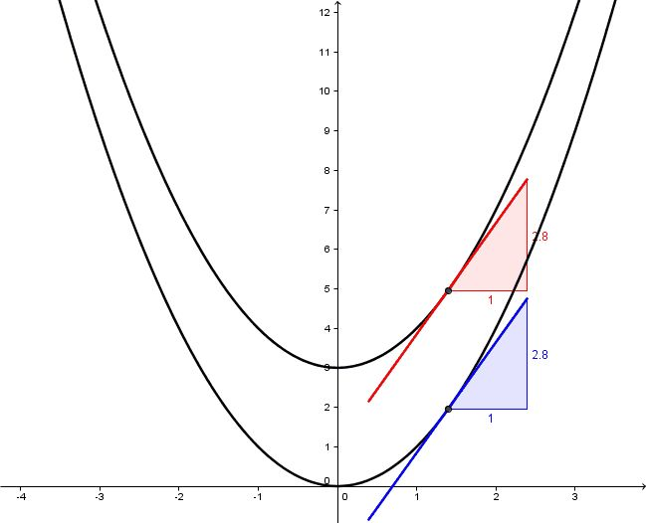
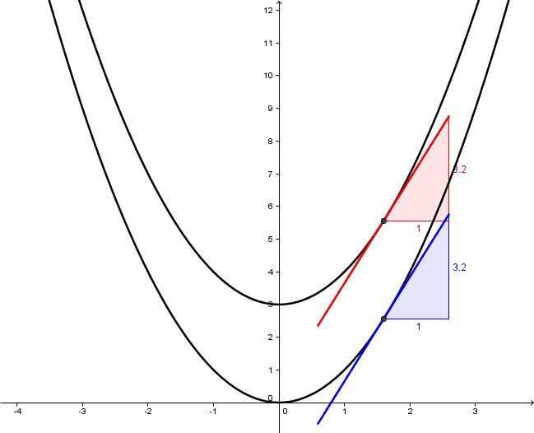
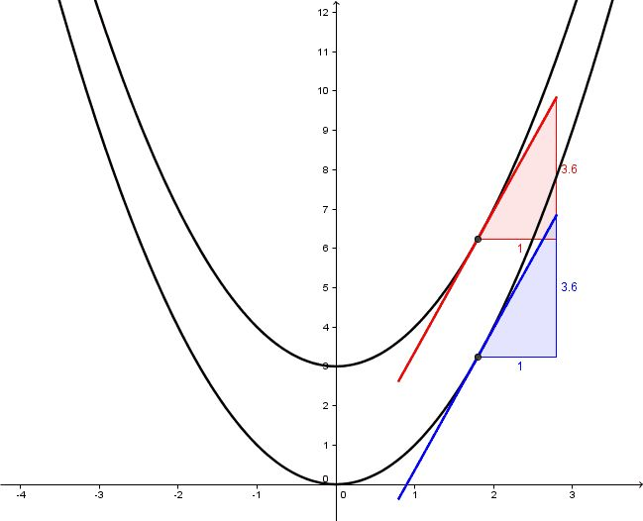
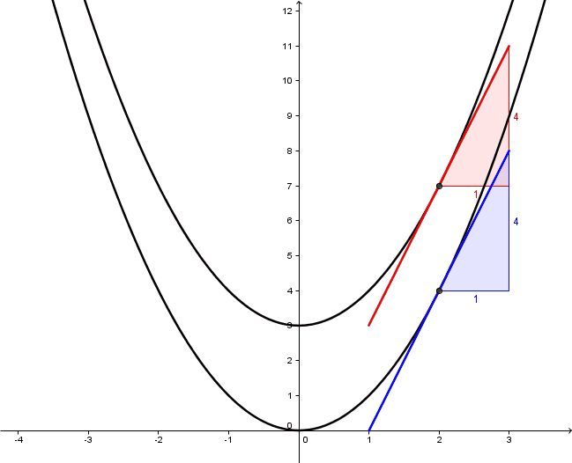
Slopes of Tangents of f(x)=x² and g(x)=x²+3
Notes:
Link to WS7.
Family of functions x2+k will all have the same derivative.

Slide 18
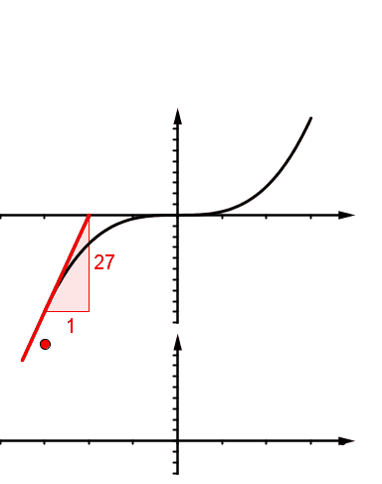
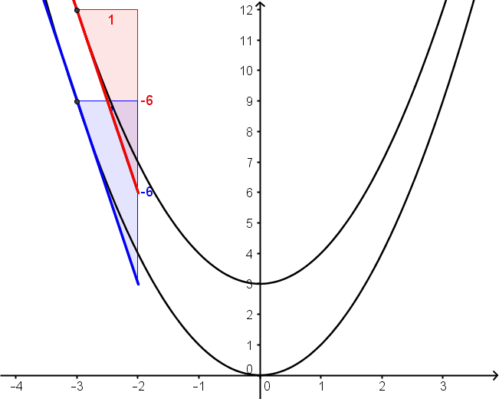
Central Ideas

Slide 19
Purpose
To identify features of the graphs of functions in preparation for sketching their corresponding slope functions.

Slide 20
Describing Functions
Pair up.
One person describes a function.
The other person draws the function on their whiteboard using only the descriptions their partner gives them.

Slide 21
Features of +x³ Graphs
The function is… f(x) is… y is…
6
y
Positive
and
Neither Increasing nor Decreasing i.e. Stationary
5
Positive
and
Increasing
Positive
and
Decreasing
Positive
and
Increasing
4
3
Neither Positive
nor Negative
and Increasing
2
Neither Positive
nor Negative
and Decreasing
Neither Positive
nor Negative
and Increasing
1
x
-6
-5
-4
-3
-2
-1
1
2
3
4
5
6
Negative
and
Decreasing
Negative
and
Increasing
-1
Negative
and
Increasing
-2
-3
Negative
and
Neither Increasing nor Decreasing i.e. Stationary
-4
-5
-6
Notes:
NOTE: The first two pieces of text come up out of order because we wanted to ask about two regions before clicking through all the parts of the function.
How function is increasing/decreasing etc
Just discussing y values here, not slope
When GeoGebra file is used we can look at the behaviour of the slope

Slide 22
Features of +x³ Graphs
The function is… f(x) is… y is…
6
y
5
4
3
Positive
2
Neither Positive
nor Negative
1
x
-6
-5
-4
-3
-2
-1
1
2
3
4
5
6
Negative
-1
-2
-3
-4
-5
-6
Notes:
NOTE: The first two pieces of text come up out of order because we wanted to ask about two regions before clicking through all the parts of the function.
How function is increasing/decreasing etc
Just discussing y values here, not slope
When GeoGebra file is used we can look at the behaviour of the slope

Slide 23
Features of +x³ Graphs
The function is… f(x) is… y is…
6
y
5
Neither Increasing nor Decreasing i.e. Stationary
4
3
Decreasing
Increasing
2
1
x
-6
-5
-4
-3
-2
-1
1
2
3
4
5
6
-1
-2
Increasing
-3
Neither Increasing nor Decreasing i.e. Stationary
-4
-5
-6
Notes:
How function is increasing/decreasing etc

Slide 24
Features of +x³ Graphs
The slope of the function is…
6
y
5
f’(x)=0
4
3
Positive
f’(x)>0
2
Positive
f’(x)>0
Negative
f’(x)<0
1
x
-6
-5
-4
-3
-2
-1
1
2
3
4
5
6
-1
-2
-3
f’(x)=0
-4
-5
-6
Notes:
How function is increasing/decreasing etc

Slide 25
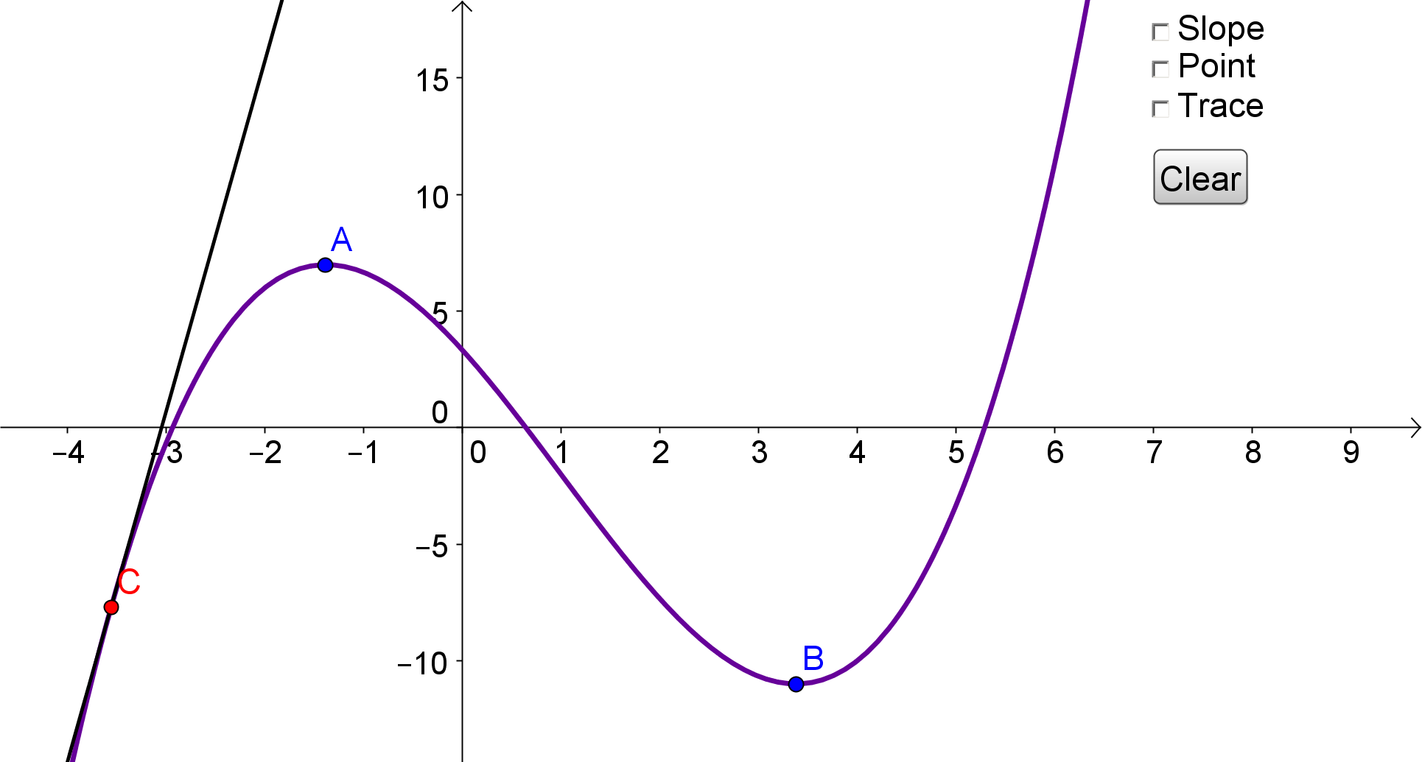
Notes:
Describe the time vs. height graph. Increasing the whole time. Increasing and speeding in at the start. Increasing and slowing down at the end. Vase is wide and narrowing and then it widens again.
GeoGebra file:
Show where slope is pos and neg without and with numbers.
Show a definite part of the graph where the slope is positive and decreasing e.g. to the left of A.
Show a definite part of the graph where the slope is negative/positive and increasing e.g. around B.
Demo the values of the whole graph but slow down near where the inflection point will be.
Where is the slope decreasing? Where is the slope increasing? Where does the slope change from decreasing to increasing?
- 0 + on flipchart.
Concave down and Concave up.
d2y/dx2=0 is too narrow on its own. If f(x)=3x+2, f’(x)=3 and f’’(x)=0 so does f(x)=3x+2 have an infinite number of inflection points?! No.
Concave Up - tangents below the curve and dy/dx increasing
Concave Down- tangents above the curve and dy/dx decreasing
Inflection point – tangent on both sides of the curve

Slide 26
Features of +x³ Graphs
The slope function is… f’(x) is… dy/dx is…
6
y
5
4
3
f’(x) is decreasing
2
f(x) is increasing
f’(x) is neither
increasing
nor
decreasing
1
x
-6
-5
-4
-3
-2
-1
1
2
3
4
5
6
-1
-2
-3
-4
-5
-6
Notes:
Could ask what is increasing in the green part of the diagram, before the text appears.
Could ask what is decreasing in the green part of the diagram, before the text appears.

Slide 27
+x² Graphs: Relating the
Function to the Slope Function
6
y
The slope function will be positive for these x-values
5
4
The slope of the function
is negative
The slope of the function
is positive
3
2
1
x
-6
-5
-4
-3
-2
-1
1
2
3
4
5
6
The slope function will be negative for these x-values
The slope of the function
is zero
-1
-2
The slope function will be 0 for this x-value.
-3
-4
-5
-6
Notes:
This slide should help you see in which area of the graph you should place/sketch parts of the slope function.
After this slide and the next one which is a cubic function you’ll be ready to sketch some slope functions.

Slide 28
+x³ Graphs: Relating the
Function to the Slope Function
The slope function will be positive for these x-values
6
y
The slope function will be positive for these x-values
5
4
The slope of the function
is positive
The slope of
the function
is negative
3
2
1
x
-6
-5
-4
-3
-2
-1
1
2
3
4
5
6
The slope function will be negative for these x-values
-1
The slope of the function
is positive
-2
-3
-4
-5
-6
Notes:
After this slide you’ll be ready to sketch some slope functions.

Slide 29
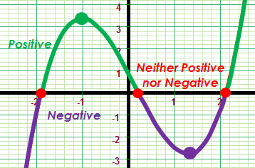
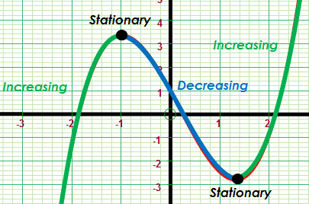
Central Ideas
Parts of a function can be
positive, negative or zero.
Parts of a function can be
increasing, decreasing or stationary.

Slide 30
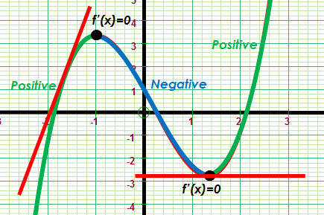
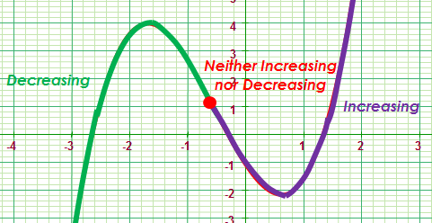
Central Ideas
The slope of a function can be
positive,
negative,
or zero.
The slope of a function can be
increasing,
decreasing,
or stationary.

Slide 31
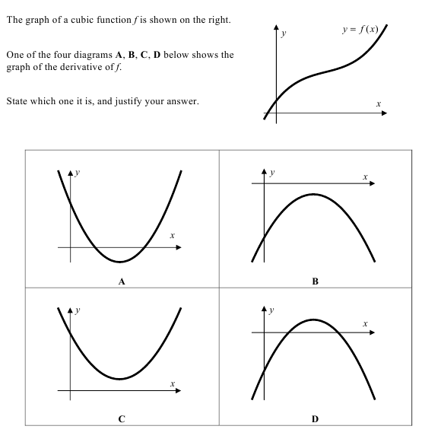
Things have changed.........

Slide 32
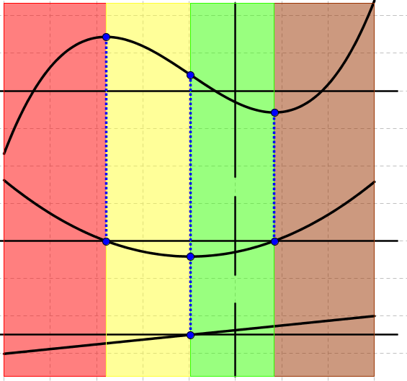
Notes:
This file can be used to show how the turning points and point of inflection relate to the graph of the first and second derivatives.
The parts of the function that are increasing are positive in the first derivative.
The parts of the slope function/first derivative that are increasing are positive in the second derivative.

Slide 33
Purpose
To use curve sketching and graph matching as tasks that check for understanding and promote learning

Slide 34
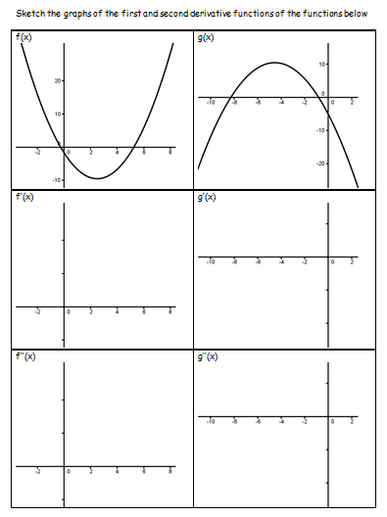
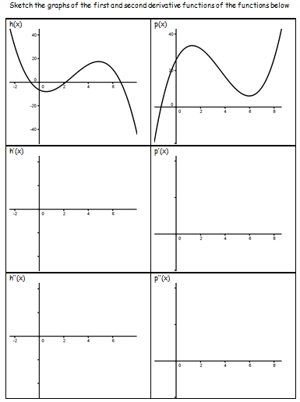
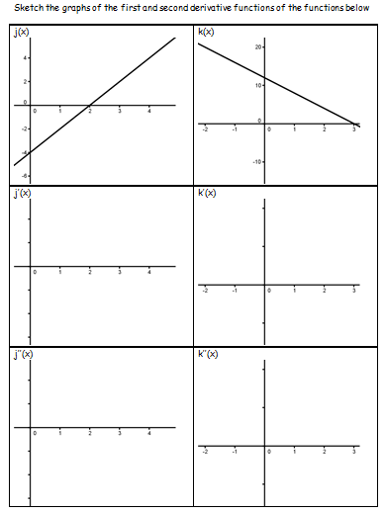
Curve Sketching
Notes:
You are going to sketch the slope functions of 6 functions. 2 quadratics, 2 cubics, and (because they shouldn’t be ignored) 2 linear.
You’re actually going to sketch the first derivative and the second derivative.
You’re going to work in pairs for a couple of minutes and learn in pairs. Then I’ll stop you it’ll be teacher-led for a minute or so where I’ll use a GeoGebra file to reinforce the main points for the quadratics.
Then it’ll be back to you to work out how to sketch the slope function of two cubic functions.

Slide 35
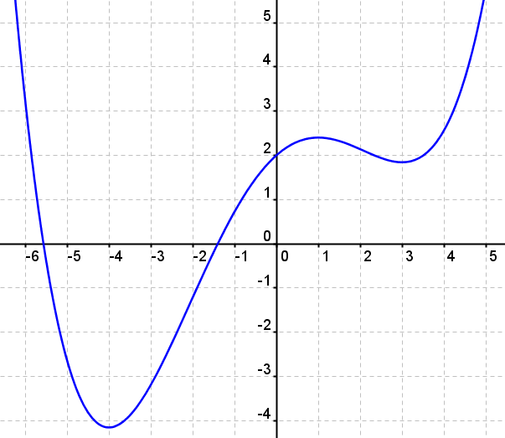
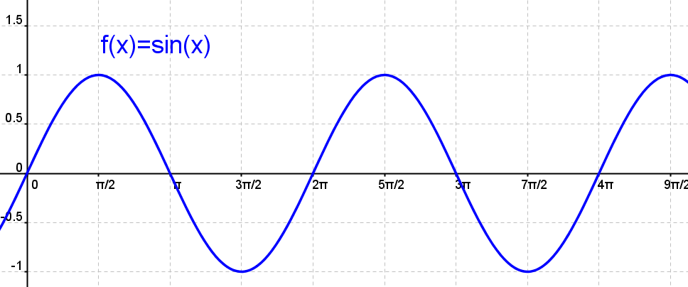
2 More Challenging Questions
Notes:
We discovered rules for differentiating polynomials earlier.
Getting students to sketch the derivative of f(x)=sin(x), g(x)=cos(x), 5sin(x) and sin(5x) would help students trust the rules and give them a method for checking their algebraic methods for differentiation.
Could ask them to sketch the slope function of a polynomial of order 4

Slide 36
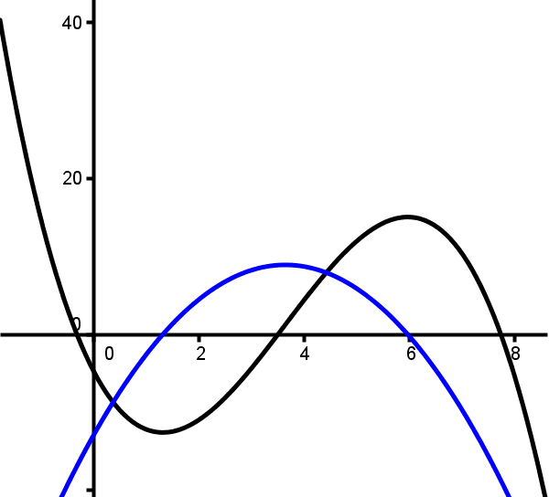
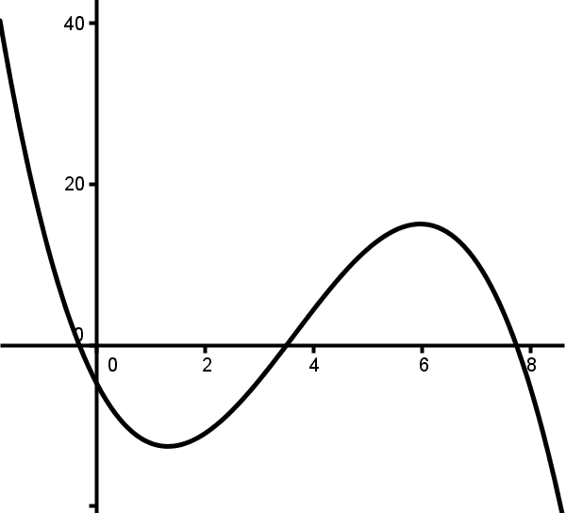
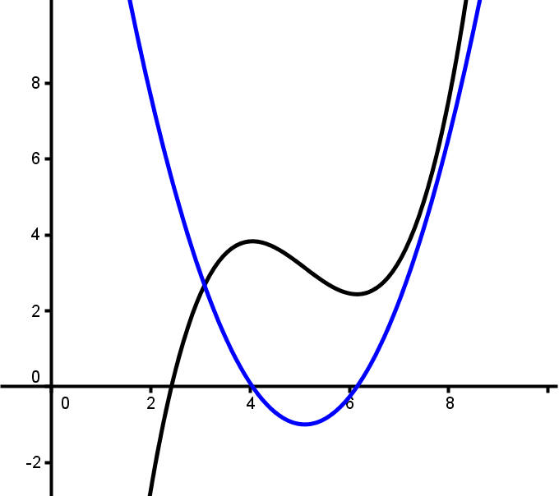
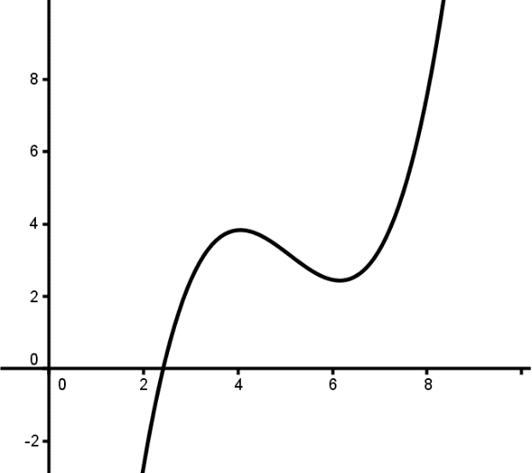
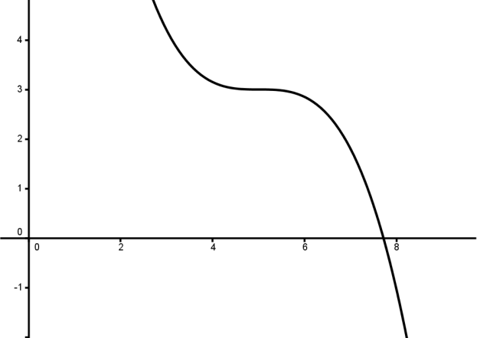
Points where the slope is zero
– – – 0 + + + + + 0 – –
– – – 0 – – –
+ + + 0 – – 0 + +
Notes:
The first diagram has two places where the slope is zero. The signs of the slopes change at both of those points. Both points are turning points. There is a point of inflection in this diagram.
The second diagram has one place where the slope is zero. The signs of the slope are the same on both sides of this point. It is not a turning point. The slope is negative and increasing, then zero, then the slope negative and decreasing. This point is an inflection point. A saddle point.
The third diagram has two places where the slope is zero. The signs of the slopes change at both of those points. Both points are turning points. There is a point of inflection in this diagram.

Slide 37
Graph Matching
Notes:
If a group finishes early ask them to put the quadratics to one side and see if they can match the cubic and linear graphs.
They could use a whiteboard and marker to help themselves.

Slide 38
Solutions
C1 C2 C3 C4 C5 C6
Q6 Q4 Q2 Q3 Q1 Q5
L3 L6 L1 L5 L4 L2

Slide 39
Central Ideas
Notes:
To sketch the first and second derivative the key features are the turning points and the points of inflection.

Slide 40
Relationship to Junior Cert. Syllabus

Slide 41
Relationship to Leaving Cert. Syllabus

Slide 42
Relationship to Leaving Cert. Syllabus

Slide 43
Notes:
REMINDER THAT TYPES NEED TO BE DISCUSSED

