Slide 1
Nets
Prior Knowledge & Rationale
Introducing Nets in 1st Year
Cuboids
Cubes
Cones
Resources

Slide 2
1. Prior Knowledge & Rationale

Slide 3
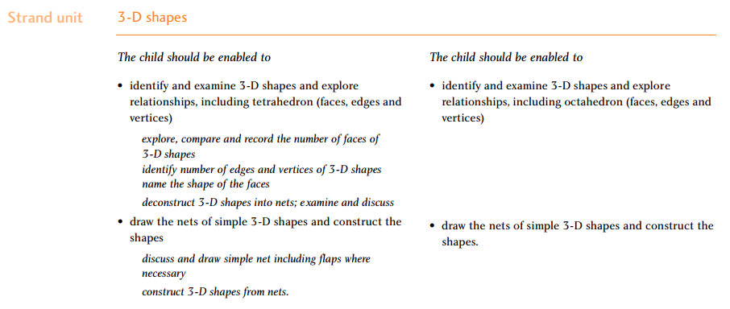
Primary School Curriculum

Slide 4

Prior Knowledge: Juice Box
Rectangular prism
Rectangle
Juice box
Nets
A 2-dimensional representation of a 3-dimensional shape.
Carton
Cuboid

Slide 5
Let’s Define it!

Slide 6
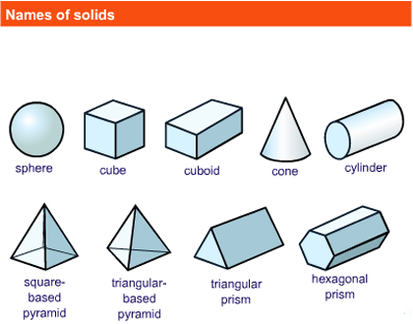
How many 3D shapes can you name?
Cone
Hexagonal prism
Cube
Triangular based pyramid
1
2
3
4
5
Sphere
Cube
Cuboid
Cone
Cylinder
Cuboid
Triangular prism
Sphere
Cylinder
Square based pyramid
6
7
Triangular based pyramid
8
Triangular prism
9
Hexagonal prism
Square based pyramid

Slide 7
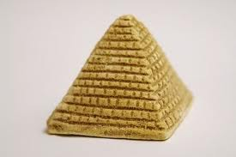
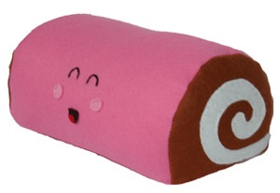
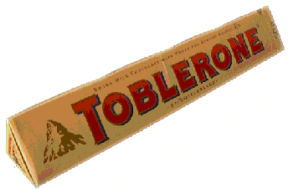
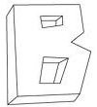
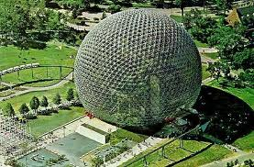

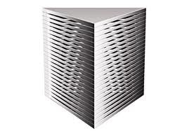
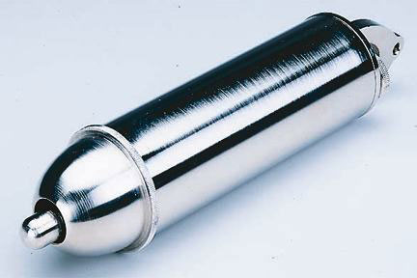
Which of the following are prisms?
A B C
D F
G H
E

Slide 8
Which of the following are prisms?
A solid object that has two identical ends and all flat sides.
The cross section is the same all along its length.
The shape of the ends give the prism a name, such as "triangular prism"

Slide 9
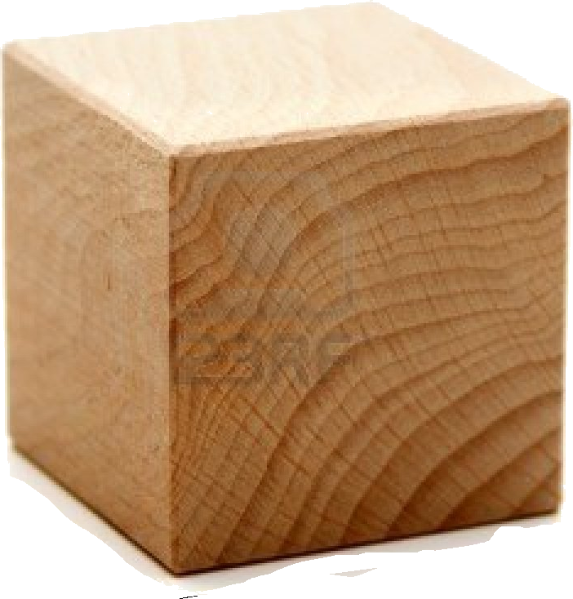
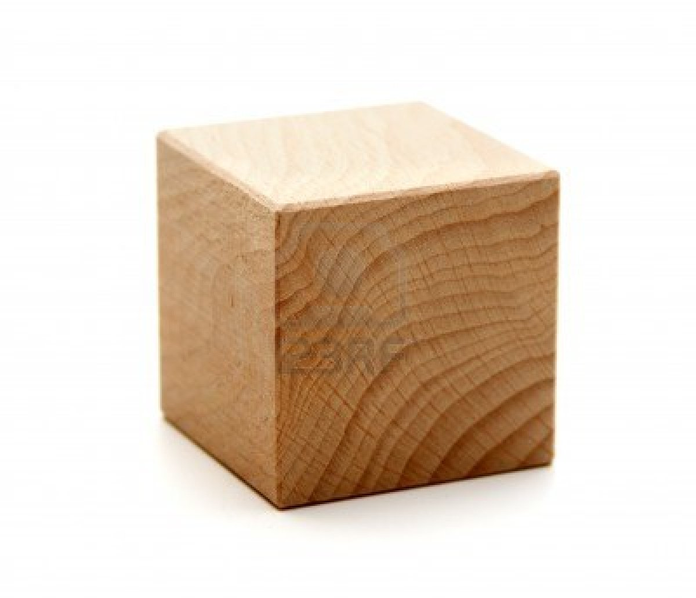
Primary School: Labelling 3D shapes
Vertex
6
Faces
Vertices
Edges
Vertices
8
Face
12
Edge

Slide 10
Summary so far
Prior Knowledge from Primary School
Defined a Prism
Language

Slide 11
2. Introducing Nets
Introducing nets
&
their development

Slide 12
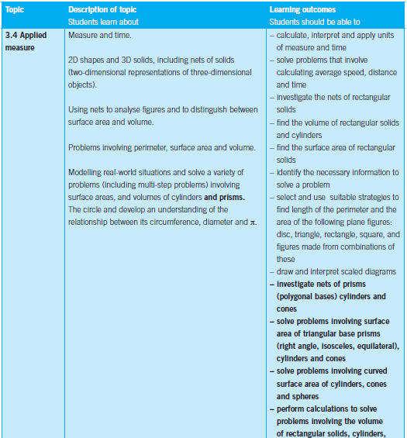
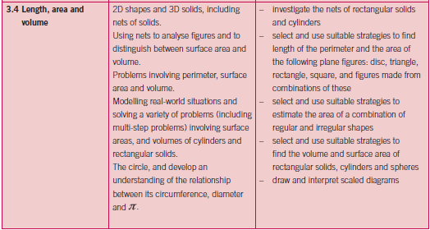


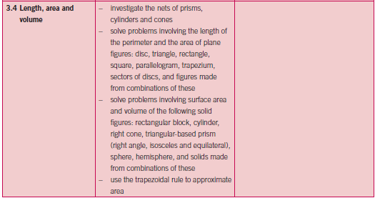

1. New to Syllabus
Strand 3: Number
Strand 3: Number – Foundation level
Strand 3: Number – Ordinary/Higher level

Slide 13
What is a net?
A 2-dimensional representation of a 3-dimensional shape.

Slide 14

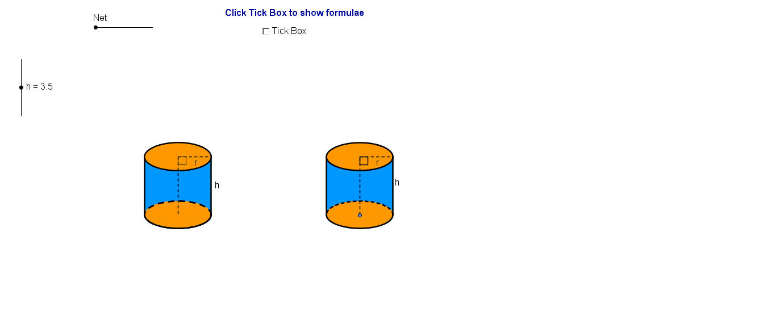
Student’s CD

Slide 15
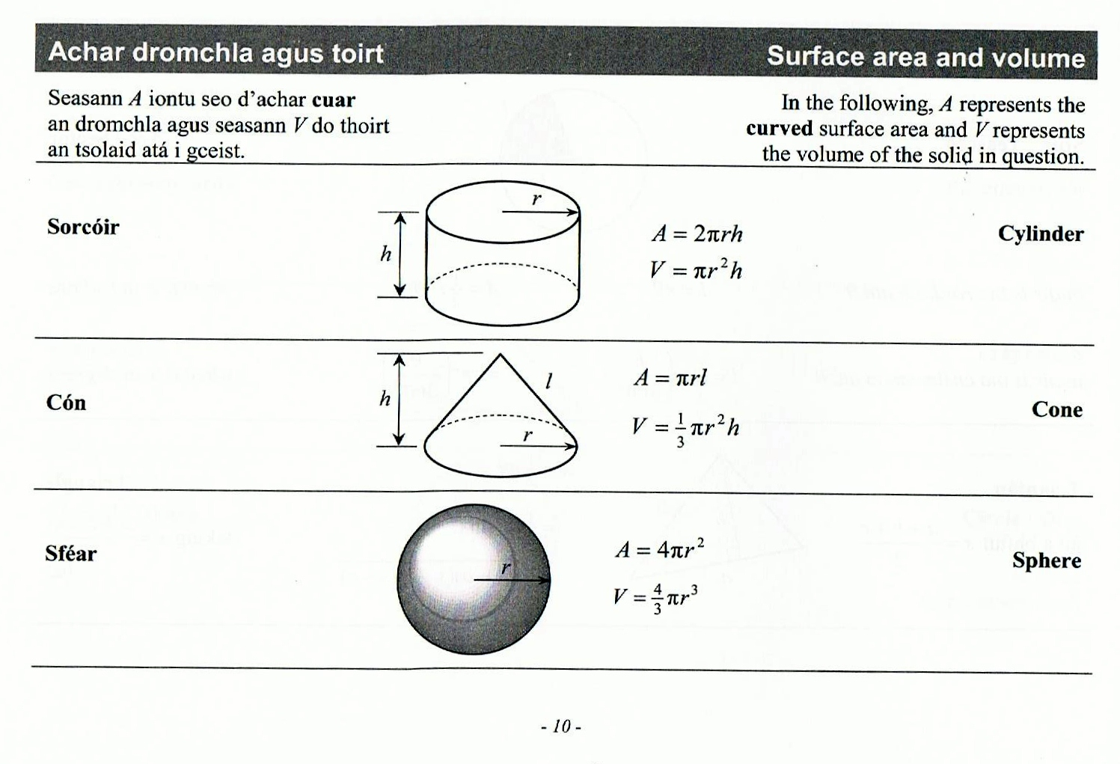




Introducing Formulae
Page 10
$$r$$
$$h$$
$$2πr$$
Surface area = $2πr^{2}+2πrh$

Slide 16
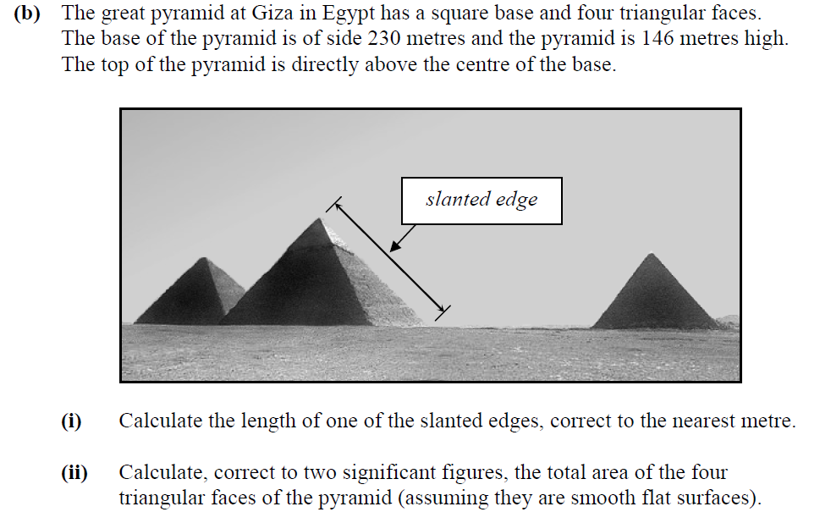
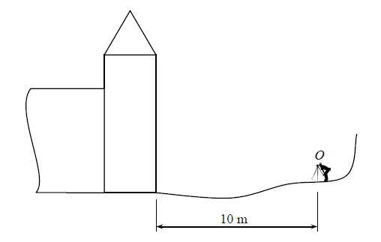
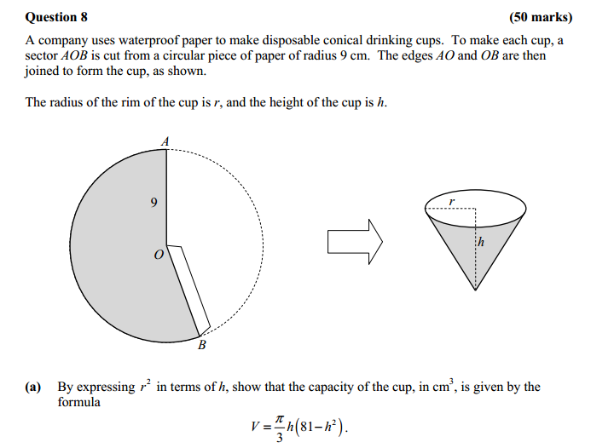
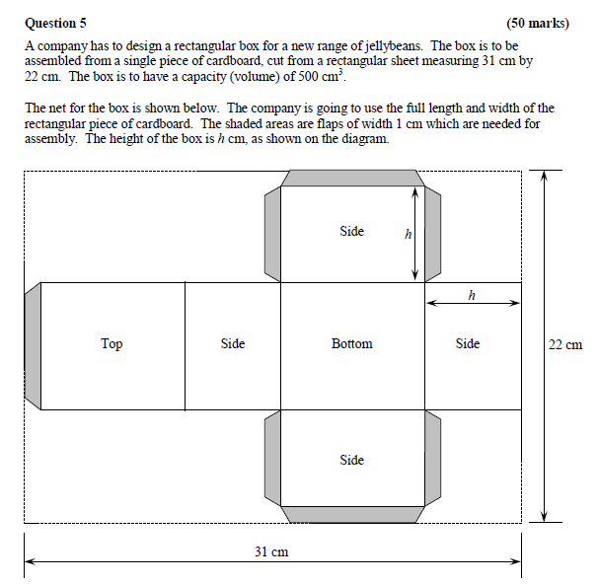
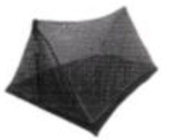
Exam questions requiring an understanding of nets
Where is the tent question?
Sean is manufacturing fly sheets for tents as shown in the diagram.
The light coloured fabric is netting and the dark coloured fabric is waterproof plastic.
The base of the tent is rectangular in shape measuring 2.2m by 3.6m and the tent poles are 2.5m long.
The waterproof fabric extends a distance of 6cm up from the base of the tent
Draw a “D diagram showing the netting required to make a flysheet for one tent. Mark the dimensions on the diagram

Slide 17
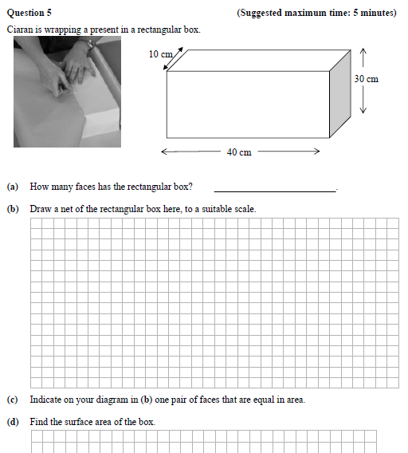
Junior Certificate
Ordinary Level 2012 PM

Slide 18
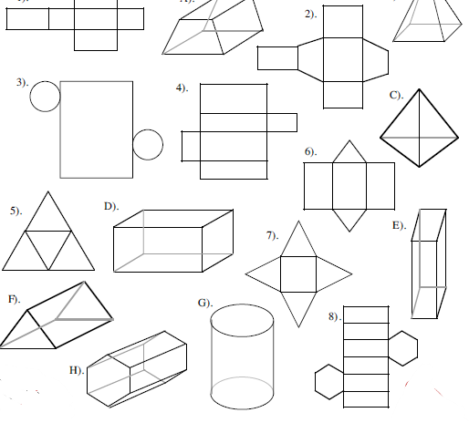
Task: Match nets and their 3D Shape
3D Shape | A | B | C | D | E | F | G | H
Net
3D Shape | A | B | C | D | E | F | G | H
Net | 2 | 7 | 5 | 1 | 4 | 6 | 3 | 8

Slide 19
Spatial Reasoning ??
Spatial Reasoning is not a natural ability
Which is the easiest to go from a Solid to a net
OR
a net to a Solid?
Research says a solid to a net is harder
What do you think? Does it depend on the solid and how familiar you are with it
Link back to previous slide

Slide 20
3. Cuboids

Slide 21
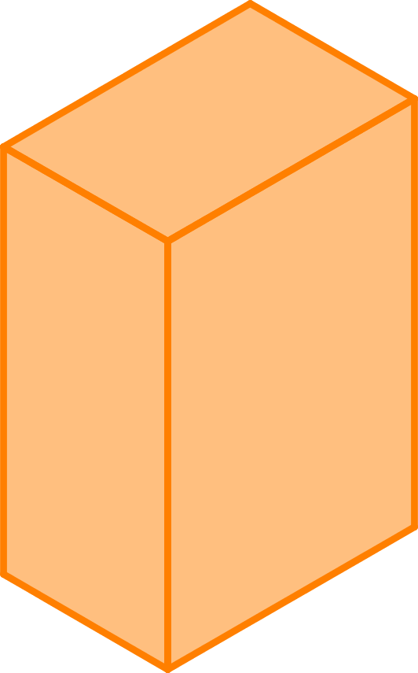
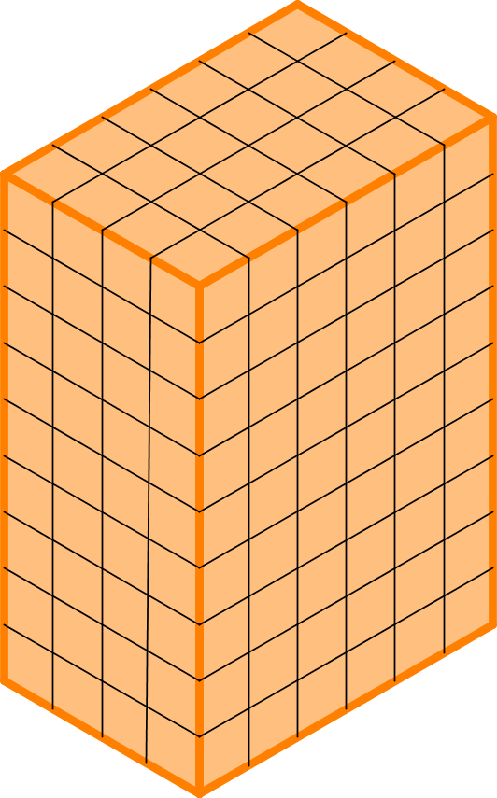
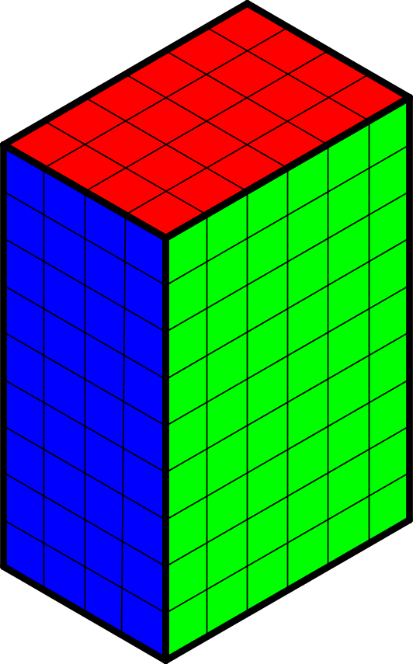
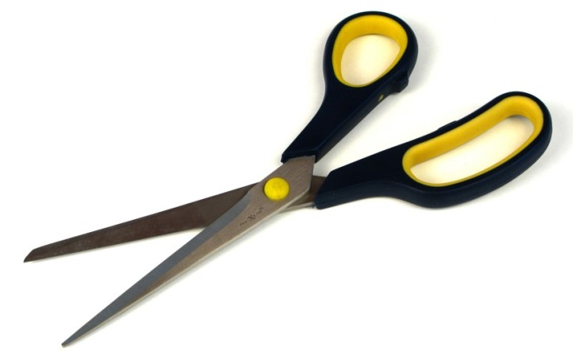
Rectangular prisms (cuboids)
Could you draw an accurate net for this Juice Box?
Juice
Box
9cm
4cm
6cm

Slide 22
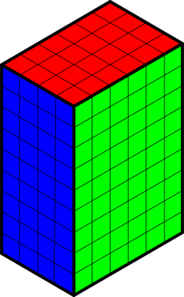
Strategy Used
 |  | C
A | B | A | B
 |  | C
 |  | Top
Back | Side | Front | Side
 |  | Base

Slide 23
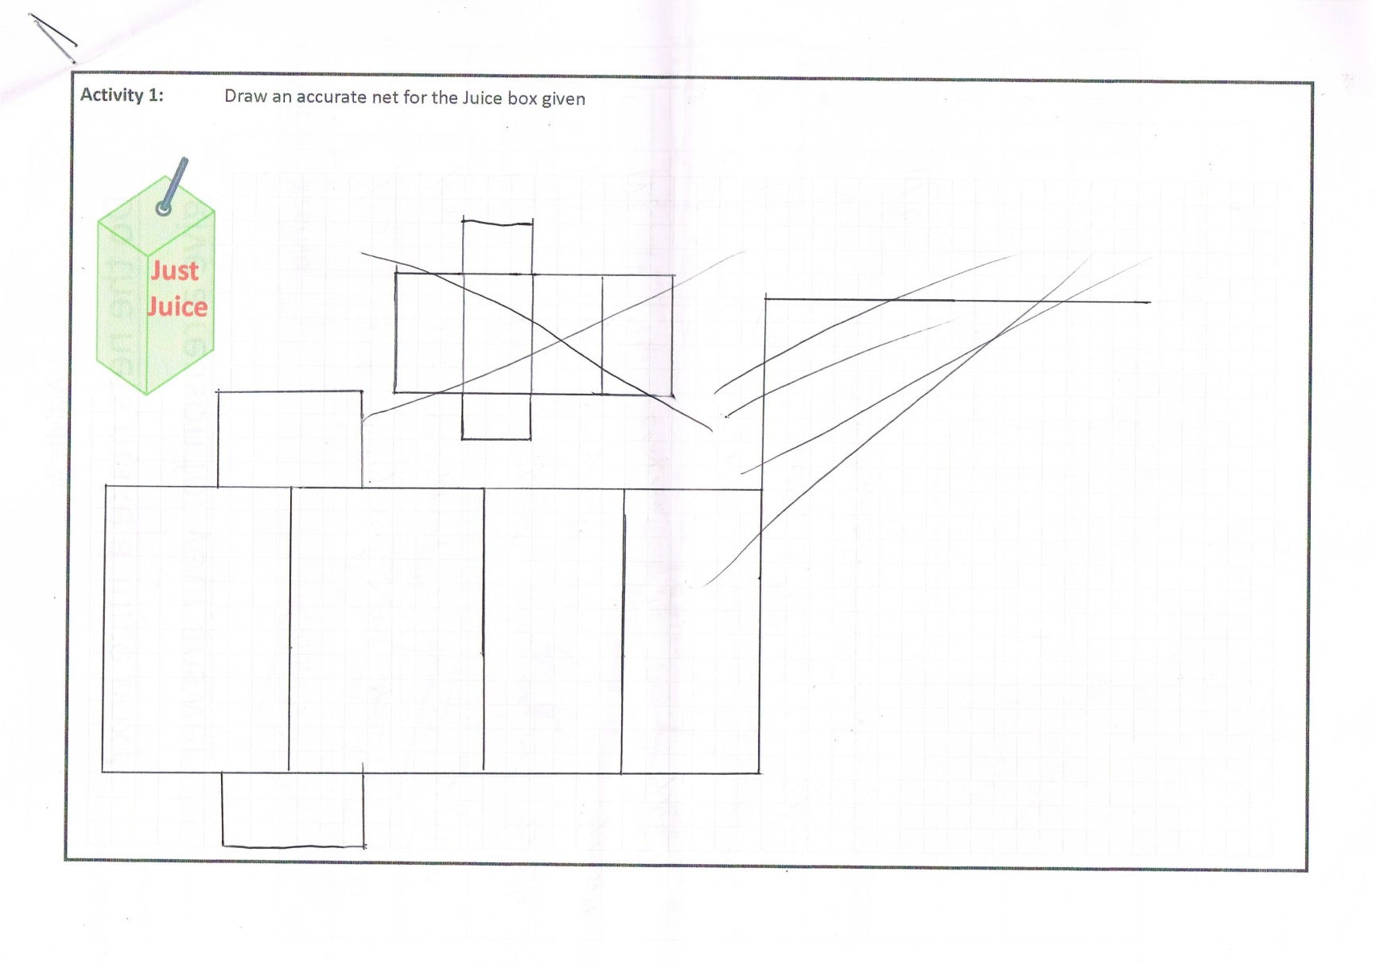
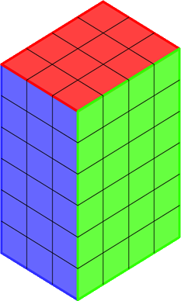
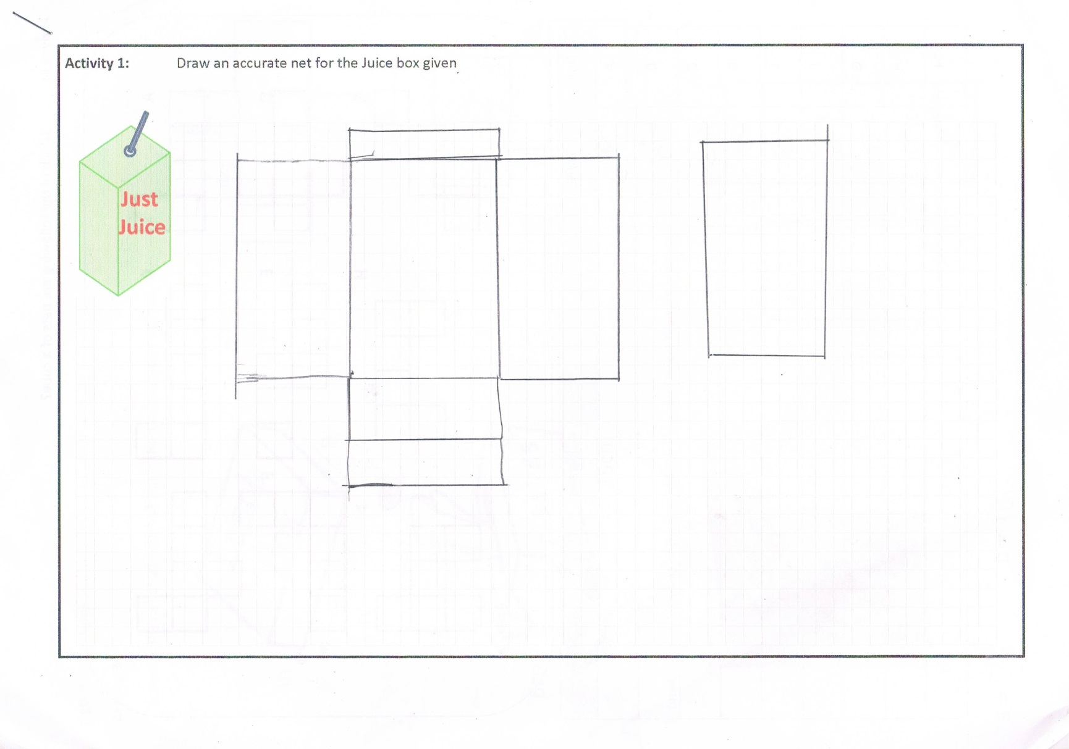
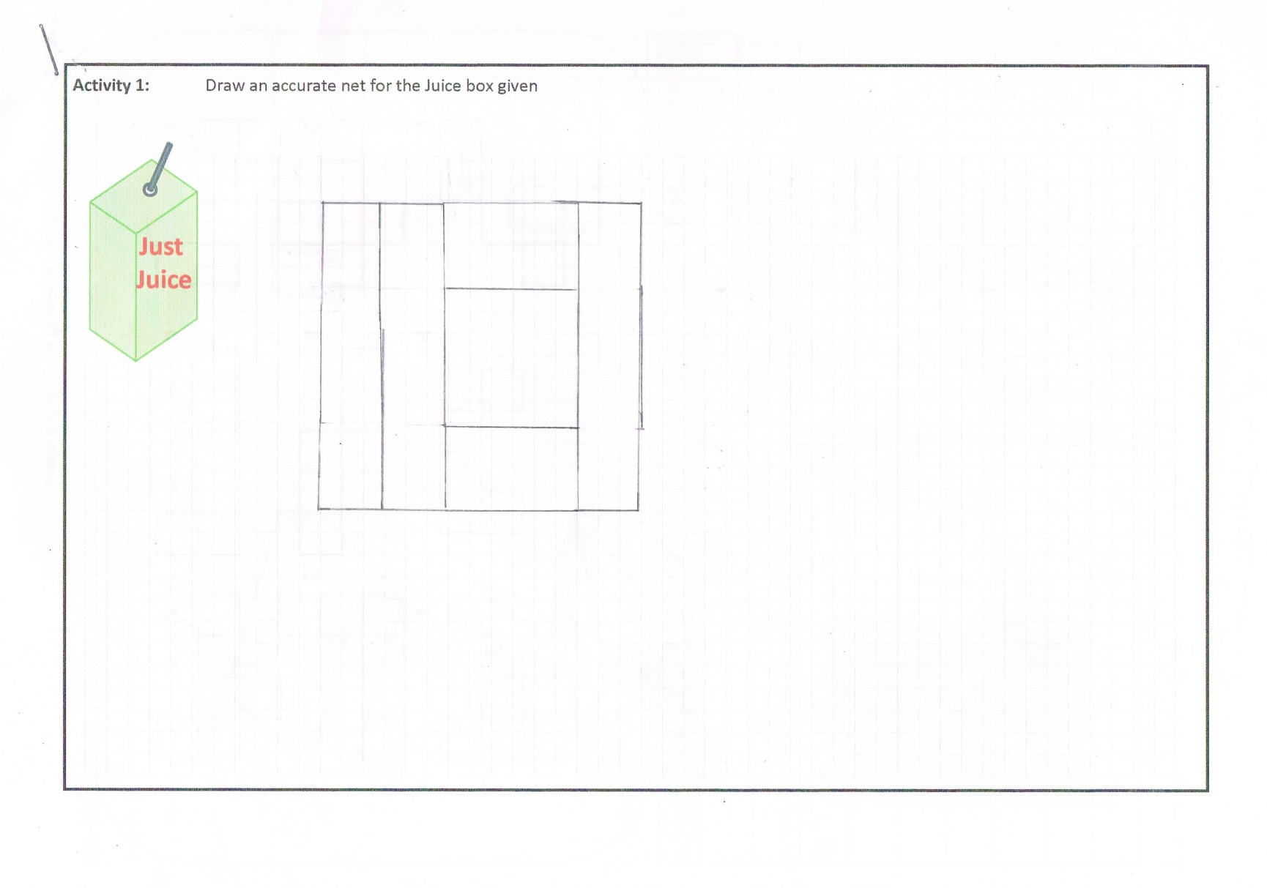
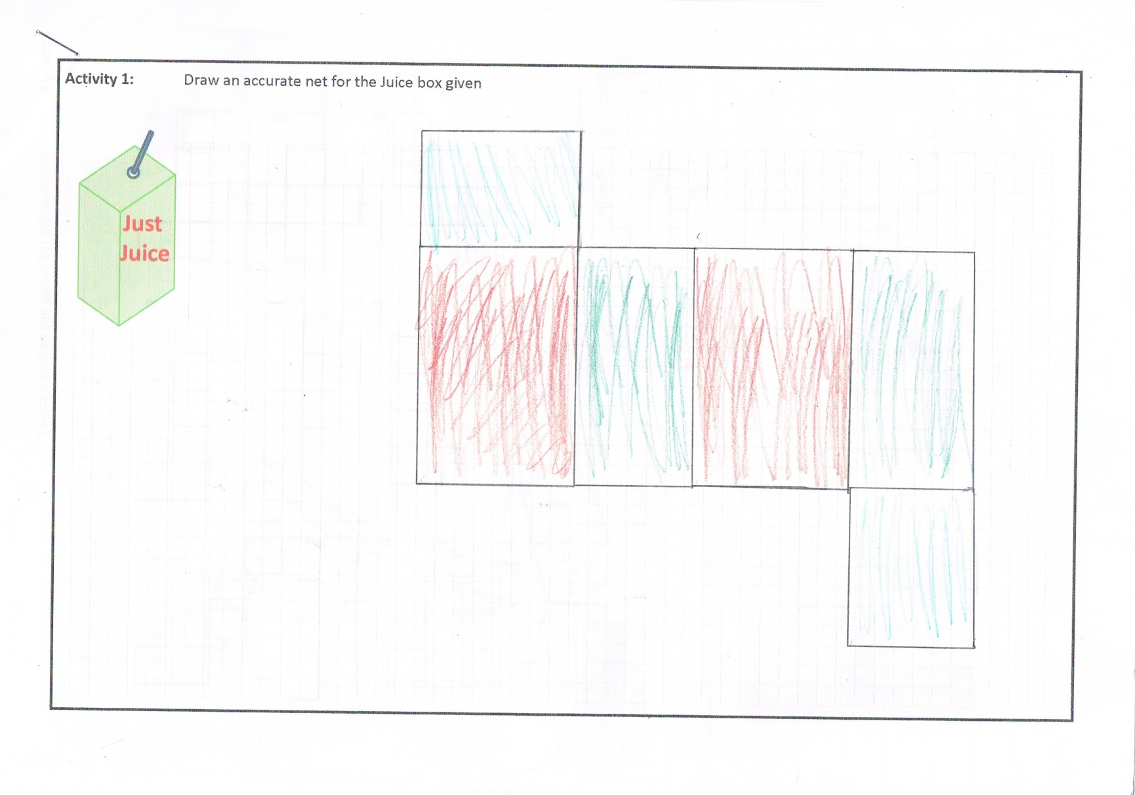
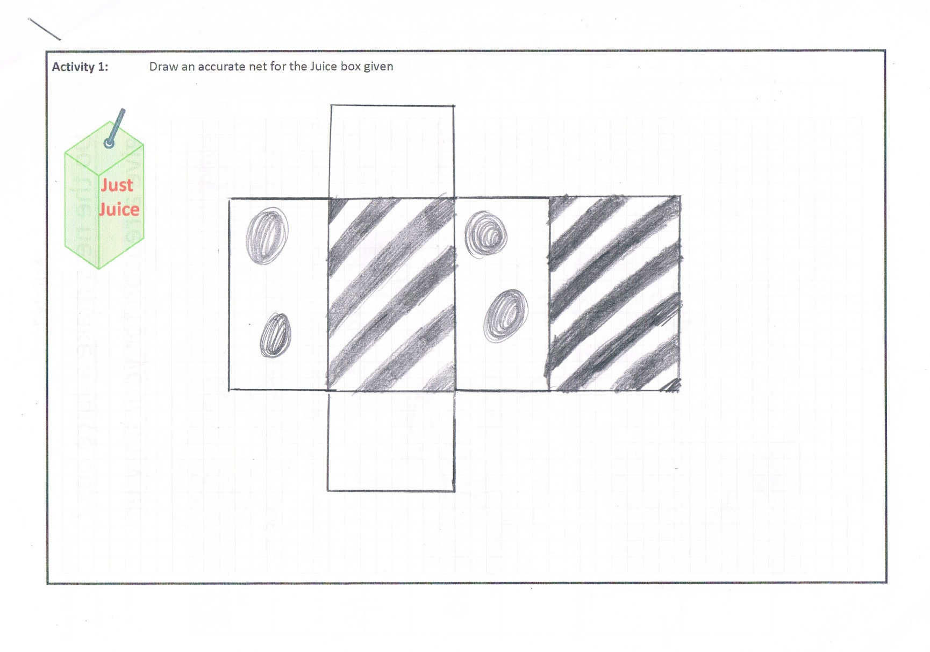
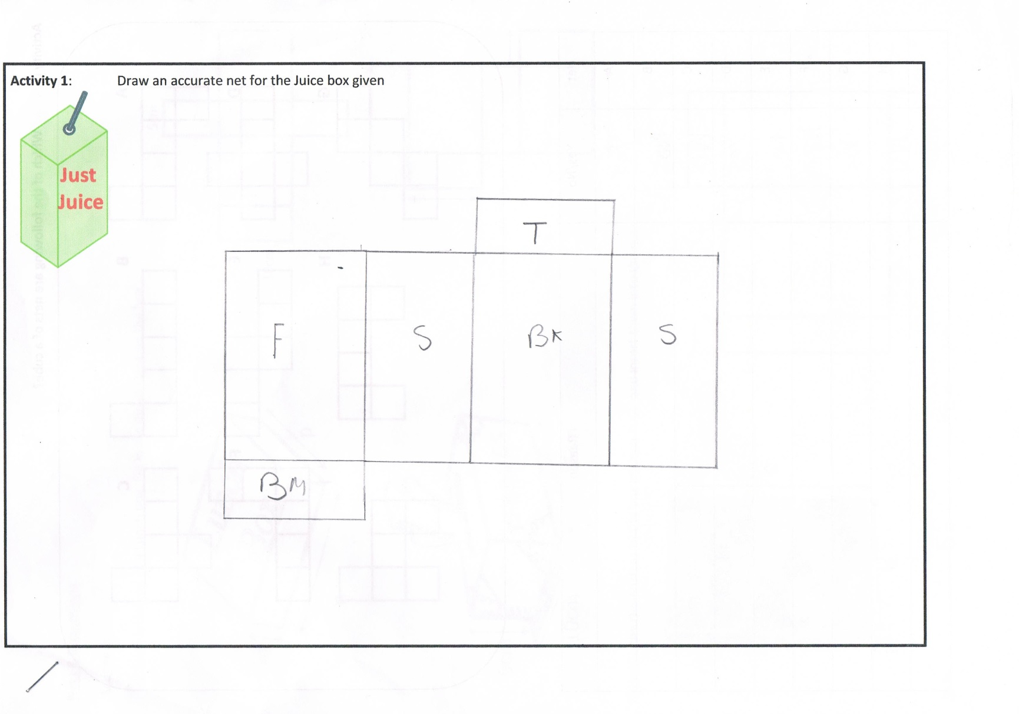
Rectangular prisms (cuboids)
6 cm
3cm
4cm

Slide 24
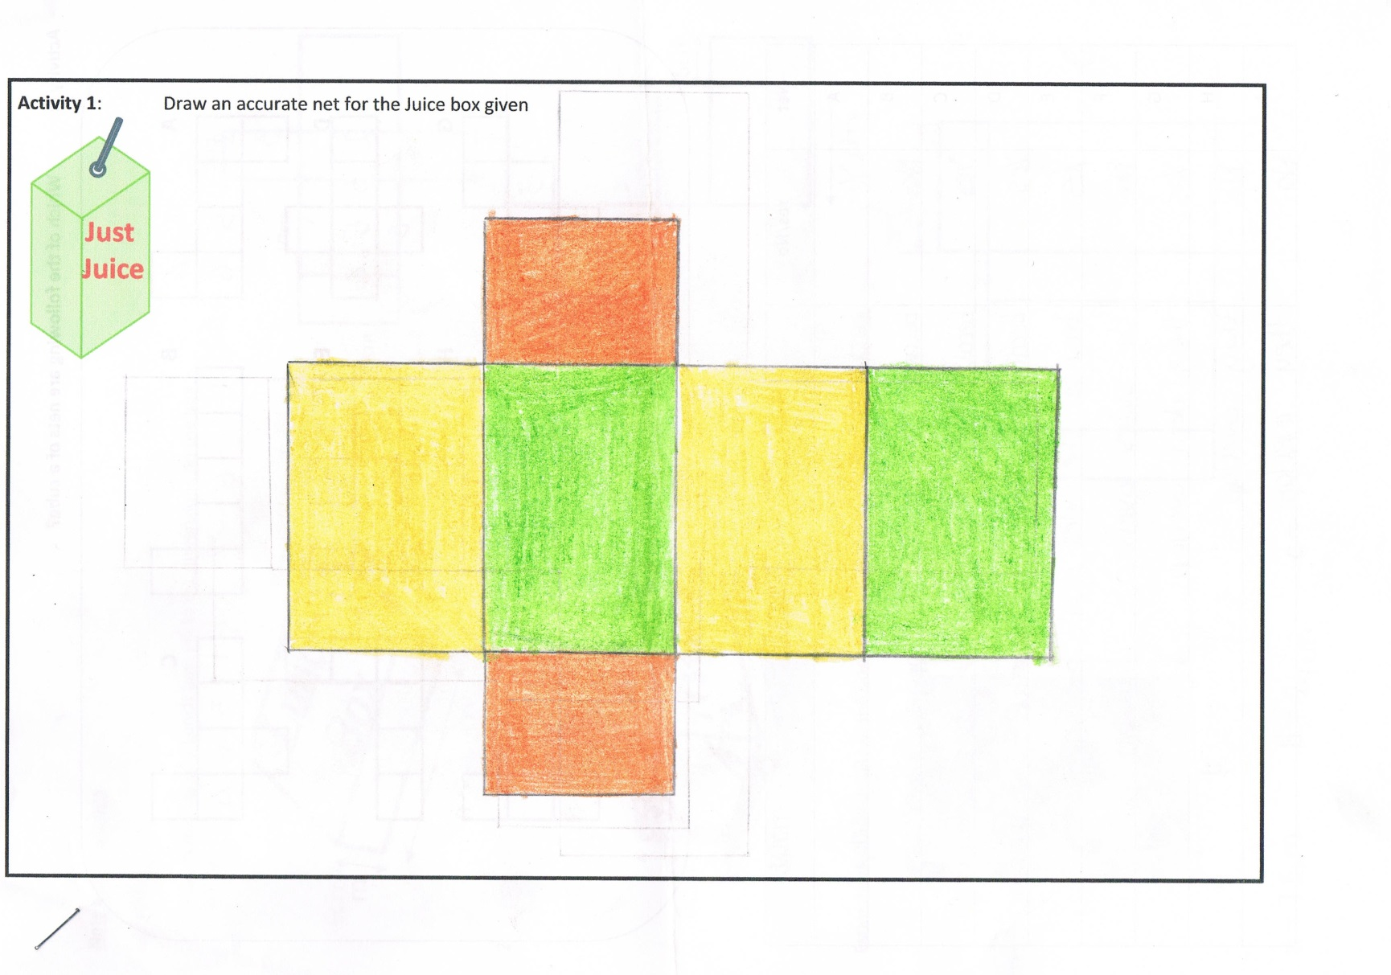
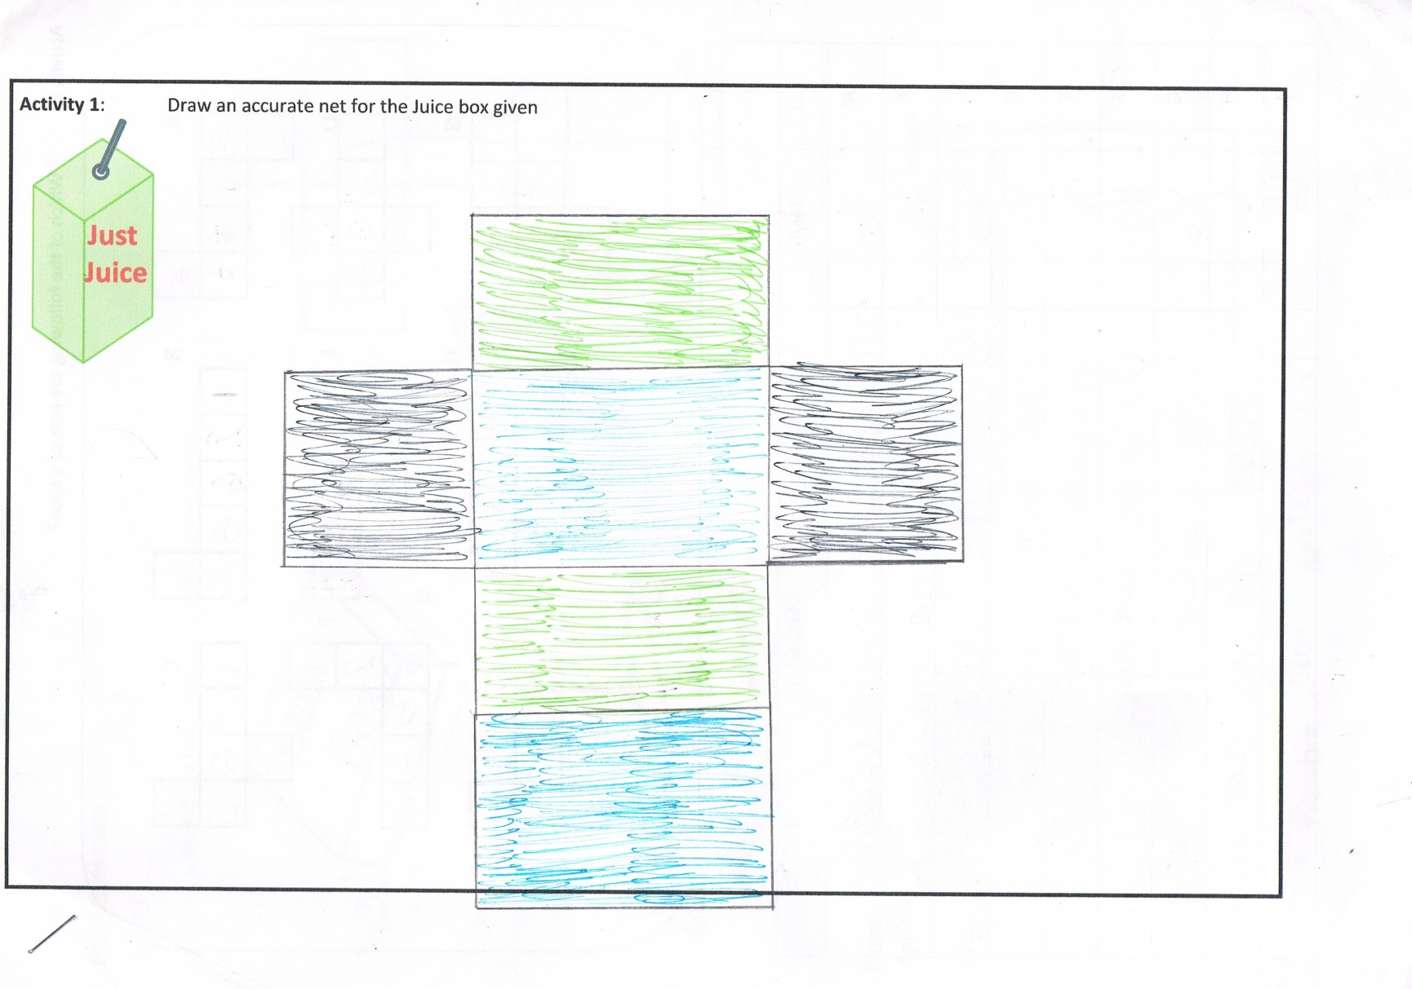
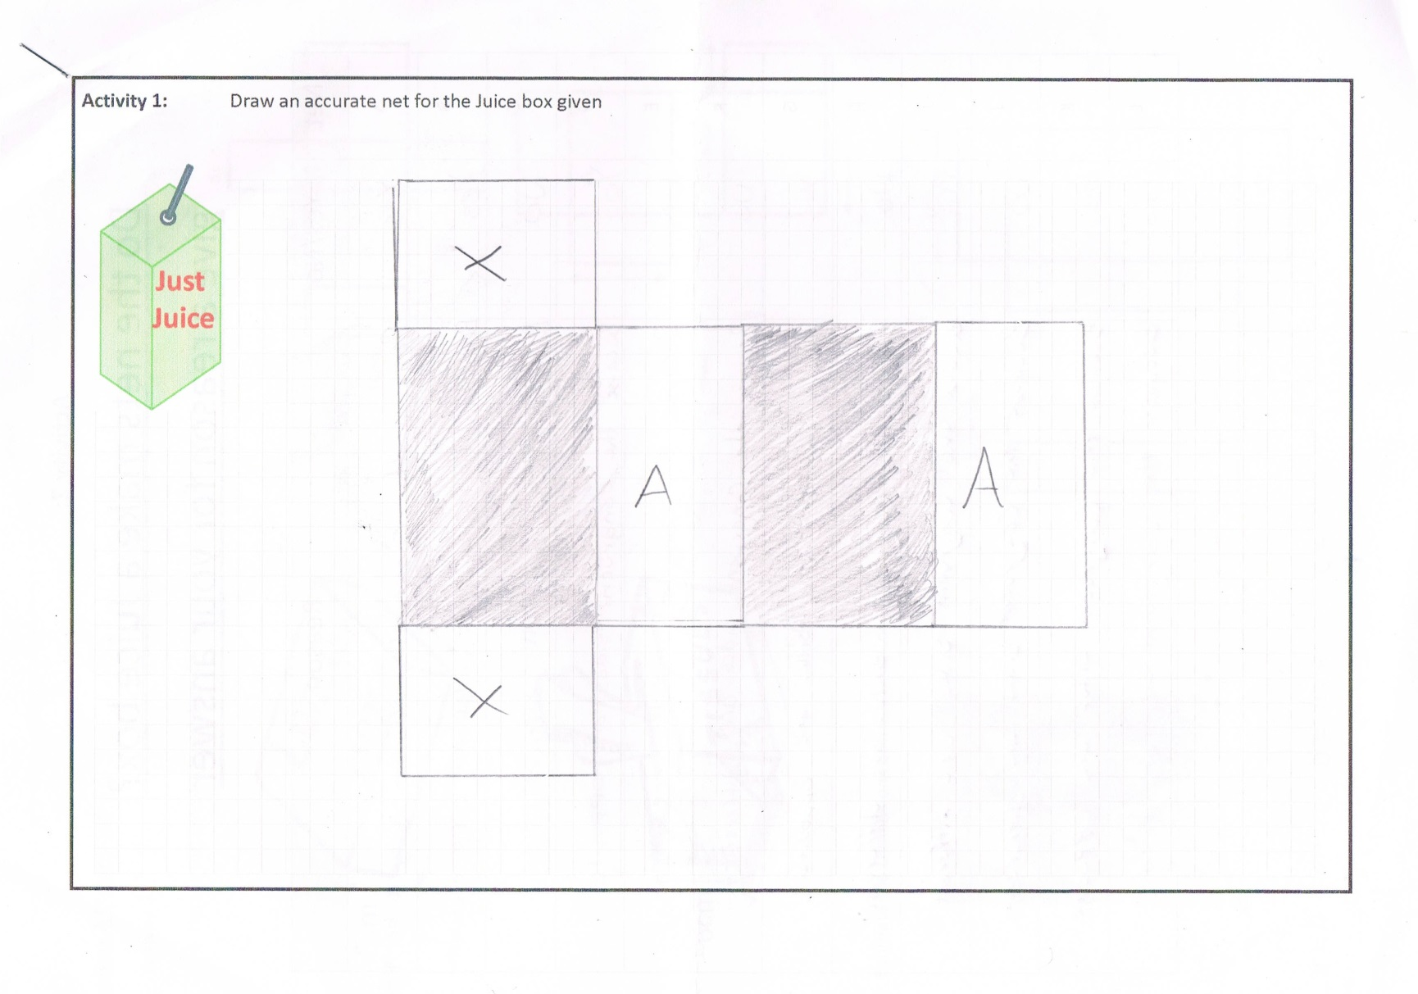
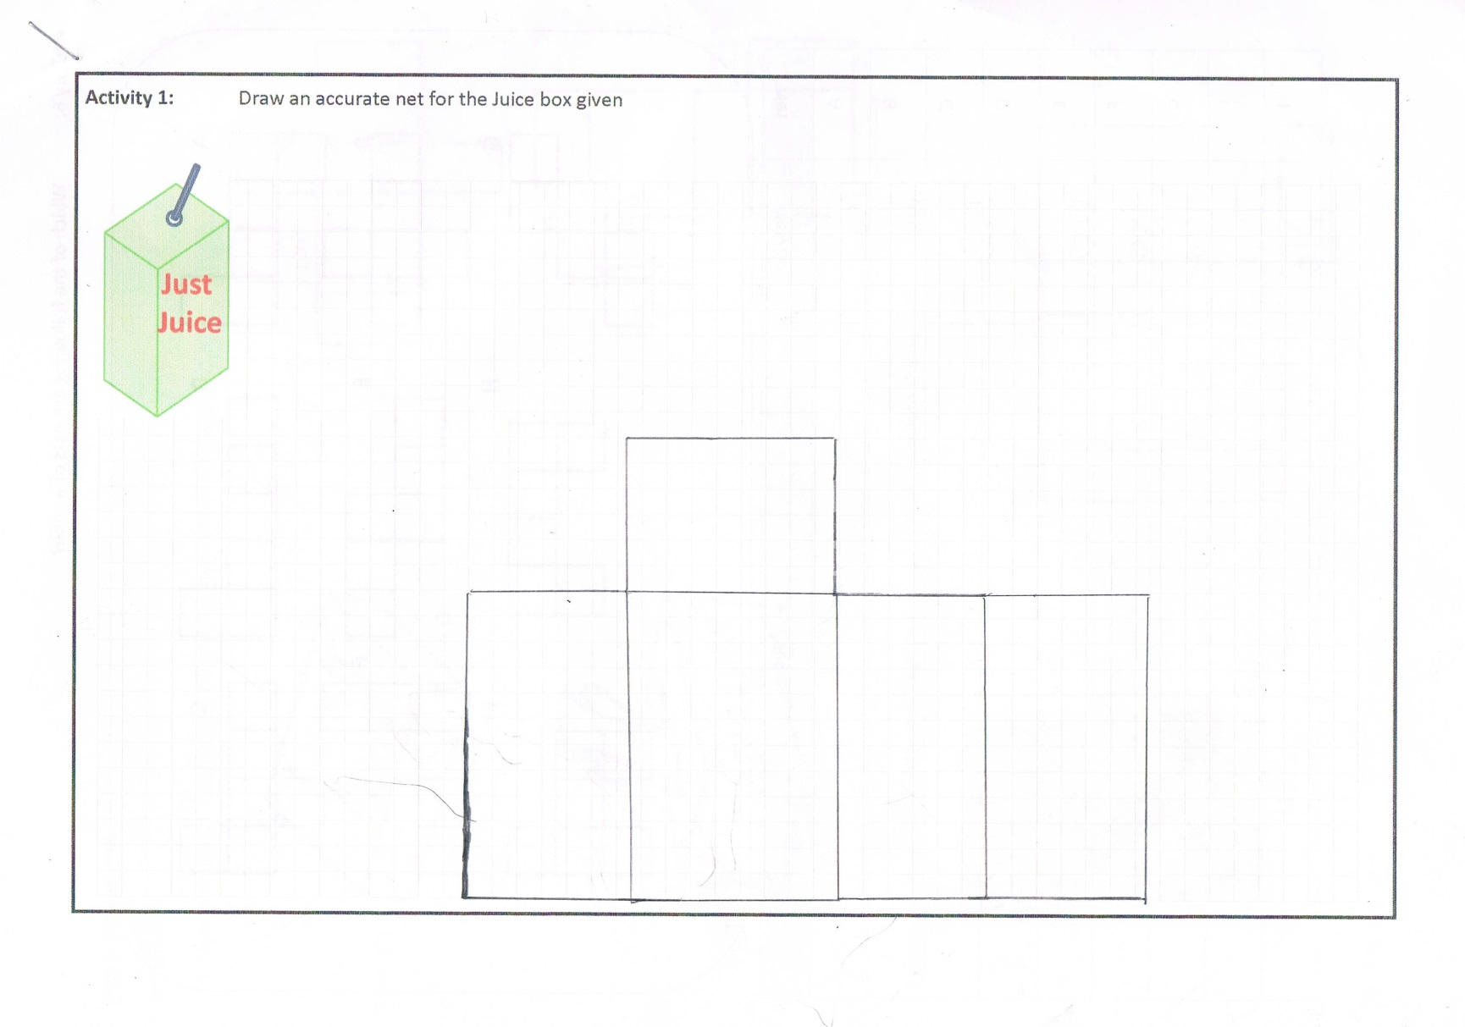
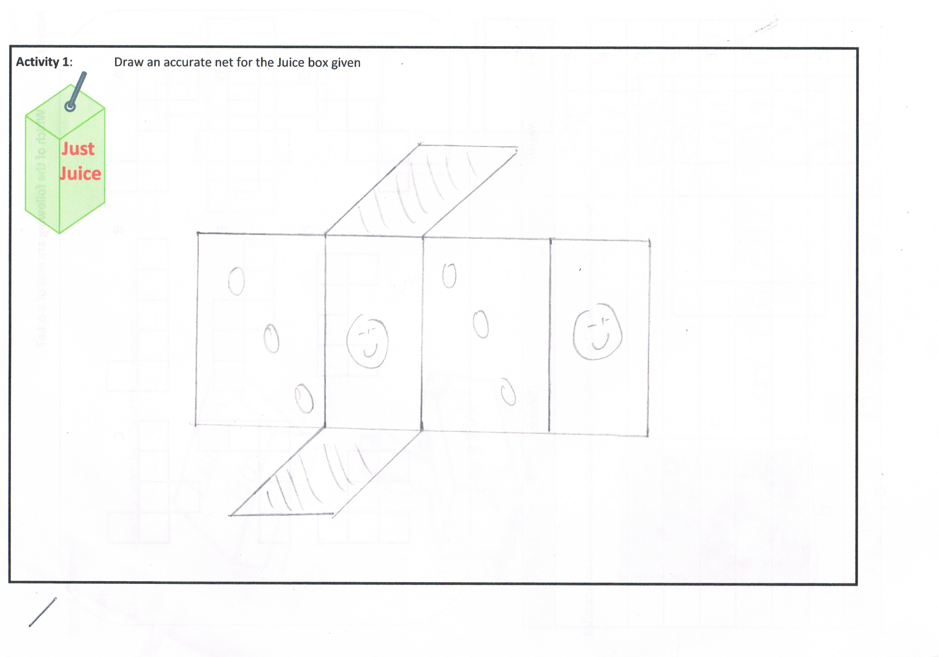
Rectangular prisms (cuboids)
6 cm
3cm
4cm

Slide 25
Rectangular prisms (cuboids)
 |  | Base
 | Side | Base | Side
 |  | Back
 | Side | Base | Side
 |  | Front
 | Strategy | Back
Top | Side | Base | Side
 |  | Front
Draw the base
The sides
The Front and the back
Don’t forget the top!
6 cm
3cm
4cm

Slide 26
Drawing nets
Draw the base
The sides
The Front and the back
Don’t forget the top!
Classroom Activities
Q1
Q2
7cm
2cm
1cm
9cm
2cm
3cm
Q3
5cm
4cm
6cm

Slide 27
Back
7cm
2cm
Side
Base
Side
3cm
Q1
Front
Draw the base
The sides
The Front and the back
Don’t forget the top!
Top

Slide 28
Connections in Mathematics
Within Strands
Curriculum
Subjects
Future
Real
World
Across Strands
Past

Slide 29

Estimating Dimensions
23cm
7.5cm
c cm
34.5cm
565g + 50% Extra Free
a cm
b cm

Slide 30

Estimating Dimensions
D cm
A cm
B cm
C cm

Slide 31
Estimating Dimensions
??cm
???cm
??cm
??cm

Slide 32
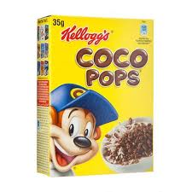
Estimate the dimension of the Coco Pops box
c cm
565g + 50% Extra Free
a cm
b cm

Slide 33
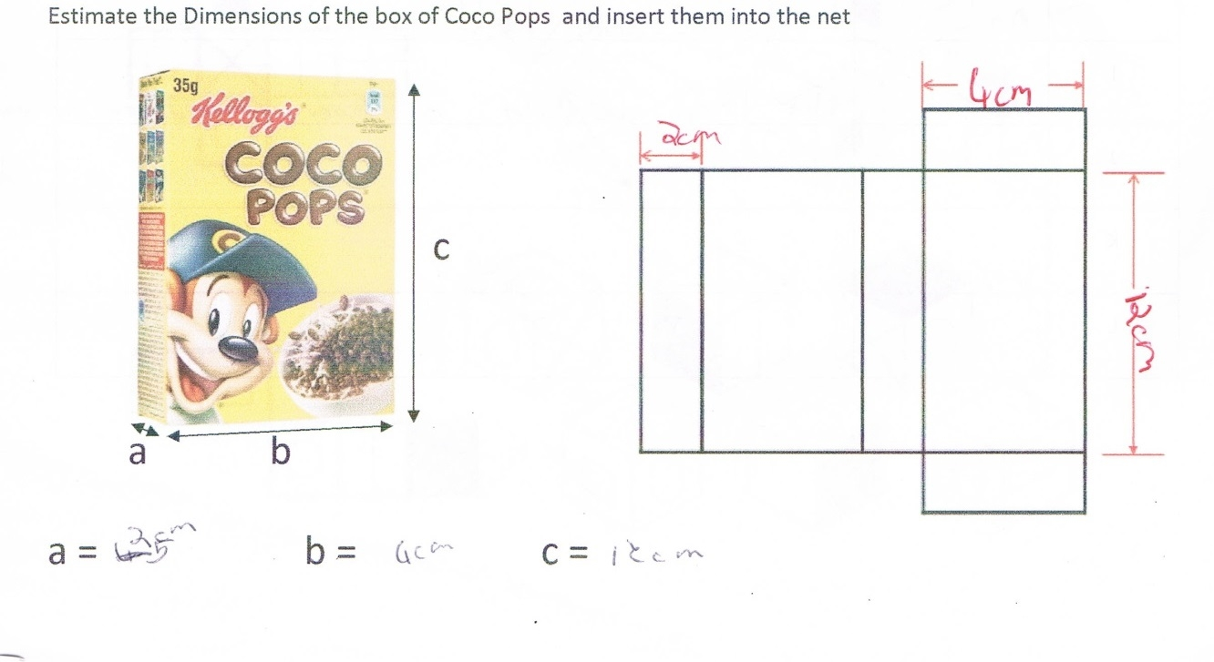
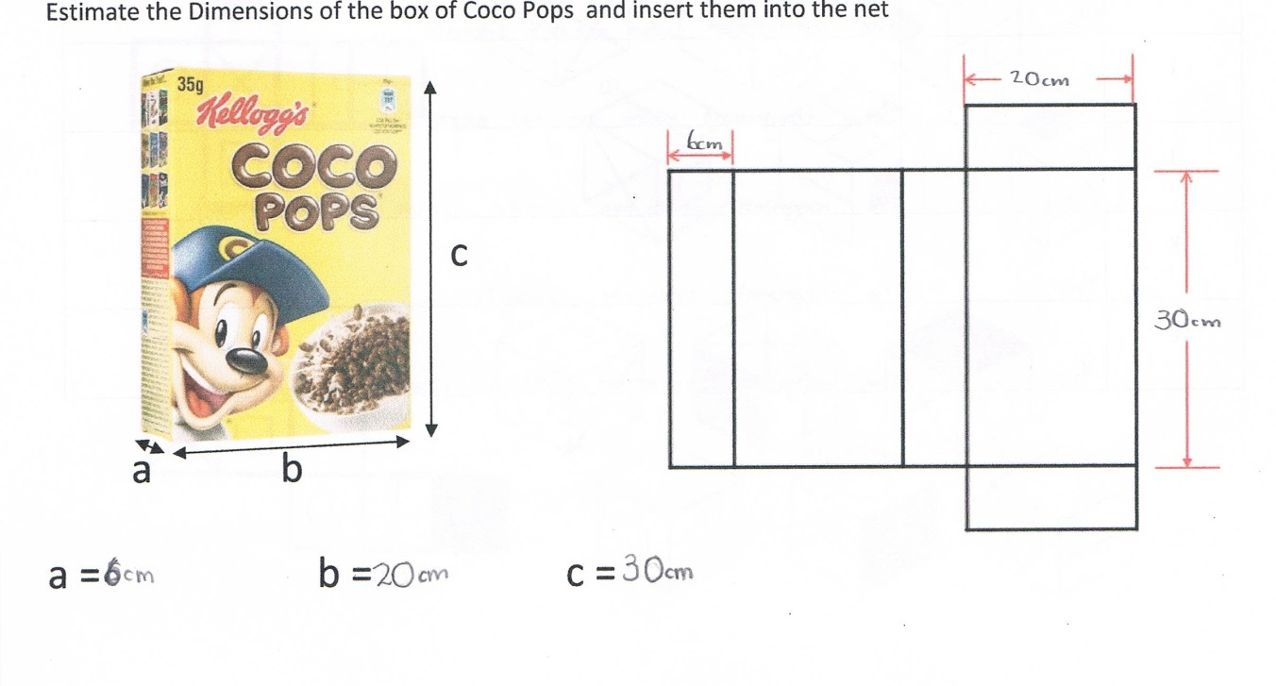
Estimating Dimensions
Jessica
John

Slide 34
Summary
Cuboids
Nets
Students’ Misconceptions
Connections…Estimating Dimensions etc

Slide 35
4. Cubes

Slide 36
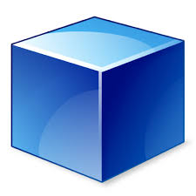
Can you draw the net of a Cube?

Slide 37
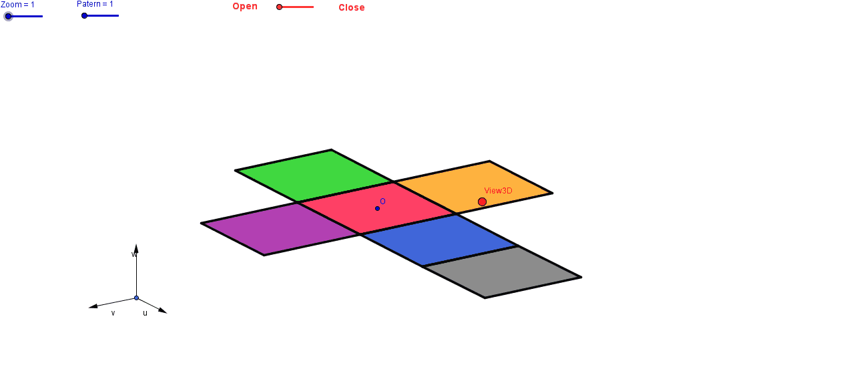


Compare yours to the person next to you

Slide 38
Solids to Nets
Nets to Solids

Slide 39
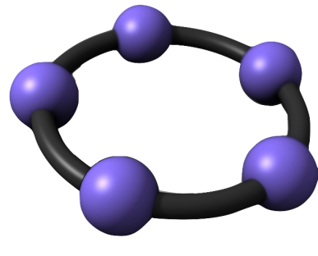
How many nets are there for a cube?

Slide 40


Net mapping
Z
Which shape is on the face opposite the circle?
Which shapes are next to the circle?
Which shape is the arrow pointing to?
Which shape is not next to the square?

Slide 41
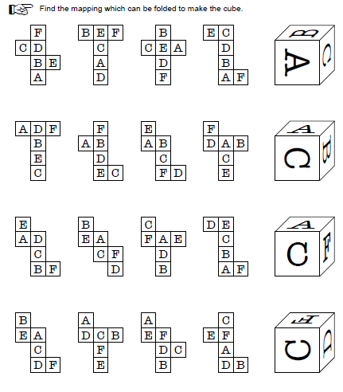
Worksheet
BOOKLET?

Slide 42
Which of the following are nets of a cube?
A B C
D E F
G H I
BOOKLET?

Slide 43
Which of the following are nets of a cube?
A B C
D E F
G H I

Slide 44


Which of the following are nets of a cube?
A B C
D E F
G H I

Slide 45
Connections in Mathematics
Within Strands
Curriculum
Subjects
Future
Real
World
Across Strands
Past

Slide 46
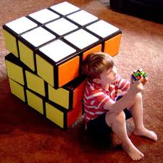

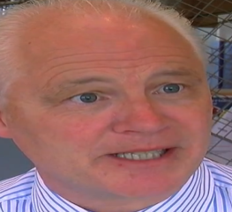
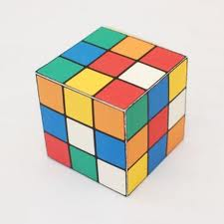
Surface Area of a cube using nets

Slide 47








Surface Area of a cube using nets
Wrapping a rubix cube
Each side is 3cm long
3cm
$Area Square =l^{2}$
3cm
9cm²
$Area Square ={(3)}^{2}$
$Area Square =9{cm}^{2}$
$$Total=$$
$$6(area of one square)$$
$$=6(9)$$
$$=54{cm}^{2}$$

Slide 48







Surface Area of a cube using nets
Wrapping a rubix cube
Each side is $lcm$ long
$$lcm$$
$Area Square =l^{2}$
$$lcm$$
$$l^{2}{cm}^{2}$$
$$Total=$$
$$6(area of one square)$$
$$=6(l^{2})$$
$$={6l}^{2}{cm}^{2}$$

Slide 49

Volume of Prisms

Slide 50
Transformations and Nets
A |  |  |  |  |  | B |  |  |  |  | C
D |  |  |  |  |  | E |  |  |  |  | F
G |  |  |  |  |  | H |  |  |  |  | I
A |  |  |  |  |  | B |  |  |  |  | C
D |  |  |  |  |  | E |  |  |  |  | F
G |  |  |  |  |  | H |  |  |  |  | I
A |  |  |  |  |  | B |  |  |  |  | C
D |  |  |  |  |  | E |  |  |  |  | F
G |  |  |  |  |  | H |  |  |  |  | I
A |  |  |  |  |  | B |  |  |  |  | C
D |  |  |  |  |  | E |  |  |  |  | F
G |  |  |  |  |  | H |  |  |  |  | I

Slide 51
What are some of the properties required to form a cube?
1 |  |  |  |  |  |  |  |  | 2
3 |  |  |  |  |  |  |  |  | 4
5 |  |  |  |  |  |  |  |  | 6

Slide 52

Eulers Formula

Slide 53
Summary
Cubes
Nets
Solids
Surface Area
Volume
Transformations
Euler’s Theorem

Slide 54

5. Cone Task
Po
st 1st Year
How many times has a student mixed up Perpendicular Height and Slant Height?
How many times have you retaught it over and over again?
NO Longer with one simple question:
Post 1st Year
How many times has a student mixed up Perpendicular Height and Slant Height?
How many times have you retaught it over and over again?
NO Longer with one simple question:
Build a cone of radius 5cm and perpendicular height 12cm

Slide 55

Extension tasks
Estimate the amount of material required to build a 2 person tent

Slide 56







Cone
$$l$$
$$2πr$$
$$2πr$$
$$l$$
$$πr$$

Slide 57


Cone
$$l$$
$$πr$$

Slide 58



Cone
$$l$$
$$Curved SA= πrl$$
$$πr$$

Slide 59
Summary
Cone
Slant Height
Perpendicular Height
Problem Solving
Pythagoras’ Theorem
Curved Surface Area Formula
Angles
Psychomotor skills

Slide 60



Session 6 3D Geometry Shapes

Slide 61

http://www.teachingcouncil.ie/latest-news/ebsco.2331.html

Slide 62

3D Geometry Shapes

