Slide 1
Finding the area of curved irregular shapes
LEAVING CERTIFCATE ORDINARY & HIGHER LEVELS

Slide 2
Find the area of your shape
Work as accurately as you can in centimetres!
1A

Slide 3
You found the area of an A4 page!
1B
1A

Slide 4
Trapezoidal Rule

Slide 5
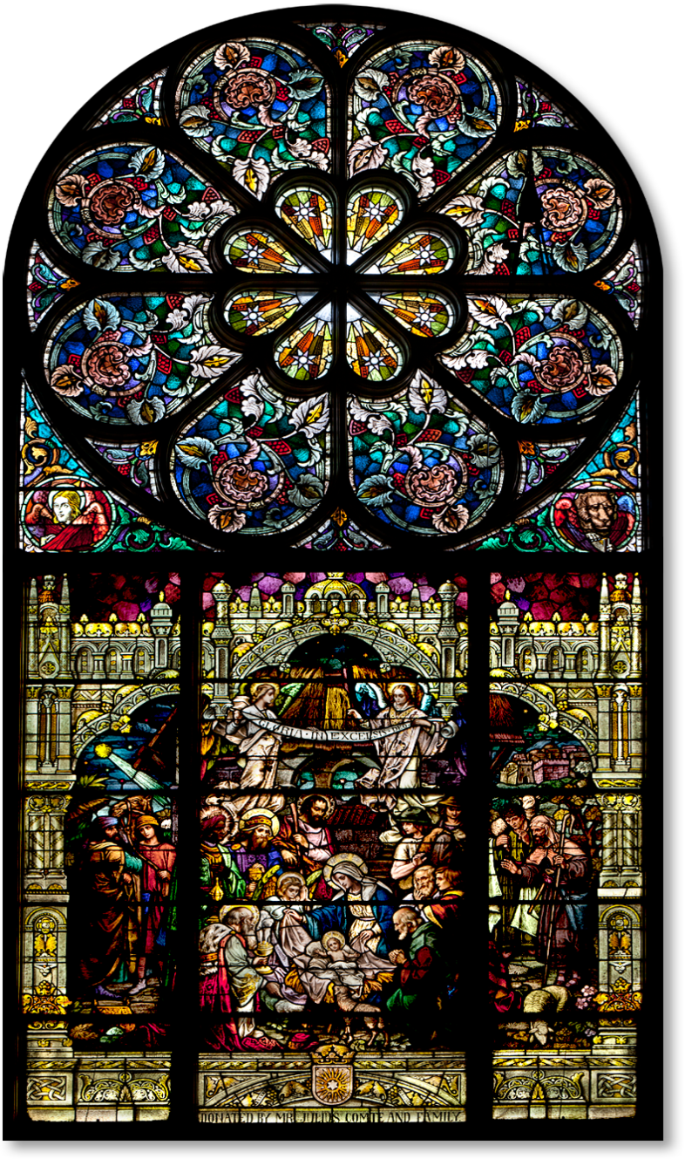
(a) Find the area of the stained glass window.
(b) Draw a scaled diagram of the window using 1 m = 5 cm on square paper.
(c) Divide the shape up into: (i) 4 trapezium's (ii) 5 trapezium’s
(ii) 10 trapeziums
and calculate the area of the window each time, (using the trapezium’s).
(d) Which part produced the smallest error and why?
2.4 m
2 m

Slide 6
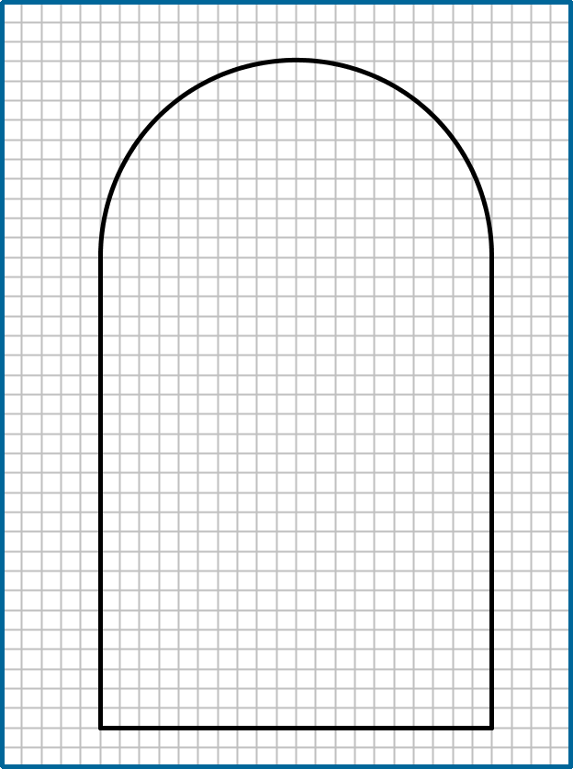
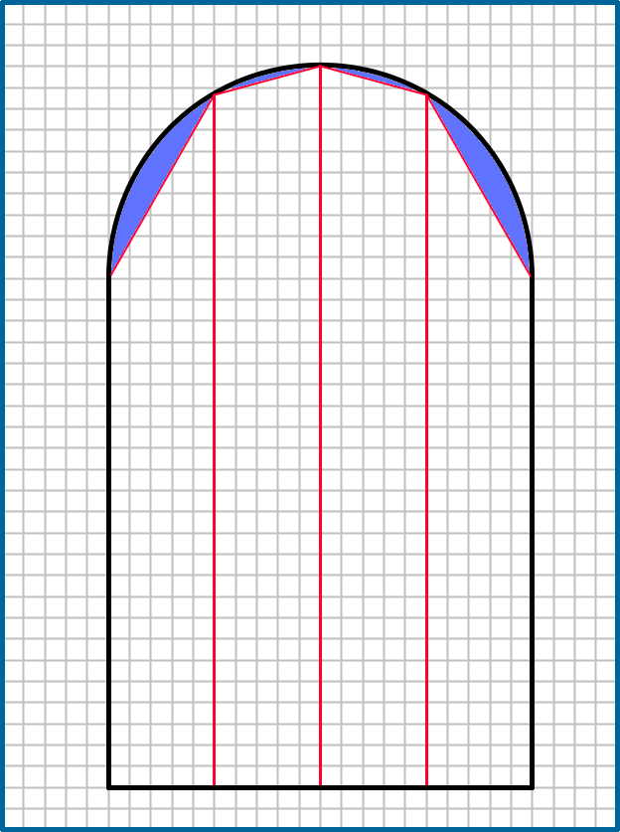
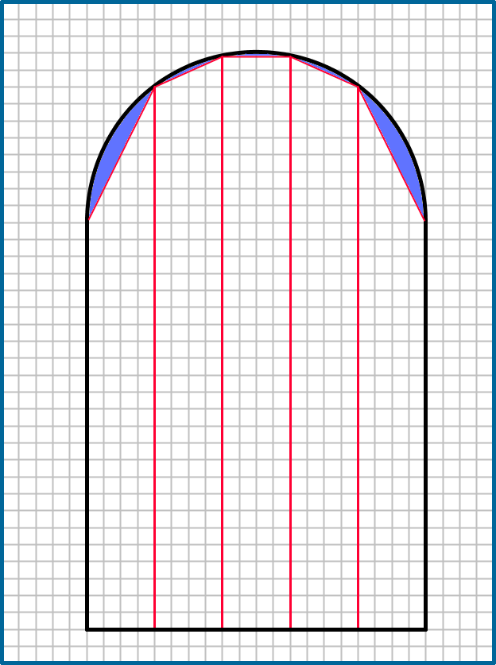
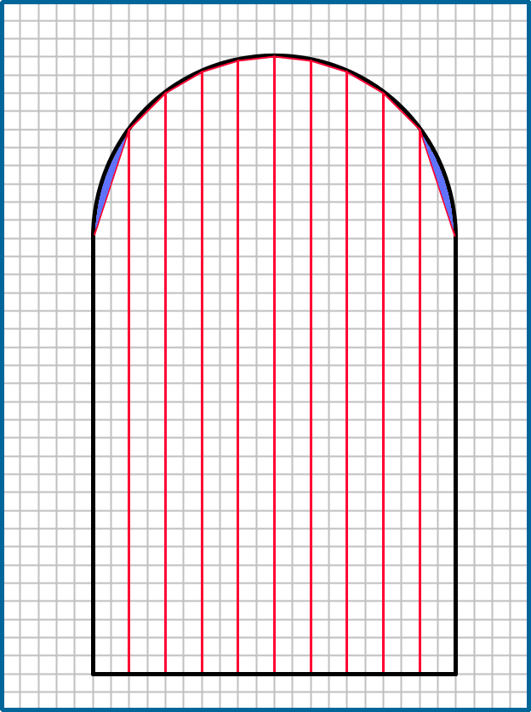
$$A=2×2.4+\frac{π{\left(1\right)}^{2}}{2}=6.37 m^{2}$$
$$A≈6.17 m^{2}$$
$$\% \text{Error}=\frac{6.37−6.17}{6.37}×100=3.14\%$$
$$A=2×2.4+\frac{π{\left(1\right)}^{2}}{2}=6.37 m^{2}$$
$$A≈6.22 m^{2}$$
$$\% \text{Error}=\frac{6.37−6.22}{6.37}×100=1.5\%$$
$$A=2×2.4+\frac{π{\left(1\right)}^{2}}{2}=6.37 m^{2}$$
$$A≈6.32 m^{2}$$
$$\% \text{Error}=\frac{6.37−6.32}{6.37}×100=0.79\%$$

Slide 7
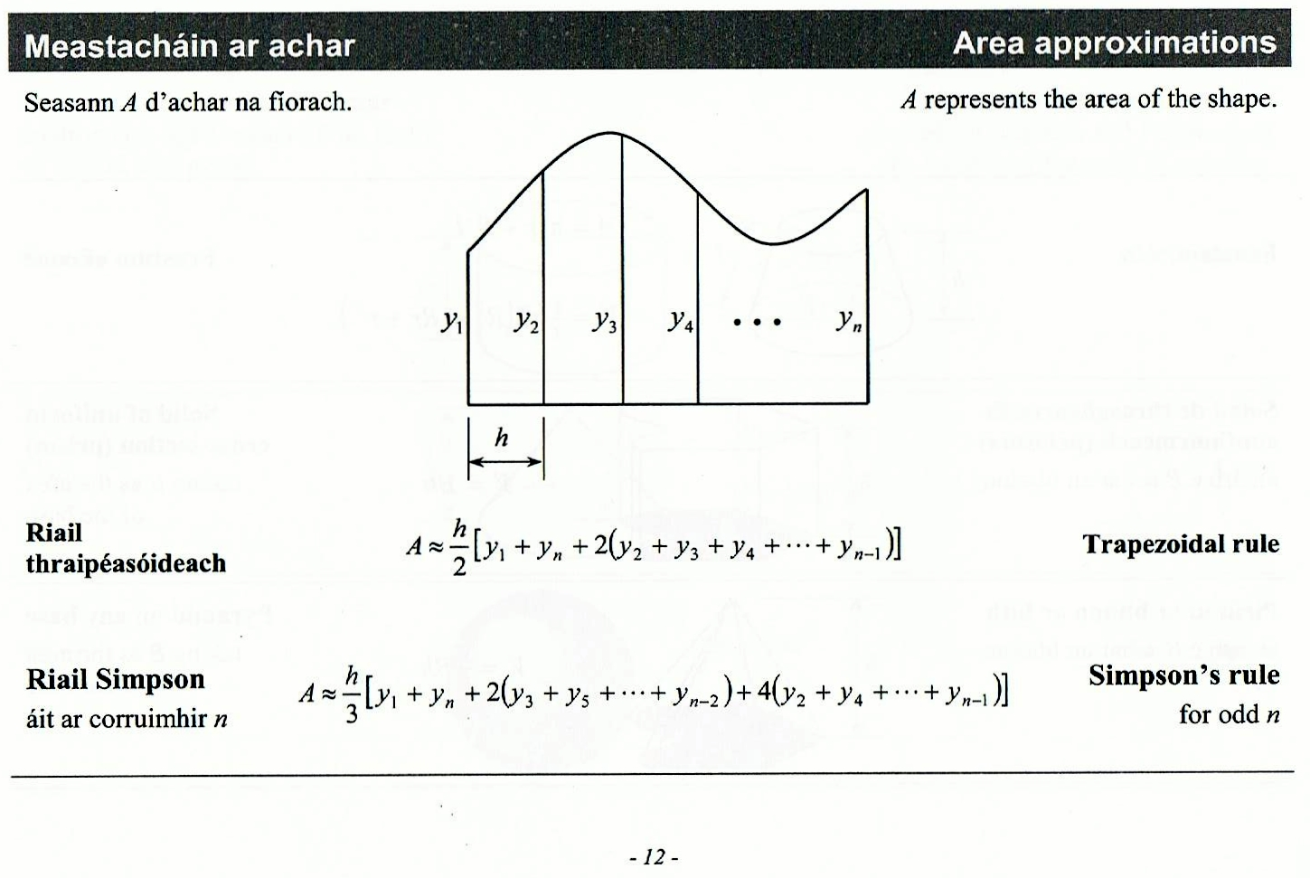
Formula and Tables Page 12
What do all the terms in the formula mean?

Slide 8
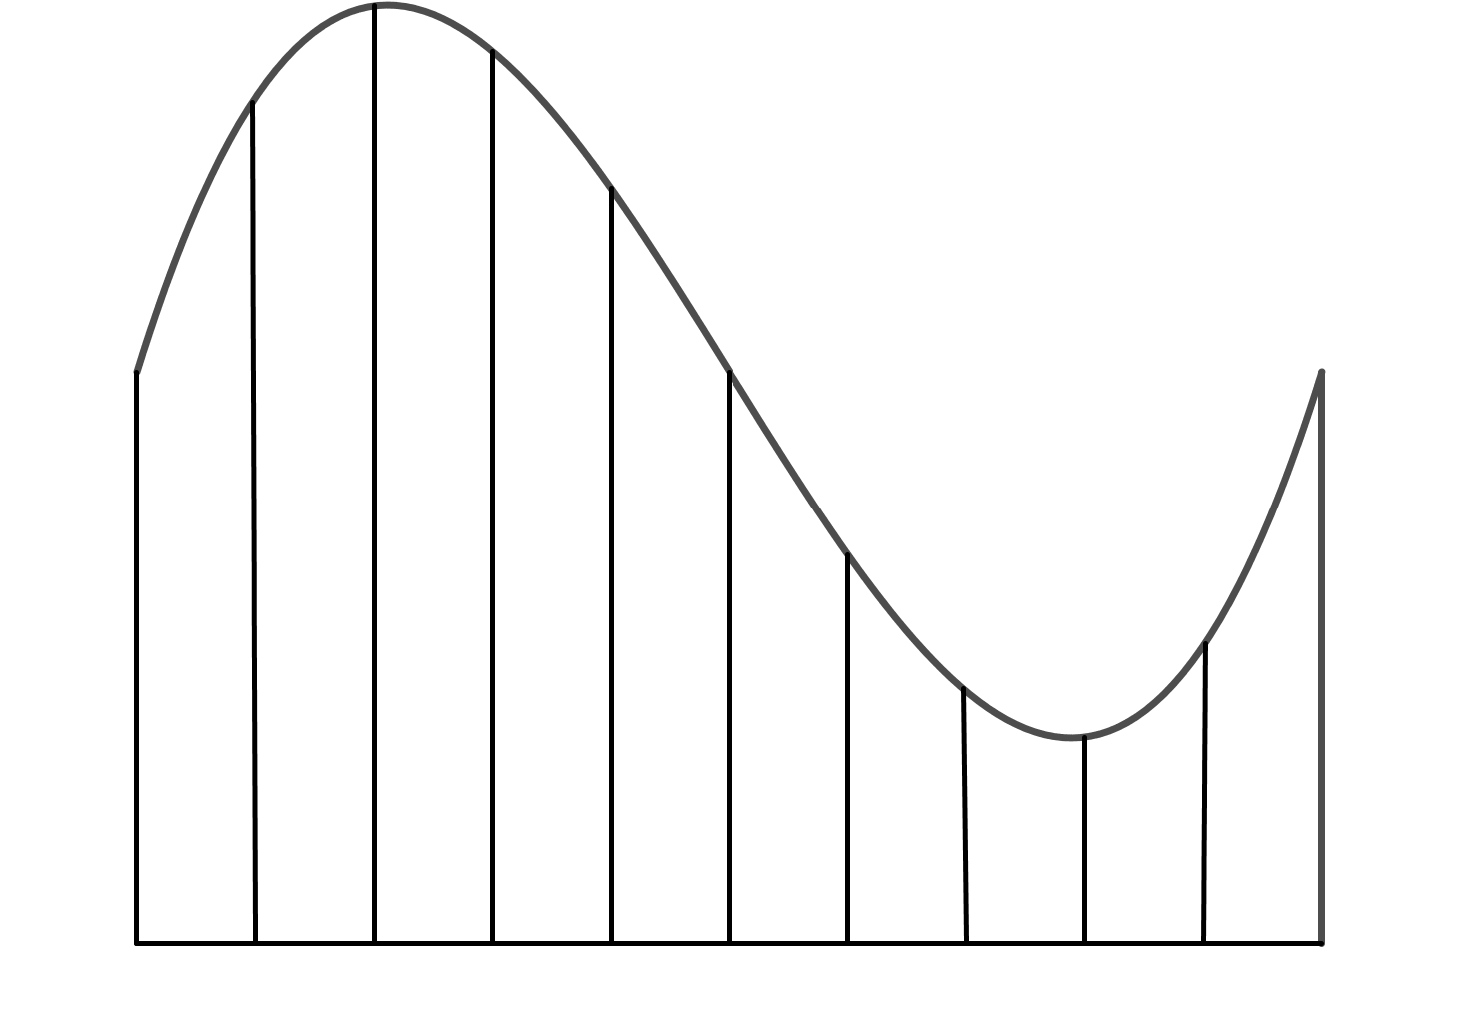

Slide 9
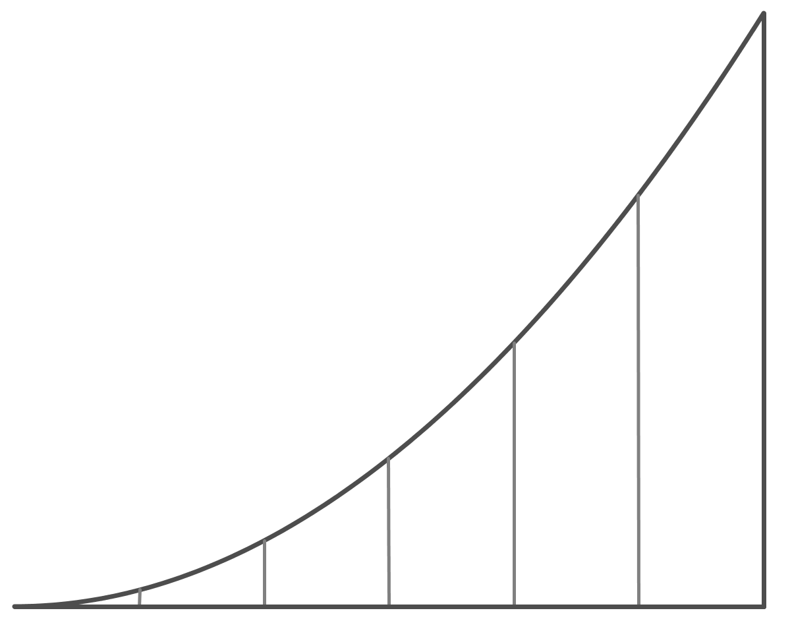

Slide 10
Derivation of the formula
$$A=T_{1}+T_{2}+T_{3}+T_{4}+⋯+T_{n} \\ A=\frac{1}{2}\left(y_{1}+y_{2}\right)h+\frac{1}{2}\left(y_{2}+y_{3}\right)h+\frac{1}{2}\left(y_{3}{+y}_{4}\right)h+\frac{1}{2}\left(y_{4}{+y}_{5}\right)h+⋯+\frac{1}{2}\left(y_{n−1}{+y}_{n}\right)h \\ A=\frac{h}{2}\left[y_{1}{+y}_{2}+y_{2}{+y}_{3}+y_{3}{+y}_{4}+y_{4}{+y}_{5}+⋯+y_{n−1}{+y}_{n}\right] \\ A=\frac{h}{2}\left[y_{1}{+y_{n}+2(y}_{2}{+y}_{3}{+y}_{4}{+y}_{5}+⋯+y_{n−1})\right]$$
$$A=\frac{1}{2}\left(a+b\right)h$$
$$a$$
$$h$$
$$b$$

Slide 11
Trapezium Rule
Why Trapezoidal Rule rather than Simpson’s Rule?
1. Easier to derive and understand what is going on.
Area of a trapezium is on Strand 3 for Ordinary Level students from 2015.
(N.B. It is on for Foundation Level in 2014)
3. For many practical cases it (the Trapezoidal rule) is accurate enough.

Slide 12
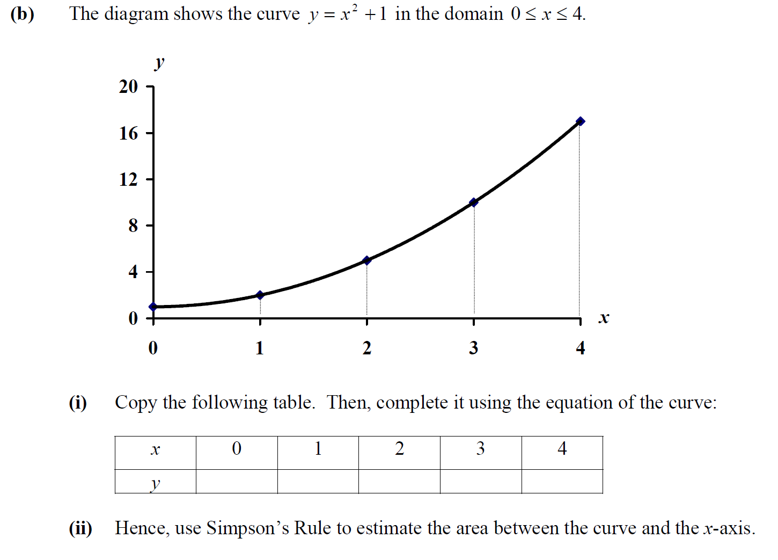
2002

Slide 13
2013 HL

Slide 14
Using 5 intervals approximate the following integral $\int_{0}^{1}{\sqrt{1−x^{2}}dx}$.
$$A≈\frac{h}{2}\left[y_{1}+y_{n}+2\left(y_{2}+y_{3}+y_{4}+⋯+y_{n−1}\right)\right]$$

Slide 15
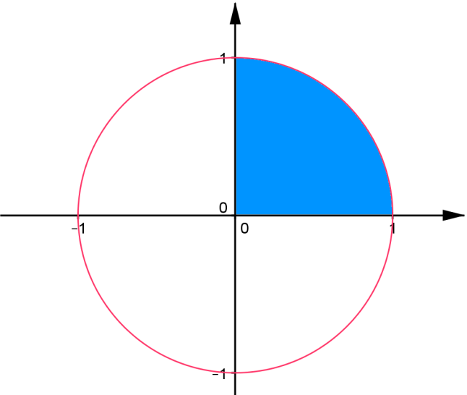
Other Methods
$$\int_{0}^{1}{\sqrt{1−x^{2}}dx}$$
$$Area=\int{y}dx \\ y=\sqrt{1−x^{2}} \\ y^{2}=1−x^{2} \\ x^{2}+y^{2}=1 \\ Area=\frac{π}{4}=0.7853$$
$$\int_{0}^{1}{\sqrt{1−x^{2}}dx} \\ x=\sin{θ} \\ \frac{dx}{dθ}=\cos{θ} \\ \frac{1}{2}\int{(1+\cos{2θ)dθ}}$$

Slide 16
