Slide 1
Workshop for Post-Primary Mathematics
Workshop 1 - GeoGebra

Slide 2
PDST Post Primary Maths Team
Contact Us:
Annie Patton
Email: anniepatton@projectmaths.ie
John Flaherty
Email: johnflaherty@projectmaths.ie
Sheelagh Clowry
Email: sheelaghclowry@projectmaths.ie
www.projectmaths.ie
Twitter Handle: @ProjectMaths_ie

Slide 3
School Visits

Slide 4
Rationale
Workshop 1:
GeoGebra
Workshop 3:
Geometry & Trigonometry
Workshop 5:
Algebra & Functions
November
January
March
December
February
April
Workshop 2:
Statistics & Probability
Workshop 4:
Number
Workshop 6:
Problem Solving

Slide 5
Timetable
19.00 - 19.10 Overview
19.10 - 19.40 Task 1 - Geometry with GeoGebra
19.40 - 20.30 Task 2 - Functions with GeoGebra
20.30 - 20.40 Break
20.40 - 21.05 Effective use of GeoGebra
21.05 - 21.15 Task 3 - Putting your Learning into Action
21.15 - 21.30 Summary

Slide 6
Your Expectations
What do you hope to gain from this workshop?
https://tinyurl.com/PostPrimary1
Password: GeoHopes

Slide 7
Key Messages
A basic understanding of GeoGebra combined with a pedagogical approach may be used to enhance students’ experience of learning mathematics.
GeoGebra may be used to promote enquiry-based learning in mathematics and to support a constructivist approach to learning.

Slide 8
Key Documents

Slide 9
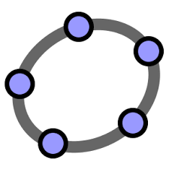
Introduction to GeoGebra
iOS: GeoGebra Classic
Android: GeoGebra Geometry
Laptop/PC: GeoGebra Version 6
Web: http://www.geogebra.org
Click ‘start graphing’
Click the menu on the left
Apps
GeoGebra Classic

Slide 10
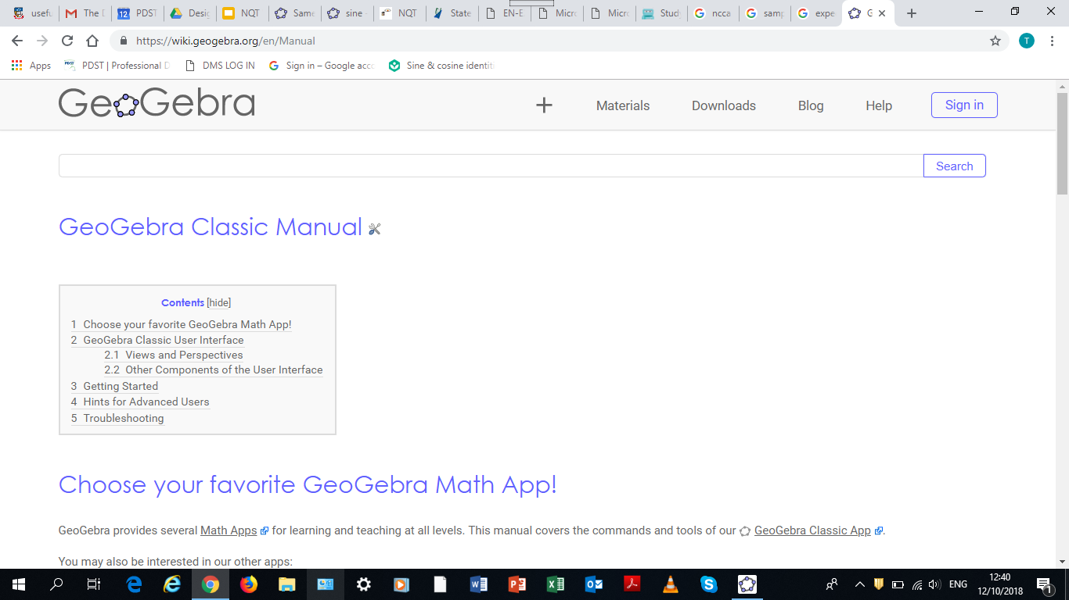
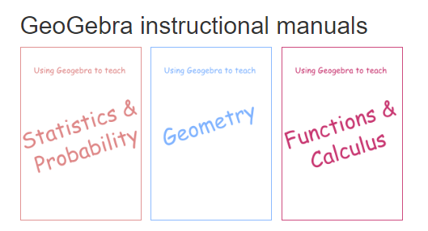
Support Resources
https://wiki.geogebra.org/en/Manual
Project Maths Website
https://tinyurl.com/PMGeoGebra
www.scoilnet.ie

Slide 11
Task 1 - Geometry
Learning Outcomes
Be proficient in the use of basic GeoGebra skills.
Become independent learners in GeoGebra.
Learn to use GeoGebra to support deeper learning in mathematics.

Slide 12
Teacher-led demonstration

Slide 13
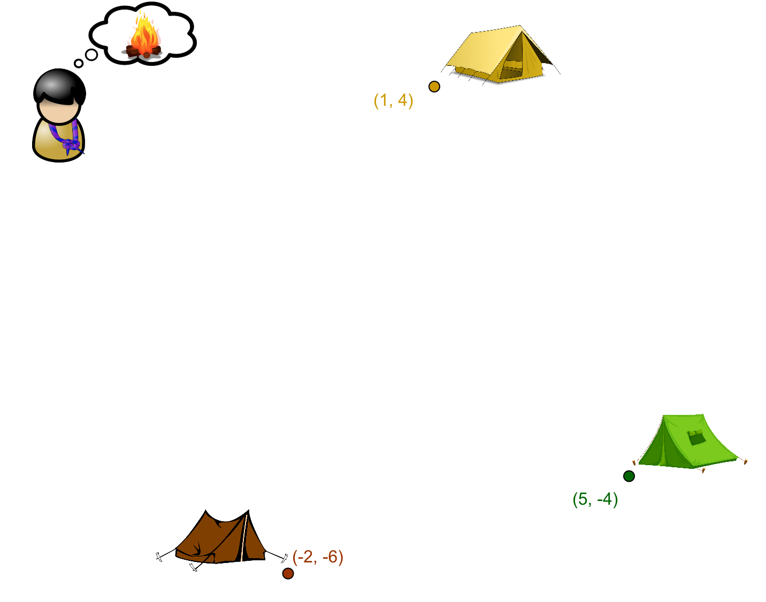
Task 1 - Geometry
Problem
A Scout Troop have pitched three tents to sleep in and wish to build one fire to cook with. Where is the fairest location for the fire?

Slide 14
Scaffolding

Slide 15
Live Demonstration of Solution:

Slide 16
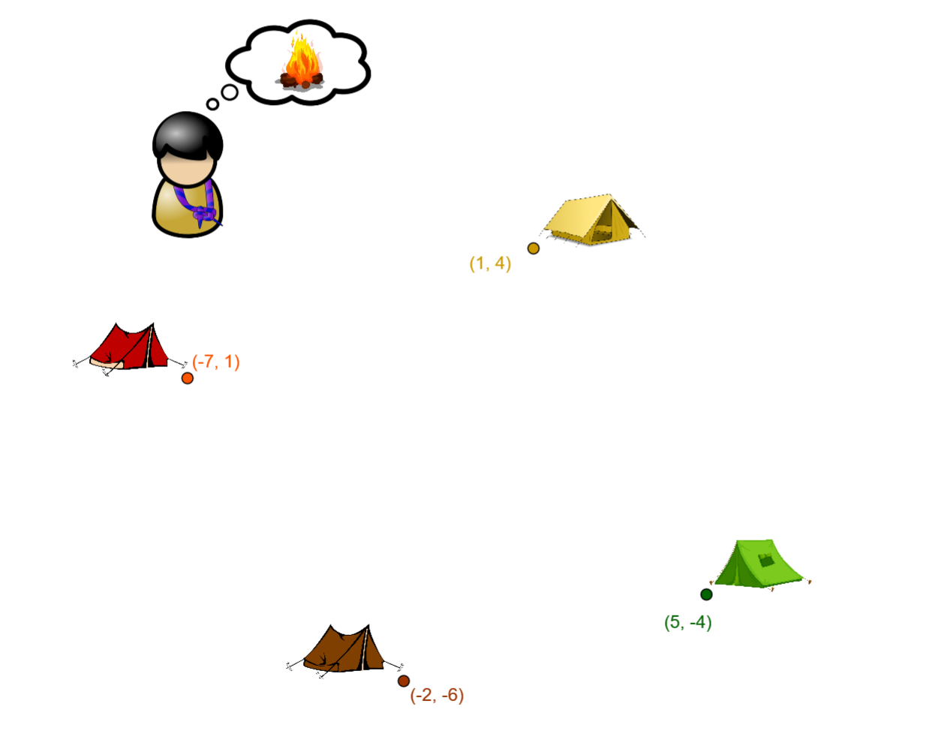
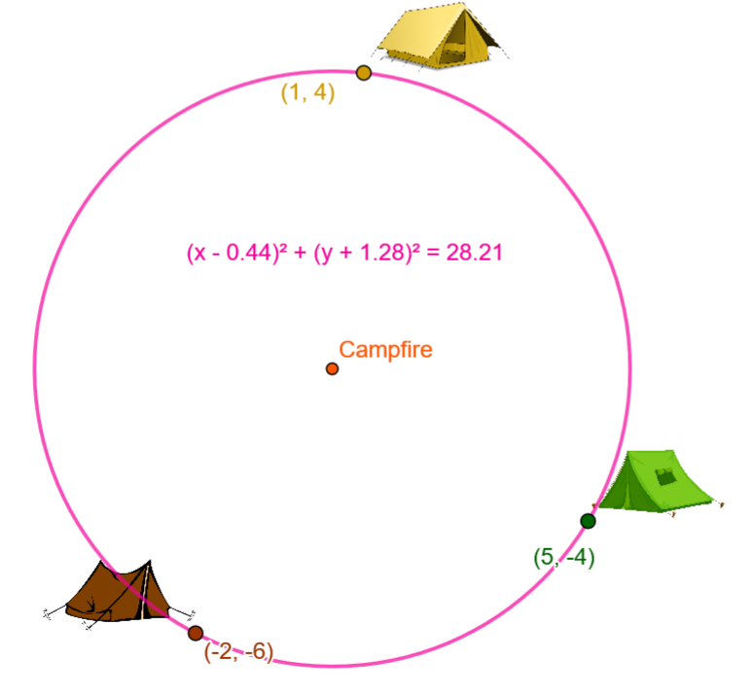
Extension Questions
Triangles
Triangles | Acute | Right Angled | Obtuse
Is the triangle always?
Is the circumcentre always inside the triangle?
Equation of the circle
Quadrilaterals

Slide 17
Task 1 - Geometry
Learning Outcomes
Be proficient in the use of basic GeoGebra skills.
Become independent learners in GeoGebra.
Learn to use GeoGebra to support deeper learning in mathematics.

Slide 18
Task 2 - Functions
Learning Outcomes
GeoGebra skills:
use the input bar for functions
use sliders to modify a function
use sliders to compare graphs of functions
Become independent learners of GeoGebra
Use GeoGebra to enhance student understanding of functions
Explore the effect of the variables a, b and c in functions taking the form:

Slide 19
Task 2 - Trigonometric functions or Quadratic functions
Task to investigate effect of changing the variables a, b, c in the following functions:

Slide 20
Live Demonstration of Solutions:

Slide 21
What do we want the students to have discovered having completed this task?
What is the effect of changing the value of a?
What is the effect of changing the value of b?
What is the effect of changing the value of c?

Slide 22
Task 2 - Functions
Learning Outcomes
GeoGebra skills:
use the input bar for functions
use sliders to modify a function
use sliders to compare graphs of functions
Become independent learners of GeoGebra
Use GeoGebra to enhance student understanding of functions
Explore the effect of the variables a, b and c in functions taking the form

Slide 23
Effective Use Of GeoGebra
Learning Outcomes
Recognise the most effective ways of integrating digital technologies to promote teaching and learning.
Recognise the importance of effective questioning to support rich tasks

Slide 24
Reflection
How would you use GeoGebra effectively if your students did not have access to their own devices?
How would you use GeoGebra effectively if your students did have access to their own devices?
What are the benefits for students of using GeoGebra to support enquiry based learning?
What are the benefits of using GeoGebra for teachers?

Slide 25
Extension Questions: LC HL 2010

Slide 26
LC HL 2017 Question 9

Slide 27
LC HL Sample Paper 2014 Question 5

Slide 28
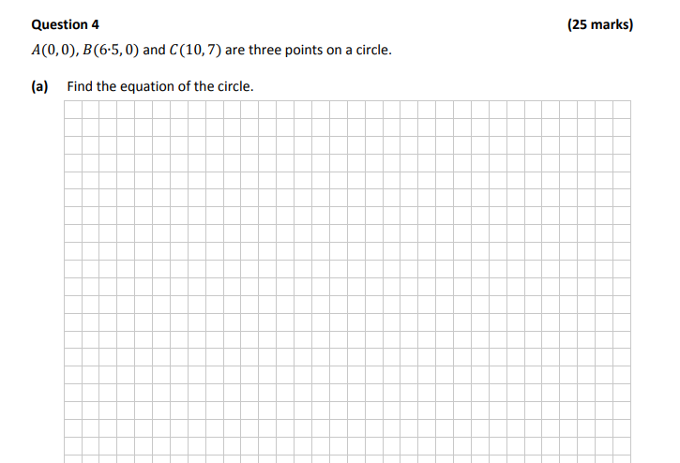
LC HL Paper 2 2017 Question 4

Slide 29
Effective Questioning
Research conducted by Cotton (2001) and Hattie (2012) showed that:
20% of classroom questions are higher cognitive questions 20% are procedural questions (‘have you got your books with you?) 60% are lower cognitive questions.
Morgan and Saxton (1991) state that the purpose of questioning is to:
Check on prior knowledge and understanding
Keep students actively involved
Focus pupils thinking on key concepts and issues
Help students extend their thinking from the concrete to the analytical
Promote reasoning and problem solving
Enable students to hear different explanations of the materials by their peers

Slide 30
Elements of Effective Questioning
Questions must have a purpose.
Questions must be linked to learning outcomes and success criteria.
Effective Questioning:
Promotes discussions.
Results in students being more likely to develop a deeper understanding of an idea because they have tried to explain it themselves.
Promotes higher-order thinking and extends learning.

Slide 31
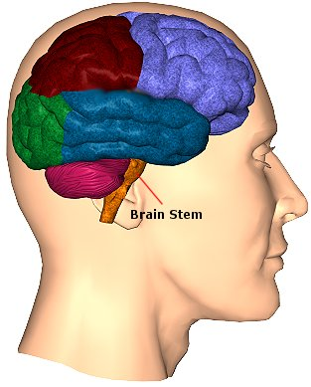
Bloom’s Taxonomy
Apply: Use what you learn in another way
How would you use it…?
What would result if…?
What other way would you plan to…?
Understand: Demonstrate understanding of facts and ideas
How would you compare…? Contrast…?
Which is the best answer…?
How would you classify the type of…?
Remember: Tell what you know or remember
What is…?
Where is…?
Which one…?
6. Create
5. Evaluate
4.Analyze
3. Apply
2. Understand
1.Remember

Slide 32
Bloom’s Taxonomy
Create: Produce new or original work
Formulate examples
Develop a point of view
Devise a question
Evaluate: Tell if something is right or wrong, good or bad
Do you agree / disagree…?
Why do you think…?
Decide if…?
Analyse: Look at something closely to find out more about it
Why do you think…?
What inference can you make…?
What is the relationship between…?
6. Create
5. Evaluate
4.Analyze
3. Apply
2. Understand
1.Remember

Slide 33
Sample Higher Order Questions for Class

Slide 34
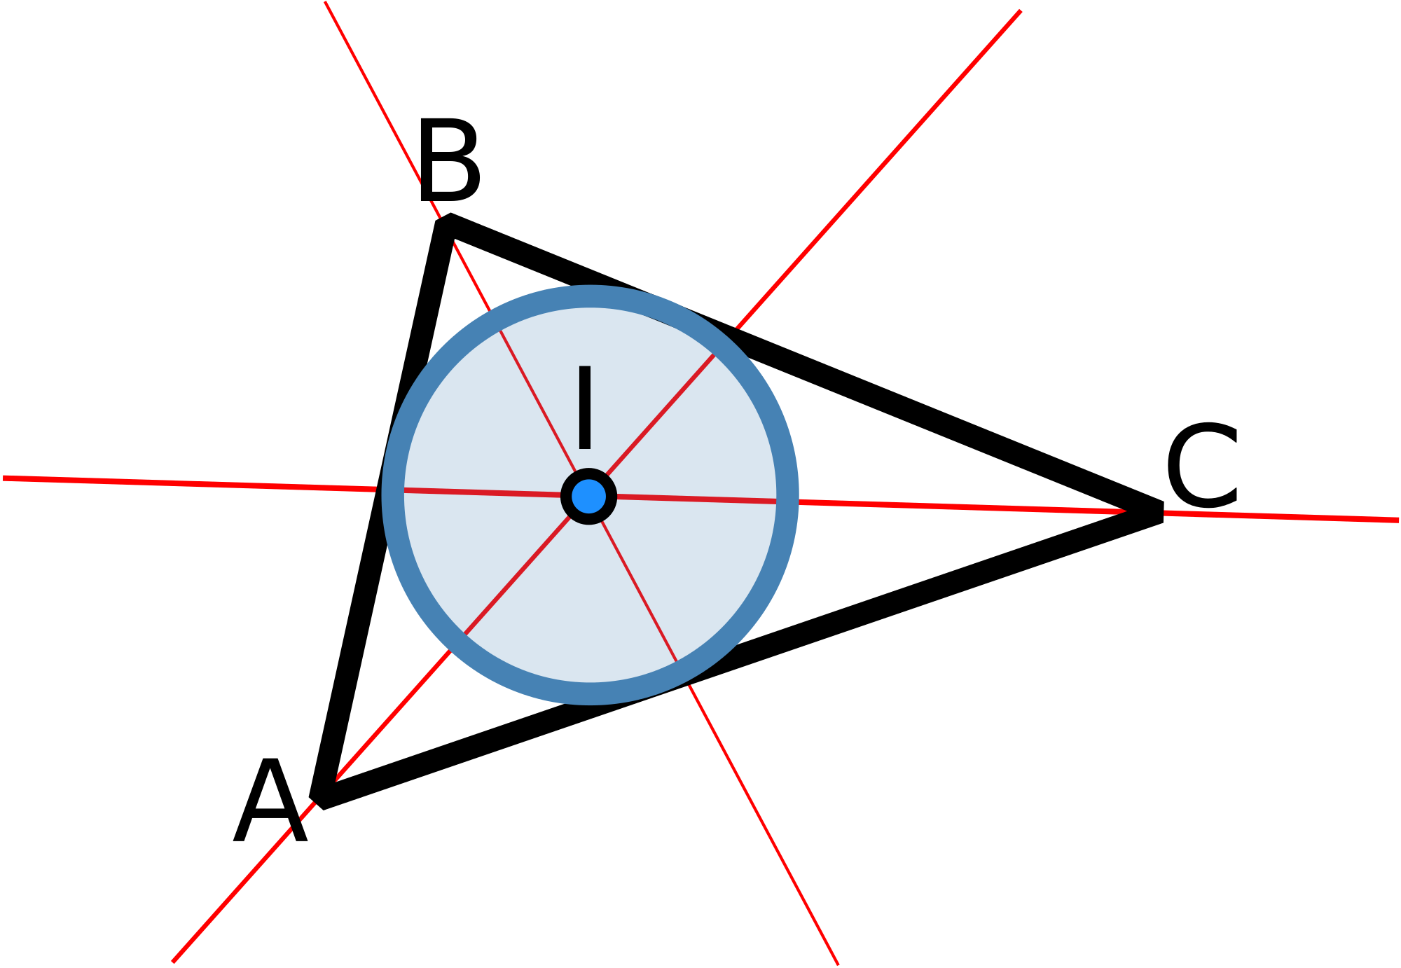
Task 3 - Putting your learning into action
Use GeoGebra to investigate why the point of intersection of the angular bisectors of a triangle is equidistant to the sides of the triangle.

Slide 35
Key Messages
A basic understanding of GeoGebra combined with a pedagogical approach may be used to enhance students’ experience of learning mathematics.
GeoGebra may be used to promote enquiry-based learning in mathematics and to support a constructivist approach to learning.

Slide 36
Summary
Evaluation Form
https://tinyurl.com/Geoevaluate
Geometry & Trigonometry questionnaire
https://tinyurl.com/GeomTrigWS

